Slide 1
The monster is blind
Interviewers predict employee performance only slightly better than chance.
A great employee is 2-300% more productive than a marginal employee.

Slide 2
The Monster is Lame
Without a valid employee selection procedure, what is going on?
A Rorschach test. Going on their gut.
Superstition. In the absence of good data, people believe in things they don’t understand.

Slide 3
How much is at stake for you?
A job can be expected to grow at a modest rate in both compensation and Quality of Work Life issues.
The difference between a fairly good job and a rather good job is large.
When projected over the remainder of your career, the difference is huge.

Slide 4
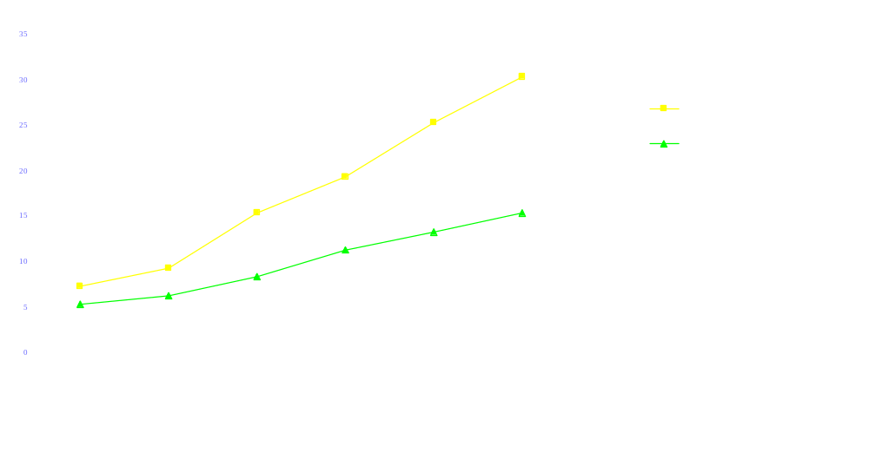
Difference between good and great over your career.

Slide 5
Cost / Benefit Analysis
Your jobs are largely risk averse.
Job search is nearly risk free.
Everything works!
Cost of approach – nil.
Upside – huge expected benefit.
A thousandth times a million is a thousand.
.001 x $1,000,000 = $1000

Slide 6
Campaigning at $1000 / hour
Do high quality and high quantity activities.
Do not suffer diminishing returns.
You can make $1000 / minute in salary negotiations.

