Slide 1
Critique
Reflection
By Chas Foreman

Slide 2
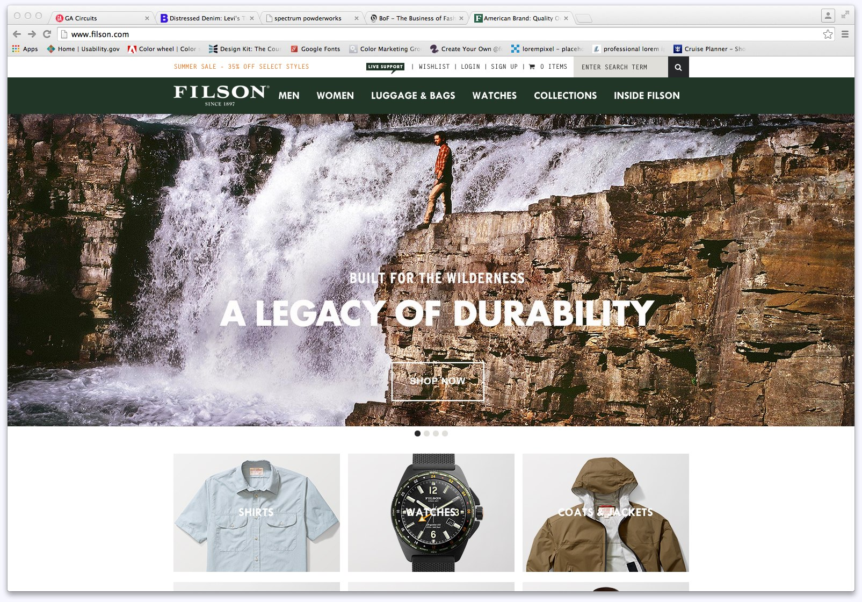
Inspiration

Slide 3
Inspiration
Original mockup based on Filson’s site
I would consider adding the slideshow hero images for movement
I respect the size of the logo
Very simple site to navigate

Slide 4
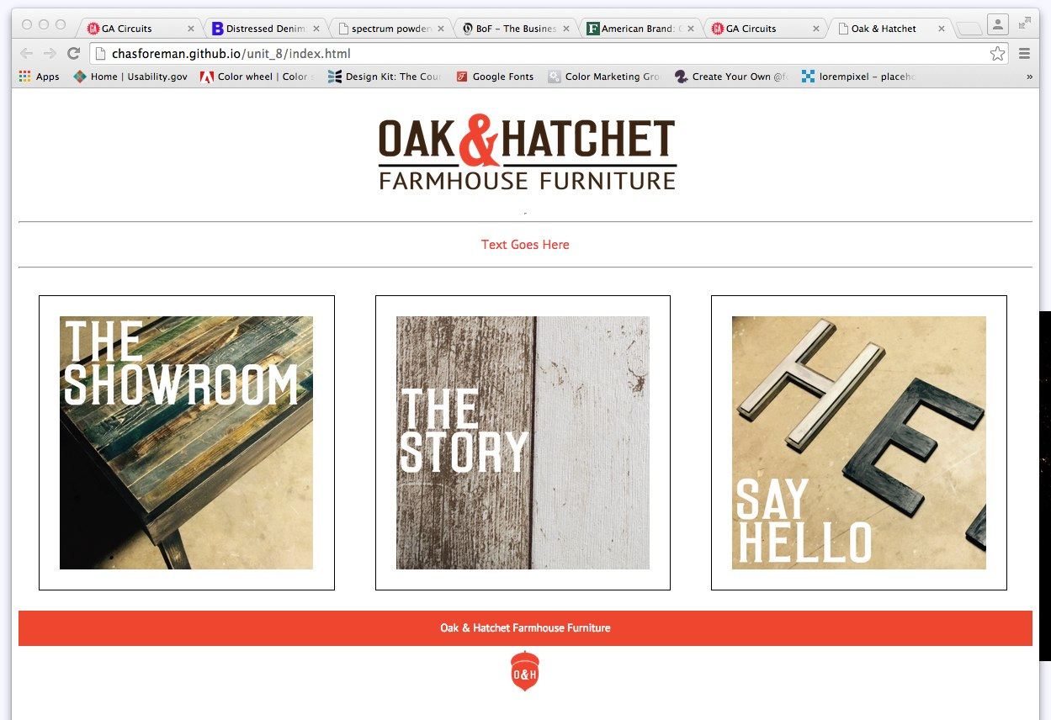
Proud of

Slide 5
Proud of
Logo design
Use of color
Whitespace
Very simple site to navigate

Slide 6
Struggles
Balancing my personal preferences for extreme minimalism with user-friendly, expected content
Understanding divs and block and inline elements helped with page development.
Making the site responsive helped me to consider user priorities and dynamic flow of the site in different states.

Slide 7
Critique
Reviews
By Chas Foreman

Slide 8
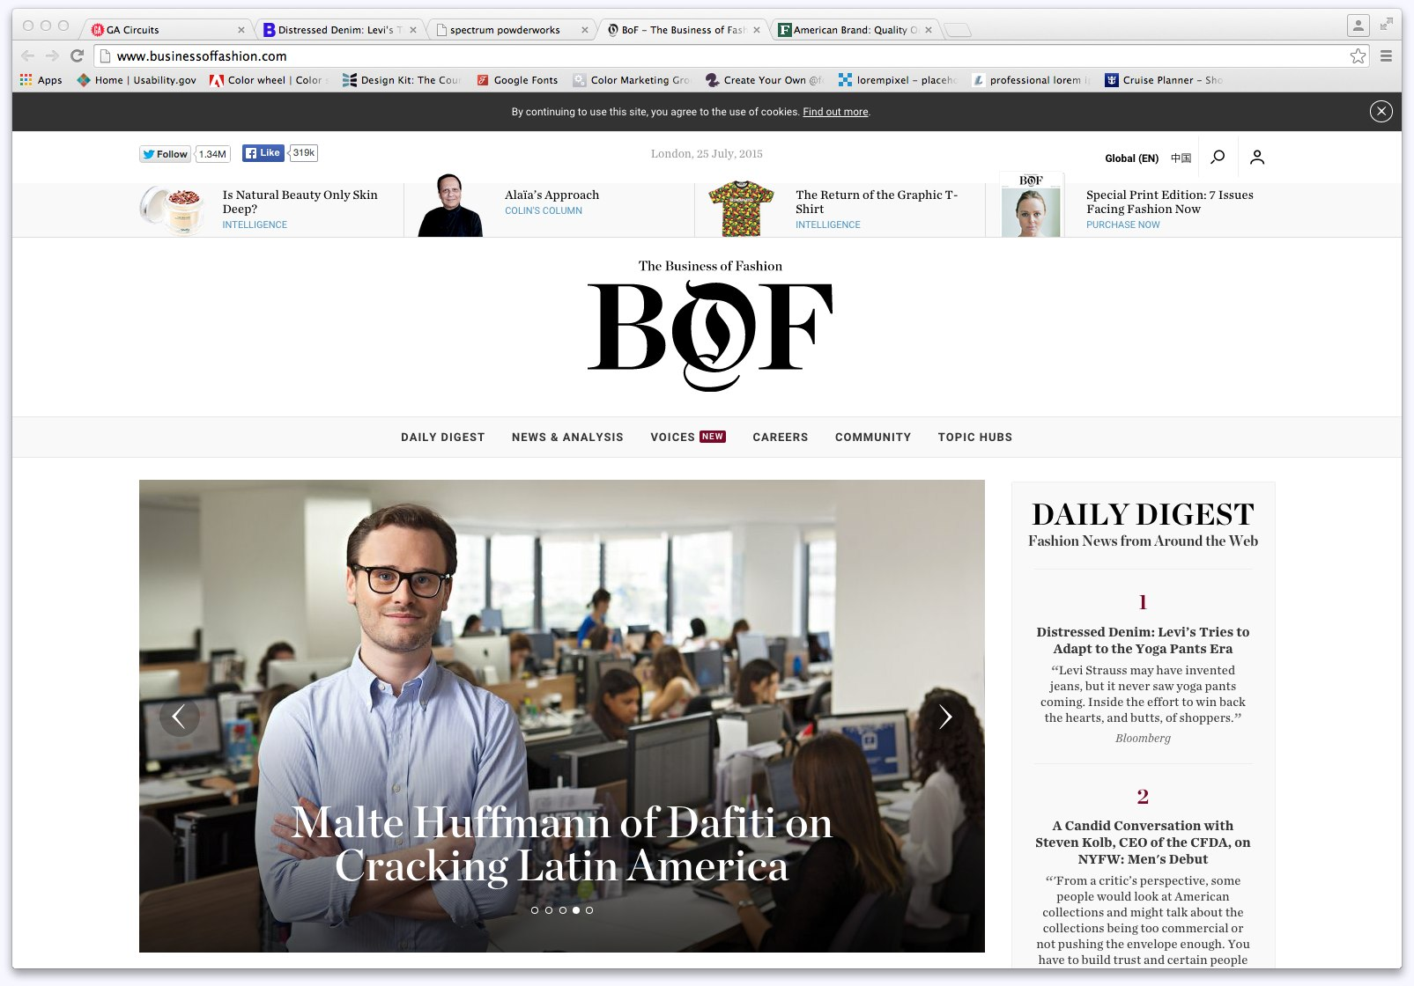
Business of Fashion: Flow

Slide 9
Business of Fashion: Flow
Good flow from logo to main content to sidebar content.
Excellent spacing
Clear direction

Slide 10
Business of Fashion: Typography
Consistent use of a font family
Use different styles of the font family to create hierarchy and flow
I like the logo being different from the interactive elements and other content

Slide 11
Business of Fashion: Navigation
Navigation is clean and clear
Appreciate the hover action that reveals sub-pages and content

Slide 12
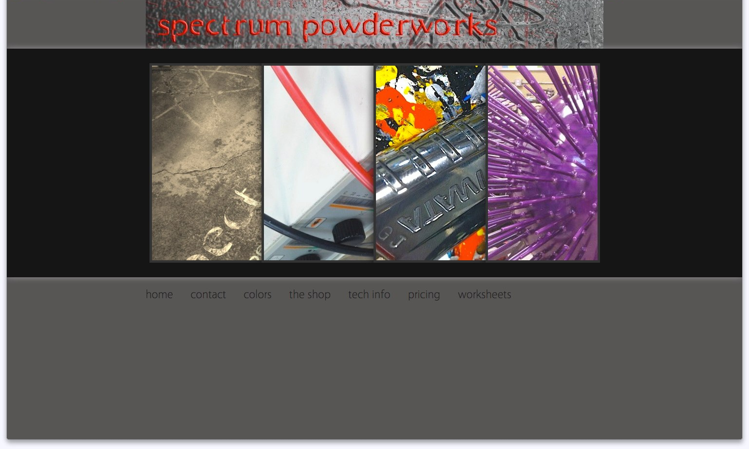
Business of Fashion: Flow

Slide 13
Spectrum Powderworks: Overall
Good flow on homepage
The rest of the site is inconsistent. Page layout changes, fonts change, use of margin and padding could be better, detail items such as capitalization of certain words and other text formatting issues persist.
Not much contrast on the grey text on grey background
Poor use and manipulation of imagery

