Slide 1
Predicting Estimated Time of Arrival for Commercial Flights
Paper By:
Samet Ayhan (University of Maryland)
Pablo Costas (Boeing Research and Tech.)
Hanan Samet (University of Maryland)
Presented By:
Chashmeet Singh (University of Windsor)

Slide 2
Outline
Introduction
Related Work
Contributions
Problem Statement
Models Used
Setup
Results
Conclusion

Slide 3
Introduction
Why do we need to calculate ETA for any flight?
Helps improve 4 key Air Traffic Management Areas
Safety
Capacity
Efficiency
Environmental Impact
For example: Delay in obtaining a wheelchair for a passenger can result in increased fuel burn, emissions and extended flight hours. This can cause passenger dissatisfaction and loss of market share hampering the corporate image of the airlines. This impact can grow exponentially due to a ripple effect caused by delays in subsequent flights.
Hence, due to the nature of unknowns and complexity of the airspace system, it’s a challenging task for accurate ETA prediction.

Slide 4
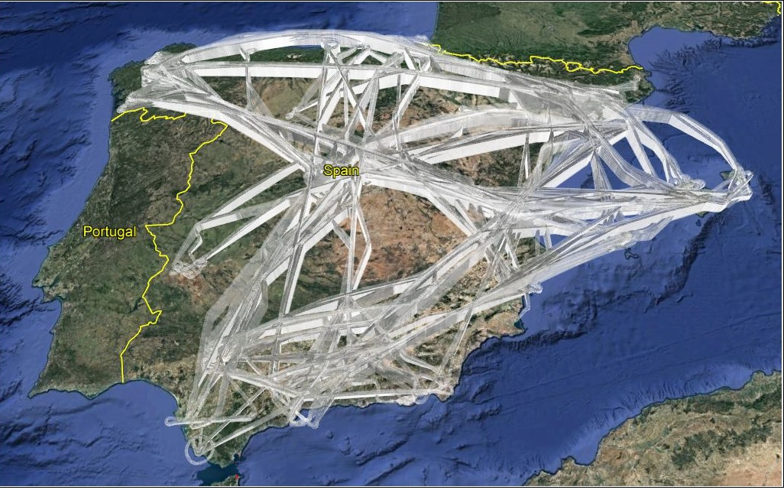
Fig 1. Air traffic in Spanish airspace on July 12, 2016

Slide 5
Introduction
Current Solutions
Traditional methods approach ETA prediction taking into account
Aircraft Performance Models
Trajectory Models
Process
Estimate the flight trajectory
Aircraft’s altitude and speed profiles
Calculate the time required to fulfill the predicted trajectory
These models fail to take into account the external factors such as
Weather Phenomena
Airspace Sector Densities along the route
Airport Congestion at the arrival airport

Slide 6
Introduction
Approach
ETA prediction for commercial flights using features not only for the arrival airport but richer set of features along the potential route such as weather parameters and air traffic data
Comparative analysis using a number of regression models and compares the best performing model results with those currently generated by EUROCONTROL

Slide 7
Introduction
Dataset (Spain)
Trajectory Data (SESAR Joint Undertaking Work Programme)
Contains a total of 119,563 trajectories
Data is downsampled from 5 secs to 60 secs
<Flight No, Departure Airport, Arrival Airport, Date, Time, Speed(x, y, z), Position(lat, long, alt)>
Meteorology Data (National Oceanic and Atmospheric Administration)
Contains over 40 weather parameters for each grid point
Airport Data (EUROCONTROL)
Contains 1,252,571 sets of records for airport traffic data
<Date, Flight No, Departure Airport, Arrival Airport, Aircraft Type, Actual Departure Time, Actual Arrival Time, Scheduled Departure Time, Scheduled Arrival Time>
Airspace Data
Computed using trajectory data with airspace sector volumes
15 min time bin for each sector in Spain for 11 months
<Sector Name, Date, Time of sector entry, Time of sector exit>

Slide 8
Related Work
Kern et al. enhanced ETA predictions generated by Federal Aviation Administration by selecting a set of baseline features and gradually increasing complexity by adding new ones but took into account data only for the arrival airports.
Takacs presents a solution using a heuristic and hand run optimization process. The model was limited by using a less number of features
Glina et al. used an extension of Random Forest to generate predictions but is limited to a single airport for a span of only 5 days

Slide 9
Contributions
Extraction of relevant features using feature engineering based on domains
Algorithms for
Airspace Sector Congestion Rate
Airport Congestion Rate

Slide 10
Feature Engineering
It is the process of using the domain knowledge of data to select features that best predict ETA resulting in improved accuracy
Features are extracted based on domains
Basic Feature Domains such as
Flight
Spatial
Temporal
Airport
Airspace
Combinational Features are features obtained by combining two or more domains
Flight-spatial
Flight-spatial-temporal-airspace
Airport-temporal

Slide 11
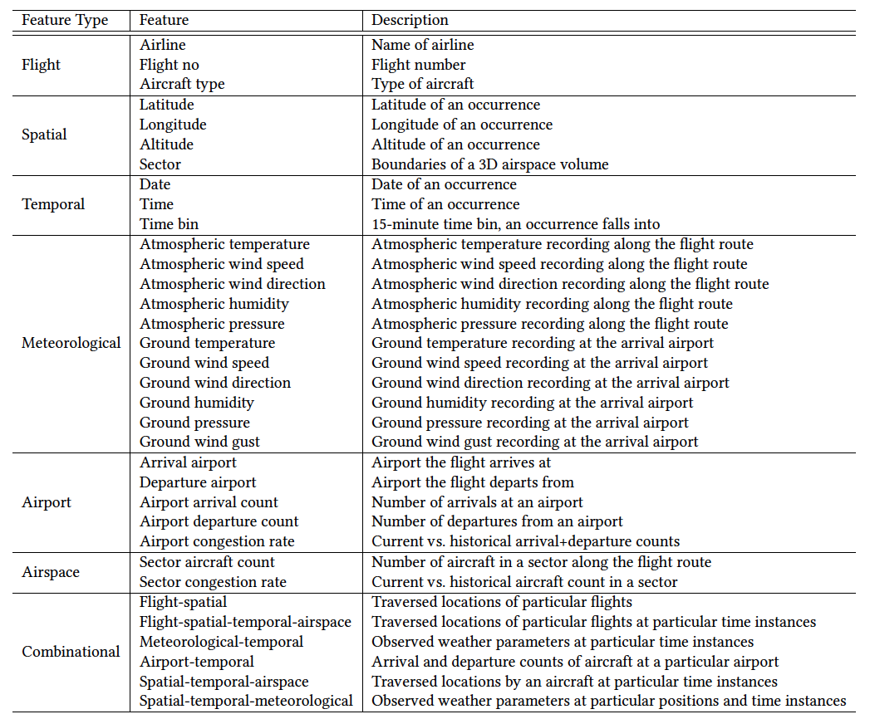
Table 1. Extracted features and their description

Slide 12
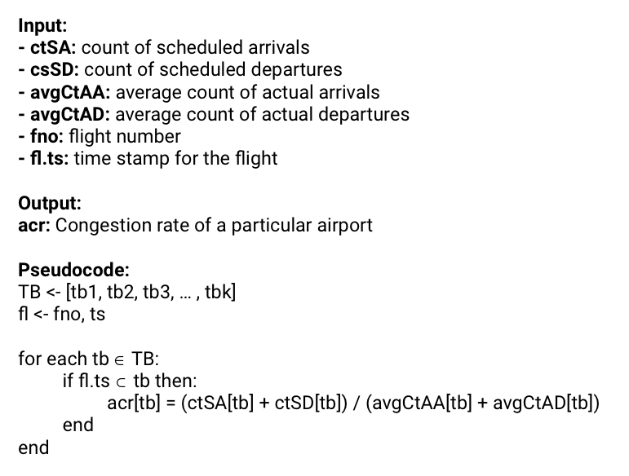
Feature
Airport Congestion Rate

Slide 13
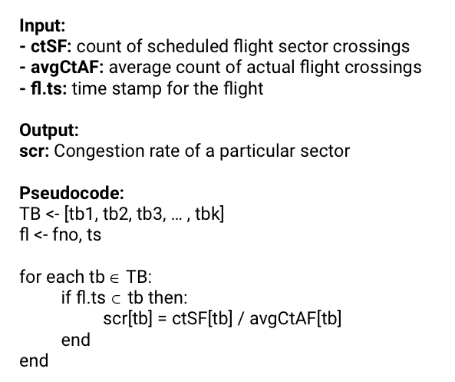
Feature
Sector Congestion Rate

Slide 14
Problem statement
Given a set of historical flights with their attributes such as
Flight number
Trajectory
Departure and Arrival airport
Actual departure and arrival date and time
Airline name
Aircraft type
Weather and air traffic parameters
we need to learn a model that predicts the current flight’s ETA before it departs.

Slide 15
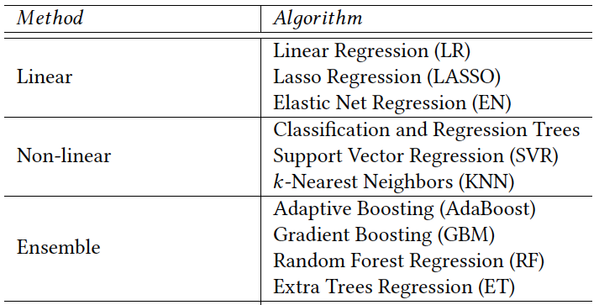
Models used for comparative analysis
Table 2. List of prediction models used in the study

Slide 16
Adaptive Boosting
This algorithm aims to train a set of weak learners sequentially by trying to reduce the error over time.
Below are the steps for performing the AdaBoost algorithm:
Initially, all observations are given equal weights.
A model is built on a subset of data.
Using this model, predictions are made on the whole dataset.
Errors are calculated by comparing the predictions and actual values.
While creating the next model, higher weights are given to the data points which were predicted incorrectly.
Weights can be determined using the error value. For instance,the higher the error the more is the weight assigned to the observation.
This process is repeated until the error function does not change, or the maximum limit of the number of estimators is reached.

Slide 17
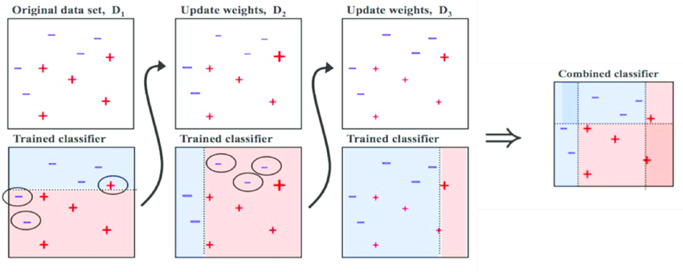
Adaptive Boosting
Example
Fig 1. AdaBoost example

Slide 18
Gradient Boosting
Similar to AdaBoost but tries to fit the new predictor to the residual errors made by the previous predictor instead of tweaking the weights for each iteration.
Below are the steps for performing the Gradient Boosting algorithm:
A model is built on a subset of data.
Using this model, predictions are made on the whole dataset.
Errors are calculated by comparing the predictions and actual values.
A new model is created using the errors calculated as target variable. Our objective is to find the best split to minimise the error.
The predictions made by this new model are combined with the predictions of the previous.
New errors are calculated using this predicted value and actual value.
This process is repeated until the error function does not change, or the maximum limit of the number of estimators is reached.

Slide 19
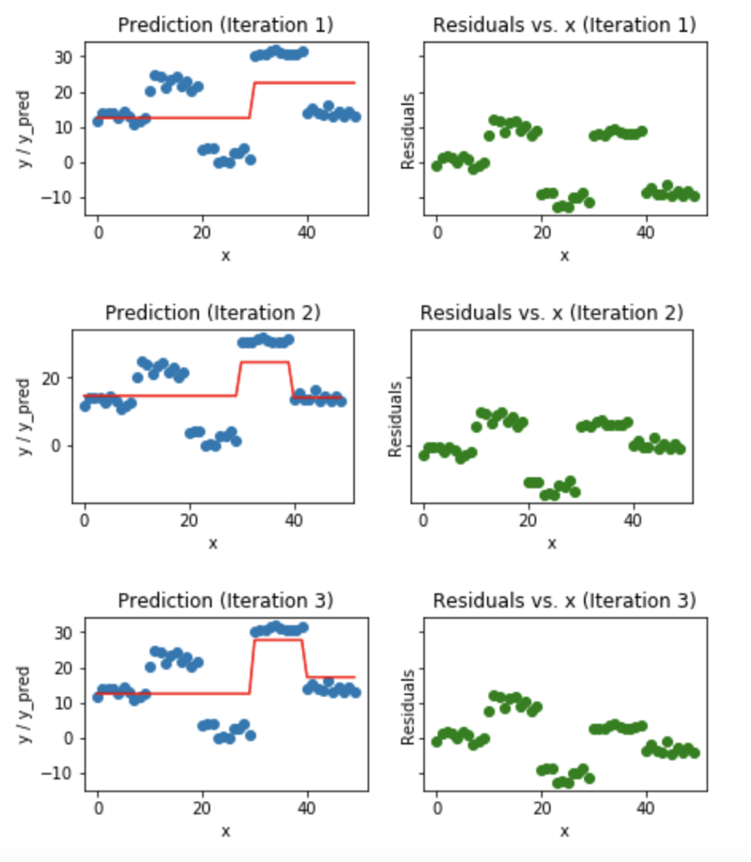
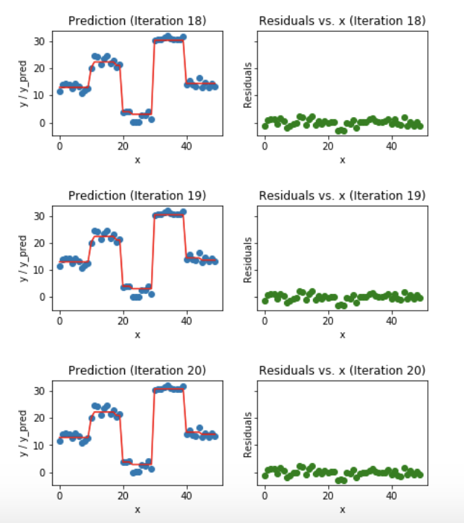
Gradient Boosting
Example
Fig 2. Gradient Boosting example

Slide 20
Setup
Performance is evaluated on the 10 major flight routes in Spain
Data is chronologically ordered for each dataset and for each route using 80% of the initial data for modeling and the remaining 20% for validation
10 fold cross validation is used and algorithms are evaluated based on RMSE
Experiments conducted on a computer with Intel Core i7-6820HQ, CPU @ 2.7 GHz and 16GB ram running on Ubuntu 16.04 64 bit

Slide 21
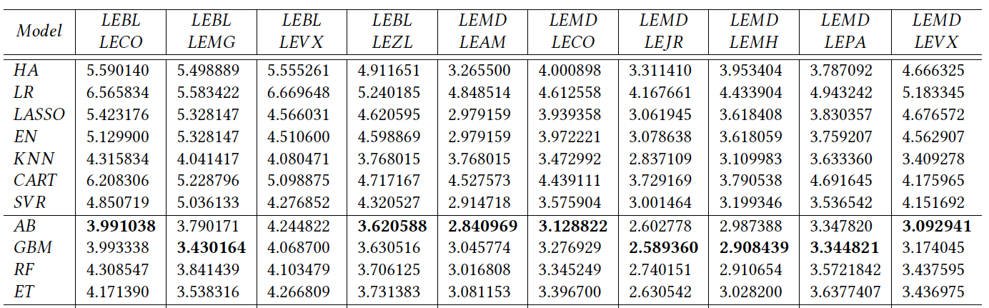
Results
Table 3. RMSE values for all the algorithms

Slide 22
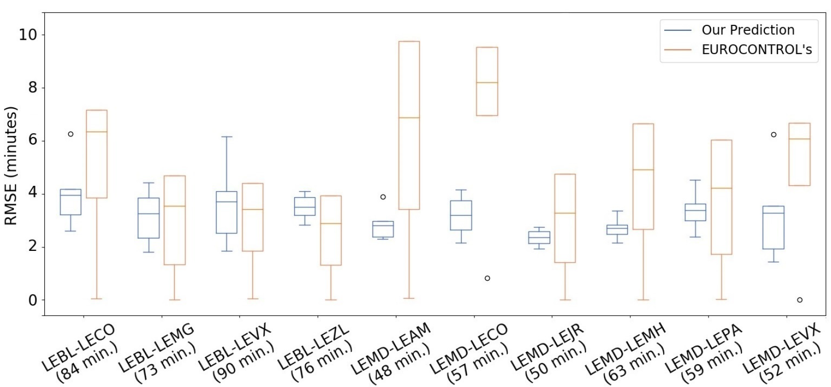
Results
Fig 3. RMSE by author’s prediction system vs EUROCONTROL’s prediction system

Slide 23
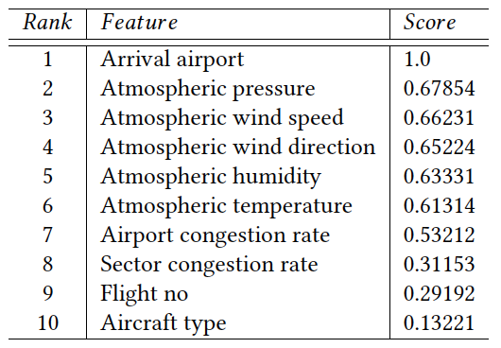
Results
Table 4. Top 10 features ranked by their relative importance

Slide 24
Conclusion
System can predict ETA for any commercial flight in Spain within 4 mins of RMSE on average
System outperforms EUROCONTROL’s ETA prediction with a high accuracy and a much less standard deviation
These results can enable airlines to better coordinate the action of ground handling personnel and equipment, thereby reducing the waste of time and energy
Air traffic flow management, airport runway and gate assignment and ground equipment usage optimization all can be benefited from an accurate ETA prediction for commercial flights.

Slide 25
Thank you!

