Slide 1
Announcements
HW5 will be online tonight

Slide 2
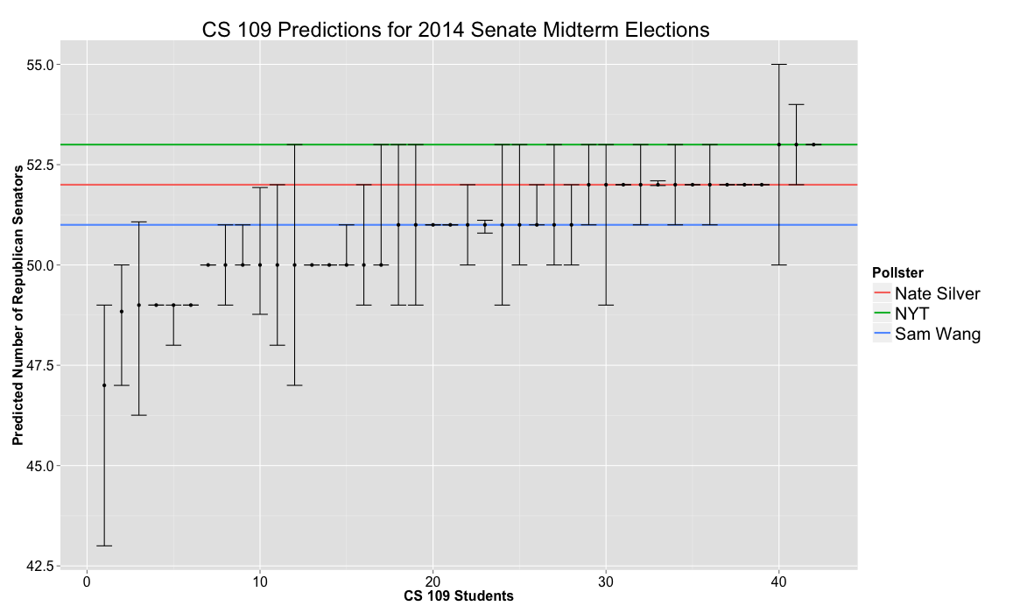

Slide 3

Today’s Agenda
Object orientated Python
Classes, generators
MapReduce design patterns
Introduction to MRJob
Overview, important functions
Jimmy Lin and Chris Dyer:
“Data-Intensive Text Processing with MapReduce”
http://lintool.github.io/MapReduceAlgorithms/

Slide 4
What is Map Reduce
programming model
addressing large data sets
parallel and distributed algorithms
cluster framework
It also is a way of thinking!

Slide 5

Map Reduce Background
Originally developed by Google
Apache Hadoop is open source implementation in Java
MrJob is a Python interface to Hadoop

Slide 6
The Map and the Reduce
Map:
performs filtering and sorting
Reduce:
summary operation

Slide 7
k₁
v₁
k₂
v₂
k₃
v₃
k₄
v₄
k₅
v₅
k₆
v₆
map
map
map
map
a
1
b
2
c
3
c
6
a
5
c
2
b
7
c
8
Shuffle and Sort: aggregate values by keys
a
1
5
b
2
7
c
2
3
6
8
reduce
reduce
reduce
r₁
s₁
r₂
s₂
r₃
s₃

Slide 8
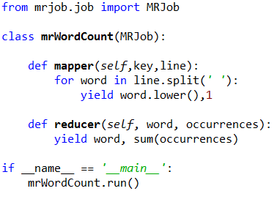
The Famous Word Count Example
Notes:
What does the import statement do?

Slide 9
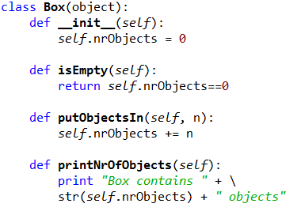
Python Classes
Notes:
Who could explain to me what object oriented programming is?
Explain self keyword – has to be there for class member functions

Slide 10
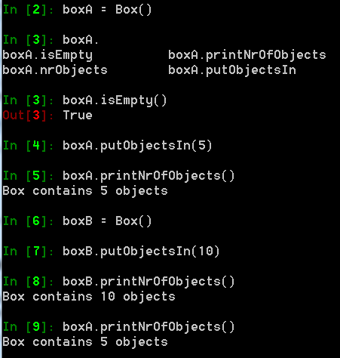
Python Classes

Slide 11
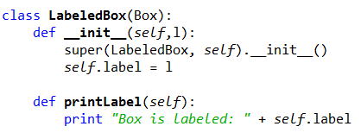
Derived Class in Python
What is does the super function do?
Notes:
What is super gonna do?
Why are there __ in front of init?

Slide 12
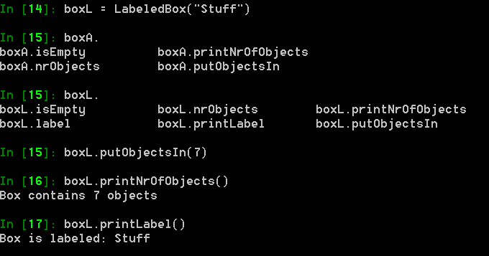
Derived Class in Python

Slide 13
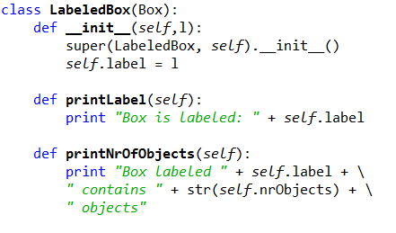
Overwriting a Function

Slide 14
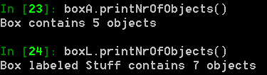
Overwriting a Function

Slide 15
The Famous Word Count Example

Slide 16
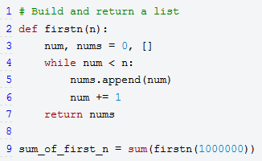
Python generators
Why is this bad?
http://wiki.python.org/moin/Generators
Notes:
Why is this bad?
- We waste a lot of memory keeping all the numbers in the list, but we re only interested in the sum!

Slide 17
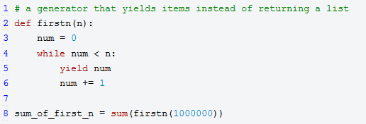
Python generators
http://wiki.python.org/moin/Generators

Slide 18
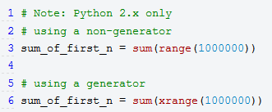
Build in Python Generators
http://wiki.python.org/moin/Generators

Slide 19
The Famous Word Count Example
Notes:
Static function call

Slide 20

Green Eggs and Ham
Result of a bet:
Can Dr. Seuss write a book using only 50 words?
Bennett Cerf (Dr. Seuss's publisher) lost.
It is the fourth best selling English-language children's hardcover book of all time.
http://en.wikipedia.org/wiki/Green_Eggs_and_Ham

Slide 21
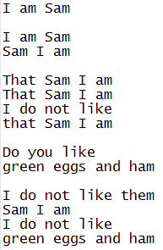
Example Input File
…

Slide 22
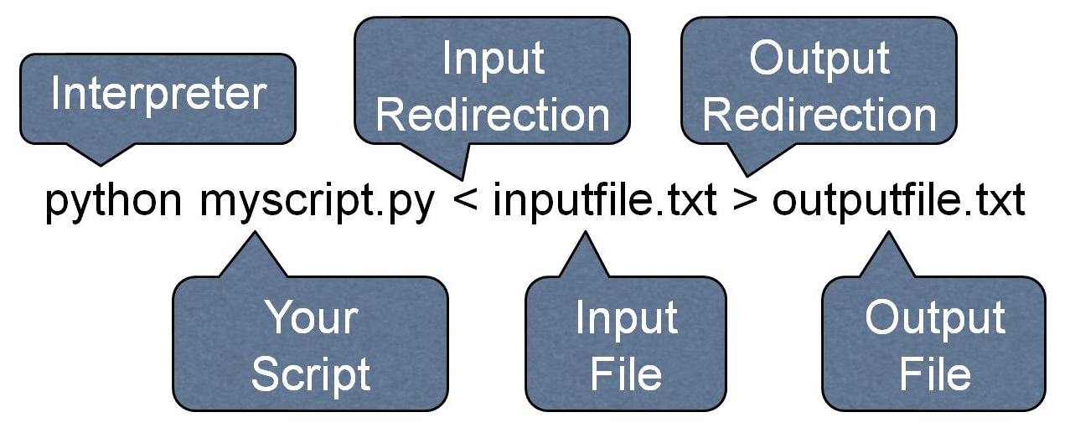
Launching the Job

Slide 23
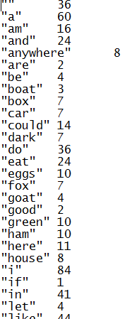
Output File
50 words in total

Slide 24
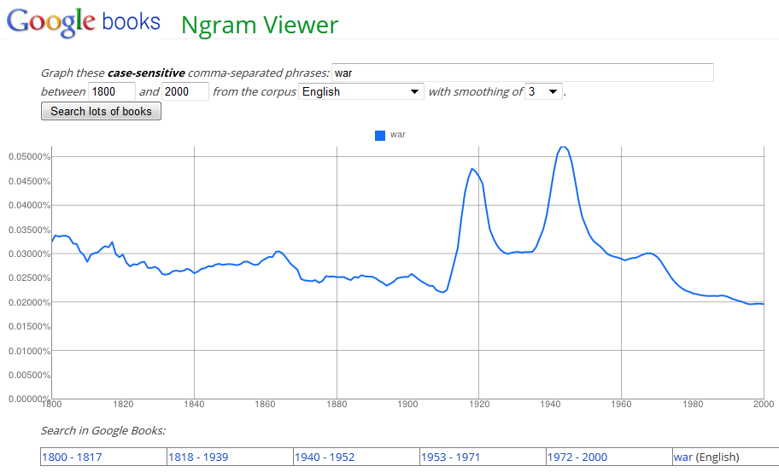
Why Counting Words is Fun
http://books.google.com/ngrams

Slide 25
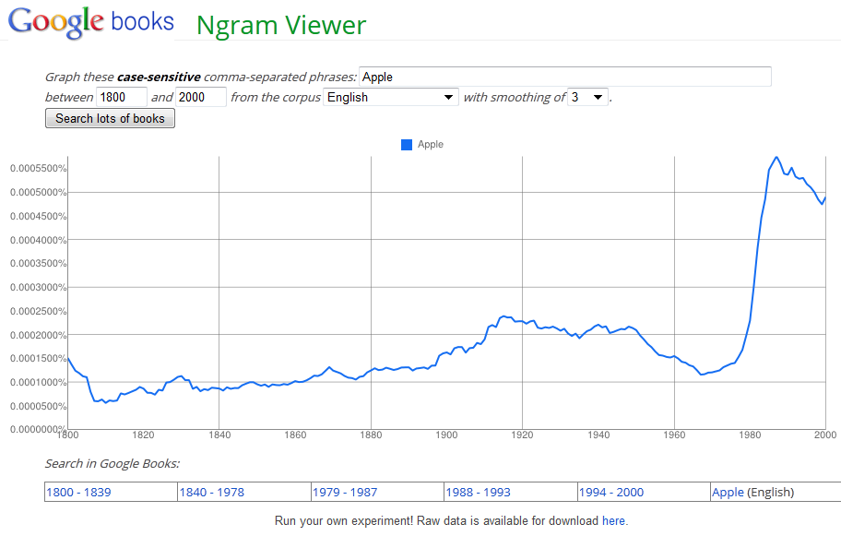
More Culturomics

Slide 26
Anagram Finder
Anagram: Words or phrases consisting of the same letters
Examples:
Dormitory – Dirty room
Astronomer – Moon starer
Election results – Lies let’s recount
Verifying anagrams with map reduce
Input: file with one word per line
http://www.fun-with-words.com/anag_example.html

Slide 27
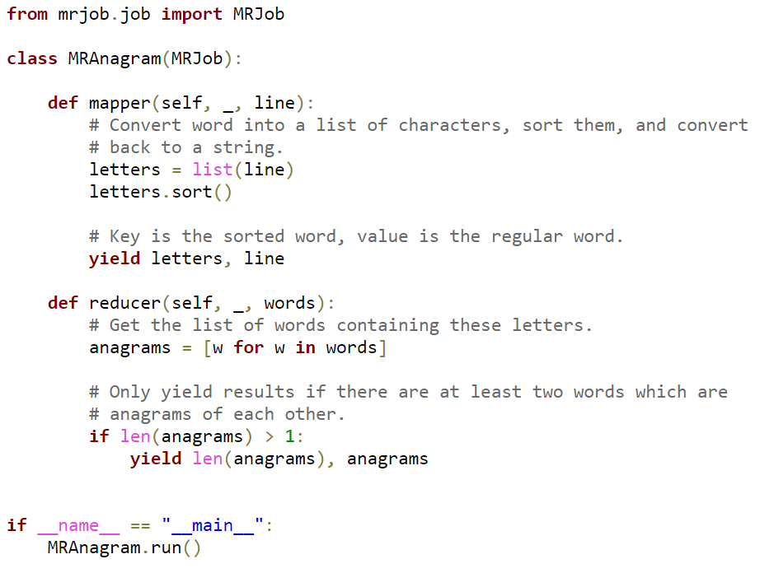

Slide 28
k₁
v₁
k₂
v₂
k₃
v₃
k₄
v₄
k₅
v₅
k₆
v₆
map
map
map
map
a
1
b
2
c
3
c
6
a
5
c
2
b
7
c
8
Shuffle and Sort: aggregate values by keys
a
1
5
b
2
7
c
2
3
6
8
reduce
reduce
reduce
r₁
s₁
r₂
s₂
r₃
s₃

Slide 29
Importance of Local Aggregation
Ideal scaling characteristics:
Twice the data, twice the running time
Twice the resources, half the running time
Why can’t we achieve this?
Synchronization requires communication
Communication kills performance
Thus… avoid communication!
Reduce intermediate data via local aggregation
Two possibilities:
Combiners
In-mapper combining

Slide 30
k₁
v₁
k₂
v₂
k₃
v₃
k₄
v₄
k₅
v₅
k₆
v₆
map
map
map
map
a
1
b
2
c
3
c
6
a
5
c
2
b
7
c
8
combine
combine
combine
combine
a
1
b
2
c
9
a
5
c
2
b
7
c
8
partition
partition
partition
partition
Shuffle and Sort: aggregate values by keys
a
1
5
b
2
7
c
2
9
8
reduce
reduce
reduce
r₁
s₁
r₂
s₂
r₃
s₃

Slide 31
Combiner
“mini-reducers”
Takes mapper output before shuffle and sort
Can significantly reduce network traffic
No access to other mappers
Not guaranteed to get all values for a key
Not guaranteed to run at all!
Key and value output must match mapper
Why does the key and value output have to match the mapper output?
Notes:
Why does the key and value output have to match the mapper?
- Because combiner is not guaranteed to run at all

Slide 32
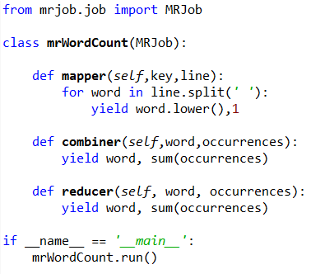
Word Count with Combiner

Slide 33
Combiner Design
Combiners and reducers share same method signature
Sometimes, reducers can serve as combiners
Often, not…
Remember: combiner are optional optimizations
Should not affect algorithm correctness
May be run 0, 1, or multiple times
Example: find average of all integers associated with the same key

Slide 34
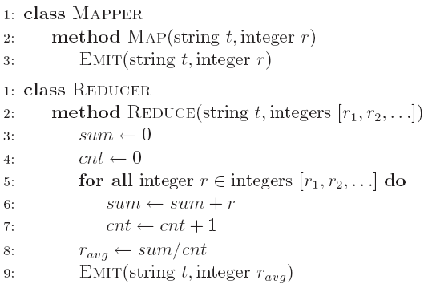
Computing the Mean: Version 1
Why can’t we use reducer as combiner?
Notes:
Mean(1,2,3,4,5) != mean(mean(1,2),mean(3,4,5))

Slide 35
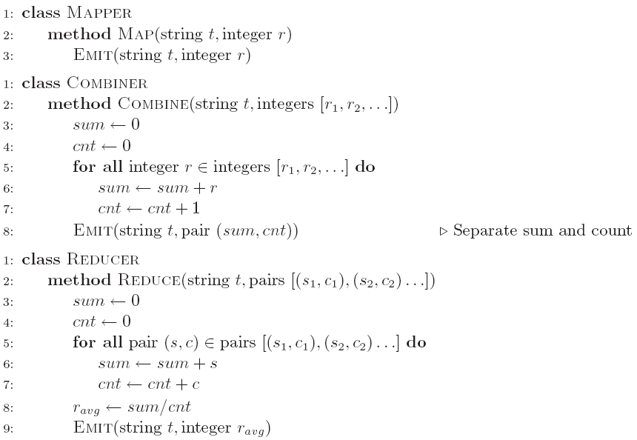
Computing the Mean: Version 2
Why doesn’t this work?
Notes:
Requires combiner to run once and only once

Slide 36
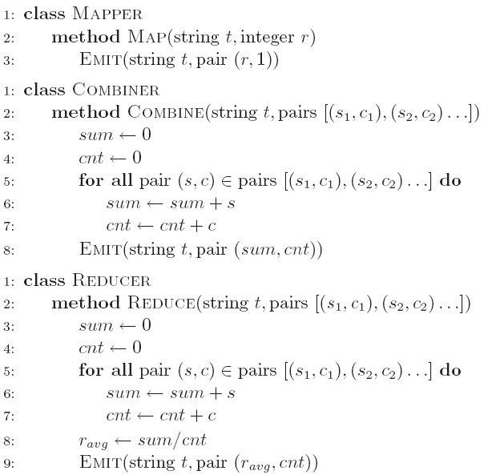
Computing the Mean: Version 3
Fixed? What if combiner does not run?
Notes:
YES!
To verify discuss what would happen if combiner does not run

Slide 37
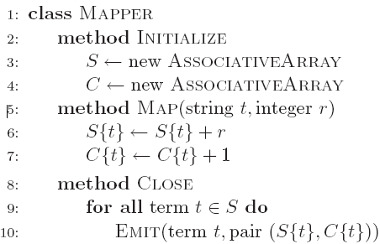
In-Mapper Combining
“Fold the functionality of the combiner into the mapper by preserving state across multiple map calls

Slide 38
In-Mapper Combining
Advantages
Speed
Why is this faster than actual combiners?
Disadvantages
Explicit memory management required
Potential for order-dependent bugs
Notes:
We save a lot of communication and (key,value) pair generations

Slide 39
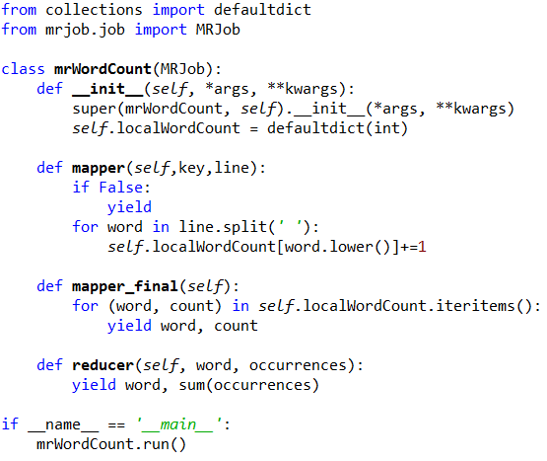
Word Count with In-Mapper-Comb.
Notes:
So which one is better?
in-mapper problem with large dictionaries – memory
In-mapper can deal with highly skewed word distributions
Reducer for “the” otherwise would take looooong

Slide 40
Which is better?
For large dictionaries?
Combiner has no memory problems
For skewed word distributions (“the”)?
In-mapper reduces load on reducer

Slide 41
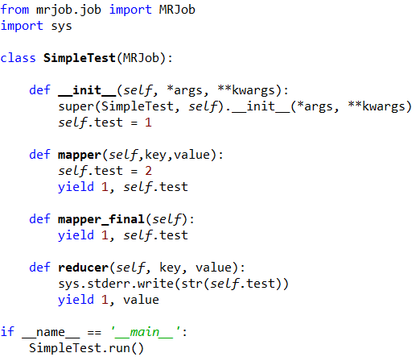
Word of Caution
1!!

Slide 42
Pairs and Stripes: Running Example
Term co-occurrence matrix for a text collection
M = N x N matrix (N = vocabulary size)
M_{ij}: number of times i and j co-occur in some context
Context can be a sentence, sequence of m words, etc.
In this case co-occurrence matrix is symmetric

Slide 43
MapReduce: Large Counting Problems
Term co-occurrence matrix for a text collection = specific instance of a large counting problem
A large event space (number of terms)
A large number of observations (the collection itself)
Goal: keep track of interesting statistics about the events
Basic approach
Mappers generate partial counts
Reducers aggregate partial counts

Slide 44
First Try: “Pairs”
Each mapper takes a sentence:
Generate all co-occurring term pairs
For all pairs, emit (a, b) → count
Reducers sum up counts associated with these pairs
Use combiners!

Slide 45
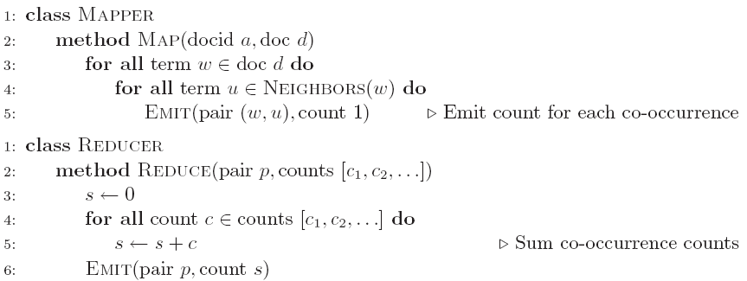
Pairs: Pseudo-Code
Notes:
What about the symmetry of the co-occurrence matrix?
It is not exploited in this example, as w goes over ALL terms in d

Slide 46
“Pairs” Analysis
Advantages
Easy to implement, easy to understand
Disadvantages
Lots of pairs to sort and shuffle around
Not many opportunities for combiners to work

Slide 47
Another Try: “Stripes”
Idea: group together pairs into an associative array
Each mapper takes a sentence:
Generate all co-occurring term pairs
For each term, emit a → { b: count_{b}, c: count_{c}, d: count_{d} … }
Reducers perform element-wise sum of associative arrays
(a, b) → 1
(a, c) → 2
(a, d) → 5
(a, e) → 3
(a, f) → 2
a → { b: 1, c: 2, d: 5, e: 3, f: 2 }
a → { b: 1, d: 5, e: 3 }
a → { b: 1, c: 2, d: 2, f: 2 }
a → { b: 2, c: 2, d: 7, e: 3, f: 2 }
+
Key: cleverly-constructed data structure
brings together partial results
Notes:
Whats the python version of an associative array?

Slide 48
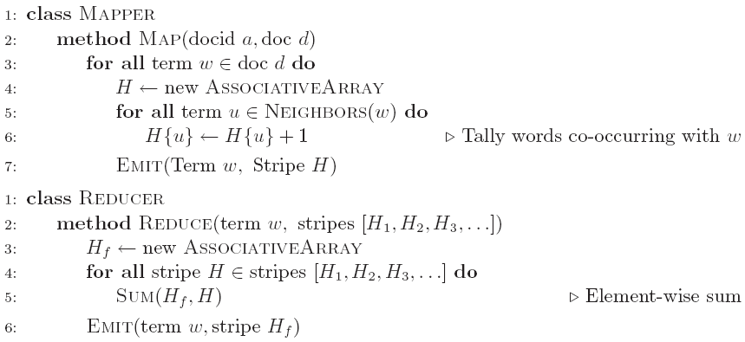
Stripes: Pseudo-Code

Slide 49
“Stripes” Analysis
Advantages
Far less sorting and shuffling of key-value pairs
Keys are less unique than in pairs approach
Can make better use of combiners
Disadvantages
More difficult to implement
Underlying object more heavyweight
Fundamental limitation in terms of size of event space
Notes:
Why can it make better use of combiners?
Keys are less unique than in pairs approach
Disadvantages
More difficult to implement
Underlying object more heavyweight
Fundamental limitation in terms of size of event space

Slide 50
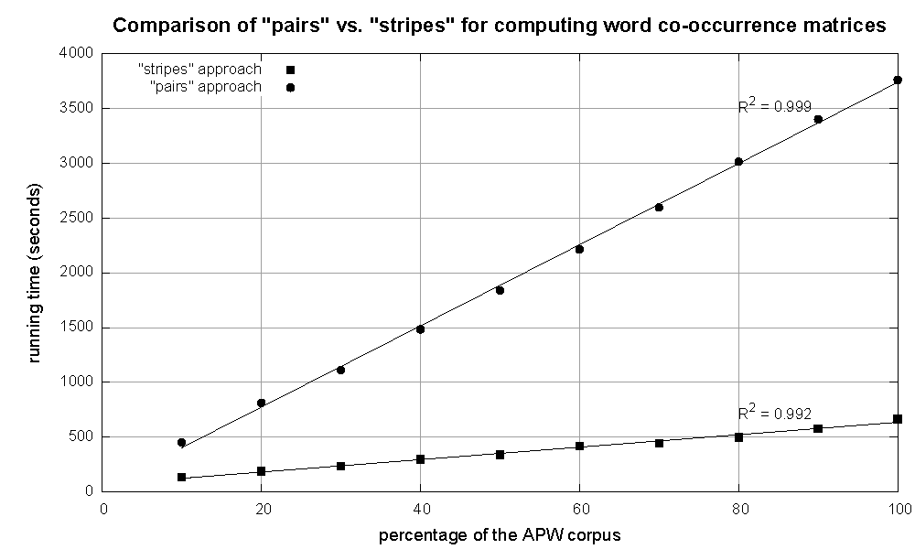
Cluster size: 38 cores
Data Source: Associated Press Worldstream (APW) of the English Gigaword Corpus (v3), which contains 2.27 million documents (1.8 GB compressed, 5.7 GB uncompressed)
Notes:
Both linear -> GREAT!

Slide 51
Map Reduce for Machine Learning
Random Forest?
SVM?

Slide 52
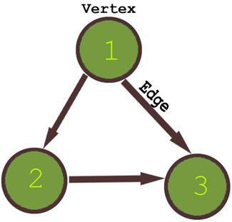
What’s a graph?
G = (V,E), where
V represents the set of vertices (nodes)
E represents the set of edges (links)
Both vertices and edges may contain additional information
Different types of graphs:
Directed vs. undirected edges
Presence or absence of cycles
Graphs are everywhere:
Hyperlink structure of the Web
Physical structure of computers on the Internet
Interstate highway system
Social networks

Slide 53
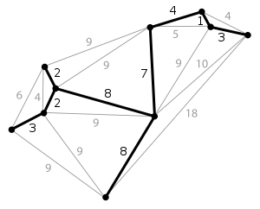
Some Graph Problems
Finding shortest paths
Routing Internet traffic and UPS trucks
Finding minimum spanning trees
Telco laying down fiber
Identify “special” nodes and communities
Breaking up terrorist cells, spread of avian flu
Bipartite matching
Monster.com, Match.com
And of course... PageRank
Notes:
Minimum spanning tree

Slide 54
Graphs and MapReduce
Graph algorithms typically involve:
Performing computations at each node: based on node features, edge features, and local link structure
Propagating computations: “traversing” the graph
Key questions:
How do you represent graph data in MapReduce?
How do you traverse a graph in MapReduce?

Slide 55
Representing Graphs
G = (V, E)
Two common representations
Adjacency matrix
Adjacency list

Slide 56
Adjacency Matrices
Represent a graph as an n x n square matrix M
n = |V|
M_{ij} = 1 means a link from node i to j
2
 | 1 | 2 | 3 | 4
1 | 0 | 1 | 0 | 1
2 | 1 | 0 | 1 | 1
3 | 1 | 0 | 0 | 0
4 | 1 | 0 | 1 | 0
1
3
4

Slide 57
Adjacency Matrices: Critique
Advantages:
Amenable to mathematical manipulation
Iteration over rows and columns corresponds to computations on outlinks and inlinks
Disadvantages:
Lots of zeros for sparse matrices
Lots of wasted space

Slide 58
Adjacency Lists
Take adjacency matrices… and throw away all the zeros
 | 1 | 2 | 3 | 4
1 | 0 | 1 | 0 | 1
2 | 1 | 0 | 1 | 1
3 | 1 | 0 | 0 | 0
4 | 1 | 0 | 1 | 0
1: 2, 4
2: 1, 3, 4
3: 1
4: 1, 3

Slide 59
Adjacency Lists: Critique
Advantages:
Much more compact representation
Easy to compute over outlinks
Disadvantages:
Much more difficult to compute over inlinks

Slide 60

JSON Encoding
JSON: JavaScript Object Notation
lightweight data interchange format
http://docs.python.org/library/json.html
Notes:
U stands for unicode, can get rid of it by using str()

Slide 61

Example Input
1
10
2
5
1
3
2

Slide 62
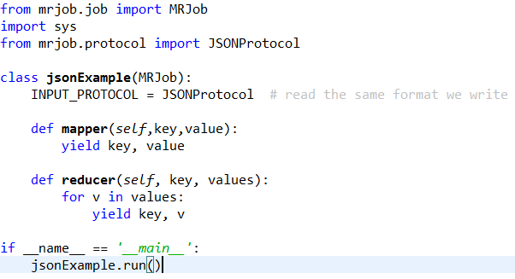
JSON for MRJob

Slide 63
Graphs and MapReduce
Graph algorithms typically involve:
Performing computations at each node: based on node features, edge features, and local link structure
Propagating computations: “traversing” the graph
Generic recipe:
Represent graphs as adjacency lists
Perform local computations in mapper
Pass along partial results via outlinks, keyed by destination node
Perform aggregation in reducer on inlinks to a node
Iterate until convergence: controlled by external “driver”
Don’t forget to pass the graph structure between iterations

Slide 64
Random Walks Over the Web
Random surfer model:
User starts at a random Web page
User randomly clicks on links, surfing from page to page
PageRank
Characterizes the amount of time spent on any given page
Mathematically, a probability distribution over pages
PageRank captures notions of page importance
Correspondence to human intuition?
One of thousands of features used in web search

Slide 65
Computing PageRank
Properties of PageRank
Can be computed iteratively
Effects at each iteration are local
Sketch of algorithm:
Start with seed PR_{i} values
Each page distributes PR_{i} “credit” to all pages it links to
Each target page adds up “credit” from multiple in-bound links to compute PR_{i+1}
Iterate until values converge

Slide 66
Sample PageRank Iteration (1)
Iteration 1
n₂ (0.2)
n₂ (0.166)
n₁ (0.2)
0.1
0.1
0.1
n₁ (0.066)
0.1
0.066
0.066
0.066
n₅ (0.2)
n₃ (0.2)
n₅ (0.3)
n₃ (0.166)
0.2
0.2
n₄ (0.2)
n₄ (0.3)

Slide 67
Sample PageRank Iteration (2)
Iteration 2
n₂ (0.166)
n₂ (0.133)
n₁ (0.066)
0.033
0.083
0.083
n₁ (0.1)
0.033
0.1
0.1
0.1
n₅ (0.3)
n₃ (0.166)
n₅ (0.383)
n₃ (0.183)
0.3
0.166
n₄ (0.3)
n₄ (0.2)

Slide 68
PageRank in MapReduce
n₂ (0.2)
n₁ (0.2)
0.1
0.1
0.1
0.1
0.066
0.066
0.066
n₅ (0.2)
n₃ (0.2)
0.2
0.2
n₄ (0.2)
n₁ [n₂, n₄]
n₂ [n₃, n₅]
n₃ [n₄]
n₄ [n₅]
n₅ [n₁, n₂, n₃]
Map
n₂
n₄
n₃
n₅
n₄
n₅
n₁
n₂
n₃
n₁
n₂
n₂
n₃
n₃
n₄
n₄
n₅
n₅
Reduce
n₁ [n₂, n₄]
n₂ [n₃, n₅]
n₃ [n₄]
n₄ [n₅]
n₅ [n₁, n₂, n₃]

Slide 69
PageRank Convergence
Alternative convergence criteria
Iterate until PageRank values don’t change
Iterate until PageRank rankings don’t change
Fixed number of iterations

