Slide 1
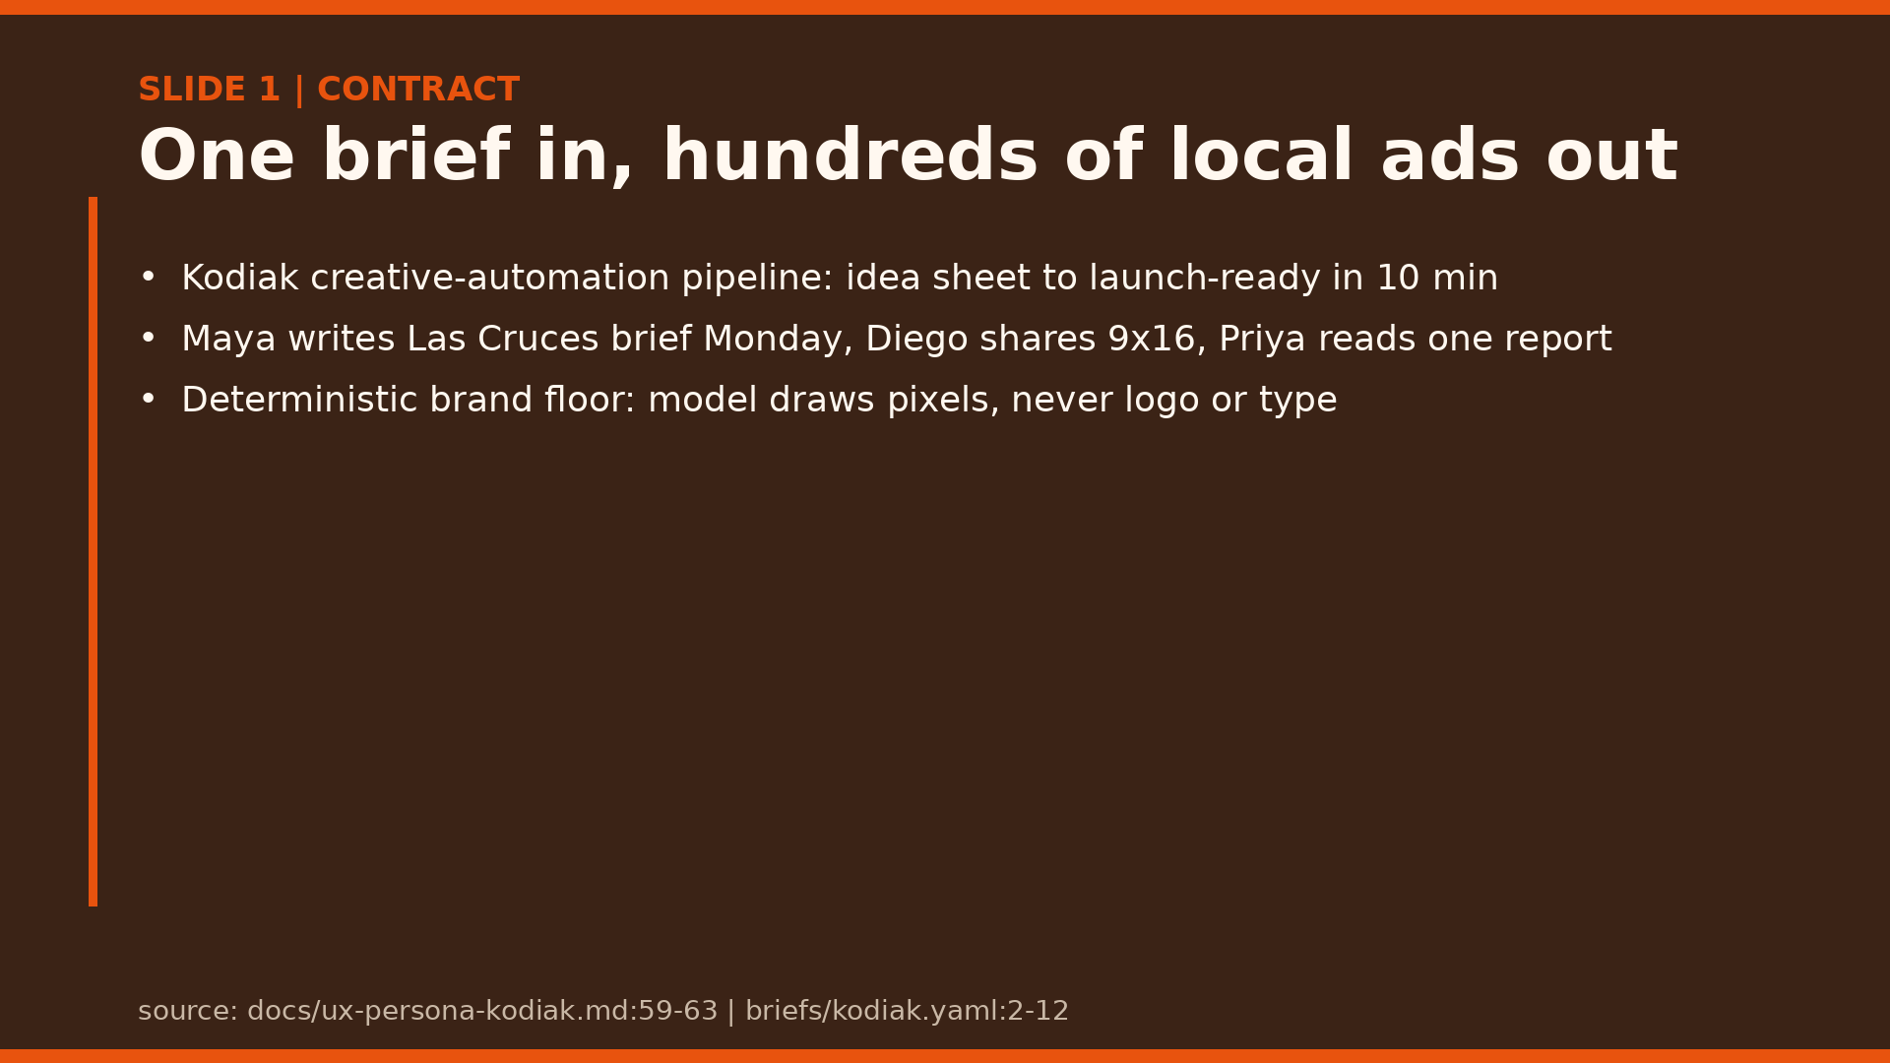
Notes:
30-second contract: what it is (one brief fans out to every market, ratio, language), who it is for (Maya, Diego, Priya), what good looks like (launch-ready in 10 min; the model never invents brand truth).

Slide 2
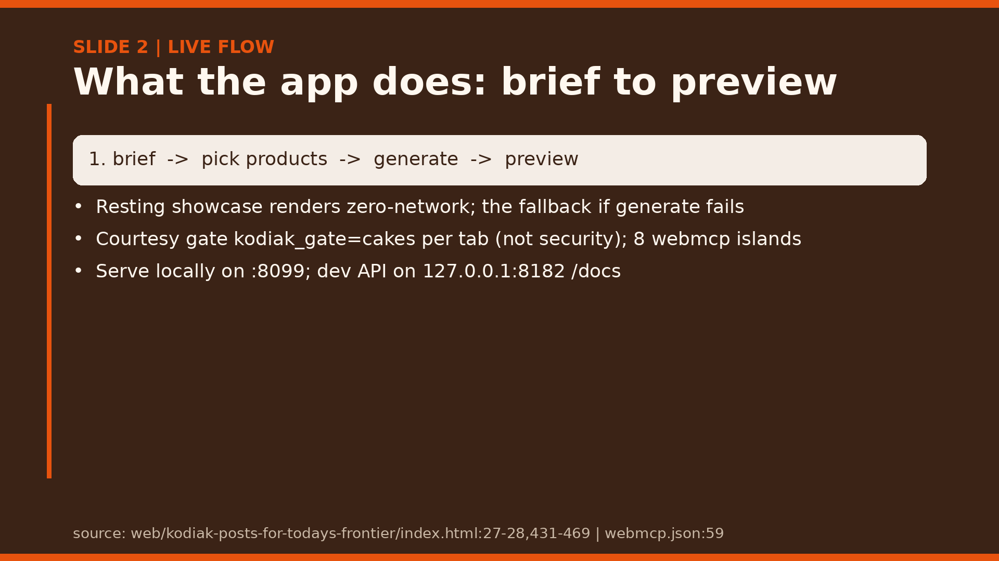
Notes:
Demo the resting page first with no clicks: five export sizes plus baked EN/ES/PT copy prove offline-first before any generate call. Fallback per demo: if generate dies, the resting render still proves offline-first; the reviewer ZIP is the dead-venue equivalent (slide 12).

Slide 3
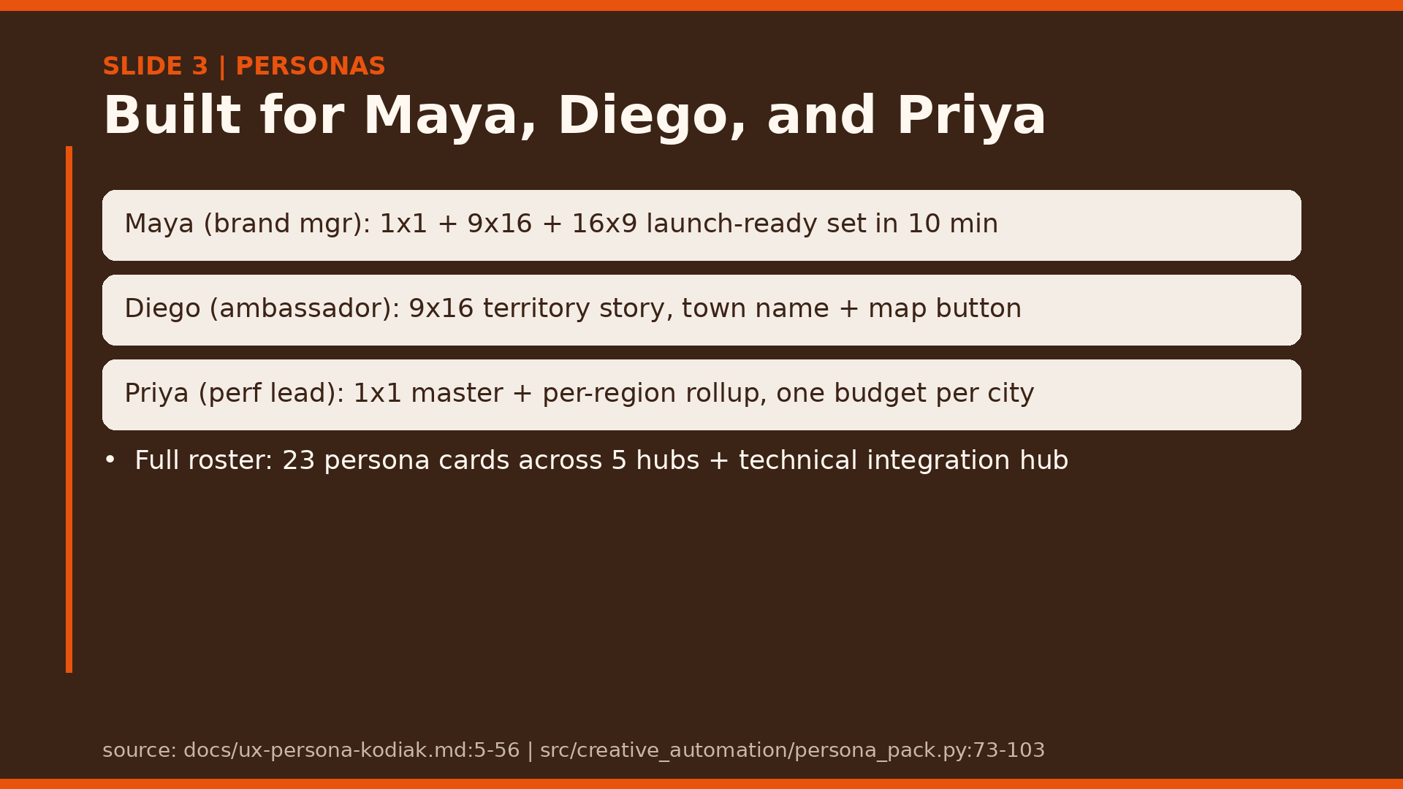
Notes:
Walk the weekly loop: Maya writes Monday, Diego shares, Priya watches taps, Friday the win becomes a training row the next run suggests first.

Slide 4
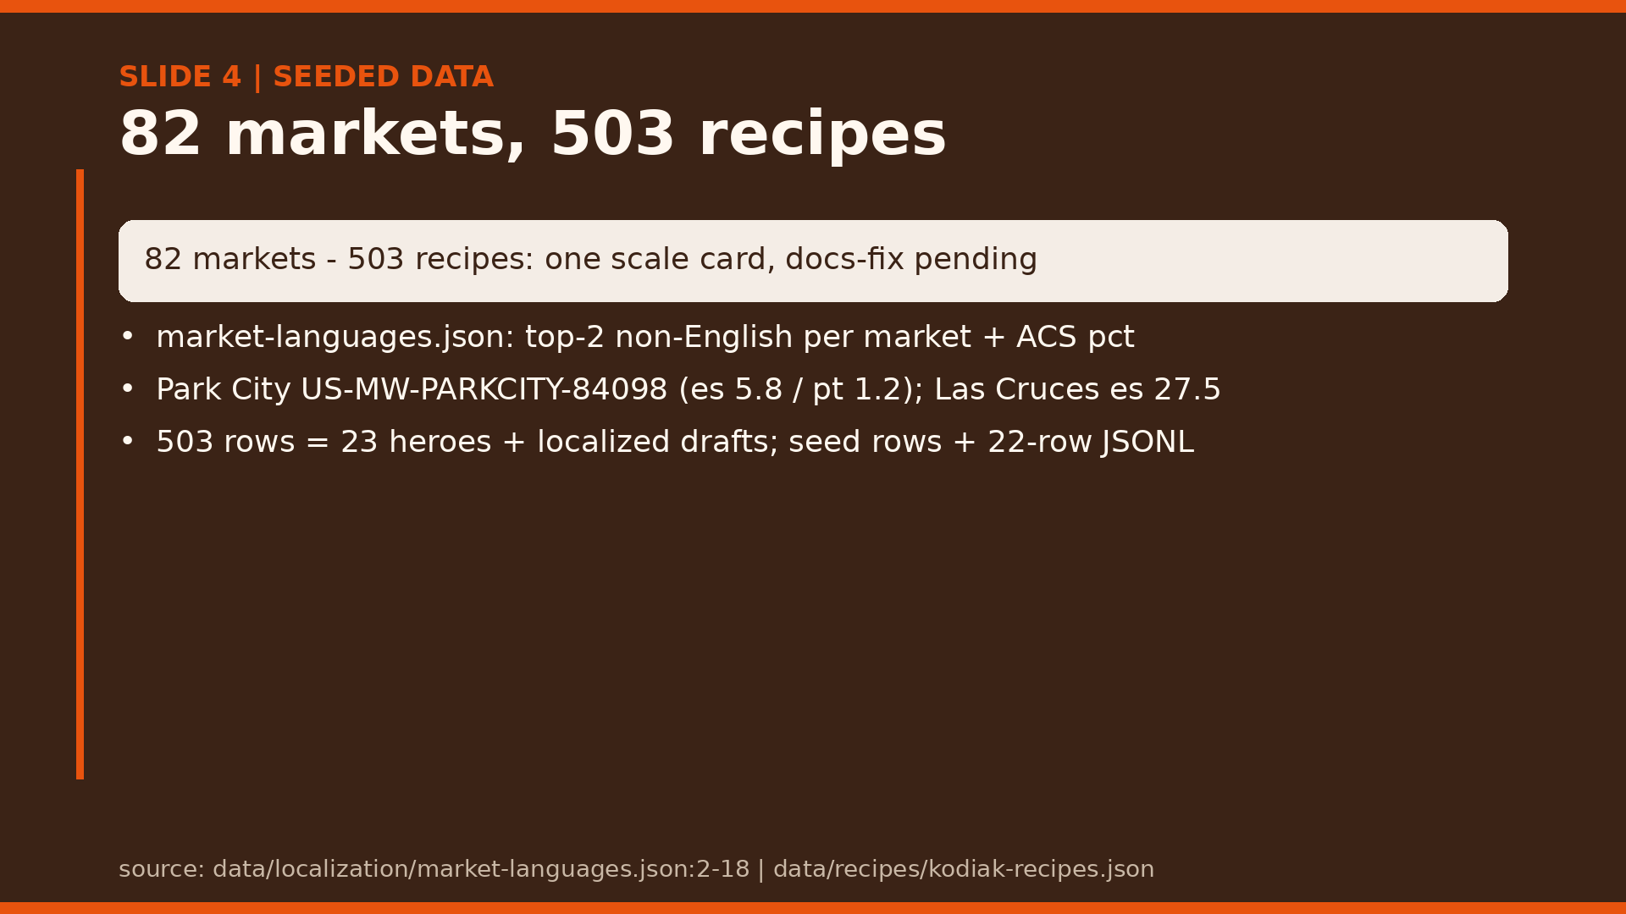
Notes:
Caveat on stage: persona docs say 23 baselines but the file holds 503 rows. Reframe as 23 heroes plus hundreds of localized drafts until docs are fixed; the card stays flagged pending, single-sourced.

Slide 5
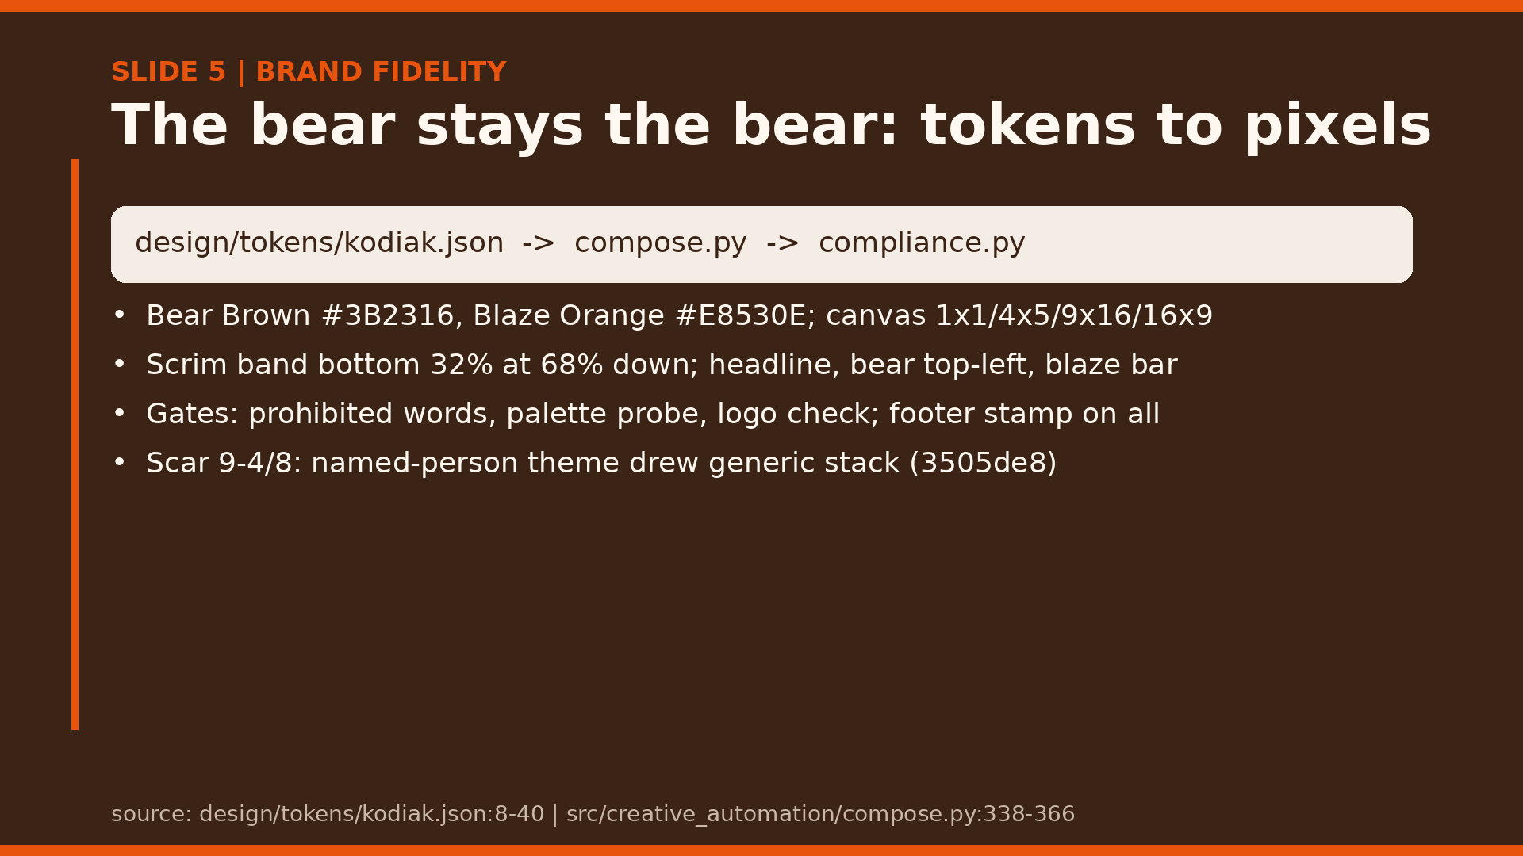
Notes:
Trace tokens to pixels live: kodiak.json is the source of truth, compose draws layout, compliance votes pass or fail. The model never touches logo or type. Efron beat (gh#251, Sep 4-8): ingested partner-libraries.json with licensed-only DAM keys plus two shot-list gaps; refusal had two faces, a silent generic stack while the receipt claimed the theme, and a hard filter trip on raw real-person names (scene_prompts.py:85-95, generate_lambda.py:2433); removal Sep 8 (3505de8, 16 files, +177/-553) after 4-5 days build-then-remove plus hardening (02ada6b, 0d79c5d); no per-theme dollar ledger exists. Survived as law: no named-person themes, retired-name scrub, match-or-abstain theme-mismatch flag, bear law, mascot-lock identity pattern.

Slide 6
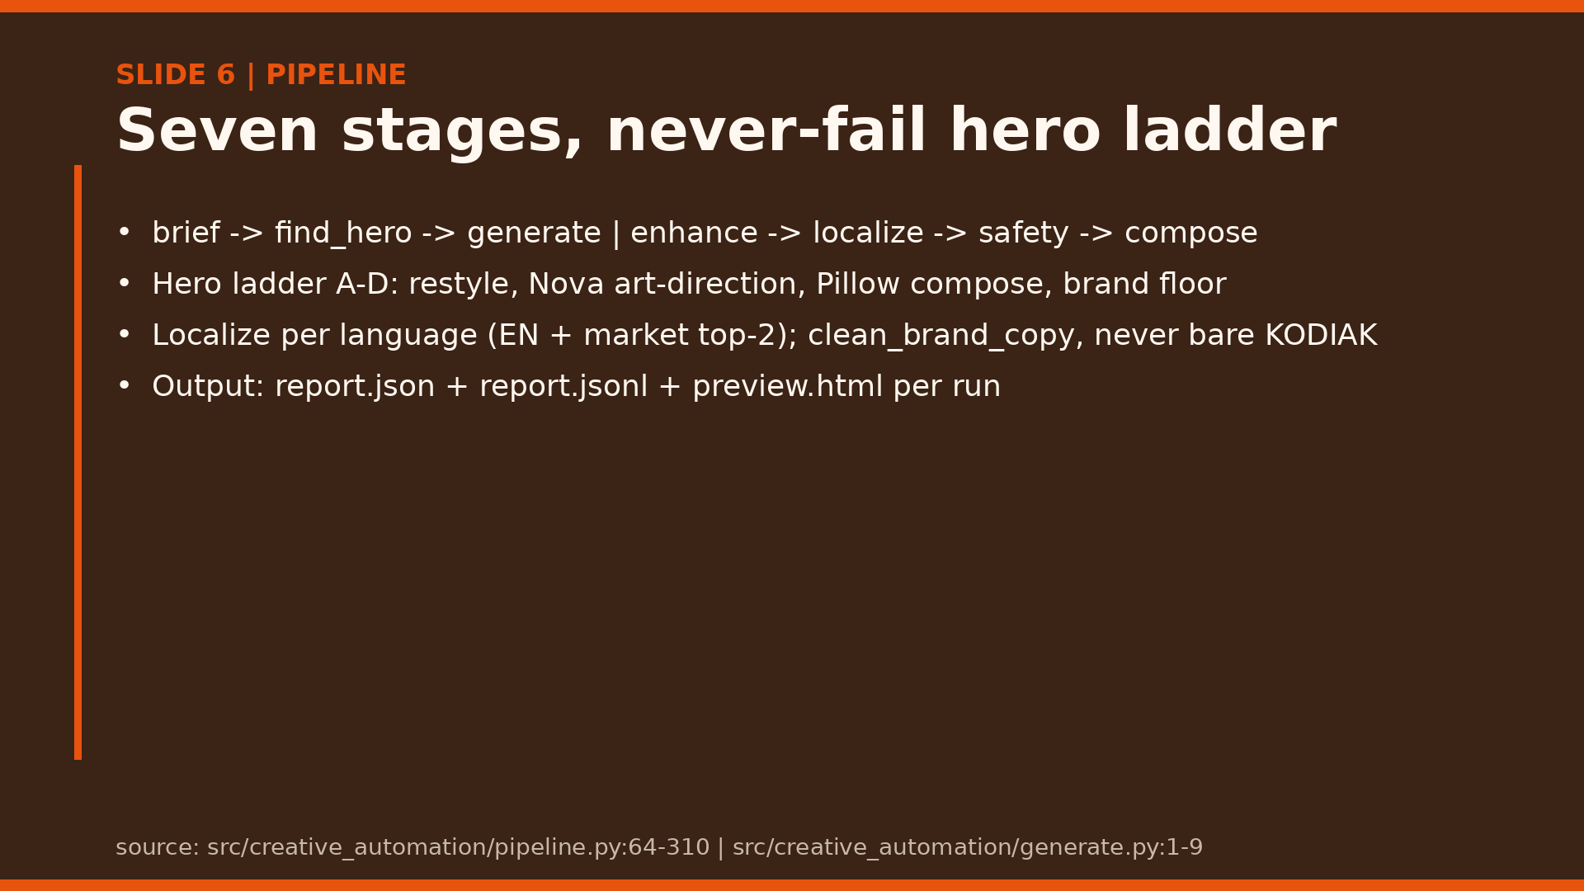
Notes:
Emphasize the ladder: rung D is a deterministic brand floor, so generate never fails open. Nova Canvas is legacy-flagged; the proof run is still open (#51).

Slide 7
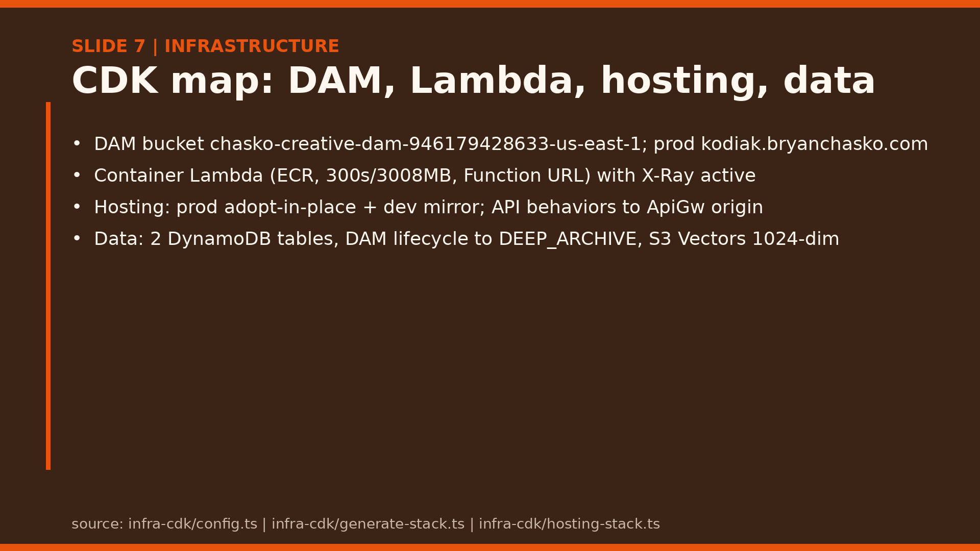
Notes:
Read the map left to right: static site, path-behavior fan-out, container Lambda, DAM plus tables plus vectors. Pre-warm was removed after the $38/day incident.

Slide 8
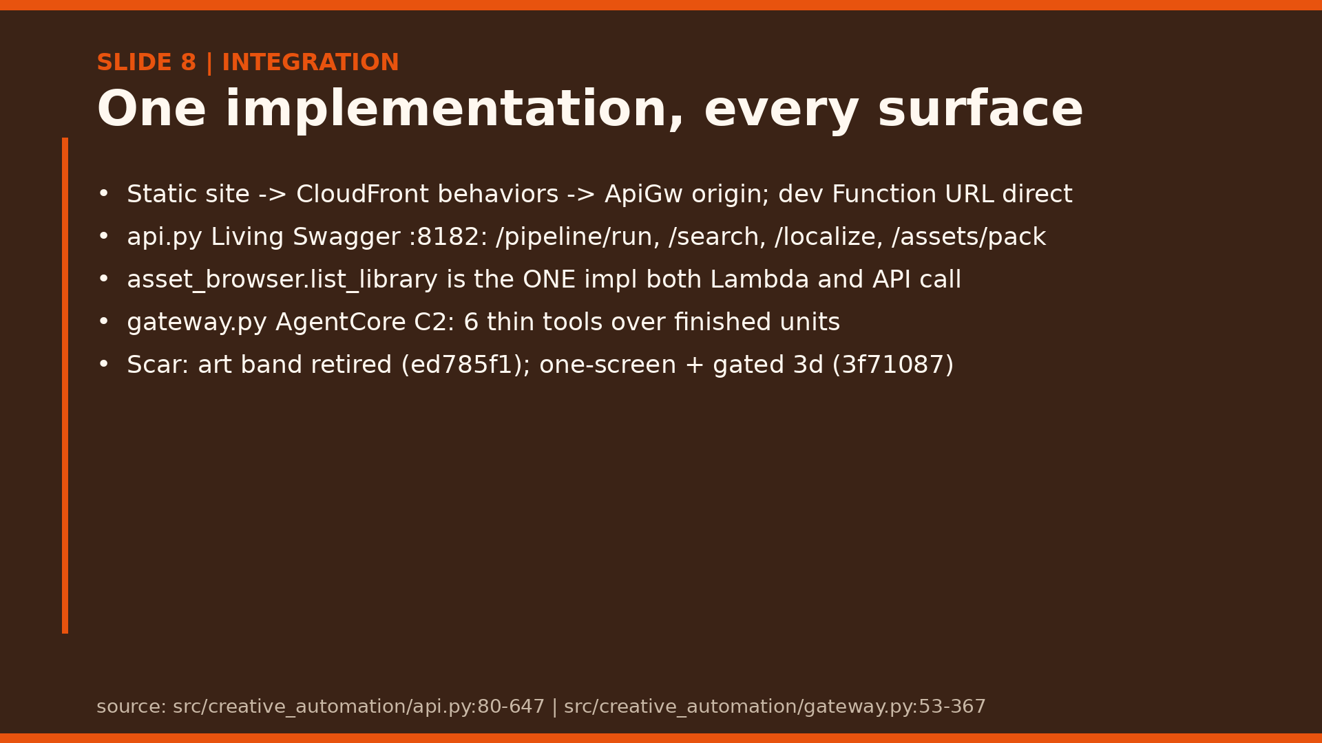
Notes:
Stress the contract: same JSON in CLI, API, and MCP. Callable or not shippable; no mock-as-success anywhere on this surface. Scar: bespoke art surfaces rotted and were cut (art band ed785f1, frontier collapsed to one screen plus gated 3d marquee 3f71087); shared forest cap and static fallback remain.

Slide 9
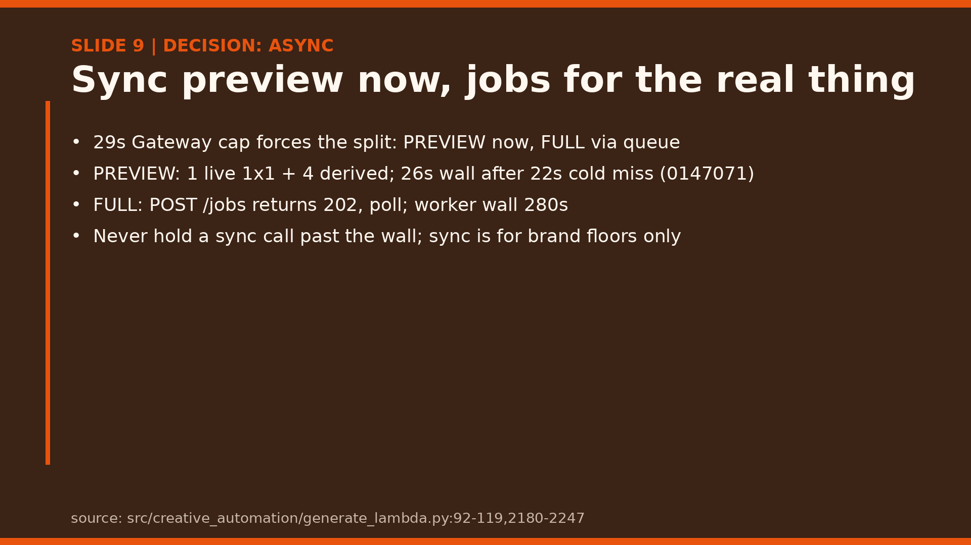
Notes:
Make the tradeoff explicit: the Gateway cap is fixed, so preview buys immediacy and jobs buy completeness. Scar: prod fell through to the brand floor on a cold-model serial chain past the 22s wall, so the wall went gateway-correct 26s (0147071); never hold a sync call past the wall.

Slide 10
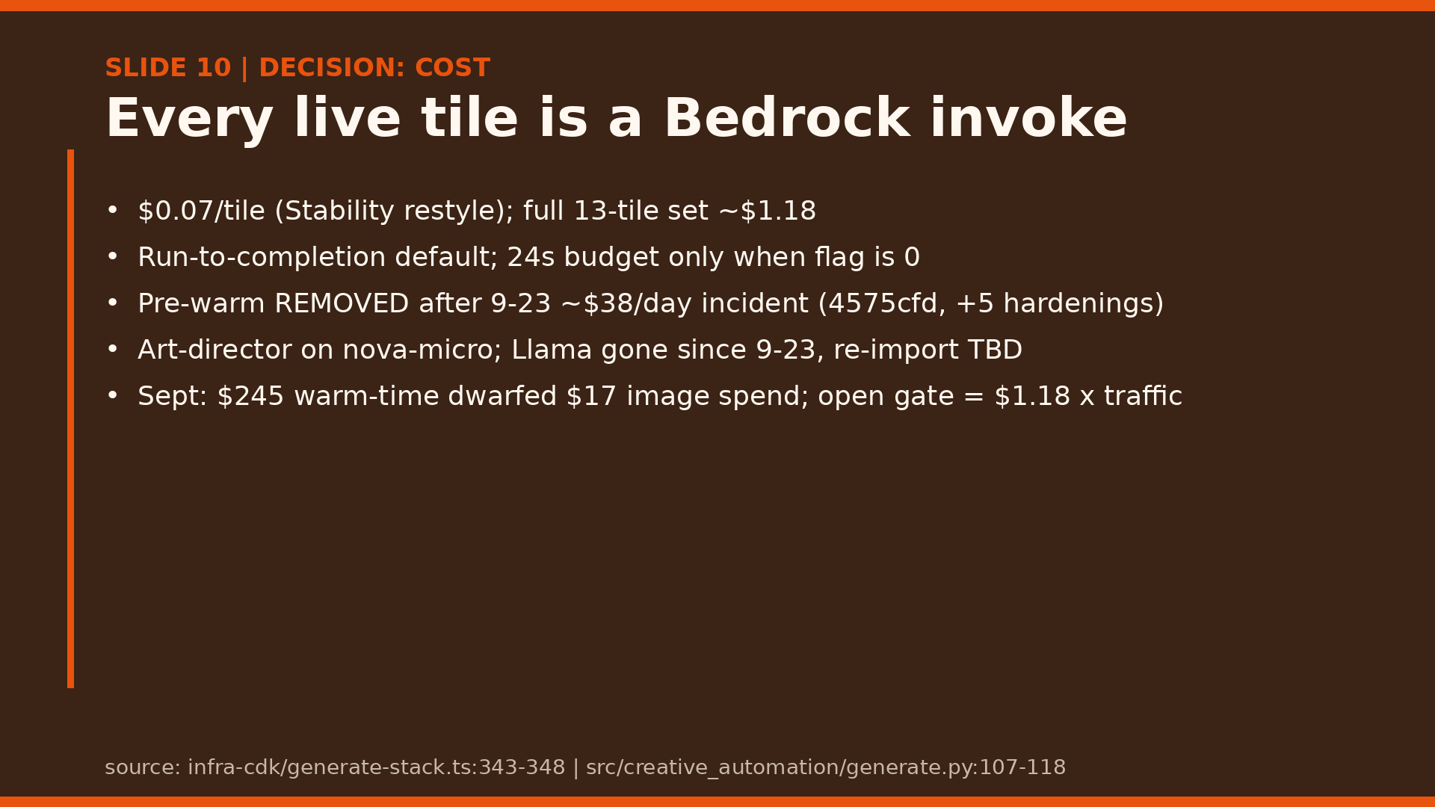
Notes:
Tell the cost story honestly: a full incident day 2026-09-23, six hardening commits (4575cfd cost stop, ac62017 voice gate, 0172e2d hardening, 351f6c2 prewarm deleted, 6c25386 IAM narrow, bdfa2e3 inference profile). Everything expensive is off by default with per-request opt-in; that is why cache plus run-to-completion plus voice-flag-off are defaults, not options. Dollar anatomy: about $0.07 per tile, about $1.18 per full 13-tile set; September warm-time $245 dwarfed about $17 of image spend; a public gate would bill $1.18 per run times traffic.

Slide 11
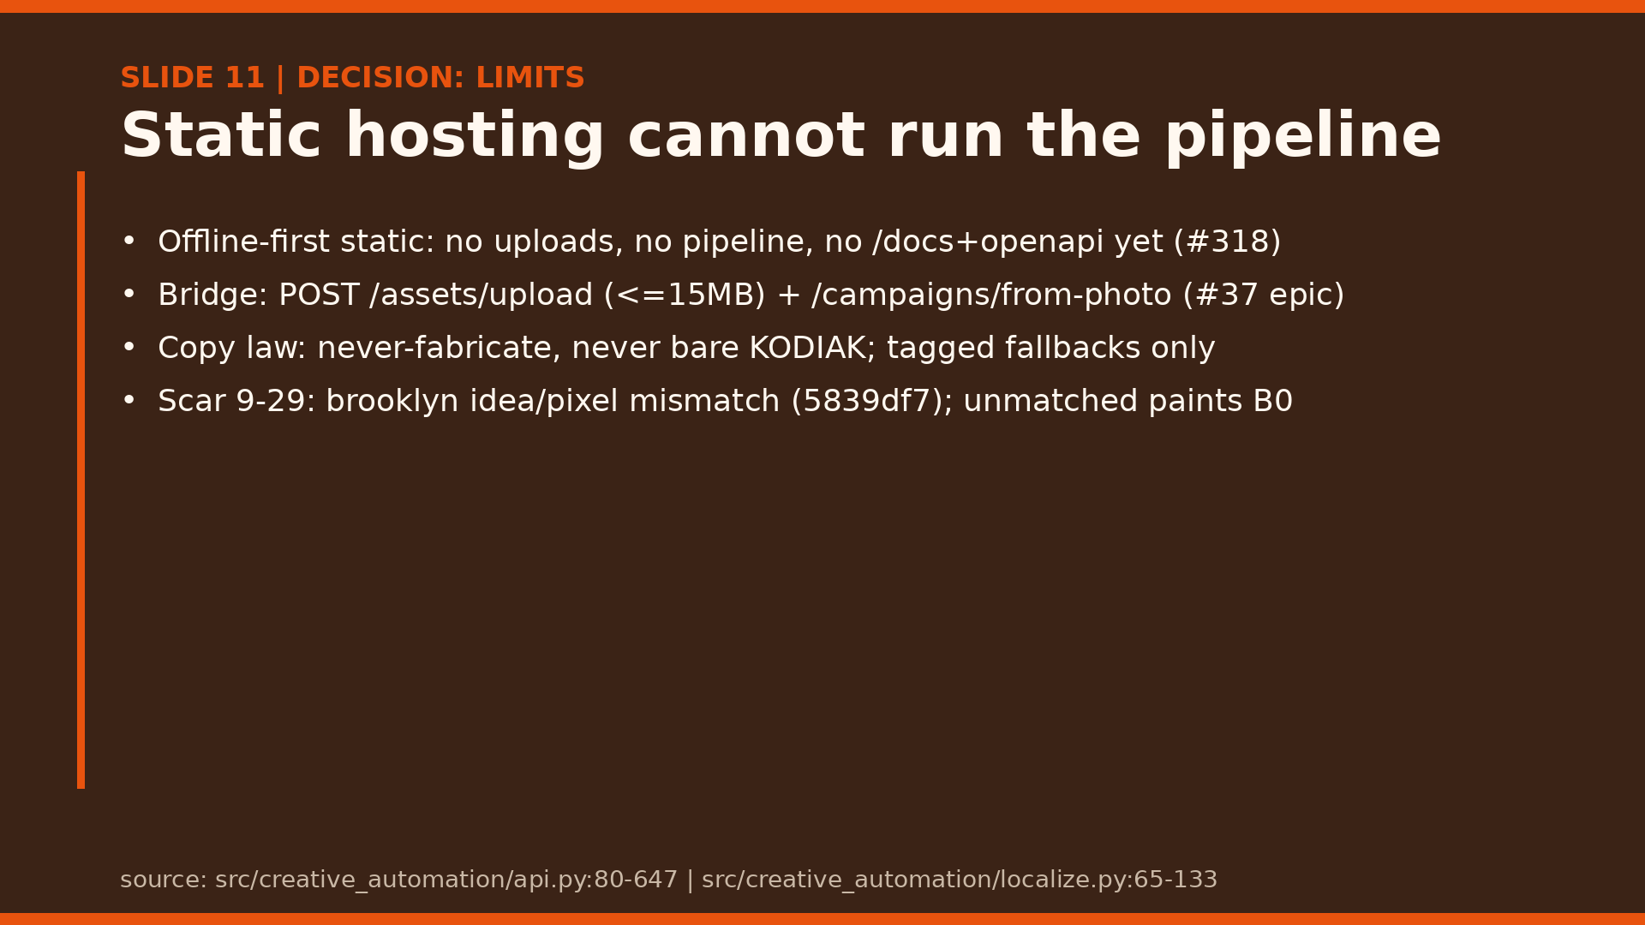
Notes:
Frame limits as design: the static host stays dumb and fast, the API does the thinking, and copy law means a missing translation degrades loudly. Scar: brooklyn idea-honesty night (5839df7), copy named the idea while pixels went generic with 1 suite failure unidentified at ship; now _brief_idea harvests ecology and unmatched ideas paint a B0 original. Demo shows graceful degradation, never silent invention.

Slide 12
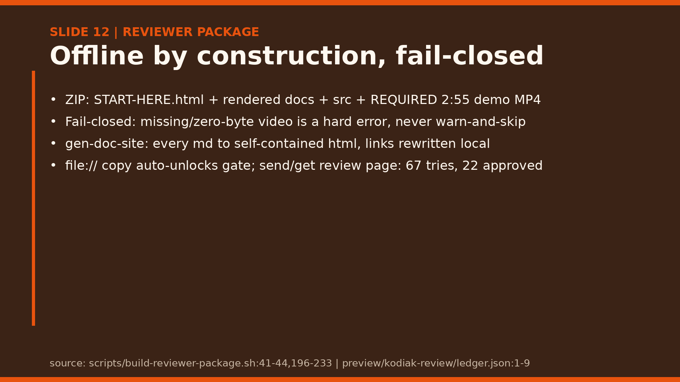
Notes:
Hand reviewers a box that works in a dead venue: launcher, docs, code, video. The send/get ledger shows exactly what was sent and what came back.

Slide 13
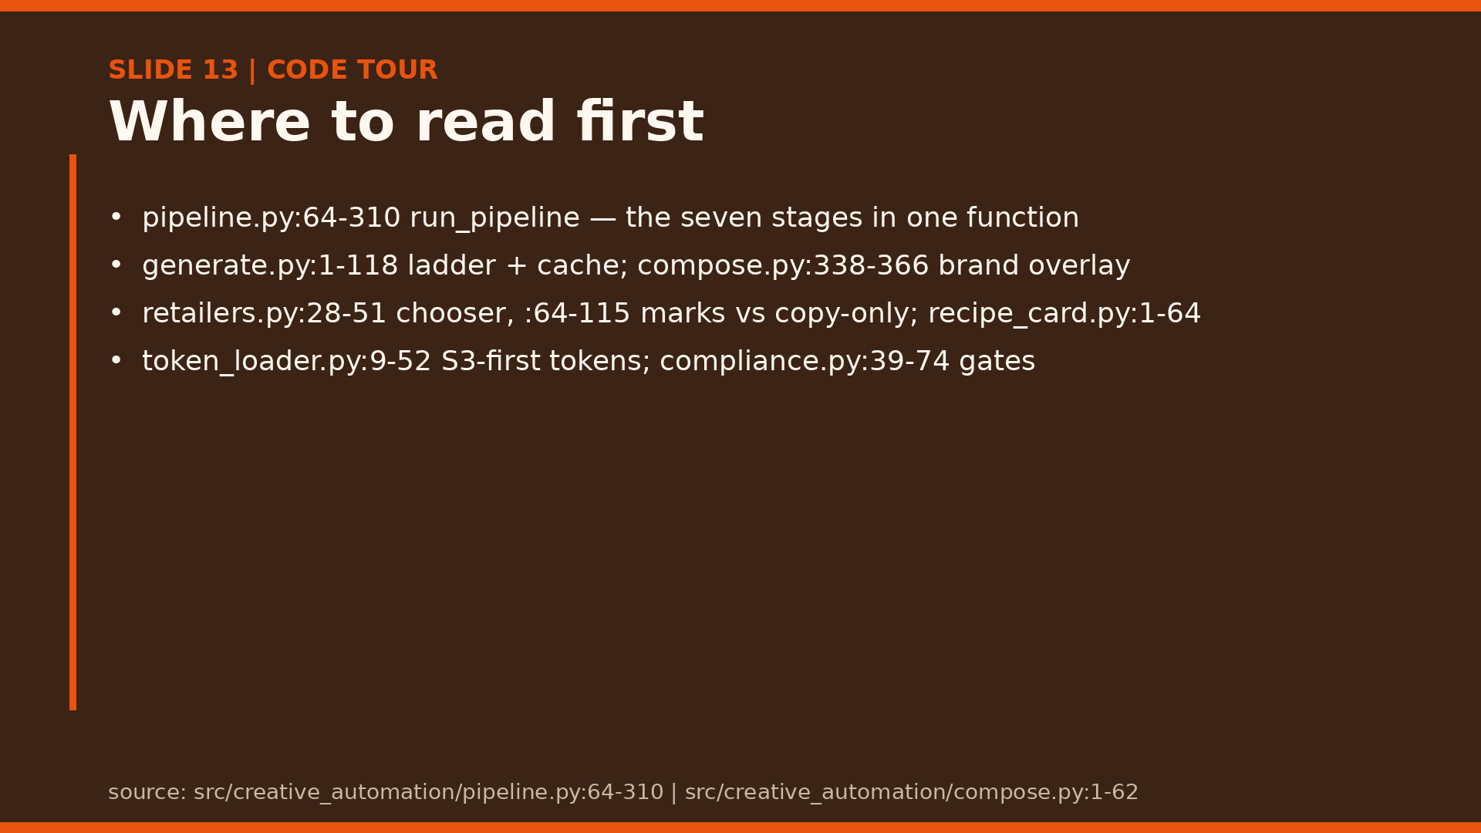
Notes:
Give the reading order, not the whole tree: pipeline first, then generate, compose, localize, retailers. Doc-as-code headers in compose say the contract.

Slide 14
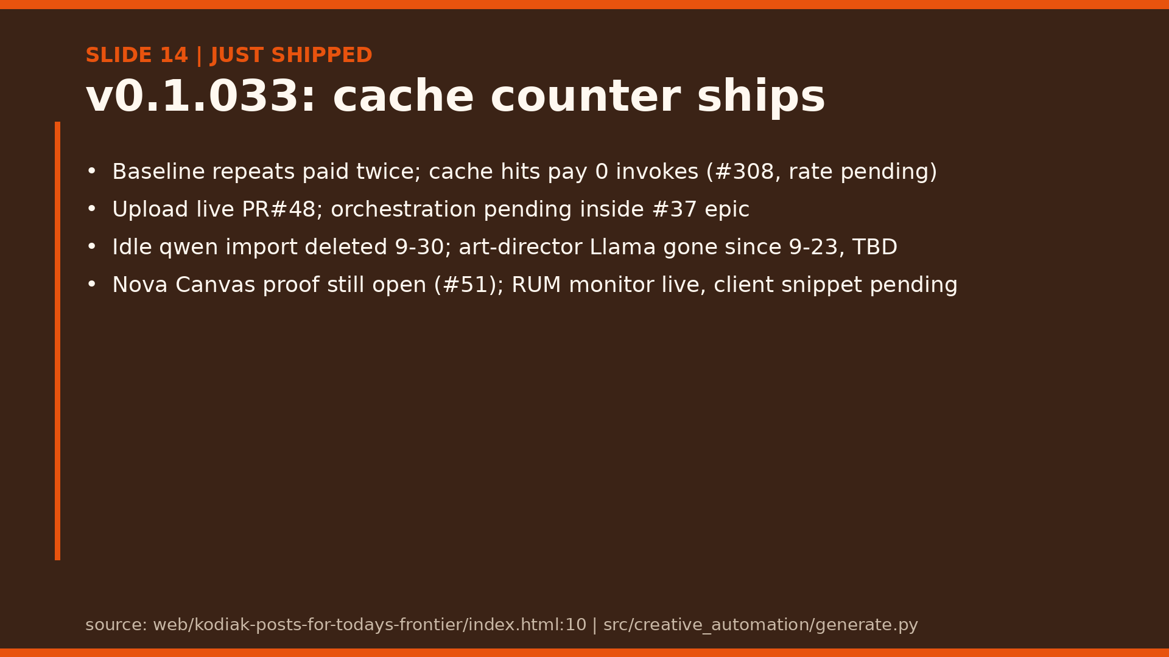
Notes:
Anchor on the cache win with the baseline beside it: before, every repeat render paid Bedrock again; after, cache-hit repeats pay 0 invokes, live hit-rate pending (#308) so the claim stays honest. Production-today close: cache counter code-done in main, RUM monitor live; Canvas proof (#51) and Llama re-import stay stated-open, not promised.

Slide 15
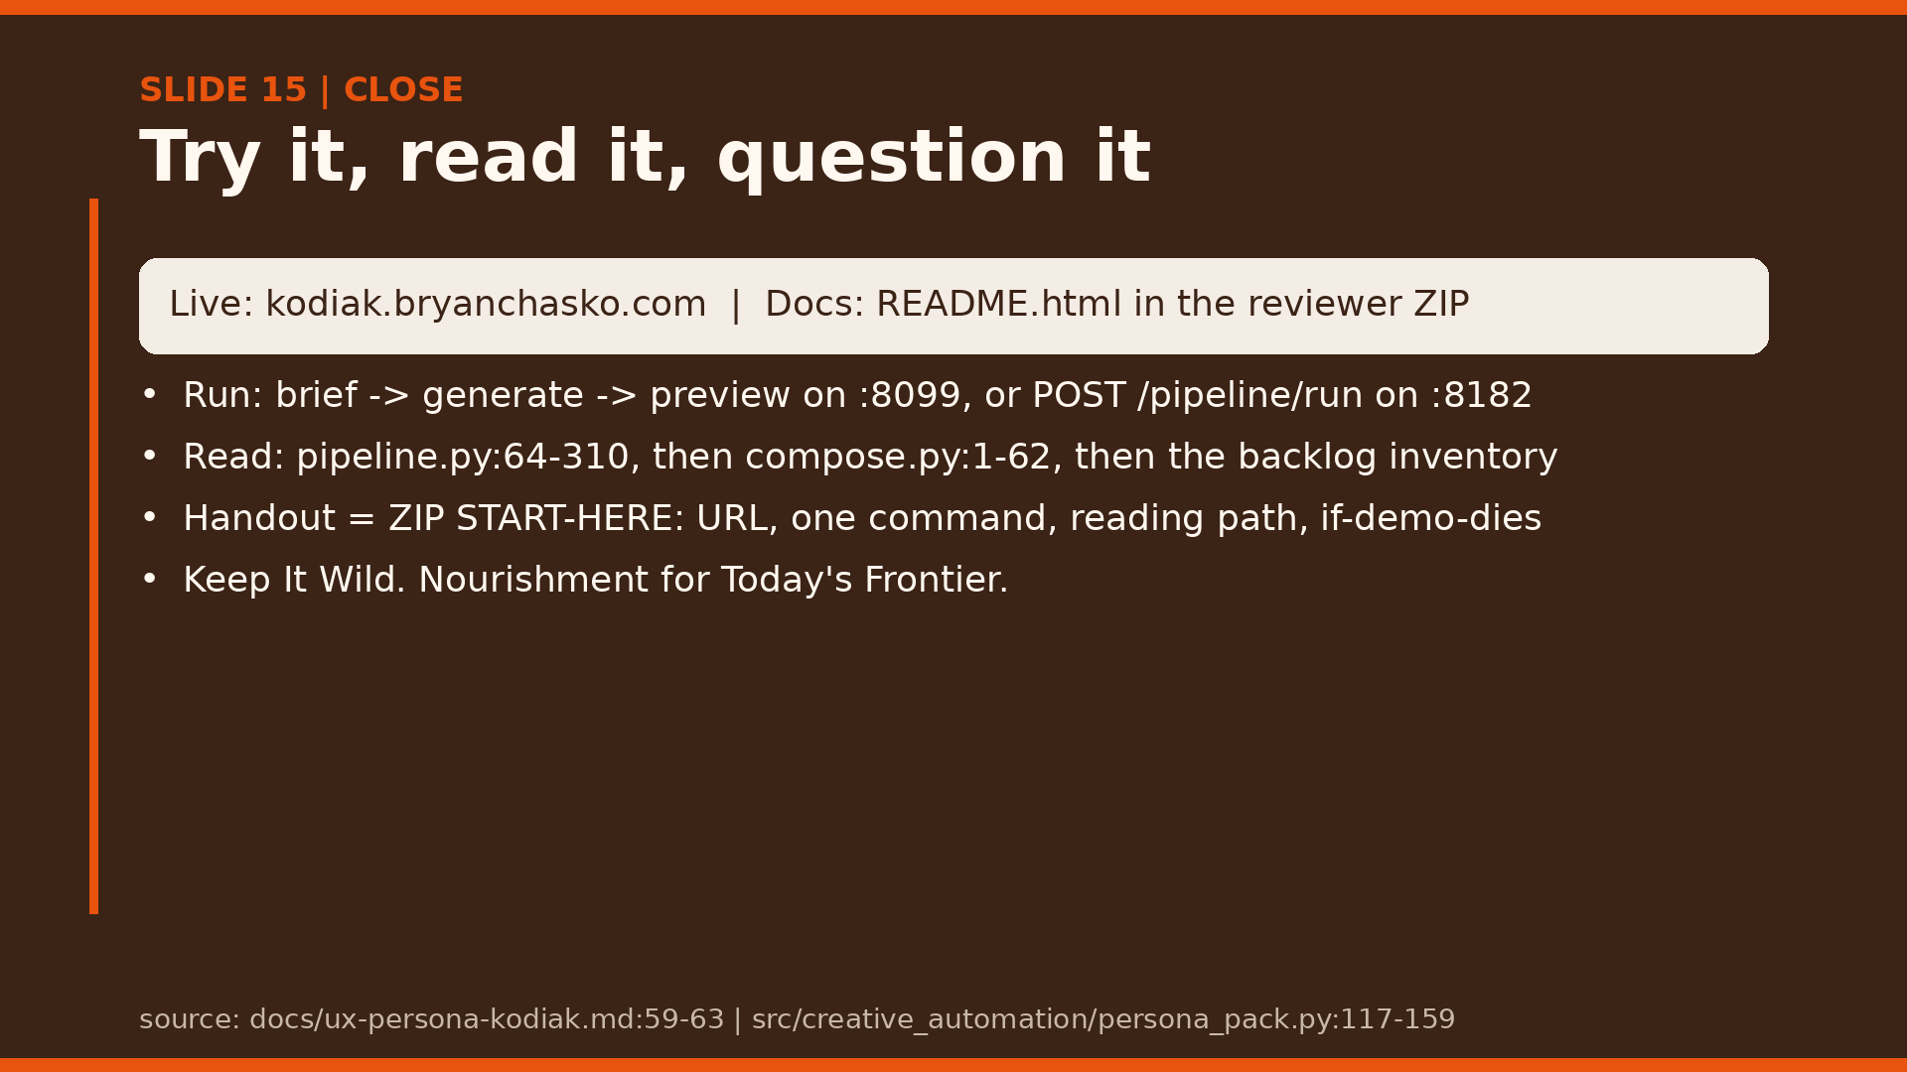
Notes:
End on the invitation: one runnable command, one reading path, one question back to the room. The reviewer ZIP START-HERE.html is the one-pager: live URL, one runnable command, reading path, and the dead-venue fallback. Thank them and take questions.

