Slide 1

CSCI E-25 Computer Vision
Introduction to Entropy
Steve Elston
Copyright 2019, 2021, 2022, Stephen F Elston. All rights reserved.

Slide 2

Entropy

Slide 3
Information
Information from observing the occurrence of an event
= the number of bits needed to encode the probability of the event.
If an event has probability p, we need –log₂(p) bits
A coin flip from a fair coin encodes 1 bit of information.
p =1/2, and then –log₂(1/2) = 1 bit
For an event with probability 1, we don’t need any bits.
p =1, and then –log₂(1) = 0 bits

Slide 4
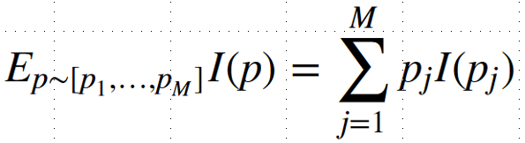
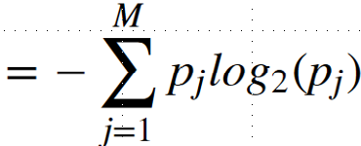

Information
If we had many events, with probabilities [p_{1,…,}p_{M}], what is their mean information?
If there are only 2 events (binary) with probabilities p and 1-p,
If the probabilities are ½ and ½:
Entropy!
If the probabilities are .99 and .01:

Slide 5
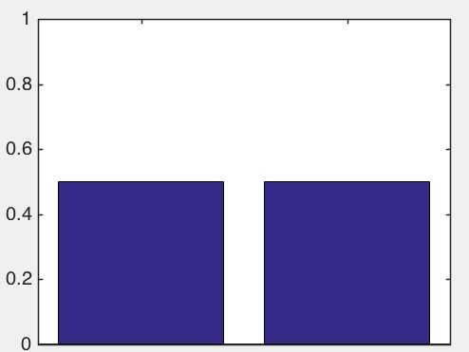
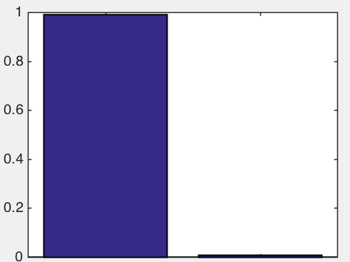
Information
If we had many events, with probabilities [p_{1,…,}p_{M}], what is their mean information?
If there are only 2 events (binary) with probabilities p and 1-p,
If the probabilities are ½ and ½:
If the probabilities are .99 and .01:

Slide 6
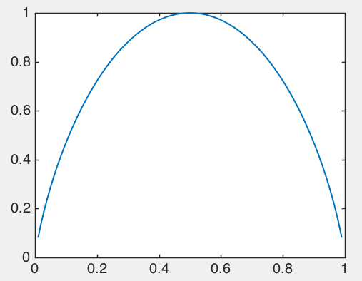
Information
Entropy changes with the probability of an event
Max entropy when max uncertainty, p = 0.5 – can’t predict next event
Min entropy when certainty, p = [0,1] – no uncertainty about next event
Entropy [p,1-p]
Probability p

Slide 7
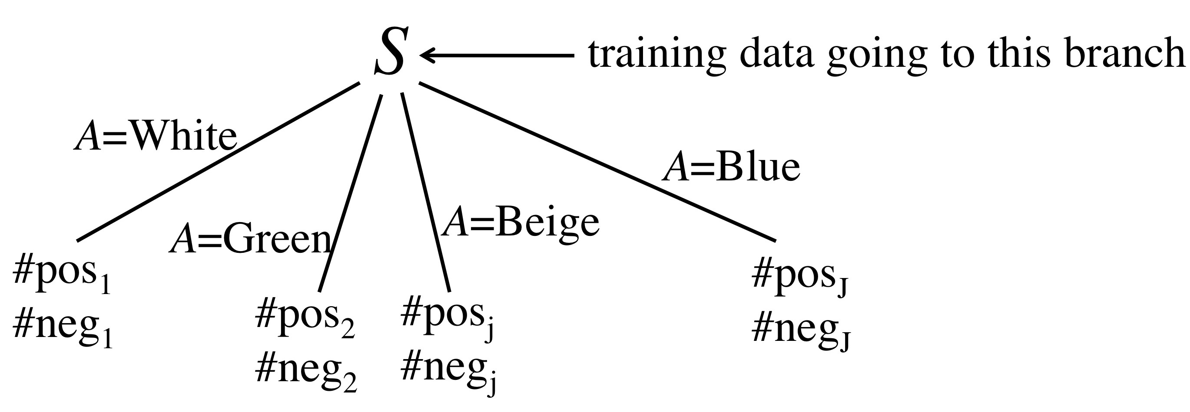

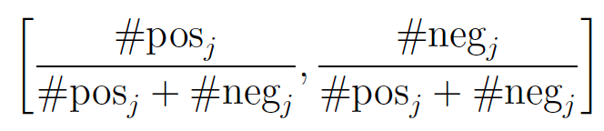
Splitting Criteria for Decision Trees: Information Gain
Rest of tree
The training probabilities in branch j are:
The training probabilities in branch j are:
[.08,.92] is good
[.50,.50] is bad

Slide 8
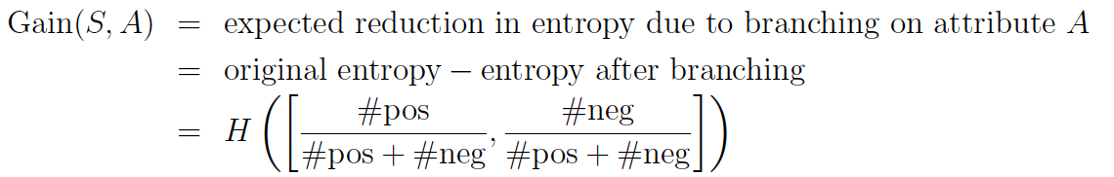
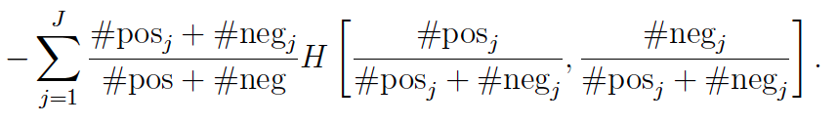
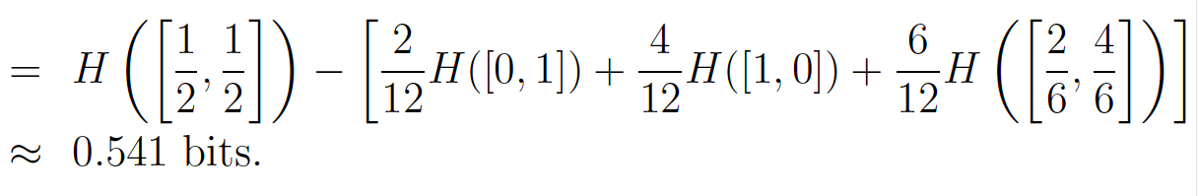
Splitting Criteria for Decision Trees: Information Gain
Gain(S,Guests)

Slide 9
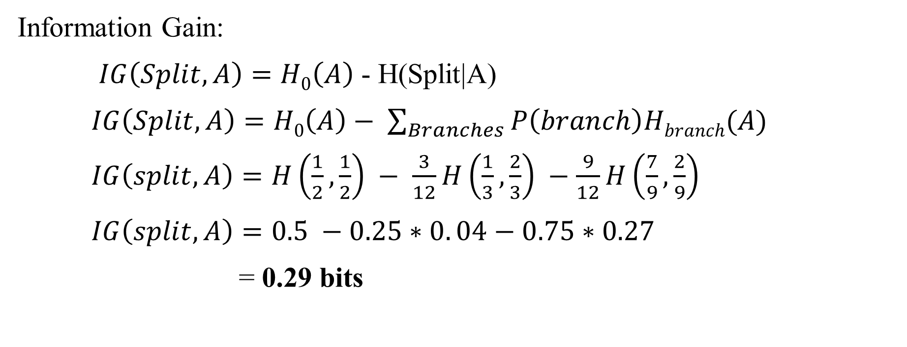
Splitting Criteria for Decision Trees: Information Gain
#A = [6,6]
H₀ = 0.5
Consider split on variable A
#A = [1,2]
H = ?
#A = [7,2]
H = ?
What is the information gain?
Information Gain:
$IG\left(Split,A\right)=H0\left(A\right)$ - H(Split|A)
$IG\left(Split,A\right)=H0\left(A\right)− \sum_{Branches}{P\left(branch\right)Hbranch(A)}$
$IG\left(split,A\right)=H\left(\frac{1}{2},\frac{1}{2}\right) − \frac{3}{12}H\left(\frac{1}{3},\frac{2}{3}\right) −\frac{9}{12}H\left(\frac{7}{9},\frac{2}{9}\right)$
$IG\left(split,A\right)=0.5 −0.25∗0. 04−0.75∗0.27$
= 0.29 bits

Slide 10

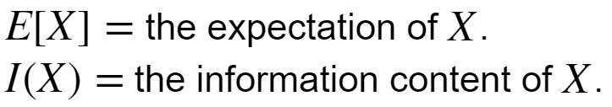
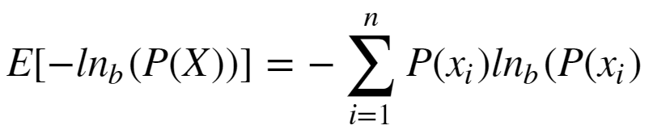
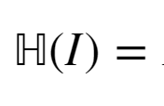
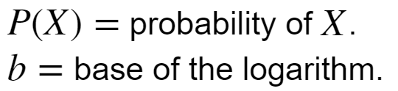
Loss Functions for Training Neural Networks
Shannon Entropy is the expected information content of data:
Where:
We are working with probability distributions, so can write entropy as an expectation:
Where:

Slide 11
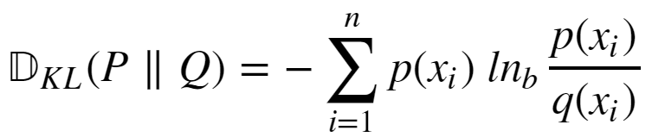
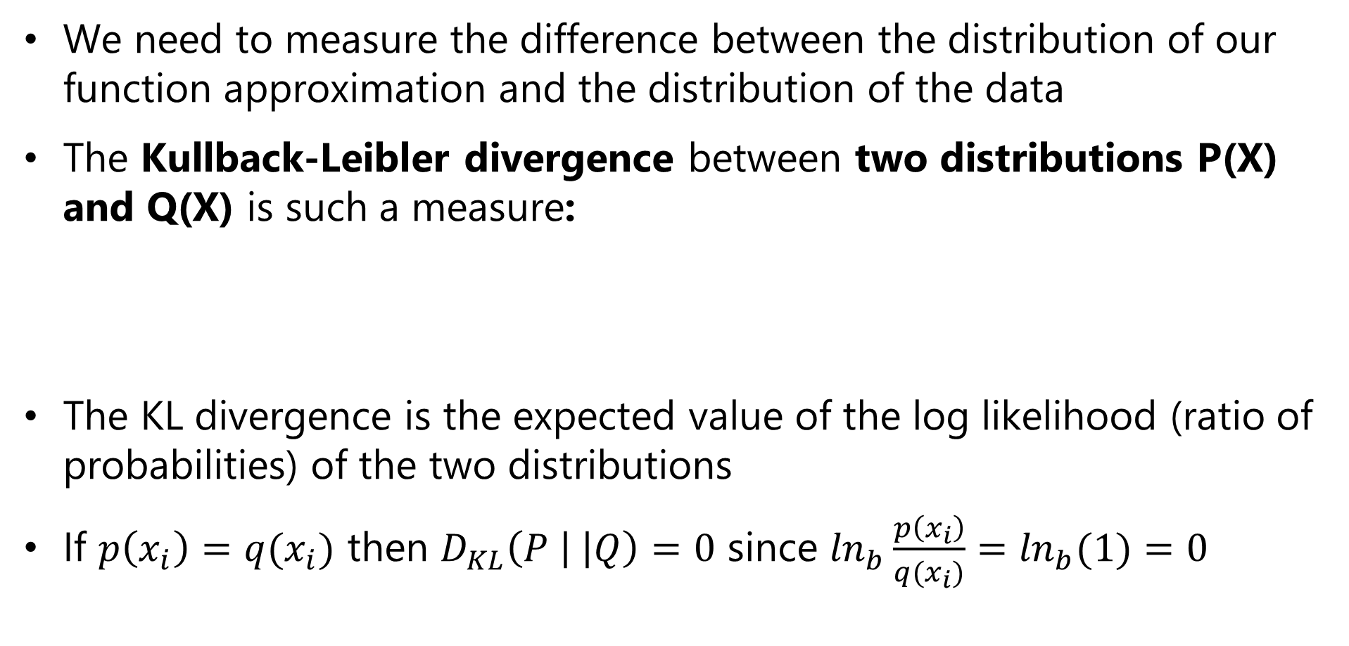
Loss Functions for Training Neural Networks
We need to measure the difference between the distribution of our function approximation and the distribution of the data
The Kullback-Leibler divergence between two distributions P(X) and Q(X) is such a measure:
The KL divergence is the expected value of the log likelihood (ratio of probabilities) of the two distributions
If $p\left(x_{i}\right)=q(x_{i})$ then $D_{KL}\left(P \left| \right|Q\right)=0$ since $\ln_{b}\frac{p\left(x_{i}\right)}{q(x_{i})}=\ln_{b}(1)=0$

Slide 12
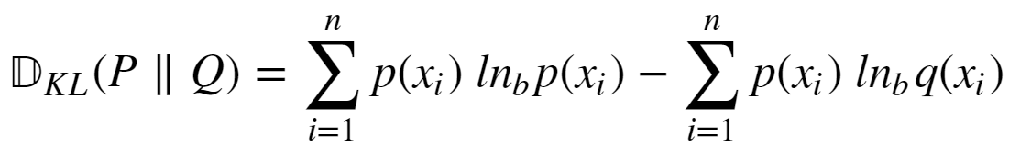
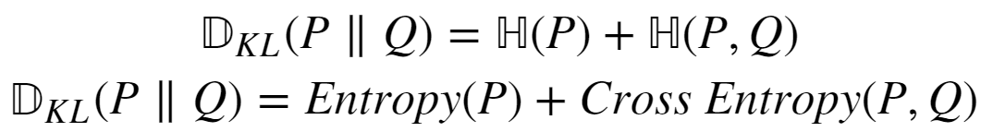
Loss Functions for Training Neural Networks
How do we compute KL divergence?
If we knew P(X) we would not need to compute KL divergence
We can expand KL divergence as:

Slide 13


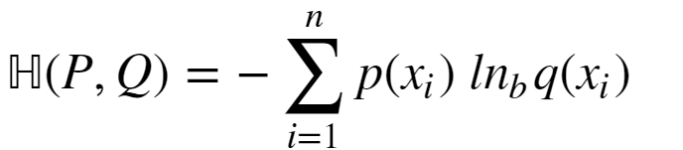
Loss Functions for Training Neural Networks
Given:
The term is constant
So, we only need the cross entropy term:

Slide 14
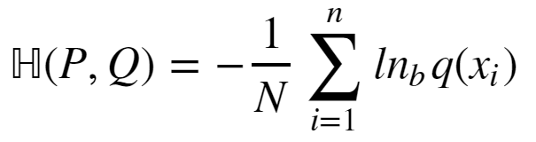
Loss Functions for Training Neural Networks
How can we compute cross entropy when we don’t know P(X):
Since we don’t know P(X), use the mean approximation:

Slide 15
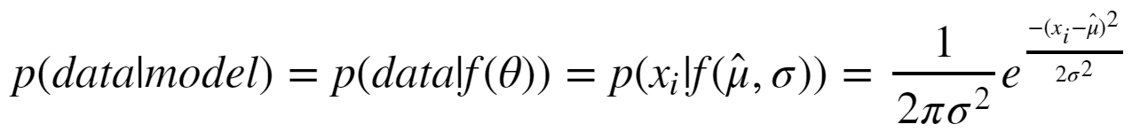
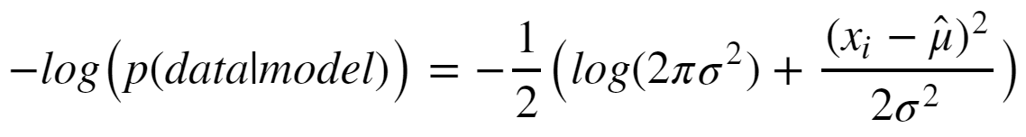
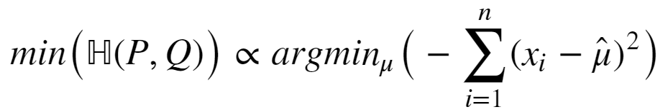
Loss Functions for Training Neural Networks
Consider the special case of Gaussian likelihood:
Taking the negative logarithm:
Ignoring the constant terms, the minimum of cross entropy is:

