Slide 1






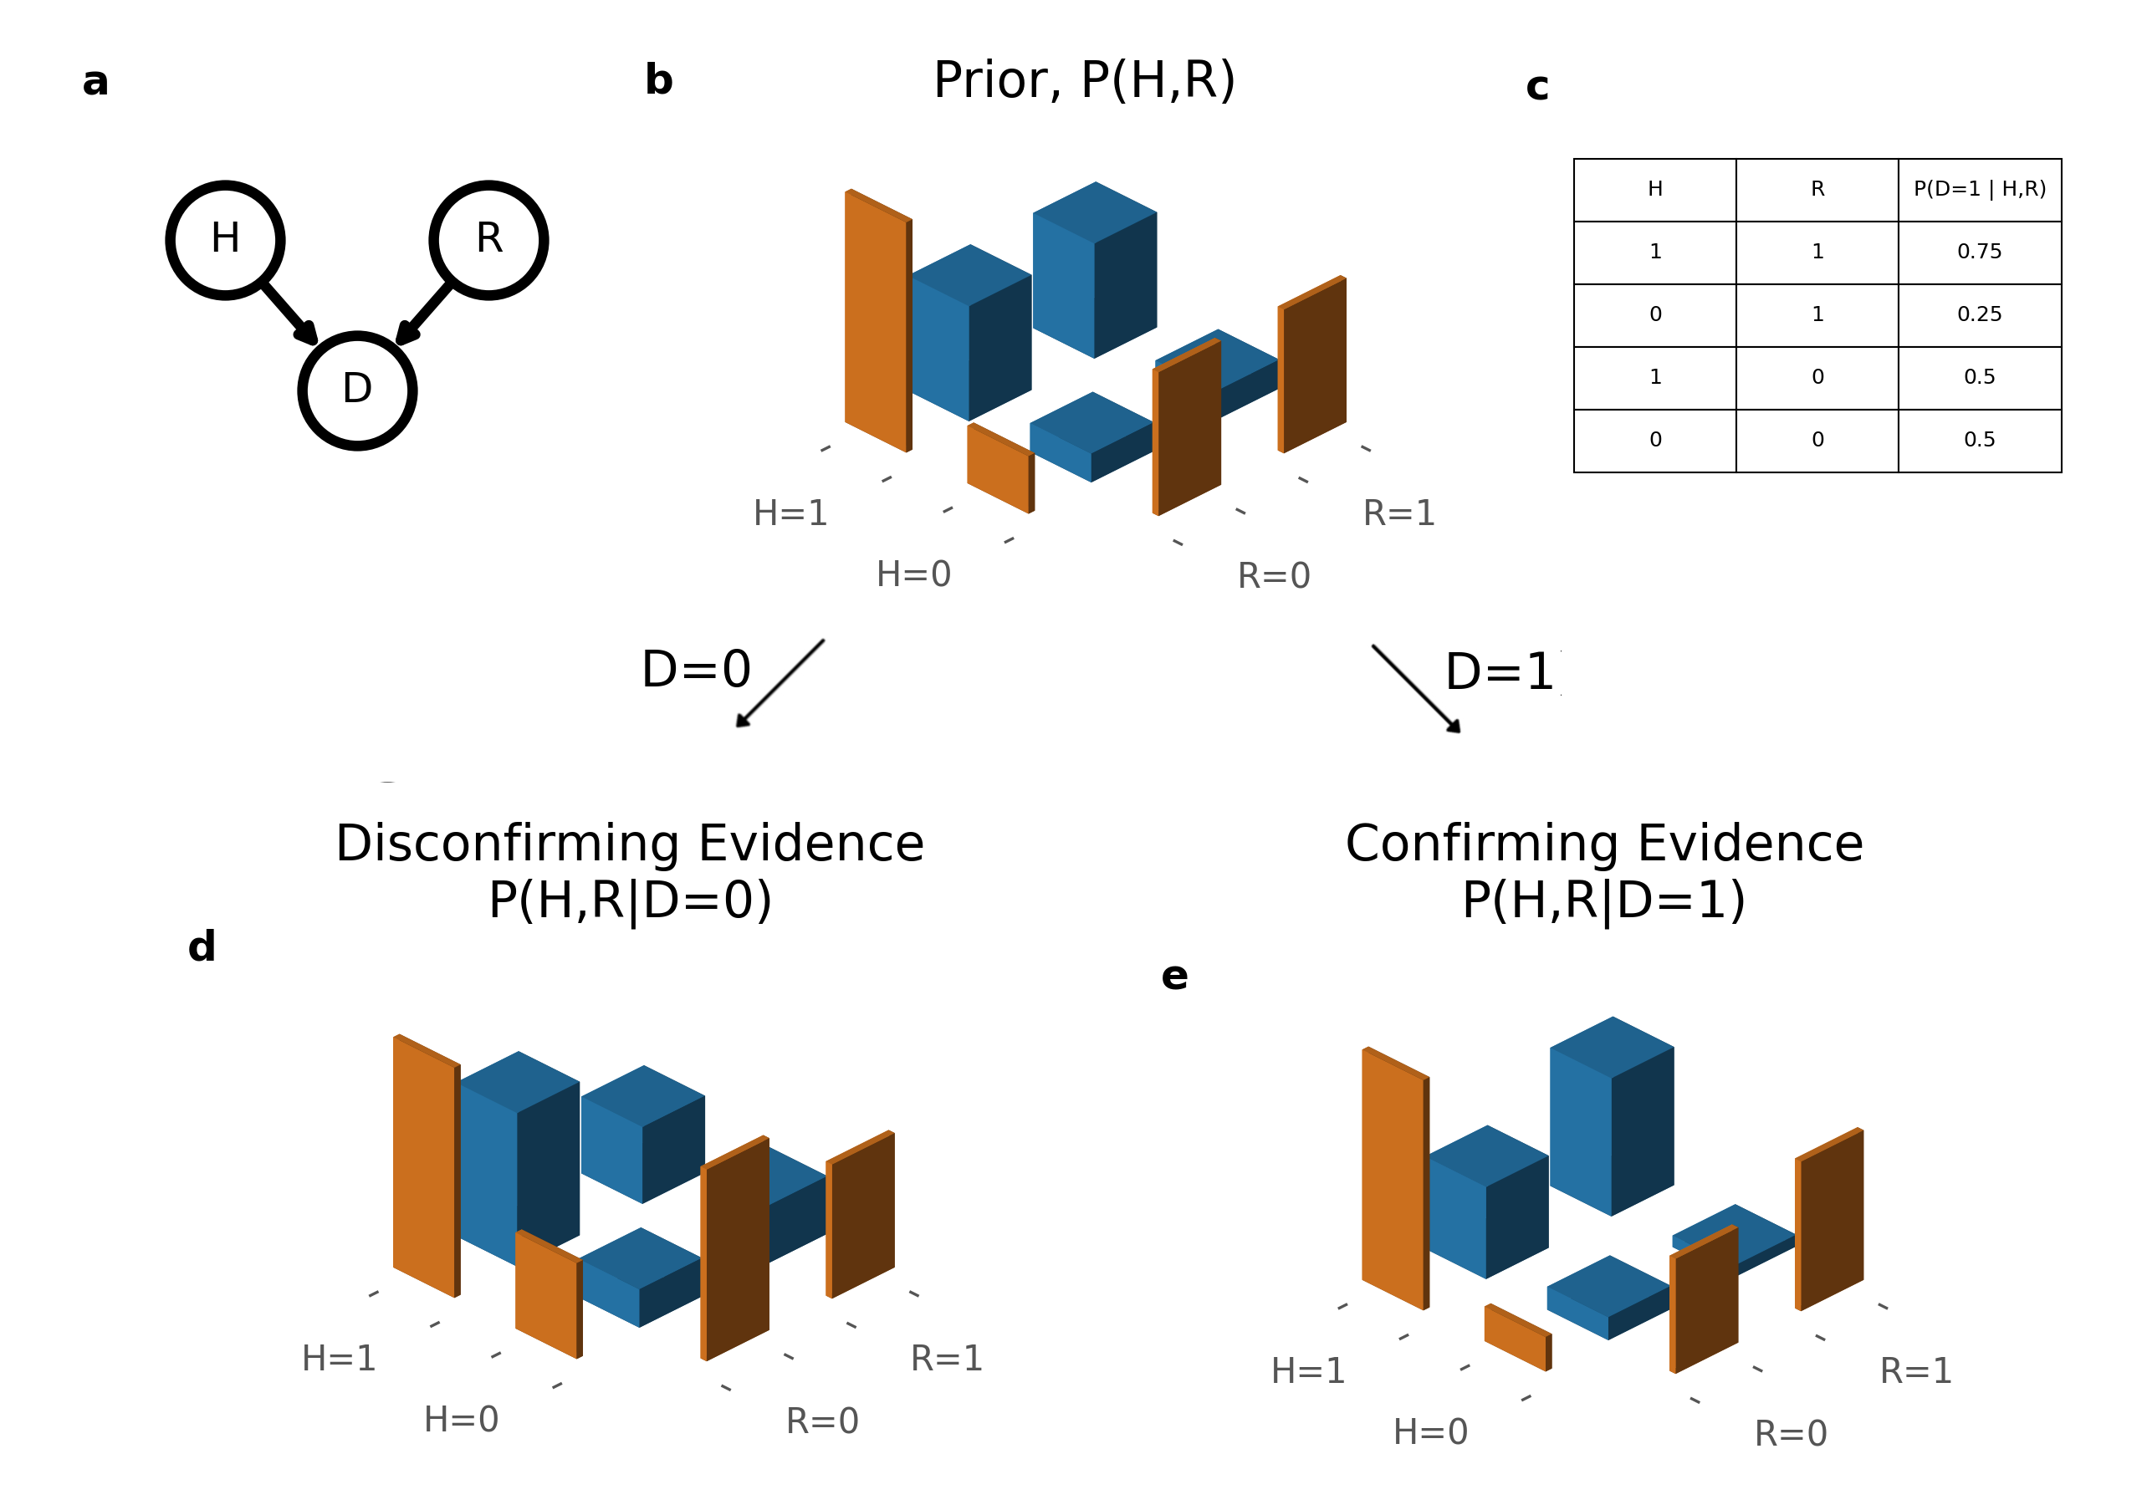
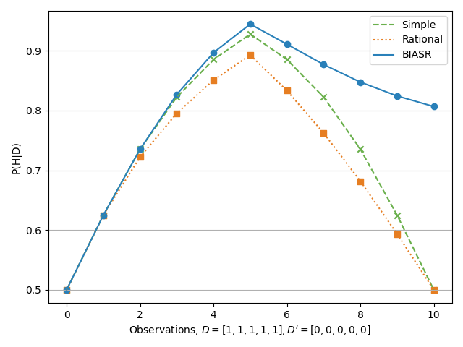
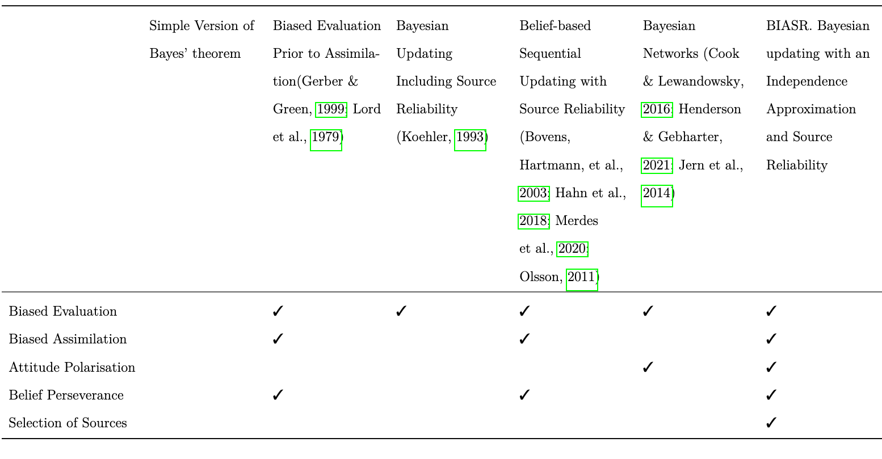
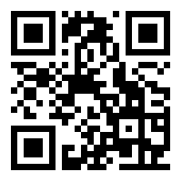
_________________________________________________________________________
Confirmation Bias Emerges from an Approximation to Bayesian Reasoning
Charlie Pilgrim (collaborators: Adam Sanborn, Eugene Malthouse, Thomas T Hills)
BIASR Model
1. Source Reliability, R
2. Simultaneous updating, P(H,R|D)
3. Independence Approximation, P(H)P(R) ≈ P(H,R)
4. Sequential Updating
Confirmation bias, as the term is typically used in the psychological literature, connotes the seeking or interpreting of evidence in ways that are partial to existing beliefs, expectations, or a hypothesis in hand.[1]
_________________________________________________________________________
_____________________________
1. Source Reliability
How reliable is Bob?
People track source reliability. [2,3]
_____________________________
3. Independence Approximation
Upon receiving data, beliefs in H and R are no longer independent. [6]
Size of joint belief distribution:
2 beliefs -> 2²=4
20 beliefs -> 2²⁰ ≈ 10⁶
300 beliefs -> 2³⁰⁰ ≈ 10⁹⁰
Unrealistic memory requirement.
Alice Bob
_____________________________
2. Simultaneous updating
Someone tells you Elvis is outside. How reliable are they?
People update beliefs together. [4, 5]
_____________________________
4. Sequential Updating
Small errors magnify.
Simultaneous updating of source reliability, R, and the central hypothesis, H. Blue (thick) bars show the joint belief distribution. Orange (thin) bars show the marginal belief distributions. a) The Bayesian network structure. b) Prior beliefs favour the central hypothesis, and are neutral about source reliability. The posterior following d) disconfirming and e) confirming evidence.
Data for, then data against, the central hypothesis are received from different sources given neutral initial priors. Under simple and rational models, the belief in the central hypothesis returns to the prior belief. With the BIASR model, data received earlier has a stronger effect on beliefs than data received later.
References 1. Nickerson, R. S. Confirmation bias: A ubiquitous phenomenon in many guises. Rev. general psychology 2, 175–220 (1998). 2. Lord, C. G., Ross, L. & Lepper, M. R. Biased assimilation and attitude polarization: The effects of prior theories on subsequently considered evidence. J. personality social psychology 37, 2098 (1979). 3. Taber, C. S. & Lodge, M. Motivated skepticism in the evaluation of political beliefs. Am. journal political science 50, 755–769 (2006). 4. Gershman, S. J. How to never be wrong. Psychon. bulletin & review 26, 13–28 (2019). 5. Dunbar, K. How scientists really reason: Scientific reasoning in real-world laboratories. The nature insight 18, 365–395 (1995). 6. Pearl, J. Causality (Cambridge university press, 2009).
Comparison of information processing models of confirmation bias.

