Slide 1
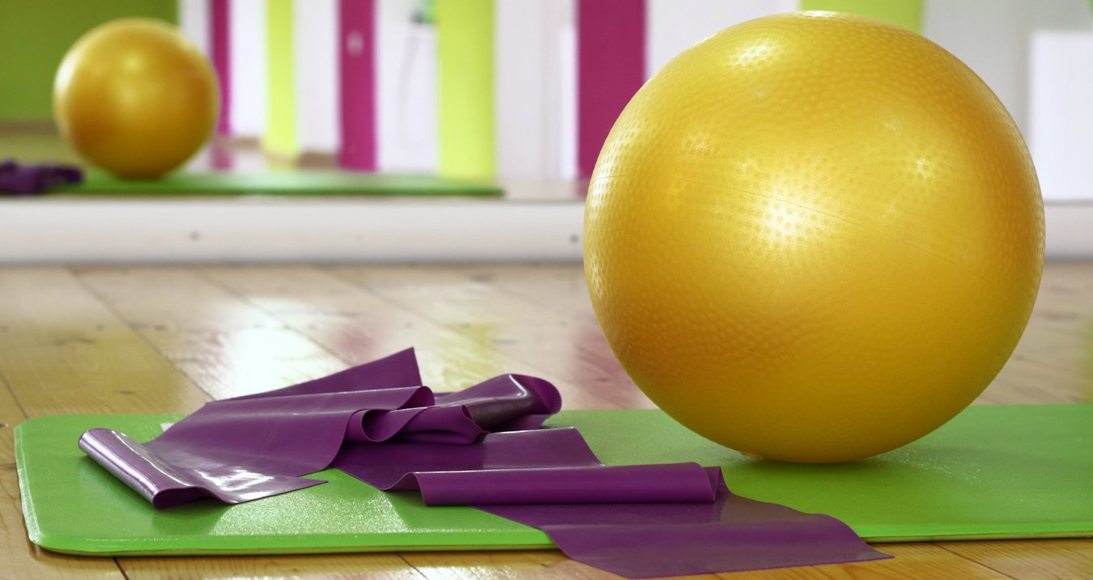
TOTAL BODY WORKOUT

Slide 2
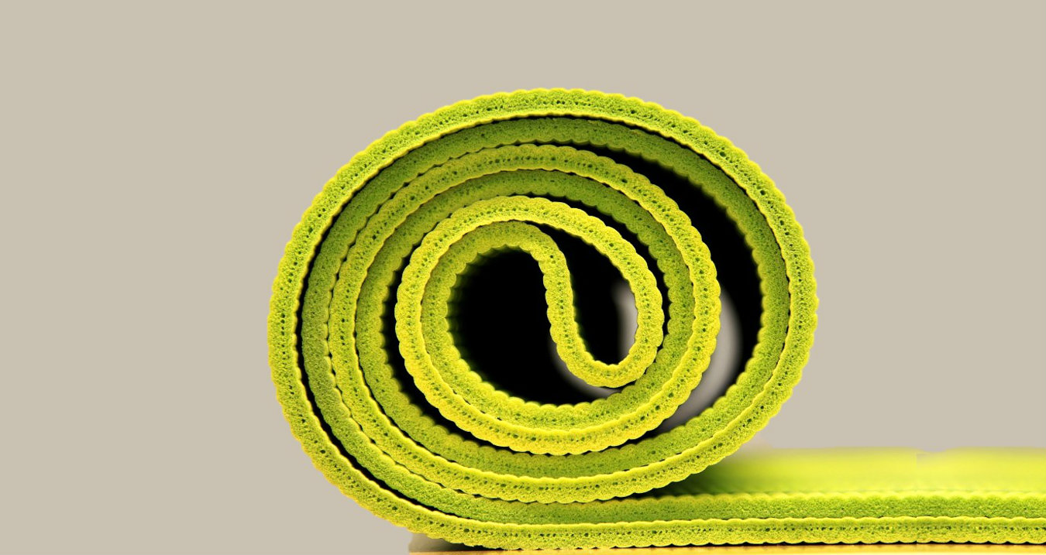
TONE AND STRENGTHEN
STRONGER CORE MUSCLES

Slide 3

REJUVENATE
REJUVENATE

Slide 4

IMPROVED POSTURE
STRENGTHEN AND TONE

Slide 5






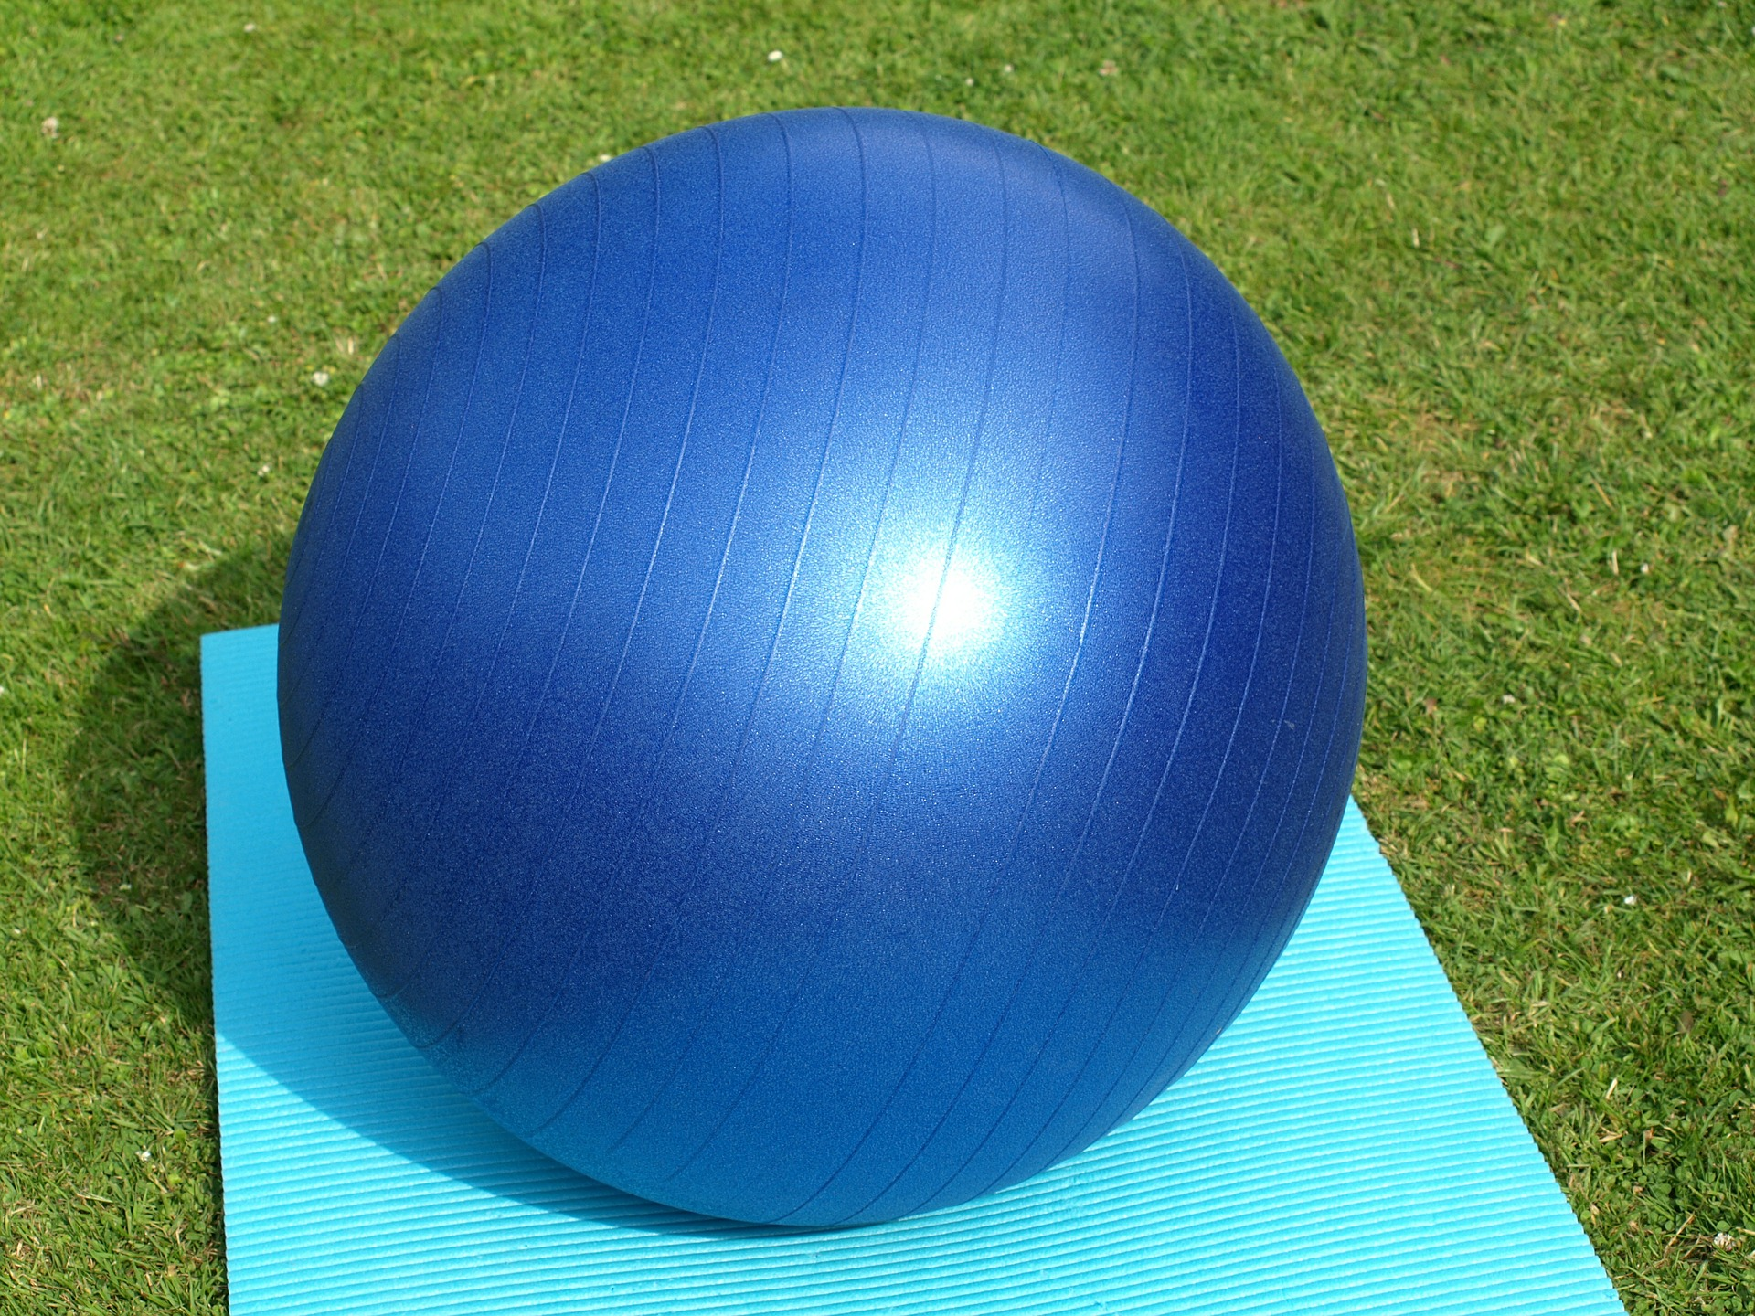
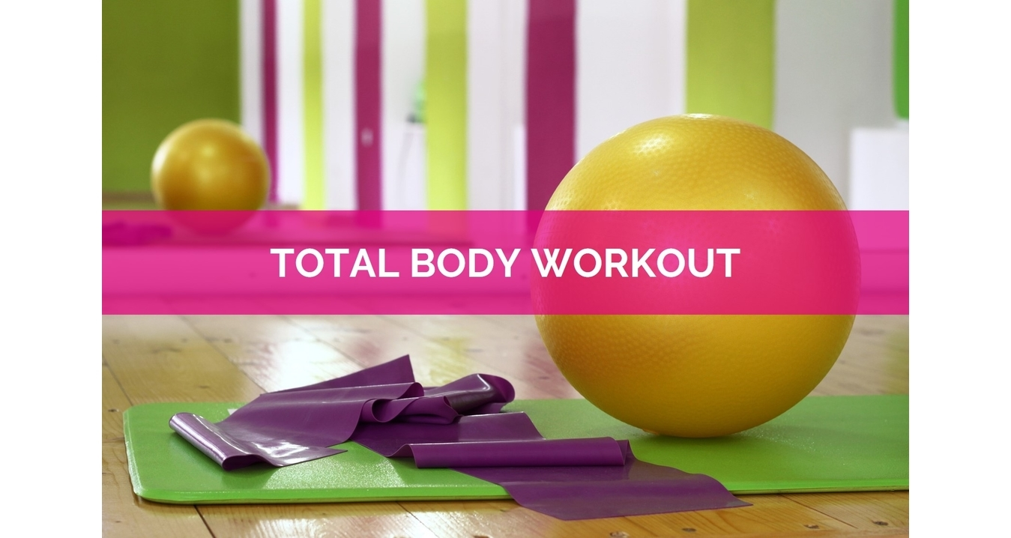
PILATES
INSPIRE

Slide 6
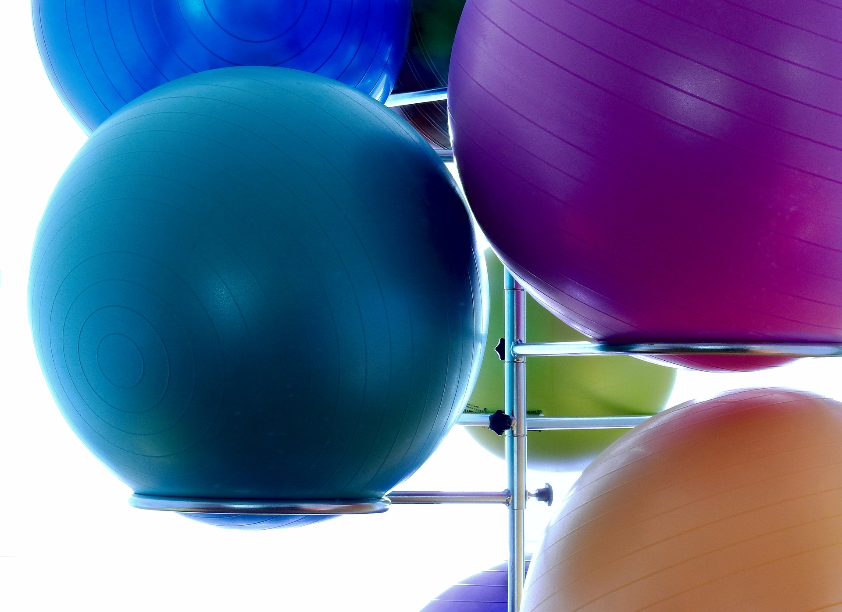

Slide 7
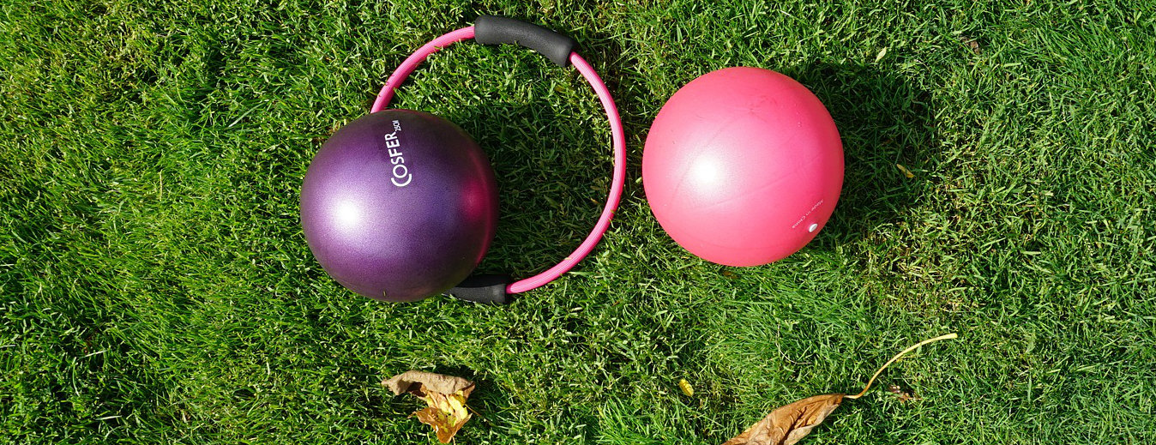
TRY OUT A CLASS AND FEEL THE BENEFITS

