Slide 1
Reaction Kinetics in Homogeneous Systems
Presented by:
Chaitanya Chopra
Roll No: 25/B19/093

Slide 2
Introduction
Reaction kinetics studies rate of reactions.
Homogeneous systems: single phase.
Important in bioreactors.

Slide 3
Rate Laws
Rate = k[A]^n
Zero, First, Second order reactions.
Predicts behavior.

Slide 4
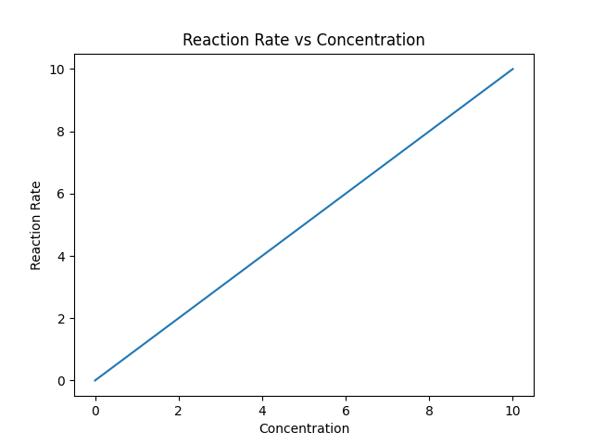
Graph: Rate vs Concentration

Slide 5
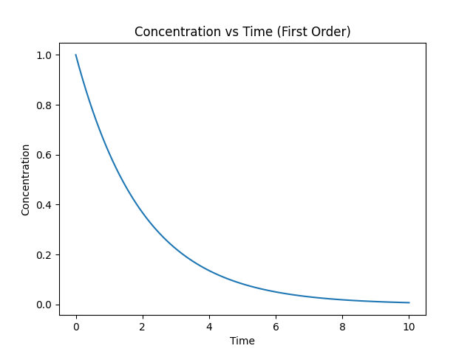
Graph: Concentration vs Time

Slide 6
Bioreactor Kinetics
Batch & CSTR reactors.
Kinetics affects design and efficiency.

Slide 7
Monod Equation
μ = μmax * S / (Ks + S)
Describes microbial growth rate.

Slide 8
Applications
Used in fermentation, enzyme reactions.
Helps optimize yield.

