Slide 1
Advanced Analytics on AWS Jumpstart
Dylan Tong, AI/Machine Learning Partner Solutions Architect
Notes:
First call deck for CXO level introduction to Amazon AI.

Slide 2
Jumpstart Workshop Menu
Predictive Churn Analytics
Focus on batch, pipelining, and database access.
TBD…

Slide 3
Advanced Analytics Workshop

Slide 4



Advanced Analytics using AI Services
INTELLIGENT BUILDING BLOCKS
Amazon
Forecast
Amazon
Comprehend
Amazon
Personalize
DATA
SOURCES
ETL
Notes:
Partner solutions?

Slide 5
Build Strategy
Data sources
Intelligent
Applications
Data lake
Machine Learning
Pipelining
[Build, Train, Deploy]

Slide 6


Data Lake Core
AWS
Lake Formation
Catalog
Centralized Security
Storage
Amazon S3

Slide 7


Data Processing
AWS
Lake Formation
AWS Glue
Amazon EMR
Tier1: Raw
Tier2: Intermediate
Tier3: Optimized
Data sources
Amazon S3

Slide 8


Traditional BI
Amazon QuickSight
AWS
Lake Formation
AWS Glue
Amazon Redshift
Tier1: Raw
Tier2: Intermediate
Tier3: Optimized
Data sources
Amazon S3

Slide 9

Machine Learning: Build and Training
Amazon
SageMaker
AWS
Lake Formation
AWS Glue
Tier1: Raw
Tier2: Intermediate
Tier3: Optimized
Data sources
Amazon S3

Slide 10
Training Mechanics

Slide 11

SageMaker Training
N Training Instances
Training Image: SageMaker managed | Marketplace | Custom
Sync or Async
Training Job
Hyperparameters
Amazon
Elastic Container Registry
Scripts (training algorithm)
[Optional: requirements.txt, dependencies]
[Optional: model artifacts]
[Optional: S3 Manifest, describes location of S3 objects]

Slide 12
SageMaker Training
N Training Instances
Model Artifacts
Modes:
File: copy full dataset to local storage
Pipe: stream directly from S3
Distribution Type:
FullyReplicated (full data set sent to each instance)
ShardbyS3Key (1/N objects sent to each instance)

Slide 13
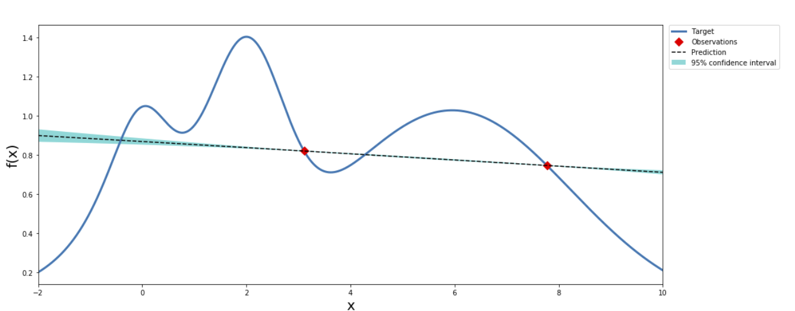
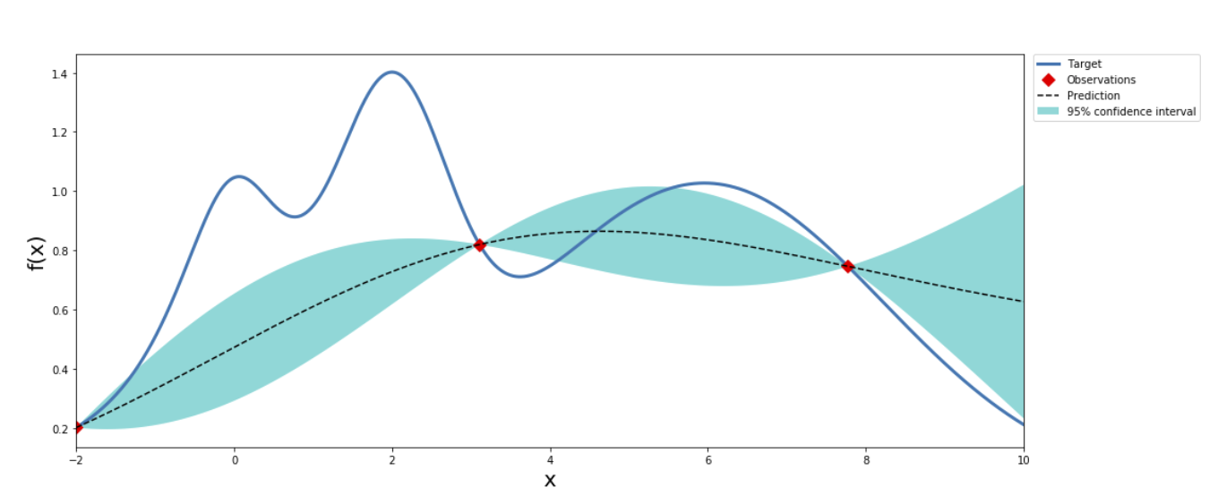
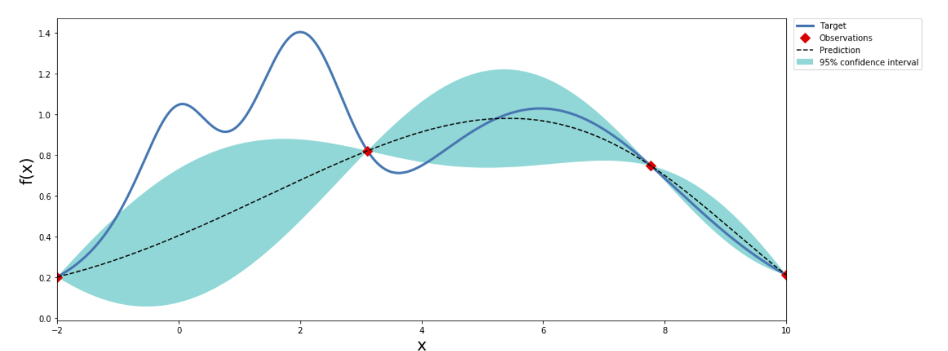
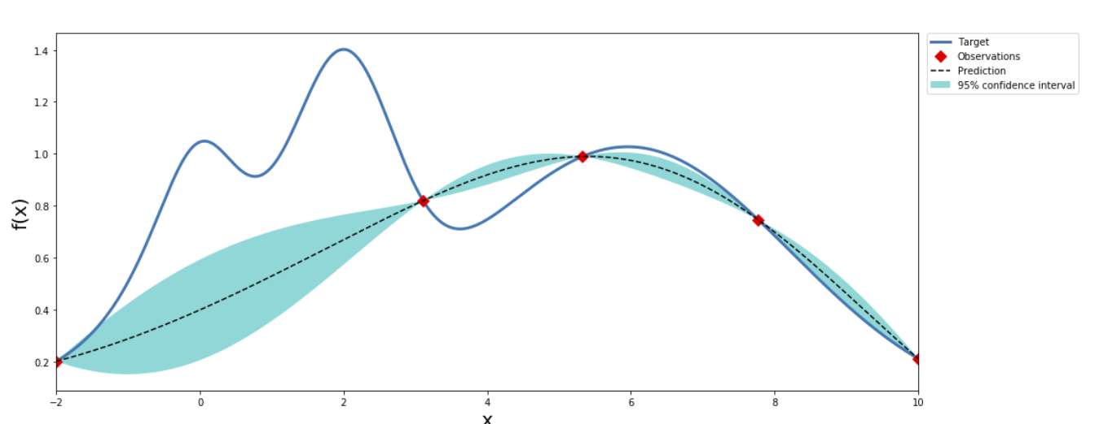
Hyperparameter Optimization
Bayesian Optimization
…
Training Job
Training Job
Training Job
Training Job
Training Job
Training Job
Training Job
Training Job
.
.
.
.
.
.
.
.
.
.
.
.
Training Job
Training Job
Training Job
Training Job

Slide 14
Inference Mechanics

Slide 15

Advanced Analytics on AWS
Hosted Endpoints:
Real-time inference
STREAMS
Amazon Kinesis
DATA
SOURCES
Enrich
ETL
Notes:
Partner solutions?

Slide 16
Real-time Inference
Amazon
Elastic Container Registry
Serving Image: SageMaker managed | Marketplace | Custom
Deploy
Endpoint Configuration
Registered Model Reference
N Instances
Instance Type
Inference Scripts
Auto-scaling policy
Variants (A/B Testing)
…

Slide 17
Real-time Inference
N Hosting Instances
Sync
Sync
Request
Response
POST /endpoints/EndpointName/invocations HTTP/1.1 Content-Type: ContentType Accept: Accept X-Amzn-SageMaker-Custom-Attributes: CustomAttributes
Auto-scale if TPS threshold is exceeded

Slide 18


Advanced Analytics on AWS
AWS Step Functions
ETL
DATA
SOURCES
DATA LAKE
DATA LAKE
Batch Transform
Notes:
Partner solutions?

Slide 19

Batch Transform
Serving Image: SageMaker managed | Marketplace | Custom
Amazon
Elastic Container Registry
Async
Async
Batched Results
Resources
Deallocated
Batch
Transform
Registered Model Reference
N Instances
Instance Type
Inference Scripts
…
S3 File
(eg. .csv, .rec)

Slide 20
Batch Processing
Instance
Agent
Single
Single Record
Size < MaxPayLoadMB
Line |
RecordIO | TFRecord
None
One or more files
Strategy
Model
AssembleWith
Concurrency
SplitType
S3 File
(eg. .csv, .rec)
Mini-batch
Size < MaxPayLoadMB
Multi
Single File
Line
Mini-batch
Size = min(FileSize, MaxPayLoadMB)
None

Slide 21
Batch Processing
Batch Transform Instance
S3 File
(eg. .csv, .rec)
.
.
.
Output to S3
(eg. .csv, .rec)
Batch Transform Instance
S3 File
(eg. .csv, .rec)

Slide 22
Inference Pipeline
Real-time Endpoint or Batch Transform
Inference Pipeline
SparkML (Mleap)
XGBoost
Request
Feature Engineering
Classifier
Example inference Pipeline: SparkML for feature engineering and XGBoost for predictions

Slide 23
Workshop Objectives and Agenda

Slide 24
Explore Databases from SageMaker
SQL QUERY → Pandas Dataframe
SageMaker Managed Notebook
Amazon Redshift

Slide 25
Train (XGBoost) and Batch Inference
XGBoost: Churn Prediction Model
Churn Scores
SageMaker Managed Notebook
SageMaker
Training
SageMaker
Batch Transform

Slide 26
Scaling the Solution
Inference Pipeline
XGBoost:
Churn Prediction Model
SparkML (Mleap)
XGBoost
Churn Scores
SageMaker Managed Notebook
AWS Glue
SageMaker
Training
Feature Engineering
Classifier
SageMaker
Batch Transform

Slide 27
https://github.com/dylan-tong-aws/aws-advanced-analytics-jumpstarter

Slide 28
Appendix

Slide 29
Future labs
Send feedback: dylatong@amazon.com

