Slide 1
Preliminary Detection of Neutron Monitor Forbush Decrease (FD) Events from Cross-Correlation with Historical FD Data
Signal and Imaging Processing Final Project
Chatdanai Sawangwong

Slide 2
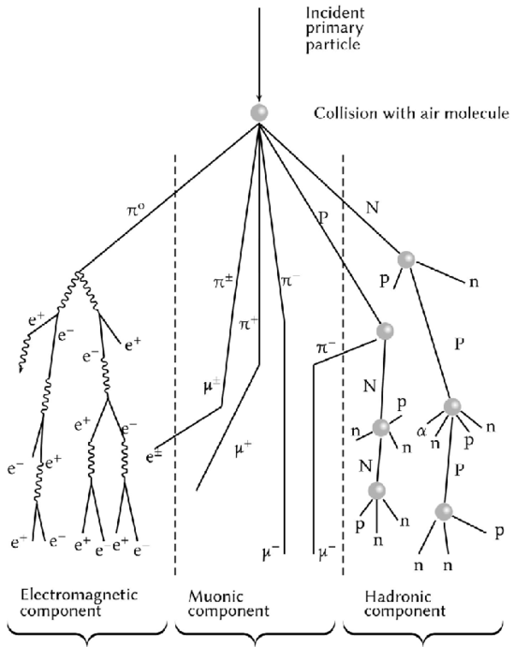
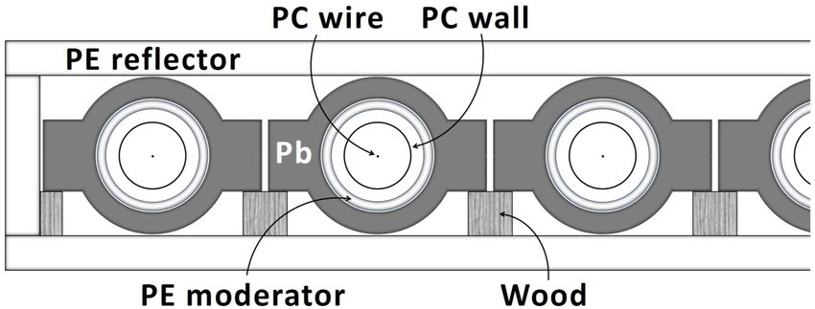
Cosmic Rays
Barrantes, et al. (2018)
High-energy particles from outer space
They collide with air particles in the atmosphere to form “air showers.”
Cosmic rays can be detected with neutron monitors (NM).
Ruffolo (2020)
Source: Barrantes, et al. (2018)

Slide 3
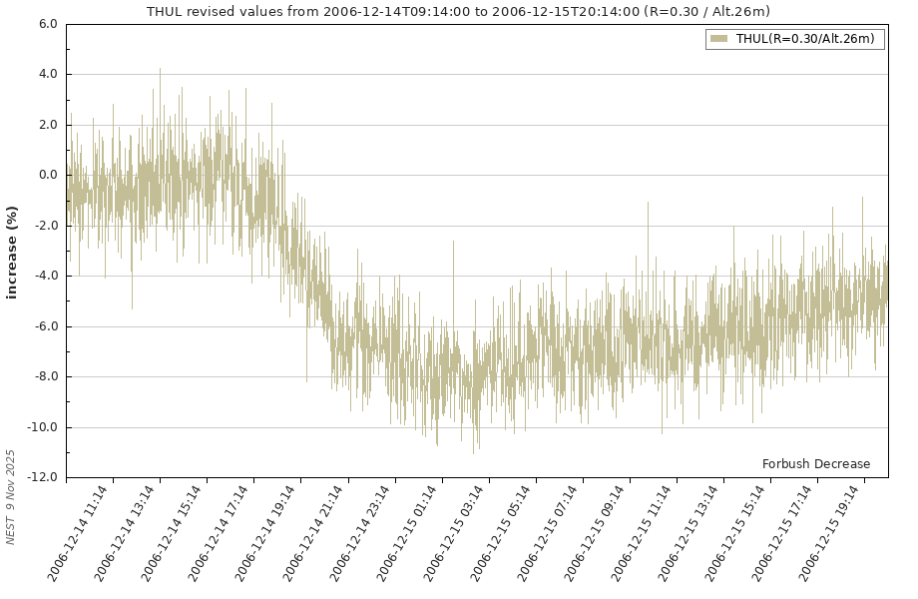
Forbush Decreases (FD)
Retrieved from nmdb NEST
Rapid decrease in observed cosmic ray intensity (up to 20%)
Occurs due to plasma ejections from the Sun sweeping cosmic rays away from Earth.
Source: Barrantes, et al. (2018)

Slide 4
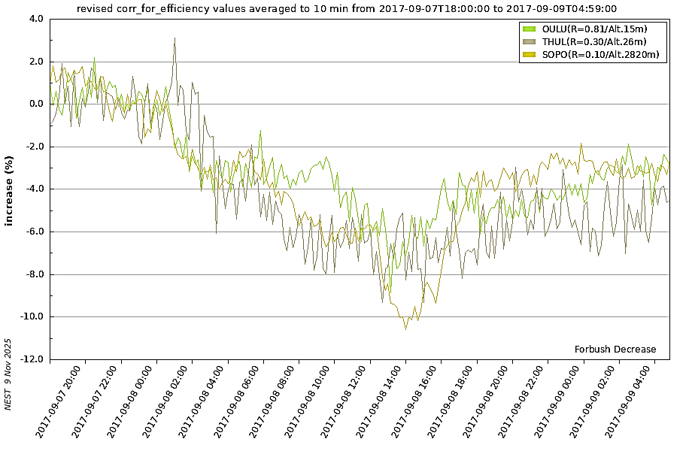
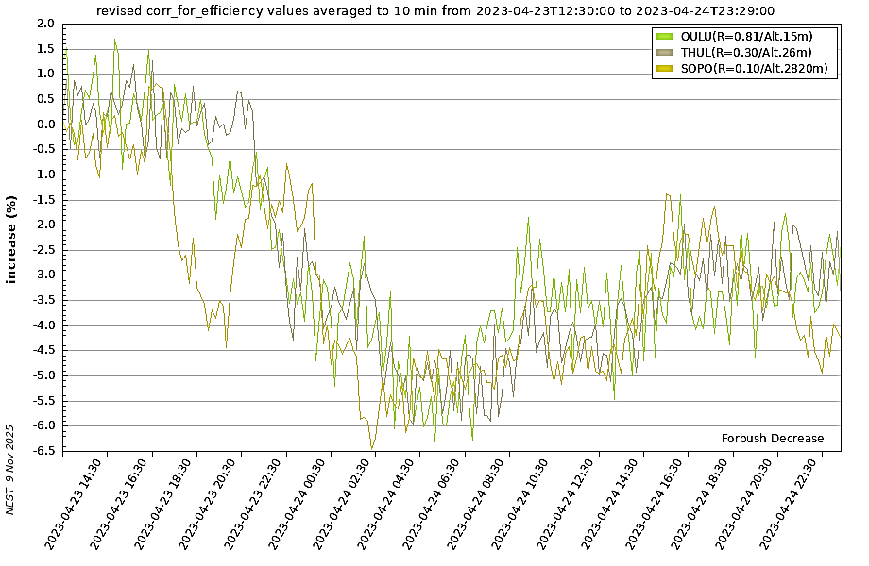
SIP Project Overview
FD graphs retrieved from nmdb NEST
NM data retrieval: nmdb NEST
Stations: OULU, THUL, SOPO, AATB, LMKS
Data resolution: 2 minutes
To-do: Cross-correlate FD data from 2015 on data across entire years of 2005, 2022, 2023 and 2024.
Evaluate performance (TP/FP/FN)
2017-09
2023-04

Slide 5
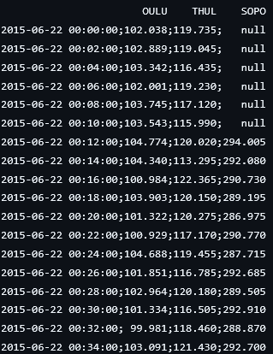
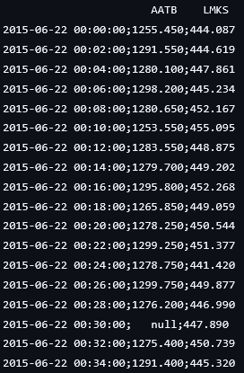
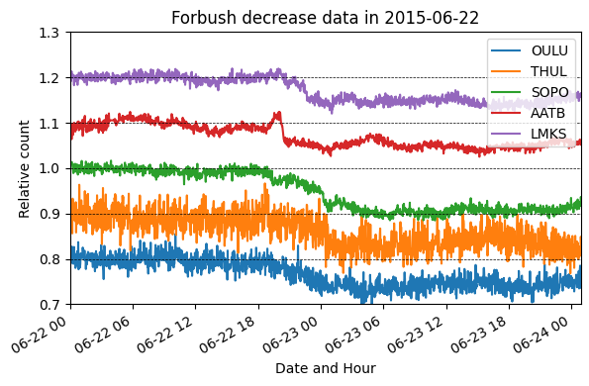
NM Data Retrieval
Read and clean data downloaded from nmdb

Slide 6
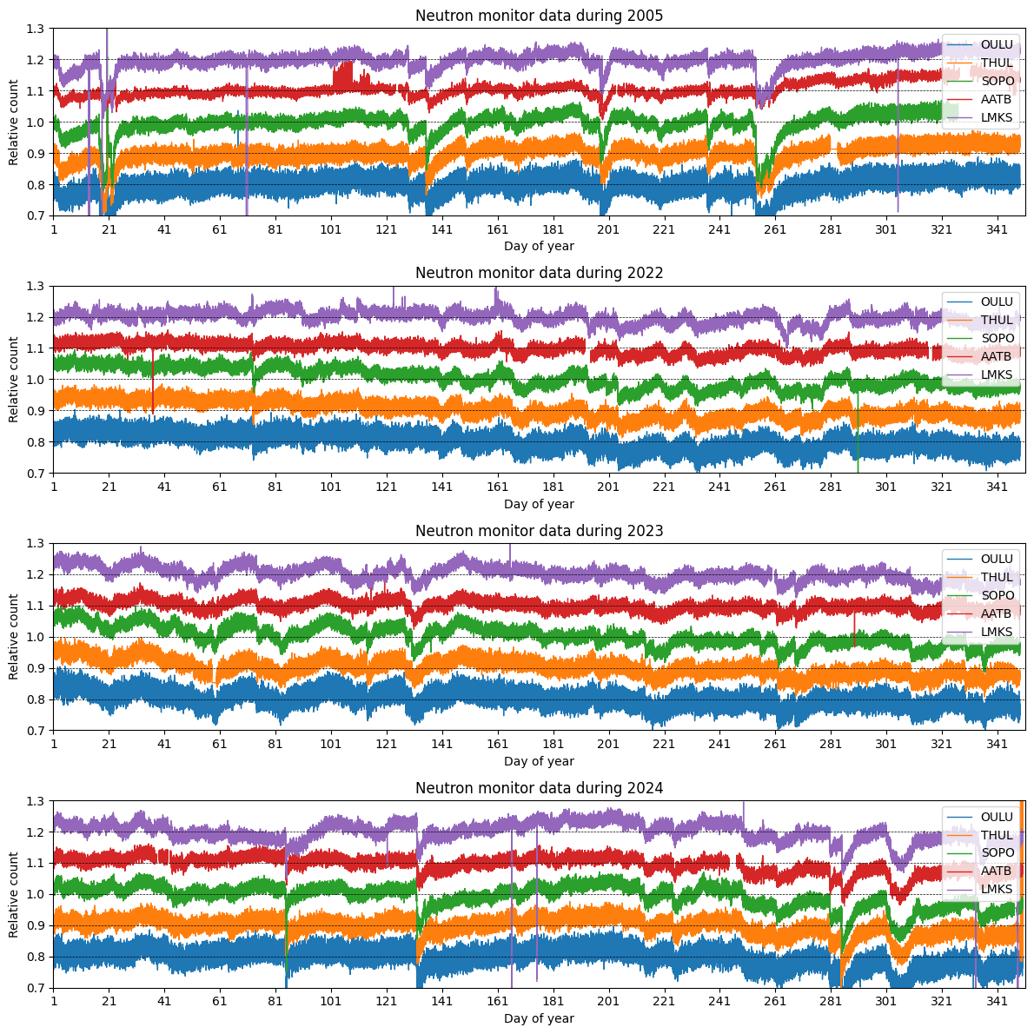
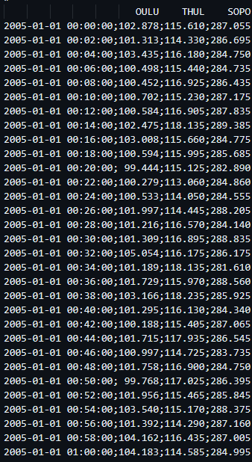
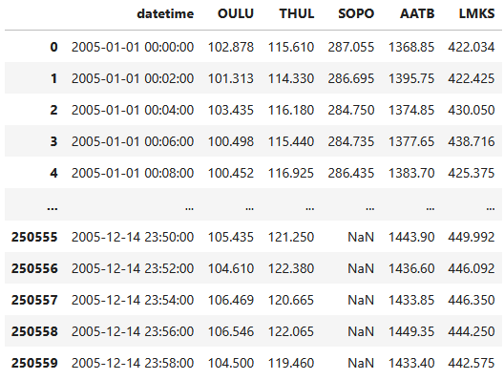
NM Data Retrieval
Read and clean nmdb data

Slide 7
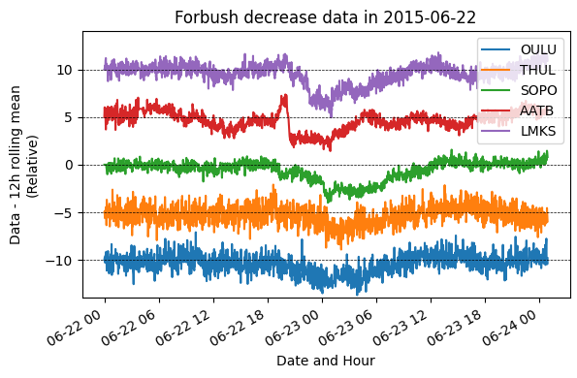
Long-term Trend Removal
Data - 12-hour moving average
Flattens long-term trends, but leaves out short-term changes

Slide 8
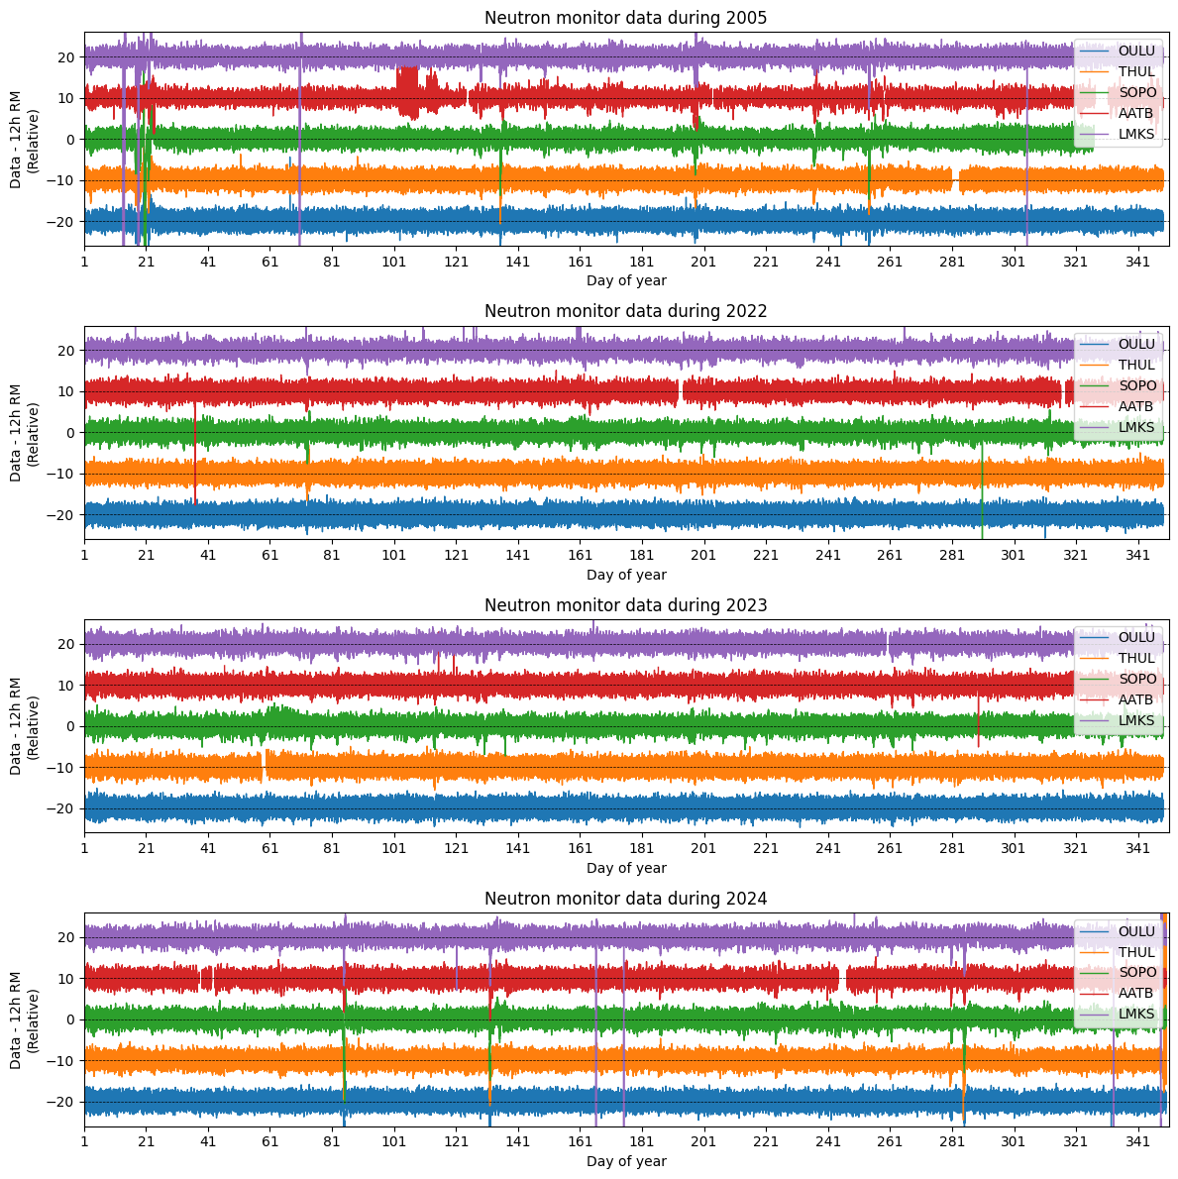
Long-term Trend Removal
Data - 12-hour moving average

Slide 9
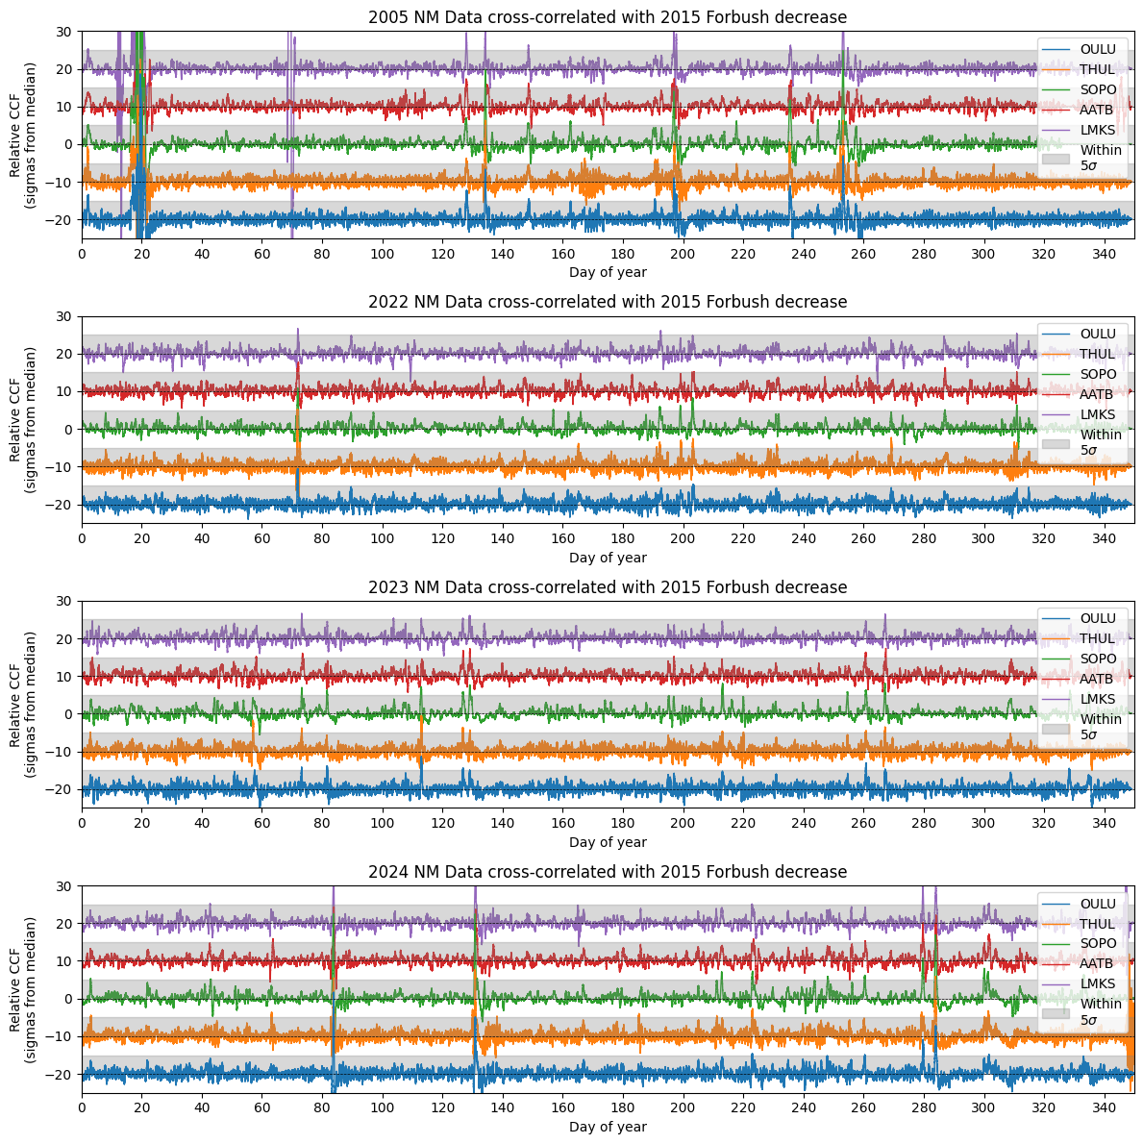
Cross-correlation

Slide 10
Forbush Decrease Detection
Forbush Decrease “detected” if CCF is +5σ from its median,
simultaneously across 5 stations

Slide 11
Results
Dates with actual FDs
2005-01-18
2005-01-21
2005-05-15
2005-08-24
2005-09-11
2023-04-23
2024-03-24
2024-05-10
Dates with ‘detected’ FDs
2005-01-18 2005-01-21
2005-05-08 2005-05-15
2005-07-16 2005-08-24
2005-09-11 2022-03-13
2023-03-15 2023-05-07
2023-05-09 2023-09-25
2024-03-24 2024-05-10
2024-08-10 2024-10-06
2024-10-10 2014-10-28

Slide 12



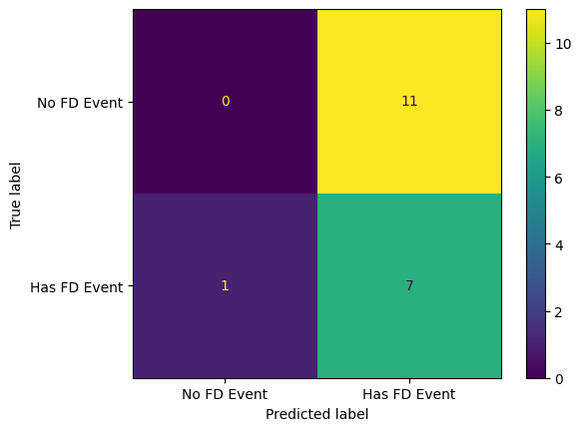
Results
(https://www.labelf.ai/blog/what-is-accuracy-precision-recall-and-f1-score)
Confusion Matrix
True Positives: 7
False Negatives: 1
False Positives: 11
Precision: 0.389
Recall: 0.875
F1 score: 0.538

Slide 13
Conclusion
Cross-correlation of year-round and historical FD data from neutron monitors can detect FD events with great recall,
but leaves many false positives.
Neutron monitor data alone is not sufficient for FD detection.
FDs are often associated with stronger interplanetary magnetic fields or disturbances in Earth’s magnetic field (Belov 2008), so the associated data may help remove false positives.

Slide 14
References
Barrantes M, Valdés-Galicia JF, Musalem O, Hurtado A, Anzorena M, García R, et al. Atmospheric corrections of the cosmic ray fluxes detected by the Solar Neutron Telescope at the Summit of the Sierra Negra Volcano in Mexico. Geofis Int. 2018;57(4):253–75. Available from: http://dx.doi.org/10.22201/igeof.00167169p.2018.57.4.2105
Belov AV. Forbush effects and their connection with solar, interplanetary and geomagnetic phenomena. Proc Int Astron Union 2008;4(S257):439–50. Available from: http://dx.doi.org/10.1017/s1743921309029676

