Slide 1
Behavioural Patterns

Slide 2
Introduction
Behavioral Patterns:
  are concerned with algorithms and the assignment of responsibilities between objects.
  describe the patterns of communication between objects or classes.
  characterize complex control flow.
Class and Object patterns
  class patterns use inheritance to distribute behavior between classes.
  object patterns use composition

Slide 3
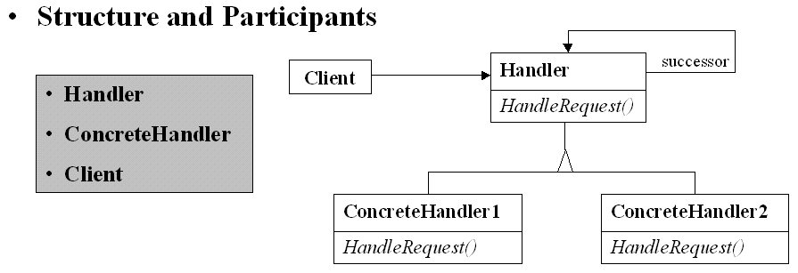
Chain of Responsibility
Intent - Chain the receiving objects and pass the request along the chain until an object handles it.
Structure and Participants
Handler
HandleRequest()
successor
Client
Handler
ConcreteHandler
Client
ConcreteHandler1
HandleRequest()
ConcreteHandler2
HandleRequest()
Applicability - use when:
  more than one object may handle a request, and the handler isn't known a priori.
  you want to issue a request to one of several objects without specifying the receiver explicitly.
  the set of objects that can handle a request should be specified dynamically.
Notes:
Participants
Handler
- defines an interface for handling requests.
- may implement the successor link.
ConcreteHandler
- handles requests it is responsible for.
- can access its successor.
- if the ConcreteHandler can handle the request, it does so; otherwise it forwards the request to its successor.
Client
- initiates the request to a ConcreteHandler object on the chain.

Slide 4
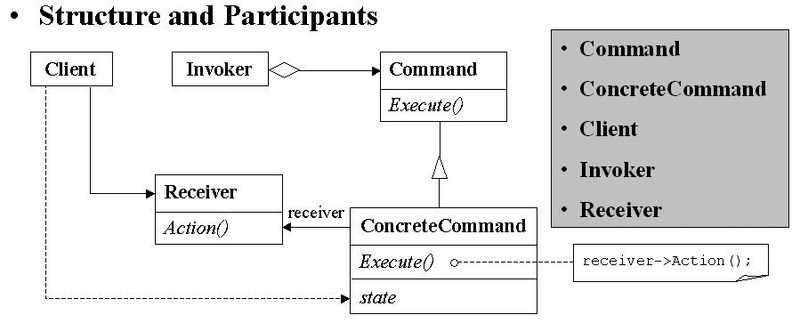
Command
Intent - Encapsulate a request as an object, thereby letting you parameterize clients with different requests, queue or log requests, and support undo operations.
Structure and Participants
Command
ConcreteCommand
Client
Invoker
Receiver
Client
Invoker
Command
Execute()
Receiver
Action()
Applicability - use when you want to:
  parameterize objects by an action to perform.
  specify, queue, and execute requests at different times.
  support undo.
  support logging changes so that they can be reapplied in case of a system crash.
  structure a system around high-level operations built on primitives operations.
receiver
ConcreteCommand
Execute()
state
receiver->Action();
Notes:
Participants
Command
- declares an interface for executing an operation.
ConcreteCommand
- defines a binding between a Receiver object and an action.
- implements Execute by invoking the corresponding operation(s) on Receiver.
Invoker
- asks the command to carry out the request.
Receiver
- knows how to perform the operations associated with carrying out a request. Any class may serve as Receiver.

Slide 5
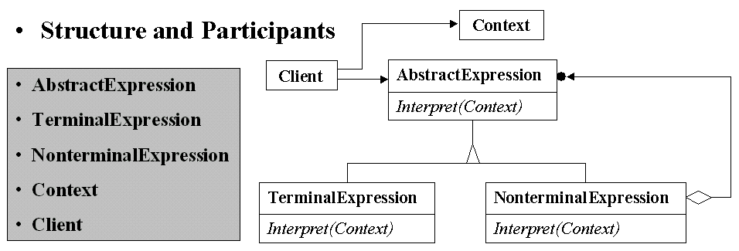
Interpreter
Intent - Given a language, define a representation for its grammar along with an interpreter that uses the representation to interpret sentences in the language.
Structure and Participants
Context
AbstractExpression
TerminalExpression
NonterminalExpression
Context
Client
Client
AbstractExpression
Interpret(Context)
Applicability
Use the Interpreter pattern when there is a language to interpret, and you can represent statements in the language as abstract syntax trees.
The Interpreter works best when:
  the grammar is simple.
  efficiency is not a critical concern.
TerminalExpression
Interpret(Context)
NonterminalExpression
Interpret(Context)
Notes:
Participants
AbstractExpression
- declares an abstract interpreter operation.
TerminalExpression
- implements an Interpret operation associated with terminal symbols in the grammar.
- an instance is required for every terminal symbol in a sentence.
NonterminalExpression
- one such class is required for every rule R::=R1R2...Rn in the grammar.
- maintains instance variables of type AbstractExpression for each of the symbols R1 through Rn.

Slide 6
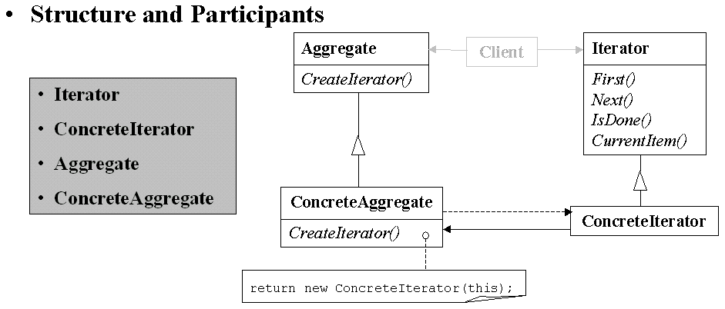
Iterator
Intent - Provide a way to access the elements of an aggregate object sequentially without exposing its underlying representation.
Structure and Participants
Aggregate
CreateIterator()
Client
Iterator
First()
Next()
IsDone()
CurrentItem()
Iterator
ConcreteIterator
Aggregate
ConcreteAggregate
Applicability - use when you want:
  to access an aggregate object's contents without exposing its internal representation.
  to support multiple traversals of aggregate objects.
  to provide a uniform interface for traversing different aggregate structures (that is, to support polymorphic iteration).
ConcreteAggregate
CreateIterator()
ConcreteIterator
return new ConcreteIterator(this);
Notes:
Iterator
defines an interface for accessing and traversing elements.
Iterator
implements the Iterator interface.
keeps track of current position in the traversal of the aggregate.
Aggregate
defines an interface for creating an Iterator object.
ConcreteAggregate
implements the Iterator creation interface to return an instance of the proper ConcreteIterator.

Slide 7
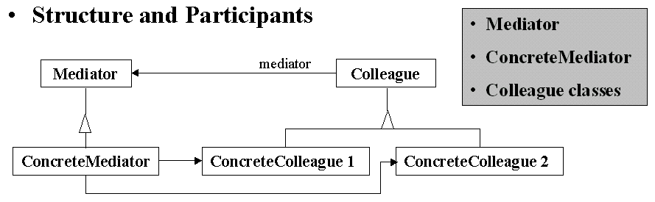
Mediator
Intent - Define an object that encapsulates how a set of objects interact. Promote loose coupling and let vary the interaction between objects independently.
Structure and Participants
Mediator
ConcreteMediator
Colleague classes
Mediator
mediator
Colleague
ConcreteMediator
ConcreteColleague 1
ConcreteColleague 2
Applicability - use when:
  a set of objects communicate in well-defined but complex ways. The resulting interdependencies are unstructured and difficult to understand.
  reusing an object is difficul because it refers to and communicates with many other objects.
  a behavior that's distributed between several classes should be customizable without a lot of subclassing.
Notes:
Mediator
defines an interface for communicating with Colleague objects.
ConcreteMediator
implements cooperative behavior by coordinating Colleague objects.
knows and maintains its colleagues.
Colleague classes
each Colleague class knows its Mediator object.
each colleague communicates with its mediator whenever it would have otherwise communicated with another colleague.

Slide 8
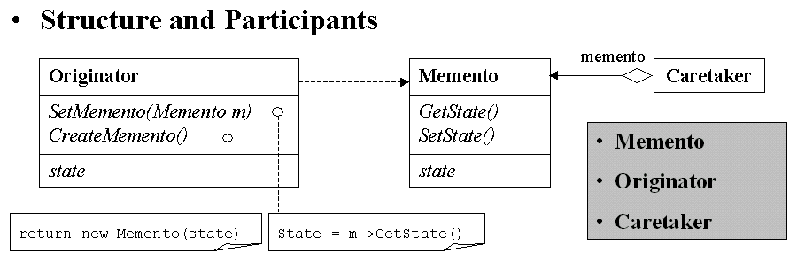
Memento
Intent - Without violating encapslation, captures and externalizes an object's internal state so that the object can be restored to this state later.
Structure and Participants
memento
Originator
SetMemento(Memento m)
CreateMemento()
state
Memento
GetState()
SetState()
state
Caretaker
Memento
Originator
Caretaker
Applicability - use when:
  a snapshot of (some portion of) an object's state must be saved so that it can be restored to that state later.
  a direct interface to obtaining the state would expose implementation details and break the object's encapsulation.
return new Memento(state)
State = m->GetState()
Notes:
Memento
stores internal state of the Originator object.
protects against access by objects other than the originator.
Originator
creates a memento containing a snapshot of its current internal state.
uses the memento to restore its internal state.
Caretaker
is responsible for the memento's safekeeping.
never operates on or examines the contents of a memento.

Slide 9
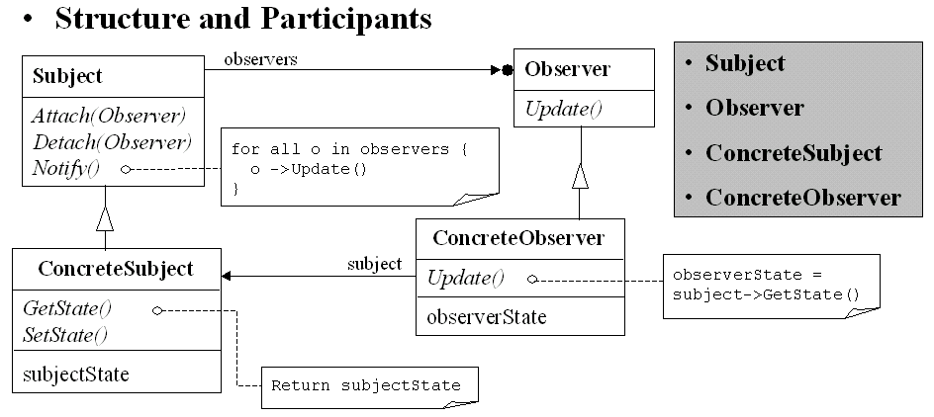
Observer
Intent - Define a one-to-many dependency between objects so that when one object changes state, all its dependencies are notified and updated automatically.
Structure and Participants
Subject
Attach(Observer)
Detach(Observer)
Notify()
observers
Observer
Update()
Subject
Observer
ConcreteSubject
ConcreteObserver
for all o in observers {
o ->Update()
}
ConcreteObserver
Update()
observerState
Applicability - use when:
  an abstraction has two aspects, one dependent on the other. Encapsulating these aspects in separate objects lets you vary and reuse them independently.
  a change to one object requires changing others, and you don't know how many objects need to be changed.
  an object should be able to notify other objects without making assuptions about who these objects are.
ConcreteSubject
GetState()
SetState()
subjectState
subject
observerState = subject->GetState()
Return subjectState
Notes:
Subject
knows its observers. Any number of Observer objects may observer a subject.
Observer
defines an updating interface for objects that should be notified of changes in a subject.
ConcreteSubject
stores state of interest to ConcreteObserver objects.
sends an notification to its observers when its state changes.
ConcreteObserver
maintains a reference to a ConcreteSubject object.
stores state that should stay consistent with the object's.
implements the Observer updating interface to keep its state consistent with the subject's.

Slide 10
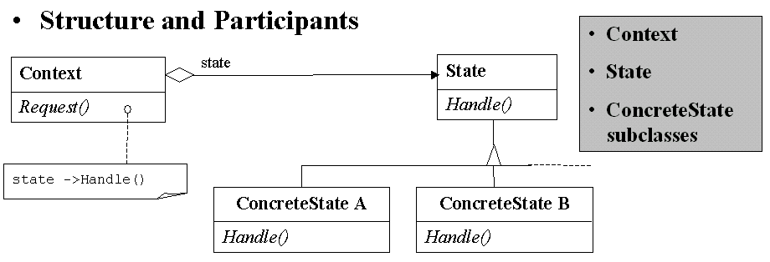
State
Intent - Allow an object to alter its behavior when its internal state changes. The object will appear to change its class.
Structure and Participants
Context
State
ConcreteState
subclasses
Context
Request()
state
State
Handle()
state ->Handle()
Applicability - use when:
  an object's behavior depends on its state, and it must change its behavior at run-time depending on that state.
  operations have large, multipart conditional statements that depend on the object's state.
ConcreteState A
Handle()
ConcreteState B
Handle()
Notes:
Context
defines the interface of interest to clients.
maintains an instance of a ConcreteState subclass that defines the current state.
State
defines an interface for encapsulating the behavior associated with a particular state of the Context.
ConcreteState subclasses
each subclass implements a behavior associated with a state of the Context.

Slide 11
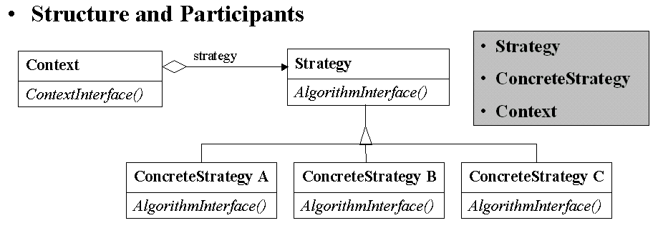
Strategy
Intent - Define a family of algorithms, encapsulate each, and make them interchangeable. It lets the algorithm vary independently from clients that use it.
Structure and Participants
Strategy
ConcreteStrategy
Context
Context
ContextInterface()
strategy
Strategy
AlgorithmInterface()
Applicability - use when:
  many related classes differ only in their behavior. Strategies provide a way to configure a class with one of many behaviors.
  you need diferrent variants of an algorithm.
  an algorithm uses data that clients shouldn't know about. Use strategy pattern to avoid exposing complex, algorithm-specific data structures.
  a class defines many behaviors, and these appear as multiple conditional statements in its operations.
ConcreteStrategy A
AlgorithmInterface()
ConcreteStrategy B
AlgorithmInterface()
ConcreteStrategy C
AlgorithmInterface()
Notes:
Strategy
declares an interface common to all supported algorithms. Context uses this interface to call the algorithm defined by a ConcreteStrategy.
ConcreteStrategy
implements the algorithm using the Strategy interface.
Context
is configured with a ConcreteStrategy object.
maintains a reference to Strategy object.
may define an interface that lets Strategy access its data.

Slide 12
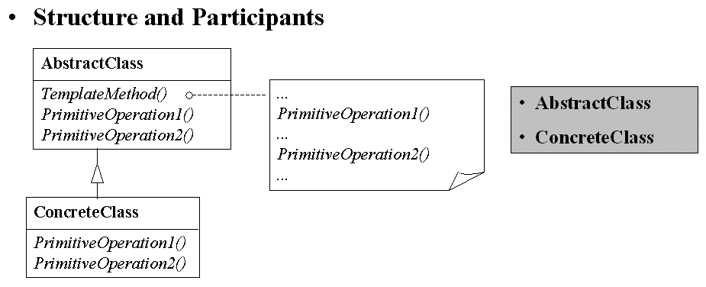
Template Method
Intent - Define the skeleton of an algorithm in an operation, deferring some steps to subclasses. Lets subclasses redefine certain steps of algorithm without changing the algorithm's structure.
Structure and Participants
AbstractClass
TemplateMethod()
PrimitiveOperation1()
PrimitiveOperation2()
...
PrimitiveOperation1()
...
PrimitiveOperation2()
...
AbstractClass
ConcreteClass
Applicability - use when:
  to implement the invariant parts of an algorithm once and leave it up to subclasses to implement the behavior that can vary.
  when common behavior among subclasses should be factored and localized in a common class to avoid code duplication.
  to control subclasses extensions.
ConcreteClass
PrimitiveOperation1()
PrimitiveOperation2()
Notes:
AbstractClass
defines abstract primitive operations that concrete suubclasses define to implement steps of an algorithm.
implements a template method defining the skeleton of an algorithm.
ConcreteClass
implements the primitive operations to carry out subclass-specific steps of the algorithm

Slide 13
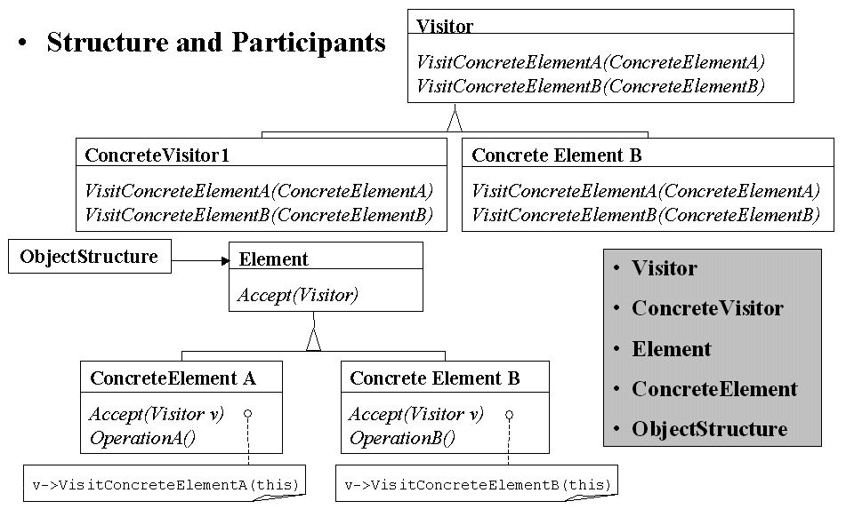
Visitor
Intent - Lets you define a new operation to be performed on the elements of an object structure, without changing the classes of the elements on which it operates.
Structure and Participants
Visitor
VisitConcreteElementA(ConcreteElementA)
VisitConcreteElementB(ConcreteElementB)
ConcreteVisitor1
VisitConcreteElementA(ConcreteElementA)
VisitConcreteElementB(ConcreteElementB)
Concrete Element B
VisitConcreteElementA(ConcreteElementA)
VisitConcreteElementB(ConcreteElementB)
Applicability - use when:
  an object structure contains many classes with different interfaces, and you want to perform operations on these objects that depend on their concrete classes.
  many distinct and unrelated operations need to be performed on objects in an object structure, and you want to avoid "polluting" classes with these operations.
  the class defining object structure rarely change, but you often want to define new operations over the structure.
ObjectStructure
Element
Accept(Visitor)
Visitor
ConcreteVisitor
Element
ConcreteElement
ObjectStructure
ConcreteElement A
Accept(Visitor v)
OperationA()
Concrete Element B
Accept(Visitor v)
OperationB()
v->VisitConcreteElementA(this)
v->VisitConcreteElementB(this)
Notes:
Visitor
declares a Visit operation for each class of ConcreteElement in the object structure. The operation's name and signature identifies the class that sends the Visit request to the visitor. That lets the visitor determine the concrete class of the element being visited. Then the visitor can access the element directly through its particular interface.
ConcreteVisitor
implements each operation declared by Visitor. Each operation implements a fragment of the algorithm defined for the corresponding class of object in the structure. ConcreteVisitor provides the context for the algorithm and stores its local state. This state often accumulates results during the traversal of the structure.
Element
defines an Accept operation that takes a visitor as an argumenet.
ConcreteElement
implements an Accept operation that takes a visitor as an argument.

Slide 14
Conclusion/Discussion
Encapsulating variation
  Iterator, Mediator, State, Strategy
Objects as arguments
  Command, Memento, Visitor
Encapsulated vs. Distributed communication
  Mediator vs. Observer
Decoupling Senders and Receivers
  Chain of Responsibility, Mediator, Command, Observer
Thanks for your attention

