Slide 1
Creational Patterns
Patterns used to abstract the process of instantiating objects.
  class-scoped patterns
    uses inheritance to choose the class to be instantiated
      Factory Method
  object-scoped patterns
    uses delegation
      Abstract Factory
      Builder
      Prototype
      Singleton

Slide 2
Importance
Becomes important as emphasis moves towards dynamically composing smaller objects to achieve complex behaviours.
  need more than just instantiating a class
  need consistent ways of creating related objects.

Slide 3
Recurring Themes
Hide the secret about which concrete classes the system uses.
Hide the secret about how instances are created and associated.
Gives flexibility in
  what gets created
  who creates it
  how it gets created
  when it get gets created

Slide 4
Running Example
Building a maze for a computer game.
A Maze is a set of Rooms.
A Room knows its neighbours.
  another room
  a wall
  a door

Slide 5
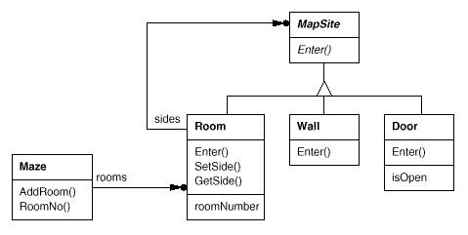
Maze Example

Slide 6
Creating Mazes
public class MazeGame
{
public static void main(String args[]) {
Maze m = new MazeGame().createMaze();
}
public Maze createMaze() {
Room r1 = new Room(1);
Room r2 = new Room(2);
Door d = new Door(r1,r2);
r1.setSide(Direction.North, new Wall());
r1.setSide(Direction.East, d);
r1.setSide(Direction.West, new Wall());
r1.setSide(Direction.South, new Wall());
r2.setSide(Direction.North, new Wall());
r2.setSide(Direction.West, d);
r2.setSide(Direction.East, new Wall());
r2.setSide(Direction.South, new Wall());
Maze m = new Maze();
m.addRoom(r1);
m.addRoom(r2);
return m;
}
}
d
r1
r2

Slide 7
Maze Classes
public abstract class MapSite
{
public abstract void enter();
}
public class Wall extends MapSite
{
public void enter() {
}
}
MapSite
enter()
Wall
enter()

Slide 8
Maze Classes
public class Door extends MapSite
{
Door(Room s1, Room s2) {
side1 = s1;
side2 = s2;
}
public void enter() {
}
public Room otherSideFrom(Room r) {
if( r == side1 )
return side2;
else if( r == side2 )
return side1;
else
return null;
}
public void setOpen(boolean b) {
open = b;
}
public boolean getOpen() {
return open;
}
private Room side1;
private Room side2;
boolean open;
}
MapSite
enter()
Door
open: boolean
enter()
otherSideFrom(Room): Room
side1, side2
[0..4]
2
Room

Slide 9
Maze Classes
public class Direction
{
public final static int First = 0;
public final static int North = First;
public final static int South = North+1;
public final static int East = South+1;
public final static int West = East+1;
public final static int Last = West;
public final static int Num = Last-First+1;
}

Slide 10
Maze Classes
public class Room extends MapSite
{
public Room(int r) {
room_no = r;
}
public void enter() {
}
public void setSide(int direction, MapSite ms) {
side[direction] = ms;
}
public MapSite getSide(int direction) {
return side[direction];
}
public void setRoom_no(int r) {
room_no = r;
}
public int getRoom_no() {
return room_no;
}
private int room_no;
private MapSite[] side = new MapSite[Direction.Num];
}
MapSite
enter()
4
Room
enter()

Slide 11
Maze Classes
import java.util.Vector;
public class Maze
{
public void addRoom(Room r) {
rooms.addElement(r);
}
public Room getRoom(int r) {
return (Room)rooms.elementAt(r);
}
public int numRooms() {
return rooms.size();
}
private Vector rooms = new Vector();
}
Maze
*
Room

Slide 12
Maze Creation
public Maze createMaze() {
Room r1 = new Room(1);
Room r2 = new Room(2);
Door d = new Door(r1,r2);
r1.setSide(Direction.North, new Wall());
r1.setSide(Direction.East, d);
r1.setSide(Direction.West, new Wall());
r1.setSide(Direction.South, new Wall());
r2.setSide(Direction.North, new Wall());
r2.setSide(Direction.East, d);
r2.setSide(Direction.West, new Wall());
r2.setSide(Direction.South, new Wall());
Maze m = new Maze();
m.addRoom(r1);
m.addRoom(r2);
return m;
}

Slide 13
Maze Creation
Fairly complex member just to create a maze with two rooms.
Obvious simplification:
  Room() could initialize sides with 4 new Wall()
  That just moves the code elsewhere.
Problem lies elsewhere: inflexibility
  Hard-codes the maze creation
  Changing the layout can only be done by re-writing, or overriding and re-writing.

Slide 14
Creational Patterns Benefits
Will make the maze more flexible.
  easy to change the components of a maze
  e.g., DoorNeedingSpell, EnchantedRoom
    How can you change createMaze() so that it creates mazes with these different kind of classes?
    Biggest obstacle is hard-coding of class names.

Slide 15
Creational Patterns
If createMaze() calls virtuals to construct components
  Factory Method
If createMaze() is passed a parameter object to create rooms, walls, …
  Abstract Factory
If createMaze() is passed a parameter object to create and connect-up mazes
  Builder
If createMaze is parameterized with various prototypical rooms, doors, walls, … which it copies and then adds to the maze
  Prototype
Need to ensure there is only one maze per game, and everybody can access it, and can extend or replace the maze without touching other code.
  Singleton

Slide 16
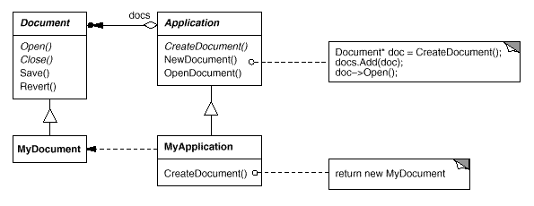
Factory Method
Define an interface for creating an object, but let subclasses decide which class to instantiate.
a.k.a. Virtual Constructor
e.g., app framework
factory method

Slide 17
Applicability
Use when:
  A class can’t anticipate the kind of objects to create.
  Hide the secret of which helper subclass is the current delegate.

Slide 18
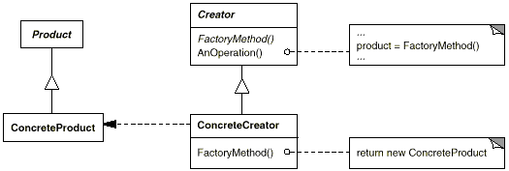
Structure
Product
  defines the interface of objects the factory method creates
ConcreteProduct
  implements the Product interface

Slide 19
Structure
Creator
  declares the factory method which return a Product type.
  [define a default implementation]
  [call the factory method itself]
ConcreteCreator
  overrides the factory method to return an instance of a ConcreteProduct

Slide 20
Sample Code
public class MazeGame {
public static void main(String args[]) {
Maze m = new MazeGame().createMaze();
}
private Maze makeMaze() { return new Maze(); }
private Wall makeWall() { return new Wall(); }
private Room makeRoom(int r) { return new Room(r); }
private Door makeDoor(Room r1, Room r2) { return new Door(r1,r2); }
public Maze createMaze() {
…
}
}

Slide 21
Sample Code
public Maze createMaze() {
Room r1 = makeRoom(1);
Room r2 = makeRoom(2);
Door d = makeDoor(r1,r2);
r1.setSide(Direction.North, makeWall());
r1.setSide(Direction.East, d);
r1.setSide(Direction.West, makeWall());
r1.setSide(Direction.South, makeWall());
r2.setSide(Direction.North, makeWall());
r2.setSide(Direction.East, d);
r2.setSide(Direction.West, makeWall());
r2.setSide(Direction.South, makeWall());
Maze m = makeMaze();
m.addRoom(r1);
m.addRoom(r2);
return m;
}

Slide 22
Sample Code
public class BombedMazeGame extends MazeGame
{
private Wall makeWall() { return new BombedWall(); }
private Room makeRoom(int r) { return new RoomWithABomb(r); }
}
public class EnchantedMazeGame extends MazeGame
{
private Room makeRoom(int r)
{ return new EnchantedRoom(r, castSpell()); }
private Door makeDoor(Room r1, Room r2)
{ return new DoorNeedingSpell(r1,r2); }
private Spell castSpell()
{ return new Spell(); }
}

Slide 23
Sample Code
public static void main(String args[]) {
Maze m = new EnchantedMazeGame().createMaze();
}
public static void main(String args[]) {
Maze m = new BombedMazeGame().createMaze();
}

Slide 24
Consequences
Advantage:
  Eliminates the need to bind to specific implementation classes.
    Can work with any user-defined ConcreteProduct classes.
Disadvantage:
  Uses an inheritance dimension
  Must subclass to define new ConcreteProduct objects
    interface consistency required

Slide 25
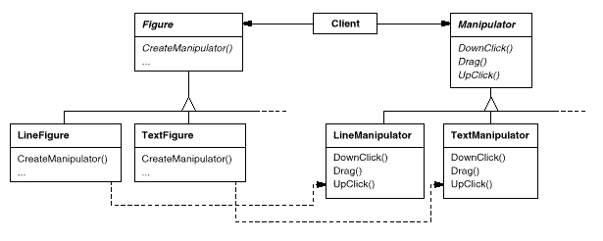
Consequences
Provides hooks for subclasses
  always more flexible than direct object creation
Connects parallel class hierarchies
  hides the secret of which classes belong together

Slide 26
Implementation
Two major varieties
  creator class is abstract
    requires subclass to implement
  creator class is concrete, and provides a default implementation
    optionally allows subclass to re-implement
Parameterized factory methods
  takes a class id as a parameter to a generic make() method.
  (more on this later)
Naming conventions
  use ‘makeXXX()’ type conventions (e.g., MacApp – DoMakeClass())
Can use templates instead of inheritance
Return class of object to be created
  or, store as member variable

Slide 27
Question
What gets printed?
public class Main {
public static void main(String args[])
{ new DerivedMain(); }
public String myClass()
{ return "Main"; }
}
class DerivedMain extends Main {
public DerivedMain()
{ System.out.println(myClass()); }
public String myClass()
{ return "DerivedMain"; }
}

Slide 28
Implementation
Lazy initialization
  In C++, subclass vtable pointers aren’t installed until after parent class initialization is complete.
    DON’T CREATE DURING CONSTRUCTION!
    can use lazy instatiation:
    Product getProduct() {
    if( product == null ) {
    product = makeProduct();
    }
    return product;
    }

Slide 29
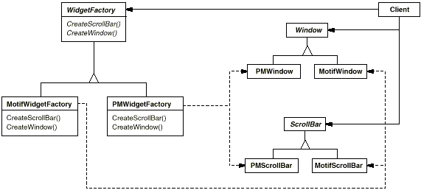
Abstract Factory
Provide an interface for creating families of related or dependent objects without specifying their concrete classes.
e.g., look-and-feel portability
  independence
  enforced consistency

Slide 30
Applicability
Use when:
  a system should be independent of how its products are created, composed, and represented
  a system should be configured with one of multiple families of products.
  a family of related product objects is designed to be used together, and you need to enforce this constraint.
  you want to provide a class library of products, and you want to reveal just their interfaces, not their implementations.
  you want to hide and reuse awkward or complex details of construction

Slide 31

Structure
AbstractFactory
  declares an interface for operations that create product objects.
ConcreteFactory
  implements the operations to create concrete product objects.

Slide 32
Structure
AbstractProduct
  declares an interface for a type of product object.
Product
  defines a product to be created by the corresponding concrete factory.
  implements the AbstractProduct interface.

Slide 33
Structure
Client
  uses only interfaces declared by AbstractFactory and AbstractProduct classes.

Slide 34
Sample Code
public class MazeFactory {
Maze makeMaze() { return new Maze(); }
Wall makeWall() { return new Wall(); }
Room makeRoom(int r) { return new Room(r); }
Door makeDoor(Room r1, Room r2) { return new Door(r1,r2);}
}

Slide 35
Maze Creation (old way)
public Maze createMaze() {
Room r1 = new Room(1);
Room r2 = new Room(2);
Door d = new Door(r1,r2);
r1.setSide(Direction.North, new Wall());
r1.setSide(Direction.East, d);
r1.setSide(Direction.West, new Wall());
r1.setSide(Direction.South, new Wall());
r2.setSide(Direction.North, new Wall());
r2.setSide(Direction.East, d);
r2.setSide(Direction.West, new Wall());
r2.setSide(Direction.South, new Wall());
Maze m = new Maze();
m.addRoom(r1);
m.addRoom(r2);
return m;
}

Slide 36
Sample Code
public Maze createMaze(MazeFactory factory) {
Room r1 = factory.makeRoom(1);
Room r2 = factory.makeRoom(2);
Door d = factory.makeDoor(r1,r2);
r1.setSide(Direction.North, factory.makeWall());
r1.setSide(Direction.East, d);
r1.setSide(Direction.West, factory.makeWall());
r1.setSide(Direction.South, factory.makeWall());
r2.setSide(Direction.North, factory.makeWall());
r2.setSide(Direction.East, d);
r2.setSide(Direction.West, factory.makeWall());
r2.setSide(Direction.South, factory.makeWall());
Maze m = factory.makeMaze()
m.addRoom(r1);
m.addRoom(r2);
return m;
}

Slide 37
Sample Code
public class EnchantedMazeFactory extends MazeFactory {
public Room makeRoom(int r) {
return new EnchantedRoom(r, castSpell());
}
public Door makeDoor(Room r1, Room r2) {
return new DoorNeedingSpell(r1,r2);
}
private protected castSpell() {
// randomly choose a spell to cast;
…
}
}

Slide 38
Sample Code
public class MazeGame
{
public static void main(String args[]) {
Maze m = new MazeGame().createMaze(new MazeFactory());
}
}
public class MazeGame
{
public static void main(String args[]) {
Maze m = new MazeGame().createMaze(new EnchantedMazeFactory());
}
}

Slide 39
Consequences
It isolates concrete classes
  Helps control the classes of objects that an application creates.
  Isolates clients from implementation classes
  Clients manipulate instances through abstract interfaces
  Product class names are isolated in the implementation of the concrete factory
    they do not appear in the client code

Slide 40
Consequences
It makes exchanging product families easy
  The class of a concrete factory appears only once in the app.
    where it’s instantiated
  Easy to change the concrete factory an app uses.
  The whole product family changes at once

Slide 41
Consequences
It promotes consistency among products
  When products are designed to work together, it’s important that an application use objects only from one family at a time.
  AbstractFactory makes this easy to enforce.

Slide 42
Consequences
Supporting new kinds of products is difficult.
  Extending AbstractFactory to produce new product types isn’t easy
    extend factory interface
    extend all concrete factories
    add a new abstract product
    + the usual (implement new class in each family)

Slide 43
Implementation
Factories as Singletons
  An app typically needs only one instance of a ConcreteFactory per product family.
  Best implemented as a Singleton

Slide 44
Implementation
Defining extensible factories
  Hard to extend to new product types
  Add parameter to operations that create products
    need only make()
    less safe
    more flexible
    easier in languages that have common subclass
      e.g. java Object
    easier in more dynamically-typed languages
      e.g., Smalltalk
    all products have same abstract interface
      can downcast – not safe
      classic tradeoff for a very flexible/extensible interface

Slide 45
Implementation
Creating the products
  AbstractFactory declares an interface for product creation
  ConcreteFactory implements it. How?
    Factory Method
      virtual overrides for creation methods
      simple
      requires new concrete factories for each family, even if they only differ slightly
    Prototype
      concrete factory is initialized with a prototypical instance of each product in the family
      creates new products by cloning
      doesn’t require a new concrete factory class for each product family
      variant: can register class objects

Slide 46
Prototype-based Implementation
abstract class AbstractProduct implements Cloneable {
public abstract int geti();
public abstract Object clone();
}
class ConcreteProduct extends AbstractProduct
{
public ConcreteProduct(int j) { i = j; }
public Object clone() { return new ConcreteProduct(i); }
public int geti() { return i; }
private int i;
}

Slide 47
Prototype-based Implementation
import java.util.Hashtable;
public class ConcreteFactory {
void addProduct(AbstractProduct p, String name) {
map.put(name, p);
}
AbstractProduct make(String name) {
return (AbstractProduct)
((AbstractProduct)map.get(name)).clone();
}
private Hashtable map = new Hashtable();
}

Slide 48
Prototype-based Implementation
public class Main {
public static void main(String args[]) {
ConcreteFactory f = new ConcreteFactory();
f.addProduct(new ConcreteProduct(42), “ap");
AbstractProduct p = f.make(“ap");
System.out.println(p.geti());
}
}

Slide 49
Class Registration Implementation
abstract class AbstractProduct {
public abstract int geti();
}
class ConcreteProduct extends AbstractProduct {
public int geti() { return i; }
private int i = 47;
}
public class ConcreteFactory {
void addProduct(Class c, String name) {
map.put(name, c);
}
Product make(String name) throws Exception {
Class c = (Class)map.get(name);
return (Product) c.newInstance();
}
private Hashtable map = new Hashtable();
}

Slide 50
Class Registration Implementation
public class Main {
public static void main(String args[]) throws Exception {
ConcreteFactory f = new ConcreteFactory();
f.addProduct(Class.forName("ConcreteProduct"), “ap");
AbstractProduct p = f.make(“ap");
System.out.println(p.geti());
}
}

Slide 51
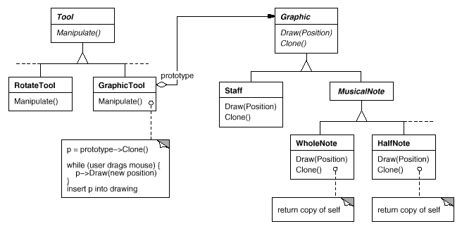
Prototype
Specify the kinds of objects to create using a prototypical instance, and create new objects by copying this prototype.
  e.g., reduce # of classes (# of tools) by initializing a generic tool with a prototype

Slide 52
Applicability
Use When:
  the classes to be instantiated are specified at run-time
    e.g., for dynamic loading
  to avoid building a class hierarchy of factories to parallel the hierarchy of products
  when instances can have only one of a few states
    may be better to initialize once, and then clone prototypes

Slide 53
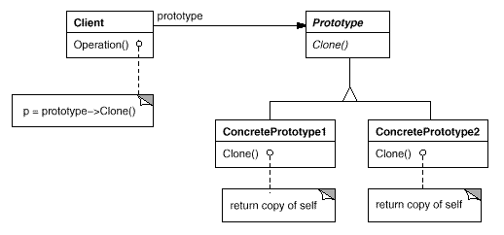
Structure
Prototype
  declares an interface for cloning itself
ConcretePrototype
  implements an operation for cloning itself
Client
  creates a new object by asking a prototype to clone itself

Slide 54
Sample Code
public class MazePrototypeFactory extends MazeFactory
{
private Maze prototypeMaze;
private Wall prototypeWall;
private Room prototypeRoom;
private Door prototypeDoor;
public MazePrototypeFactory(Maze pm, Wall pw, Room pr, Door pd) {
prototypeMaze = pm;
prototypeWall = pw;
prototypeRoom = pr;
prototypeDoor = pd;
}
…
}

Slide 55
Sample Code
public class MazePrototypeFactory extends MazeFactory
{
Wall makeWall() {
Wall wall = null;
try {
wall = (Wall)prototypeWall.clone();
} catch(CloneNotSupportedException e) { throw new Error(); }
return wall;
}
Room makeRoom(int r) {
Room room = null;
try {
room = (Room)prototypeRoom.clone();
} catch(CloneNotSupportedException e) { throw new Error(); }
room.initialize(r);
return room;
}
…
}

Slide 56
Sample Code
public abstract class MapSite implements Cloneable
{
public abstract void enter();
public String toString() {
return getClass().getName();
}
public Object clone() throws CloneNotSupportedException {
return super.clone();
}
}

Slide 57
Sample Code
public class Door extends MapSite
{
public Door(Room s1, Room s2) {
initialize(s1,s2);
}
public void initialize(Room s1, Room s2) {
side1 = s1;
side2 = s2;
open = true;
}
private Room side1;
private Room side2;
boolean open;
…
}

Slide 58
Sample Code
public class Room extends MapSite
{
public Room(int r) {
initialize(r);
}
public void initialize(int r) {
room_no = r;
}
public Object clone() throws CloneNotSupportedException {
Room r = (Room)super.clone();
r.side = new MapSite[Direction.Num];
return r;
}
…
private int room_no;
private MapSite[] side = new MapSite[Direction.Num];
}

Slide 59
Sample Code
public class EnchantedRoom extends Room
{
public EnchantedRoom(int r, Spell s) {
super(r);
spell = s;
}
public Object clone() throws CloneNotSupportedException {
EnchantedRoom r = (EnchantedRoom)super.clone();
r.spell = new Spell();
return r;
}
private Spell spell;
}

Slide 60
Sample Code
public static void main(String args[]) {
MazeFactory mf = new MazePrototypeFactory(
new Maze(), new Wall(),
new Room(0), new Door(null,null));
Maze m = new MazeGame().createMaze(mf);
}
public static void main(String args[]) {
MazeFactory mf = new MazePrototypeFactory(
new Maze(), new Wall(),
(Room)Class.forName("EnchantedRoom").newInstance(),
(Door)Class.forName("DoorNeedingSpell").newInstance());
Maze m = new MazeGame().createMaze(mf);
}

Slide 61
Consequences
Many of the same as AbstractFactory
Can add and remove products at run-time
new objects via new values
  setting state on a prototype is analogous to defining a new class
new structures
  a multi-connected prototype + deep copy
reducing subclassing
  no need to have a factory or creator hierarchy
dynamic load
  cannot reference a new class’s constructor statically
  must register a prototype
Disadvantage
  implement clone() all over the place (can be tough).

Slide 62
Consequences
No parallel class hierarchy
  awkward initialization
MapSite
Room
int r
MazePrototypeFactory
MazeGame
MazeFactory
EnchantedRoom
Spell s
EnchantedMazeGame
EnchantedMazeFactory

Slide 63
Implementation
Use a prototype manager
  store and retrieve in a registry (like Abstract Factory e.g.).
Shallow versus deep copy
  consider a correct implementation of clone() for Maze.
  need a concept of looking up equivalent cloned rooms in the current maze
d
m.clone()
  r1.clone()
    n.wall.clone()
    e.door.clone()
      r1.clone()
        !!!
r1
r2
m

Slide 64
Singleton
Ensure a class only has one instance, and provide a global point of access to it.
  Many times need only one instance of an object
    one file system
    one print spooler
    …
  How do we ensure there is exactly one instance, and that the instance is easily accessible?
    Global variable is accessible, but can still instantiate multiple instances.
    make the class itself responsible

Slide 65
Applicability
Use when:
  there must be exactly one instance accessible from a well-known access point
  the sole instance should be extensible via subclassing
    clients should be able to use the extended instance without modifying their code

Slide 66
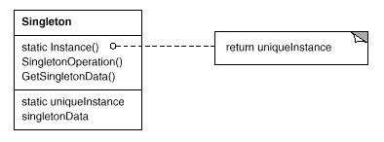
Structure
Singleton
  defines a class-scoped instance() operation that lets clients access its unique instance
  may be responsible for creating its own unique instance

Slide 67
Sample Code
package penny.maze.factory;
public class MazeFactory {
MazeFactory() { }
private static MazeFactory theInstance = null;
public static MazeFactory instance() {
if( theInstance == null ) {
String mazeKind =
AppConfig.getProperties().getProperty("maze.kind");
if( mazeKind.equals("bombed") ) {
theInstance = new BombedMazeFactory();
} else if( mazeKind.equals("enchanted") ) {
theInstance = new EnchantedMazeFactory();
} else {
theInstance = new MazeFactory();
}
}
return theInstance;
}
…
}

Slide 68
Sample Code
file .mazerc:
# Maze application parameters
maze.kind=enchanted

Slide 69
Sample Code
import java.io.*;
import java.util.Properties;
public class AppConfig {
public static Properties getProperties() {
if( props == null ) {
props = new Properties(defaults());
try {
props.load(new FileInputStream(".mazerc"));
} catch(IOException e) {
System.err.println("Cannot read .mazerc, using defaults");
}
}
return props;
}
private static Properties defaults() {
Properties p = new Properties();
p.put("maze.kind", "bombed");
return p;
}
private static Properties props = null;
}

Slide 70
Sample Code - More Dynamic
file .mazerc:
# Maze application parameters
maze.factory=EnchantedMazeFactory

Slide 71
Sample Code - More Dynamic
package penny.maze.factory;
public class MazeFactory {
MazeFactory() { }
private static MazeFactory theInstance = null;
public static MazeFactory instance() {
if( theInstance == null ) {
String mazeFactory =
AppConfig.getProperties().getProperty("maze.factory");
try{
theInstance = (MazeFactory)
Class.forName(mazeFactory).newInstance();
} catch(Exception e) {
theInstance = new MazeFactory();
}
}
return theInstance;
}
…
}

Slide 72
Consequences
Controlled access to sole instance.
  Because singleton encapsulates the sole instance, it has strict control.
Reduced name space
  one access method only
Variable # of instances
  can change your mind to have e.g., 5 instances
Easy to derive and select new classes
  access controlled through a single point of entry

Slide 73
Implementation
Ensuring a unique instance
  can’t define singleton as a global object!
    no guarantee only one will get created
      must prohibit instantiation
    may not know the state settings at init time (prior to main())
    must create whether used or not
  can’t define as a static object
    all of the above +
      C++ doesn’t define the order of construction across translation units.
Subclassing the singleton class
  as shown
  C++: implement Singleton::instance() in each sub-class, only link one in at link time.
  registry of singletons: instance(“bombed”)
    subclasses register in static initializers (or “init()” methods).

Slide 74
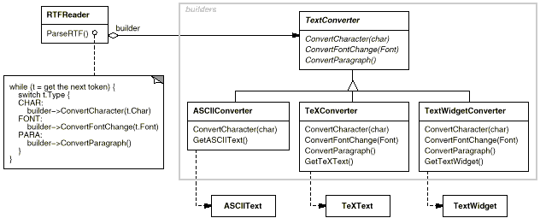
Builder
Separate the construction of a complex object from its representation so that the same construction process can create different representations.
  e.g., read in Rich Text Format, converting to may different formats on load.

Slide 75
Applicability
Use When:
  the algorithm for creating a complex object should be independent of the parts that make up the object and how they're assembled
  the construction process must allow different representations for the object that's constructed

Slide 76
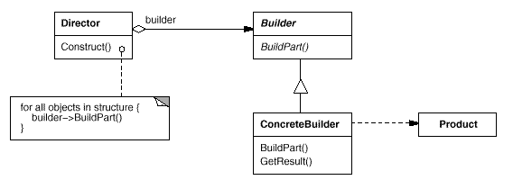
Structure
Builder
  specifies an abstract interface for creating parts of a Product object
Concrete Builder
  constructs and assembles parts of the product by implementing the Builder interface
  defines and keeps track of the representation it creates
  provides an interface for retrieving the product

Slide 77
Structure
Director
  constructs an object using the Builder interface
Product
  represents the complex object under construction.
  includes classes that define the constituent parts, including interfaces for assembling the parts into the final result

Slide 78
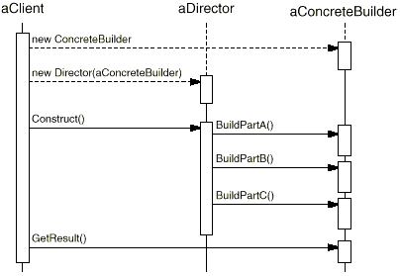
Collaborations
The client creates the Director object and configures it with the Builder object.
Director notifies the builder whenever a part of the product should be built.
Builder handles requests from the director and adds parts to the product.
The client retrieves the product from the builder.

Slide 79
Sample Code
public abstract class MazeBuilder {
public void buildRoom(int r){}
public void buildDoor(int r1, int direction, int r2){}
public Maze getMaze(){return null;}
}
public class MazeGame {
…
public Maze createMaze(MazeBuilder b) {
b.buildRoom(1);
b.buildRoom(2);
b.buildDoor(1, Direction.North, 2);
return b.getMaze();
}
…
}

Slide 80
Sample Code
public class StandardMazeBuilder extends MazeBuilder
{
private Maze currentMaze;
public Maze getMaze() {
if( currentMaze==null )
currentMaze = new Maze();
return currentMaze;
}
…
}

Slide 81
Sample Code
public class StandardMazeBuilder extends MazeBuilder
{
…
public void buildRoom(int r) {
if( getMaze().getRoom(r) == null ) {
Room room = new Room(r);
getMaze().addRoom(room);
for(int d = Direction.First; d <= Direction.Last; d++)
room.setSide(d, new Wall());
}
}
…
}

Slide 82
Sample Code
public class StandardMazeBuilder extends MazeBuilder
{
…
public void buildDoor(int r1, int d, int r2) {
Room room1 = getMaze().getRoom(r1);
Room room2 = getMaze().getRoom(r2);
if( room1 == null ) {
buildRoom(r1);
room1 = getMaze().getRoom(r1);
}
if( room2 == null ) {
buildRoom(r2);
room2 = getMaze().getRoom(r2);
}
Door door = new Door(room1, room2);
room1.setSide(d, door);
room2.setSide(Direction.opposite(d), door);
}
…
}

Slide 83
Sample Code
public class CountingMazeBuilder extends MazeBuilder
{
private int rooms = 0;
private int doors = 0;
public void buildDoor(int r1, int direction, int r2) {
doors++;
}
public void buildRoom(int r) {
rooms++;
}
public int getDoors() { return doors; }
public int getRooms() { return rooms; }
}

Slide 84
Sample Code
public class MazeGame
{
public static void main(String args[]) {
MazeGame mg = new MazeGame();
Maze m = mg.createMaze(new StandardMazeBuilder());
System.out.println(m);
CountingMazeBuilder cmb = new CountingMazeBuilder();
mg.createMaze(cmb);
System.out.println("rooms = "+cmb.getRooms());
System.out.println("doors = "+cmb.getDoors());
}
…
}

Slide 85
Sample Code
public Maze createMaze(MazeFactory f) {
Room r1 = f.makeRoom(1);
Room r2 = f.makeRoom(2);
Door d = f.makeDoor(r1,r2);
r1.setSide(Direction.North, f.makeWall());
r1.setSide(Direction.East, d);
r1.setSide(Direction.West, f.makeWall());
r1.setSide(Direction.South, f.makeWall());
r2.setSide(Direction.North, f.makeWall());
r2.setSide(Direction.East, f.makeWall());
r2.setSide(Direction.West, d);
r2.setSide(Direction.South, f.makeWall());
Maze m = f.makeMaze();
m.addRoom(r1);
m.addRoom(r2);
return m;
}

Slide 86
Sample Code
public Maze createMaze(MazeBuilder b) {
b.buildDoor(1, Direction.North, 2);
return b.getMaze();
}

Slide 87
Consequences
lets you vary a product's internal representation
isolates code for construction and representation
gives you control over the construction process

Slide 88
Implementation
Assembly interface
  sometimes can just append next element to structure
  more often must lookup previously constructed elements
    need an interface for doing this that hides Products
      cookie of some sort
    beware order of construction
Product hierarchy?
  often no great similarity
  no great need
  don’t use up a precious inheritance dimension
abstract v.s. empty methods?
  empty methods more generally useful
User-installable product classes

Slide 89
Creational Patterns
If createMaze() calls virtuals to construct components
  Factory Method (class scoped)
If createMaze() is passed a parameter object to create rooms, walls, …
  Abstract Factory
If createMaze() is passed a parameter object to create and connect-up mazes
  Builder
If createMaze is parameterized with various prototypical rooms, doors, walls, … which it copies and then adds to the maze
  Prototype
Need to ensure there is only one maze per game, and everybody can access it, and can extend or replace the maze without touching other code.
  Singleton

