Slide 1
Structural
Design Patterns

Slide 2
Design Patterns
“Each pattern describes
a problem which occurs over and over again in our environment, and then describes the core of the solution to that problem, in such a way that you can use this solution a million times over, without ever doing it the same way twice”.
--- Christopher Alexander, 1977
This was in describing patterns in buildings and towns.
In SE, design patterns are in terms of objects and interfaces, not walls and doors.
The manner in which a collection of interacting objects collaborate to accomplish a specific task or provide some specific functionality.

Slide 3
Architecture vs. Design Patterns
Architecture
High-level framework for structuring an application
  “client-server based on remote procedure calls”
  “abstraction layering”
  “distributed object-oriented system based on CORBA”
Defines the system in terms of computational components & their interactions
Design Patterns
Lower level than architectures (Sometimes, called micro-architecture)
Reusable collaborations that solve subproblems within an application
  how can I decouple subsystem X from subsystem Y?
Why Design Patterns?
Design patterns support object-oriented reuse at a high level of abstraction
Design patterns provide a “framework” that guides and constrains object-oriented implementation

Slide 4
4 Essential Elements of Design Patterns
  Name: identifies a pattern
  Problem: describes when to apply the pattern in terms of the problem and context
  Solution: describes elements that make up the design, their relationships, responsibilities, and collaborations
  Consequences: results and trade-offs of applying the pattern

Slide 5
How to Describe Design Patterns more fully
This is critical because the information has to be conveyed to peer developers in order for them to be able to evaluate, select and utilize patterns.
  A format for design patterns
      Pattern Name and Classification
      Intent
      Also Known As
      Motivation
      Applicability
      Structure
      Participants
      Collaborations
      Consequences
      Implementation
      Sample Code
      Known Uses
      Related Patterns

Slide 6
Organizing Design Patterns
By Purpose (reflects what a pattern does):
  Creational Patterns
  Structural Patterns
  Behavioral Patterns
By Scope: specifies whether the pattern applies primarily to
  classes or to
  objects.

Slide 7
Design Patterns Space
Purpose
Creational
Structural
Behavioral
Scope
Class
Factory Method
Adapter
Interpreter
Template
Object
Abstract Factory
Builder
Prototype
Singleton
Adapter
Bridge
Composite
Decorator
Façade
Flyweight
Proxy
Chain of
Responsibility
Command
Iterator
Mediator
Memento
Observer
State
Strategy
Visitor

Slide 8
Structural Patterns
concerned with how classes and objects are composed to form larger structures
  Adapter
    interface converter
  Bridge
    decouple abstraction from its implementation
  Composite
    compose objects into tree structures, treating all nodes uniformly
  Decorator
    attach additional responsibilities dynamically
  Façade
    provide a unified interface to a subsystem
  Flyweight
    using sharing to support a large number of fine-grained objects efficiently
  Proxy
    provide a surrogate for another object to control access

Slide 9
Adapter
Intent
Convert the interface of a class into another interface clients expect. Adapter lets classes work together that couldn’t otherwise because of incompatible interfaces.
Applicability
Reuse of an existing class is desired, but the interface does not match the need.
Design of a reusable class that cooperates with unrelated or unforeseen classes, but classes don’t have compatible interfaces.

Slide 10
Adapter
Class Diagram
Adaptee
Client
Target
+specialOperation()
+request()
Adapter
adaptee.specificOperation()
+request()

Slide 11
Adapter Continued
Participants
Target — defines the domain-specific interface that the client uses.
Client — collaborates with objects conforming to the Target interface.
Adaptee — defines an existing interface that needs adapting.
Adapter — adapts the interface of Adaptee to the Target interface.
Collaborations
Clients call operations on an Adapter instance. In turn, the Adapter calls Adaptee operations that carry out the request.

Slide 12
Bridge
Window
DrawText()
DrawRect()
WindowImp
devDrawText()
devDrawLine()
Imp.devDrawLine() Imp.devDrawLine() Imp.devDrawLine() Imp.devDrawLine()
Icon_Window
DrawBorder()
Transient_Window
DrawCloseBox()
MS_Window
devDrawText()
devDrawLine()
Mac_Window
devDrawText()
devDrawLine()
DrawRect()
MSDrawLine()
MSDrawString()

Slide 13
Bridge
Decouple an abstraction from its implementation so that the two can vary independently
Also known as Handle/Body
Use the bridge pattern when
You want to avoid a permanent binding between an abstraction and its implementation
Both the abstractions and their implementations should be extensible by subclassing.
Changes in the implementation of an abstraction class should have no impact on clients
You want to hide the implementation of an abstraction completely from clients

Slide 14
Structure
Client
Abstraction
Operation()
imp
Implementor
OperationImp()
Imp.OperationImp()
RefinedAbstraction
ConcreteImplementorA
OperationImp()
ConcreteImplementorA
OperationImp()

Slide 15
Consequences
Decoupling interface and implementation – the implementation of an abstraction can be configured at run-time.
Improved extensibility – you can extend the abstraction and implementor hierarchies independently
Hiding implementation details from clients

Slide 16
Some Implementation Issues
Only one implementor – the abstract implementor class is not necessary
Creating the right implementor object
  Instantiate one of them in its constructor
  Choose an default implementation initially and change it alter according to usage

Slide 17
Structural Patterns - Composite
Intent
Compose objects into tree structures to represent part-whole hierarchies. Composite lets clients treat individual objects and compositions of objects uniformly.
Composite: Applicability
Represents part-whole hierarchies of objects.
Clients ignore the difference between compositions of objects and individual objects.
Clients treat all objects in the composite structure uniformly.

Slide 18
Structural Patterns – Composite
Class Diagram
Component
Client
operation()
*
getChild( i:int )
Leaf
Composite
operation()
operation()
operation()
{
add( c:Component )
for all g in children
remove( c:Component )
g.operation()
getChild( i:int )
}

Slide 19
Structural Patterns - Composite
Object Diagram
top : Composite
a : Leaf
b : Leaf
top : Composite
c : Leaf
d : Leaf
e : Leaf

Slide 20
Structural Patterns – Composite
Participants
Component
Declares the interface for objects in the composition.
Implements default behavior for the interface common to all classes, as appropriate.
Declares an interface for accessing and managing its child components.
Optionally defines an interface for accessing a components parent.
Leaf
Represents leaf objects in the composition.
Defines behavior for primitive objects in the composition.
Client
Manipulates objects in the composition through the Component interface.

Slide 21
Structural Patterns – Composite
Composite
Defines behavior for components having children.
Stores child components.
Implements child-related operations.
Collaborations
Clients use the Component class interface to interact with objects in the composite structure.
If the recipient is a Leaf, then the request is handled directly.
If the recipient is a Composite, then it usually forwards requests to its child components, possibly performing additional operations before and/or after forwarding.

Slide 22
Structural Patterns - Decorator
Attach additional responsibilities to an object dynamically. Decorators provide a flexible alternative to subclassing for extending functionality. Also known as Wrapper
Client
Component
Operation()
ConcreteComponent
Operation()
Decorator
Operation()
component
Component.operation()
ConcreteDecoratorA
Operation()
addedBehavior()
ConcreteDecoratorB
Operation( )
addedBehavior()
Decorator:operation() addedBehavior();

Slide 23
Consequences
More flexibility than static inheritance – responsibilities can be added and removed at run-time simply by attaching and detaching them
Avoids heavy featured classes high up in the hierarchy
A decorator and its component aren’t identical
Lots of little objects.

Slide 24
Some Implementation Issues
Interface conformance – A decorator object’s interface must conform to the interface of the component it decorates.
Omitting the abstract decorator class if you only need to add one responsibility
Keeping component classes lightweight – it should focus on defining an interface, not on storing data
Different from Adapter pattern

Slide 25
Structural Patterns - Façade
Intent
Provide a unified interface to a set of interfaces in a subsystem. Façade
defines a higher-level interface that makes the subsystem easier to use.
Applicability
Provides a simple interface to a complex subsystem.
Decouples the details of a subsystem from clients and other subsystems.
Provides a layered approach to subsystems.

Slide 26
Structural Patterns - Façade
Class Diagram
subsystem
Facade

Slide 27
Structural Patterns - Façade
Participants
Façade
  Knows which classes are responsible for each request.
  Delegates client requests to appropriate objects.
Subsystem classes
  Implement subsystem functionality.
  Handle work assigned by the Façade object.
  Have no knowledge of the façade.
Collaborations
Clients communicate with the subsystem sending requests to the Façade.
  Reduces the number of classes the client deals with.
  Simplifies the subsystem.
Clients do not have to access subsystem objects directly.

Slide 28
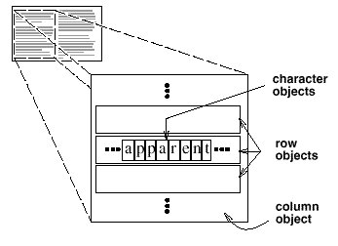
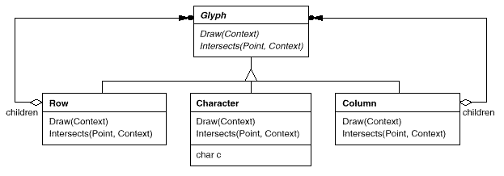
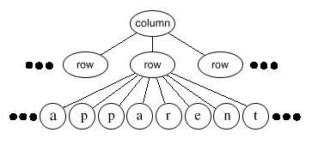
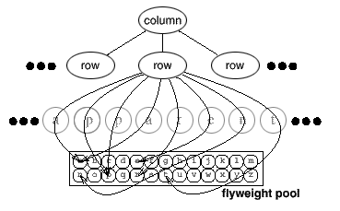
Structural Patterns - Flyweight
Use sharing to support large numbers of fine-grained objects efficiently

Slide 29
Applicability
Use when:
  An application uses a large number of objects
  Storage costs are high because of the sheer quantity of objects
  Most object state can be made extrinsic
  Many groups of objects may be replaced by relatively few shared objects once extrinsic state is removed
  The application doesn't depend on object identity
    Since flyweight objects may be shared, identity tests will return true for conceptually distinct objects

Slide 30
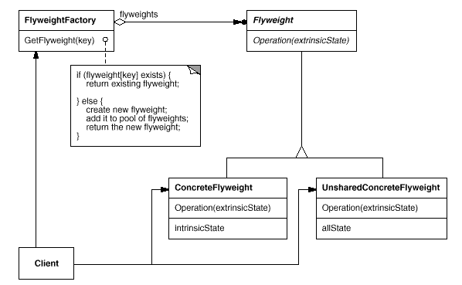
Structure
Flyweight
  declares an interface through which flyweights can receive and act on extrinsic state

Slide 31
Structure
ConcreteFlyweight
  implements the Flyweight interface and adds storage for intrinsic state, if any
  must be sharable
    any state it stores must be intrinsic (independent of context)

Slide 32
Structure
UnsharedConcreteFlyweight
  not all Flyweight subclasses need to be shared.
  The Flyweight interface enables sharing; it doesn't enforce it

Slide 33
Structure
FlyweightFactory
  creates and manages flyweight objects
  ensures that flyweights are shared properly
    when a client requests a flyweight, the FlyweightFactory object supplies an existing instance or creates one, if none exists

Slide 34
Structure
Client
  maintains a reference to flyweights
  computes or stores the extrinsic state of flyweights

Slide 35
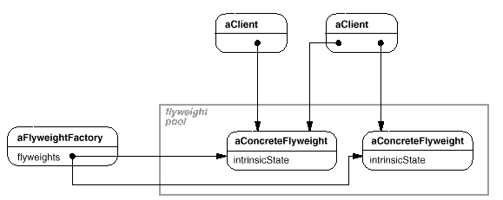
Structure
Clients should not instantiate ConcreteFlyweights directly.
Clients must obtain ConcreteFlyweight objects exclusively from the FlyweightFactory object to ensure they are shared properly

Slide 36
Structural Patterns - Proxy
Intent
Provide a surrogate or placeholder for another object to control access to it.
Applicability
Remote proxy — provides a local representative for an object in a different address space.
Virtual proxy — creates expensive objects on demand.
Protection proxy — controls access to the original object.
Smart reference — replacement for a bare pointer
  Reference counting
  Loading persistent object on access
  Transactional locking

Slide 37
Structural Patterns - Proxy
Class Diagram
<<abstract>>
Subject
Client
request()
...
RealSubject
Proxy
request()
request()
request()
{
...
...
...
realSubject.request()
...
}

Slide 38
Structural Patterns - Proxy
Object Diagram
aClient:
aProxy : Proxy
subject : RealSubject

