Slide 1
What is a Pattern

Slide 2
Talk outline
Pattern origins and history
Definition
Properties
Types of patterns
Describing design patterns
Pattern language, system, catalog
Reorganizing an object-oriented application using design patterns

Slide 3
Pattern origins and history
writings of architect Christopher Alexander
(coined this use of the term "pattern" ca. 1977-1979)
Kent Beck and Ward Cunningham, Textronix, OOPSLA'87
(used Alexander's "pattern" ideas for Smalltalk GUI design)
Erich Gamma, Ph. D. thesis, 1988-1991
James Coplien, Advanced C++ Idioms book, 1989-1991
Gamma, Helm, Johnson, Vlissides ("Gang of Four“ - GoF)
Design Patterns: Elements of Reusable Object-Oriented Software, 1991-1994
PLoP Conferences and books, 1994-present
Buschmann, Meunier, Rohnert, Sommerland, Stal, Pattern -Oriented Software Architecture: A System of Patterns (“POSA book”)
Notes:
As mentioned before, the current use of the term "pattern" is derived from the writings of the architect Christopher Alexander who has written several books on the topic as it relates to urban planning and building architecture (list of books).
Patterns in software first became popular with the wide acceptance of the book Design Patterns: Elements of Reusable Object-Oriented Software by Erich Gamma, Richard Helm, Ralph Johnson, and John Vlissides (frequently referred to as the Gang of Four or just GoF).
Other recent books that have helped popularize patterns are:
Pattern-Oriented Software Architecture: A System of Patterns (also called the POSA book) by Frank Buschmann, Regine Meunier, Hans Rohnert, Peter Sommerlad, and Michael Stal (sometimes called the Siemens Gang of Five or just GoV); and the books Pattern Languages of Program Design and Pattern Languages of Program Design 2, which are selected papers from the first and second conferences on
Patterns Languages of Program Design (PLoP or PLoPD). Many of these books are part of the Software Patterns Series from Addison-Wesley.

Slide 4
Definition
… a fully realized form, original, or model accepted or proposed for imitation…[dictionary]
... describes a problem which occurs over and over again in our environment, and then describes the core of the solution to that problem, in such a way that you can use this solution a million times over, without ever doing it the same way twice [Alexander]
… the abstraction from a concrete form which keeps recurring in specific non-arbitrary contexts [Riehle]
…both a thing and the instructions for making the thing [Coplien]
...a literary format for capturing the wisdom and experience of expert designers, and communicating it to novices
Notes:
It is unavoidable to mention what Alexander says about patterns, since the origin of design patterns lies in work done by him in late 70is.
Although Alexander was talking about patterns in buildings, the core of patterns in object-oriented design and building is a solution to a problem in a context.
In "Understanding and Using Patterns in Software Development", Dirk Riehle and Heinz Zullighoven give a nice definition of the term "pattern" which is very broadly applicable.
Coplein in his paper “Software Design Patterns: Common questions and Answers” refers to patterns as both the thing and the instructions for making the thing.
Basically, pattern can be viewed as a particular prose form of recording design information such that designs which have worked well in the past can be applied again in similar situations in the future. (Beck, Coplien - “Industrial experience with design patterns”

Slide 5
Properties
Patterns do...
provide common vocabulary
provide “shorthand” for effectively communicating complex principles
help document software architecture
capture essential parts of a design in compact form
show more than one solution
describe software abstractions
Patterns do not...
provide an exact solution
solve all design problems
only apply for object-oriented design
Notes:
Patterns provide a common vocabulary for designers to communicate, document, and explore design alternatives (Gamma93-paper). Consequently enabling effective communicating of complex concepts between designers. Patterns capture solutions and essential parts of design in a compact form. Pattern describe software abstractions, ensuring vide applicability, but a pattern may provide hints about potential implementation issues). Simply said, patterns help designer get a design “right” faster.
Patterns are not necessarily object.oriented, and patterns can be found in a variety of software systems, independent of the methods used in developing those systems (Coplien, Industrial experience)
However, a pattern is not an implementation. It describes when, why, and how to go about creating an implementation or other engineering product.
Also, patterns do not solve all design problems.

Slide 6
Patterns can be
non-generative (Gamma patterns)
  observed in a system
  descriptive and passive
generative
  generate systems or pats of systems
  perspective and active
Notes:
Patterns that we observe in a system that has already been built are non-generative, and are sometimes called Gamma patterns. Such patterns are descriptive and passive. (they describe recurring phenomenon without necessary saying how to reproduce them).
Patterns designed to shape system architectures are called generative patterns. They are descriptive and active. These patterns generate systems ad parts of systems. (that is tell us how to create something and can be observed in the resulting system architectures they shaped).
The opinion in Pattern community is that we should strive to document generative patterns, since they not only show us characteristics of good system, but also they teach us how to build them.
Another aspect of generativity is about crating “live” architectures, which are capable of dynamically adapting to fulfill changing needs and demands.

Slide 7
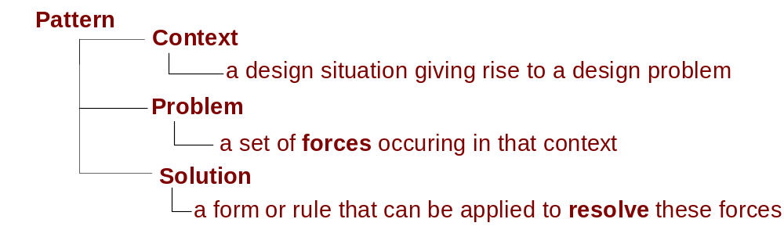
Ingredients
Example – window place
forces
  he wants to sit down and be comfortable
  he is drawn toward the light
solution
  in every room, make at least one window into a “window place”
Notes:
Every pattern has these essential elements:
Context - refers to a recurring set of situations in which the pattern applies.
Problem -refers to a set of forces -- goals and constraints -- that occur in this context. (describes when to apply the pattern)
Solution -refers to a design form or design rule that someone can apply to resolve these forces. (describes the elements that make up design, their relationships, responsibilities and collaboration)

Slide 8
Types of software patterns
design patterns (software design)
[Buschmann-POSA]
  architectural (systems design)
  design (micro-architectures) [Gamma-GoF]
  idioms (low level)
analysis patterns (recurring & reusable analysis models) [Flower]
organization patterns (structure of organizations/projects)
process patterns (software process design)
domain-specific patterns
Notes:
Much of the initial patterns focus in the software community has been on design patterns. The patterns in the [GoF] book are object-oriented design patterns. However, there are many other kinds of software patterns besides design patterns. For example, Martin Fowler has written a book of Analysis Patterns. Patterns cover all aspects of software engineering including: development organization, software process, project planning, requirements engineering, and software configuration, management (just to name a few). Presently however, design patterns still seem to be the most popular (though organization patterns seem to be gaining momentum).
----
The difference between these three kinds of design patterns are in their corresponding levels of abstraction and detail. Architectural patterns are high-level strategies that concern large-scale components and the global
properties and mechanisms of a system. They have wide-sweeping implications which affect the overall skeletal structure and organization of a software system. Design patterns are medium-scale tactics that flesh
out some of the structure and behavior of entities and their relationships. They do not influence overall system structure, but instead define micro-architectures of subsystems and components. Idioms are
paradigm-specific and language-specific programming techniques that fill in low-level internal or external details of a component's structure or behavior.

Slide 9
Alexandrian form (canonical form)
Name
meaningful name
Problem
the statement of the problem
Context
a situation giving rise to a problem
Forces
a description of relevant forces and constraints
Solution
proven solution to the problem
Examples
sample applications of the pattern
Resulting context (force resolution)
the state of the system after pattern has been applied
Notes:
Several different formats have been used for describing patterns The pattern description format used in Alexander's work is called the "Alexandrian form". The format used in [GoF] is referred to as "GoF format".
NAME - pattern must have a meaningful name. This allows us to use a single word or short phrase to refer to the pattern Good pattern names form a vocabulary for discussing conceptual abstractions. Sometimes a pattern may have more than one commonly used name in the literature. In this case it is common practice to document these nicknames or synonyms under the heading of Aliases or Also Known As.
PROBLEM - the problem pattern is trying to solve (if people know what the problem the pattern solves, they’ll know when to apply it.
CONTEXT - A pattern solves a problem in a given context and it may not make sense elswhere.The preconditions under which the problem and its solution seem to recur, and for which the solution is desirable. This tells us the pattern's applicability. It can be thought of as the initial configuration of the system before the pattern is applied to it.
FORCES- A concrete scenario which serves as the motivation for the pattern is frequently employed … Not all problems are clear cut. Forces make clear intricacies of a problem)
SOLUTION- The solution should describe not only static structure but also dynamic behavior. The static structure tells us the form and organization of the pattern, but often it is the behavioral dynamics that make the pattern "come alive". The description of the pattern's solution may indicate guidelines to keep in mind (as well as pitfalls to avoid) when attempting a concrete implementation of the solution.

Slide 10
Alexandrian form (canonical form)
Rationale
explanation of steps or rules in the pattern
Related patterns
static and dynamic relationship
Known use
occurrence of the pattern and its application within existing system
Notes:
EXAMPLES - are present in all good patterns, visual analogies are good for pattern. Examples help thereader understand the pattern's use and applicability. Visual examples and analogies can often be especially illuminating. An example may be supplemented by a sample implementation to show one way the solution might be realized.
FORCE RESLOUTION or RESULTING CONTEXT - Few patterns are perfect or stand on their own. A good pattern tells what forces it leaves unresolved, or what other pattern must be applied, and how the context is changed by the pattern. The state or configuration of the system after the pattern has been applied, including the consequences (both good and bad) of applying the pattern, and other problems and patterns that may arise from the new context. It describes the postconditions and side-effects of the pattern.
RATIONALE - This tells where the pattern comes from, why it works, and why expert use.The rationale provides insight into the deep structures and key mechanisms that are going on beneath the surface of the system.
RELATED PATTERNS - The static and dynamic relationships between this pattern and others within the same pattern language or system.
KNOWN uses - Describes known occurrences of the pattern and its application within existing systems. This helps validate a pattern by verifying that it is indeed a proven solution to a recurring problem. Known uses of the pattern can often serve as instructional examples

Slide 11
GoF format
Pattern name and classification
Intent
what does pattern do / when the solution works
Also known as
other known names of pattern (if any)
Motivation
the design problem / how class and object structures solve the problem
Applicability
situations where pattern can be applied
Structure
a graphical representation of classes in the pattern
Participants
the classes/objects participating and their responsibilities
Collaborations
of the participants to carry out responsibilities
Notes:
Design patterns must be described using consistent format (Gamma). Each pattern is divided into these sections according to the presented template.
Pattern name and classification
Intent A statement of a problem which describes intent, that is the goals and objectives it wants to reach within given contexts and force.
-Motivation - A scenario that illustrates a design problem and how the class and object structures in the pattern solve the problem.
Applicability - The situations in which the problem and its solution seem to recur, and for which the solution is desirable. It can be thought of as the initial configuration of a system before the pattern is applied to it.
Structure - A graphical representation of the classes in the pattern using notation based on the Object Modeling technique.
Participants -
Collaborations - How the partic…
Consequences - of applying the pattern, both good and bad, and other problems and patterns that may arise from the new context. It describes the postconditions and side-effects of the pattern.
Implementation - What pitfalls, hints, or techniques should you be aware of when implementing the patterns? What are language-specific issues?
Related patterns - What design patterns are closely related to this one? What are important differences? With which other patterns should this one be used?

Slide 12
GoF format
Consequences
trade-offs, concerns
Implementation
hints, techniques
Sample code
code fragment showing possible implementation
Known uses
patterns found in real systems
Related patterns
closely related patterns

Slide 13

Pattern templates
[PATTERN-NAME]
Author
[YOUR-NAME] ([YOU@YOUR.ADDR]).
Last updated on [TODAY'S-DATE]
Context
[PARAG-1]
[PARAG-2]
Problem
[ONE-ASPECT]
[ANOTHER-ASPECT]
Examples
Forces
1.[FORCE-1]
2.[FORCE-2]
Design
[PARAG-1]
[PARAG-2]
An Implementation
[SOME-CODE]
Examples
Variants
[VARIANT]
[ANOTHER-VARIANT]
See Also
[ANOTHER-REF]
IF you find yourself in CONTEXT
for example EXAMPLES,
with PROBLEM,
entailing FORCES
THEN for some REASONS,
apply DESIGN FORM AND/OR RULE
to construct SOLUTION
leading to NEW CONTEXT and OTHER PATTERNS
http://g.oswego.edu/dl/pd-FAQ/pd-FAQ.html
http://hillside.net/patterns/Writing/Lea.html
More pattern templates:
http://hillside.net/patterns/template.html
http://www.paterndepot.com/pages (Templates)
Notes:
Pattern templates can be found on the web. An interesting is one given by Dag Lea, at “Design patterns-FAQ page” ---on the web there is a LOT of templates and they are similar , but differ from one another in some ingredient, but essential give the same information in a slightly different form.

Slide 14
Pattern language
[Coplien]
…is a structured collection of patterns that build on each other to transform needs and constraints into an architecture [Software Design Patterns: Common Questions and Answers]
…defines collection of patterns and rules to combine them into an architectural style…describe software frameworks or families of related systems [Patterns Home Page ->Patterns Definitions]
Notes:
In the Patterns Definitions section of the Patterns Home Page, Cope defines a pattern language as follows: A pattern language defines a collection of patterns and the rules to combine them into an architectural style. Pattern languages describe software frameworks or families of related systems.
Cope gives a slightly different definition in "Software Design Patterns: Common Questions and Answers": A pattern language is a structured collection of patterns that build on each other to transform needs and constraints into an architecture.
A pattern language includes rules and guidelines which explain how and when to apply its patterns to solve a problem which is larger than any individual pattern can solve.
These rules and guidelines suggest the order and granularity for applying each pattern in the language. A pattern language may be regarded as a lexicon of patterns plus a grammar that defines how to weave them
together into valid sentences (or artful tapestries if you will). Ideally, good pattern languages are generative, capable of generating all the possible sentences from a rich and expressive pattern vocabulary.

Slide 15
Pattern catalogs and systems
[Buschmann, POSA]
pattern catalog
  …a collection of related patterns, where patterns are subdivided into small number of broad categories…
pattern system
  …a cohesive set of related patterns, which work together to support the construction and evolution of hole architectures...
Notes:
The authors of [POSA] have classified different kinds of pattern collections that possess varying degrees of structure and interaction into pattern catalogs, systems, and languages:
Pattern Catalogs
A pattern catalog is a collection of related patterns (perhaps only loosely or informally related). It typically subdivides the patterns into at least a small number of broad categories and may include some amount of cross referencing between patterns.
Pattern Systems
A pattern system is a cohesive set of related patterns which work together to support the construction and evolution of whole architectures. It describes many interrelationships between the patterns and their groupings and how they may be combined and composed to solve more complex problems.
The primary difference between the pattern system and a pattern language is that, ideally, pattern languages are computationally complete, showing all possible combinations of patterns and their variations to produce complete architectures. In practice however, the difference between pattern systems and pattern languages can be extremely difficult to ascertain.

Slide 16
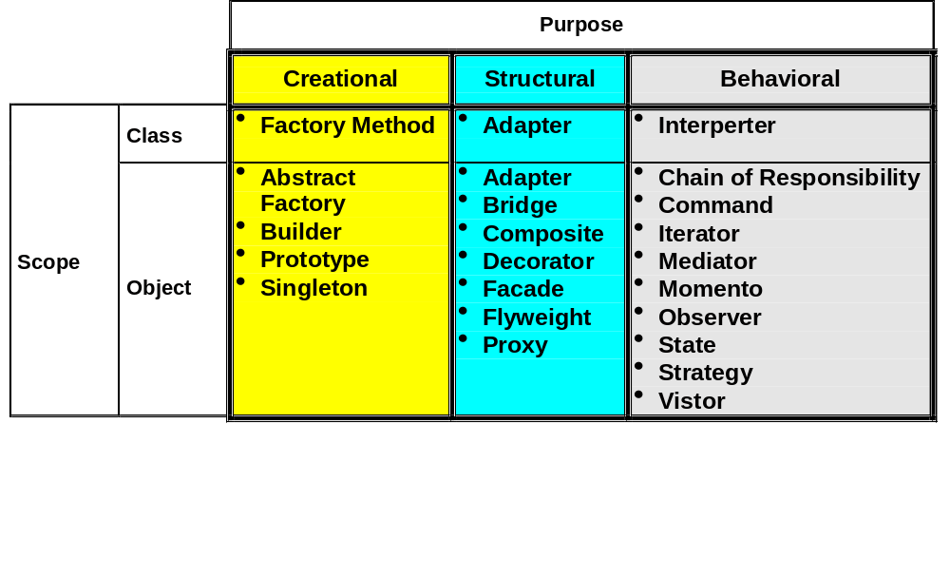
Design pattern catalog - GoF
Notes:
In Gamma’s book, patterns are classified by two criteria. First is Purpose, which reflects what pattern does. Patterns can have either creational, structural, or behavioral purpose. Creational patterns concern the process of object creation. Structural patterns deal with the composition of classes or objects. Behavioral patterns characterize the ways in which classes or objects interact and distribute responsibility.
The second criterion is scope, which specifies whether the pattern applies primarly on classes or objects. Class patterns deal with relationships between classes and their sub-classes. These relationships are established through inheritance, so they are static (fixed at compile time). Object patterns deal with object relationships, which can be changed at run-time and are more dynamic. (petterns labeled as class patterns are those that focus on class relationships.

Slide 17
Handling Hotspots in a Framework
What varies | Design Pattern
Algorithms | Strategy, Visitor
Actions | Command
Implementations | Bridge
Response to change | Observer
Interactions between objects | Mediator
Object being created | Factory Method, Abstract Factory, Prototype
Structure being created | Builder
Traversal Algorithm | Iterator
Object interfaces | Adapter
Object behavior | Decorator, State

Slide 18
Reorganization using patterns
Experiences using Design Patterns to Reorganize an Object-Oriented Application, Walter Zimmer
hypermedia application
  developed by the European Museum Network (EMN)
  on top of MacApp
  50 classes
goal of reorganization
  eliminate deficiencies in the design and implementation
Application specific parts
Reorganized hypermedia application
Existing hypermedia application
Reusable framework layer
Generic, reusable parts
MacApp
MacApp

Slide 19
Steps in reorganization
PRELIMINARY STEPS
1 documentation
2 finding staring points
  identification of classes / subsystems
  with design goals similar to ones of
  design patterns
  experiences and future scenarios
  metrics / design rules
  analyzing the application for
  existing patterns
REOGANIZATIONAL STEPS
1 finding and exploring suitable design patterns
2 reconstructing and documentation
  application classes corresponding to the design pattern
  incorporate names of the application classes to the classes in the design pattern (e.g., LinkStrategy, HyperMediaDecorator)
design patterns
parts of the system
critical application parts
and their deficiencies

Slide 20
Results and experiences
RESULTS
drastic reduction of dependencies between subsystems
short design documentation
EXPERIENCES
common vocabulary - main advantage
reorganization is time-intensive task
good knowledge of design patterns needed
combination of several design patterns required

