Slide 1
OSGi & UPnP Technology
2008 Summer
Cheng-Yi Chien

Slide 2



Outline
What is OSGi Technology
Introduction
  Alliance
  Specifications
  Key Benefits
OSGi Framework
Service & Bundle
Use Cases
OSGi Implementation

Slide 3
What is OSGi Technology
It’s a module system for the Java platform
It’s dynamic
It’s service-oriented
A specification of the OSGi Alliance, a non-profit organization

Slide 4
Outline
What is OSGi Technology
Introduction
  Alliance
  Specifications
  Key Benefits
OSGi Framework
Service & Bundle
Use Cases
OSGi Implementation

Slide 5
Alliance
“Open Service Gateway Institute”
The Alliance has been founded by Sun Microsystems, IBM, Ericsson and others in March 1999.
Among its members are (as of April 2006) more than 35 companies from quite different business areas, for example Nokia, Motorola, Philips, BenQ, Siemens VDO Automotive, BMW, Gatespace Telematics, ProSyst, Samsung Electronics…

Slide 6
Specifications
OSGi Release 1 (R1): May 2000
OSGi Release 2 (R2): October 2001
OSGi Release 3 (R3): March 2003
OSGi Release 4 (R4): October 2005 / September 2006
  Core Specification (R4 Core): October 2005
  Mobile Specification (R4 Mobile / JSR-232): September 2006

Slide 7
Specifications
OSGi framework
Standard service definitions
  Log Service
  Http Service
  Device Service
  Package Administration Service
  Permission Administration Service
  Configuration Administration Service
  Preferences Service
  User Administration Service

Slide 8
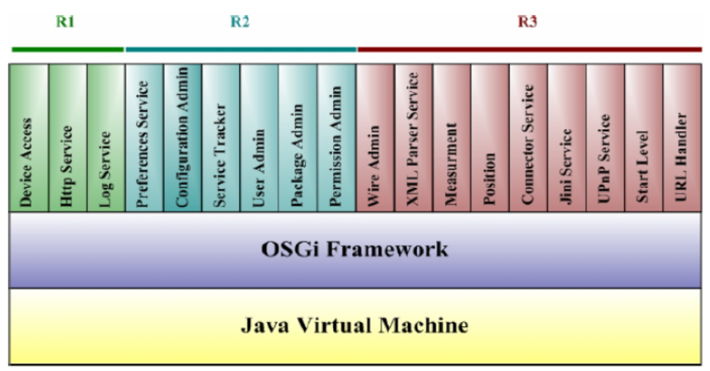

Slide 9
Key Benefits
Platform Independence:
OSGi member companies work in many different environments and as such they suffer different constraints, resulting in widely varying product characteristics and capabilities.
Application Independence:
The OSGi specifications focus on defining common APIs for service deployment. This makes the specifications suitable for Service Platforms for a variety of applications in different markets.

Slide 10

Key Benefits
Multiple Service Support:
OSGi environments should be capable of hosting multiple applications from different Service Providers on a single Service Platform with each application providing an independent set of services to the end user.
Service Collaboration Support:
An important aspect of the OSGi deployment model is that it allows the core platform to be extended with deployed services. This is not limited to end user oriented services only, which is a limitation of some other deployment models.

Slide 11
Key Benefits
Multiple Network Technology Support:
OSGi Service Platforms can work with wide area technologies like xDSL, Cable modems, Satellite, ISDN and PSTN and local area networks like Bluetooth, USB, IEEE 1394 Firewire.
Popular service discovery techniques like UPnP, Jini, Salutation and several others work very well in conjunction with an OSGi Service Platform and can even potentially interwork transparently.

Slide 12
Key Benefits
Security:
The OSGi offers a fine grained security architecture that limits the potential harm a malicious or badly written application can do.
Simplicity:
The OSGi environment offers a service environment for everybody by removing much of the complexity and putting it into the hands of professionals. The environment can be remotely managed by a professional organization, if so desired.

Slide 13
Outline
What is OSGi Technology
Introduction
  Alliance
  Specifications
  Key Benefits
  OSGi Terminology
OSGi Framework
Service & Bundle
Use Cases
OSGi Implementation

Slide 14
OSGi Framework
Services gateway
Generic application framework
Lightweight framework
  Simple component model
  Service registry
  Support for deployment

Slide 15
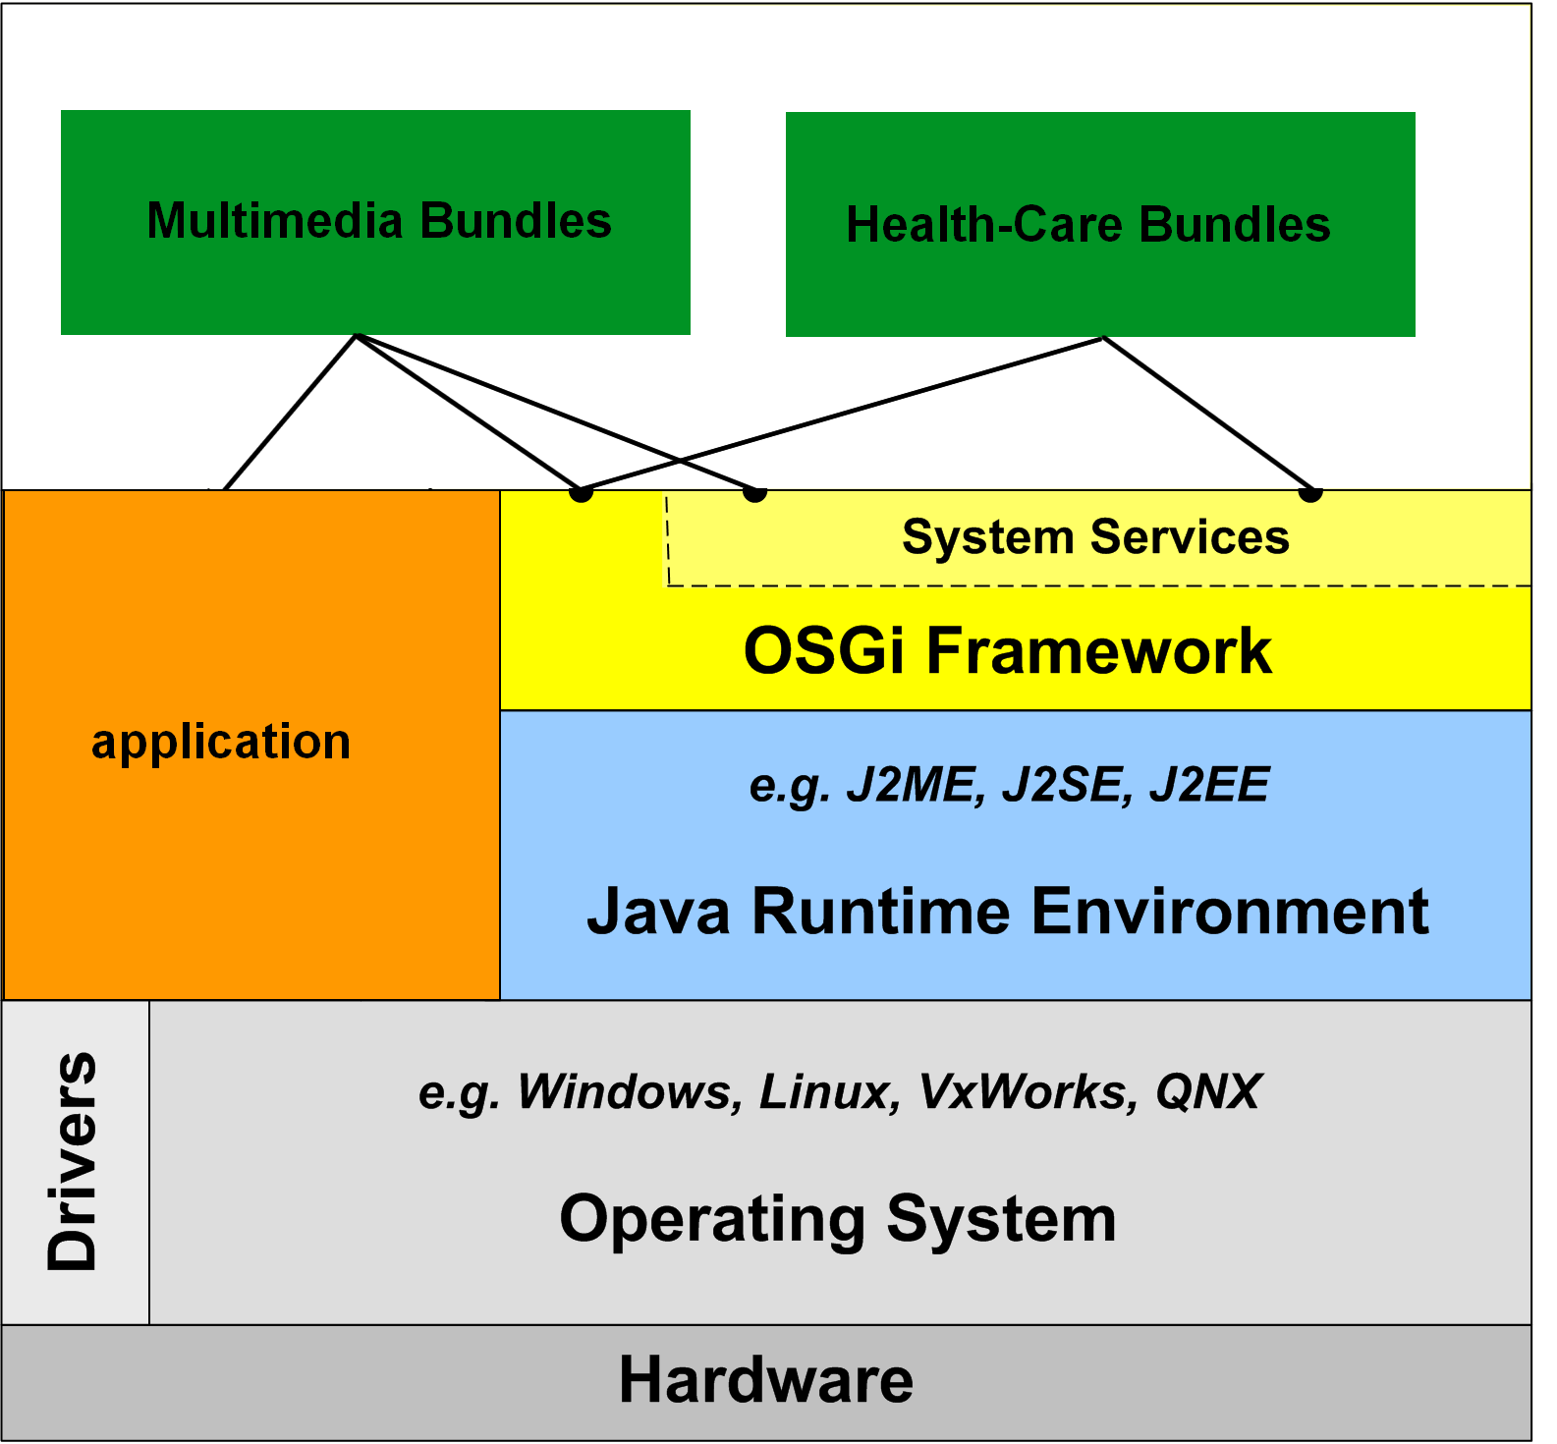
OSGi Framework

Slide 16
OSGi Framework
Hardware:
the physical part of a computer.
Operating System:
a software program that manages the hardware and software resources of a computer.
Java Runtime Environment:
a software bundle from Sun Microsystems that allows a computer system to run a java application.
Application:
a subclass of computer software that employs the capabilities of a computer directly to a task that the user wishes to perform.

Slide 17
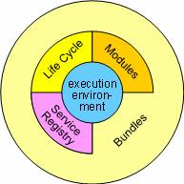
OSGi Framework
The Framework is divided in a number of layers: Execution Environment, Modules, Life Cycle Management and Service Registry. Additionally, there is a security system that is deeply intertwined with all the layers.

Slide 18
OSGi Framework
Execution environment:
the specification of the Java environment. Java 2 Configurations and Profiles.
Modules:
defines the class loading policies. The OSGi Framework is a powerful and strictly specified class loading model. It is based on top of Java but add modularization.
Life Cycle Management:
adds bundles that can be dynamically installed, started, stopped, updated, and uninstalled. Bundles rely on the module layer for class loading but add an API to manage the modules in run time.

Slide 19
OSGi Framework
Service Registry:
The service registry provides a cooperation model for bundles that takes the dynamics into account. The service registry provides a comprehensive model to share objects between bundles. A number of events are defined to handle the coming and going of services.
Security is based on Java and the Java 2 security model.

Slide 20
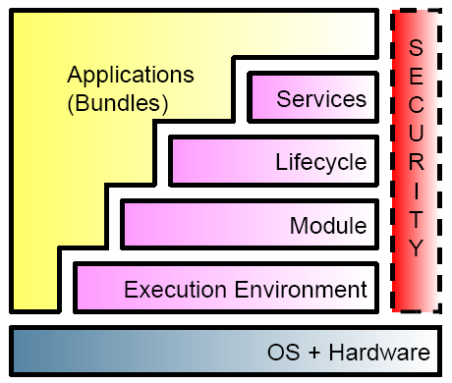
OSGi Framework

Slide 21
Outline
What is OSGi Technology
Introduction
  Alliance
  Specifications
  Key Benefits
  OSGi Terminology
OSGi Framework
Service & Bundle
Use Cases
OSGi Implementation

Slide 22
Service & Bundle
Services
  Provide applications
Bundles (JAR file)
  Provide (export) and reuse (import) services via the framework
  Identify Java packages (classes)
  Implement specified interface (services)
  Register services with the Service Registry

Slide 23
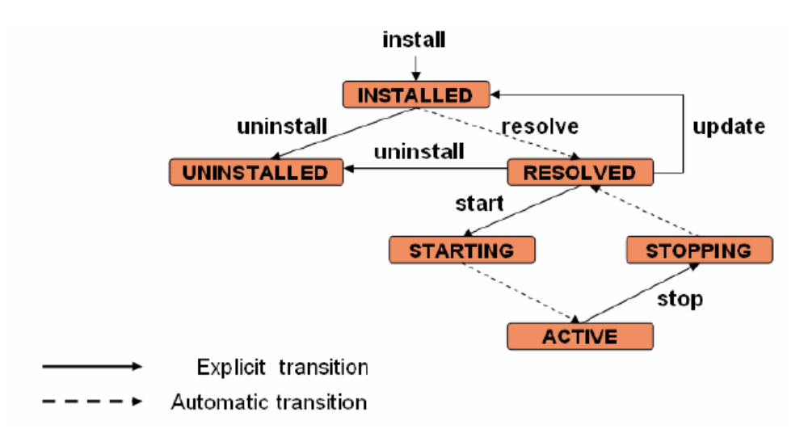
Bundle Life Cycle

Slide 24
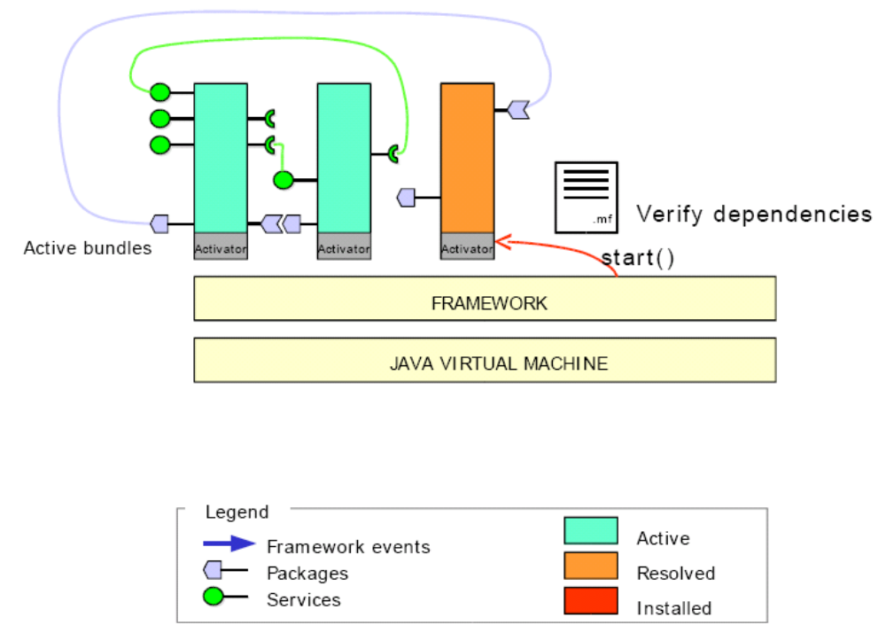

Slide 25
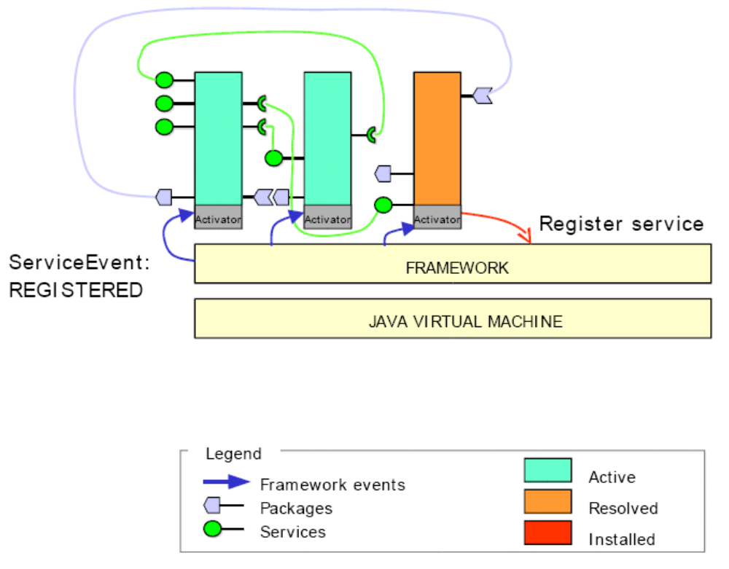

Slide 26
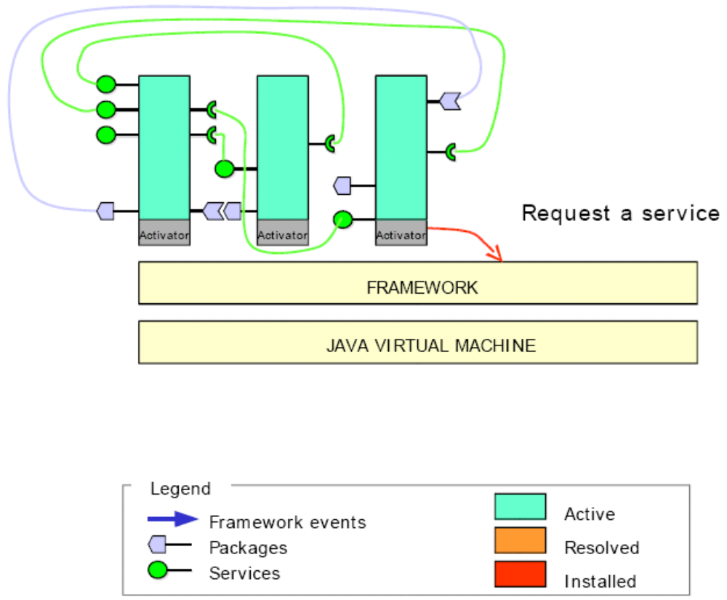

Slide 27
Outline
What is OSGi Technology
Introduction
  Alliance
  Specifications
  Key Benefits
  OSGi Terminology
OSGi Framework
Service & Bundle
Use Cases
OSGi Implementation

Slide 28
Typical Use Cases
Internet Access
Personal Communications
Home Automation
Home Security
Home health care monitoring
Entertainment
Information management
Automobiles

Slide 29
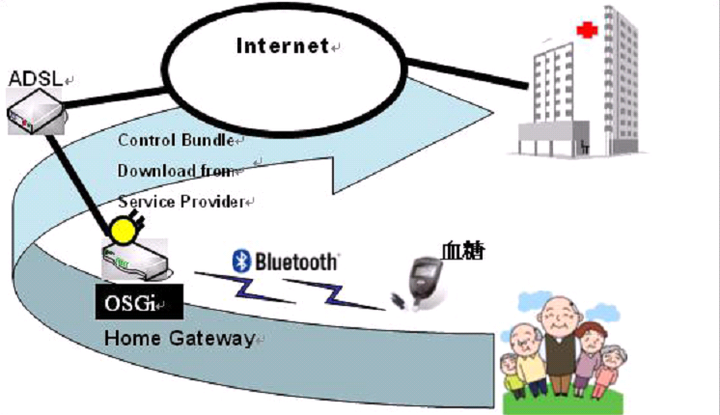
Typical Use Cases

Slide 30

Commercial Use Cases
Nokia implements OSGi on 800
Ricoh
  Multi-functional Products (MFPs)
  laser printers
BMW Research
  3GT, Ertico GST
Volvo Technology (VTEC)
  3GT (Third Generation Telematics)
  GST (Global System for Telematics)
  CVIS (Cooperative Vehicle Infrastructure Systems)
Philips
  iPronto

Slide 31
Outline
What is OSGi Technology
Introduction
  Alliance
  Specifications
  Key Benefits
  OSGi Terminology
OSGi Framework
Service & Bundle
Use Cases
OSGi Implementation

Slide 32
Framework Implementation
IBM Lotus Expeditor
ProSyst Software
Knopflerfish OSGi
  Makewave (formerly Gatespace Telematics)
Equinox OSGi (Eclipse project)
Objectweb Oscar
  Apache Felix

Slide 33
Knopflerfish Installation (1)
Software Environment
  JRE 1.6.0_04
  Window XP
Download jar file
  http://www.knopflerfish.org/download.html
  Knopflerfish support OSGi R4 from 2.0.5
  Download knopflerfish_osgi_<version>.jar

Slide 34
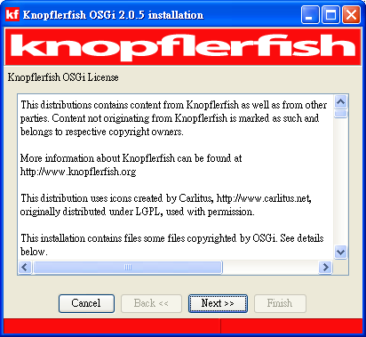
Knopflerfish Installation (2)
Execute knopflerfish_osgi_<version>.jar
  double-clicking on the distribution file
  use the command: java -jar knopflerfish_osgi_<version>.jar

Slide 35
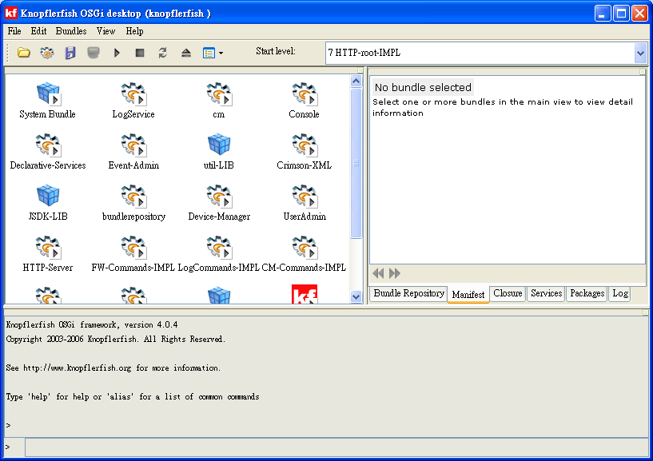

Startup Knopflerfish
Change the directory to the installation directory and start Knopflerfish
  double-clicking on framework.jar
  use the command: java -jar framework.jar
Eclipse plugin http://www.knopflerfish.org/eclipse_install.html

Slide 36

Bundle Activator
Activator Class (implements BundleActivator)
  start()
    This method implements what should the bundle do when it starts. The same as main() method in common Java program.
  stop()
    This method implements what should the bundle do when it is going to stop.

Slide 37
A Simple Bundle Implement
public class Activator implements BundleActivator
{
public void start(BundleContext context)
{
System.out.println(“Hello World.");
}
public void stop(BundleContext context)
{
System.out.println(“Bye World.");
}
}

Slide 38
Service Export
Activator Class (implements BundleActivator)
  start()
    We have to implement a class and a service method for this class, and register this service in the start() method.
    BundleContext.registerService (java.lang.String class, java.lang.Object service, java.util.Dictionary properties)
  stop()
    Some services should be unregistered before the bundle stopped.
    ServiceRegistration.unregister()

Slide 39
Service Export
public void start(BundleContext context)
throws Exception
{
..........
this.logReg = this.context.registerService(
LogService.class.getName(), this.logServ, null);
this.readerReg = this.context.registerService(
LogReaderService.class.getName(), this.readerServ, null);
..........
}

Slide 40
Service Export
Manifest file
Bundle-Name: Log Service
Bundle-Description: OSGi compliant log service.
Bundle-Version: 1.0.0
…………
Import-Package: org.osgi.framework
Export-Package: org.osgi.service.log; specification-version=1.1
Export-Service: org.osgi.service.log.LogService, org.osgi.service.log.LogReaderService

Slide 41
Service Import
public void start(BundleContext context) throws Exception
{
………………..
m_context.addServiceListener(this,
"(&(objectClass=" + DictionaryService.class.getName() + ")" +
"(Language=*))");
// Query for any service references matching any language.
ServiceReference[] refs = m_context.getServiceReferences(
DictionaryService.class.getName(), “(Language=*)”);
………………..
}

Slide 42
Service Import
public void serviceChanged(ServiceEvent event)
{
switch (event.getType())
{
case ServiceEvent.REGISTERED:
registerServlet();
break;
case ServiceEvent.UNREGISTERING:
unregisterServlet();
break;
}
}

Slide 43
Service Import
Manifest file
Bundle-Name: Homebox Logger
..........
Bundle-Activator: ismp.homebox.Activator
Bundle-Description: collect bundle information
Import-Package: org.osgi.framework,
org.osgi.service.http,
javax.servlet,
javax.servlet.http,
org.ungoverned.osgi.service.shell

Slide 44
Export Jar
Eclipse Export
Install Bundle
Uninstall Bundle

Slide 45
UPnP Device Architecture
Notes:
UPnP Device Architecture 1.0
Approved 1.0 by UPnP Forum Technical Committee
13 June 2000

Slide 46
Outline
What is UPnP?
Why UPnP?
Goals of UPnP
UPnP Protocol Stack
Steps to UPnP Networking
Summary

Slide 47

What is UPnP?
Universal Plug and Play
  Peer-to-peer network connectivity of intelligent appliances, wireless devices and PCs of all forms
  Zero-configuration, flexible networking
  Standard-based connectivity to ad-hoc or unmanaged networks
  Distributed
  Reduces footprint
  OS, language and media independent
  Uses IP, TCP, UDP, HTTP and XML

Slide 48
Why UPnP?
We need connectivity to remotely control devices, to move digital data in the form of audio, video and still images between devices, to share information among devices and with the World Wide Web , and to exchange structured and secure digital data to support electronic commerce.
The choice of language and operating system will give vendors the flexibility to choose the best platform for their device and still be confident that their products will be able to interact with other Universal Plug and Play devices, regardless of platform.

Slide 49
More than Plug & Play
A device can automatically join the network
Obtain an IP address
Convey its capabilities
Learn about the presence and capabilities of other devices
Use those capabilities
Can leave the network smoothly

Slide 50
Goals
Describe the protocols for communication between
  Control points
    Controller, usually client
  Device
    Controlled,
    usually server
  An actual device
  might contain
  both functions
Control Point
Device
Service
Control Point
Device
Service
Notes:
Terms control point and device are key. UPnP has an asymmetric networking model. (Not all nodes on the network are the same.) A good litmus test is if a node sends actions, it is a control point; if a node receives actions, it is a device.
Devices include embedded functionality called services, to be explained later.
A node on the network can be both a control point and a device.

Slide 51
Steps to UPnP Networking
3 Control
4 Eventing
5 Presentation
0 Control point and device get addresses
1 Control point finds interesting device
2 Control point learns about device capabilities
3 Control point invokes actions on device
4 Control point listens to state changes of device
5 Control point controls device and/or views device status using HTML UI
2 Description
1 Discovery
0 Addressing
Notes:
Roadmap for the talk.
Will successively describe how networking is built up from bottom to top.
Will eventually describe how control, eventing, and presentation are loosely coupled.

Slide 52
UPnP Protocol Stack
UPnP vendor
UPnP Forum
UPnP Device Architecture
Vendor-specific physical net
HTTPU/MU
SOAP
HTTP
GENA
SSDP
GENA
HTTP
UDP
TCP
IP
Notes:
Overall protocol stack. Following slides pull out subset of this.
All starts with IP.
UDP used for discovery. TCP used for description, control, and eventing.
GENA, SSDP, SOAP described in upcoming slides.
UPnP Device Architecture – the mail focus of this talk – contributed by Microsoft to the UPnP Forum.
UPnP Forum working committees define domain- and device-specific meaning and format of data on top of UPnP Device Architecture.
UPnP vendor specify their own extensions on top of working committee work.
Note color and font style. Used throughout talk to clarify who owns what in the protocol.
Vendors can choose their own programming model on top of UPnP.
Vendors can choose their own OS and hardware to implement UPnP.
Vendors can deliver UPnP on a variety of physical networks. Only requirement is that it support IP. (Otherwise must be bridged.)

Slide 53
Steps to UPnP Networking
3 Control
4 Eventing
5 Presentation
0 Control point and device get addresses
1 Control point finds interesting device
2 Control point learns about device capabilities
3 Control point invokes actions on device
4 Control point listens to state changes of device
5 Control point controls device and/or views device status using HTML UI
2 Description
1 Discovery
0 Addressing

Slide 54
0 Addressing
Control point and device get address
  Use a DHCP server
  Else use Auto IP (Always looking for DHCP server)
What is Auto IP?
  Pick an address in 169.254/16 range
  Check to see if it is used (ARP)
  Periodically check for DHCP server
Use DNS if available
  Easier for a human to use
Notes:
Remember, because we care about ad hoc / peer-peer scenarios, we don't want to assume that components exist just for the sake of the network, but we do want to work well with those components when they are present. Here is a key example of this.
Not much else to say here, so go on to next step.

Slide 55
Steps to UPnP Networking
3 Control
4 Eventing
5 Presentation
0 Control point and device get addresses
1 Control point finds interesting device
2 Control point learns about device capabilities
3 Control point invokes actions on device
4 Control point listens to state changes of device
5 Control point controls device and/or views device status using HTML UI
2 Description
1 Discovery
0 Addressing

Slide 56
1 Discovery
New device can advertise its services to control points
Control point can search for the devices of interest
Control point gets to know about the devices, its services and a pointer to a more detailed information

Slide 57
1 Discovery: Protocol Stack
UPnP vendor
UPnP Forum
UPnP Device Architecture
HTTPMU
(multicast)
HTTPU
(unicast)
GENA
SSDP
SSDP
UDP
IP

Slide 58
1 Discovery: Advertising
New device multicasts a number of discovery messages to a standard multicast address using GENA
Sends a cancellation message if device is going to become unavailable
NOTIFY * HTTP/1.1
HOST: 239.255.255.250:1900
CACHE-CONTROL: max-age = seconds until advertisement expires
LOCATION: URL for UPnP description for root device
NT: search target
NTS: ssdp:alive
USN: advertisement UUID
Notes:
Devices multicast this message when they are added to the network and when they renew their advertisements.
The message uses
The NOTIFY verb defined by GENA (discussed later in this presentation).
The multicast address and port reserved by IANA for SSDP in the HOST header
A duration for the advertisement in the CACHE-CONTROL header
A location for discovery in the LOCATION header (discussed later in this presentation)
A specific type for the advertisement in the NT (notification type) header
A subtype in the NTS (notification sub type) header – ssdp:alive for advertisements, ssdp:byebye to cancel advertisements
A unique ID for this advertisement in the USN (unique serial number) header
(Other headers omitted for clarity. Check UPnP Device Architecture and related standards for complete details.)
Advertisements are atomic and are sent repeatedly to fully advertise the capabilities of a device.
Special token upnp:rootdevice enables apps to display UI that corresponds to physical devices. (More on root devices later in this presentation.)

Slide 59
1 Discovery: Search
Control point multicasts a search message with a target equal to the type or identifier for a device or service
Uses multicast variant of HTTP that has been extended using SSDP methods headers
M-Search is a method defined by SSDP
M-SEARCH * HTTP/1.1
HOST: 239.255.255.250:1900
MAN: "ssdp:discover"
MX: seconds to delay response
ST: search target
Notes:
Control points multicast this message when they are trying to find devices, typically when the apps starts up or is added to the network.
The message uses:
SEARCH method with a HTTP Extension Framework prefix for M-SEARCH
The multicast address and port reserved by IANA for SSDP in the HOST header
Type ssdp:discovery in the MAN (mandatory) header.
Duration for devices to delay their response in the MX header – helps with congestion control
Item searched for (usually a device or service type) in the ST (search target) header
In addition to the NT (notification types) listed in the NOTIFY message, ST may contain the special value ssdp:all that is defined to match all NT values.

Slide 60
1 Discovery: Response
  Responses from devices contain discovery messages identical to those advertised by newly connected devices except that now they are unicast.
HTTP/1.1 200 OK
CACHE-CONTROL: max-age = seconds until advertisement expires
LOCATION: URL for UPnP description for root device
ST: search target
USN: advertisement UUID

Slide 61
Steps to UPnP Networking
3 Control
4 Eventing
5 Presentation
0 Control point and device get addresses
1 Control point finds interesting device
2 Control point learns about device capabilities
3 Control point invokes actions on device
4 Control point listens to state changes of device
5 Control point controls device and/or views device status using HTML UI
2 Description
1 Discovery
0 Addressing

Slide 62
2 Description
Control point issues an HTTP GET request on the URL provided by the device in the discovery message to retrieve a description of the device and its capabilities.
UPnP vendor
UPnP Forum
UPnP Device Architecture
HTTP
TCP
IP

Slide 63

2 Description: Contents
Device description
  Type
  Physical container
  Logical container
    For each service
      Type
      URL for description
      URL for control
      URL for eventing
  UI
    Icons
    URL for presentation
Services
  Functional units within devices
Service description
  Actions
  State variables
  Actual (vs. designed) implementation
Expressed in XML
Notes:
Overview of the content of the device and service descriptions.
Devices are typed containers and have some user interface information as well. The type, container properties, and UI information is contained in the device description, an XML document that follows a specific format. (The format is defined in detail in the UPnP Device Architecture and is reviewed briefly in this presentation.)
Services are functional units – always contained within a container. Services have actions (~ methods) and state variables (~ properties). This information is contained in a service description which lists what is actually implemented (including vendor extensions) rather than just what is called out in the standard.

Slide 64
2 Description: Device (physics)
Includes vendor-specific, manufacturer information like the model name and number, serial number, manufacturer name , URLs to vendor-specific Web-sites, etc.

Slide 65
2 Description: Device (physics)
<?xml version="1.0"?>
<root xmlns="urn:schemas-upnp-org:device-1-0">
<URLBase>base URL for all relative URLs</URLBase>
<device>
<friendlyName>short user-friendly title</friendlyName>
<manufacturer>manufacturer name</manufacturer>
<manufacturerURL>URL to manufacturer site</manufacturerURL>
<modelDescription>long user-friendly title</modelDescription>
<modelName>model name</modelName>
<modelNumber>model number</modelNumber>
<modelURL>URL to model site</modelURL>
<serialNumber>manufacturer's serial number</serialNumber>
<UDN>uuid:UUID</UDN> Unique Device Name
<UPC>Universal Product Code</UPC>
<deviceType>urn:schemas-upnp-org:device:deviceType</deviceType>
<serviceList>
<service>
<serviceType>urn:schemas-upnp-org:service:serviceType:v</serviceType>
<serviceId>urn:upnp-org:serviceId:serviceID</serviceId>
<SCPDURL>URL to service description</SCPDURL>
<controlURL>URL for control</controlURL>
<eventSubURL>URL for eventing</eventSubURL>
</service>
Declarations for other services (if any) go here
</serviceList>
<deviceList>Description of embedded devices (if any) go here</deviceList>
<iconList>
<icon>
<mimetype>image/format</mimetype>
<width>horizontal pixels</width>
<height>vertical pixels</height>
<depth>color depth</depth>
<url>URL to icon</url>
</icon>
XML to declare other icons, if any, go here
</iconList>
<presentationURL>URL for presentation</presentationURL>
</device>
<specVersion>
<major>1</major> <minor>0</minor>
</specVersion>
</root>
Notes:
Don't panic. The device description is XML. Too much to show on one slide. So most of the description here is in a small font, but part is enlarged – under a magnifying glass if you will – here. Later slides will magnify different parts.
This slide shows the XML that describes the device's physical properties. Note that this information is specified by UPnP vendors (purple italics).
Some of this information is optional; some required. UPnP Device Architecture specifies which.

Slide 66
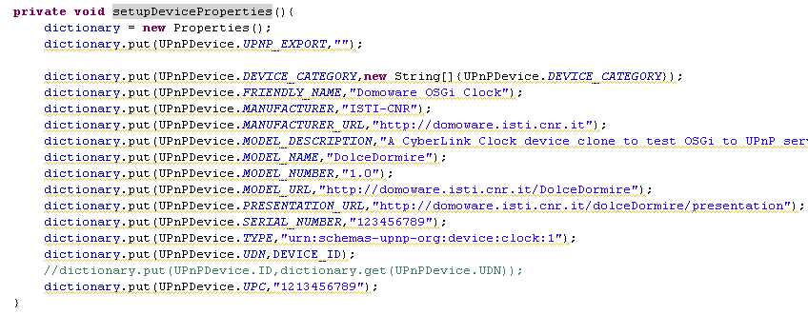


Example : Clock Device (physics)
ClockDevice.java
Implement UPnPDevice
SetupDeviceProperties()

Slide 67
2 Description: Device (logical)
For each each service included in the device, the device description lists the service type , name, a URL for a service description, a URL for control, and a URL for eventing.

Slide 68
2 Description: Device (logical)
<?xml version="1.0"?>
<root xmlns="urn:schemas-upnp-org:device-1-0">
<URLBase>base URL for all relative URLs</URLBase>
<device>
<friendlyName>short user-friendly title</friendlyName>
<manufacturer>manufacturer name</manufacturer>
<manufacturerURL>URL to manufacturer site</manufacturerURL>
<modelDescription>long user-friendly title</modelDescription>
<modelName>model name</modelName>
<modelNumber>model number</modelNumber>
<modelURL>URL to model site</modelURL>
<serialNumber>manufacturer's serial number</serialNumber>
<UDN>uuid:UUID</UDN>
<UPC>Universal Product Code</UPC>
<deviceType>urn:schemas-upnp-org:device:deviceType :v</deviceType>
<serviceList>
<service>
<serviceType>urn:schemas-upnp-org:service:serviceType:v</serviceType>
<serviceId>urn:upnp-org:serviceId:serviceID</serviceId>
<SCPDURL>URL to service description</SCPDURL>
<controlURL>URL for control</controlURL>
<eventSubURL>URL for eventing</eventSubURL>
</service>
Declarations for other services (if any) go here
</serviceList>
<deviceList>Description of embedded devices (if any) go here</deviceList>
<iconList>
<icon>
<mimetype>image/format</mimetype>
<width>horizontal pixels</width>
<height>vertical pixels</height>
<depth>color depth</depth>
<url>URL to icon</url>
</icon>
XML to declare other icons, if any, go here
</iconList>
<presentationURL>URL for presentation</presentationURL>
</device>
<specVersion>
<major>1</major> <minor>0</minor>
</specVersion>
</root>
Notes:
Zooming in on the logical properties of a device as a container.
Device and service types are defined by UPnP Forum working committee. Device and service types are versioned with an integer version. Version n+1 is fully backward compatible with version n.
Device type n+1 must include all the services required by device type n.
Service type n+1 must include all actions / state variables required by service type n.
(Other rules too, but this gives the idea.)
Which types of services are contained in which types of devices is decided by a UPnP Forum working committee.
To distinguish between > 1 instance of the same service type, services have locally-unique names / identifiers (in the serviceId element).
Note the SCPDURL (outdated acronym, used to stand for service control protocol declaration URL) – it points to the service description shown shortly.
Vendors may add more services to add value.
Devices may be nested. Structure is identical to that shown here for a device.

Slide 69
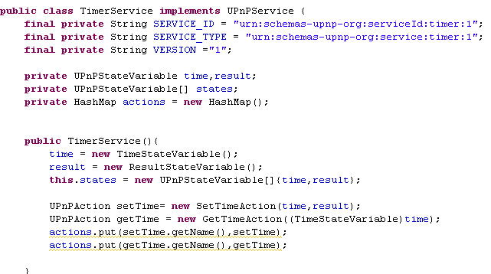

Example : Clock Device (logical)
TimeService.java
implements UPnPService

Slide 70
2 Description: Device (other)
<?xml version="1.0"?>
<root xmlns="urn:schemas-upnp-org:device-1-0">
<URLBase>base URL for all relative URLs</URLBase>
<device>
<friendlyName>short user-friendly title</friendlyName>
<manufacturer>manufacturer name</manufacturer>
<manufacturerURL>URL to manufacturer site</manufacturerURL>
<modelDescription>long user-friendly title</modelDescription>
<modelName>model name</modelName>
<modelNumber>model number</modelNumber>
<modelURL>URL to model site</modelURL>
<serialNumber>manufacturer's serial number</serialNumber>
<UDN>uuid:UUID</UDN>
<UPC>Universal Product Code</UPC>
<deviceType>urn:schemas-upnp-org:device:deviceType</deviceType>
<serviceList>
<service>
<serviceType>urn:schemas-upnp-org:service:serviceType:v</serviceType>
<serviceId>urn:upnp-org:serviceId:serviceID</serviceId>
<SCPDURL>URL to service description</SCPDURL>
<controlURL>URL for control</controlURL>
<eventSubURL>URL for eventing</eventSubURL>
</service>
Declarations for other services (if any) go here
</serviceList>
<deviceList>Description of embedded devices (if any) go here</deviceList>
<iconList>
<icon>
<mimetype>image/format</mimetype>
<width>horizontal pixels</width>
<height>vertical pixels</height>
<depth>color depth</depth>
<url>URL to icon</url>
</icon>
XML to declare other icons, if any, go here
</iconList>
<presentationURL>URL for presentation</presentationURL>
</device>
<specVersion>
<major>1</major> <minor>0</minor>
</specVersion>
</root>
Notes:
Last zoom in for a device type showing misc properties.
Note presentation URL – pointer to presentation described later.
Note major and minor version for the protocol itself.
If x is a major version number, and y and z are minor version numbers, then x.z is fully backward compatible with x.y where z > y.
Changing major version number is reserved for unexpected circumstances.

Slide 71
2 Description: Service (actions)
A list of commands, or actions, the service responds to, and parameters, or arguments, for each action
List of state variables that model the state of the services at run time, and are described in terms of their data type, range, and event characteristics

Slide 72
2 Description: Service (actions)
<?xml version="1.0"?>
<scpd xmlns="urn:schemas-upnp-org:service-1-0">
<actionList>
<action>
<name>actionName</name>
<argumentList>
<argument>
<name>formalParameterName</name>
<direction>in xor out</direction>
<retval />
<relatedStateVariable>stateVariableName</relatedStateVariable>
</argument>
Declarations for other arguments (if any) go here
</argumentList>
</action>
Declarations for other actions (if any) go here
</actionList>
<serviceStateTable>
<stateVariable sendEvents=“yes” xor “no”>
<name>variableName</name>
<dataType>variable datatype</dataType>
<defaultValue>default value</defaultValue>
<allowedValueRange>
<minimum>minimum value</minimum>
<maximum>maximum value</maximum>
<step>increment value</step>
</allowedValueRange>
</stateVariable>
<stateVariable sendEvents=“yes” xor “no”>
<name>variableName</name>
<dataType>variable data type</dataType>
<defaultValue>default value</defaultValue>
<allowedValueList>
<allowedValue>some value</allowedValue>
<allowedValue>some value</allowedValue>
</allowedValueList>
</stateVariable>
Declarations for other state variables (if any) go here
</serviceStateTable>
<specVersion>
<major>1</major> <minor>0</minor>
</specVersion>
</scpd>
Notes:
One of three zoom-ins for service description.
Service description lists what's implemented by service. Here's how actions are listed.
Actions may have zero or more arguments (parameters)
Each argument may be an in or an out argument.
One of the out arguments may be marked as a return value for programming languages that distinguish such a value.
Each argument is tied to a state variable (described later). Provides strong typing and reinforced the state variable model of the device.
Note that all of this information is defined by a UPnP Forum working committee for a standard service. If a vendor wanted to create a non-standard service, then the vendor would provide this information.

Slide 73
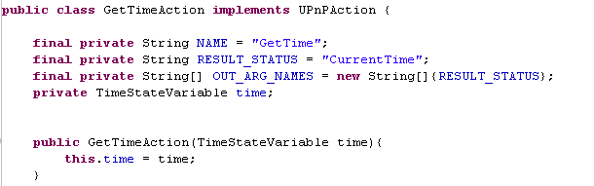
Example : Clock Device (actions)
GetTimeAction.java
implements UPnPAction

Slide 74
2 Description: Service (variable)
<?xml version="1.0"?>
<scpd xmlns="urn:schemas-upnp-org:service-1-0">
<actionList>
<action>
<name>actionName</name>
<argumentList>
<argument>
<name>formalParameterName</name>
<direction>in xor out</direction>
<retval />
<relatedStateVariable>stateVariableName</relatedStateVariable>
</argument>
Declarations for other arguments (if any) go here
</argumentList>
</action>
Declarations for other actions (if any) go here
</actionList>
<serviceStateTable>
<stateVariable sendEvents=“yes” xor “no”>
<name>variableName</name>
<dataType>variable datatype</dataType>
<defaultValue>default value</defaultValue>
<allowedValueRange>
<minimum>minimum value</minimum>
<maximum>maximum value</maximum>
<step>increment value</step>
</allowedValueRange>
</stateVariable>
<stateVariable sendEvents=“yes” xor “no”>
<name>variableName</name>
<dataType>variable data type</dataType>
<defaultValue>default value</defaultValue>
<allowedValueList>
<allowedValue>some value</allowedValue>
<allowedValue>some value</allowedValue>
</allowedValueList>
</stateVariable>
Declarations for other state variables (if any) go here
</serviceStateTable>
<specVersion>
<major>1</major> <minor>0</minor>
</specVersion>
</scpd>
Notes:
Last zoom in. This one for a string state variable.
Note that the list of allowable values is enumerated. Some programming languages will match this to an ENUM type.

Slide 75
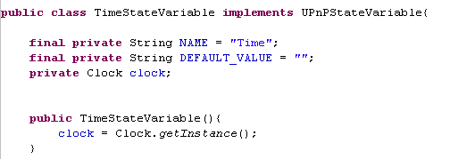
Example : Clock Device (actions)
TimeStateVariable.java
implements UPnPStateVariable

Slide 76
Steps to UPnP Networking
3 Control
4 Eventing
5 Presentation
0 Control point and device get addresses
1 Control point finds interesting device
2 Control point learns about device capabilities
3* Control point invokes actions on device
4 Control point listens to state changes of device
5 Control point controls device and/or views device status using HTML UI
2 Description
1 Discovery
0 Addressing

Slide 77

3 Control
Control point invokes actions on device
  0 get address
  1 discover device
  2 retrieve description
    get URL for control
  3 send actions to device
UPnP vendor
Protocol stack
UPnP Forum
UPnP Device Architecture
SOAP
HTTP
TCP
IP
Notes:
Control requires an address, discovery, and description.
The control URL in the device description is where control messages are sent. One URL per service.
Stack includes SOAP described next.

Slide 78
3 Control: What happens?
Invoking actions is a kind of remote procedure call
A control point sends the action to the device’s service
When the action has completed(or failed), the service returns any results or errors
Polling for the value of state variable is a special case

Slide 79
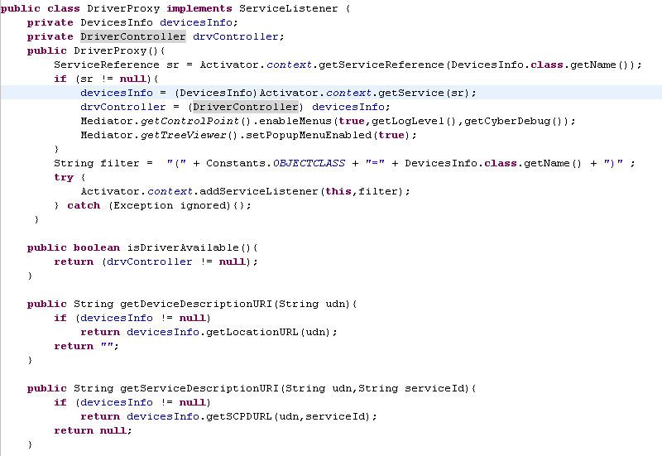
Example : (Control Point)
DriverProxy.java
Implements ServiceListener

Slide 80
3 Control: SOAP Sidebar
What is SOAP?
  Simple Object Access Protocol defines the use of XML and HTTP for remote procedure calls
  SOAP defines additional HTTP headers, and to ensure that these are not confused with other HTTP extensions
  SOAP specifies a unique URI in the MAN header and prefixes the HTTP method with M-
Notes:
Really just an XML convention for where the action name will go, where the arguments will go, and where contextual information (not yet used by UPnP) will go.
Items specified by SOAP in blue underline in the following slides.

Slide 81
3 Control: Invoke Action
M-POST path of control URL HTTP/1.1
HOST: host of control URL:port of control URL
CONTENT-TYPE: text/xml; charset="utf-8"
MAN:
“http://schemas.xmlsoap.org/soap/envelope/”;
ns=01
01-SOAPACTION:
"urn:schemas-upnp-org:service:serviceType:v#actionName“
<s:Envelope xmlns:s="http://schemas.xmlsoap.org/soap/envelope/"
s:encodingStyle="http://schemas.xmlsoap.org/soap/encoding/">
<s:Body>
</s:Body>
</s:Envelope>
<u:actionName xmlns:u="urn:schemas-upnp-org:service:serviceType:v">
<argumentName>in arg value</argumentName>
other in args and their values (if any) go here
</u:actionName>
Notes:
Control point sends this message to a service within a device to invoke an action.
This message uses:
POST. M-POST also used to handle firewall issues, but not shown here for brevity.
Sent to the control URL in the device description for the particular service.
With the type of service concatenated to the action name in the SOAPACTION header
With an XML body that contains
The SOAP envelope
(No SOAP headers, maybe in the future)
The SOAP body with an element for the action name, and within that element, an element for each in argument.
This format is the same as for other Web systems using SOAP, and leverages tools and scenarios being built for those systems.

Slide 82
3 Control: Action Result
Service must respond within 30 seconds
Actions that take longer than this should return early and send an event when it completes
Out arguments must not be used to convey error information
HTTP/1.1 200 OK
CONTENT-TYPE: text/xml; charset="utf-8"
<s:Envelope xmlns:s="http://schemas.xmlsoap.org/soap/envelope/"
s:encodingStyle="http://schemas.xmlsoap.org/soap/encoding/">
<s:Body>
</s:Body>
</s:Envelope>
<u:actionNameResponse
xmlns:u="urn:schemas-upnp-org:service:serviceType:v">
<argumentName>out arg value</argumentName>
other out args and their values (if any) go here
</u:actionNameResponse>
Notes:
Device responds with this type of message.
This message uses:
SOAP envelope (as before)
(No SOAP header)
SOAP body (as before) with an element named for the action and the word Response
That contains an element for each out argument.
Errors not shown here but specified in detail in the UPnP Device Architecture.

Slide 83
3 Control: Query for variable
Control point may also poll the service for the value of a state variable by sending a query message
Query request is sent to control URL
Uses SOAP
A query message may query only one state variable
Query will yield more up-to-date value than those received via eventing

Slide 84
Steps to UPnP Networking
3 Control
4 Eventing
5 Presentation
0 Control point and device get addresses
1 Control point finds interesting device
2 Control point learns about device capabilities
3 Control point invokes actions on device
4 Control point listens to state changes of device
5 Control point controls device and/or views device status using HTML UI
2 Description
1 Discovery
0 Addressing

Slide 85
4 Eventing
Control point listens to state changes of device a
  0 get address
  1 discover device
  2 retrieve descr
    get URL for eventing
  4 subscribe to events from device
Control point can renew subscription
Control point can cancel subscription
Protocol stack
UPnP vendor
UPnP Forum
UPnP Device Architecture
HTTP
GENA
TCP
IP
Notes:
Eventing requires getting an address, discovery, and description. (It does not require control.)
Just like the URL for control, the URL for eventing is in the device description. One URL per service.
To get events, control points subscribe to eventing for a specific service within a device.
Then when the service has an event, it sends that event to all current subscribers.
Eventing is a very simple push model.
Eventing uses an extension to HTTP called GENA (described next)

Slide 86

4 Eventing: GENA Sidebar
What is GENA?
  General Event Notification Architecture
  Send and receive notifications using HTTP over TCP/IP and administratively-scoped multicast UDP.
    SUBSCRIBE to notifications
    UNSUBSCRIBE
    NOTIFY
      Of device availability
      Of state variable changes
Notes:
UPnP uses GENA to define subscriptions and event notifications.
UPnP also uses GENA to define discovery advertisements (recall from the beginning of this presentation.)
GENA defined over both HTTP/TCP and HTTP/UDP.

Slide 87
4 Eventing: Subscribing
SUBSCRIBE publisher path HTTP/1.1
HOST: publisher host:publisher port
CALLBACK: <delivery URL>
NT: upnp:event
TIMEOUT: Second-requested subscription duration
Control point subscribes to receive messages of a services
Sends a URL to receive event messages
Subscribe, callback and NT are GENA headers
Publisher sends a response to this message
Notes:
Control point sends this message to subscribe to events coming from a specific service.
This message uses:
SUBSCRIBE method defined by GENA
Sent to the eventSubURL for the service in the device description
A delivery address (a URL) in the CALLBACK header
A notification type in the NT (notification type) header. Always upnp:event. Could be something different in the future.
Requested duration for the subscription in the TIMEOUT header.
To renew an existing subscription, a control point sends a similar (but different) message to this one.

Slide 88
4 Eventing: Subscription
It gives the subscription id and the duration for which this subscription is valid
  Device immediately sends a special, initial event to control point with the value of all evented variables
HTTP/1.1 200 OK
SID: uuid:subscription-UUID
TIMEOUT: Second-actual subscription duration
Notes:
To accept a subscription, device returns this message.
This message uses:
A unique identifier for the subscription in the SID (subscription ID) header. This value is used to renew or cancel a subscription. It is also sent along with each event to disambiguate which subscriber it is for.
An actual duration for the subscription in the TIMEOUT header. May be different than the requested duration in the subscription (or re-subscription) request.
Acceptance of the subscription is immediately followed by a special event. Includes the value of all evented variables to 'boot' the subscriber's model of the service.

Slide 89
4 Eventing: Publisher
Publisher maintains a table
  Unique subscription identifier
  Delivery URL for event messages
  Event key. 0 for initial message
    Useful for error detection by subscriber
  Subscription duration
Publisher may persist subscription across power failures
Some state variables have large values and hence they are non-evented

Slide 90
4 Eventing: Notify
The values of changed state variables to all the subscribers. The initial message contains all the state variables.
NOTIFY delivery path HTTP/1.1
HOST: delivery host:delivery port
CONTENT-TYPE: text/xml
NT: upnp:event
NTS: upnp:propchange
SID: uuid:subscription-UUID
SEQ: event key
<e:propertyset xmlns:e="urn:schemas-upnp-org:event-1-0">
<e:property>
<variableName>new value</variableName>
</e:property>
Other variable names and values (if any) go here
</e:propertyset>
Notes:
Device sends a message of this type each time one of its state variables changes.
This message uses:
NOTIFY method defined by GENA
Sent to the delivery URL (from the CALLBACK header of the subscription)
With upnp:event in the NT (notification type) header
With upnp:propchange in the NTS (notification sub type) header
With the subscription ID in the SID (subscription ID) header
With an event number in the SEQ (sequence) header
An XML body with an element named for each variable that changes and containing the new value.
The event number is unique per subscriber, starts at 0 with the special, just-subscribed event, and is incremented for each subsequent event.
Some state variables are not evented – they have "no" as the value for sendEvents attribute in the service description. The value for these state variables are never sent in an event – neither the initial, just-subscribed event nor others. A control point would have to call QueryStateVariable or some other action to retrieve the value of these state variables.

Slide 91
4 Eventing: Facts
If the subscription is not renewed, the publisher ceases to sent event messages
For renewal and unsubscription, subscriber just has to send SID
The frequency of notification determines the traffic on the network
The volatility of value of state variable determines the frequency of notifications
If a subscriber misses a notification(missing key), it has to unsubscribe and then re-subscribe
A message is sent even if that control point didn’t cause change in state variables

Slide 92
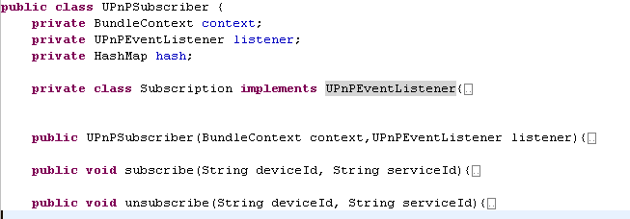
Example : (Control Point)
UPnPSubscriber.java
Implement UPnPEventListener

Slide 93
Steps to UPnP Networking
3 Control
4 Eventing
5 Presentation
0 Control point and device get addresses
1 Control point finds interesting device
2 Control point learns about device capabilities
3 Control point invokes actions on device
4 Control point listens to state changes of device
5 Control point controls device and/or views device status using HTML UI
2 Description
1 Discovery
0 Addressing

Slide 94


5 Presentation
Control point controls device and/or views device status using HTML UI
  0 get address
  1 discover device
  2 retrieve descr
    get URL for presentation
  5 load presentation page
User can interact with the device
Protocol stack
UPnP vendor
UPnP Device Architecture
HTTP
TCP
IP
Notes:
Presentation requires getting an address, discovery, and description. (Does not require control or eventing).
URL for presentation page in the device description. One presentation URL per device.
Standard HTTP stack.
Notice that there isn't a layer for the UPnP Forum working committee. UPnP doesn't constrain this layer.

Slide 95
Summary
UPnP says
  Just send data, not code (reduces testing)
  Keep implementation private (API)
  Agree on content / format of data
UPnP is
  Web-based protocols
  Tailored by a Forum for device (service) types
  That are API, OS, physical network neutral
  For discovery, description, control, eventing
  And simple HTML UI too
For more information
  Resources: http://www.upnp.org

Slide 96
UPnP Bundle & Device Setup
Demo Domoware UPnP Device

Slide 97
Homework
Modify the Domoware UPnP Devices for adding new functionalities which can be controlled by UPnP Control Point.
Each Group chooses different devices to modify.

