Slide 1
JUnit Testing Framework

Slide 2
Agenda
Introduction to unit testing
Test Driven Development
The framework of JUnit
Coding conventions
Programming with JUnit
A Case Study
Exercises

Slide 3


The Testing Problems
Should write
Do
programmers
few
Why?
I am so busy
It is difficult

Slide 4
Unit Testing
Software development process
Test individual units
Detect the introduction of bugs
Consider possible edge cases
Test independently

Slide 5
Test Driven Development (TDD)
A software development technique
Write tests before writing the code
Gives rapid feedback

Slide 6
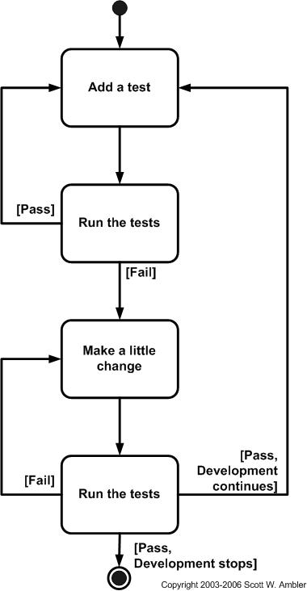
Flow of TDD

Slide 7
Merits of TDD
Quick results
Flexibility
Automatic catalog of regression tests
Good, clean code that works
Such a tool for Java is called JUnit

Slide 8
JUnit
Open-source testing framework
Cycle of coding and testing during the development cycle
Easy to use to create tests
Create tests that retain their value over time
Leverage existing tests to write new ones

Slide 9
Why use JUnit
Allow to write code faster with increasing quality
Elegantly simple
Immediate feedback
Tests composed into hierarchy of test suites
Writing JUnit tests is inexpensive
Increase the stability of software
JUnit tests are developer tests.

Slide 10
JUnit
1
TestSuite
*
1
*
TestCase

Slide 11
Assert
assertEquals(expected, actual)
assertEquals(message, expected, actual)
assertEquals(expected, actual, delta)
assertEquals(message, expected, actual, delta)
assertFalse(condition)
assertFalse(message, condition)
Assert(Not)Null(object)
Assert(Not)Null(message, object)
Assert(Not)Same(expected, actual)
Assert(Not)Same(message, expected, actual)
assertTrue(condition)
assertTrue(message, condition)

Slide 12
Structure
setUp()
to initialize object(s) under test
Storing the fixture's objects in instance variables of your TestCase subclass and initialize them by overriding the setUp method
tearDown()
Releasing the fixture’s/object(s) under test.
run()
Defining how to run an individual test case.
Defining how to run a test suite.

Slide 13
testXXX()
exercise the object(s) under test and assert expected results.

Slide 14
Test Case and Test Suite
A simple java class
public class Calculator{
public int sum(int num1,int num2){
return num1+num2;
}
}

Slide 15
Coding Conventions
Name of the test class must end with “Test”
Name of the method must begin with “test”
Return type of a test method must be void
Test method must not throw any exception
Test method must not have any parameter.

Slide 16
Test Class
import junit.framework.TestCase;
public class CalculatorTest extends TestCase {
protected void setUp() {
Calculator cal=new Calculator();
}
protected void tearDown() {
// release objects under test here, as necessary
}
public void testSum() {
assertEquals(2,cal.sum(1,1));
}
} }

Slide 17
Test Suite
import junit.framework.Test;
import junit.framework.TestSuite;
public class EcommerceTestSuite {
public static Test suite() {
TestSuite suite = new TestSuite();
suite.addTestSuite(CalulatorTest.class);
suite.addTest(CreditCardTestSuite.suite());
return suite;
}
public static void main(String[] args) {
junit.textui.TestRunner.run(suite());
}
}

Slide 18
Excercise…………

