Slide 1
SPRING
Basics of Spring
Inversion of Control(IOC)
Dependency Injection
Aspect Oriented Programming(AOP)

Slide 2
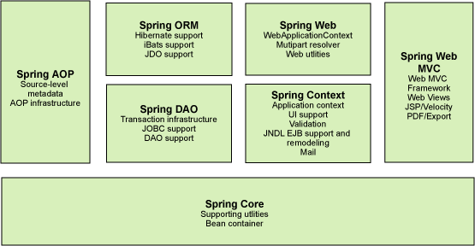
Basics of Spring
Developed by Rod Johnson and was first released under the Apache 2.0 license in June 2003.
Light Weight Framework. The Spring Modules are

Slide 3
Inversion Of Control (IOC)
To Instantiate the application class
To Configure the objects
To Assemble the dependencies between objects
Two Types of IOC
BeanFactory
ApplicationContext

Slide 4
Inversion Of Control (IOC)
BeanFactory
Resource resource=new ClassPathResource("applicationContext.xml");
BeanFactory factory=new XmlBeanFactory(resource);
ApplicationContext
ApplicationContext context =
new ClassPathXmlApplicationContext("applicationContext.xml");
Adds Additional functionality like
Spring AOP
Message Resource Handling
Event Propagation

Slide 5
Dependency Injection
Design Pattern that removes dependency from the code
Loosely coupled
Two Types of DI
Constructor
Setter Method

Slide 6
Constructor Dependency Injection
Employee.java
public class Employee {
private int id;
private String name;
public Employee() {System.out.println("def cons");}
public Employee(int id) {this.id = id;}
public Employee(String name) { this.name = name;}
public Employee(int id, String name) {
this.id = id;
this.name = name;
}
void show(){
System.out.println(id+" "+name);
}
}

Slide 7
Constructor Dependency Injection
ApplicationContext.xml
<?xml version="1.0" encoding="UTF-8"?>
<beans
xmlns="http://www.springframework.org/schema/beans"
xmlns:xsi="http://www.w3.org/2001/XMLSchema-instance"
xmlns:p="http://www.springframework.org/schema/p"
xsi:schemaLocation="http://www.springframework.org/schema/beans
http://www.springframework.org/schema/beans/spring-beans-3.0.xsd">
<bean id="e" class="com.javatpoint.Employee">
<constructor-arg value="10" type="int"></constructor-arg>
</bean>
</beans>

Slide 8
Constructor Dependency Injection
Test.java
package com.javatpoint;
import org.springframework.beans.factory.BeanFactory;
import org.springframework.beans.factory.xml.XmlBeanFactory;
import org.springframework.core.io.*;
public class Test {
public static void main(String[] args) {
Resource r=new ClassPathResource("applicationContext.xml");
BeanFactory factory=new XmlBeanFactory(r);
Employee s=(Employee)factory.getBean("e");
s.show();
}
}
Output : 10 null

Slide 9
Setter Dependency Injection
Employee.java
public class Employee {
private int id;
private String name;
private String city;
public int getId() { return id;}
public void setId(int id) {
this.id = id;
}
public String getName() { return name;}
public void setName(String name) {
this.name = name;
}
public String getCity() { return city;}
public void setCity(String city) {
this.city = city;
}
void display(){
System.out.println(id+" "+name+" "+city);
}
}

Slide 10
Setter Dependency Injection
ApplicationContext.xml
<?xml version="1.0" encoding="UTF-8"?>
<beans
xmlns="http://www.springframework.org/schema/beans"
xmlns:xsi="http://www.w3.org/2001/XMLSchema-instance"
xmlns:p="http://www.springframework.org/schema/p"
xsi:schemaLocation="http://www.springframework.org/schema/beans
http://www.springframework.org/schema/beans/spring-beans-3.0.xsd">
<bean id="obj" class="com.javatpoint.Employee">
<property name="id">
<value>20</value>
</property>
<property name="name">
<value>SCOPE</value>
</property>
<property name="city">
<value>CHENNAI</value>
</property>
</bean>
</beans>

Slide 11
Setter Dependency Injection
Test.java
import org.springframework.beans.factory.BeanFactory;
import org.springframework.beans.factory.xml.XmlBeanFactory;
import org.springframework.core.io.*;
public class Test {
public static void main(String[] args) {
Resource r=new ClassPathResource("applicationContext.xml");
BeanFactory factory=new XmlBeanFactory(r);
Employee e=(Employee)factory.getBean("obj");
s.display();
}
}
Output: 20 SCOPE CHENNAI

Slide 12
Aspect Oriented Programming
Implement Custom Aspects
Centralized Location in one code
Transaction Management
Logging
Authentication
Security

Slide 13
AOP - Concepts and Terminology
Aspect - Modularization of a concern that cuts across multiple classes. Example: Transaction management
Point cut: Predicate that matches join points.
Joint Point - A point during the execution of a program, such as the execution of a method or the handling of an exception. In Spring AOP, a join point always represents a method execution.
Advice - Action taken by an aspect at a particular join point.

Slide 14
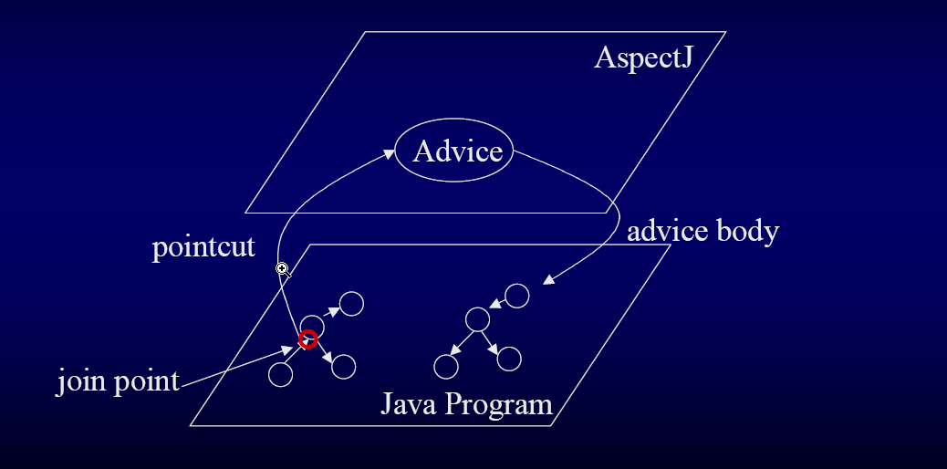
High Level View of Aspect

Slide 15
AOP - Concepts and Terminology
Types of advice:
Before advice: Advice that executes before a join point, but which does not have the ability to prevent execution flow proceeding to the join point (unless it throws an exception).
After returning advice: Advice to be executed after a join point completes normally: for example, if a method returns without throwing an exception.
After throwing advice: Advice to be executed if a method exits by throwing an exception.
After (finally) advice: Advice to be executed regardless of the means by which a join point exits (normal or exceptional return).
Around advice: Advice that surrounds a join point such as a method invocation. This is the most powerful kind of advice. Around advice can perform custom behavior before and after the method invocation. It is also responsible for choosing whether to proceed to the join point or to shortcut the advised method execution by returning its own return value or throwing an exception

Slide 16
AOP - Concepts and Terminology
With Annotation
Spring-Customer.xml:
<beans xmlns="http://www.springframework.org/schema/beans"
xmlns:xsi="http://www.w3.org/2001/XMLSchema-instance"
xmlns:aop="http://www.springframework.org/schema/aop"
xsi:schemaLocation="http://www.springframework.org/schema/beans
http://www.springframework.org/schema/beans/spring-beans-3.0.xsd
http://www.springframework.org/schema/aop
http://www.springframework.org/schema/aop/spring-aop-3.0.xsd ">
<aop:aspectj-autoproxy />
<bean id="customerBo" class="com.mkyong.customer.bo.impl.CustomerBoImpl" />
<!-- Aspect -->
<bean id="logAspect" class="com.mkyong.aspect.LoggingAspect" />
</beans>

Slide 17
Aspect Oriented Programming
Without Annotation
<!-- Aspect -->
<bean id="logAspect" class="com.mkyong.aspect.LoggingAspect" />
<aop:config>
<aop:aspect id="aspectLoggging" ref="logAspect" >
<!-- @Before --> <aop:pointcut id="pointCutBefore" expression="execution(* com.mkyong.customer.bo.CustomerBo.addCustomer(..))" />
<aop:before method="logBefore" pointcut-ref="pointCutBefore" />
</aop:aspect> </aop:config>

Slide 18
Aspect Oriented Programming
LoggingAspect.java
import java.util.Arrays;
import org.aspectj.lang.JoinPoint;
import org.aspectj.lang.ProceedingJoinPoint;
import org.aspectj.lang.annotation.After;
import org.aspectj.lang.annotation.AfterReturning;
import org.aspectj.lang.annotation.AfterThrowing;
import org.aspectj.lang.annotation.Around;
import org.aspectj.lang.annotation.Aspect;
import org.aspectj.lang.annotation.Before;
@Aspect
public class LoggingAspect {

Slide 19
Aspect Oriented Programming
@Around("execution(* com.mkyong.customer.bo.CustomerBo.addCustomerAround(..))")
public void logAround(ProceedingJoinPoint joinPoint) throws Throwable {
System.out.println("logAround() is running!");
System.out.println("hijacked method : " + joinPoint.getSignature().getName());
System.out.println("hijacked arguments : " + Arrays.toString(joinPoint.getArgs()));
System.out.println("Around before is running!");
joinPoint.proceed();
System.out.println("Around after is running!");
System.out.println("******");
}
*** - @Before/ @After/ @AfterReturning/ @AfterThrowing

Slide 20
Aspect Oriented Programming
public interface CustomerBo {
void addCustomer();
String addCustomerReturnValue();
void addCustomerThrowException() throws Exception;
void addCustomerAround(String name);
}

Slide 21
Aspect Oriented Programming
public class CustomerBoImpl implements CustomerBo {
public void addCustomer(){
System.out.println("addCustomer() is running ");
}
public String addCustomerReturnValue(){
System.out.println("addCustomerReturnValue() is running ");
return "abc";
}
public void addCustomerThrowException() throws Exception {
System.out.println("addCustomerThrowException() is running ");
throw new Exception("Generic Error");
}
public void addCustomerAround(String name){
System.out.println("addCustomerAround() is running, args : " + name);
}
}

Slide 22
Aspect Oriented Programming
import org.springframework.context.ApplicationContext;
import org.springframework.context.support.ClassPathXmlApplicationContext;
import com.mkyong.customer.bo.CustomerBo;
public class App {
public static void main(String[] args) throws Exception {
ApplicationContext appContext = new ClassPathXmlApplicationContext("Spring-Customer.xml");
CustomerBo customer = (CustomerBo) appContext.getBean("customerBo");
//customer.addCustomer();
//customer.addCustomerReturnValue();
//customer.addCustomerThrowException();
customer.addCustomerAround("mkyong");
}
}

Slide 23
The End

