Slide 1


XML

Slide 2
Agenda
What is XML
Difference between XML and HTML
XML Basics
Examples

Slide 3

What is XML
XML stands for EXtensible Markup Language
XML is a markup language much like HTML
XML was designed to describe data
XML tags are not predefined. You must define your own tags
XML uses a Document Type Definition (DTD) or an XML Schema to describe the data
XML with a DTD or XML Schema
is designed to be self-descriptive

Slide 4
Main Difference between XML and HTML
XML and HTML were designed for different goals.
XML is not a replacement for HTML.
XML and HTML were designed with different goals:
XML was designed to describe data and to focus on what data is.
HTML was designed to display data and to focus on how data looks.
HTML is about displaying information, while XML is about describing information

Slide 5
XML is not a replacement for HTML
Web development it is most likely that XML will be used to describe the data, while HTML will be used to format and display the same data.
# XML is a complement to HTML

Slide 6
XML does not DO anything
XML was not designed to DO anything
  XML is created to structure, store, and to send information.
  Someone must write a piece of software to send, receive, or display it.

Slide 7
A Simple Example
<note>
  <to>Team</to>
  <from>Manager</from>
  <heading>Reminder</heading>
  <body>Please fill your pulse.</body>
</note>
Some more samples book-order.xml.

Slide 8
XML is free and extensible
XML tags are not predefined. You must "invent" your own tags.
like <to> and <from> in the example.
HTML tags are predefined.
like <p>, <h1>, etc.

Slide 9
How can XML be Used?
XML can Separate Data from HTML.
With XML, your data is stored outside your HTML.
XML is used to Exchange Data
With XML, data can be exchanged between incompatible systems.
XML can be used to Store Data.
XML can make your Data more Useful.
With XML, your data is available to more users.
XML can be used to Create new Languages
XML is the mother of WAP and WML

Slide 10



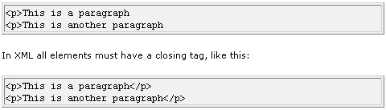
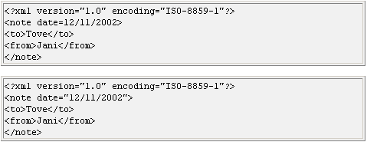
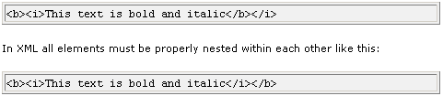
XML Syntax
XML documents use a self-describing and simple syntax.
All XML elements must have a closing tag.
XML tags are case sensitive.
All XML elements must be properly nested.
All XML documents must have a root tag
Attribute values must always be quoted.
<note date="12/11/99">
With XML, White Space is Preserved.
Comments in XML.

Slide 11
Rule #1: One and only one root element
<html>
<head>
<title>Hello, World</title>
</head>
<body>
<p>Hello, World</p>
</body>
</html>

Slide 12
Rule #2: XML is case sensitive
These element names are not equivalent:
  book
  Book
  BOOK
  BoOk

Slide 13
Rule #3: Elements are always closed
<html>
<body>
<p>Hello, World<br />
How are you today?</p>
</body>
</html>

Slide 14
Rule #4: Elements must be nested
Correct
<p>This is a test. This is a test of the <strong><em>Emergency</em> Broadcast System.</strong></p>
Incorrect
<p>This is a test. This is a test of the <em><strong>Emergency</em> Broadcast System.</strong></p>

Slide 15
Rule #5: Attributes must be quoted
Correct
<length unit='feet'>5</length>
Incorrect
<length unit=feet>5</length>

Slide 16
Rule #6: There are only five default entities
To display this… | …write this.
& | &amp;
< | &lt;
> | &gt;
' | &apos;
" | &quot;

Slide 17
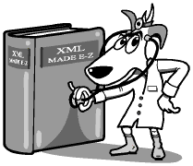
Exercise #1
How many errors are in the XML file and what are they?

Slide 18
Seven things wrong
<soup>
<name>Oyster Soup</name>
<author>Eric Lease Morgan</author>
<copyright holder=Eric Lease Morgan>&copy; 2003</copyright>
<ingredients>
<list>
<item>1 stalk of celery</item>
<item>1 onion</item>
<item>2 tablespoons of butter</item>
<item>2 cups of oysters and their liquor</item>
<item>2 cups of half & half</item>
</list>
</ingredients>
<process>
<P>Begin by sauteing the celery and onions in butter
until soft. Add oysters, oyster liquor, and cream.
Heat until the oysters float. Serve in warm bowls.</p>
<p><i>Yummy!</p></i>
</process>
</soup>
No root element
Attribute not quoted
Elements not closed
Illegal entities
Case in-sensitive element
Elements improperly nested

Slide 19
Example
<?xml version="1.0"?>
<!-- This is a note from Manager to Team -->
<note>
  <to>Team</to>
  <from>Manager</from>
  <heading>Reminder</heading>
  <body>Please fill your pulse.</body>
</note>

Slide 20
XML Elements
Element Naming rule:
- Names can contain letters, numbers, and other characters
- Names must not start with a number or punctuation character
- Names must not start with the letters xml (or XML or Xml ..)
- Names cannot contain spaces
<first_name>, <last_name>.
Elements have Content
- element content
- mixed content
- simple content or empty content
- an element can also have attributes
XML Elements have Relationships
Elements are related as parents and children.

Slide 21
XML Elements (Example)
<book>
<title>My First XML</title>
<prod id="33-657" media="paper"></prod>
<chapter>Introduction to XML
<para>What is HTML</para>
<para>What is XML</para>
</chapter>
<chapter>XML Syntax
<para>Elements must have a closing tag</para> <para>Elements must be properly nested</para> </chapter>
</book>

Slide 22
XML Attributes
Attributes provide additional information about elements.
<file type="gif">computer.gif</file>
Attribute values must always be quoted.
<person sex="female">,
or <person sex='female'>

Slide 23
Element Attributes
Attribute name
<bibliography>
<paper ID="object-fusion">
<authors>
<author>Y.Papakonstantinou</author>
<author>S. Abiteboul</author>
<author>H. Garcia-Molina</author>
</authors>
<fullPaper source="fusion"/>
<title>Object Fusion in Mediator Systems</title>
<booktitle>VLDB 96</booktitle>
</paper>
</bibliography>
Attribute Value

Slide 24
Elements vs Attributes
Data can be stored in child elements or in attributes.
  <person sex="female"> <firstname>Anna</firstname> <lastname>Smith</lastname>
  </person>
  Or
  <person>
  <sex>female</sex>
  <firstname>Anna</firstname>
  <lastname>Smith</lastname>
  </person>

Slide 25
Contd…
Should you avoid using attributes?
  attributes cannot contain multiple values (child elements can)
  attributes are not easily expandable (for future changes)
  attributes cannot describe structures (child elements can)
  attributes are more difficult to manipulate by program code
  attribute values are not easy to test against a Document Type Definition (DTD) - which is used to define the legal elements of an XML document
An Exception to my Attribute rule
Rules always have exceptions.
  My rule about attributes has one exception:
  Sometimes I assign ID references to elements. These ID references can be used to access XML elements in much the same way as the NAME or ID attributes in HTML.

Slide 26
XML = Labeled Ordered Trees
bibliography
paper
paper
...
can also represent
  relational and
  object-oriented data
authors
fullpaper
title
author
author
...
Object Fusion
<bibliography>
<paper ...>
<authors>
<author>Yannis</author>
<author>Serge</author>
...
</authors>
<title>Object Fusion</title>
...
</paper>
</bibliography>
Yannis
Serge
≈ semistructured data
≈ labeled trees/graphs

Slide 27

Exercise #2
Creating our own markup
Notes:
Write a letter
As a group, decide on a mark up
Mark up your letter

Slide 28
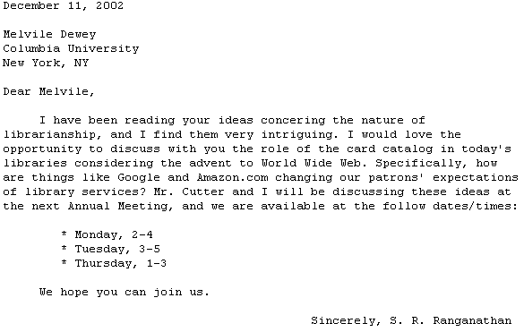

Slide 29
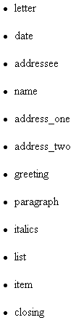

Slide 30
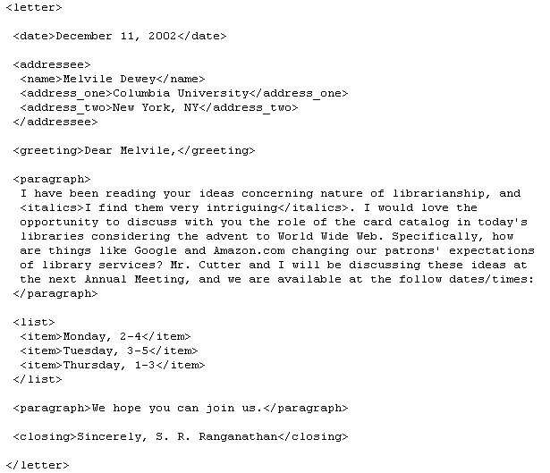

Slide 31
XML Validation
"Well Formed" XML documents
A "Well Formed" XML document has correct XML syntax
"Valid" XML documents
A "Valid" XML document is a "Well Formed" XML document, which also conforms to the rules of Document Type Definition (DTD) or XML Schema Definition (XSD).
Errors will stop your XML Program if Your XML is not valid.

Slide 32
Adding Structure and Semantics
XML Document Type Definitions (DTDs):
  define the structure of "allowed" documents (i.e., valid wrt. a DTD)
  ≈ database schema
  => improve query formulation, execution, ...
XML Schema
  defines structure and data types
  allows developers to build their own libraries of interchanged data types
XML Namespaces
  identify your vocabulary
  Example namespace.xml

Slide 33
Parsers
To read and update - create and manipulate - an XML document, you need an XML parser.
Parsers APIs are SAX, DOM
Available parsers are Xerces, Microsoft XML parser, xml4j etc.,

Slide 34
End
Thank You

