Slide 1


XSLT
Copyright ©2004 Virtusa Corporation | CONFIDENTIAL

Slide 2
XSL: Extensible Stylesheet Language Transformations (XSLT)
Outline
12.1 Introduction
12.2 Setup
12.3 Templates
12.4 Creating Elements and Attributes
12.5 Iteration and Sorting
12.6 Conditional Processing
12.7 Copying Nodes
12.8 Combining Stylesheets
12.9 Variables

Slide 3
12.1 Introduction
Extensible Stylesheet Language (XSL)
  Used to format XML documents
  Consist of two parts
    XSL Transformation Language (XSLT)
      Transform XML document from one form to another
      Use XPath to match nodes
    XSL formatting objects
      Alternative to CSS

Slide 4
12.2 Setup
XSLT processor
  Microsoft Internet Explorer 5
  Apache’s Xalan
  Java 2 Standard Edition required
    Download at www.java.sun.com/j2se
  Xalan required
    Download at xml.apache.org/xalan

Slide 5
12.3 Templates
XSLT document
  XML document with root element stylesheet
  template element
    Matches specific XML document nodes
    Uses XPath expression in attribute match

Slide 6
12.3 Templates (cont.)
XSLT
  Two trees of nodes
    Source tree corresponds to original XML document
    Result tree contains nodes produced by transformation
  Fig. 12.1 transforms intro.xml into HTML document

Slide 7
1 <?xml version = "1.0"?>
Root element stylesheet
2
3 <!-- Fig. 12.1 : intro.xsl -->
Fig. 12.1 Simple Template.
Root element stylesheet
XSLT namespace
Use XPath expression in template element to match any myMessage element nodes
template element contents are placing in resulting tree when myMessage element node is matched
4 <!-- Simple XSLT document for intro.xml -->
XSLT namespace
5
6 <xsl:stylesheet version = "1.0"
7 xmlns:xsl = "http://www.w3.org/1999/XSL/Transform">
8
Use XPath expression in template element to match any myMessage element nodes
9 <xsl:template match = "myMessage">
10 <html>
11 <body><xsl:value-of select = "message"/></body>
12 </html>
13 </xsl:template>
template element contents are placing in resulting tree when myMessage element node is matched
14
15 </xsl:stylesheet>

Slide 8
1 <?xml version = "1.0"?>
Element stylesheet attaches style sheet to XML document
2
3 <!-- Fig. 12.2 : intro.xml -->
Fig. 12.2 Input XML document.
Element stylesheet attaches style sheet to XML document
4 <!-- Simple introduction to XML markup -->
5
6 <?xml:stylesheet type = "text/xsl" href = "intro.xsl"?>
7
8 <myMessage>
9 <message>Welcome to XSLT!</message>
10 </myMessage>

Slide 9
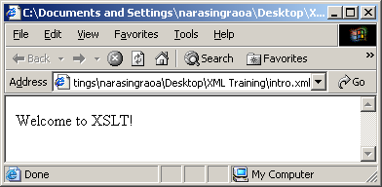
1 <html><body>Welcome to XSLT!</body></html>
Fig. 12.3 Internet Explorer 5 displaying the results of an XSL transformation.

Slide 10
12.4 Creating Elements and Attributes
Creation of elements and attributes

Slide 11
1 <?xml version = "1.0"?>
2
3 <!-- Fig. 12.4 : games.xml -->
Fig. 12.4 XML document containing a list of sports.
4 <!-- Sports Database -->
5
6 <sports>
7
8 <game title = "cricket">
9 <id>243</id>
10
11 <para>
12 More popular among commonwealth nations.
13 </para>
14 </game>
15
16 <game title = "baseball">
17 <id>431</id>
18
19 <para>
20 More popular in America.
21 </para>
22 </game>
23
24 <game title = "soccer">
25 <id>123</id>
26
27 <para>
28 Most popular sport in the world.
29 </para>
30 </game>
31
32 </sports>

Slide 12
1 <?xml version = "1.0"?>
2
3 <!-- Fig. 12.5 : elements.xsl -->
4 <!-- Using xsl:element and xsl:attribute -->
Fig. 12.5 Using XSLT to create elements and attributes.
Use attribute match to select XML document root
Element apply-templates applies XSLT document templates to specific nodes
match element sports and apply templates to sport node’s child nodes
Create element title
Create attribute id for element title
Create comment with element para comments
5
6 <xsl:stylesheet version = "1.0"
7 xmlns:xsl = "http://www.w3.org/1999/XSL/Transform">
8
Use attribute match to select XML document root
9 <xsl:template match = "/">
10 <xsl:apply-templates/>
11 </xsl:template>
Element apply-templates applies XSLT document templates to specific nodes
12
13 <xsl:template match = "sports">
14 <sports>
15 <xsl:apply-templates/>
match element sports and apply templates to sport node’s child nodes
16 </sports>
17 </xsl:template>
18
19 <xsl:template match = "game">
Create element title
20 <xsl:element name = "{@title}">
21
22 <xsl:attribute name = "id">
23 <xsl:value-of select = "id"/>
Create attribute id for element title
24 </xsl:attribute>
25
26 <comment>
Create comment with element para comments
27 <xsl:value-of select = "para"/>
28 </comment>
29
30 </xsl:element>
31 </xsl:template>
32
33 </xsl:stylesheet>

Slide 13
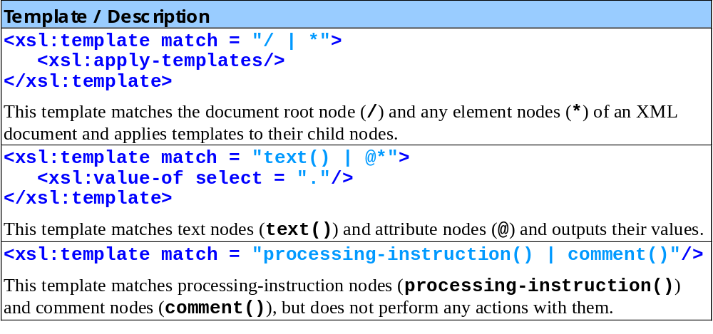
Fig. 12.6 Default XSLT Templates

Slide 14
1 <?xml version = "1.0" encoding = "UTF-8"?>
2 <sports>
3
Fig. 12.7 Output of transformation.
4 <cricket id = "243">
5 <comment>
6 More popular among commonwealth nations.
7 </comment>
8 </cricket>
9
10 <baseball id = "431">
11 <comment>
12 More popular in America.
13 </comment>
14 </baseball>
15
16 <soccer id = "123">
17 <comment>
18 Most popular sport in the world.
19 </comment>
20 </soccer>
21
22 </sports>

Slide 15
1 <?xml version = "1.0"?>
2 <?xml:stylesheet type = "text/xsl" href = "games.xsl"?>
3
4 <!-- Fig. 20.23 : games.xml -->
5 <!-- Sports Database -->
6 <sports>
8 <game id = "783">
10 <name>Cricket</name>
11
12 <paragraph>
13 More popular among commonwealth nations.
14 </paragraph>
15 </game>
16
17 <game id = "239">
18 <name>Baseball</name>
19
20 <paragraph>
21 More popular in America.
22 </paragraph>
23 </game>
24
25 <game id = "418">
26 <name>Soccer (Football)</name>
27
28 <paragraph>
29 Most popular sport in the world.
30 </paragraph>
31 </game>
32 </sports>
Games1.xml
Value type specifies that games.xsl is a text/xsl file.
A processing instruction that references the XSL stylesheet games.xsl.

Slide 16
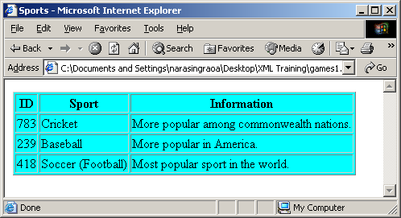
Program Output

Slide 17
1 <?xml version = "1.0"?>
2
3 <!-- Fig. 20.24 : elements.xsl -->
4 <!-- A simple XSLT transformation -->
5
6 <!-- reference XSL stylesheet URI -->
7 <xsl:stylesheet version = "1.0"
8 xmlns:xsl = "http://www.w3.org/1999/XSL/Transform">
9
10 <xsl:output method = "html" omit-xml-declaration = "no"
11 doctype-system =
12 "http://www.w3.org/TR/xhtml1/DTD/xhtml1-strict.dtd"
13 doctype-public = "-//W3C//DTD XHTML 1.0 Strict//EN"/>
14
15 <xsl:template match = "/">
16
17 <html xmlns="http://www.w3.org/1999/xhtml">
18
19 <head>
20 <title>Sports</title>
21 </head>
22
23 <body>
24
25 <table border = "1" bgcolor = "cyan">
26
27 <thead>
28
29 <tr>
30 <th>ID</th>
31 <th>Sport</th>
32 <th>Information</th>
33 </tr>
34
35 </thead>
The stylesheet start tag—which begins the XSL stylesheet.
Element xsl:output writes an XHTML document type declaration to the result tree.
The match attribute to select the document root of the source document (i.e., game.xml).
games.xsl

Slide 18
36
37 <!-- insert each name and paragraph element value -->
38 <!-- into a table row. -->
39 <xsl:for-each select = "sports/game">
40
41 <tr>
42 <td><xsl:value-of select = "@id"/></td>
43 <td><xsl:value-of select = "name"/></td>
44 <td><xsl:value-of select = "paragraph"/></td>
45 </tr>
46
47 </xsl:for-each>
48
49 </table>
50
51 </body>
52
53 </html>
54
55 </xsl:template>
56
57 </xsl:stylesheet>
games.xsl
Element xsl:for-each iterates through the source XML document and search for game elements.
Element value-of retrieves attribute id’s value and place it in a td element in the result tree.

Slide 19
12.5 Iteration and Sorting
XSLT allows
  Iteration through node set
    Element for-each
  Sorting node set
    Element sort
      Attribute ascending (i.e., A-Z)
      Attribute descending (i.e., Z-A)

Slide 20
1 <?xml version = "1.0"?>
2
3 <!-- Fig. 12.8 : usage.xml -->
Fig. 12.8 Book table of contents as XML.
4 <!-- Usage of elements and attributes -->
5
6 <?xml:stylesheet type = "text/xsl" href = "usage.xsl"?>
7
8 <book isbn = "999-99999-9-X">
9 <title>Deitel&apos;s XML Primer</title>
10
11 <author>
12 <firstName>Paul</firstName>
13 <lastName>Deitel</lastName>
14 </author>
15
16 <chapters>
17 <preface num = "1" pages = "2">Welcome</preface>
18 <chapter num = "1" pages = "4">Easy XML</chapter>
19 <chapter num = "2" pages = "2">XML Elements?</chapter>
20 <appendix num = "1" pages = "9">Entities</appendix>
21 </chapters>
22
23 <media type = "CD"/>
24 </book>

Slide 21
1 <?xml version = "1.0"?>
2
3 <!-- Fig. 12.9 : usage.xsl -->
Fig. 12.9 Transforming XML data into HTML.
Element for-each applies element contents to each preface element node
Use element sort to sort nodes (selected by for-each) in ascending order
4 <!-- Transformation of Book information into HTML -->
5
6 <xsl:stylesheet version = "1.0"
7 xmlns:xsl = "http://www.w3.org/1999/XSL/Transform">
8
9 <xsl:template match = "/">
10 <html>
11 <xsl:apply-templates/>
12 </html>
13 </xsl:template>
14
15 <xsl:template match = "book">
16 <head>
17 <title>ISBN <xsl:value-of select = "@isbn"/> -
18 <xsl:value-of select = "title"/></title>
19 </head>
20
21 <body bgcolor = "white">
Element for-each applies element contents to each preface element node
22 <h1><xsl:value-of select = "title"/></h1>
23
24 <h2>by <xsl:value-of select = "author/lastName"/>,
25 <xsl:value-of select = "author/firstName"/></h2>
Use element sort to sort nodes (selected by for-each) in ascending order
26
27 <table border = "1">
28 <xsl:for-each select = "chapters/preface">
29 <xsl:sort select = "@num" order = "ascending"/>

Slide 22
30 <tr>
31 <td align = "right">
32 Preface <xsl:value-of select = "@num"/>
33 </td>
Fig. 12.9 Transforming XML data into HTML (Part 2).
Iterate and sort chapter elements
Iterate and sort appendix elements
34
35 <td>
36 <xsl:value-of select = "."/> (
37 <xsl:value-of select = "@pages"/> pages )
38 </td>
39 </tr>
Iterate and sort chapter elements
40 </xsl:for-each>
41
42 <xsl:for-each select = "chapters/chapter">
43 <xsl:sort select = "@num" order = "ascending"/>
44 <tr>
45 <td align = "right">
46 Chapter <xsl:value-of select = "@num"/>
47 </td>
48
49 <td>
50 <xsl:value-of select = "."/> (
51 <xsl:value-of select = "@pages"/> pages )
52 </td>
53 </tr>
Iterate and sort appendix elements
54 </xsl:for-each>
55
56 <xsl:for-each select = "chapters/appendix">
57 <xsl:sort select = "@num" order = "ascending"/>
58 <tr>
59 <td align = "right">
60 Appendix <xsl:value-of select = "@num"/>
61 </td>

Slide 23
62
63 <td>
64 <xsl:value-of select = "."/> (
Fig. 12.9 Transforming XML data into HTML (Part 3).
65 <xsl:value-of select = "@pages"/> pages )
66 </td>
67 </tr>
68 </xsl:for-each>
69 </table>
70 </body>
71 </xsl:template>
72
73 </xsl:stylesheet>

Slide 24
1 <html>
2 <head>
3 <title>ISBN 999-99999-9-X - Deitel's XML Primer</title>
4 </head>
Fig. 12.10 Output of the transformation.
5
6 <body bgcolor = "white">
7 <h1>Deitel's XML Primer</h1>
8 <h2>by Deitel, Paul</h2>
9
10 <table border = "1">
11 <tr>
12 <td align = "right">Preface 1</td>
13 <td>Welcome ( 2 pages )</td>
14 </tr>
15
16 <tr>
17 <td align = "right">Chapter 1</td>
18 <td>Easy XML ( 4 pages )</td>
19 </tr>
20
21 <tr>
22 <td align = "right">Chapter 2</td>
23 <td>XML Elements? ( 2 pages )</td>
24 </tr>
25
26 <tr>
27 <td align = "right">Appendix 1</td>
28 <td>Entities ( 9 pages )</td>
29 </tr>
30 </table>
31 </body>
32
33 </html>

Slide 25
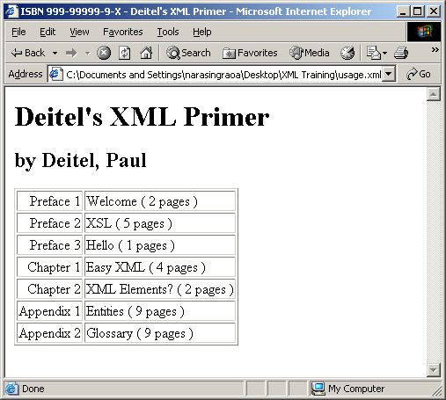
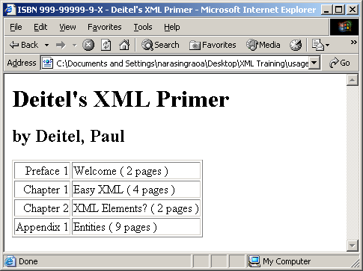
Output from Fig. 12.10

Slide 26
12.6 Conditional Processing
Perform conditional processing
  Such as if statement
  Use element choose
    Allows alternate conditional statements
    Similar to switch statement
    Has child elements when and otherwise
      when element content used if condition is met
      otherwise element content used if no conditions in when condition are met

Slide 27
1 <?xml version = "1.0"?>
2
3 <!-- Fig. 12.11 : conditional.xsl,planner.xml -->
Fig. 12.11 Using conditional elements.
4 <!-- xsl:choose, xsl:when, and xsl:otherwise -->
5
6 <xsl:stylesheet version = "1.0"
7 xmlns:xsl = "http://www.w3.org/1999/XSL/Transform">
8
9 <xsl:template match = "/">
10 <html>
11
12 <body>
13 Appointments
14 <br/>
15 <xsl:apply-templates select = "planner/year"/>
16 </body>
17
18 </html>
19 </xsl:template>
20
21 <xsl:template match = "year">
22 <strong>Year:</strong>
23 <xsl:value-of select = "@value"/>
24 <br/>
25 <xsl:for-each select = "date/note">
26 <xsl:sort select = "../@day" order = "ascending"
27 data-type = "number"/>

Slide 28
28 <strong>
29 Day:
30 <xsl:value-of select = "../@day"/>/
31 <xsl:value-of select = "../@month"/>
Fig. 12.11 Using conditional elements (Part 2).
Allow conditional statements
Content of when element used if condition is met
Content of otherwise element used if no conditions are met
32 </strong>
33
Allow conditional statements
34 <xsl:choose>
35
36 <xsl:when test =
37 "@time &gt; '0500' and @time &lt; '1200'">
38 Morning (<xsl:value-of select = "@time"/>):
39 </xsl:when>
40
41 <xsl:when test =
42 "@time &gt; '1200' and @time &lt; '1700'">
43 Afternoon (<xsl:value-of select = "@time"/>):
44 </xsl:when>
Content of when element used if condition is met
45
46 <xsl:when test =
47 "@time &gt; '1200' and @time &lt; '1700'">
48 Evening (<xsl:value-of select = "@time"/>):
49 </xsl:when>
50
51 <xsl:when test =
52 "@time &gt; '1200' and @time &lt; '1700'">
53 Night (<xsl:value-of select = "@time"/>):
54 </xsl:when>
55
56 <xsl:otherwise>
Content of otherwise element used if no conditions are met
57 Entire day:
58 </xsl:otherwise>

Slide 29
59
60 </xsl:choose>
61
Fig. 12.11 Using conditional elements (Part 3).
62 <xsl:value-of select = "."/>
63
64 <xsl:if test = ". = ''">
65 n/a
66 </xsl:if>
67
68 <br/>
69 </xsl:for-each>
70
71 </xsl:template>
72
73 </xsl:stylesheet>

Slide 30
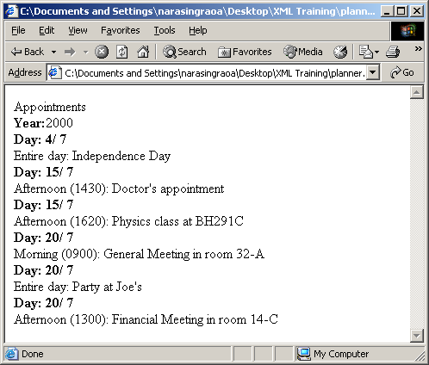
Output from Fig. 12.11

Slide 31
12.7 Copying Nodes
Duplicate nodes from sources tree to result tree
  Element copy
    Produce copy of context node
    Place copy in result tree
    No child nodes or attributes are duplicated
  Element copy-of
    Performs copy of subtree
    Duplicates children (i.e., text, processing instructions, etc.)

Slide 32
1 <?xml version = "1.0"?>
2
3 <!-- Fig. 12.12: copyIntro.xsl -->
Fig. 12.12 Using the XSLT element copy.
Apply templates to element’s child nodes
Replace element content with text
4 <!-- xsl:copy example using Intro1.xml -->
5
6 <xsl:stylesheet version = "1.0"
7 xmlns:xsl = "http://www.w3.org/1999/XSL/Transform">
8
9 <xsl:template match = "myMessage">
10
11 <xsl:copy>
Apply templates to element’s child nodes
12 <xsl:apply-templates/>
13 </xsl:copy>
14
15 </xsl:template>
16
17 <xsl:template match = "message">
18
19 <xsl:copy>
Replace element content with text
20 How about &apos;Hi World&apos; for a change!
21 </xsl:copy>
22
23 </xsl:template>
24
25 </xsl:stylesheet>

Slide 33
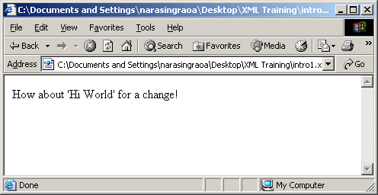
1 <?xml version = "1.0" encoding = "UTF-8"?>
2 <myMessage>
3 <message>
Fig. 12.13 Resulting transformation.
4 How about 'Hi World' for a change!
5 </message>
6 </myMessage>

Slide 34
1 <?xml version = "1.0"?>
2
3 <!-- Fig. 12.14 : usingCopyOf.xsl -->
Fig. 12.14 xsl:copy-of element.
Copy-of : Each node and all associated attribute nodes, namespace nodes, children and descendants are copied. In other words, it is a complete, unabridged copy of the set.
Value-of : The value being copied is converted into a string for display in the output.
Copy : the xsl:copy element copies the current node in the source document to the output.
4 <!-- xsl:copy-of example using intro2.xml -->
5
6 <xsl:stylesheet version = "1.0"
7 xmlns:xsl = "http://www.w3.org/1999/XSL/Transform">
8
9 <xsl:template match = "myMessage">
10
11 <xsl:comment>
Create comment in resulting XML document
12 The following XML tree has been copied into output.
13 </xsl:comment>
Duplicate nodes selected by attribute select into resulting XML document
14
15 <xsl:copy-of select = "."/>
16 </xsl:template>
17
18 </xsl:stylesheet>

Slide 35
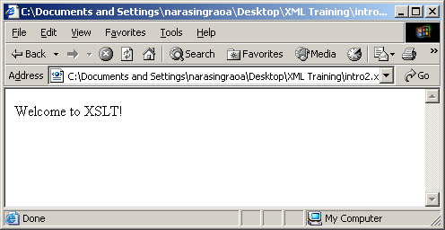
1 <?xml version = "1.0" encoding = "UTF-8"?>
2 <!-- The following XML tree has been copied into output. -->
3 <myMessage>
Fig. 12.15 Output of the copy-of transformation.
4 <message>Welcome to XSLT!</message>
5 </myMessage>

Slide 36
12.8 Combining Stylesheets
XSLT document can import others
  Element import
    local templates have higher precedence as included templates
  Element include
    Included templates have same precedence as local templates

Slide 37
1 <?xml version = "1.0"?>
2
3 <!-- Fig. 12.16 : usage2.xsl -->
Fig. 12.16 XSLT document being imported.
4 <!-- xsl:import example -->
5
6 <xsl:stylesheet version = "1.0"
7 xmlns:xsl = "http://www.w3.org/1999/XSL/Transform">
8
9 <xsl:template match = "book">
10 <html>
11
12 <body>
13 <xsl:apply-templates/>
14 </body>
15 </html>
16
17 </xsl:template>
18
19 <xsl:template match = "title">
20 <xsl:value-of select = "."/>
21 </xsl:template>
22
23 <xsl:template match = "author">
24 <br/>
25
26 <p>Author:
27 <xsl:value-of select = "lastName"/>,
28 <xsl:value-of select = "firstName"/>
29 </p>

Slide 38
30
31 </xsl:template>
32
Template to match any text and leftover element nodes
Fig. 12.16 XSLT document being imported (Part 2).
Template to match any text and leftover element nodes
33 <xsl:template match = "*|text()"/>
34
35 </xsl:stylesheet>

Slide 39
1 <?xml version = "1.0"?>
2
3 <!-- Fig. 12.17 : usage1.xsl -->
Fig. 12.17 Importing another XSLT document.
Use templates in usage2.xsl
Template for element title used instead of one defined in usage2.xsl
4 <!-- xsl:import example using usage.xml -->
5
6 <xsl:stylesheet version = "1.0"
7 xmlns:xsl = "http://www.w3.org/1999/XSL/Transform">
8
Use templates in usage2.xsl
9 <xsl:import href = "usage2.xsl"/>
10
11 <!-- This template has higher precedence over the
12 templates being imported -->
Template for element title used instead of one defined in usage2.xsl
13 <xsl:template match = "title">
14
15 <h2>
16 <xsl:value-of select = "."/>
17 </h2>
18
19 </xsl:template>
20
21 </xsl:stylesheet>

Slide 40
1 <html>
2 <body>
3 <h2>Deitel's XML Primer</h2>
Fig. 12.18 Resulting HTML document using XSLT import.
4 <br>
5 <p>
6 Author: Deitel, Paul
7 </p>
8 </body>
9 </html>

Slide 41
1 <?xml version = "1.0"?>
2
3 <!-- Fig. 12.19 : book.xsl -->
4 <!-- xsl:include example using usage.xml -->
Fig. 12.19 Combining stylesheets using xsl:include.
Include author.xsl and chapters.xsl, but templates in stylesheets have same precedence as local templates
5
6 <xsl:stylesheet version = "1.0"
7 xmlns:xsl = "http://www.w3.org/1999/XSL/Transform">
8
9 <xsl:template match = "/">
10
11 <html>
12 <body>
13 <xsl:apply-templates select = "book"/>
14 </body>
15 </html>
16
17 </xsl:template>
18
19 <xsl:template match = "book">
20
21 <h2>
22 <xsl:value-of select = "title"/>
23 </h2>
24
25 <xsl:apply-templates/>
26 </xsl:template>
27
Include author.xsl and chapters.xsl, but templates in stylesheets have same precedence as local templates
28 <xsl:include href = "author.xsl"/>
29 <xsl:include href = "chapters.xsl"/>
30
31 <xsl:template match = "*|text()"/>
32
33 </xsl:stylesheet>

Slide 42
1 <?xml version = "1.0"?>
2
3 <!-- Fig. 12.20 : author.xsl -->
Fig. 12.20 XSLT document for rendering the author’s name.
4 <!-- xsl:include example using usage.xml -->
5
6 <xsl:stylesheet version = "1.0"
7 xmlns:xsl = "http://www.w3.org/1999/XSL/Transform">
8
9 <xsl:template match = "author">
10
11 <p>Author:
12 <xsl:value-of select = "lastName"/>,
13 <xsl:value-of select = "firstName"/>
14 </p>
15
16 </xsl:template>
17
18 </xsl:stylesheet>

Slide 43
1 <?xml version = "1.0"?>
2
3 <!-- Fig. 12.21 : chapters.xsl -->
Fig. 12.21 XSLT document for rendering chapter names.
4 <!-- xsl:include example using usage.xml -->
5
6 <xsl:stylesheet version = "1.0"
7 xmlns:xsl = "http://www.w3.org/1999/XSL/Transform">
8
9 <xsl:template match = "chapters">
10 Chapters:
11
12 <ul>
13 <xsl:apply-templates select = "chapter"/>
14 </ul>
15 </xsl:template>
16
17 <xsl:template match = "chapter">
18
19 <li>
20 <xsl:value-of select = "."/>
21 </li>
22
23 </xsl:template>
24
25 </xsl:stylesheet>

Slide 44
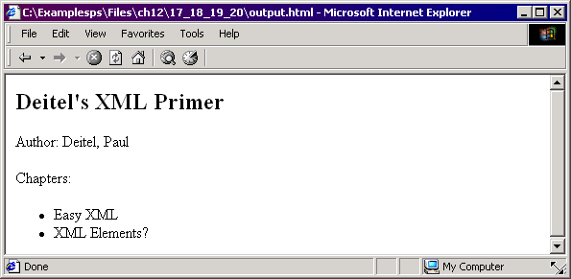
1 <html>
2 <body>
3 <h2>Deitel’s XML Primer</h2>
Fig. 12.22 Output of an XSLT document using element include.
Output from Fig. 12.22
4 <p>Author:
5 Deitel, Paul</p>
6
7 Chapters:
8 <ul>
9 <li>Easy XML</li>
10 <li>XML Elements?</li>
11 </ul>
12 </body>
13 </html>

Slide 45
12.9 Variables
Variables for processing information
  Element variable

Slide 46
1 <?xml version = "1.0"?>
2
3 <!-- Fig. 12.23 : variables.xsl -->
Fig. 12.23 Example for xsl:variable.
Create element variable with attribute name to store number of pages in book
Element value-of uses dollar sign ($) to reference and output variable sum
4 <!-- using xsl:variables -->
5
6 <xsl:stylesheet version = "1.0"
7 xmlns:xsl = "http://www.w3.org/1999/XSL/Transform">
8
9 <xsl:template match = "/">
Create element variable with attribute name to store number of pages in book
10
11 <total>
12 Number of pages =
13 <xsl:variable name = "sum"
14 select = "sum(book/chapters/*/@pages)"/>
15 <xsl:value-of select = "$sum"/>
16 </total>
Element value-of uses dollar sign ($) to reference and output variable sum
17
18 </xsl:template>
19
20 </xsl:stylesheet>

Slide 47
1 <?xml version = "1.0" encoding = "UTF-8"?>
2 <total>Number of pages = 17</total>
Fig. 12.24 Output of transformation.

