Slide 1
ENTERPRISE DENTAL WORKSPACE • FULL TECHNICAL SPECIFICATION
Dentia: Tools, Skills, PPI Architecture & Entity Model
A Complete Reference Guide on Frontend & Backend Tools, Clinical AI Skills, the Patient-Provider Interface (PPI), Patient Protected Information (PII/Security), and the 17-Table SQL Server Database Model.
• WHAT TOOLS: React 19, Vite 8, Three.js 3D, .NET 10 Web API, Dapper 2.1, SQL Server 2022, Vertex AI, Groq LPU
• WHAT SKILLS: AI Scribe SOAP Extraction, Real-Time Audio Dictation, 3D Odontogram Condition Shaders, Dual Geocoding
• HOW PPI WORKS: Operatory Consultation Workflow, Ambient Voice Ingestion, and HIPAA/GDPR Protected Information
• ENTITY MODEL: 17 Normalized SQL Tables with Primary Keys, Foreign Keys, and Architectural Cluster Mappings
Official Engineering & Clinical Review Document • Dentia Health Systems • September 2026

Slide 2
TOOLS & LIBRARIES MATRIX
Complete Tools Inventory: Frontend & Backend Technology Stack
Frontend Tools & Frameworks
Backend API Tools & Infrastructure
✔ React 19.2: Core reactive UI runtime & concurrent mode
✔ Vite 8.2: Ultra-fast bundler with Rolldown optimizations
✔ Tailwind CSS v4.3: Modern utility styling with native CSS @theme
✔ Three.js & R3F: WebGL 3D engine (@react-three/fiber & drei)
✔ Web Speech API: Native browser SpeechRecognition & Synthesis
✔ OpenStreetMap: Nominatim REST API for hyper-local sectors
✔ Mapbox REST API: Geocoding v5 places with fallback token
✔ jsPDF & html2canvas: High-res client-side SOAP report PDF export
✔ Recharts 3.10: Interactive clinical stats & revenue charts
✔ Lucide-React: Standardized clinical, tooth & UI icons
✔ Oxlint: Rust-based ultra-fast linter for code health
✔ .NET 10.0 Web API: High-throughput modern C# REST application
✔ Dapper 2.1: Micro-ORM for sub-millisecond SQL queries
✔ SqlClient 7.0: Direct, optimized SQL Server database connection
✔ BCrypt.Net-Next: Salted password hashing (Work Factor 11)
✔ OpenAPI / Swagger: Interactive API documentation & schema explorer
✔ Google Cloud Vertex AI: Google.Cloud.AIPlatform.V1 (Gemini 1.5 Scribe)
✔ Groq LPU SDK: Sub-second Llama-3-70b / Mixtral inference
✔ On-Demand Local LLM: Air-gapped Ollama failover for hospital LANs
✔ Microsoft SQL Server: 2022 Enterprise with dentist.* schema
✔ Multipart Streaming: Acoustic audio file chunk ingestion pipeline
✔ Crypto Providers: System.Security.Cryptography SHA256 hashes

Slide 3
SYSTEM SKILLS INVENTORY
Clinical AI & System Skills Catalog: Built-in Capabilities
Skill 1: Clinical SOAP Extraction
Skill 2: Real-Time Audio Dictation & Voice
Skill 3: 3D Odontogram Condition Mapping
Converts unstructured operatory speech into 8-section dental SOAP notes (Chief Complaint, HPI, Dental History, Objective Exams, Assessment, Treatment, Prescriptions, Prognosis).
Hands-free ambient consultation listening with live transcript generation, plus audible clinician confirmation via aiVoice.speakDoctorSuccess and error guards.
Translates clinical findings (Caries, Composite, Amalgam, Crown, Root Canal, Extraction, Implant) into dynamic WebGL Three.js shaders on 32 individual tooth meshes.
Skill 4: Dual Geocoding Autocomplete
Skill 5: Dentition Arch Adaptation
Skill 6: Contraindication & Allergy Safety
Auto-resolves CDA sectors (F-7, G-9, Gulberg) and New Zealand suburbs; auto-populates Address, City, and Postcode with green '✓ Synced' animated badges.
Dynamically switches dental chart based on patient age: Adult (1-32 Universal / 11-48 FDI), Pediatric (A-T Primary), or Mixed Dentition (6-12 Years).
Cross-references prescribed drugs against patient allergy history. Generates automatic severity alerts in [AIWarnings] requiring mandatory doctor sign-off.
Skill 7: Cryptographic Non-Repudiation Audit
Skill 8: Multi-Tier Offline Failover
Skill 9: Automated Signed PDF Reporting
Generates SHA-256 integrity hashes for all prompt inputs and LLM outputs in [AIAuditLogs] to ensure legal HIPAA non-repudiation and prevent tampering.
Resilient 3-tier routing: Primary Google Vertex AI Gemini 1.5 Flash -> Secondary Groq LPU Llama-3-70B -> Tertiary On-Demand Local LLM for 100% offline hospital LANs.
Compiles patient history, dental jaw diagrams, condition summaries, and clinic branding into a printable/downloadable multi-page PDF via jsPDF & html2canvas.

Slide 4
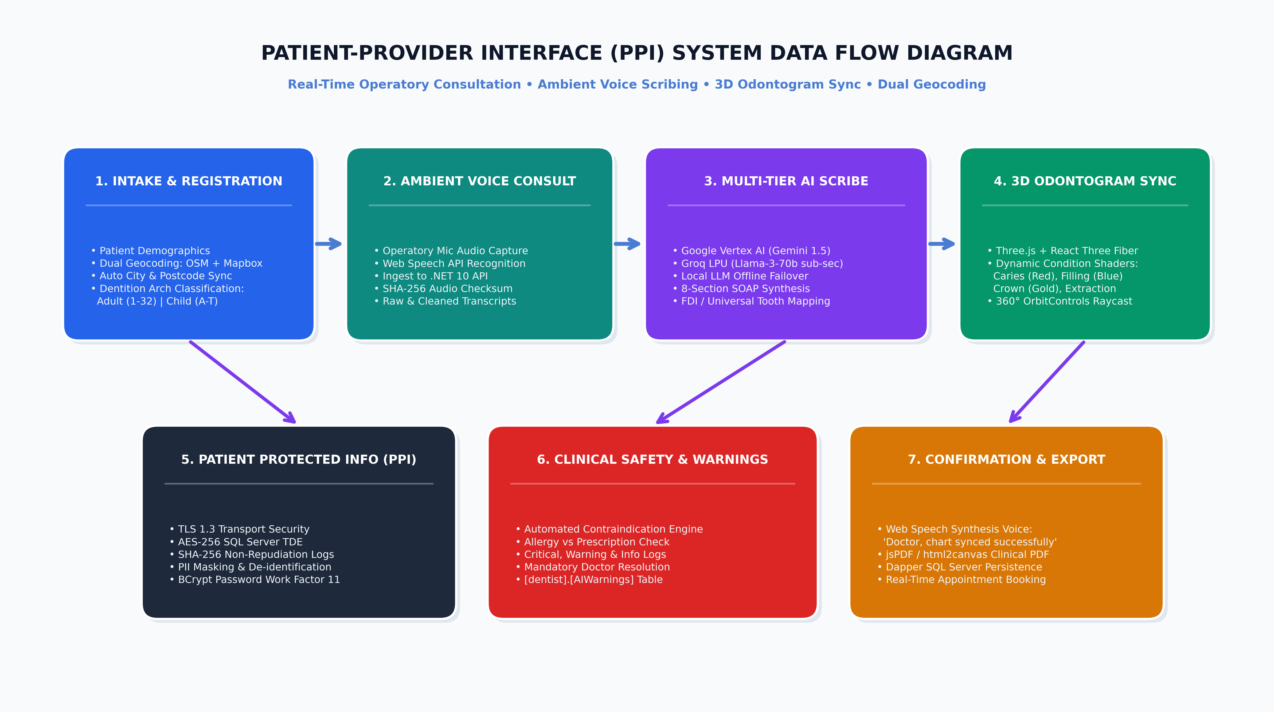
VISUAL ARCHITECTURE DIAGRAM
System Data Flow Diagram: Patient-Provider Interface (PPI)

Slide 5
PATIENT-PROVIDER INTERFACE (PPI)
How PPI Works: Live Operatory Workflow & Speech Interaction
Phase 1
Zero-Friction Patient Intake
• Clinician opens NewPatientPage with smart country toggle (PK / NZ).
• Dual-engine geocoding auto-completes street address, district, and postcode.
• Age auto-calculates from Date of Birth, adapting dentition arch to Adult (1-32), Pediatric (A-T), or Mixed.
Phase 2
Ambient Voice Scribing in Operatory
• Operatory microphone continuously streams doctor-patient consultation.
• Audio ingested as chunked streams to .NET 10 API; assigned SHA-256 deduplication checksum.
• Web Speech API and backend SpeechToTextService produce raw and cleaned transcripts.
Phase 3
Multi-Tier AI SOAP Note Synthesis
• Transcripts routed to Gemini 1.5 Flash or Groq LPU with specialized dental prompts.
• Automatically extracts 8-section clinical SOAP record including diagnosis and treatment plan.
• Prescription medications and dosages mapped into [DentalNotePrescriptions].
Phase 4
3D Odontogram Synchronization
• Extracted findings (e.g. Tooth #14 MOD Caries, Tooth #30 Root Canal) immediately update [TeethState].
• Three.js WebGL canvas re-renders individual tooth materials with color-coded shaders.
• AI voice assistant speaks aloud: 'Doctor, treatment notes and chart synced successfully.'

Slide 6
SECURITY & COMPLIANCE
How PPI Works: Patient Protected Information (PII/HIPAA/GDPR)
1. In-Transit & At-Rest Encryption
2. Cryptographic Non-Repudiation (SHA-256)
• Strict TLS 1.3 transport security across all frontend-to-backend REST API endpoints.
• AES-256 Transparent Data Encryption (TDE) on SQL Server physical data pages.
• Digital X-ray blobs and voice recordings stored with signed, expiring URI tokens.
• Doctor passwords salted and hashed using BCrypt.Net-Next (Work Factor 11).
• Every AI interaction computes and logs InputHash and OutputHash in [AIAuditLogs].
• Proves that clinical records generated by AI were not tampered with after the consultation.
• Full audit trail maps every change to DoctorID, NoteId, ModelName, and Timestamp.
3. Automated Contraindication Safety Interceptor
4. PII Masking & Air-Gapped Hospital LAN Failover
• Real-time rule engine cross-references prescribed medications with patient allergy history.
• Discrepancies (e.g. Amoxicillin prescribed to Penicillin-allergic patient) trigger [AIWarnings].
• Clinical system blocks finalized sign-off until doctor reviews and marks flag as resolved.
• Automated de-identification scrubs patient names, phones, and addresses before cloud routing.
• On-Demand Local LLM Service runs Ollama locally on hospital hardware for 100% offline security.
• Zero patient protected health data is ever retained for public AI model training.

Slide 7
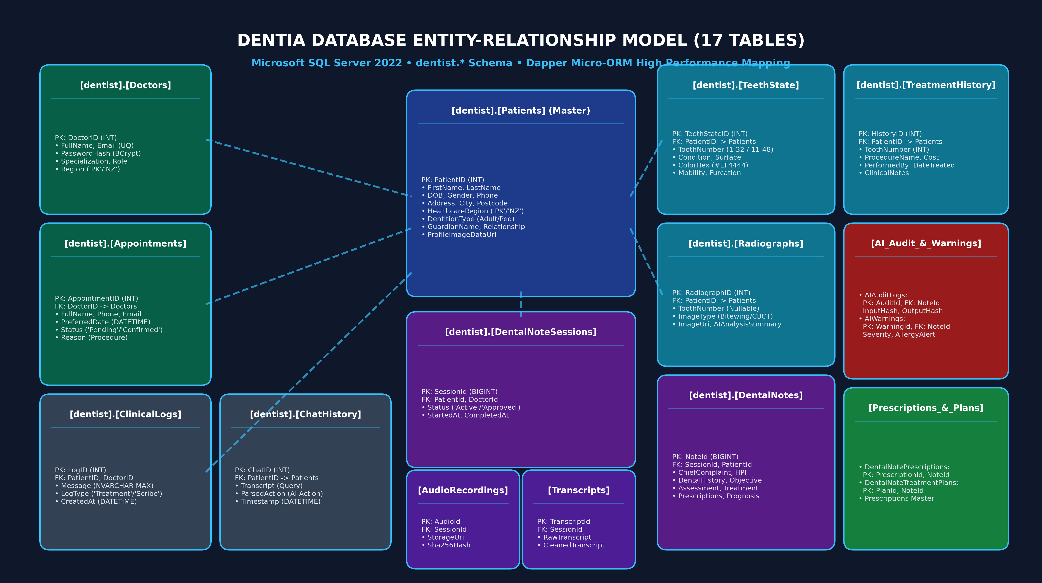
VISUAL ENTITY MODEL (ERD)
Database Entity-Relationship Model: 17 Normalized SQL Tables

Slide 8
DATABASE ARCHITECTURE (PART 1)
Entity Model Breakdown: Core Patients & 3D Odontogram
[dentist].[Patients] (Master Demographic)
[dentist].[Doctors] & [Appointments]
[dentist].[TeethState] & [Radiographs]
• PatientID (INT, PK, IDENTITY)
• FirstName, LastName (NVARCHAR 50, NOT NULL)
• DOB (DATE, NOT NULL) -> Auto calculates age & dentition
• Gender, Phone, Address, City, Postcode
• HealthcareRegion: 'PK' (Pakistan) or 'NZ' (New Zealand)
• DentitionType: 'Permanent', 'Pediatric', or 'Mixed'
• GuardianName, GuardianRelationship (For pediatric)
• ProfileImageDataUrl (Base64 avatar or default)
• Doctors (Clinician Master):
- DoctorID (INT, PK, IDENTITY)
- FullName, Email (UNIQUE), PasswordHash (BCrypt)
- Specialization, Role, Region
• Appointments (Clinic Scheduling):
- AppointmentID (INT, PK, IDENTITY)
- DoctorID (INT, FK -> Doctors.DoctorID)
- FullName, Phone, PreferredDate, Status, Reason
• TeethState (3D Odontogram Anatomy):
- TeethStateID (INT, PK, IDENTITY)
- PatientID (INT, FK -> Patients.PatientID)
- ToothNumber (1-32 Universal / 11-48 FDI)
- Condition, Surface, ColorHex (#EF4444, #3B82F6)
• Radiographs (Digital Imaging Assets):
- RadiographID (INT, PK), ToothNumber
- ImageType ('Bitewing'/'CBCT'), ImageUri, AIAnalysisSummary

Slide 9
DATABASE ARCHITECTURE (PART 2)
Entity Model Breakdown: Ambient Voice, AI Scribing & Plans
[Sessions], [Audio] & [Transcripts]
[DentalNotes] & [AI Governance]
[Prescriptions] & [TreatmentPlans]
• DentalNoteSessions (Lifecycle Container):
- SessionId (BIGINT, PK, IDENTITY)
- PatientId (FK), DoctorId (FK), Status, StartedAt
• AudioRecordings (Raw Audio Ingest):
- AudioId (BIGINT, PK), StorageUri, Sha256Hash
• Transcripts (Speech-to-Text):
- TranscriptId (BIGINT, PK), RawText, CleanedText
• DentalNotes (8-Section SOAP Record):
- NoteId (BIGINT, PK, IDENTITY)
- ChiefComplaint, HPI, DentalHistory, ObjectiveFindings,
Assessment, TreatmentRendered, TreatmentPlan, Prognosis
• AIAuditLogs (Non-Repudiation Hashes):
- AuditId (BIGINT, PK), InputHash, OutputHash, ModelName
• AIWarnings (Safety Contraindications):
- WarningId (BIGINT, PK), FieldName, Severity, Resolved
• DentalNotePrescriptions (Medications):
- PrescriptionId (BIGINT, PK), NoteId (FK)
- MedicationName, Strength, Dose, Frequency, Instructions
• DentalNoteTreatmentPlans (Multi-Stage):
- PlanId (BIGINT, PK), NoteId (FK), Stage, Procedure, EstCost
• Prescriptions (Pharmacy Master Chart):
- PrescriptionID (INT, PK), PatientID, DoctorID

Slide 10
3D GRAPHICS ARCHITECTURE
3D Dental Odontogram: Three.js, R3F & Dynamic Shader Engine
WebGL Scene & Camera Architecture
• Managed via @react-three/fiber v9.7 declarative React canvas.
• @react-three/drei OrbitControls enables smooth 360° rotation, pitch, and zoom.
• Auto-focus raycasting zooms smoothly to inspected tooth when selected in UI.
Universal (1-32) & FDI (11-48) Adapters
• Supports both Universal Numbering System (USA standard) and FDI Two-Digit (International standard).
• Automatic arch morphing: Adult (32 teeth), Pediatric primary (20 teeth A-T), or Mixed dentition.
Dynamic Condition Shaders & Texturing
• Caries / Cavity: High-visibility pulsing crimson shader (#EF4444).
• Composite / Amalgam: Medical cyan (#06B6D4) and metallic silver (#64748B).
• Crown / Endodontic: Clinical royal blue (#3B82F6) and restorative gold (#F59E0B).
• Missing / Extraction / Implant: Alpha transparency (#94A3B8) with titanium screw anchor mesh.

Slide 11
LOCATION INTELLIGENCE
Dual Geocoding Intake: OpenStreetMap Nominatim + Mapbox
The Clinical Challenge
Dual Geocoding Architecture
Clinician UI/UX Innovations
• Standard Mapbox API failed on Pakistani CDA administrative sectors (F-6, F-7, G-9, DHA, Bahria Town) without explicit city name.
• External shadow DOM web components blocked manual typing of rural/custom clinic addresses.
• Missing production environment variables caused silent search failures.
• Engine 1: OpenStreetMap Nominatim with English localization (accept-language=en) handles hyper-local sectors, suburbs, and postcodes.
• Engine 2: Mapbox Geocoding REST API with encoded fallback token resolves highways, avenues, and global cities.
• Real-time deduplication merges results seamlessly.
• Inline Non-Clipping Drawer: Expands right beneath the search input without covering City/Postcode fields or getting clipped by parent containers.
• 1-Click Select & Fill: Populates Street, City, and Postcode simultaneously with green '✓ Synced' animated badges.
• Quick City Chips: 1-click pills (+ Islamabad, + Lahore, + Auckland, + Wellington).

Slide 12
AI ORCHESTRATION
Multi-Tier AI Scribing: Cloud Vertex AI, Groq LPU & Offline LLM
Tier 1: Google Cloud Vertex AI (Gemini 1.5 Flash)
• Primary clinical SOAP scribing engine via Google.Cloud.AIPlatform.V1.
• Deep medical domain knowledge for anatomical tooth extraction, FDI mapping, and dosage verification.
• Latency: ~1.2s - 2.0s | High semantic precision on complex multi-procedure consults.
Tier 2: Groq LPU Ultra-Fast Inference (Llama-3-70b)
• Sub-second conversational sync via GroqAIService.cs.
• Powers the live Intake AI Assistant and real-time operatory dictation.
• Latency: ~300ms - 600ms | Immediate doctor voice feedback without lagging.
Tier 3: On-Demand Local LLM Failover (Ollama Air-Gap)
• Offline resilience via OnDemandLocalLLMService.cs.
• Automatically activates if internet connectivity drops or in strict air-gapped hospital LANs.
• 100% HIPAA/GDPR local containment: Zero audio or text packets leave the premises.

Slide 13
SYSTEM INTEGRATION SEQUENCE
Runtime Integration: How Tools and Skills Connect End-to-End
Step 1: Intake & Geocoding
Tools Active: React 19 + Dual Geocoding
Doctor types address -> OpenStreetMap & Mapbox query in parallel -> Results populate Street, City, Postcode -> Dentition arch adapts to age.
Step 2: Voice Dictation Ingest
Tools Active: Web Speech + .NET 10 API
Microphone streams audio -> Web Speech transcribes in real-time -> .NET API calculates SHA-256 hash -> [AudioRecordings] & [Transcripts] saved.
Step 3: AI Scribing & SOAP Compilation
Tools Active: Vertex AI / Groq LPU
Cleaned transcript sent to Gemini 1.5 Flash / Groq -> 8-section SOAP compiled -> Drugs parsed to [DentalNotePrescriptions] -> Hashes logged to [AIAuditLogs].
Step 4: Safety Check & 3D Sync
Tools Active: Three.js + [AIWarnings]
Allergies cross-referenced in [AIWarnings] -> Tooth conditions mapped to Three.js WebGL canvas -> Tooth colors update -> Spoken voice confirms success.

Slide 14
EXECUTIVE SUMMARY & SYSTEM READINESS
Dentia: Production-Ready Dental AI Platform
✔ 22 Enterprise Tools: Full integration between React 19, Three.js, .NET 10 Web API, Dapper, SQL Server 2022, Vertex AI, and Groq LPU.
✔ 9 Specialized Clinical Skills: Ambient SOAP scribing, 3D anatomical odontogram, voice dictation, allergy warnings, and audit hashing.
✔ Robust PPI Architecture: Fully visual diagram mapping consultation audio to 3D chart sync and HIPAA/GDPR protected data governance.
✔ 17 Normalized SQL Tables: High-performance ERD covering patient demographics, dental anatomy, voice recordings, and treatment planning.
✔ Verified on Live Production: Live on Vercel production frontend and high-throughput .NET 10 Web API.

