Slide 1
Hip & Knee replacement packages

Slide 2


GL BUS Hospital
(For Joint Replacement)
drrksinghindia@live.in, Web: globushospital.com
“We have Expertise in
ZERO Error Joint Replacement Technique”
HIP
Zero Muscle Cutting
Zero Error Technique
Zero Friction Implant
Zero Loss of Movement
Zero Error Balancing
REPLACEMENT
KNEE
REPLACEMENT

Slide 3
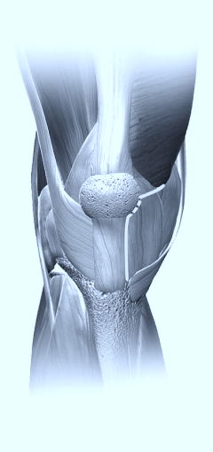
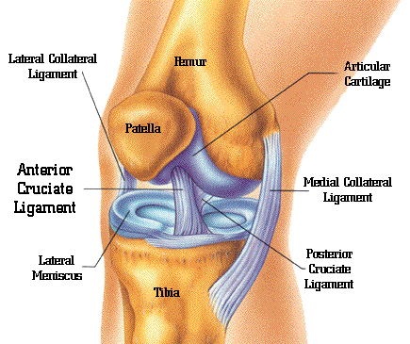
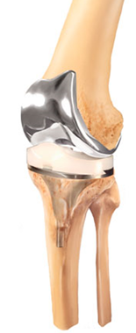
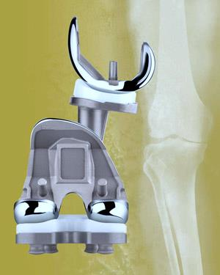
Standard Knee Replacement A) GENERAL RS. 175000/- B)CUBICAL Rs.177000/- (C) TWIN RS. 182000/- (D)COMFY RS. 188000 (E) ELITE –Rs. 200000/- (C) MAJESTY-Rs. 217000/-
_{Traditional Implant Material}
Quad Muscle Sparing Surgical Technique.
_{Cruciate Retaining Knee}
Implant Allows 0 to 120 Degree movements
Approved by C.G.H.S. & equivalent institutions
_{Total Surgical Package cost}
Is mentioned above
“This Package Does not include the treatment cost of other associated diseases like Diabetes,Heart, Lung, Liver, kidney or its complications.”

Slide 4
High Flex / Gender Knee Replacement (A) TWIN- 215000/- (B)COMFY- 230000 (C) ELITE- 240000/- (D) MAJESTY-258000/-
Latest High Flexion Thin Profile Implant Material with High Link Cross Poly Insert
Quad Muscle Sparing Surgical Technique.
_{Cruciate Retaining Knee}
Implant Allows 0 t0 155 Degree movements (Equal to Normal Knee)
_{C.G.H.S. & other} Beneficiaries has to pay the deference of the actual expenses.
Total Surgical Package for Single Knee Cost
_{is mentioned above.}
“This Package Does not include the treatment cost of other associated diseases like Diabetes, Heart, Lung, Liver, kidney or its complications.”

Slide 5
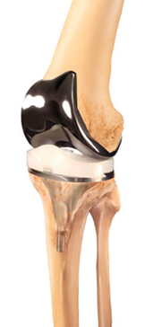
OXINIUM Knee Replacement (A) COMFY- RS. 255000 (B) ELITE- Rs.260000/- (C) MAJESTY- 280000/-
Latest High Flexion Thin Profile Oxinium Implant Material with High Link Cross Poly Insert [Verilast Technology USFDA Approved]
Quad Muscle Sparing Surgical Technique.
_{Cruciate Retaining Knee}
Implant Allows 0 t0 155 Degree movements (Equal to Normal Knee)
_{C.G.H.S. & other} Beneficiaries has to pay the deference of the actual expenses.
Total Surgical Package for Single Knee Cost is mentioned above
“This Package Does not include the treatment cost of other associated diseases like Diabetes, Heart, Lung, Liver, Kidney or its complications.”

Slide 6
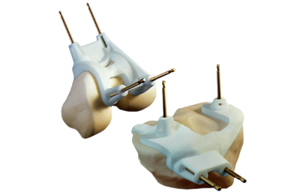
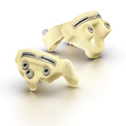
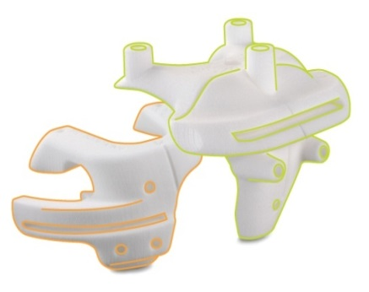
OXINIUM Knee PSI (Custom Made Instrumentation) (A) COMFY- RS. 295000 (B)ELITE-Rs. 300000/- (C) MAJESTY- Rs. 320000/-
Latest High Flexion Thin Profile Oxinium Implant Material with High Link Cross Poly Insert [Verilast USFDA Approved]
Quad Muscle Sparing Surgical Technique & Cruciate Retaining Knee
For Patient Specific Customized Instrumentation, One Has to Pay 40000/- Extra for special MRI, X-Rays & Instrumentation making charges.,
Implant Allows 0 t0 155 Degree movements (Equal to Normal Knee)
_{C.G.H.S. & other} Beneficiaries has to pay the deference of the actual expenses.
Total Surgical Package for Single Knee Cost is mentioned above
“This Package Does not include the treatment cost of other associated diseases like Diabetes, Heart, Lung, Liver, kidney or its complications.”

Slide 7
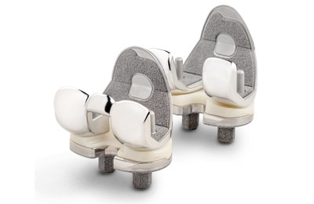
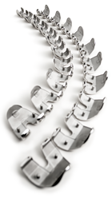
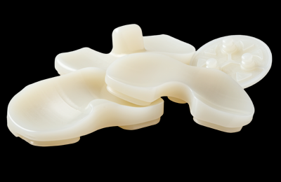

Persona Knee Replacement (A) ELITE- Rs.320000/- (B) MAJESTY- Rs. 337000/-
Persona Knee is the most clinically successful knee, focusing on the unique needs of the patient, custom fit accurate knee implant
Quad Muscle Sparing Surgical Technique & Cruciate Retaining Knee
Implant Allows 0 t0 155 Degree movements (Equal to Normal Knee)
_{C.G.H.S. & other} Beneficiaries has to pay the deference of the actual expenses.
Total Surgical Package for Single Knee Cost is mentioned above.
“This Package Does not include the treatment cost of other associated diseases like Diabetes, Heart, Lung, Liver, kidney or its complications.”
Persona Knee

Slide 8
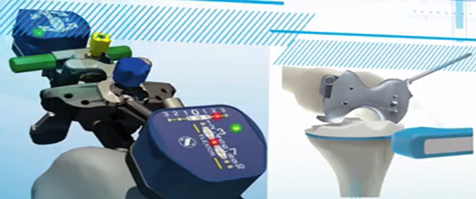
Persona Knee Replacement (with I-assist ) (A) ELITE- Rs.358000/- (B) MAJESTY- 375000/-
Persona Knee is the most clinically successful knee, focusing on the unique needs of the patient, custom fit accurate knee implant
Quad Muscle Sparing Surgical Technique & Cruciate Retaining Knee
I-ASSIST & E-LIBRA is the World’s Most Advanced Knee Replacement system which is done by Computer Chip Integrated Intelligent Customised instrumentation
Implant Allows 0 t0 155 Degree movements (Equal to Normal Knee)
_{C.G.H.S. & other} Beneficiaries has to pay the deference of the actual expenses.
Total Surgical Package for Single Knee Cost is mentioned above(inclusive of Rs 50000/- for I-ASSIST & _{E-LIBRA Charges).}
“This Package Does not include the treatment cost of other associated diseases like Diabetes, Heart, Lung, Liver, kidney or its complications.”
Persona Knee
I-ASSIST
E-LIBRA

Slide 9
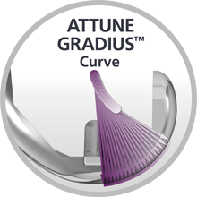
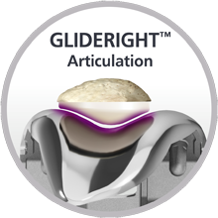
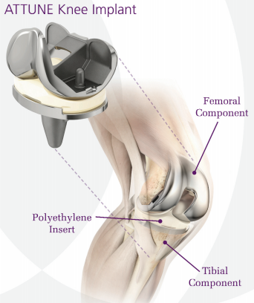
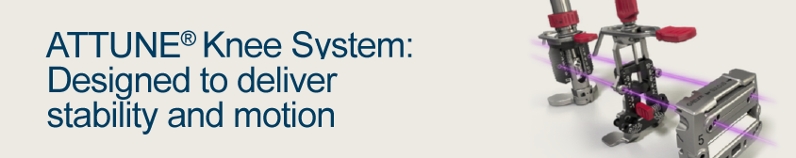
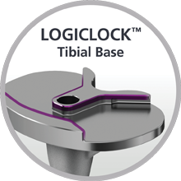
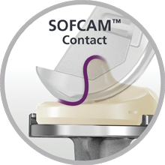
Attune Knee Majesty- Rs. 450000/-
A FULLy INTEGRATED TOTAL KNEE SYSTEM
The INTUITION™ Instrumentation for Perfect Precise Control
Gives Full stability in motion
Gradius Curve Femoral Component
Perfect Glide Ride Patella
Logi-Lock Tibial tray
Sofcam for PS Version

Slide 10
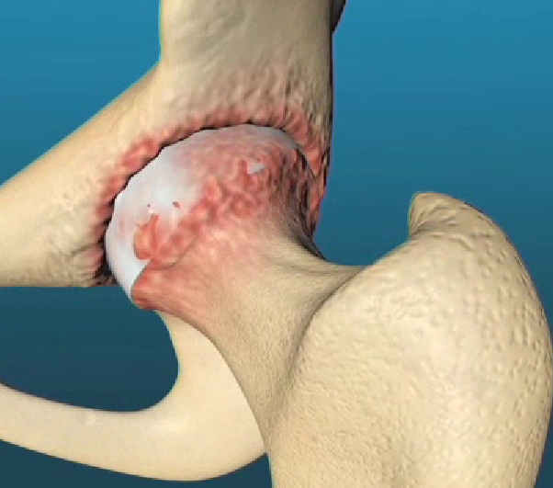
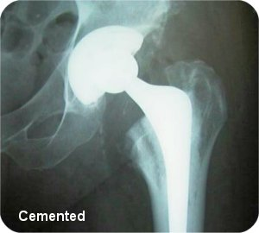
Economy Package for Cemented Hip Replacement (A)GENERAL- RS. 145000 (B) CUBICAL- Rs. 150000/- (C) TWIN- Rs. 158000/- (D)COMFY RS. 164000/-
Cemented Cobalt Chrome on second Generation poly Implant Material
Muscle Sparing Surgical Technique.
_{MIS Surgical Approach}
Implant & Surgery Allows limited Range of movements. (Squatting & sitting on ground to be avoided)
Approved by CGHS/ECHS, Insurance & other Beneficiary Institutions
Total Surgical Package cost is mentioned above
“This Package Does not include the treatment cost of other associated diseases like Diabetes, Heart, Lung, Liver, kidney or its complications.”

Slide 11
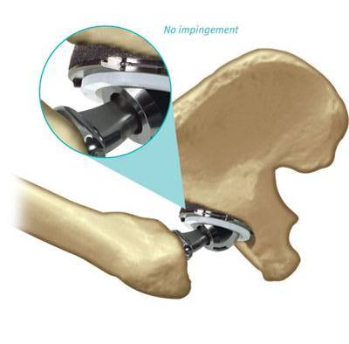
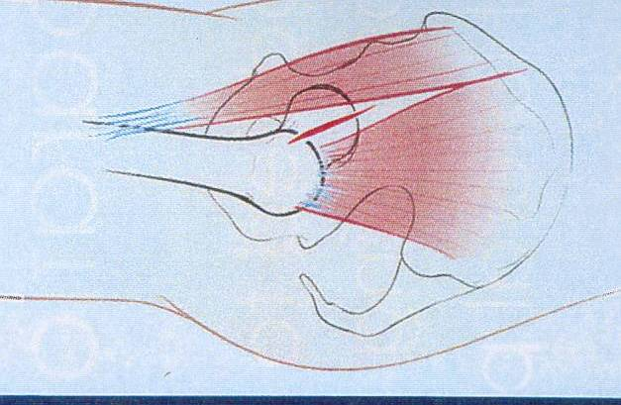
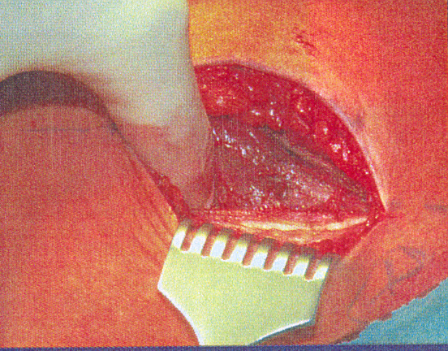
Standard Package for Cement less Hip Replacement (A) CUBICAL-Rs. 220000/- (B) TWIN- Rs. 225000/- (C) COMFY –RS. 232000/- (D) ELITE- Rs. 240000/-
_{Un-cemented Implant Material}
Muscle Sparing Surgical Technique.
_{MIS Surgical Approach}
Implant & Surgery Allows Full Range of movements
Approved by Insurance & other Beneficiary Institutions. .(Not payable by CGHS/ECHS etc.)
_{Total Surgical Package cost is}
mentioned above.
“This Package Does not include the treatment cost of other associated diseases like Diabetes, Heart, Lung, Liver, kidney or its complications.”

Slide 12
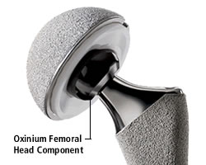
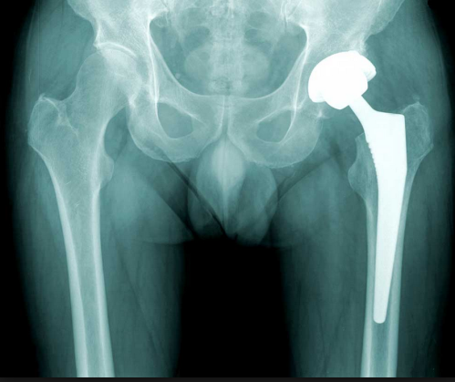
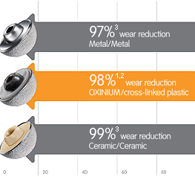
Deluxe Package for cement less Oxinium Hip Replacement (A) ELITE- Rs.265000/- (B) MAJESTY- Rs. 285000/-
Un-cemented Oxinium on Cross poly Implant Material, or Ceramic on Cross-poly
Muscle Sparing Surgical Technique.
_{MIS Surgical Approach}
Implant & Surgery Allows Full Range of movements
Approved by Insurance & other Beneficiary Institutions.(Not payable by CGHS/ECHS etc.)
_{Total Surgical Package cost is}
mentioned above
“This Package Does not include the treatment cost of other associated diseases like Diabetes, Heart, Lung, Liver, kidney or its complications.”

Slide 13
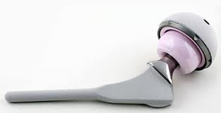
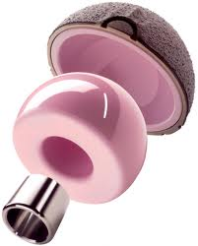
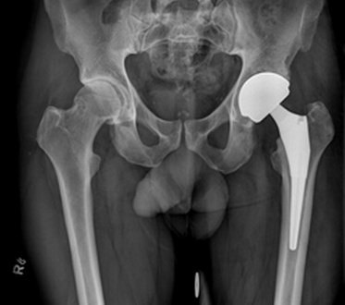
Super Deluxe Package for Cement less Ceramic Hip Replacement (Rs. 318000/-)
Un-cemented Ceramic on ceramic Implant Material
Muscle Sparing Surgical Technique.
_{MIS Surgical Approach}
Implant & Surgery Allows Full Range of movements
Approved by Insurance & other Beneficiary Institutions. (Not payable by CGHS/ECHS etc.)
Total Surgical Package cost Rs.290000/-
“This Package Does not include the treatment cost of other associated diseases like Diabetes,Heart, Lung, Liver, kidney or its complications.”

