Slide 1

ENHANCED AGRICULTURAL MANAGEMENT APPROACH FROM SUSTAINABLE CROP PRODUCTION TO SELLING INCLUDING CROP INSURANCE AND STUBBLE UTILIZATION FRAMEWORK USING BLOCK CHAIN SECURITY WITH IOT & MACHINE LEARNING ALGOIRITHMS
KKR & KSR INSTITUTE OF TECHNOLOGY AND SCIENCES
Team Members:
Divvela Sindhu Venkata Durga Gowri (20JR1A0523)
Chatharasupalli Gayathri (20JR1A0510)
Jagarlamudi Sai Sathvika (20JR1A0528)
Mathe Vijaya Mercy (21JR5A0504)
Project Guide:
Dr. Chittineni Aruna
Professor & Head-Administration
Computer Science and Engineering

Slide 2
Abstract
Agriculture, pivotal for a country with the largest global population, faces challenges in maintaining an efficient supply chain and ensuring data transparency. This initiative aims to revolutionize the agricultural sector by leveraging blockchain technology. The implementation of blockchain addresses issues such as fraud prevention, enhancement of food safety, quality management, and ensuring equitable prices for farmers. Incorporating IoT sensors generates valuable data reflecting crop quality, while machine learning algorithms analyze this data for effective crop disease detection. The introduction of a bidding smart contract streamlines the crop-selling process, facilitating insurance claims for farmers, with all pertinent information securely stored in an immutable and transparent ledger. Additionally, optimizing the treatment of crop remnants contributes to increased farmer income. By seamlessly integrating these technologies with agriculture, overall efficiency and the potential of the agricultural sector are significantly heightened.

Slide 3
Introduction
The integration of IoT technologies in agriculture facilitates real-time data access, with key parameters such as soil moisture levels, temperature, air quality, soil fertility, and light intensity contributing significantly to crop quality determination.
Blockchain emerges as a critical component for ensuring security and trust in agricultural processes and supply chains. The utilization of a distributed ledger is pivotal in storing essential data, including crop quality information, sales transactions, and stubble-related documentation.
Machine learning algorithms further enhance precision by detecting crop diseases and providing tailored remedies for optimal results in agricultural practices.

Slide 4
Literature Review
1.The integration of IoT, Machine Learning, and Blockchain in precision agriculture, as explored by Akhila Susan Babu and Supriya M, promises to revolutionize farming practices by optimizing resource usage, enhancing product quality, and ensuring transparent transactions throughout the supply chain. Their comprehensive review underscores the potential of these technologies to empower farmers with data-driven insights and secure, traceable transactions, paving the way for a more sustainable and efficient agricultural ecosystem.
2. The work by Hajar Moudoud, Soumaya Cherkaoui, and Lyes Khoukhi introduces LC4IoT, a specialized blockchain architecture tailored for supply chains integrating distributed IoT entities. Their innovative approach incorporates a lightweight consensus mechanism, effectively reducing computational requirements, storage overhead, and latency, thereby enhancing the efficiency and scalability of supply chain operations.
3. M. Harini, D. Dhinakaran, D. Prabhu, S. M. Udhaya Sankar, V. Pooja, and P. Kokila Sruthi explore blockchain's impact on India's agriculture. Their study emphasizes enhanced supply chain management, transparency, and efficiency through IoT data, machine learning, and smart contracts, offering insights for sustainable growth.
4. S. Madumidha, P. Siva Ranjani, U. Vandhana, and B. Venmuhilan propose a decentralized blockchain traceability system for

Slide 5
Literature Review
agriculture food supply chains. Their focus on transparency, security, and traceability aims to enhance community engagement and satisfaction, ensuring trust and accountability from providers to consumers in the agricultural ecosystem.
5. Kavita Saini, Ishika Mishra, and Shreya Srivastava examine the significance of e-commerce in enhancing business profitability. Their paper delves into the creation of an e-commerce platform for Indian farmers, aiming to eliminate intermediaries and overcome challenges through careful planning, domain modeling, and architectural patterns.
6. H. Binici, M. Eken, M. Kara, and M. Dolaz investigate the use of sunflower stalks, cotton textile waste, and stubble as composite materials for insulation production. Their study aims to decrease heating and cooling expenses while tackling environmental concerns related to sunflower stem disposal.
7. Miguel Pincheira Caro, Muhammad Salek Ali, Massimo Vecchio, and Raffaele Giaffreda present AgriBlockIoT, a decentralized blockchain-based traceability solution for Agri-Food supply chains. Seamlessly integrating IoT devices, it tackles data integrity and transparency issues. The study assesses Ethereum and Hyperledger Sawtooth implementations' performance in a comprehensive from-farm-to-fork use-case evaluation.

Slide 6
Literature Review
8. Aloysius Chiong Zhen Quan, Khairunnisa binti Sufian, Ng Sing Woei, Lai Li Ying, and Amanda Ling Tzi Yun introduce FarmBid, an integrated e-commerce platform addressing contract farming challenges in Malaysia. By facilitating direct sales and offering standardized delivery services, it empowers farmers, enhances their bargaining power, and ultimately improves their income prospects.
9. Rahul Talreja, Rohan Chouksey, and Sushma Verma present a farmer's portal leveraging blockchain technology and Python programming. This integration ensures secure and immutable recording of crop transactions, enhancing transparency and economic efficiency in agricultural operations.

Slide 7
Review Findings
Here are some review findings for the existing agricultural management system:
Reviewers noted that accessing real-time data on soil parameters and atmospheric conditions was challenging due to connectivity issues and outdated technology.
Farmers expressed frustration with the limited availability of data, hindering their ability to make informed decisions about crop management.
Users highlighted the reliance on manual intervention for irrigation practices as a major drawback.
Manual irrigation control led to inefficiencies and inconsistencies in water usage, resulting in suboptimal crop growth and yield.
Reviewers found that the existing disease detection methods were not always accurate or timely.
Delayed or inaccurate diagnosis of crop diseases resulted in increased risk of crop loss and reduced productivity. • Users reported inefficiencies in the existing selling mechanisms, such as delays and disputes in transactions.

Slide 8
Review Findings
Lack of transparency and reliability in the selling process posed challenges for both farmers and buyers.
It was observed that crop residues (stubble) were often underutilized, representing a missed opportunity for additional income generation.
Reviewers noted a lack of effective mechanisms for stubble utilization, leading to environmental and economic inefficiencies.
Users expressed concerns about the limited coverage and flexibility of existing insurance schemes.
Some farmers felt that the available insurance options did not adequately protect against various risks, leaving them financially vulnerable.
Reviewers found the user interface to be complex and difficult to navigate, especially for users with limited technical expertise.
Complicated user interface design led to user frustration and reduced system adoption rates.

Slide 9
Existing Systems
In this study, precision agriculture is explored through the integration of IoT, Machine Learning, and blockchain technologies on a permission-based blockchain network. The implementation, utilizing IBM dependencies, ensures secure and efficient communication among interconnected elements in agriculture. The research successfully demonstrates the incorporation of IoT data for crop recommendations, secured by blockchain, and envisions future enhancements, such as cloud deployment for broader accessibility and the exploration of public/private sub-networks for specific agricultural groups within the main network. The study highlights the potential of technology convergence in optimizing resource utilization and communication in precision agriculture.

Slide 10
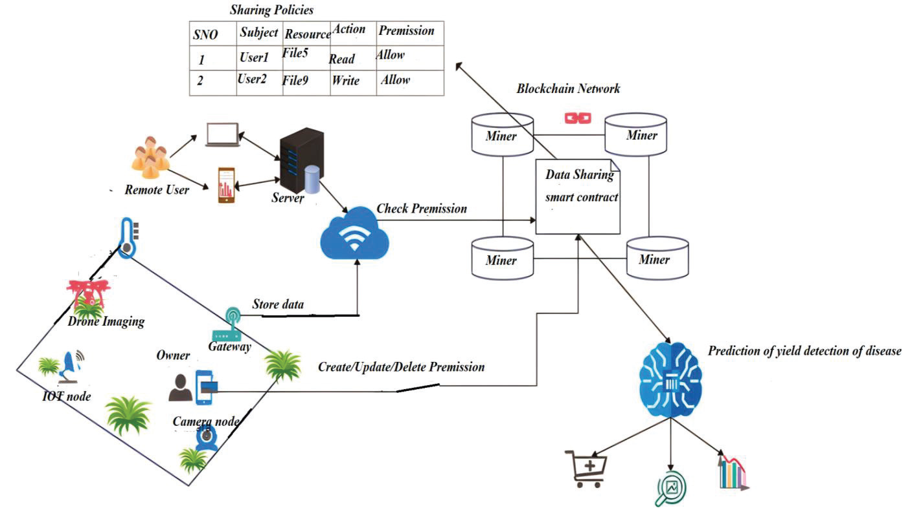
Existing Systems(Contd..)
By leveraging IoT sensors for data collection and machine learning for crop analysis, blockchain integration streamlines the supply chain, reducing middlemen, transaction costs, and enhancing farmer profits. The proposed methodology ensures secure, transparent, and efficient transactions, facilitating easy insurance claims for farmers. In conclusion, blockchain has the potential to revolutionize the entire food and agriculture supply chain, fostering trust, reducing fraud, and increasing overall efficiency. Future advancements are expected to introduce even more cutting-edge applications in the agriculture sector.

Slide 11
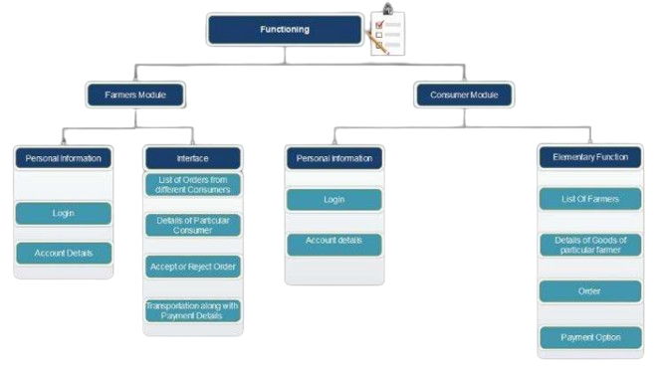
Existing Systems(Contd..)
The proposed web application serves as a bridge between farmers and consumers, offering farmers an additional income source by enabling direct product sales through electronic media. By empowering farmers to manage complete payments independently, it eliminates middlemen involvement prevalent in traditional mandi systems. The platform caters to two primary users: farmers, who showcase crop information and rates on the website, and consumers, who place orders with a 40% advance payment. The application's workflow involves HTML, CSS3, and Vanilla JavaScript for frontend design and functionality, integrated with Django for backend support. The system undergoes testing and improvements before delivering results, ensuring a seamless and efficient agricultural marketplace.

Slide 12
Problem Identification
The problems that gave rise to our proposed system:
Concerns about accuracy and reliability of collected data, especially in challenging environments.
Challenges related to storage capacity, scalability, and management in centralized repository.
Accuracy concerns with disease identification system using machine learning algorithms.
Issues with integrating blockchain, including scalability and transaction speed.
Managing multiple selling methods (individual buyers, bidding contracts, digital market).
Challenges in logistics and coordination for selling stubble to bioenergy industries.
Accessibility and suitability concerns for farmers regarding insurance schemes.

Slide 13
Proposed System
A comprehensive dataset is systematically compiled, encompassing soil parameters (Fertility - Nitrogen, Phosphorus, Potassium), moisture levels, and atmospheric parameters (air quality, temperature, light intensity).
Collected data is presented to farmers at 2-hour intervals, stored temporarily in a centralized repository, allowing for subsequent averaging on a daily, monthly, and blockchain-compatible block level.
Utilizing moisture data, an automated irrigation system is implemented, enabling the automatic activation or deactivation of the water motor without direct farmer intervention, optimizing water resource utilization.
A sophisticated disease identification system employs machine learning algorithms to detect crop diseases, providing farmers with precise organic remedies.
Results from disease identification are securely stored in the blockchain network, ensuring transparency and traceability.
Three distinct methods for crop selling are proposed:
1. Individual Buyer Transactions 2. Bidding Smart Contracts 3. Digital Market Interface

Slide 14
Proposed System(Cont’d..)
Crop residues, or stubble, are repurposed by selling them to bioenergy-producing industries in proximity to the farmer's location, contributing to additional income.
The conclusive report on stubble sales is recorded in the blockchain by the farmer, ensuring a transparent and verifiable transaction history.
A catalog of insurance schemes is made available to farmers, providing options tailored to individual needs and addressing potential risks associated with natural calamities.
Farmers can apply for relevant insurance schemes based on their specific requirements, promoting risk mitigation and financial security.
All critical data, including crop parameters, disease identification results, crop selling transactions, stubble sales, and insurance schemes, is securely stored in the blockchain.
Blockchain technology ensures immutability, transparency, and traceability, enhancing the overall integrity and reliability of the agricultural system.

Slide 15
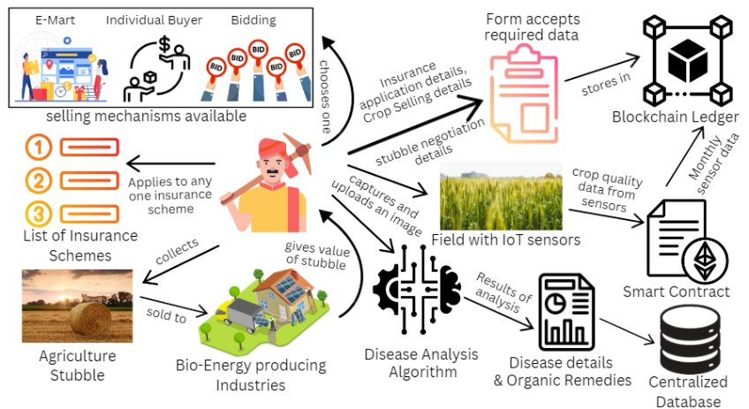

Slide 16
Benefits of the proposed system
Enhanced Data Management:The system offers farmers significant insights into their agricultural operations through the methodical compilation and storage of extensive statistics that include soil properties, moisture levels, atmospheric parameters, and crop data.
Better Decision-Making: Farmers can make well-informed decisions about crop management, irrigation, and disease prevention since they receive real-time data every two hours. For improved trend analysis and long-term planning, an averaging on daily, monthly, and blockchain-compatible block levels is then provided.
Optimized Resource Utilization: The automated irrigation system saves money and conserves water by using moisture data to determine when to turn on or off the water motor without the need for human interaction.
Enhanced Disease Detection and Management: To precisely identify agricultural illnesses, the advanced disease identification system uses machine learning algorithms. This helps farmers to minimize crop losses and increase output by enabling them to act promptly and apply accurate organic solutions.
Transparent and Secure Transactions: The application of blockchain technology guarantees traceability and transparency in insurance plans, stubble sales, and crop sales. Farmers have three options for selling their crops, and the blockchain securely stores all relevant data, encouraging honesty and integrity in farming dealings.

Slide 17
Benefits of the proposed system
Additional Income Opportunities: Farmers can generate extra revenue by selling their crop remains, or stubble, to businesses that produce bioenergy. The final report on stubble sales that is stored on the blockchain guarantees clear and corroborated transactions, which increases confidence even more.
Risk Mitigation and Financial Security: Farmers can reduce the risks associated with natural disasters by choosing from a variety of insurance plans that are customized to meet their specific needs. In order to provide financial stability and security in the face of unanticipated catastrophes, farmers can apply for appropriate insurance plans depending on their unique circumstances.
Integrity and Reliability: The system guarantees immutability, transparency, and traceability by securely storing all crucial data on the blockchain, including crop parameters, disease identification results, crop selling transactions, stubble sales, and insurance schemes. This builds stakeholder trust by improving the agricultural system's overall integrity and dependability.

Slide 18
Potential Users
Farmers
Crop Buyers/Stakeholders
Bioenergy-producing Industries
Insurance Providers
Government Agencies (Agricultural and Environmental)
End Consumers (for direct digital market transactions)
Environmental Agencies (related to stubble management)

Slide 19
Area Specification
Data Collection and Monitoring:- Soil parameters, Atmospheric parameters, Frequency
Temporary Centralized Storage:- Monthly range averaging, Storage in a blockchain as a block.
Automated Water Motor Control:- Based on moisture data, automatically controls water motor without farmer involvement.
Disease Identification System:- Identifies diseases in crops, Recommends organic remedies.
Crop Selling Mechanisms:- Individual buyers list., Smart contract-based bidding system, Digital market UI for direct farmer-to-consumer transactions.
Stubble Utilization:- Stubble sold to bioenergy-producing industries.
Insurance Schemes:- List of insurance schemes for farmers.
Blockchain Integration:- Storage of final reports in blockchain, Farmer contributes data to the blockchain.

Slide 20
Unique Features of the System
Organic Remediation for disease identified
Diversified Crop Selling Mechanisms
Stubble Monetization Strategy
Blockchain-Logged Transaction History
Tailored Insurance Scheme Catalog
User-Friendly Digital Market Interface
Comprehensive Monthly Averaging

Slide 21
Technologies of Proposed System
IoT
Machine Learning Algorithm
Blockchain
Mobile Application Development / Web Development
Database Management
Programming Languages

Slide 22
Demand for the Product
Growing Agricultural Technology Adoption
Rising Awareness of Sustainable Practices
Need for Data-driven Decision-making
Market Demand for Crop Quality Assurance
Increased Interest in Blockchain Security
Shift Towards Direct-to-Consumer Models
Financial Incentives for Stubble Utilization
Risk Mitigation through Insurance
Overall Agricultural Sector Modernization

Slide 23
Design constraints
Scalability: The system must be designed to accommodate a large volume of data generated by IoT sensors and machine learning algorithms as the agricultural operations scale up.
Interoperability: Ensure compatibility and seamless integration with existing agricultural technologies and platforms to facilitate widespread adoption.
Resource Efficiency: Given the often remote and resource-constrained environments in which agriculture operates, the system should be optimized for minimal energy consumption and bandwidth usage.
Data Privacy and Security: Implement robust encryption and authentication measures to safeguard sensitive agricultural data against unauthorized access, ensuring compliance with data protection regulations.
User-Friendliness: Design user interfaces that are intuitive and accessible to farmers with varying levels of technological proficiency, promoting adoption and usability.
Reliability and Availability: The system should be designed with redundancies and failover mechanisms to ensure uninterrupted access to critical agricultural data and services.

Slide 24
Design constraints
Cost-effectiveness: Develop solutions that are economically viable for farmers, considering factors such as initial setup costs, ongoing maintenance expenses, and affordability in low-income agricultural communities.
Regulatory Compliance: Ensure adherence to relevant agricultural, environmental, and financial regulations governing data management, crop sales, insurance, and other aspects of agricultural operations.
Infrastructure Constraints: Account for limitations in internet connectivity, power supply, and hardware availability in rural agricultural areas when designing and deploying the system.
Adaptability and Future-proofing: Build the system with flexibility to accommodate future technological advancements, changes in agricultural practices, and evolving regulatory requirements over time.

Slide 25
Requirements Analysis
The functions involved in this project are:
User Authentication and Authorization
Data Collection and Display
Automatic Irrigation Control
Disease Identification and Remedy Recommendation
Crop Selling Mechanisms
Stubble Utilization
Insurance Scheme Management
Now we will analyze each function individually..

Slide 26
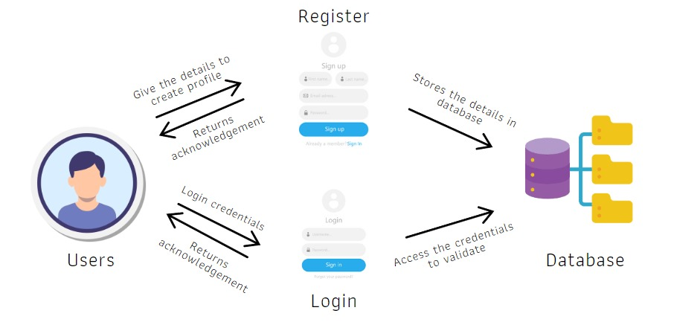
1. User Authentication and Authorization

Slide 27
1. Functional Requirements
Authenticate users based on provided credentials (e.g., username and password).
Verify user identity against stored user data (e.g., in a database).
Grant access to authorized users based on defined roles and permissions.
Deny access to unauthorized users and provide appropriate error messages.
Support multi-factor authentication methods for enhanced security.
Enable password reset and account recovery mechanisms
2. Non-Functional Requirements
Security: Ensure secure transmission and storage of user credentials using encryption protocols.
Performance: Authenticate users within a specified time frame to minimize login delays.
Scalability: Handle authentication requests from a large number of concurrent users.
Usability: Provide a user-friendly interface for login and authentication processes.
Reliability: Ensure high availability of authentication services to prevent system downtime.
Compliance: Adhere to relevant security standards and regulations (e.g., GDPR, HIPAA).

Slide 28
3. User Requirements
Users should be able to log in using a username and password combination.
Users may require assistance with password reset and account recovery processes.
Users should receive clear and informative messages in case of authentication failures.
4. Hardware Requirements
Server infrastructure to host authentication services.
Network infrastructure to facilitate communication between clients and authentication server.
5. Software Requirements
Authentication software (e.g., LDAP, Active Directory) for verifying user credentials.
Encryption protocols (e.g., SSL/TLS) for secure transmission of authentication data.
Database software to store user authentication data (e.g., usernames, passwords, roles).
Multi-factor authentication tools or libraries for implementing additional security measures.

Slide 29
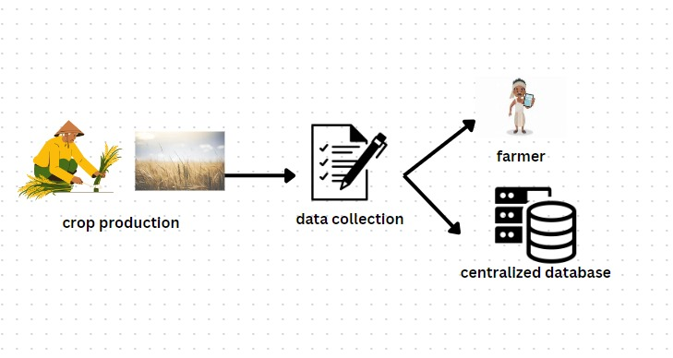
2. Data Collection and Display

Slide 30
1. Functional Requirements
Collect data on soil parameters (Fertility: Nitrogen, Phosphorus, Potassium), moisture levels, and atmospheric parameters (air quality, temperature, light intensity).
Display real-time data to farmers at regular intervals (e.g., every 2 hours).
Store collected data in a centralized storage system for further analysis.
Calculate daily and monthly averages of collected data.
Provide a user-friendly interface for farmers to view the collected data.
2. Non-Functional Requirements
Performance: Collect and display data efficiently to minimize delays in updating information for farmers.
Scalability: Handle a large volume of data from multiple sensors and users.
Reliability: Ensure accurate and reliable data collection and display to support decision-making by farmers.
Usability: Design the user interface to be intuitive and easy to navigate for farmers of varying technical expertise.
Data Accuracy: Ensure the accuracy and precision of collected data to provide reliable insights to farmers.

Slide 31
3. User Requirements
Farmers should be able to access the data collection and display system from any device with internet access.
Farmers may require training on how to interpret the displayed data and make informed decisions based on it.
4. Hardware Requirements
Sensors for collecting data on soil parameters, moisture levels, and atmospheric parameters.
Server infrastructure to host the centralized storage system for collected data.
Network infrastructure to facilitate communication between sensors, servers, and user devices.
5. Software Requirements
Data collection software to gather information from sensors and store it in the centralized storage system.
Data display software to visualize the collected data in a user-friendly format for farmers.
Database software to manage the storage and retrieval of collected data.
Web application or mobile application for farmers to access the data collection and display system.

Slide 32
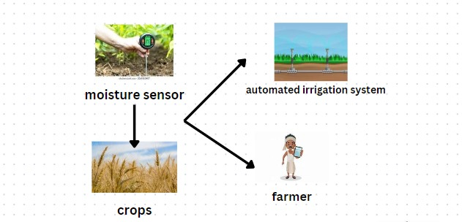
3.Automatic Irrigation Control

Slide 33
1. Functional Requirements
Monitor soil moisture levels using sensors.
Automatically activate or deactivate the water motor based on soil moisture data.
Implement scheduling capabilities to adjust irrigation timing as needed.
Provide manual override functionality for farmers to control irrigation manually if required.
2. Non-Functional Requirements
Reliability: Ensure accurate and timely control of irrigation based on soil moisture data.
Efficiency: Optimize water usage by irrigating only when necessary, based on real-time soil moisture conditions.
Scalability: Support irrigation control for large agricultural areas with multiple zones.
Robustness: Handle communication failures or sensor malfunctions gracefully to prevent irrigation errors.
Compatibility: Integrate with existing irrigation systems and infrastructure on the farm.

Slide 34
3. User Requirements
Farmers should be able to set irrigation schedules and thresholds for automated control.
Farmers may require training on how to configure and use the automatic irrigation control system.
4. Hardware Requirements
Soil moisture sensors distributed throughout the agricultural area.
Water motor or irrigation system capable of automated control based on external signals.
Microcontroller or PLC (Programmable Logic Controller) to process sensor data and control irrigation equipment.
5. Software Requirements
Control software to interface with soil moisture sensors and irrigation equipment.
User interface for farmers to configure irrigation settings, view sensor data, and monitor irrigation activities.
Communication protocols (e.g., MQTT, Modbus) for data exchange between sensors, controllers, and user interfaces.
Integration with existing farm management software or IoT platforms for data analysis and reporting.

Slide 35
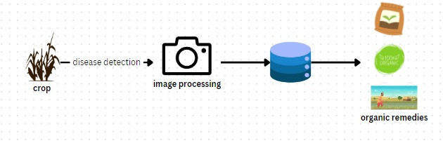
4. Disease Identification and Remedy Recommendation

Slide 36
1. Functional Requirements
Analyze collected data on crop health and symptoms to identify potential diseases.
Utilize machine learning algorithms to classify and diagnose crop diseases based on symptoms.
Recommend organic remedies or treatments for identified diseases based on established best practices.
Provide farmers with detailed information on recommended remedies, including application instructions and dosage.
2. Non-Functional Requirements
Accuracy: Ensure accurate identification of crop diseases to prevent misdiagnosis and ineffective treatments.
Speed: Process disease identification and remedy recommendation quickly to provide timely assistance to farmers.
Scalability: Support the identification and recommendation for a wide range of crop diseases across different crops and regions.
Reliability: Deliver consistent and reliable recommendations under varying environmental conditions and crop health states.
Usability: Design user interfaces to be intuitive and easy to understand for farmers with varying levels of technical expertise.

Slide 37
3. User Requirements
Farmers should be able to easily submit images or descriptions of crop symptoms for analysis.
Farmers may require guidance on interpreting disease identification results and implementing recommended remedies.
4. Hardware Requirements
Cameras or imaging devices for capturing images of crop symptoms.
Processing hardware (e.g., servers, cloud infrastructure) for running machine learning algorithms and recommending remedies.
5. Software Requirements
Disease identification software employing machine learning models for analyzing crop symptoms and diagnosing diseases.
Database or knowledge base containing information on crop diseases, symptoms, and organic remedies.
User interface (web or mobile application) for farmers to submit symptom data, view diagnosis results, and receive remedy recommendations.
Integration with existing agricultural management systems or IoT platforms for seamless data exchange and analysis.

Slide 38
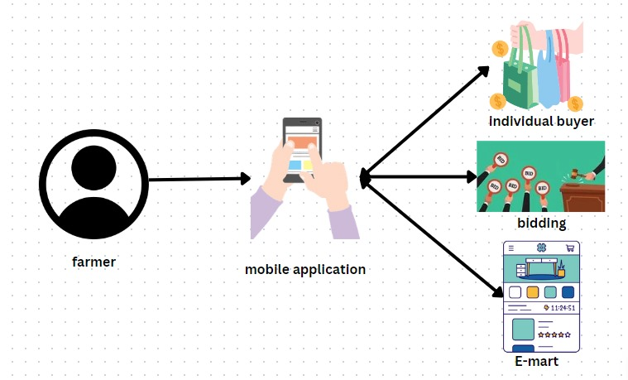
5. Crop Selling Mechanisms

Slide 39
1. Functional Requirements
Individual Buyers List:
Maintain a list of individual buyers interested in purchasing crops directly from farmers.
Enable farmers to view and contact individual buyers for selling their crops.
Bidding Smart Contracts:
Develop smart contracts to facilitate crop selling through bidding.
Allow farmers to list their crops for auction and specify minimum bid prices.
Enable buyers to place bids on listed crops, with the highest bid winning the auction.
Digital Market Interface:
Design a user-friendly digital market interface for farmers to list their crops.
Provide features for farmers to upload crop details, pricing, and images.
Allow end consumers to browse and directly purchase crops from the digital market interface.
2. Non-Functional Requirements
Security: Ensure secure transactions and data protection in all crop selling mechanisms.
Reliability: Ensure the reliability and integrity of the bidding and purchasing processes.
Scalability: Support a large number of transactions and users on the digital market interface.
Usability: Design intuitive user interfaces for easy navigation and interaction.
Performance: Provide fast response times and seamless user experiences during bidding and purchasing processes.

Slide 40
3. User Requirements
Farmers should be able to easily list their crops for sale and manage their listings.
Buyers should have access to a variety of crops and convenient purchasing options.
End consumers should be able to trust the authenticity and quality of the crops available for purchase.
4. Hardware Requirements
Server infrastructure to host the digital market platform and smart contracts.
Network infrastructure to facilitate communication between buyers, sellers, and the platform.
5. Software Requirements
Development of smart contracts using blockchain technology for secure and transparent transactions.
Design and implementation of a digital market interface using web or mobile application development technologies.
Integration with payment gateways and cryptocurrency wallets for secure financial transactions.

Slide 41
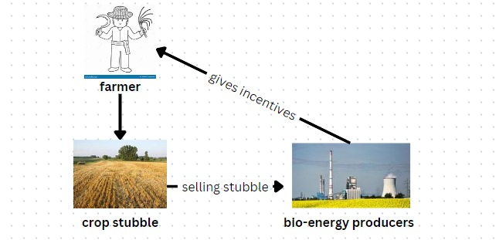
6. Stubble Utilization

Slide 42
1. Functional Requirements
Listing Industries: Maintain a list of bioenergy-producing industries interested in purchasing stubble.
Selling Process: Facilitate the selling of stubble to bioenergy-producing industries through a transparent and efficient process.
Reporting: Generate reports on stubble sales transactions and earnings for farmers.
Blockchain Integration: Store stubble sales data securely in the blockchain for transparency and traceability.
2. Non-Functional Requirements
Reliability: Ensure the reliability and accuracy of the stubble sales process.
Scalability: Support the sale of stubble from a large number of farmers to multiple bioenergy-producing industries.
Transparency: Provide transparent and verifiable stubble sales transactions for both farmers and industries.
Security: Protect stubble sales data stored in the blockchain from unauthorized access or tampering.
Efficiency: Streamline the stubble sales process to minimize delays and administrative overhead.

Slide 43
3. User Requirements
Farmers should have access to a platform or system for listing and selling their stubble.
Bioenergy-producing industries should be able to easily browse and purchase stubble from farmers.
Both farmers and industries should receive timely and accurate reports on stubble sales transactions.
4. Hardware Requirements
Server infrastructure to host the stubble sales platform or system.
Network infrastructure to facilitate communication between farmers, industries, and the platform.
5. Software Requirements
Implementation of a stubble sales platform or system with user interfaces for farmers and industries.
Integration with blockchain technology for securely storing stubble sales data and reports.

Slide 44
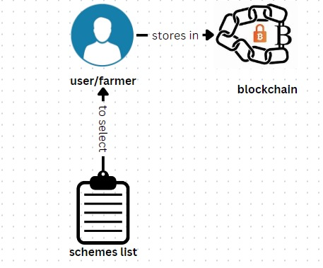
7. Insurance Scheme Management

Slide 45
1. Functional Requirements
Scheme Listing: Provide a comprehensive list of available insurance schemes tailored to the needs of farmers.
Blockchain Integration: Enable farmers to store final insurance scheme reports securely in the blockchain.
2. Non-Functional Requirements
Security: Ensure secure storage and access to final insurance scheme reports stored in the blockchain.
Usability: Design user-friendly interfaces for farmers to easily browse and select insurance schemes and to upload final reports to the blockchain.

Slide 46
3. User Requirements
Farmers should have access to a platform or system for browsing and selecting insurance schemes.
Farmers should be able to securely store final insurance scheme reports in the blockchain, ensuring data integrity and transparency.
4. Hardware Requirements
Server infrastructure to host the platform or system for scheme listing and blockchain integration.
Network infrastructure to support communication between farmers and the platform or system.
5. Software Requirements
Development of a user interface for farmers to browse and select insurance schemes.
Integration with blockchain technology to enable farmers to securely store final insurance scheme reports.
Implementation of security measures to protect data integrity and prevent unauthorized access to the blockchain.

Slide 47
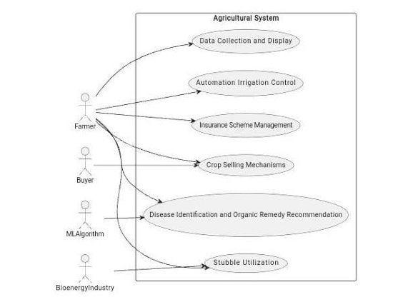
UML Diagrams Usecase diagram

Slide 48
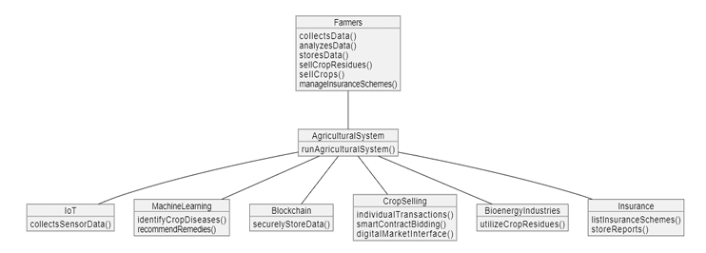
Object diagram

Slide 49
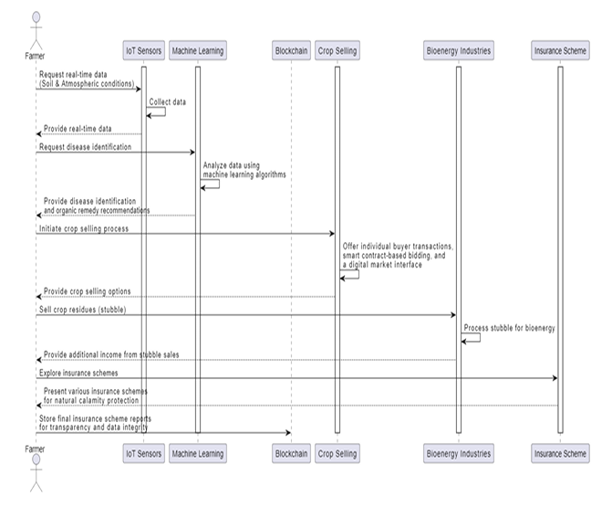
Sequence Diagram

Slide 50
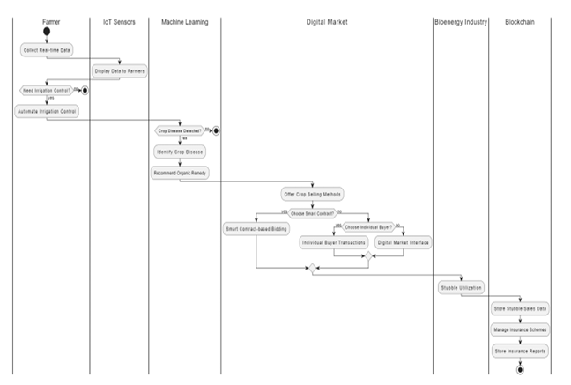
Activity Diagram

Slide 51
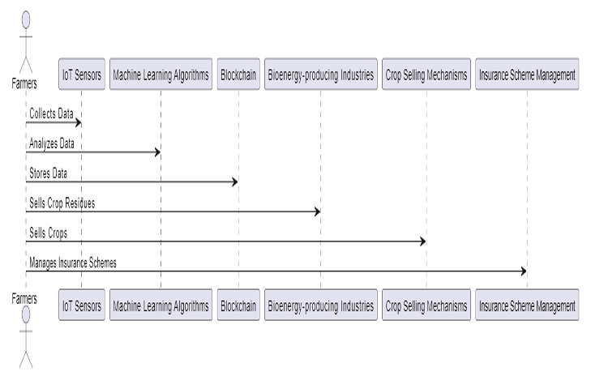
Collaboration diagram

Slide 52
Algorithmic Design
1. Start
2. Farmers register on the dedicated agricultural platform with valid credentials.
3. Upon successful registration, farmers log in to the platform to access its features.
4. IoT sensors are deployed across agricultural fields to collect real-time data on soil parameters, moisture levels, and atmospheric conditions.
5. Data from IoT sensors is transmitted to the platform's server for processing and analysis.
6. Machine learning algorithms analyze the collected data to detect crop diseases and provide tailored remedies.
7. Results from disease identification are securely stored in the blockchain network, creating an immutable ledger.
8. The platform presents collected data to farmers at 2-hour intervals through a user-friendly interface.
9. Utilizing moisture data, an automated irrigation system is activated or deactivated without direct farmer intervention, optimizing water resource utilization.
10. Three distinct methods for crop selling are provided: Individual Buyer Transactions, Bidding Smart Contracts, and Digital Market Interface.
11. Crop residues, or stubble, are repurposed by selling them to bioenergy-producing industries, contributing to additional farmer income.

Slide 53
Algorithmic Design
15. All critical data, including crop parameters, disease identification results, crop selling transactions, stubble sales, and insurance schemes, is securely stored in the blockchain.
16. Blockchain technology ensures immutability, transparency, and traceability, enhancing the overall integrity and reliability of the agricultural system.
17. Stopsidues, or stubble, are repurposed by selling them to bioenergy-producing industries, contributing to additional farmer income.

Slide 54
Database Design
1. User Details:
Table that stores the details of users who register for the application.
2. Agro Input Dealers Details:
Table that stores the dealers which sell all the required capital to start a crop production.
3. Sensor data:
Table to store the sensor values.
4. Disease Details:
Table to store disease details and remedies given.
5. Buyers:
Table to store individual buyers.
6. Bio-Energy producers:
Table to store individual buyers.

Slide 55
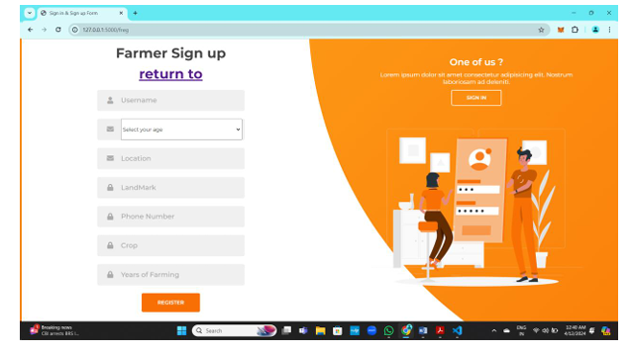
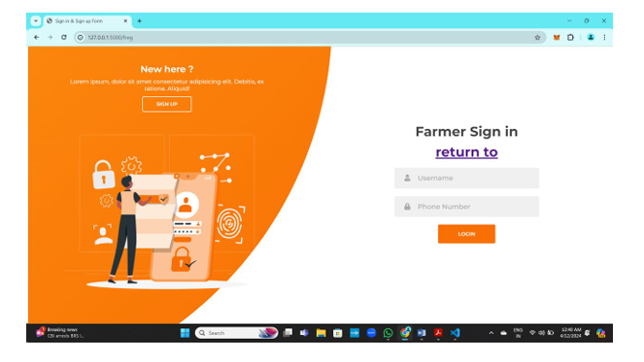
Coding and Outputs

Slide 56
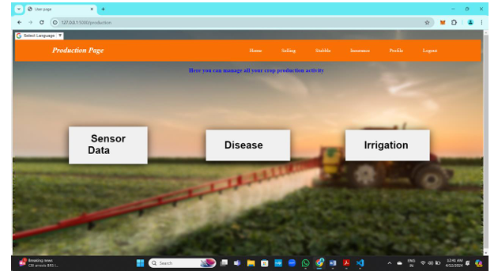
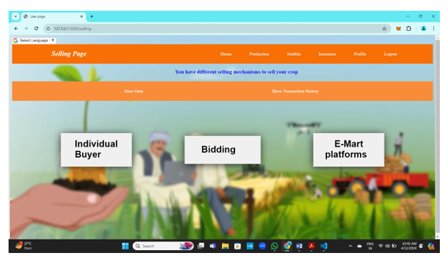
Coding and Outputs

Slide 57
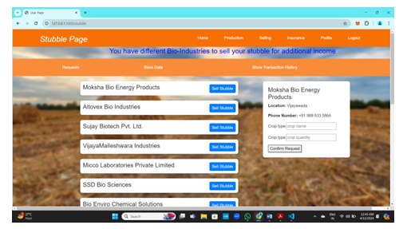
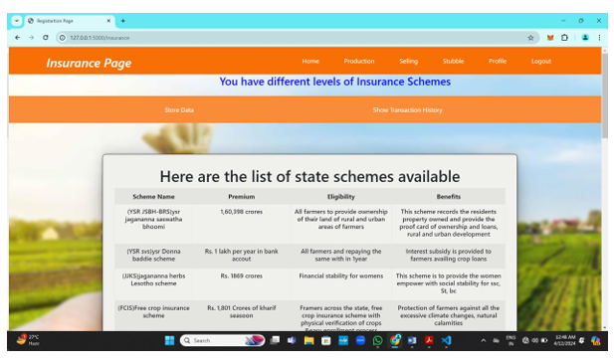
Coding and Outputs

Slide 58
Conclusion
In summary, our agricultural project stands as a testament to the transformative potential of technology in addressing key challenges within the farming industry. By prioritizing user needs and leveraging advanced tools, we have developed a comprehensive solution that addresses critical aspects such as crop monitoring, irrigation management, selling mechanisms, and financial protection. Through collaboration with stakeholders and adherence to best practices, our project not only streamlines existing processes but also sets new standards for efficiency, transparency, and sustainability in agriculture. As we move forward, our commitment to innovation and continual improvement remains unwavering, driving us towards a future where farming is not just a livelihood but a thriving, resilient ecosystem supported by technology.

Slide 59
Future scope
These advancements have the potential to revolutionize agricultural processes, making them more robust, efficient, and sustainable. Additionally, blockchain technology simplifies insurance transactions, further modernizing and streamlining the industry
Blockchain Technology in Insurance Plans:
Integrating blockchain technology into insurance plans can streamline transactions and provide farmers with more transparency.
AI Algorithms for Pest Monitoring:
Utilizing AI algorithms for sophisticated pest monitoring enables early detection and focused action to reduce crop damage.
AI-Driven Crop Rotation Planning:
AI-driven algorithms for smart crop rotation planning, based on past performance and soil health data, can maximize yields and soil fertility.
Mobile Application for Farmers:
A user-friendly mobile application can provide farmers with personalized agronomic advice, weather forecasts, market trends, and training materials.
IoT-Enabled Hydroponic and Vertical Farming:
Investigating IoT-enabled hydroponic and vertical farming methods can ensure year-round crop supply, lower land needs, and boost production efficiency, particularly in urban settings.

Slide 60
BIBLIOGRAPHY
Books Referred:
"Blockchain Basics: A Non-Technical Introduction in 25 Steps" by Daniel Drescher
"IoT Solutions in Microsoft's Azure IoT Suite: Data Acquisition and Analysis in the Real World" by Scott Klein, Mark Dunkel, and Paolo Patierno
"Practical Machine Learning for Computer Vision" by Valliappa Lakshmanan
"Blockchain Applications: A Hands-On Approach" by Arshdeep Bahga and Vijay Madisetti
"Precision Agriculture Technology for Crop Farming" edited by Qin Zhang
"Crop Modeling and Decision Support" edited by Jim Jones and Peter Antle

Slide 61
Websites Referred
IEEE Xplore: IEEE Xplore Digital Library provides access to scientific and technical content published by the Institute of Electrical and Electronics Engineers (IEEE) and its publishing partners.
Kaggle: Kaggle is a platform for data science competitions and provides datasets, notebooks, and forums where data scientists and researchers share code and insights.

Slide 62
References
[1] Ilhaam A. Omar, Raja Jayaraman, Khaled Salah, Haya R. Hasan, Jiju Antony, Mohammed Omar, “Blockchain-Based Approach for Crop Index Insurance in Agricultural Supply Chain,” IEEE Access ( Volume: 11), October 2023.
[2] M. Harini, D. Dhinakaran, D. Prabhu, S. M. Udhaya Sankar, V. Pooja, P. Kokila Sruthi, “Levarging Blockchain for Transparency in Agriculture Supply Chain Management Using IoT and Machine Learning,” 2023 World Conference on Communication & Computing (WCONF), September 2023.
[3] Akhila Susan Babu, Supriya M, “Blockchain Based Precision Agriculture Model Using Machine Learning Algorithms,” 2022 International Conference on Breakthrough in Heuristics And Reciprocation of Advanced Technologies (BHARAT), October 2022.
[4] Kavita Saini, Ishika Mishra, Shreya Srivastava, “Farmer’s E-mart : An E-Commerce Store For Crops,” 2021 3rd International Conference on Advances in Computing, Communication Control and Networking (ICAC3N), March 2022.
[5] Aditya Ghodke, Ajay Kokare, Rakesh Shinde, Akshay Marathe, P. S. Kashid, ”E-Application for Farmers to Sell Their Food Products through E-Auction”, https://api.semanticscholar.org/CorpusID:262077123, 2022.
[6] Apeksha Thorat, Sangeeta Kumari, Nandakishor D. Valakunde, ”An IoT Based Smart Solution for Leaf Disease Detection,” 2017 International Conference on Big Data, IoT and Data Science (BID), April 2018.

Slide 63
Thank You !!

