Slide 1
Automated Readability Clustering
Charles Hathaway

Slide 2
Motivation
Exploration of existing reading comprehension features and clustering tools
Testing of new and existing reading comprehension features
Analysis of results and discussion
Interface to allow others to utilize the tool
Organize a larger corpus for new/challenged readers

Slide 3
Sample Input
The train from 'Frisco was very late. It should have arrived at Hugson's Siding at midnight, but it was already five o'clock and the gray dawn was breaking in the east when the little train slowly rumbled up to the open shed that served for the station-house. As it came to a stop the conductor called out in a loud voice:
"Hugson's Siding!"
At once a little girl rose from her seat and walked to the door of the
car, carrying a wicker suit-case in one hand and a round bird-cage
covered up with newspapers in the other, while a parasol was tucked under her arm. The conductor helped her off the car and then the engineer started his train again, so that it puffed and groaned and moved slowly away up the track. The reason he was so late was because all through the night there were times when the solid earth shook and trembled under him, and the engineer was afraid that at any moment the rails might spread apart and an accident happen to his passengers. So he moved the cars slowly and with caution.
Steve Tolman had done a wrong thing and he knew it.
While his father, mother, and sister Doris had been absent in New York for a week-end visit and Havens, the chauffeur, was ill at the hospital, the boy had taken the big six-cylinder car from the garage without anybody's permission and carried a crowd of his friends to Torrington to a football game. And that was not the worst of it, either. At the foot of the long hill leading into the village the mighty leviathan so unceremoniously borrowed had come to a halt, refusing to move another inch, and Stephen now sat helplessly in it, awaiting theaid his comrades had promised to send back from the town.

Slide 4
Sample Output
Cluster: Adult Fiction
The train from 'Frisco was very late. It should have arrived at Hugson's Siding at midnight, but it was already five o'clock and the gray dawn was breaking in the east when the little train slowly rumbled up to the open shed that served for the station-house. As it came to a stop the conductor called out in a loud voice:
"Hugson's Siding!"
At once a little girl rose from her seat and walked to the door of the
car, carrying a wicker suit-case in one hand and a round bird-cage
covered up with newspapers in the other, while a parasol was tucked under her arm. The conductor helped her off the car and then the engineer started his train again, so that it puffed and groaned and moved slowly away up the track. The reason he was so late was because all through the night there were times when the solid earth shook and trembled under him, and the engineer was afraid that at any moment the rails might spread apart and an accident happen to his passengers. So he moved the cars slowly and with caution.
Cluster: Children's Fiction
Steve Tolman had done a wrong thing and he knew it.
While his father, mother, and sister Doris had been absent in New York for a week-end visit and Havens, the chauffeur, was ill at the hospital, the boy had taken the big six-cylinder car from the garage without anybody's permission and carried a crowd of his friends to Torrington to a football game. And that was not the worst of it, either. At the foot of the long hill leading into the village the mighty leviathan so unceremoniously borrowed had come to a halt, refusing to move another inch, and Stephen now sat helplessly in it, awaiting theaid his comrades had promised to send back from the town.

Slide 5
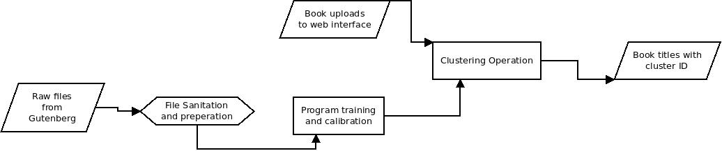
Initial System Design

Slide 6
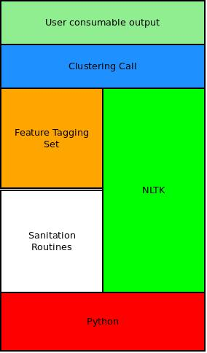
Initial System Design

Slide 7
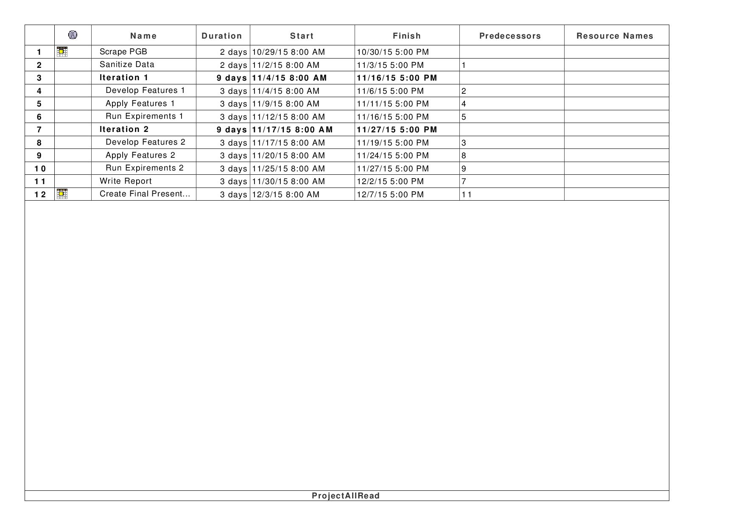
Timetable

Slide 8
Summary
Cluster books based on readability
Do it within the next month
Questions?

