Slide 1
How creative is this app?
Use of social elements to encourage healthy living
Personalized medicine
Ability to form therapeutic groups

Slide 2
How does this app help make decisions?
Provide data graphically indicating current, and future, health
We assist in locating healthy activities for groups to do

Slide 3
What audiences does this app target?
Core audience: people between the ages of 10-25, and their parents
  Groups of families
Physicians
  Maintain data throughout year regarding several important health markers

Slide 4
How feasible is to implement this app?
Very feasible, it currently works well enough for beta testing
Another 48 hours, well rested and caffeinated, to polish the app enough for it to be launched for real

Slide 5
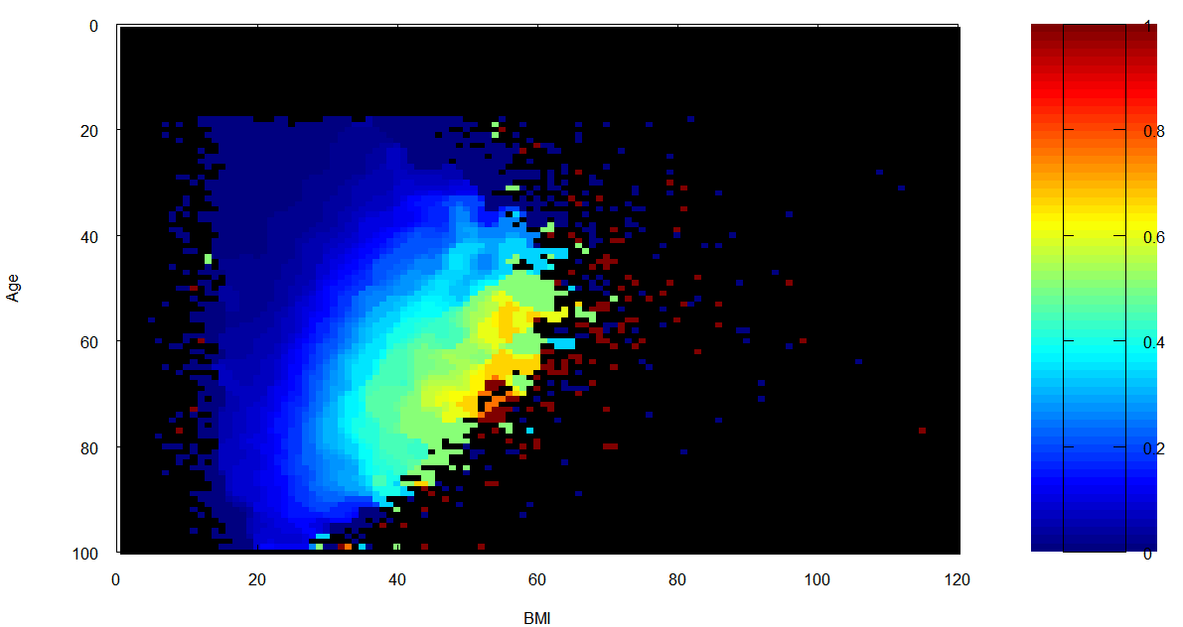
Does this app utilize open data?
We utilize 5 datasets; 4 geo data sets, one diabetes CDC data set (image below)

