Slide 2
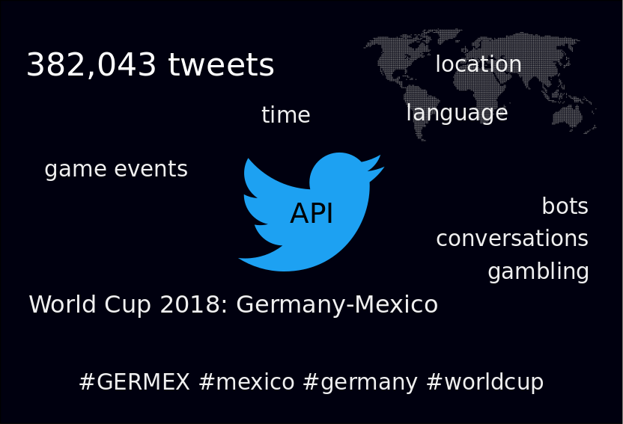

Slide 3
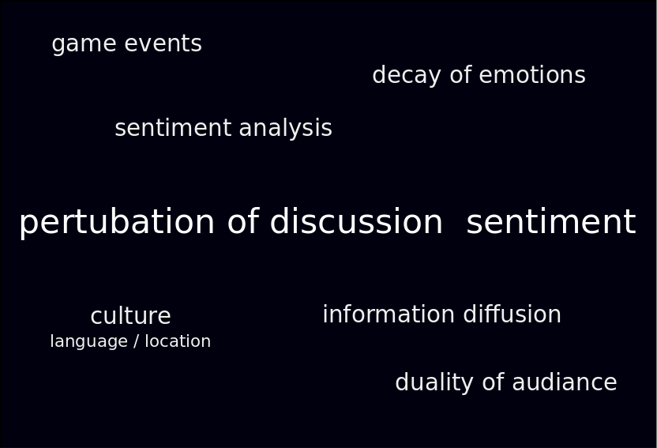

Slide 4
Preprocessing Steps
Clean tweets:
Remove URLs
Translate: mtranslate and langdetect
Sentiment Analysis:
NLTK
TextBlob

Slide 5
Analysis Methods
Non-linear time series; Hidden Markov Models; Power laws

Slide 6
TISEAN: Non-linear Timeseries Analysis of Sentiment
Mutual info
False nearest
Surrogate

Slide 7
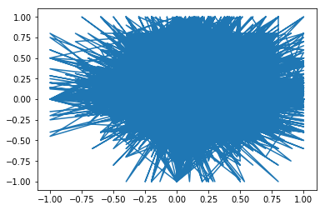

Slide 8
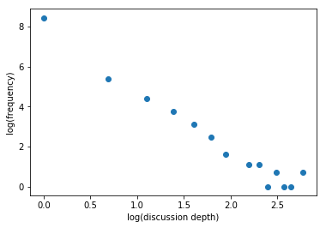
Discussion Depth
Twitter discussions continue as replies to previous tweets
We find that the frequency of depths of discussion follow a power law

Slide 9
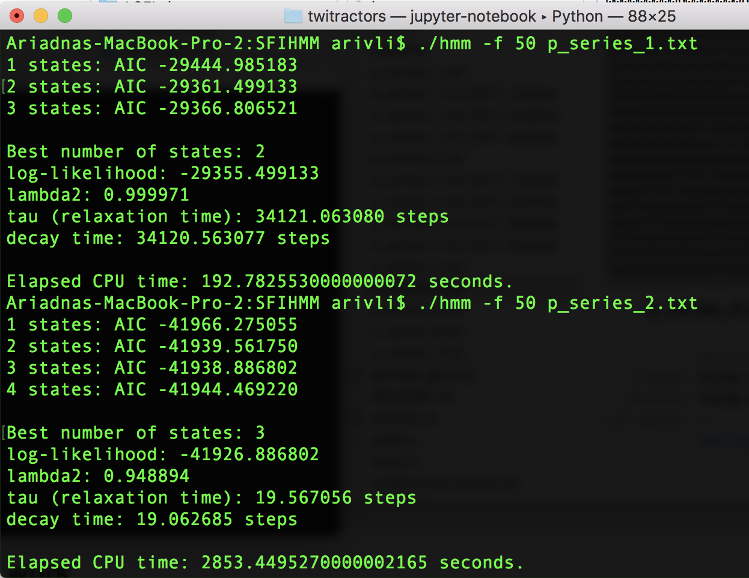
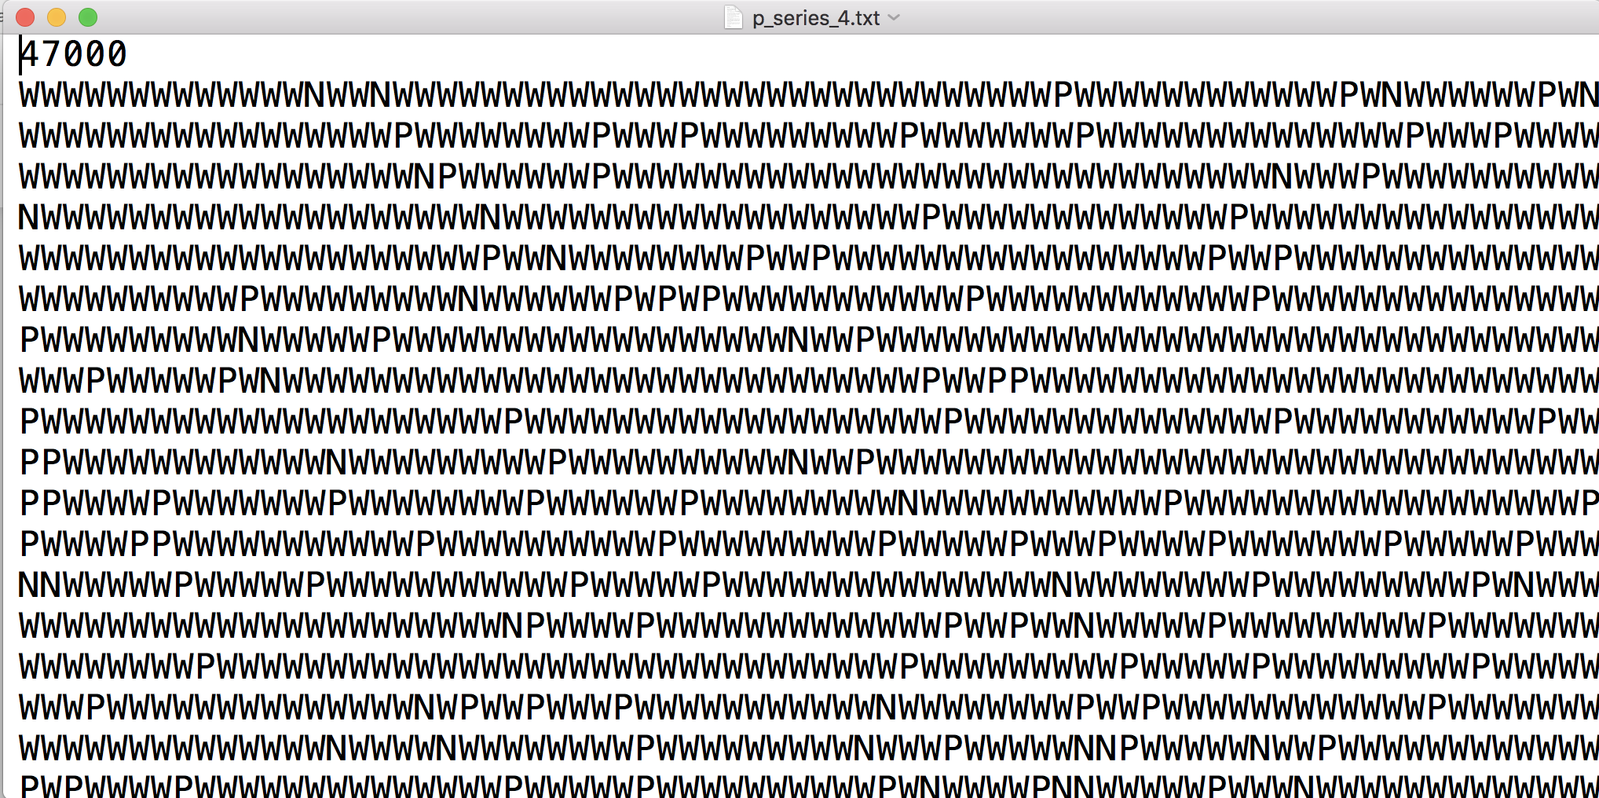
Hidden Markov Models

