Slide 1
Non-linearities on Twitter Discussions
Ariadna, Carol, Chathika, Laura, Maria, Subash

Slide 2
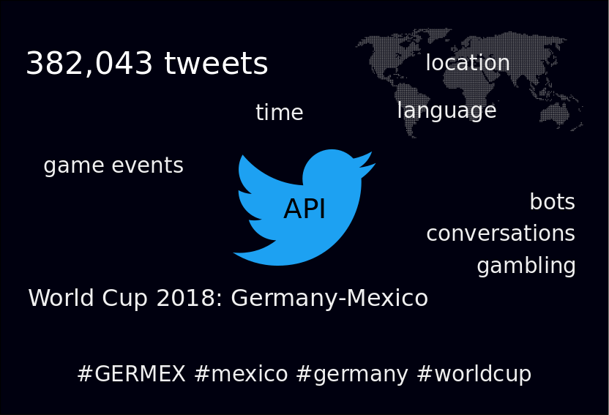

Slide 3
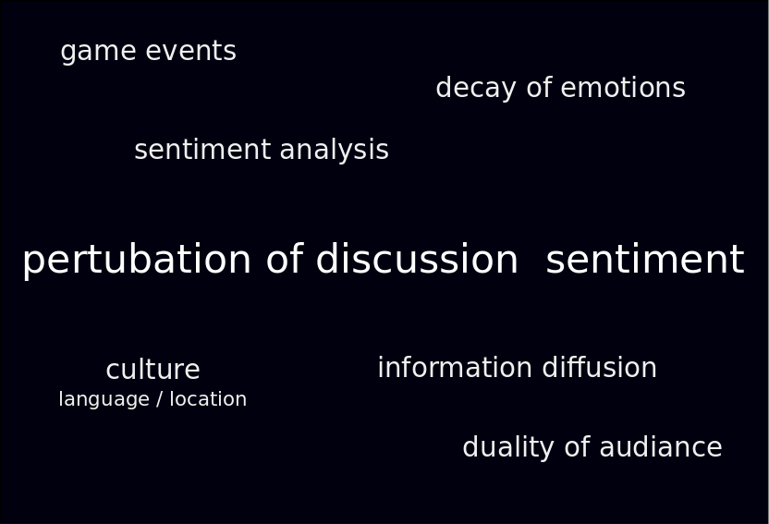

Slide 4
Preprocessing Steps
Clean tweets:
Remove URLs
Translate: mtranslate and langdetect
Sentiment Analysis:
NLTK
TextBlob
Extract location
Geocoding with OSM and Google

Slide 5
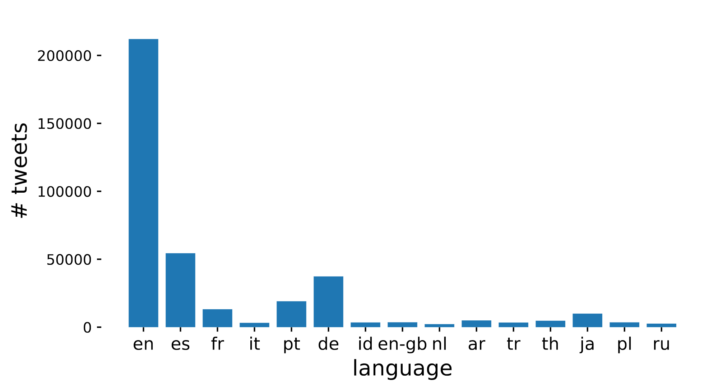
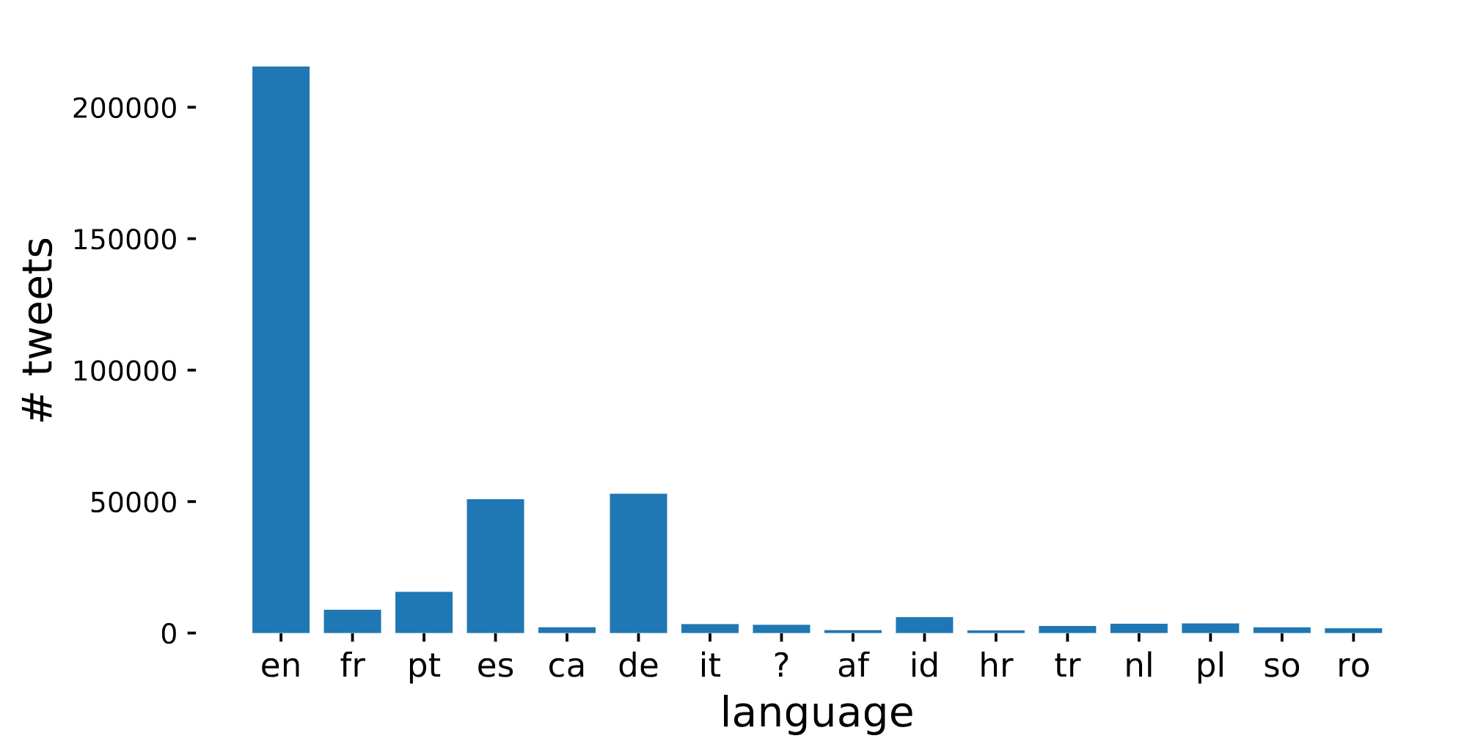

Slide 6
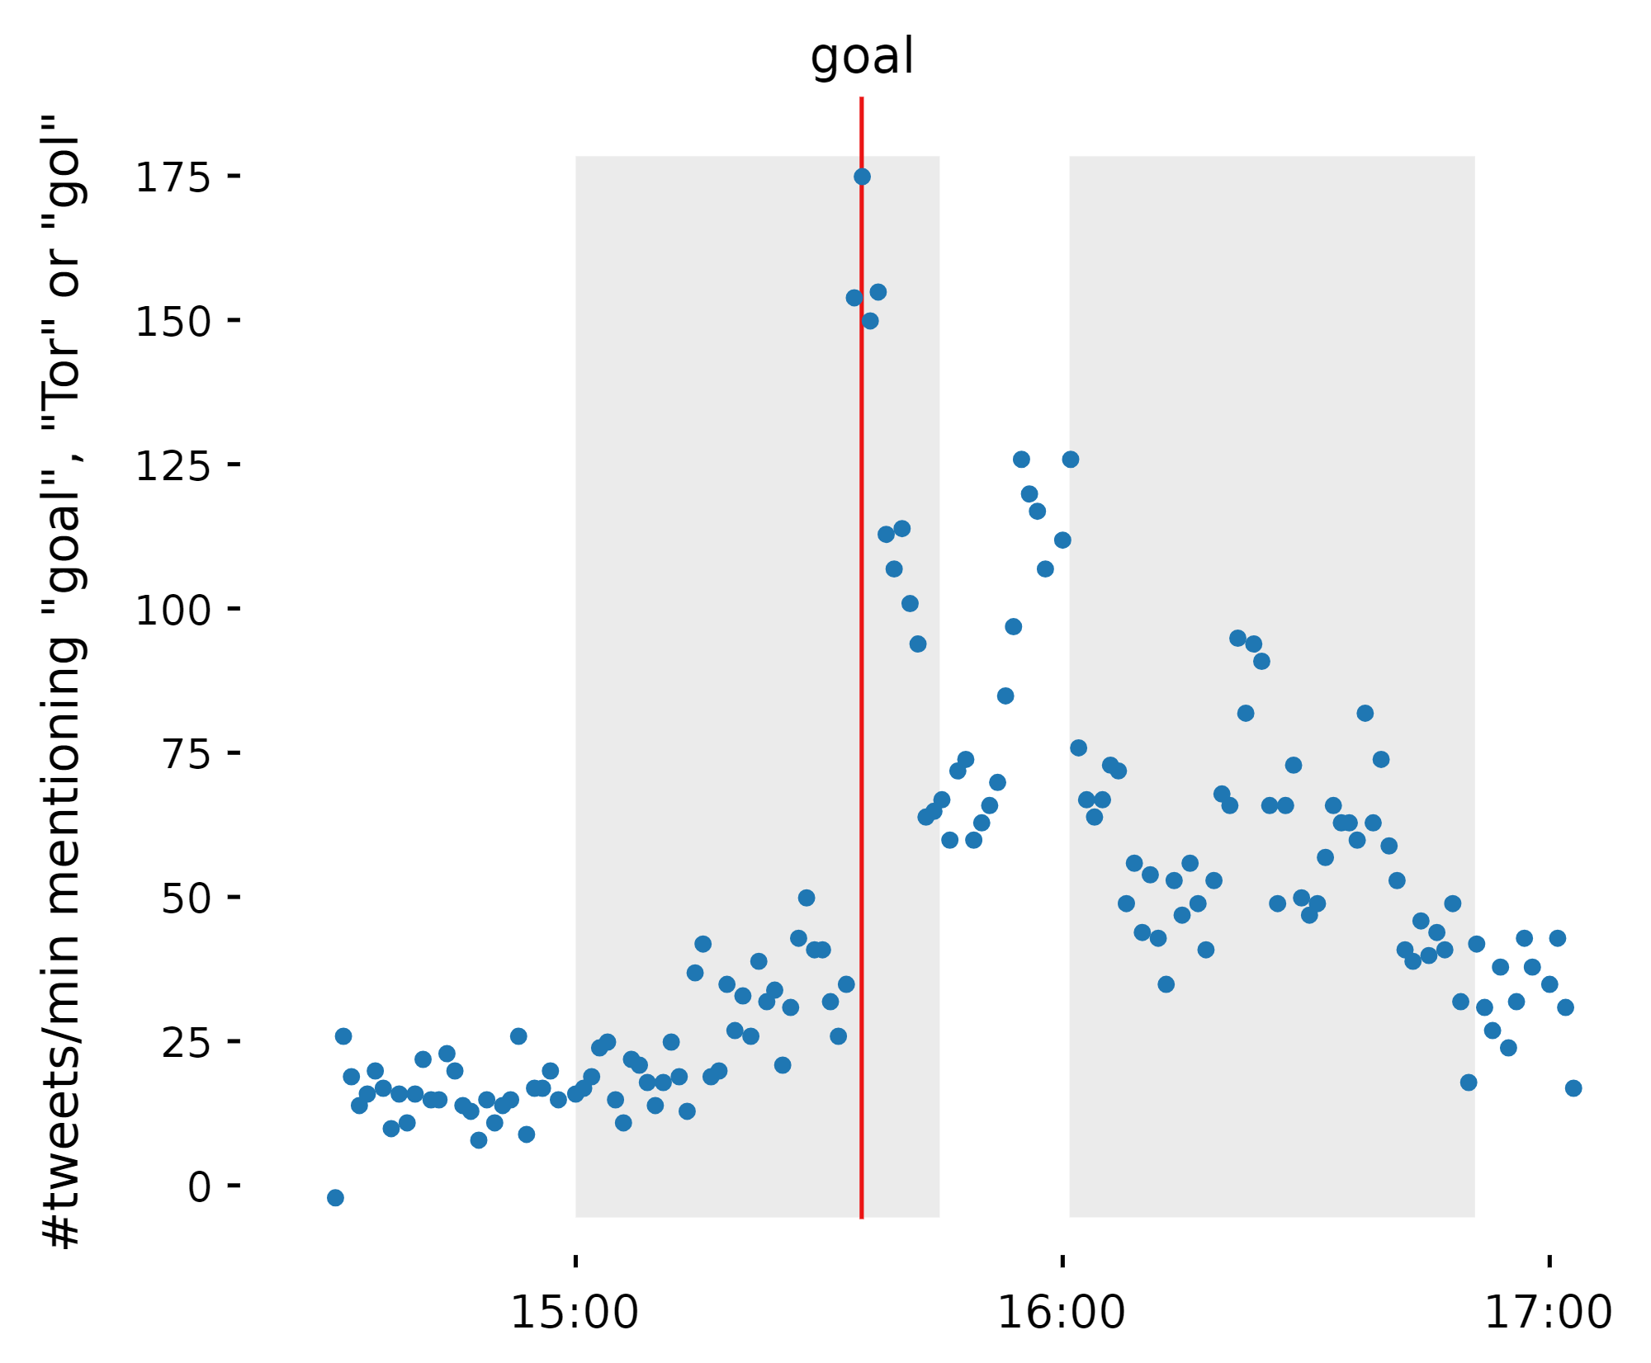

Slide 7
Analysis Methods
Non-linear time series; Hidden Markov Models; Power laws

Slide 8
TISEAN: Non-linear Timeseries Analysis of Sentiment
Delay coordinate embedding of sentiment:
Mutual info: best time delay: 100
False nearest: gave best dimension: 5
Used “surrogate” to create smaller data set

Slide 9
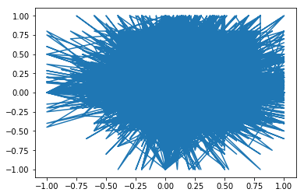

Slide 10
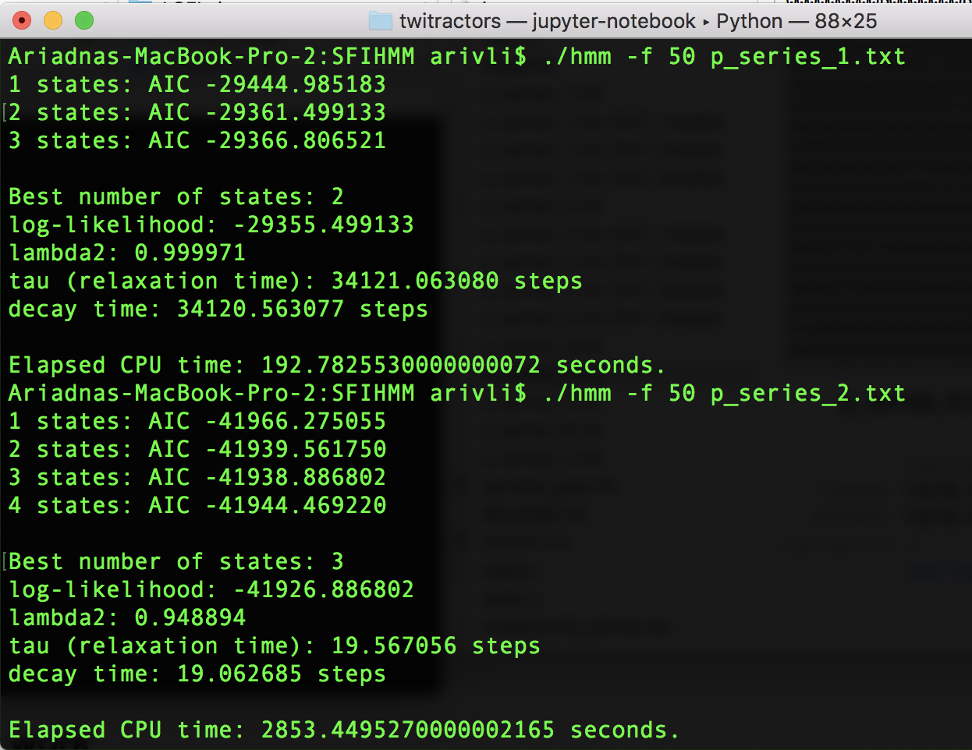
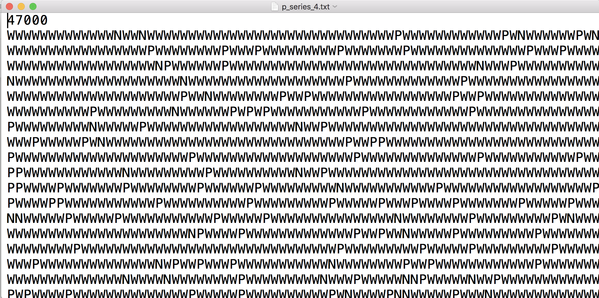
Hidden Markov Models

Slide 11
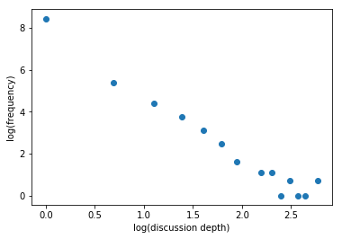
Discussion Depth
Twitter discussions continue as replies to previous tweets
We find that the frequency of depths of discussion follow a power law

Slide 12
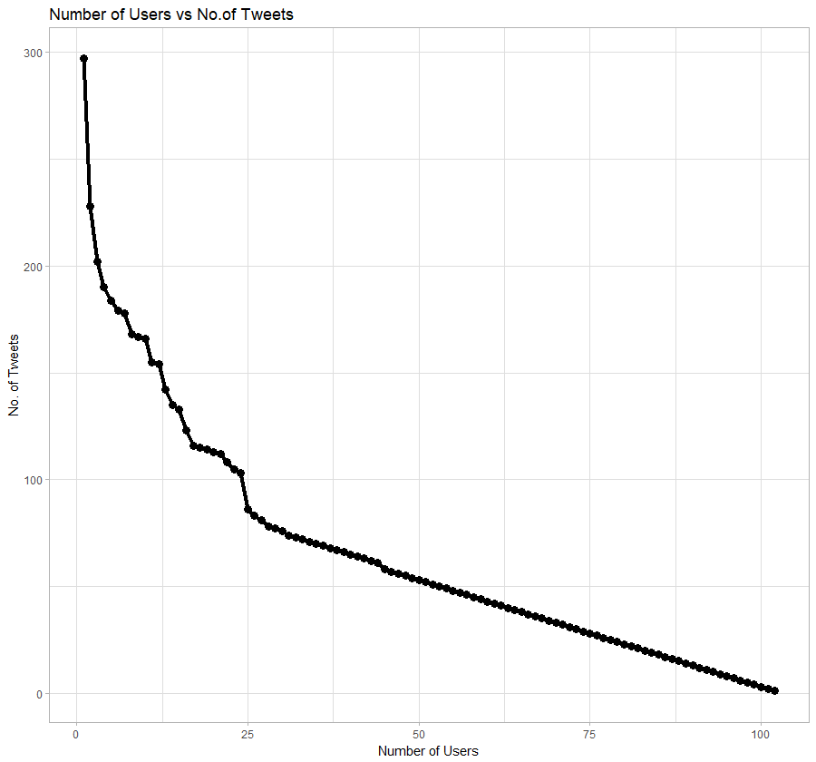
User Activity

Slide 13
Future Directions
Complete Translation and Geocoding
Extract Mexico fans and German fans tweets
Redo non-linear timeseries analysis and HMM

Slide 14


