Slide 1
Non-linearities on Twitter Discussions
Ariadna, Carol, Chathika, Laura, Maria, Subash

Slide 2
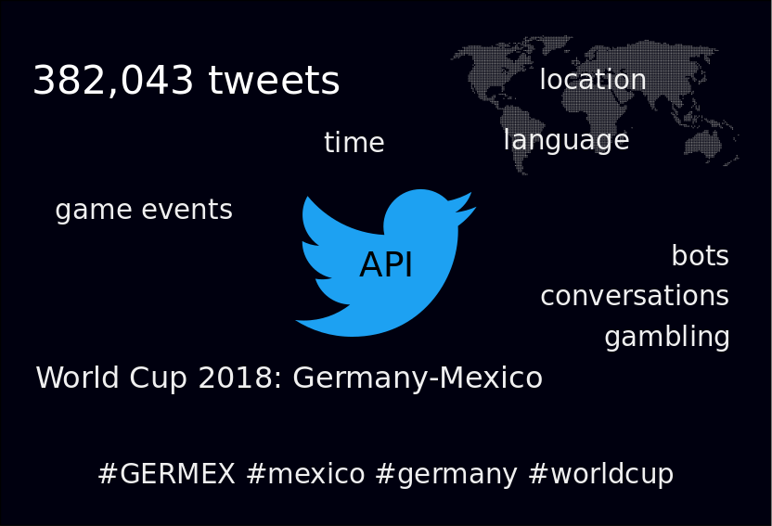

Slide 3
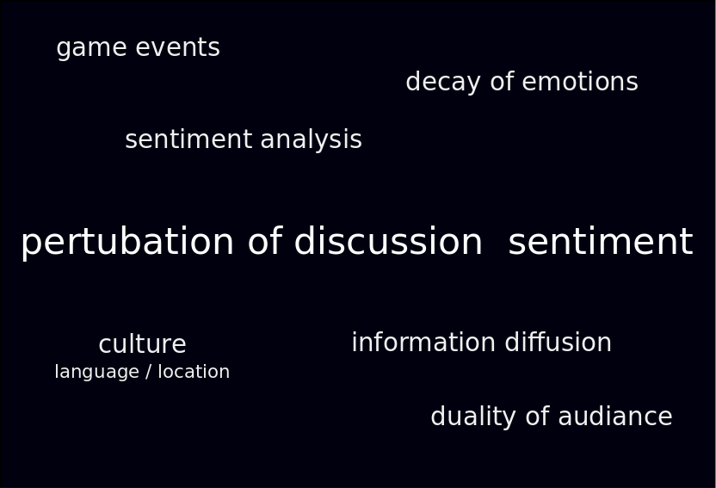

Slide 4
Preprocessing Steps
Clean tweets:
Remove URLs
Translate: mtranslate and langdetect
Sentiment Analysis:
NLTK
TextBlob
Extract location
Geocoding with OSM and Google

Slide 5
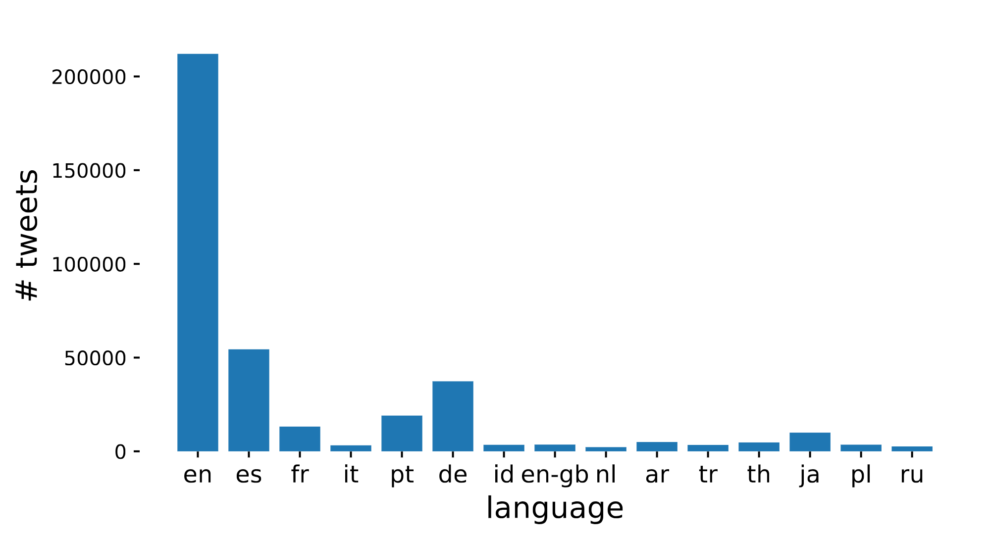
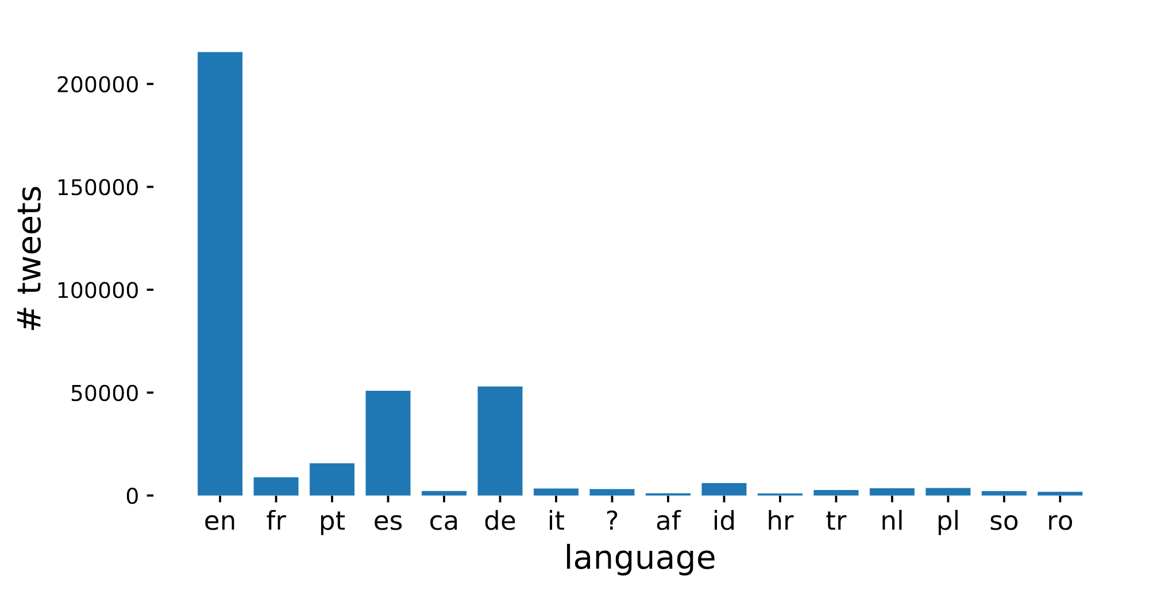

Slide 6
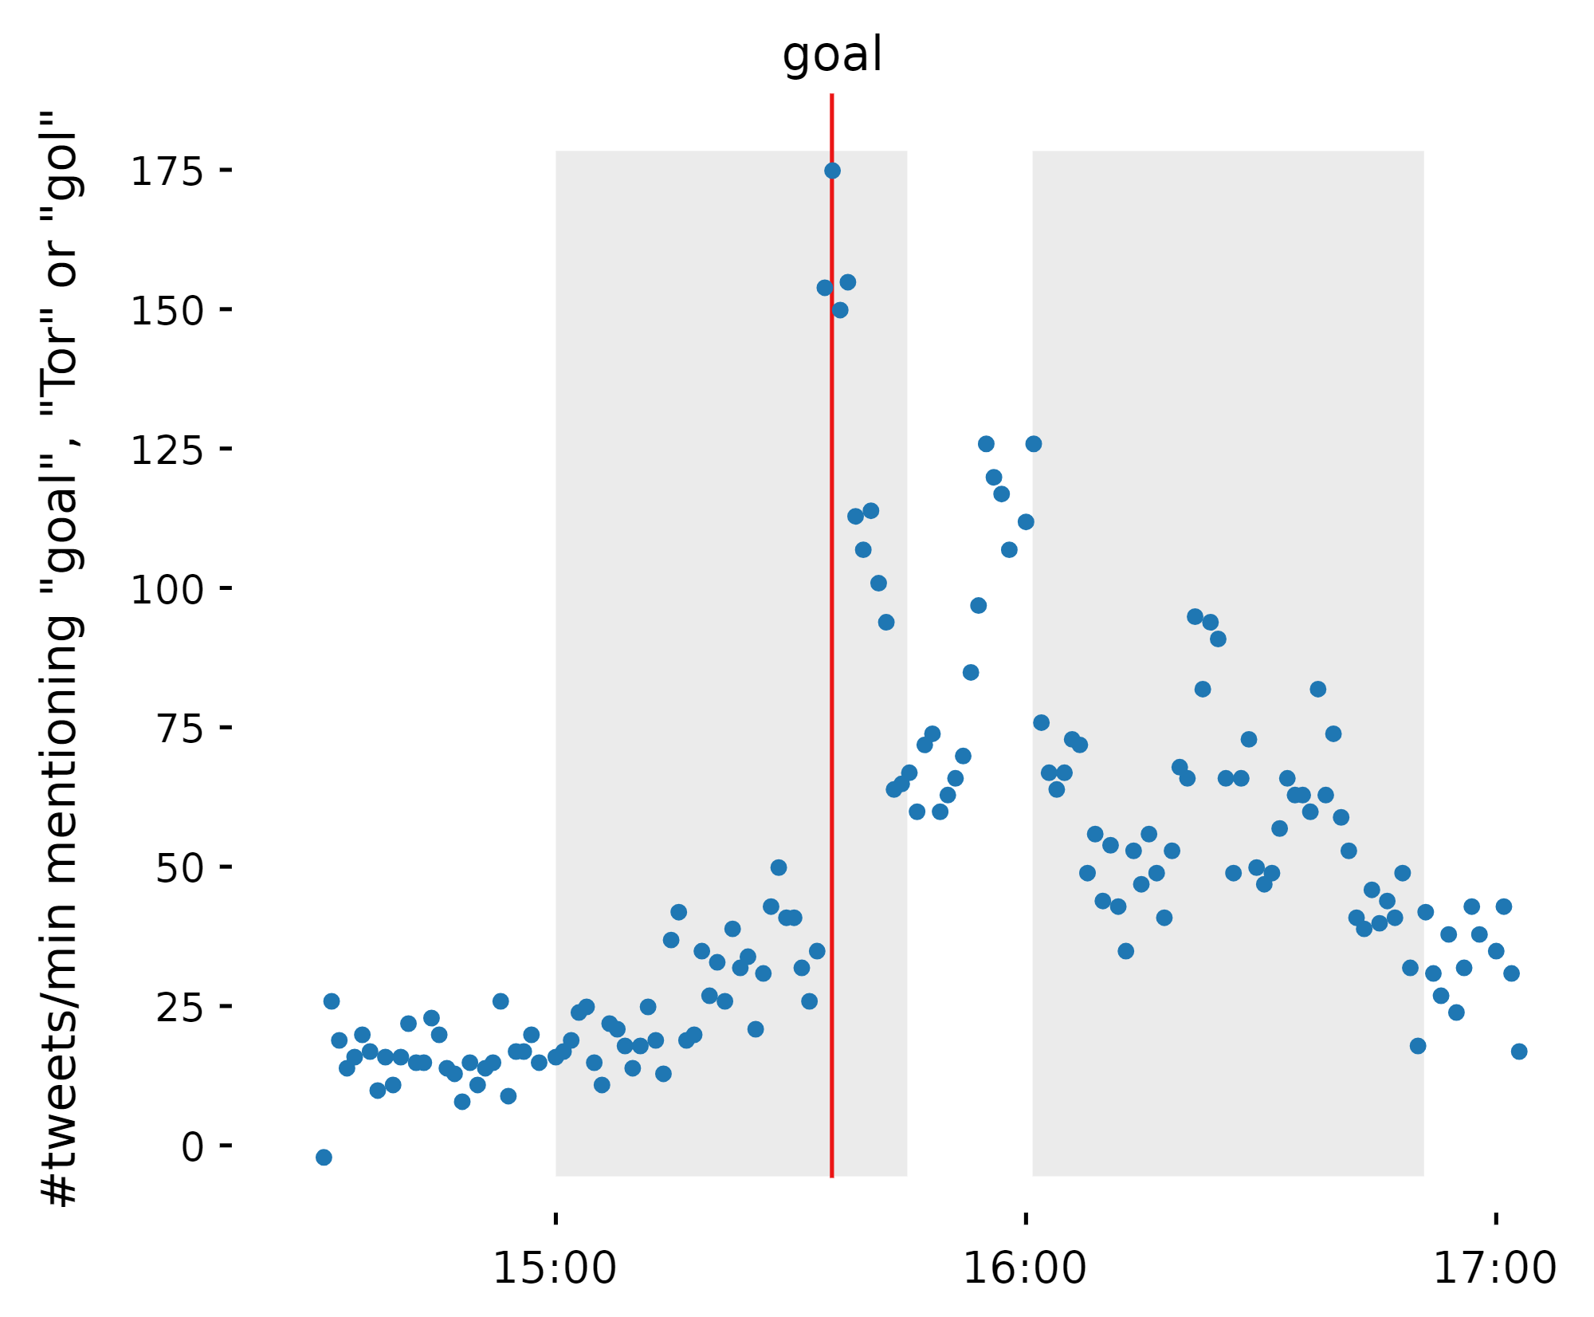

Slide 7
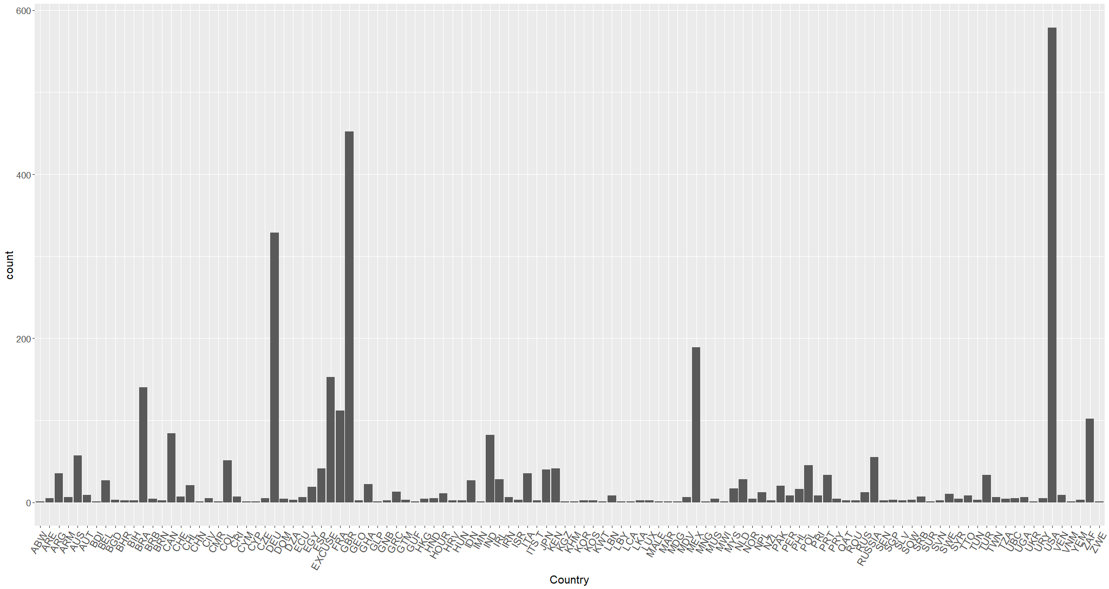
Tweet Frequencies Following Goal
USA
GBR
DEU
MEX
BRA

Slide 8
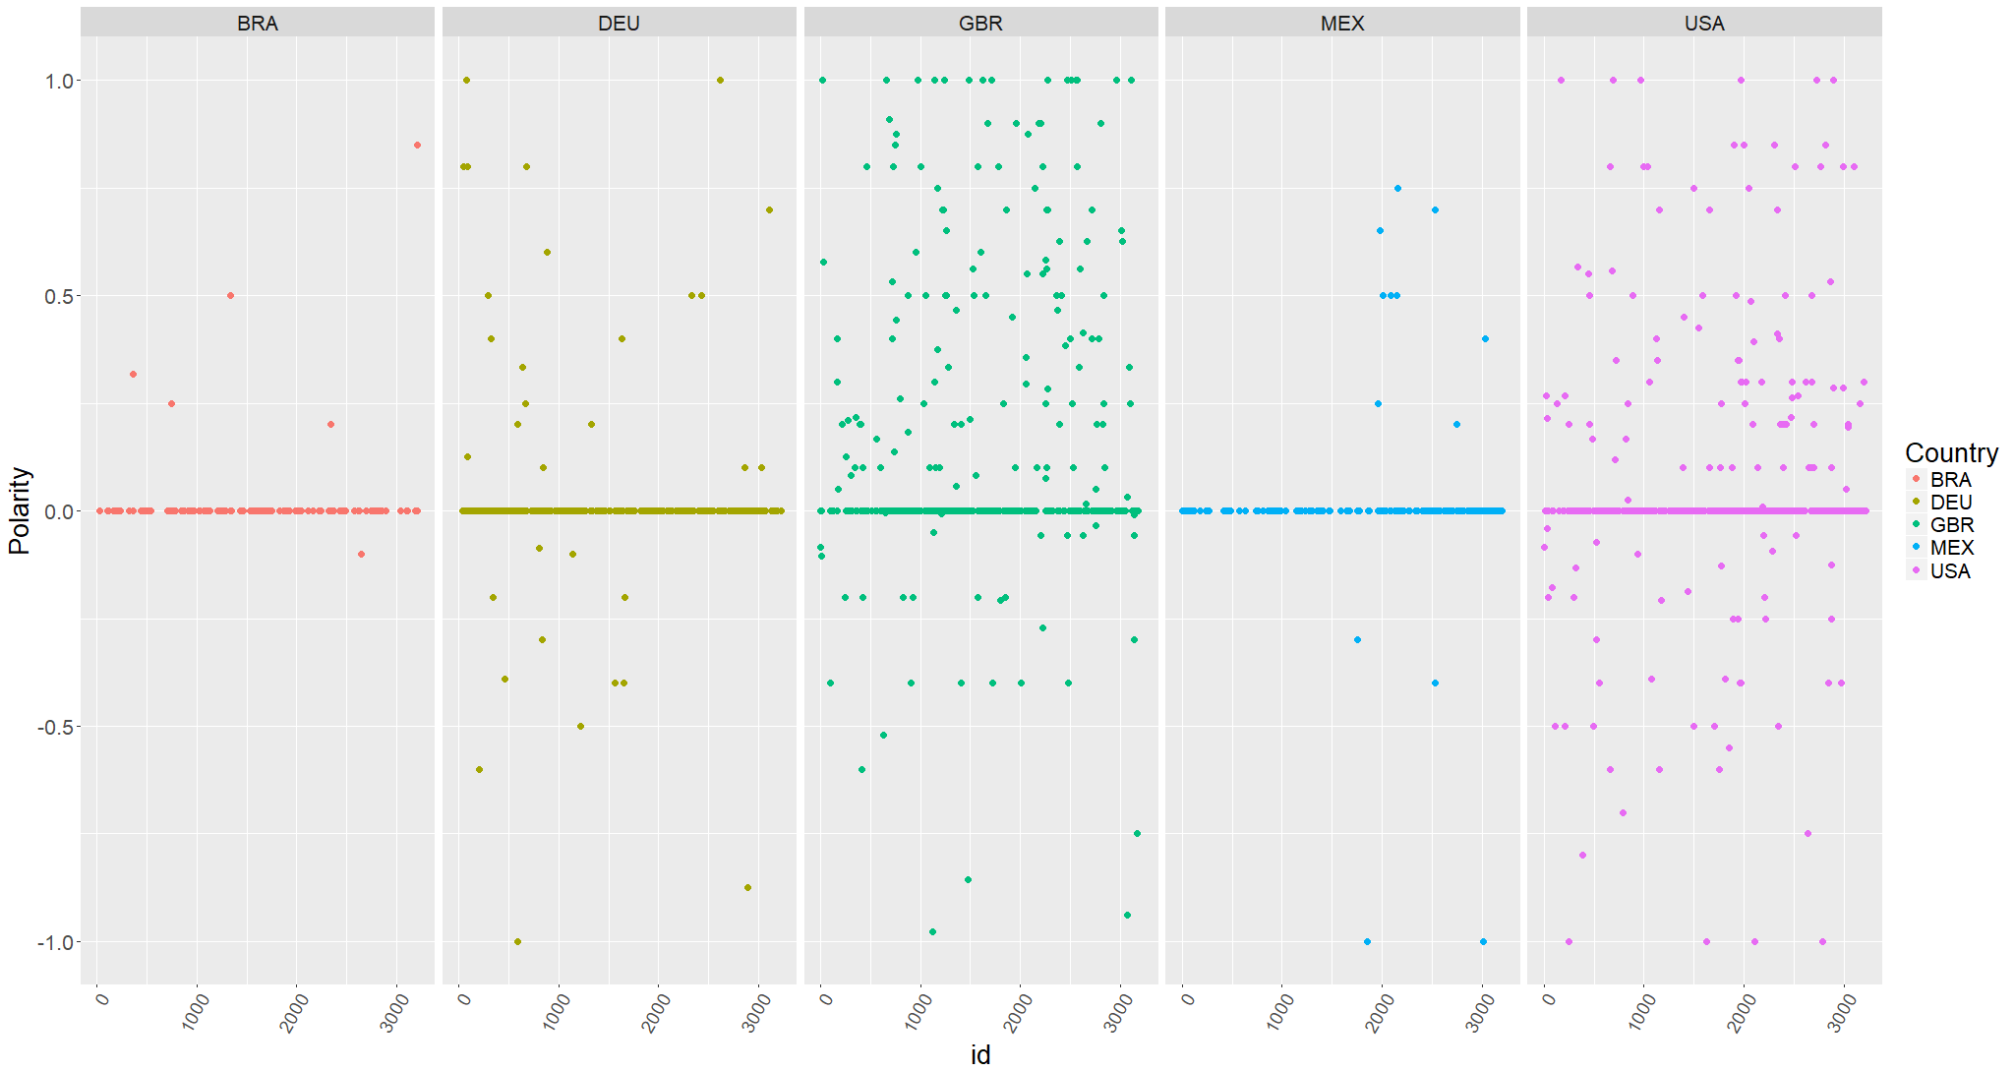

Slide 9
Analysis Methods
Non-linear time series; Hidden Markov Models; Power laws

Slide 10
TISEAN: Non-linear Timeseries Analysis of Sentiment
Delay coordinate embedding of sentiment:
Mutual info: best time delay: 100
False nearest: gave best dimension: 5
Used “surrogate” to create smaller data set

Slide 11
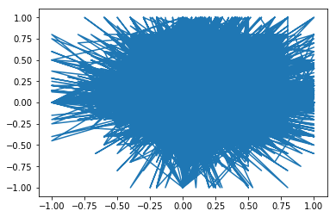

Slide 12
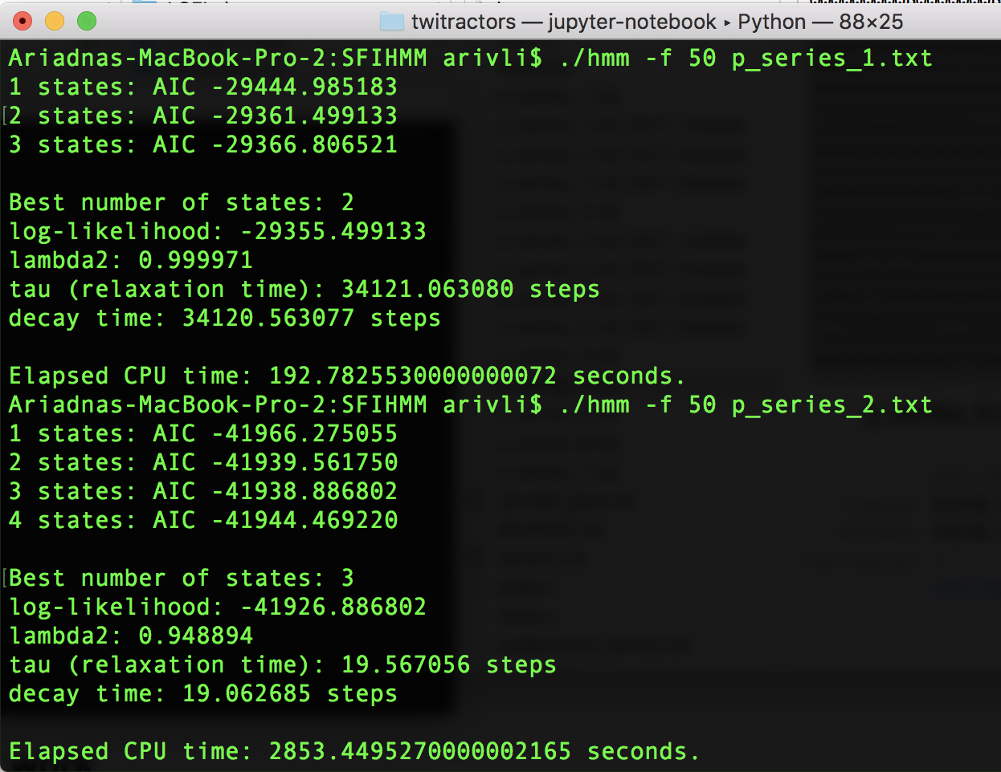
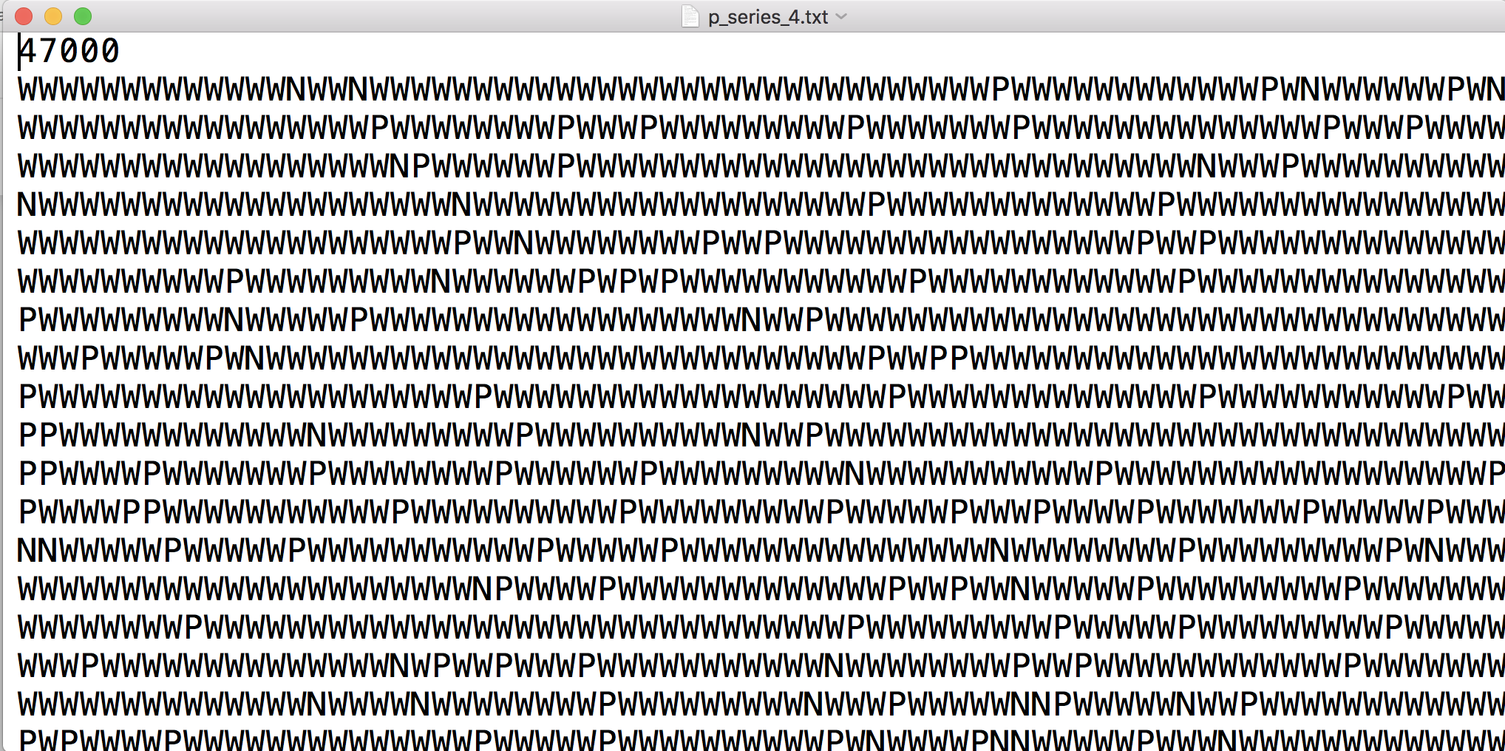
Hidden Markov Models

Slide 13
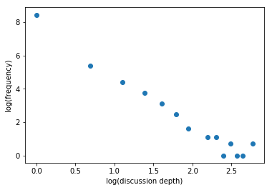
Discussion Depth
Twitter discussions continue as replies to previous tweets
We find that the frequency of depths of discussion follow a power law

Slide 14
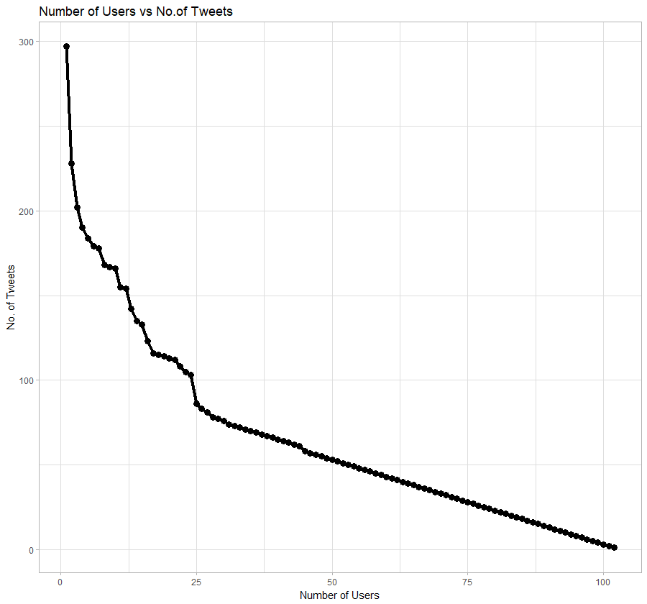
User Activity

Slide 15
Future Directions
Complete Translation and Geocoding
Extract Mexico fans and German fans tweets
Redo non-linear timeseries analysis and HMM
Investigate gambling and bots
Compare decay of positive and negative emotions

Slide 16
Thank you!

