Slide 1
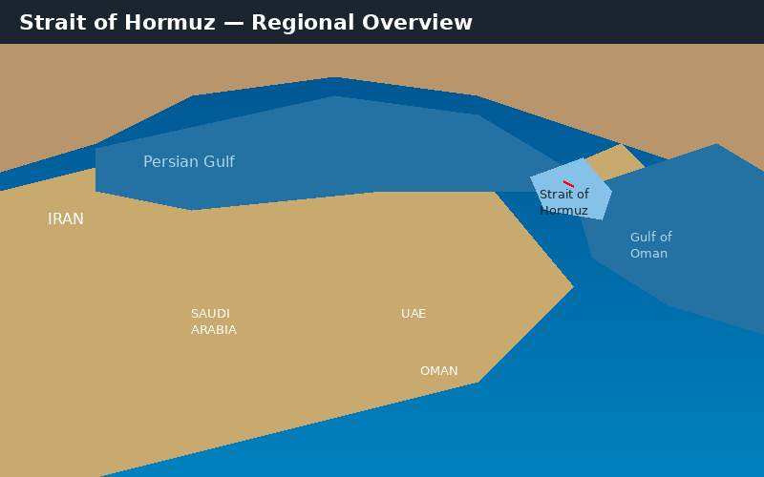
WHY GEOGRAPHY MATTERS
Strategic Location of the
Strait of Hormuz
A GIS Analysis Using QGIS | Natural Earth · DIVA-GIS · Global Energy Monitor
GIS Practical Project · April 16, 2026

Slide 2
Presentation Overview
Strait of Hormuz GIS Project
Introduction & Location
Shipping Routes Analysis
01
05
Where is the Strait and why does it matter geographically?
Maritime trade lanes and the chokepoint mechanism
Data & Methodology
Population Distribution
02
06
What GIS data was collected and how maps were made in QGIS
Demographic patterns and coastal dependency
Political Map Analysis
Geographic Importance
03
07
Country borders, coastal control and political geography
Synthesised analysis answering the four assignment questions
Resource Map Analysis
Conclusion
04
08
Oil and gas field distribution across the region
Summary findings and geographic significance
Source: GIS Project Group | GIS Project — Strait of Hormuz | April 2026

Slide 3
01 — Introduction: Where is the Strait of Hormuz?
Location Overview
Key Geographic Facts
Location:
Between Iran (north) and Oman/UAE (south)
Width:
~33 km at narrowest point
Channel:
~3 km navigable each direction
Connects:
Persian Gulf → Gulf of Oman → Arabian Sea
Countries:
Iran, Oman, UAE share the strait
Importance:
Only exit from the Persian Gulf
The Strait of Hormuz is a narrow waterway that serves as the sole maritime exit for all Persian Gulf nations. Its geographic position makes it one of the most critical locations on Earth for global energy supply.
Source: Natural Earth, DIVA-GIS | GIS Project — Strait of Hormuz | April 2026

Slide 4
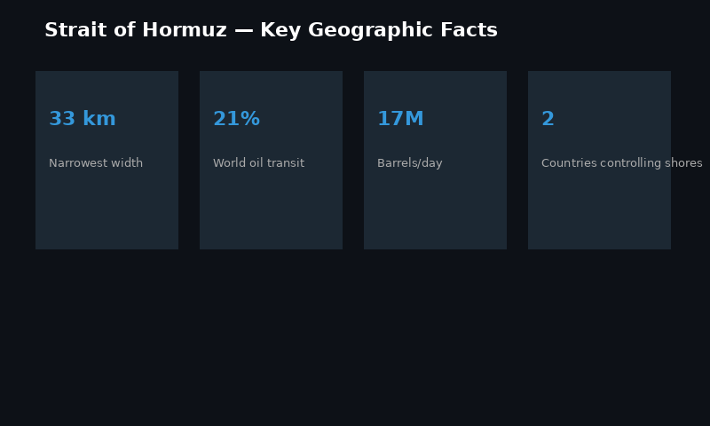
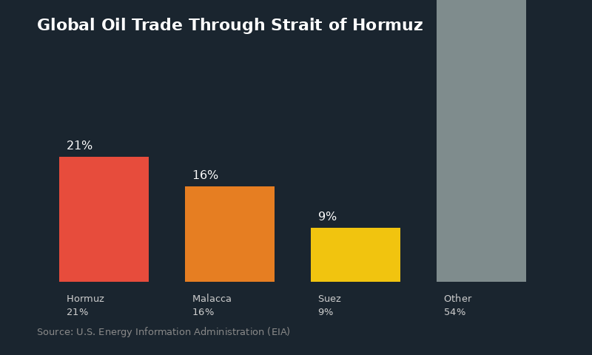
01 — Key Statistics at a Glance
Why This Strait Matters
Source: U.S. Energy Information Administration (EIA), 2023 | GIS Project — Strait of Hormuz | April 2026

Slide 5
02 — Data Sources & GIS Methodology
How We Built the Maps
Data Layer | Source | Format | Used In Map
Country Boundaries | Natural Earth | .shp Shapefile | Map 1 — Political
Coastlines | DIVA-GIS | .shp Shapefile | Maps 1, 2, 3
Rivers | DIVA-GIS | .shp Shapefile | Map 1 — Political
Ports | DIVA-GIS | .shp Shapefile | Map 3 — Shipping
Oil & Gas Fields | Global Energy Monitor | .csv → Points | Map 2 — Resource
Population Density | DIVA-GIS (Iran+Oman) | .tif Raster | Map 4 — Population
Elevation / Terrain | DIVA-GIS (Iran+Oman) | .tif Raster | Map 4 — Population
Shipping Lanes | Digitized in QGIS | Line Feature | Map 3 — Shipping
QGIS Workflow
1
Set CRS to EPSG:4326 (WGS 84)
2
Load all shapefiles + rasters
3
Zoom to Strait region
4
Style each layer (symbology)
5
Merge Iran+Oman rasters
6
Create Print Layout per map
7
Add title, scale bar, north arrow, legend
8
Export each map at 300 DPI
Software: QGIS 3.x (Open Source) | Coordinate Reference System: EPSG:4326 WGS 84 | Export resolution: 300 DPI
Source: Natural Earth | DIVA-GIS | Global Energy Monitor | GIS Project — Strait of Hormuz | April 2026

Slide 6
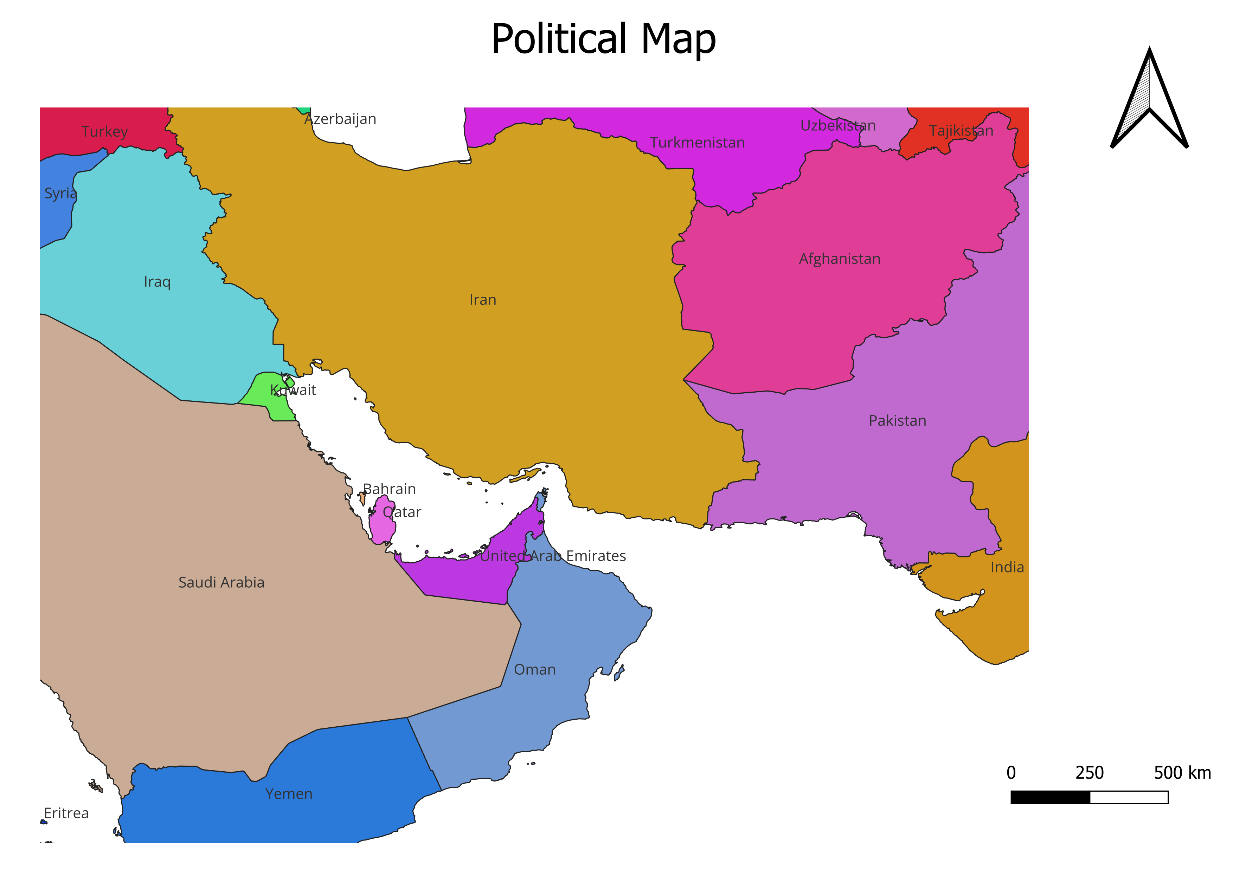
03 — Political Map: Country Borders & Control
Map 1 Analysis
What Our Map Shows
Iran controls the entire northern coastline of the Strait, giving it direct geographic authority over half the waterway.
Oman's Musandam Peninsula forms the southern shore — a geographically isolated exclave surrounded by UAE territory.
The UAE controls ports including Dubai and Abu Dhabi, all dependent on Strait access for maritime trade.
Our QGIS measurement confirmed the narrowest point is approximately 33 km — visible clearly in the political layer.
There are no overland connections between the Persian Gulf states and the Indian Ocean — the Strait is the only route.
QGIS — Political Map
Source: Natural Earth country boundaries shapefile | DIVA-GIS coastlines | GIS Project — Strait of Hormuz | April 2026

Slide 7
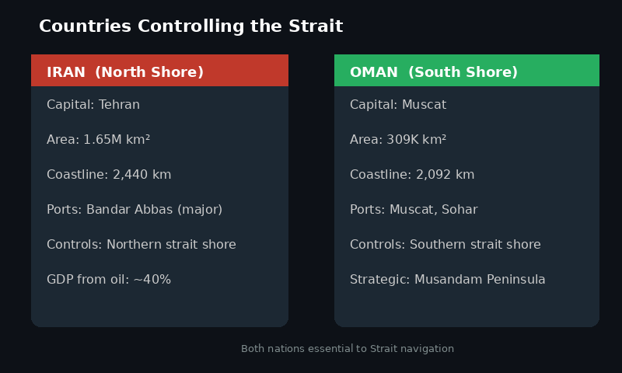
03 — Key Countries: Iran and Oman
Political Geography Detail
Geographic fact: The Musandam Peninsula (Oman) is physically separated from mainland Oman by UAE territory — making it a strategic exclave that directly controls the southern shore of the Strait.
Source: DIVA-GIS administrative boundaries | Natural Earth | GIS Project — Strait of Hormuz | April 2026

Slide 8
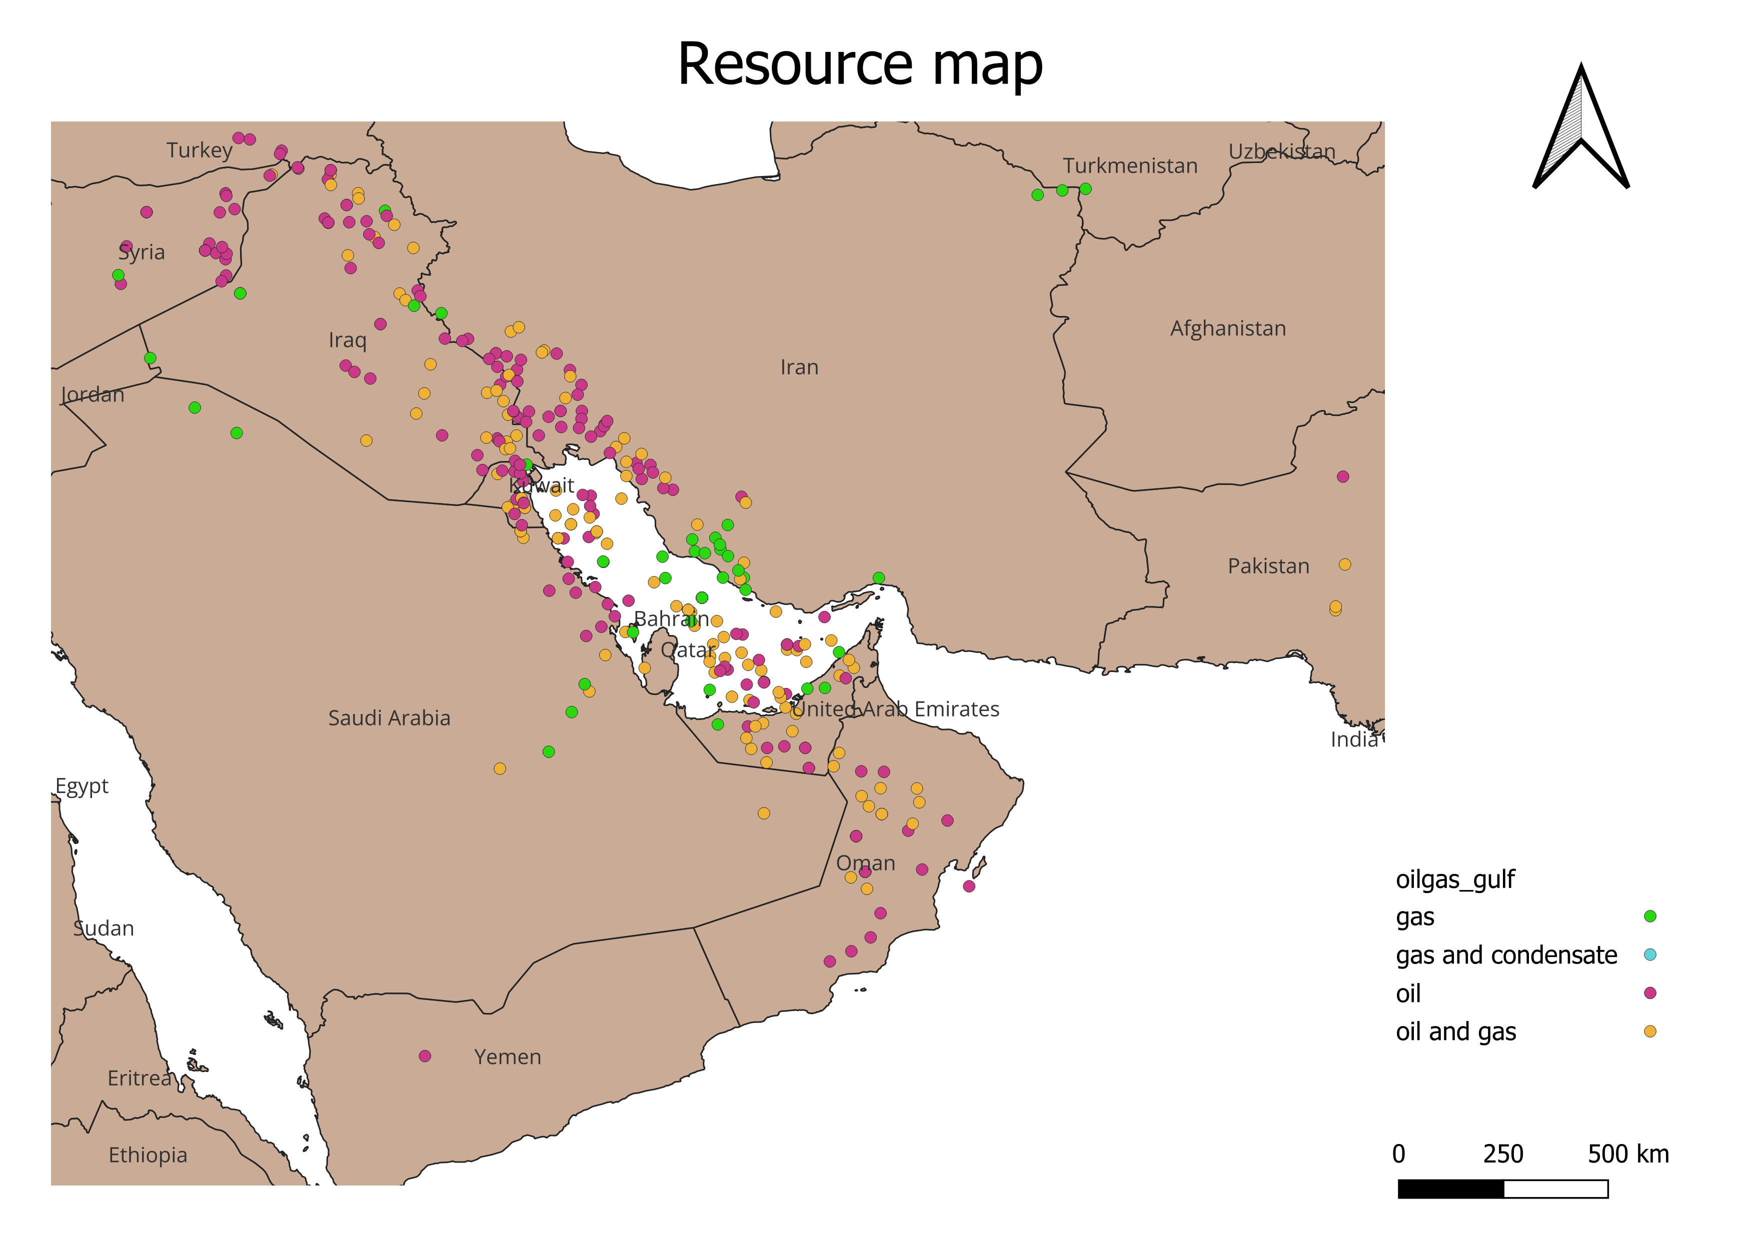
04 — Resource Map: Oil & Gas Fields
Map 2 Analysis
What Our Map Shows
Heavy clustering of oil and gas extraction points around the Persian Gulf coastline — all pointing toward the Strait as the only export exit.
South Pars/North Dome field (Iran/Qatar border) is the world's largest natural gas field — visible as a dense cluster in our map.
Saudi Arabia, Kuwait, Iraq and UAE fields appear in our map — all landlocked from global ocean trade without the Strait.
Our CSV data from Global Energy Monitor showed over 200 active extraction points in the immediate region.
QGIS — Resource Map
Source: Global Energy Monitor — Global Oil & Gas Extraction Tracker (CSV) | GIS Project — Strait of Hormuz | April 2026

Slide 9
04 — Global Oil Dependency on the Strait
Resource Significance
Key Resource Data
21%
of global oil trade daily
17M
barrels per day transit
3.8B
cubic feet of LNG daily
12+
countries depend on this route
Source: U.S. Energy Information Administration (EIA), 2023 | GIS Project — Strait of Hormuz | April 2026

Slide 10
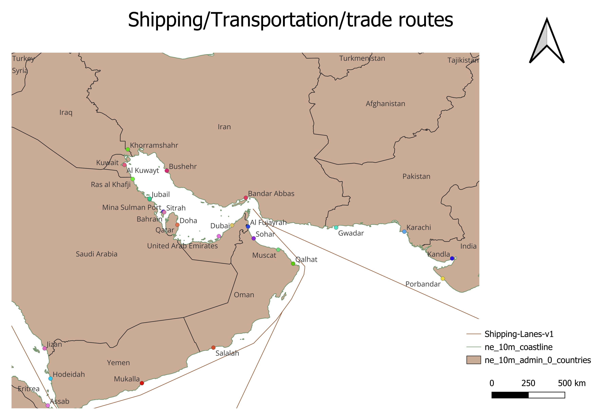
05 — Shipping Routes: The Maritime Chokepoint
Map 3 Analysis
What Our Map Shows
All shipping lanes in our map converge at one single narrow point — the Strait. There is no alternative visible route.
Major ports (Bandar Abbas, Dubai, Muscat, Abu Dhabi) all connect through this single corridor.
The traffic separation scheme shows inbound and outbound lanes only ~3 km wide each — confirmed by our QGIS measurement.
Our digitized shipping lane clearly demonstrates why geographers call this a 'chokepoint' — a geographic bottleneck.
QGIS — Shipping / Trade Routes Map
Source: DIVA-GIS ports shapefile | Shipping lane digitized in QGIS | GIS Project — Strait of Hormuz | April 2026

Slide 11
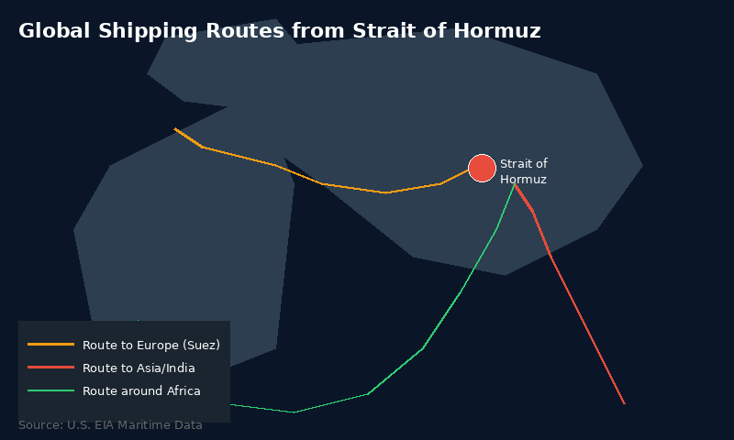
05 — Global Shipping Routes from the Strait
Where the Oil Goes
Destination Regions
Asia-Pacific
Japan, China, South Korea, India
Europe
Via Suez Canal — Spain, France, Italy
Americas
Via Cape of Good Hope (longer)
Asia-Pacific receives ~70%
of Hormuz oil exports
Source: U.S. EIA | International Energy Agency (IEA) | GIS Project — Strait of Hormuz | April 2026

Slide 12
06 —Elevation Map
Map 4 Analysis
What Our Map Shows
Dark red (high density) areas cluster tightly along the Gulf coastline — Tehran, Mashhad and Muscat all show as dense zones.
Interior desert regions appear yellow/pale — very low population — confirming the Rub' al Khali desert is uninhabited.
Coastal concentration shows these populations are directly connected to and dependent on Strait maritime trade.
Elevation raster from same DIVA-GIS data confirms mountainous terrain in northern Iran — Zagros range visible.
QGIS — Population Density (YlOrRd ramp | Iran + Oman merged raster)
Source: DIVA-GIS Population Raster — Iran + Oman merged | Styled: YlOrRd ramp | GIS Project — Strait of Hormuz | April 2026

Slide 13
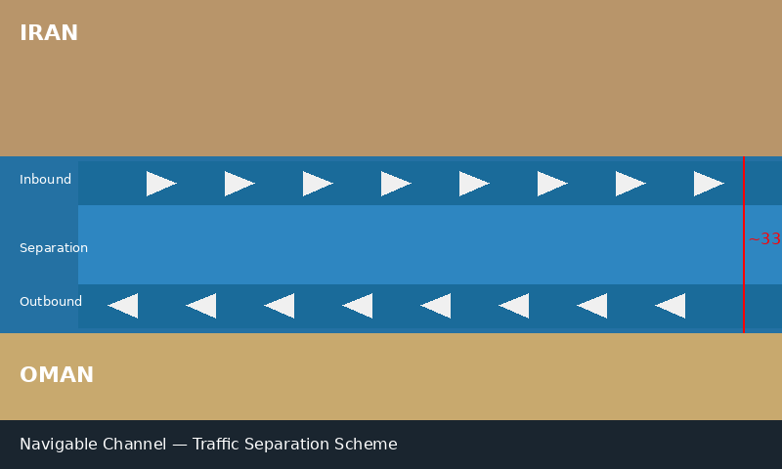
05 — Inside the Chokepoint: Navigation Lanes
Geographic Detail
Navigation Facts
Total width: ~33 km
Inbound lane: ~3 km
Separation zone: ~3 km
Outbound lane: ~3 km
Depth: 60–100 m
~17 tankers per day
Managed by: IMO
The International Maritime Organization (IMO) manages a Traffic Separation Scheme (TSS) in the Strait — all vessels must follow designated lanes to prevent collision in this extremely narrow passage.
Source: IMO Traffic Separation Scheme | U.S. EIA Maritime Data | GIS Project — Strait of Hormuz | April 2026

Slide 14
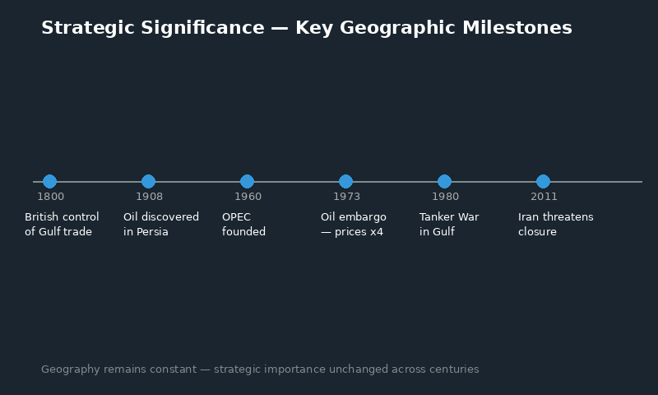
07 — Geographic Importance Through History
Why Location Has Always Mattered
Geographic Permanence — The Key Insight
The Strait of Hormuz has been geographically critical for over 200 years — and this will not change. Political situations come and go. Trade partners change. But the physical geography is permanent. The 33 km gap between Iran and Oman is a geographic fact — not a political one.
Source: Historical data — U.S. EIA | IEA | Academic geography sources | GIS Project — Strait of Hormuz | April 2026

Slide 15
07 — Geographic Analysis: Answering the Four Questions
Assignment Requirements
Q1
Why is this region important?
Q3
Does location affect trade or conflict?
It is the only maritime exit from the Persian Gulf. All energy exports from Iran, Iraq, Kuwait, Qatar, UAE and Saudi Arabia must pass through this 33 km gap. Geography forces every barrel of oil through one point.
Directly. Location is the entire reason this place matters. The strait's geography creates an unavoidable dependency — no overland pipeline replaces 21% of global oil flow. Every trade disruption here causes immediate global price effects.
Q2
What natural resources does it have?
Q4
Are there strategic geographic features?
Our resource map shows the world's single largest concentration of oil and gas reserves. The South Pars/North Dome field straddles the Iran-Qatar border — the largest natural gas field on Earth. Saudi Arabia's Ghawar field is the largest oil field.
Three visible in our maps: (1) Extreme channel narrowness — 3 km lanes. (2) Competing national borders on both shores creating jurisdictional complexity. (3) Major port concentration with no viable alternative route — confirmed by our shipping map.
Source: Analysis based on QGIS maps + U.S. EIA data | GIS Project — Strait of Hormuz | April 2026

Slide 16
07 — Summary: Our Four QGIS Maps
Complete Map Portfolio
Map 1 — Political
Map 2 — Resources
Country borders, coastlines, rivers
Oil & gas field points (CSV data)
Map 3 — Shipping
Map 4 — Elevation
Trade routes, ports, chokepoint
Density raster + elevation (Iran/Oman)
Source: All maps created in QGIS 3.x | Data: Natural Earth, DIVA-GIS, Global Energy Monitor | GIS Project — Strait of Hormuz | April 2026

Slide 17
CONCLUSION
The Strait of Hormuz:
Geography as Global Power
Our GIS analysis confirms the Strait of Hormuz is geographically irreplaceable — a 33 km gap that handles 21% of global oil trade.
Four QGIS maps built from real data (Natural Earth, DIVA-GIS, Global Energy Monitor) prove the geographic pattern: resources concentrate around the Gulf, all exits lead through one point.
Physical geography — not politics — explains this location's global importance. The channel width, the bordering coastlines, and the absence of any alternative route are permanent geographic facts.
Thank you — Questions welcome

