Slide 1
Competitive Programming vs Software Engineering in C++
What I learnt from 3 years being a software engineer

Slide 2

Who am I?
2018-2022, B.Tech. Electrical Engineering
2022-present, Software Engineer, Jump Trading Singapore

Slide 3
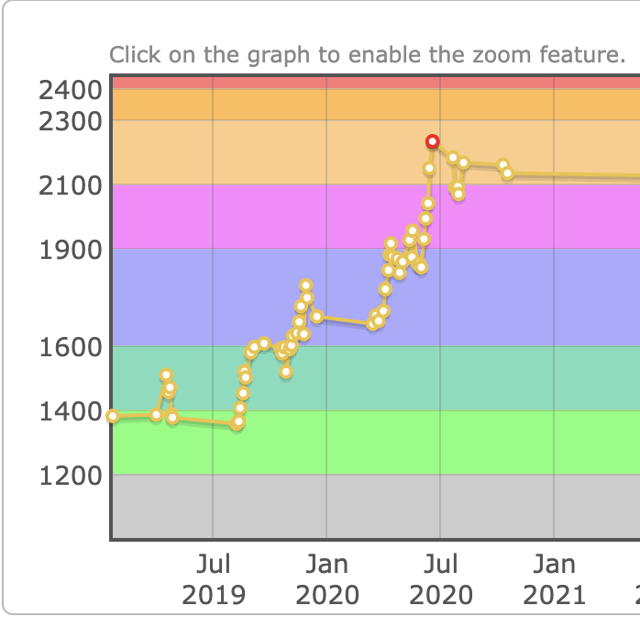

Slide 4
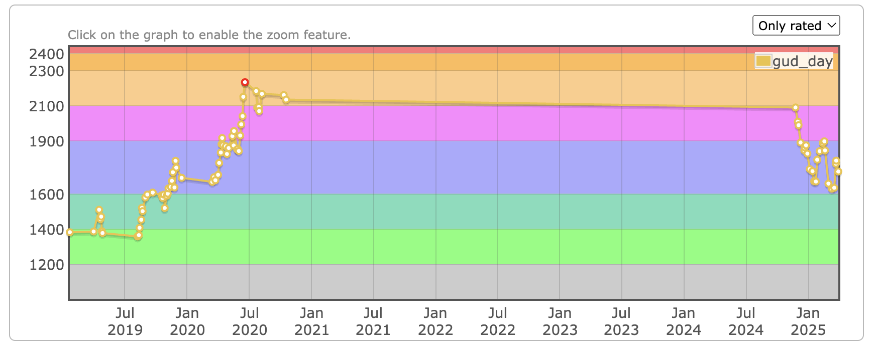

Slide 5
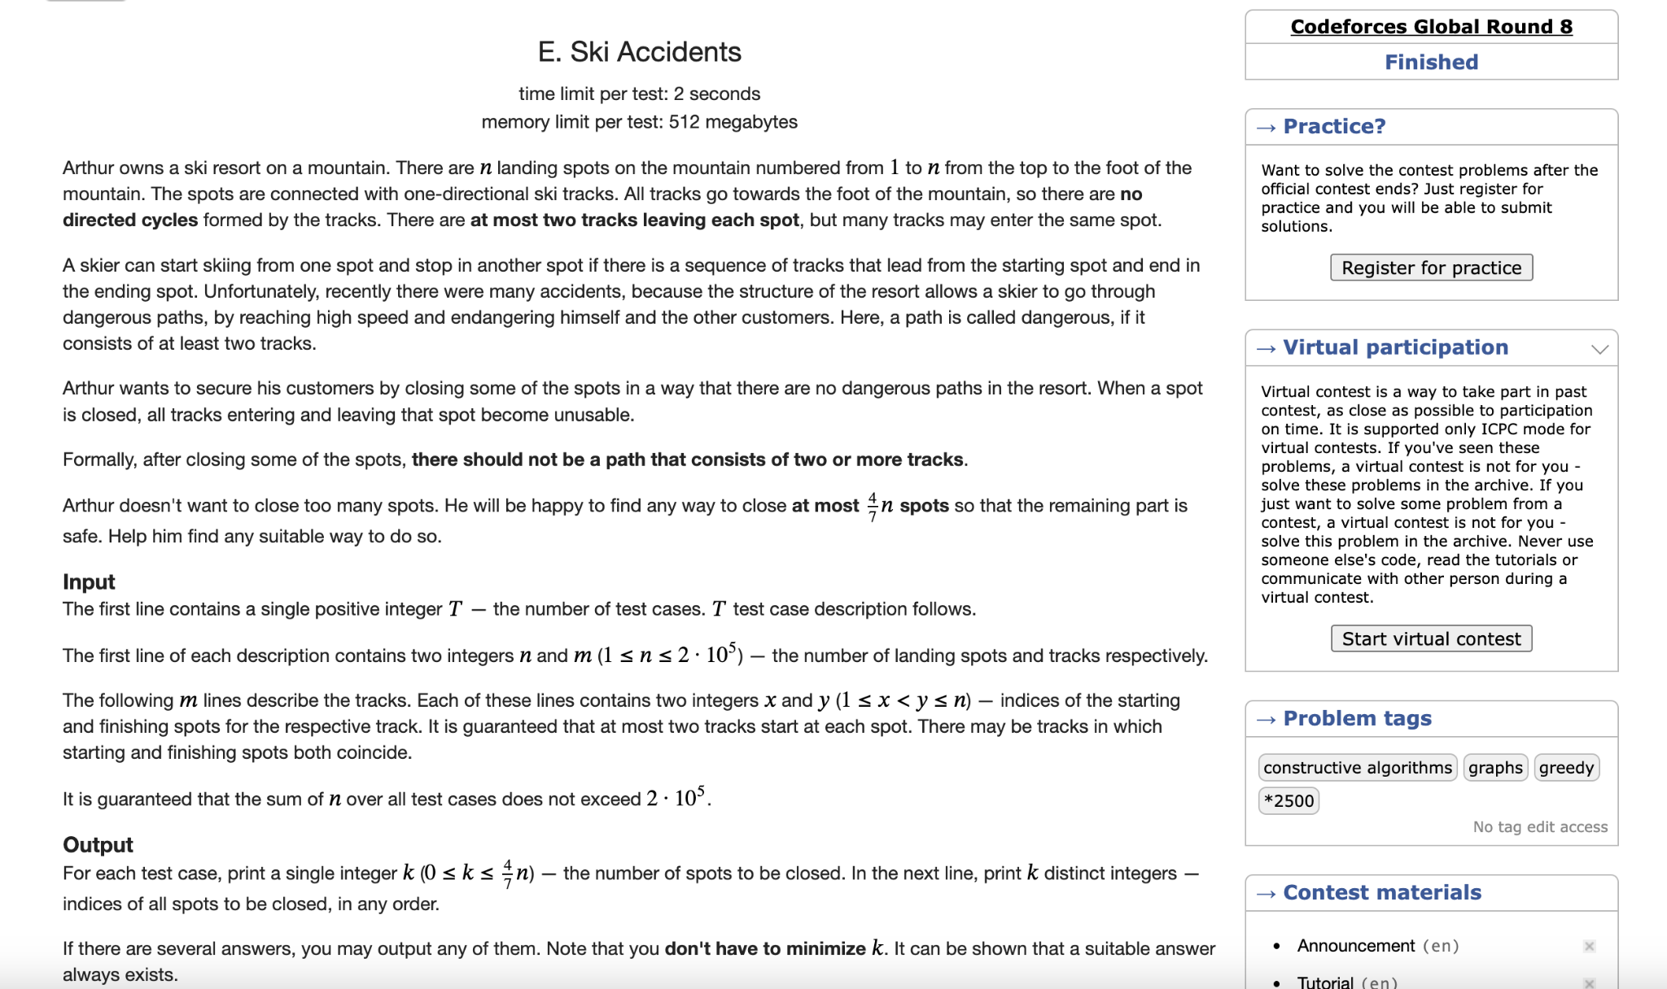

Slide 6
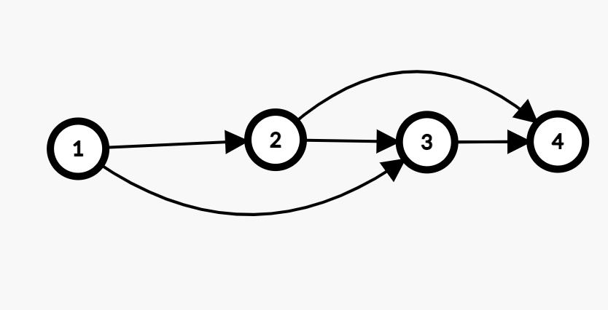

Slide 7
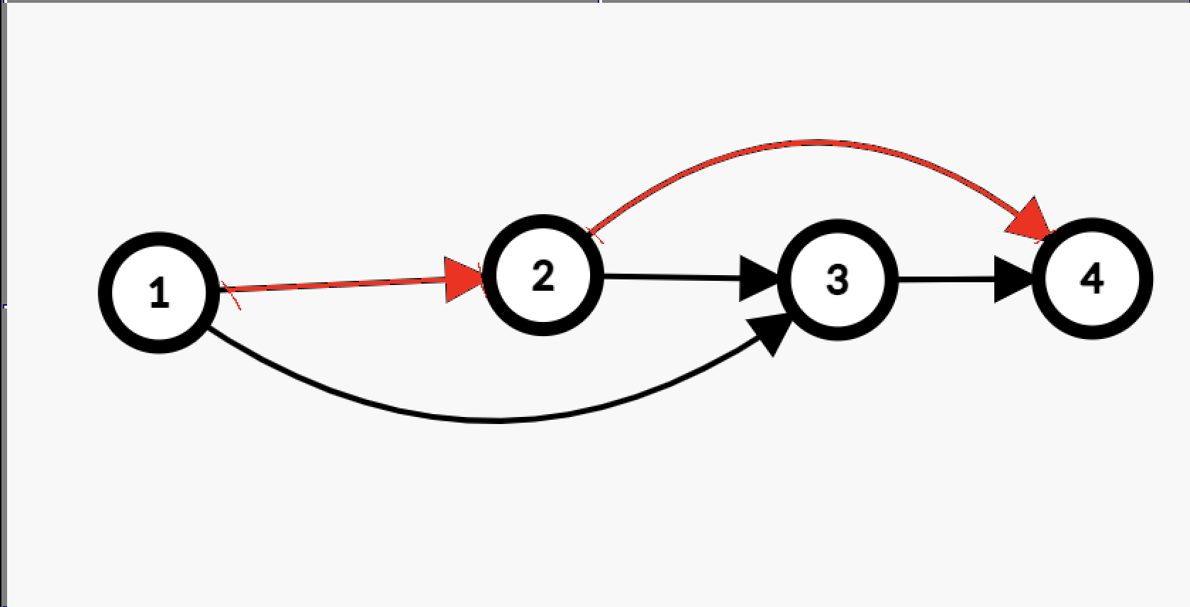

Slide 8
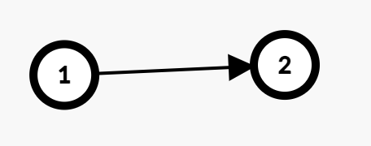

Slide 9
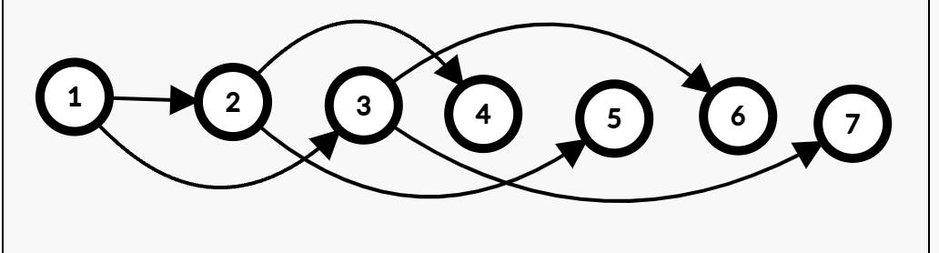

Slide 10
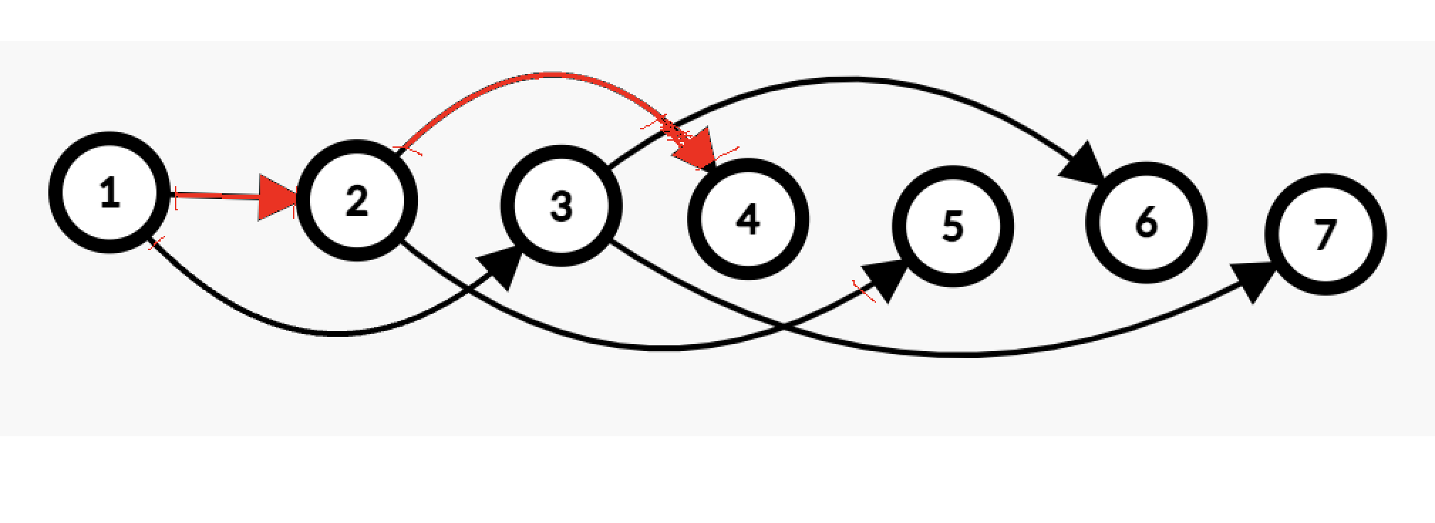

Slide 11
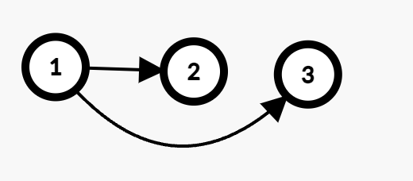

Slide 12
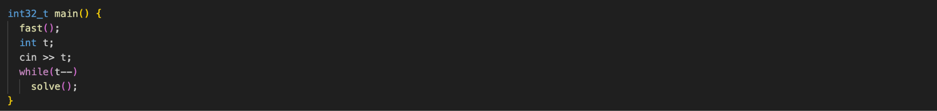

Slide 13
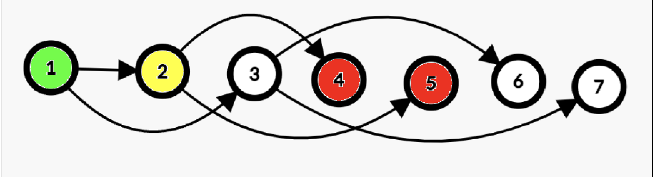

Slide 14
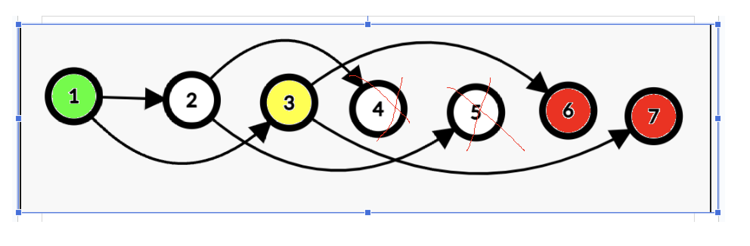

Slide 15
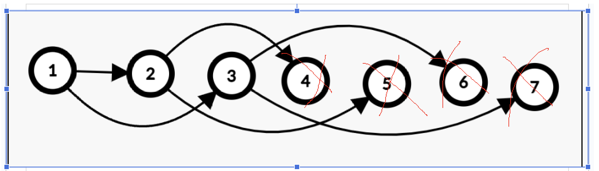

Slide 16
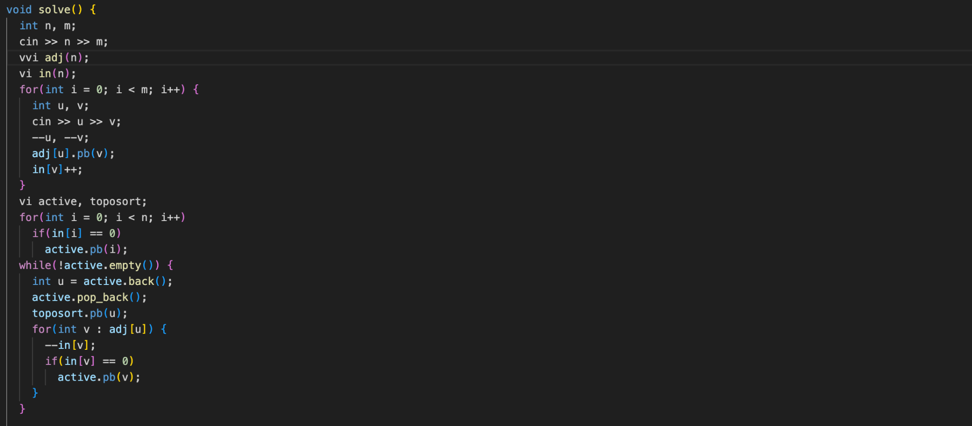
Step 1: Toposort

Slide 17
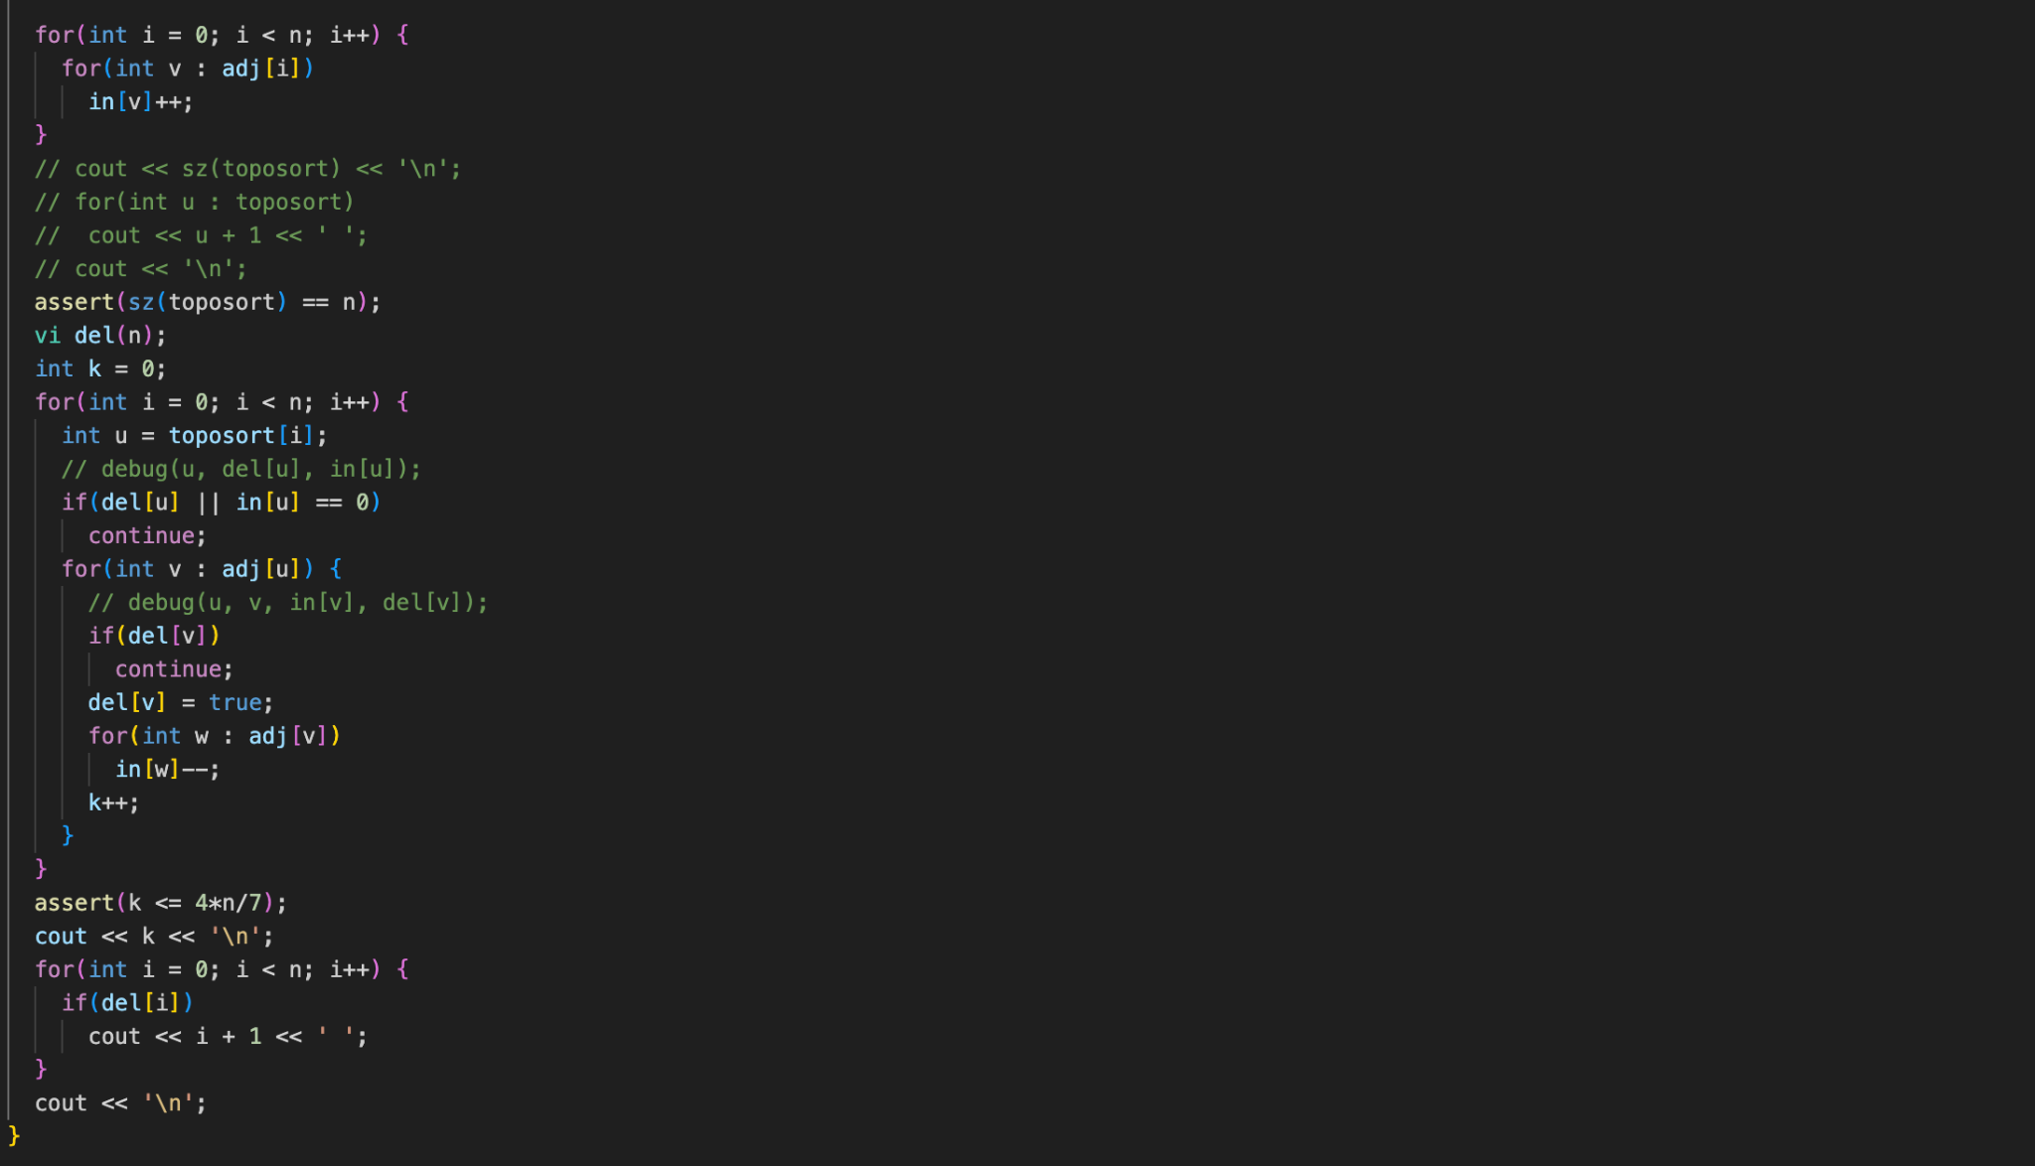
Step 2: Greedily remove vertices which are two steps away

Slide 18
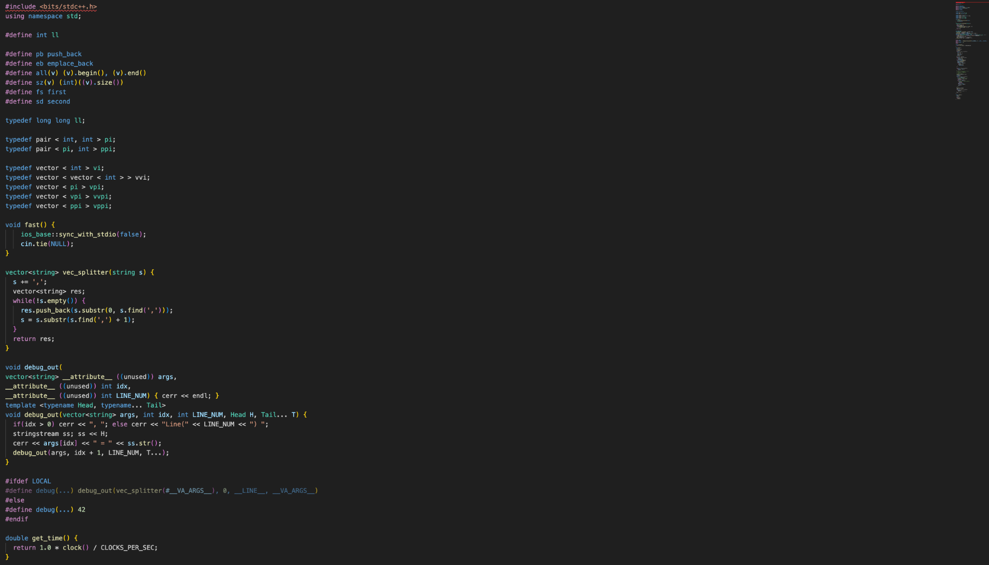

Slide 19
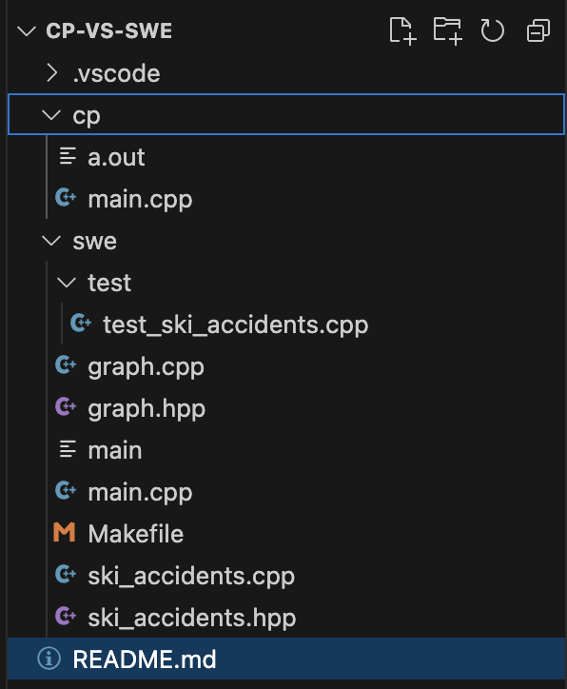

Slide 20
1. Multiple files.
2. Better data abstractions.
3. Makefile.
4. Unit tests.
5. Code comments.
6. Descriptive variable names.
7. Exceptions.

Slide 21
Thank you!

