Slide 1
Track E | Megacity Pandemic Response in NYC
Team E_008
Chathurangi Pathiravasan, Ph.D, BU
David Perticone, Ph.D. MIT
Raiana Rocha, University of São Paulo

Slide 2
Research Question
What are the patterns in population health and correlations with COVID-19 outcomes in NYC? (EDA, Feature Engineering).
We will explore zip code based analysis including temporal evolution and socio-economic factors.
We developed a metric for the infection spread in each ZIP Code and used that to search for differences in high and low infection rate data.

Slide 3
Datasets
The primary feature dataset used was the American Community Survey. It has 229 variables by zip code grouped as follows:
NYCHealth github provided zip code granularity of infections counts and rates
https://github.com/nychealth/coronavirus-data (scraped by all commits to repo)
Category- American Community Survey | Percent
Demographics | 30
Financial | 10
Housing | 25
Commute | 10
Education | 10
Employment | 10

Slide 4
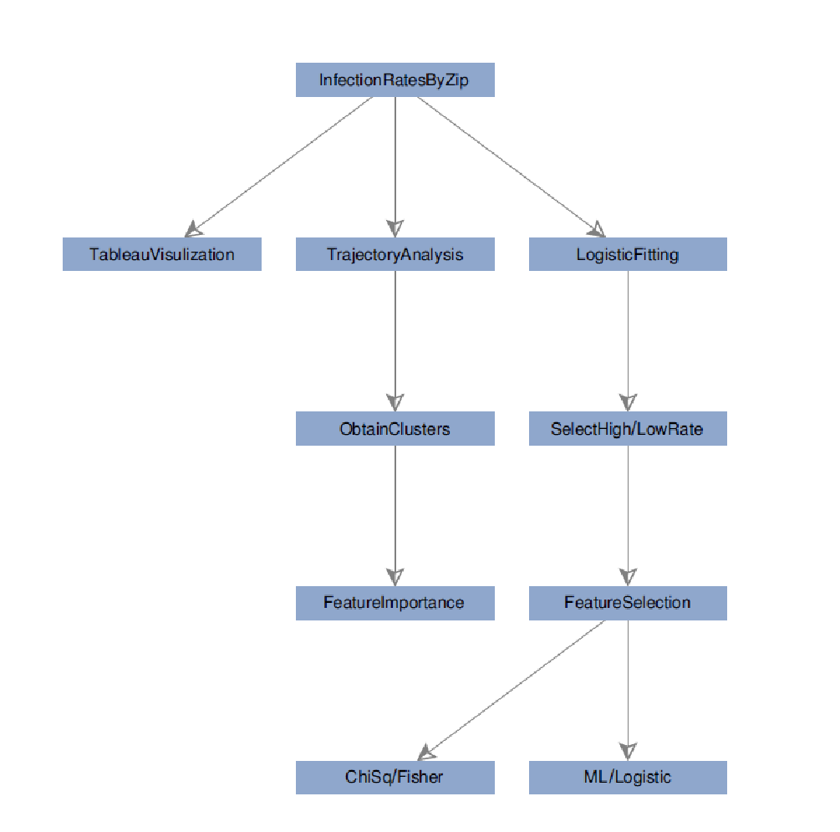
Methodology

Slide 5
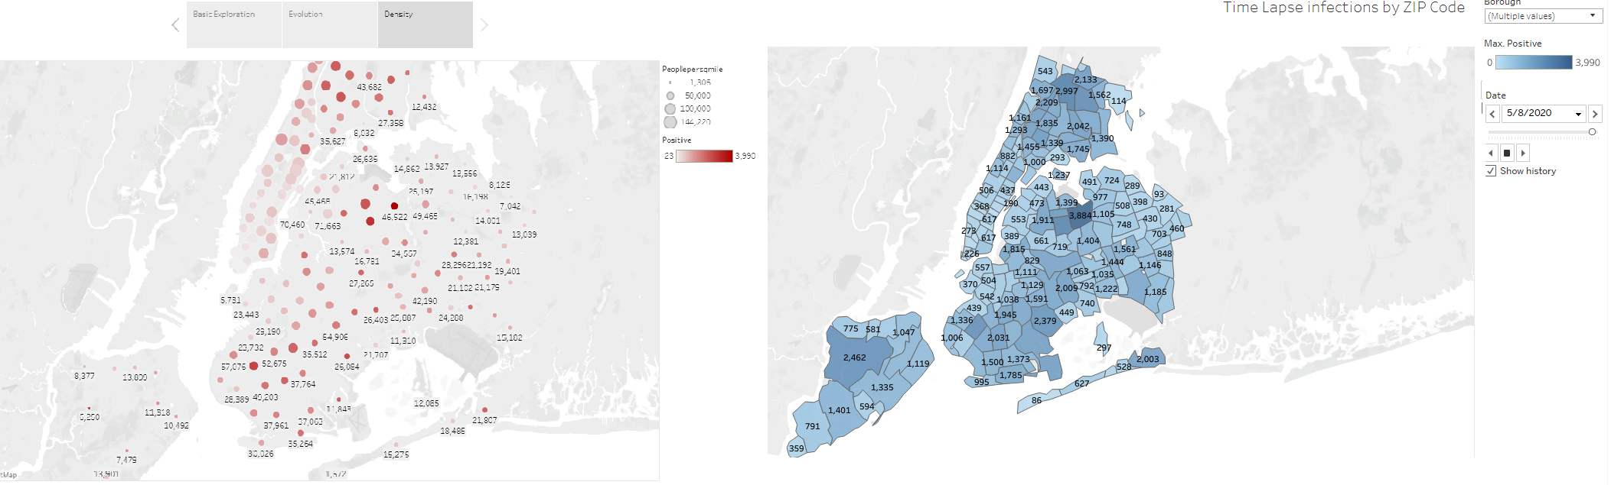
Exploratory Data Analysis
Population Density by ZIP Code
Time Lapse Infections by ZIP Code

Slide 6
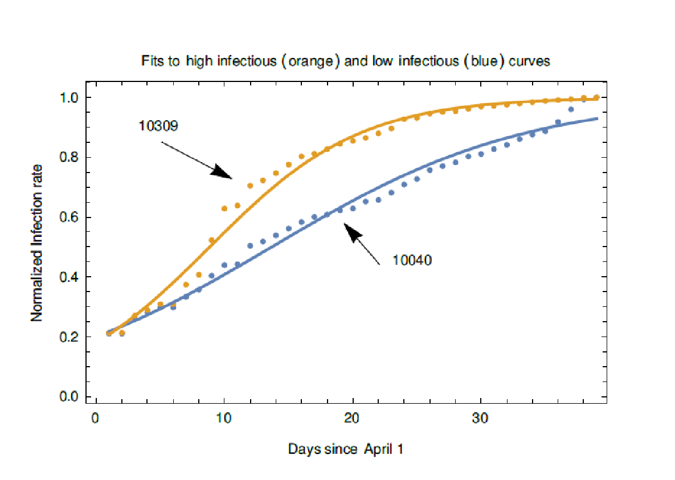
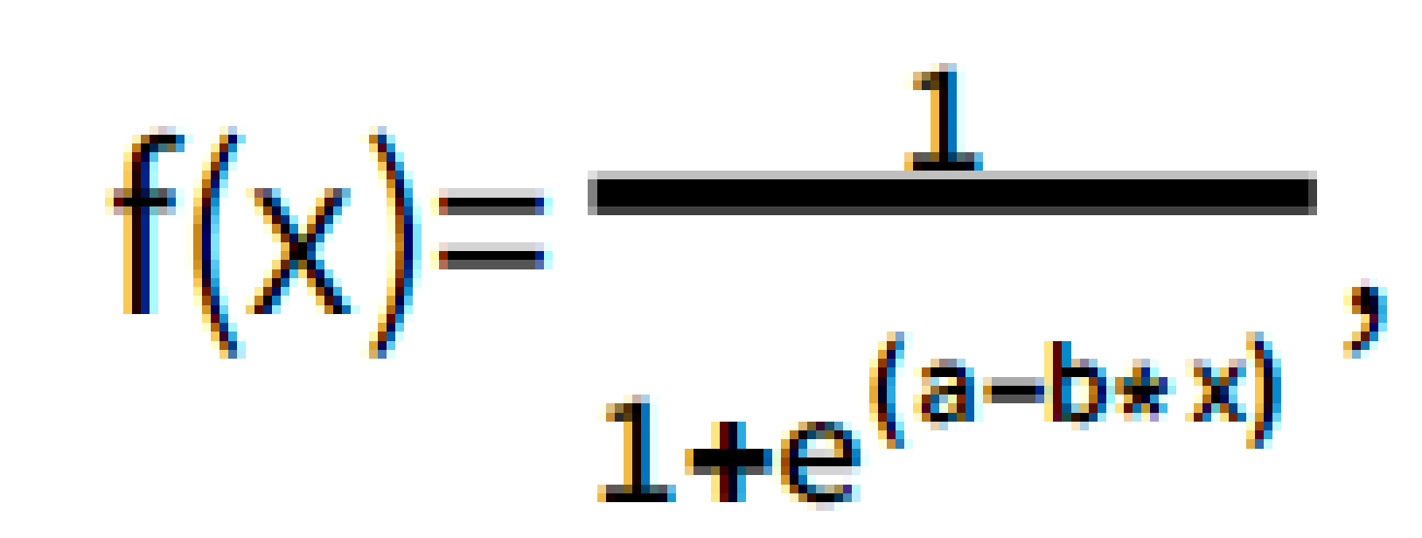
Infection growth modeling
We normalize each time Series to be between 0 and 1 and fit to
High and Low infection rate curves are shown on the right.
We selected 30 highly infectious and 30 less infectious Zip Codes and searched for differences

Slide 7
Feature Selection based on 𝝌²
Explored all 229 features using a Pearson ChiSquared test to identify feature differences. We used a control set of 60 random selected ZIP Codes to exclude chance variable differences.
The most interesting ACS features are shown below. We used the Fisher Exact Test to determine these could not have arisen from the random set.
Demographic | Housing | Commute | Employment
male_under_5 | renter_occupied_housing_units_paying_cash_median_gross_rent | commute_35_44_mins | employed_wholesale_trade
male_65_to_66 | owner_occupied_housing_units_median_value | walked_to_work | occupation_management_arts
male_70_to_74 | owner_occupied_housing_units_upper_value_quartile | worked_at_home | management_business_sci_arts_employed
female_80_to_84 | vacant_housing_units_for_sale | no_car
asian_male_55_64 | dwellings_3_to_4_units
 | dwellings_5_to_9_units
 | median_year_structure_built
 | male_male_households
 | median_rent
 | million_dollar_housing_units

Slide 8
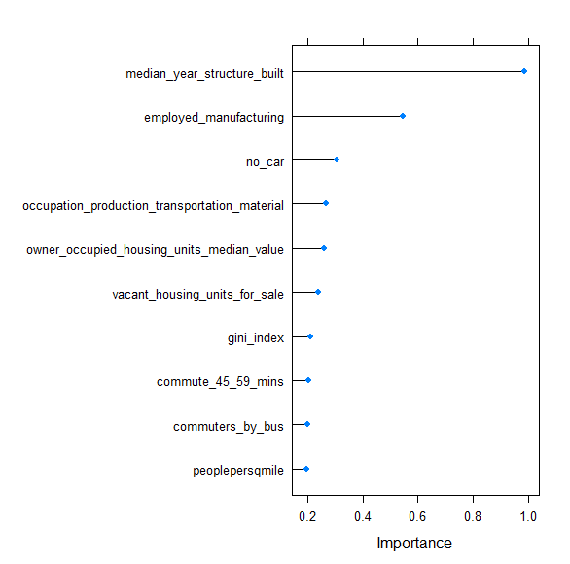
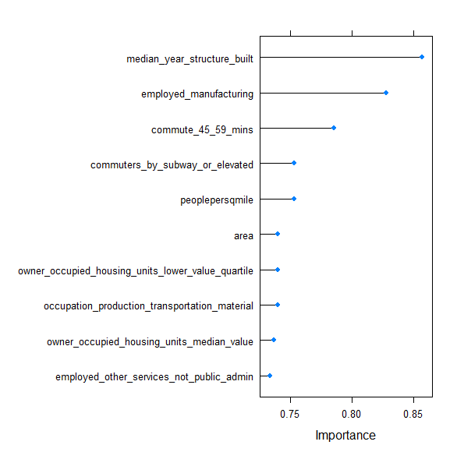
Feature selection using Machine Learning
 | Random Forests | SVM
AUC | 0.97 | 0.95
Sensitivity | 0.83 | 1
Specificity | 0.93 | 0.73
Feature Importance Random Forest
Feature Importance SVM

Slide 9
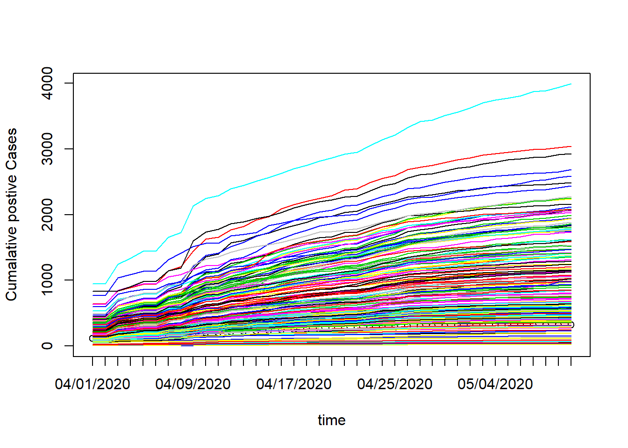
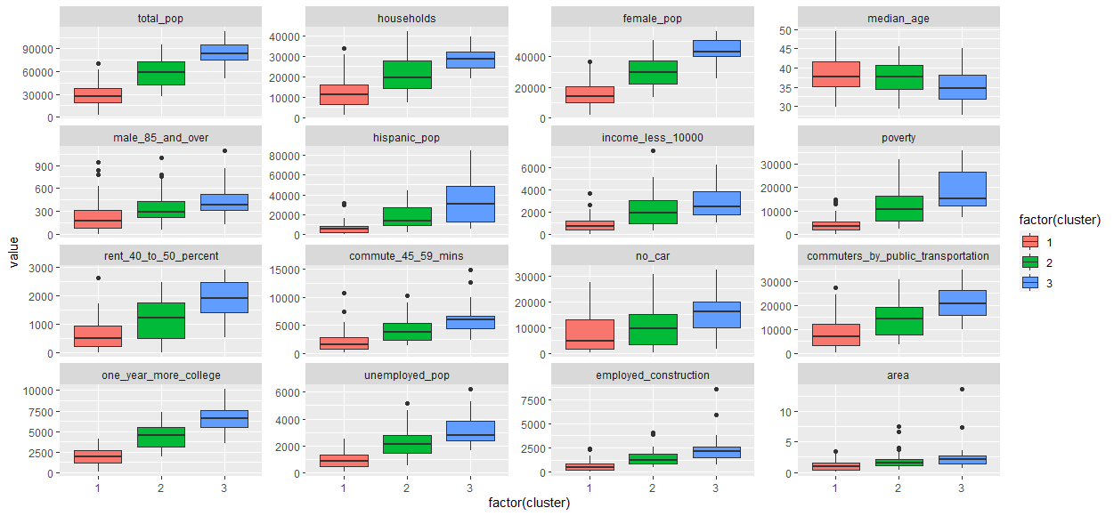
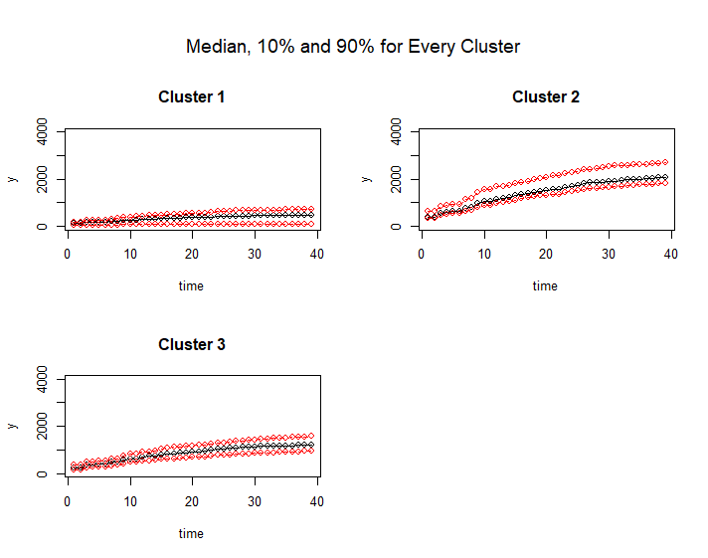
Trajectory Analysis
To expand to all ZIP Codes we used cluster analysis of the infection rate time series
Factor analysis identified 3 clusters
We identified the feature differences based on ChiSquared tests

Slide 10
Summary and future directions
Similar density populations can have different infection rates so there might be other covariates.
A variety of approaches showed differences between high and low infection zones using ZIP Code based analysis.
The census data should be supplemented with additional variables such as,
Patient specific data
Data about death rates
Lower granularity approaches should be tried.
There are still various approaches worth exploring.

Slide 11
Links
Github
https://github.com/chathurangiheshani/MIT_Covid19_Datathon_TeamE
Data Visualization with Tableau
https://public.tableau.com/profile/chathurangi.pathiravasan#!/vizhome/MITDatathon/MidPresentation?publish=yes
https://public.tableau.com/profile/raiana#!/vizhome/covid_15893383290120/Dashboard1

