Slide 1
Track E | Megacity Pandemic Response in NYC
Team E_008
Chathurangi Pathiravasan, Ph.D, BU
David Perticone, Ph.D. MIT
Raiana Rocha, University of São Paulo

Slide 2
Research Question
What are the patterns in population health and correlations with COVID-19 outcomes in NYC? (EDA, Feature Engineering).
We will explore zip code based analysis including temporal evolution and socio-economic factors.

Slide 3
Data Sets
We start by reviewing publicly available data sets on the web and gcp
NYCHealth github provided zip code granularity of infections counts and rates
https://github.com/nychealth/coronavirus-data (scraped by all commits to repo)
This was supplemented by census data providing detailed community features on gcp
zip_codes_2018_5yr (American Community Survey ~300 demographic features: commuting, race, education, housing, employment)
population_by_zip_2010
www.zip-codes.com (zip code geographic size sqmi)

Slide 4
Methods: Visualize and Analyze
Objective is to identify most and least infectious regions and find out why.
Will select and analyze factors that contribute to the differentiation using fitting and predictive modeling methods.
We will calculate a metric to measure infection severity to guide selection of areas for factor determination.

Slide 5
EDA Results at midpoint
Time Lapse of infections by zip code
infection rates and population density by zip
Videos provided in following slides

Slide 6
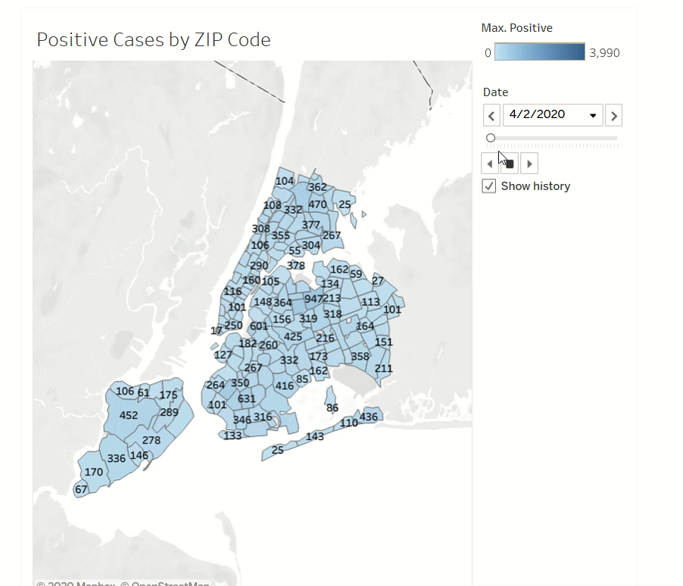

Slide 7
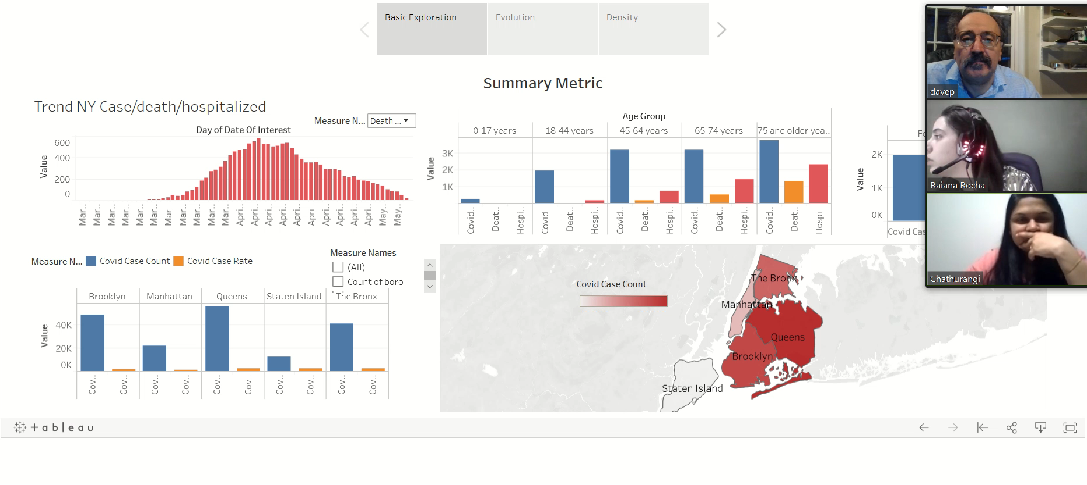

Slide 8
Interpretation and Implication
Ideally we would find factors that could influence policy and metrics which need to be gathered if not already done so.
This method is applicable throughout the United States and any other region with similar measured statistics.

