Slide 1
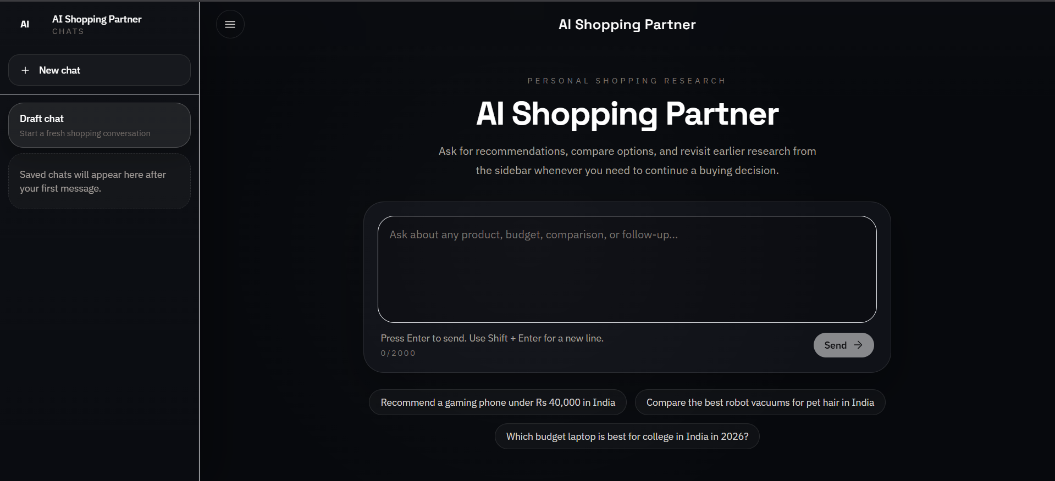
PROJECT REVIEW DECK
Agentic AI
Personal Shopper
Full-stack AI shopping assistant for evidence-grounded product decisions
Built with React, Flask, Gemini, YouTube transcript research, SSE, and Postgres
Review scope: vision, architecture, engineering journey, deployment, and outcomes
Item | Details
Names | V Rama Chandra Chathurvedi, Aravind Prasad R
Reg. No. | 25MCS0067, 25MCS0060
Guide | Dr. Baiju B V
Project | AI Shopping Partner
Final landing experience of the deployed web application

Slide 2
Executive Summary and Core Ideologies
VISION
Core ideology | How it was implemented | Review value
Evidence-grounded shopping | Recommendations synthesized from YouTube review transcripts and explicit source links | Moves output away from generic chatbot advice
Conversational continuity | Follow-up questions, saved sessions, auto-titles, rename/delete, sidebar revisit flow | Let’s users continue buying decisions over time
Latency-conscious engineering | ThreadPoolExecutor, SSE streaming, hybrid tool routing, lighter transcript payloads, caching | Improves both real and perceived responsiveness
Privacy-first persistence | Anonymous browser-scoped ownership for each session | Prevents chat leakage on a public website
Deployment realism | GitHub source control, Render Blueprint, Postgres, env wiring, health checks | Makes the project review-ready beyond localhost
Overall design target: a practical AI shopping product, not a toy demo.
2

Slide 3
Problem Statement and Project Goals
WHY THIS PROJECT
Problem being solved
Project goals
Online product research is fragmented across videos, specs, comments, and opinions.
Buyers need verdicts and comparisons, not just a list of links.
Typical chatbots often lack cited evidence and strong session continuity.
Public deployment introduces privacy and persistence challenges.
Accept natural-language shopping requests and follow-up questions.
Search YouTube reviews only when fresh evidence is required.
Extract transcripts automatically and synthesize a shopping verdict.
Stream responses live and save research for later reuse.
Deploy publicly with a professional UI and production-style persistence.
3

Slide 4
Development Timeline: From MVP to Public Deployment
JOURNEY
Phase | What was built | Outcome
1. Foundation | React/Vite frontend shell + modular Flask backend (app.py, agent.py, scraper.py) | Stable starting architecture
2. Retrieval + AI | YouTube search, transcript extraction, Gemini synthesis, SSE streaming | End-to-end chat research flow
3. Product UX | Dark interface, prompt composer, source chips, better output formatting | Professional and review-friendly UI
4. Session features | Saved chats, smart title generation, rename/delete, sidebar navigation | Conversation continuity
5. Hardening | Privacy isolation, latency fixes, model fallback, Render/Postgres deployment | Publicly usable system
The project evolved from a functional prototype into a production-style full-stack application.
Each iteration addressed a real engineering limitation: reliability, speed, privacy, or UX clarity.
4

Slide 5
Initial Scope vs Final Delivered System
REQUIREMENTS
Area | Initial requirement | Final implementation | Status
Backend structure | app.py, agent.py, scraper.py | Added storage.py, session CRUD routes, privacy ownership, deployment-ready configuration | Delivered
Intent routing | Fast decision on whether fresh YouTube research is needed | Hybrid fast-path research + Gemini tool decision for ambiguous turns | Delivered
Parallel retrieval | Fetch top video transcripts in parallel | Multi-variant search + dedupe + ThreadPoolExecutor transcript extraction | Delivered
Streaming | Gemini response streamed to UI | SSE with session, status, sources, chunk, done, and error events | Delivered
Chat UI | Modern conversational interface | Dark minimal interface with collapsible sidebar and keyboard-first composer | Delivered
History | Maintain conversation context | Saved chats, smart titles, rename/delete, DB persistence, browser privacy | Delivered
5

Slide 6
Technology Stack and Platform Choices
STACK
Layer | Technology | Purpose | Why this choice
Frontend | React + Vite + Tailwind CSS + react-markdown | Interactive chat UI and fast development | Component-based, responsive, lightweight, markdown-friendly
Backend API | Python Flask + Gunicorn | REST API, SSE streaming, routing | Simple, modular, and suitable for Render web services
AI layer | Google Gemini Flash family | Product verdicts, comparisons, titles | Fast enough for conversational synthesis
Retrieval | youtube-search-python + youtube-transcript-api | Review discovery and evidence extraction | No official YouTube Data API keys required
Persistence | SQLite locally, Postgres on Render | Session and message storage | Easy local setup + durable production deployment
Deployment | GitHub + Render Blueprint | Public hosting and infra wiring | Straightforward for Flask, SSE, and Postgres
6

Slide 7
System Architecture and End-to-End Flow
ARCHITECTURE
Stage | Responsible layer | Output / behavior
1. Prompt entry | React frontend | Captures query, updates local state, opens/uses active session
2. Chat request | Flask POST /api/chat | Creates or resumes a session and starts streaming events
3. Routing | agent.py | Decides follow-up vs fresh YouTube research
4. Evidence retrieval | scraper.py | Search variants + parallel transcript extraction + source list
5. Synthesis | Gemini | Generates verdict, compare blocks, watch-outs, and INR pricing cues
6. Streaming | SSE | Delivers status, source chips, and text chunks in real time
7. Persistence | storage.py | Stores messages, sessions, titles, and owner-scoped visibility
8. Revisit | Sidebar + session API | Lets user reopen, rename, or delete research threads
SSE event contract used by the UI: session, status, sources, chunk, done, and error.
Architecture intentionally separates routing, retrieval, synthesis, storage, and presentation concerns.
7

Slide 8
Backend Module Design
IMPLEMENTATION
Module | Primary responsibilities | Notable implementation details
app.py | Flask setup, CORS, routes, SSE streaming, session endpoints | Owns POST /api/chat, health checks, title scheduling, and cookie identity
agent.py | Gemini orchestration and shopping reasoning | Hybrid routing, tool wrapper, model fallback, response policy, title generation
scraper.py | YouTube search and transcript extraction | India-focused query shaping, transcript fallback logic, dedupe, caching support
storage.py | DB schema and CRUD | SQLite local fallback, Postgres production support, owner-scoped session filtering
The modular backend kept routing, research, model logic, and persistence independently maintainable.
This structure also made it easier to debug individual issues such as quota failures, transcript failures, and chat leakage.
8

Slide 9
YouTube Retrieval Engine and Gemini Intelligence
AI ORCHESTRATION
YouTube evidence pipeline
Gemini orchestration strategy
Derived search variants from the user query with India- and review-oriented bias.
Searched multiple candidate videos and removed duplicates.
Fetched transcripts in parallel with ThreadPoolExecutor for lower latency.
Skipped videos that raised TranscriptsDisabled or NoTranscriptFound.
Used transcript fallbacks, trimming, and caching before passing evidence to Gemini.
Wrapped YouTube research as a native tool: fetch_youtube_reviews(product_name).
Used a hybrid router: fast-path for obvious new research, model decision for ambiguous or follow-up turns.
Streamed final responses through SSE for a live typing effect.
Added stronger prompts for specific models, INR budgets, comparisons, and watch-outs.
Introduced model fallback and quota-aware behavior for public deployment.
9

Slide 10
Frontend UX and Interaction Design
USER EXPERIENCE
UX objective | Final implementation
Minimal visual noise | Dark, low-glare interface with centered landing page and restrained accent colors
Fast first interaction | Suggestion chips, large composer, keyboard-first prompt flow
Streaming clarity | Live status labels, source chips, incremental answer rendering
Navigation | Collapsible sidebar, home click behavior, draft/new chat flow
Session control | Rename, delete, revisit, and single smart auto-title generation
Responsiveness | Desktop sidebar plus mobile-friendly drawer behavior
The UI deliberately moved away from cluttered tables and duplicated controls.
The final design aligns more closely with the interaction patterns of ChatGPT, Gemini, Claude, and Copilot.
10

Slide 11
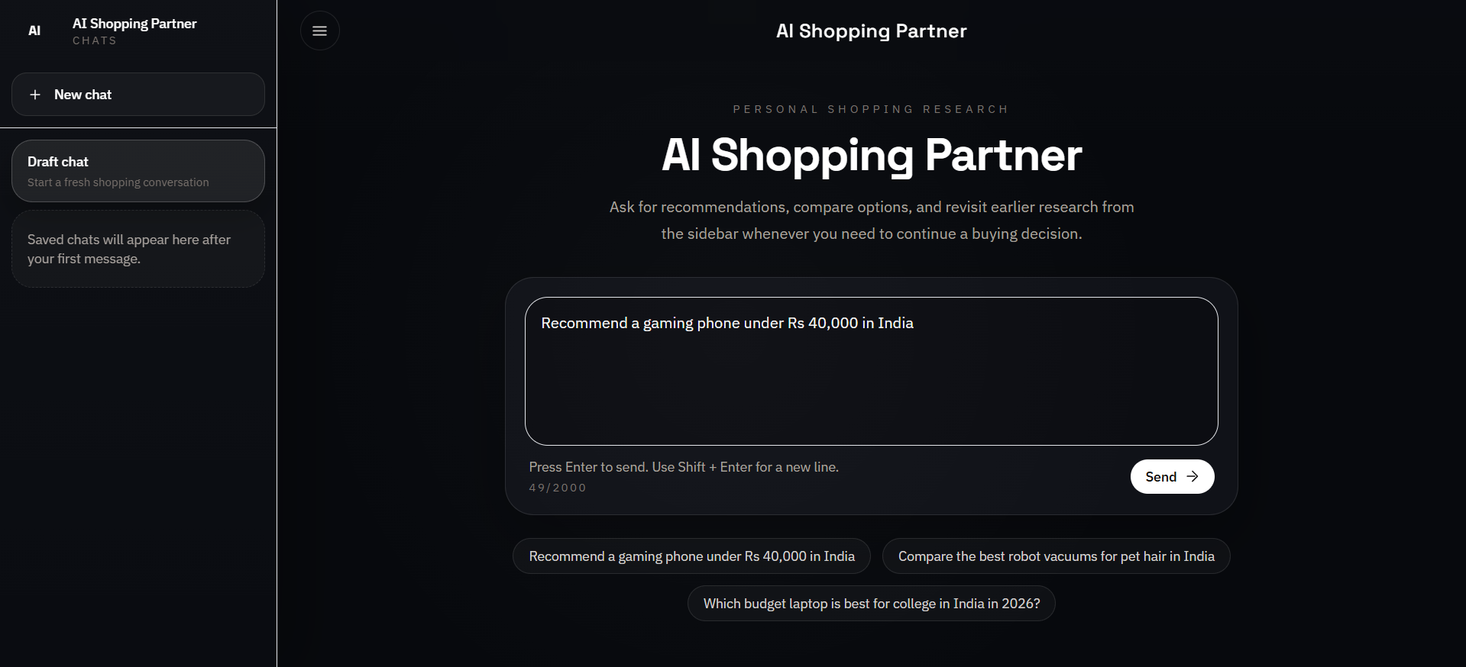
UI Walkthrough: Landing State and Prompt Entry
SCREENS
Home view before a prompt is sent
Prompt drafted for a specific Indian-market shopping query
Clean landing page with one clear call to action: ask a shopping question.
Prompt suggestions accelerate first use and demonstrate supported query styles.
Composer supports Enter-to-send and Shift+Enter for multiline prompts.
11

Slide 12
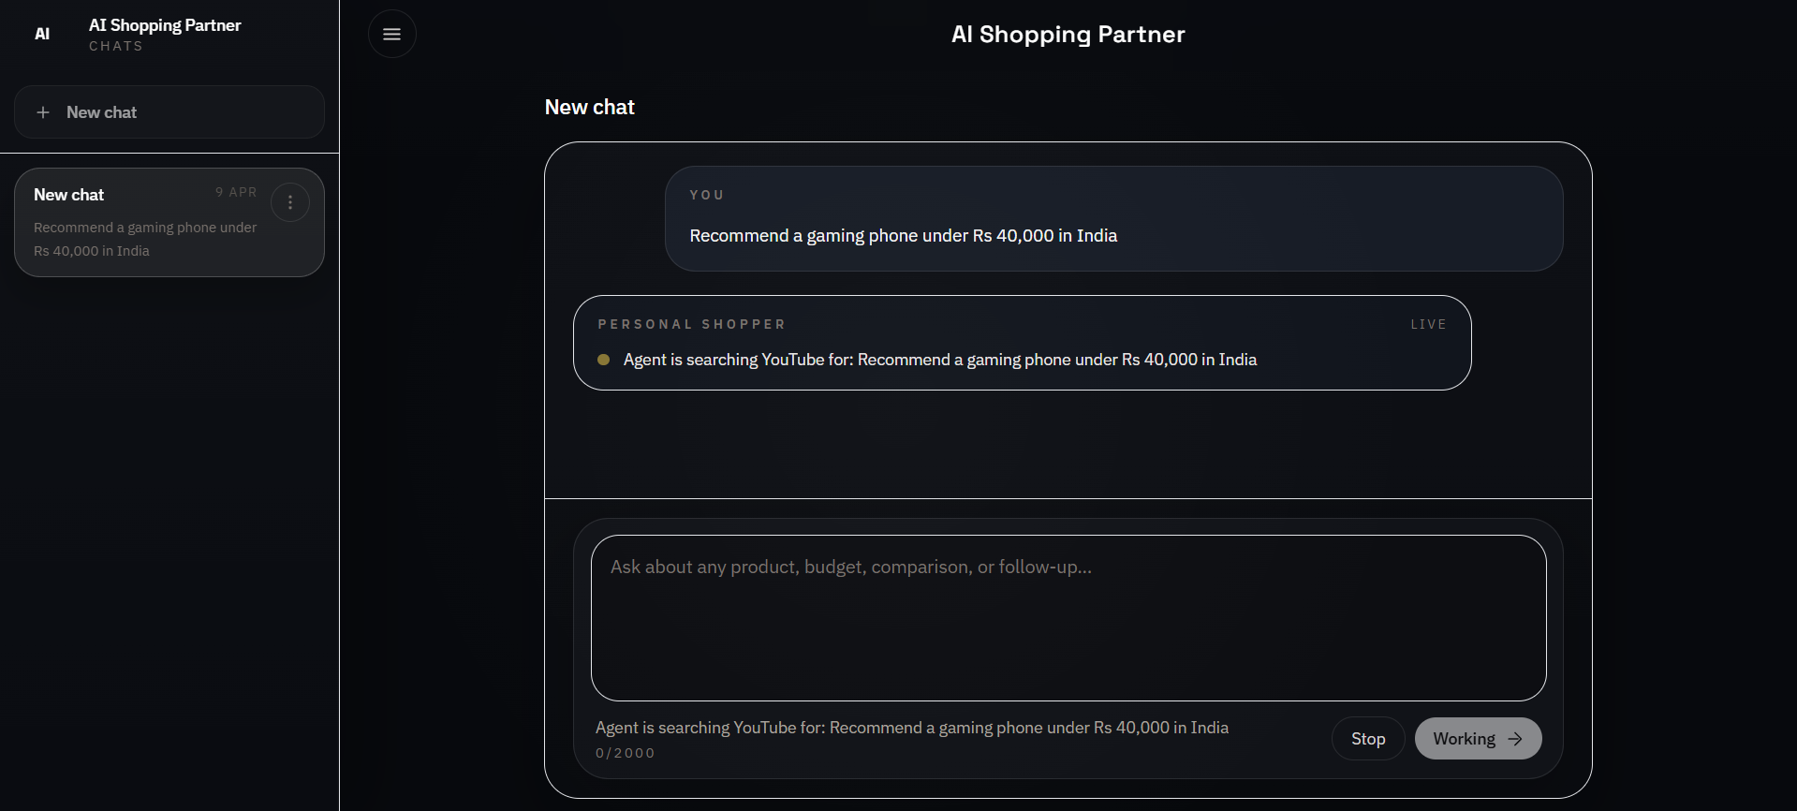
UI Walkthrough: Live Research and Streaming States
SCREENS
Thread begins with the user message and immediately surfaces live research status
State | Meaning
Searching YouTube | Retrieval is running and transcript evidence is being collected
Live | Assistant stream is active and the response channel is open
Working | Composer is locked to prevent conflicting requests during an active run
Stop | User can interrupt the active generation
12

Slide 13
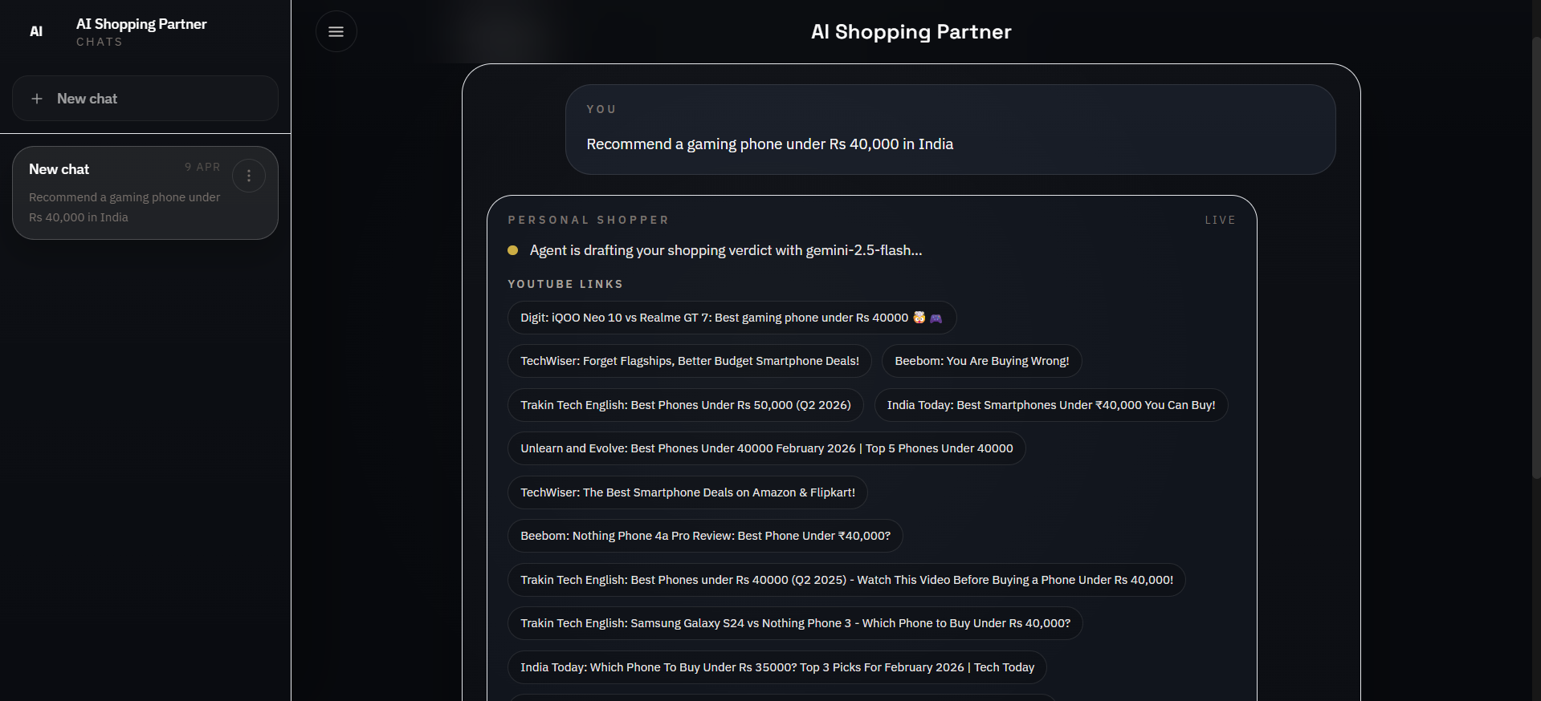
UI Walkthrough: Source Transparency During Generation
SCREENS
Source links are surfaced while the verdict is still being drafted
Multiple review channels contribute evidence instead of relying on a single video.
Users can see exactly which review videos informed the answer before the response completes.
This improves trust, explainability, and review auditability.
13

Slide 14
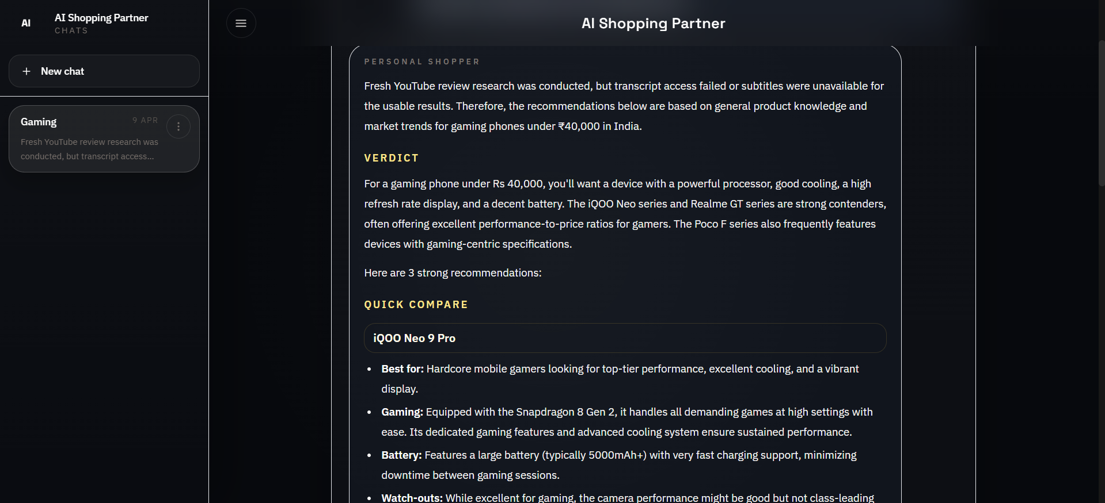
Recommendation Output: Verdict and Quick Compare
SCREENS
Final answer format emphasizes verdict, quick compare blocks, watch-outs, and pricing
The output moved away from clumsy markdown tables toward compact compare blocks.
Each recommendation includes best-for guidance, gaming/performance notes, battery, watch-outs, and approximate INR pricing.
When transcript access is limited, the assistant degrades gracefully instead of failing outright.
14

Slide 15
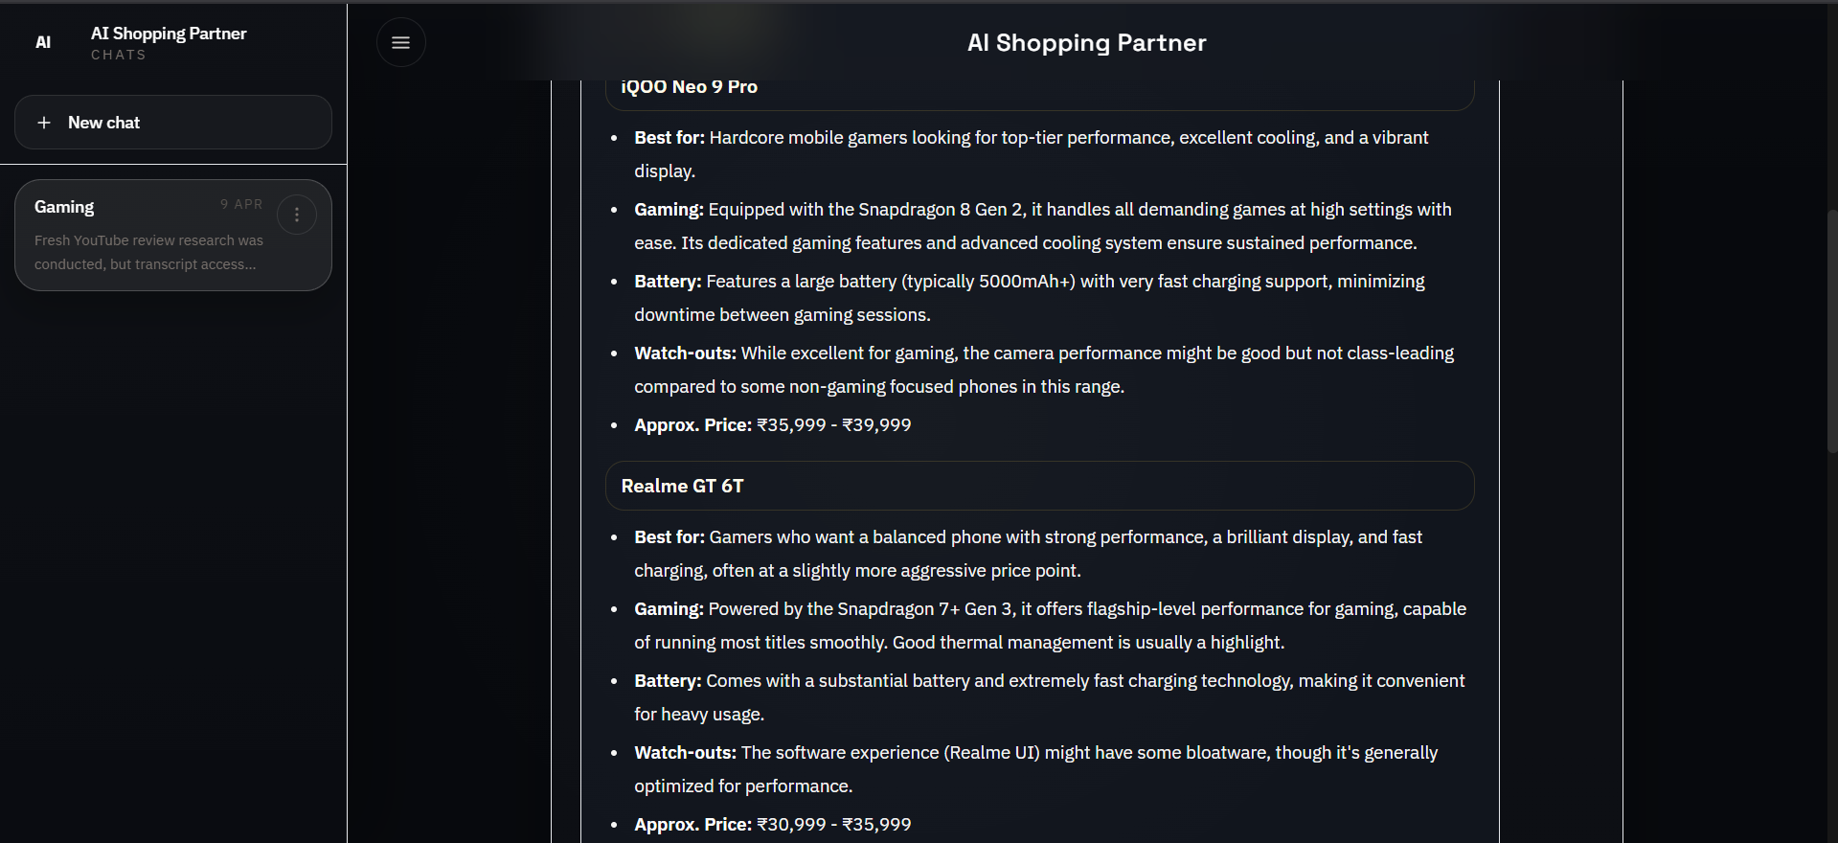
Recommendation Output: Product-Level Specificity
SCREENS
Recommendations are presented as concrete product options rather than brand-only advice
The response policy was strengthened to prefer exact models and budget-relevant shortlists.
Ambiguous categories can trigger clarifications instead of generic recommendations.
India-focused pricing improves practical decision support for the target audience.
15

Slide 16
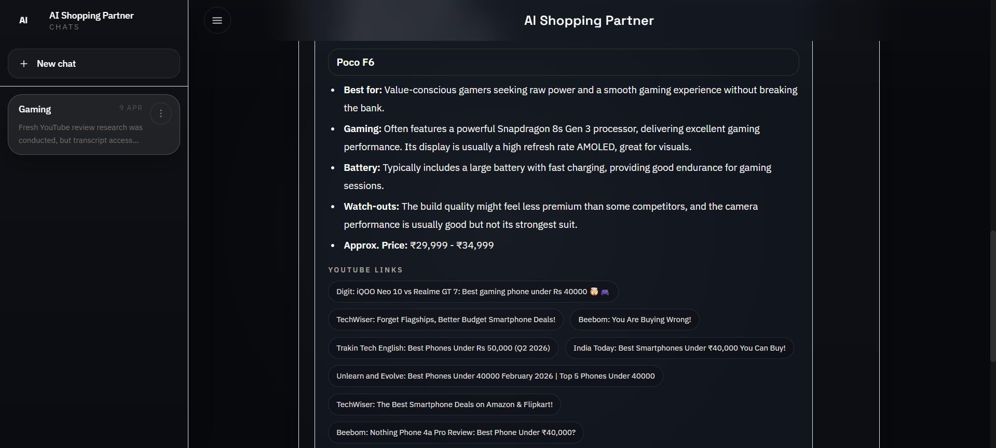
Recommendation Output: Attached Evidence Links
SCREENS
Source chips remain attached to the recommendation output for quick verification
Final answers keep source visibility close to the recommendation itself.
This supports follow-up questions such as battery, thermals, value, or camera trade-offs.
The UI is designed to feel conversational while still preserving evidence grounding.
16

Slide 17
Sessions, Privacy, and Persistence
STATE MANAGEMENT
Capability | Final behavior | Engineering mechanism
Saved sessions | Reopen earlier chats from the sidebar | Session and message tables in DB
Rename / delete | Users control chat titles and cleanup | PATCH/DELETE session endpoints + sidebar actions
Single smart auto-title | One refined title appears after the first answer | Background title generation after assistant response
Browser-private chats | One visitor cannot see another visitor's conversations | Anonymous cookie + owner_id session filtering
Local and production storage | SQLite locally, Postgres on Render | DB_PATH fallback locally, DATABASE_URL in production
A critical late-stage fix was preventing public chat leakage once the site was deployed on a shared URL.
Authentication was intentionally avoided to keep the product lightweight, so privacy was implemented per browser session instead.
17

Slide 18
Deployment Architecture and Production Setup
DEPLOYMENT
Deployment layer | What was done | Outcome
Source control | Initialized Git repository, created GitHub repo, documented setup in README | Reproducible project history
Backend hosting | Deployed Flask API to Render Web Service with Gunicorn | Public SSE-capable API
Frontend hosting | Deployed Vite build to Render Static Site | Public client URL
Database | Provisioned Render Postgres and injected DATABASE_URL | Durable session persistence in production
Configuration | Wired GEMINI_API_KEY, CORS_ORIGIN, VITE_API_BASE_URL, health checks | Connected services and prevented CORS issues
Operational fit | Chose Render over Vercel for Flask + SSE + long-lived backend patterns | Simpler deployment model for this architecture
Production persistence was upgraded from SQLite to Postgres because free service filesystems are not durable enough for shared deployment.
A Render Blueprint (render.yaml) keeps frontend, backend, and database wiring aligned.
18

Slide 19
Major Technical Issues and Their Resolutions
LESSONS LEARNED
Issue | Observed problem | Resolution
PowerShell execution policy | Blocked venv activation and direct npm usage | Used .venv\\Scripts\\python and npm.cmd instead of changing global policy
Python dependency mismatch | youtube-transcript-api 0.6.3 failed on Python 3.14 | Upgraded to a compatible version
YouTube search breakage | youtube-search-python conflicted with newer httpx | Pinned a compatible httpx release
Gemini model / config errors | Unavailable model aliases and invalid function calling config | Updated model defaults, added fallback logic, corrected tool config
Quota exhaustion | Public traffic exceeded free-tier request limits | Added model fallback, better usage patterns, and quota-aware messaging
These issues were part of turning the app from a local prototype into a public deployment.
19

Slide 20
Major Product and UX Issues and Their Resolutions
LESSONS LEARNED
Issue | Observed problem | Resolution
Public chat leakage | Shared URL exposed saved chats to other users | Introduced browser-scoped anonymous ownership filtering
Generic recommendations | Queries like watches under 5000 produced brand-level answers | Strengthened prompts, added category clarification, pushed model-specific output
Slow first responses | Fresh research paid for multiple AI/retrieval costs | Hybrid fast-path routing, leaner transcripts, candidate tuning, short-lived cache
Vague chat titles | Auto-titles were not useful in the sidebar | Moved to one smarter title generated after the first answer
Cluttered UI | Duplicate controls and poor comparison formatting reduced clarity | Redesigned the interface, simplified controls, replaced tables with compare blocks
The final user experience is the result of iterative correction, not just initial implementation.
20

Slide 21
Final Feature Set and Review Readiness
OUTCOME
Capability group | Delivered features
Core AI | Conversational shopping assistant, follow-up support, Gemini synthesis, India-focused outputs
Retrieval | YouTube review search, transcript-backed reasoning, parallel transcript extraction, source dedupe, caching
Streaming UX | SSE response streaming, live status updates, source chips, incremental rendering
Sessions | Saved chats, smart titles, rename/delete, sidebar revisit flow
Privacy | Browser-scoped session isolation with no cross-user leakage
Deployment | GitHub repo, Render frontend/backend, Postgres persistence, health checks
UI polish | Dark minimal design, collapsible sidebar, centered landing page, keyboard-first interaction
Final result: a publicly deployed, evidence-grounded AI shopping assistant with real engineering depth across retrieval, AI orchestration, UX, privacy, persistence, and deployment.
The system is ready for project review because it demonstrates both product thinking and end-to-end implementation rigor.
21

