Slide 1

Superstore Sales Analysis
Sales, profit and performance insights, 2014–2017
By Chathurya Athukorala | Tools: Excel . Powerpoint
Notes:
Overview of the Superstore dataset (Orders sheet), covering January 2014 to December 2017.

Slide 2






Business at a Glance
$2.30M in sales and $286K in profit over four years
$2.30M
$286K
12.5%
Total sales
Total profit
Overall profit margin
5,009
793
37,873
Orders placed
Unique customers
Units sold
Superstore Sales Analysis | 2014–2017
2
Notes:
Headline KPIs: 5,009 unique orders from 793 customers between Jan 2014 and Dec 2017.

Slide 3
Sales & Profit Summary
Highest growth recorded in Technology, with Furniture showing a notable profit dip.
$ 836.15 K
Sales growth, in Technology
$ 145.15 K
Profit growth, in Technology
$ 18.45 K
Profit dip in Furniture
Superstore Sales Analysis | 2014–2017
3
Notes:
Sales: $484K (2014), $471K (2015), $609K (2016), $733K (2017). Profit grew faster than sales, lifting margin.

Slide 4
Monthly Sales Trend
September to December bring 52% of annual sales
$1.19M
Sales in Sep–Dec (51.6% of total)
$60K
Weakest month: February
Superstore Sales Analysis | 2014–2017
4
Notes:
Monthly totals are summed across all four years. November ($353K) and December ($325K) are the strongest months, followed by September ($308K).

Slide 5
Sub-Category Profitability
Tables, Bookcases and Supplies lose money; Copiers lead
-$22.4K
Combined loss: Tables, Bookcases, Supplies
$55.6K
Copiers: top profit sub-category
1.8%
Machines margin on $189K sales
Superstore Sales Analysis | 2014–2017
5
Notes:
Tables -$17.7K, Bookcases -$3.5K, Supplies -$1.2K. Machines have $189K of sales but only $3.4K profit.

Slide 6
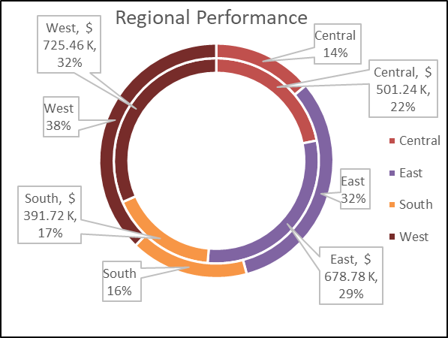
Regional Performance
West and East lead; Central has the weakest margin
38%
32%
West margin profit
East margin profit
16%
14%
South margin profit
Central margin profit
Inner: Sales | Outer: Profit
Superstore Sales Analysis | 2014–2017
6
Notes:
Central: $501K sales, $39.7K profit, the lowest margin of the four regions.

Slide 7
Key Takeaways
1
Growth with better margins
2
Plan for the Q4 peak
Technology recorded $ 836.15 K in sales growth and $ 145.15 K in profit growth.
Sep–Dec generates 52% of annual sales.
3
High discounts cause massive losses
4
Lift Central region margin
Tables, Bookcases and Supplies lost $22.4K combined.
Central earns 7.9%, versus 14.9% in the West.
Notes:
Each takeaway comes from one of the four charts: yearly summary, monthly trend, sub-category profit and regional performance.

Slide 8
Recommendations
1
Providing a maximum discount limit of 15%-20% for tables and bookcases.
2
Review of promotional discounts in the central region.
Notes:
Each takeaway comes from one of the four charts: yearly summary, monthly trend, sub-category profit and regional performance.

Slide 9


Thank You!
Connect with me
LinkedIn
GitHub
Notes:
Each takeaway comes from one of the four charts: yearly summary, monthly trend, sub-category profit and regional performance.

