Slide 1
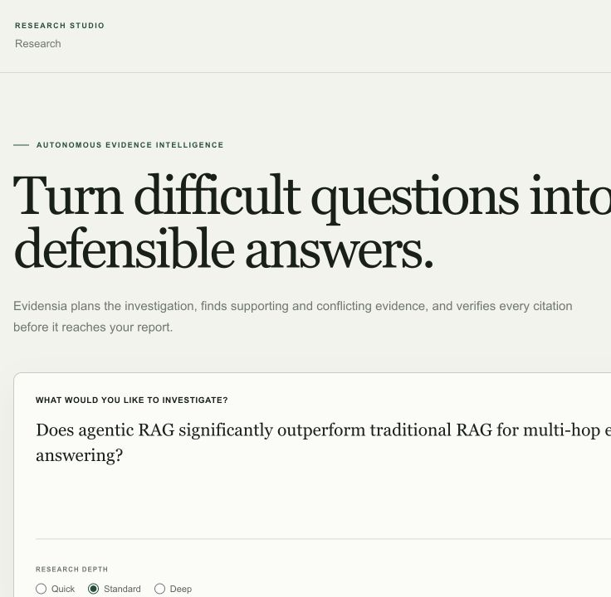
AUTONOMOUS EVIDENCE INTELLIGENCE
Evidensia AI
Research that shows its work.
A local-first platform for scholarly discovery, hybrid retrieval, corrective investigation, and citation-checked evidence synthesis.
PROJECT OVERVIEW
Working prototype · August 2026
EVIDENSIA AI / PROJECT OVERVIEW
01
Notes:
Open with the product promise: a defensible answer requires a visible evidence process, not only fluent generation.
[Sources]
- Evidensia AI local repository and source design, inspected 20 August 2026.
- Product screenshots captured from the local Research Studio at http://localhost:3000.

Slide 2
WHY THIS EXISTS
One-pass RAG is too fragile for serious research
TRADITIONAL RAG
EVIDENSIA
Question → retrieve → generate
Plan → search → challenge → verify
Fast for lookup, but weak when the question is multi-hop, the evidence conflicts, or the answer needs to be audited.
The system decomposes the investigation, finds supporting and opposing passages, corrects weak retrieval, and exposes exact source spans.
The output is an evidence-backed argument—not a confident black box.
EVIDENSIA AI
02
Notes:
Contrast the single retrieval pass with an auditable, stateful research loop.
[Sources]
- Evidensia AI local repository and source design, inspected 20 August 2026.
- Product screenshots captured from the local Research Studio at http://localhost:3000.

Slide 3
SYSTEM ARCHITECTURE
Stable contracts keep the prototype replaceable
01
02
03
04
05
Research Studio
FastAPI
LangGraph
Retrieval
Evidence index
React interface
Structured API
Corrective workflow
Dense + BM25 + RRF
Local persistence
PROVIDER SEAMS
Hosted embeddings, reranking, model-backed agents, PostgreSQL, Redis, and object storage can replace local baselines without changing the user-facing research contract.
EVIDENSIA AI
03
Notes:
Explain that the local build is intentionally deterministic and modular; production providers remain explicit seams.
[Sources]
- Evidensia AI local repository and source design, inspected 20 August 2026.
- Product screenshots captured from the local Research Studio at http://localhost:3000.

Slide 4
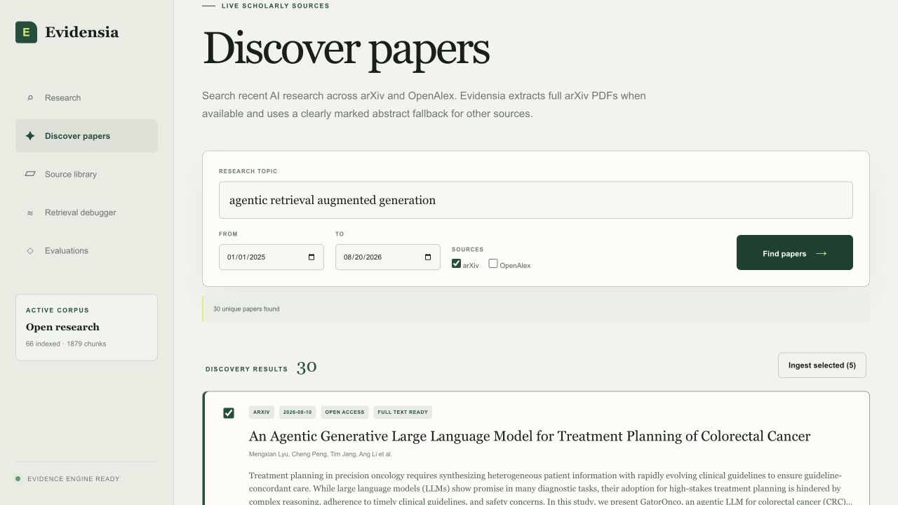
SCHOLARLY DISCOVERY
Recent AI papers can flow directly into the evidence library
30
unique arXiv results
in the captured query
2025–2026 date bounds
Full-text arXiv extraction
OpenAlex abstract fallback
DOI / title deduplication
EVIDENSIA AI
04
Notes:
Describe the metadata-first search, deduplication, full-text arXiv path, and clearly marked abstract fallback.
[Sources]
- Evidensia AI local repository and source design, inspected 20 August 2026.
- Product screenshots captured from the local Research Studio at http://localhost:3000.

Slide 5
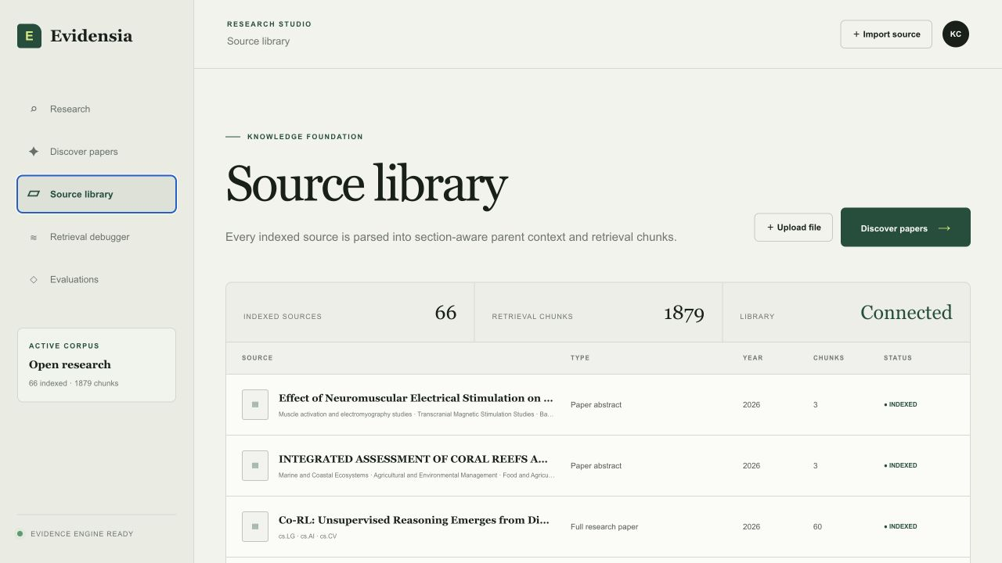
EVIDENCE FOUNDATION
The source library is persistent, visible, and growing
66
indexed documents
1,879
retrieval chunks
CONNECTED
Source identity, year, type, provenance, and ingestion status remain visible.
EVIDENSIA AI
05
Notes:
Counts are the live local corpus snapshot captured on 20 August 2026.
[Sources]
- Evidensia AI local repository and source design, inspected 20 August 2026.
- Product screenshots captured from the local Research Studio at http://localhost:3000.

Slide 6
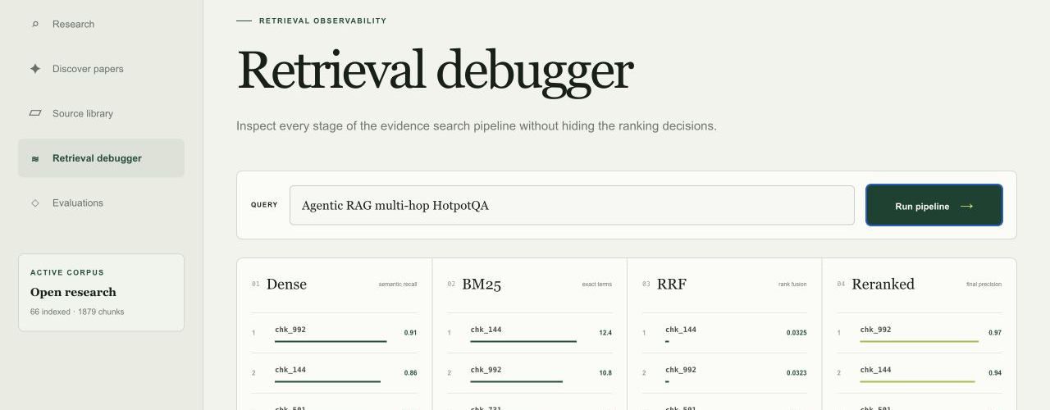
HYBRID RETRIEVAL
Every ranking stage is inspectable
Dense recall → BM25 exactness → reciprocal-rank fusion → final precision
EVIDENSIA AI
06
Notes:
Use the debugger to show that retrieval quality is diagnosable rather than hidden behind a single relevance score.
[Sources]
- Evidensia AI local repository and source design, inspected 20 August 2026.
- Product screenshots captured from the local Research Studio at http://localhost:3000.

Slide 7
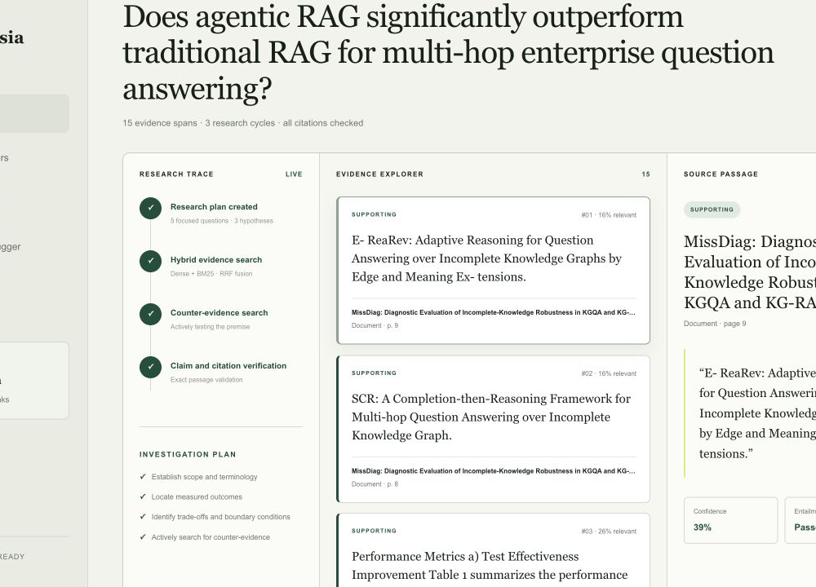
CORRECTIVE RESEARCH
A stateful agent can search again when evidence is weak
Plan
Retrieve
Challenge
Verify
focused questions
hybrid search
counter-check
claims + citations
Evidence spans preserve the source, page or section, exact passage, stance, and relevance score. The visible trace makes correction and verification part of the product—not hidden implementation details.
EVIDENSIA AI
07
Notes:
Walk through the research state: plan, retrieve, challenge, correct when needed, synthesize, and verify exact passages.
[Sources]
- Evidensia AI local repository and source design, inspected 20 August 2026.
- Product screenshots captured from the local Research Studio at http://localhost:3000.

Slide 8
APPLICATION CONTRACT
The API already supports an end-to-end research product
INGEST
RETRIEVE
RESEARCH
Discover + import
Search + debug
Run + stream
/v1/documents
/v1/sources/discover
/v1/sources/import
/v1/search
/v1/search/debug
/v1/evals/run
/v1/research
/v1/research/{id}/events
/v1/research/{id}/evidence
Structured Pydantic models keep free-form model output from becoming the system of record.
EVIDENSIA AI
08
Notes:
Emphasize that the frontend can stay stable while local providers are replaced by hosted infrastructure later.
[Sources]
- Evidensia AI local repository and source design, inspected 20 August 2026.
- Product screenshots captured from the local Research Studio at http://localhost:3000.

Slide 9
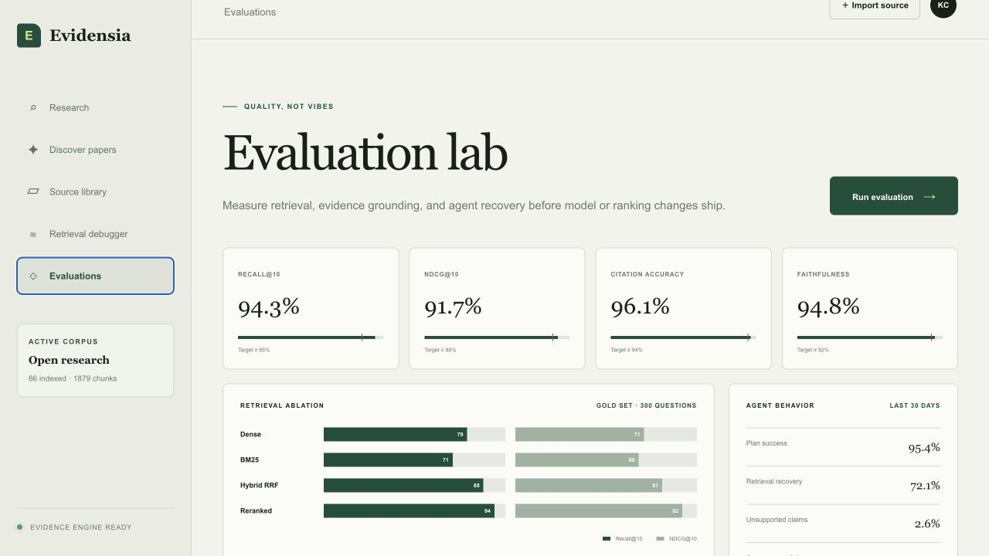
EVALUATION
Quality is a product surface—not an afterthought
15
automated tests passed
Unit, integration, and end-to-end coverage spans parsing, persistence, scholarly discovery, retrieval, corrective research, and evaluation.
Dashboard percentages are illustrative. Production claims require a versioned gold set and recorded experiment run.
EVIDENSIA AI
09
Notes:
The visible percentages are static UI demonstration values. Present the implemented metrics APIs and tests as verified capabilities, not the displayed percentages as measured results.
[Sources]
- Evidensia AI local repository and source design, inspected 20 August 2026.
- Product screenshots captured from the local Research Studio at http://localhost:3000.

Slide 10
IMPLEMENTATION SCOPE
Built for evidence quality; scale comes next
1
2
3
4
5
6
7
Retrieval
Agentic RAG
Evidence
Evaluation
Production
Studio
Scale
IMPLEMENTED
IMPLEMENTED
IMPLEMENTED
IMPLEMENTED
DEFERRED
IMPLEMENTED
DEFERRED
Phase 5 and Phase 7 stay out of scope so retrieval and evidence quality can mature before infrastructure and scale work begin.
EVIDENSIA AI
10
Notes:
Phase 5 production infrastructure and Phase 7 scale were intentionally excluded by the project brief.
[Sources]
- Evidensia AI local repository and source design, inspected 20 August 2026.
- Product screenshots captured from the local Research Studio at http://localhost:3000.

Slide 11
PROJECT TAKEAWAY
Research should be an auditable evidence process.
Evidensia now demonstrates the complete product contract—from scholarly discovery to exact source passages and visible verification.
NEXT QUALITY MILESTONE
Versioned gold set · provider-backed retrieval · hosted backend when authorized
Evidensia AI · August 2026
11
Notes:
Close on the product distinction, then name the next quality milestone without expanding the deferred production scope.
[Sources]
- Evidensia AI local repository and source design, inspected 20 August 2026.
- Product screenshots captured from the local Research Studio at http://localhost:3000.

