Slide 1


Macroeconomics
Ninth Edition
Chapter 5
The Economics of Health Care
Copyright © 2025, 2021, 2018 Pearson Education, Inc. All Rights Reserved
Notes:
If this PowerPoint presentation contains mathematical equations, you may need to check that your computer has the following installed:
1) MathType Plugin
2) Math Player (free versions available)
3) NVDA Reader (free versions available)
Slides in this presentation contain hyperlinks. JAWS users should be able to get a list of links by using INSERT+F7

Slide 2
Chapter Outline
5.1 The Improving Health of People in the United States
5.2 Health Care around the World
5.3 Information Problems and Externalities in the Market for Health Care
5.4 The Debate over Health Care Policy in the United States

Slide 3

Covid-19 and the U.S. Health Care System
The Covid-19 pandemic presented the U.S. health care system with its greatest challenge since the 1918 influenza pandemic.
A strength of the U.S. health care system was shown in the speed with which U.S.-based pharmaceutical firms Pfizer, Moderna, and Johnson & Johnson developed effective vaccines.
The pandemic highlighted debates over health care in the U.S. – Should the government provide health care?

Slide 4
5.1 The Improving Health of People in the United States
Use data to discuss trends in U.S. health over time.
Health care expenditure in the United States is higher than anywhere else in the world.
Why is this the case? Ideas:
High quality of health care
System of payment for health care
Higher demand for health care
In this chapter, we will address some of the elements of health care that make it a rich field of study for economists.
Health care: Goods and services, such as prescription drugs, consultations with doctors, and surgeries, that are intended to maintain or improve a person’s health.

Slide 5
Table 5.1 Health in the United States, 1850 and Today
Variable | 1850 | Today
Life expectancy at birth | 38.3 years | 76.1 years
Average height (adult males) | 5’5’’ | 5’7’’
Infant mortality (death of a child under 1 year of age) | 228.9 per 1,000 live births | 5.4 per 1,000 live births
The last couple of centuries have brought incredible advances in health outcomes for Americans.
Explanations:
Improvements in nutrition
Public health movement (late 19th, early 20th century)
Improvements in sanitation, food distribution, etc.
Feedback loop: better health to higher incomes to better health

Slide 6
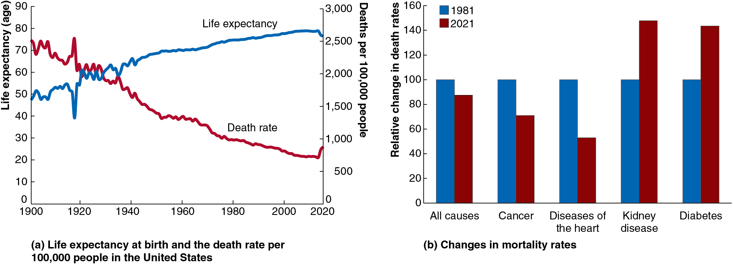
Figure 5.1 The Improving Health of the U.S. Population (1 of 2)
The most dramatic gains in health have occurred in the twentieth century.
(Mostly) steady increases in life expectancy.
Corresponding decreases in the death rate (adjusted for life expectancy).
Notes:
Graph A is a line graph, representing life expectancy at birth and the death rate per 100,000 people in the United States. The X axis represents time ranging from 1900 to 2020 in increments of 20 years. The Y axis represents life expectancy in age and ranges from 0 to 90 in increments of 10 years. The curve for life expectancy, in blue, starts at (1900, 48), (1920, 61), (1940, 68), (1960, 70), (1980, 72), (2000, 75), and (2020, 80). The curve for death rate, in red, starts at (1900, 2500), and falls across the graph with slight irregularity, spiking prior to 1920. It fell to its lowest point of 750 deaths per 100,000 people in 2020.

Slide 7
Figure 5.1 The Improving Health of the U.S. Population (2 of 2)
Medical advances in prevention and treatment are reducing the death rate.
Notice in particular the fall in the death rate from cardiovascular disease.
However, deaths due to some obesity-related illnesses have risen.
Notes:
The X axis represents causes of death, and the Y axis represents the relative change in death rates and ranges from 0 to 160 in increments of 20. The data is as follows.
• 1981. All causes, 100. Cancer, 100. Diseases of the heart, 100. Kidney disease, 100. Diabetes, 100. • 2021. All causes, 82. Cancer, 70. Diseases of the heart, 50. Kidney disease, 146. Diabetes, 140. All values are estimated.

Slide 8
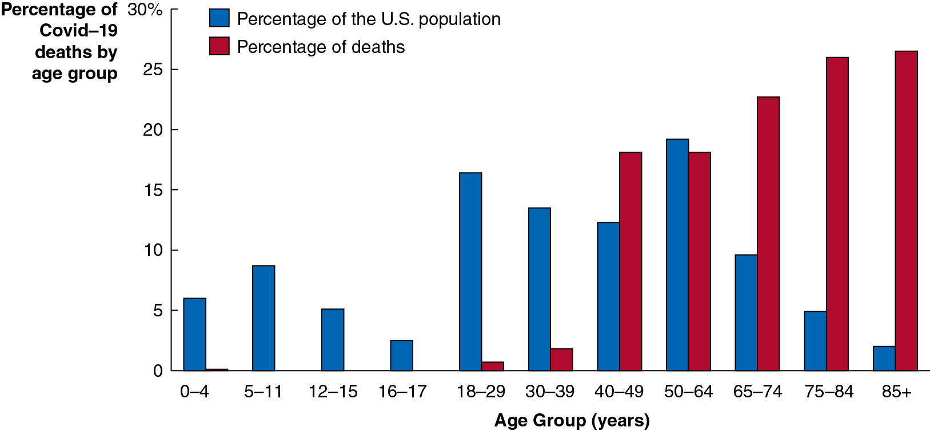
Apply the Concept: The Demographics of Covid-19 Mortality (1 of 3)
Few diseases affect all demographic groups equally. Half of all deaths from the 1918 influenza pandemic were among 20-40 year olds; but Covid-19 deaths primarily affected older people. Why? Weaker immune systems and proximity in nursing homes.
Notes:
The horizontal axis plots the age groups. The vertical axis plots the percentage of COVID 19 deaths by age group. The percentage of U S population is plotted as follows.
0 to 4 years, 6%
5 to 11 years, 8%
12 to 15 years, 4%
16 to 17 years, 3%
18 to 29 years, 16%
30 to 39 years, 13.9%
40 to 49 years, 13.1%
50 to 64 years, 19%
65 to 74 years, 9.7%
75 to 84 years, 4.8%
85+, 2%.
The percentage of deaths plotted is as follows.
0 to 4 years, 0.2%
5 to 11 years, Nil
12 to 15 years, Nil
16 to 17 years, Nil
18 to 29 years, 0.9%
30 to 39 years, 2.2%
40 to 49 years, 17.3%
50 to 64 years, 17.3%
65 to 74 years, 23.2%
75 to 84 years, 25.1%
85+, 25.8%.

Slide 9
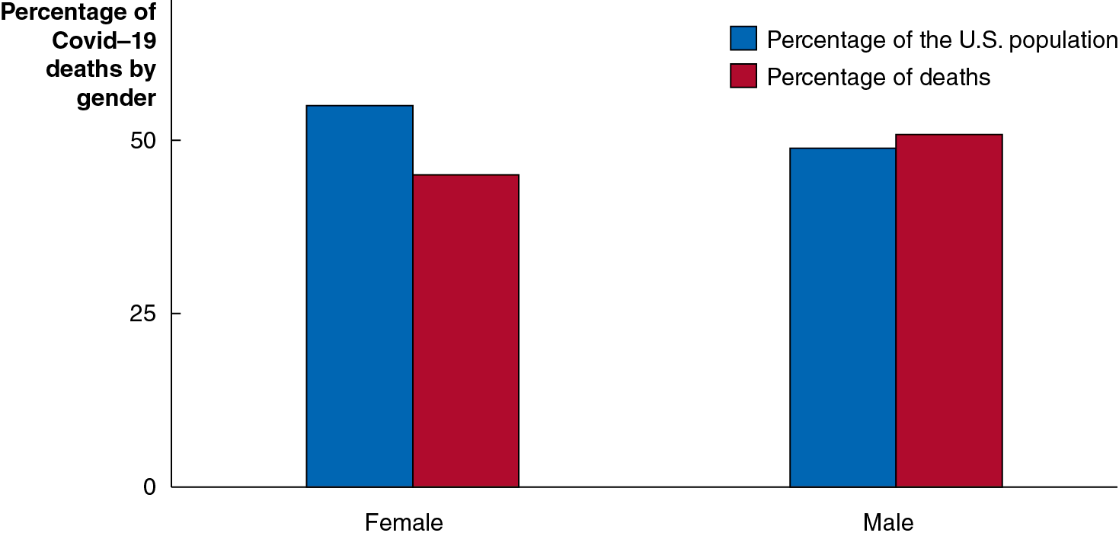
Apply the Concept: The Demographics of Covid-19 Mortality (2 of 3)
More men than women died from Covid-19. Why? We don’t know all the reasons yet, but one reason is that vaccination rates among men are lower.
Notes:
The horizontal axis plots the gender. The vertical axis plots the percentage of COVID 19 deaths by gender ranging from 0 to 50 in increments of 25. The data plotted are as follows. Percentage of the U S population. Female, 54. Male, 44. Percentage of deaths. Female, 40. Male, 50.

Slide 10
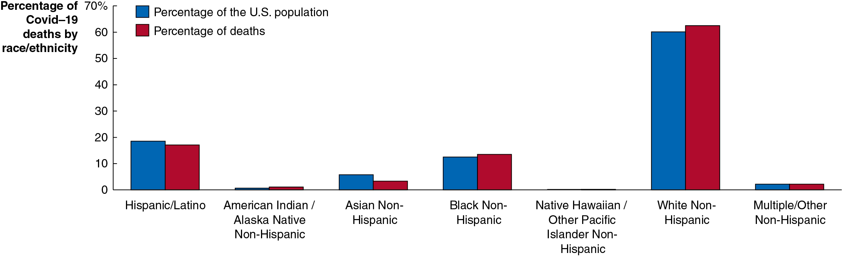
Apply the Concept: The Demographics of Covid-19 Mortality (3 of 3)
Researchers are still trying to figure out what caused differences in mortality rates across racial and ethnic groups. Vaccination rates and access to health care are two important factors, along with socioeconomic status and different occupational exposure.
Notes:
The horizontal axis plots the race or ethnicity. The vertical axis plots the percentage of COVID 19 deaths by race or ethnicity ranging from 0 to 70 in increments of 10. The data plotted are as follows.
Hispanic or Latino. Percentage of the U S population, 19.5. Percentage of deaths, 17.5.
American Indian or Alaska Native Non Hispanic. Percentage of the U S population, 0.5. Percentage of deaths, 0.9.
Asian Non Hispanic. Percentage of the U S population, 5.2. Percentage of deaths, 2.1.
Black Non Hispanic. Percentage of the U S population, 11.5. Percentage of deaths, 12.8.
Native Hawaiian or Other Pacific Islander Non Hispanic. Percentage of the U S population, 0.2. Percentage of deaths, 0.2.
White Non Hispanic. Percentage of the U S population, 59.5. Percentage of deaths, 61.
Multiple or Other Non Hispanic. Percentage of the U S population, 1.2. Percentage of deaths, 1.2.

Slide 11
5.2 Health Care Around the World
Compare the health care systems and health care outcomes in the United States and other countries.
There are important differences between the health care systems of the United States and those of other countries, both in terms of who provides the health care, and who pays for the health care.
Most health care in the United States is provided by private firms and paid for through health insurance.
Health insurance: A contract under which a buyer agrees to make payments, or premiums, in exchange for the provider’s agreeing to pay some or all of the buyer’s medical bills.
Insurance payments can take the form of fee-for-service, where doctors and hospitals receive a payment for each service they provide; or Health Maintenance Organizations (H M O s), where doctors receive a flat fee per patient.

Slide 12
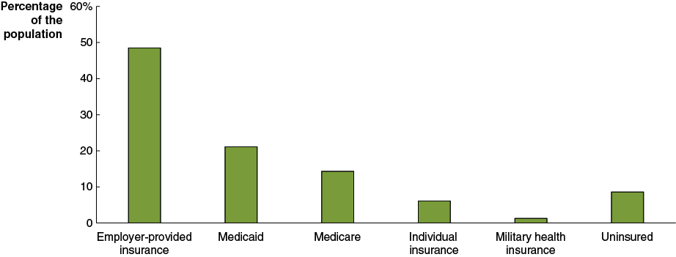
Figure 5.2 Sources of Health Insurance in the United States, 2021
In 2021, about 49 percent of people received health insurance through their employer; about 6 percent of people directly purchased insurance; and about 37 percent of people received it through government sources including Medicare, Medicaid, and Tricare.
Some people have multiple sources of health insurance.
About 9 percent of Americans had no health insurance in 2021.
Notes:
The X axis represents insurance options, and the Y axis represents the percentage of the population ranging from 0 to 60% in increments of 10%.
Employer provided insurance 49%
Medicaid 21%
Medicare 14%
Individual insurance 4.5%
Military health insurance 1.5%
Uninsured 6.2%
All values are estimated.

Slide 13
Why Are So Many Americans Uninsured?
The proportion of Americans without health insurance is lower now than in recent years, partly because of the Affordable Care Act (A C A), health care reform legislation passed by Congress and signed by President Barack Obama in 2010.
This law enacted subsidies for lower-income people and introduced penalties for people not having health insurance and employers not providing it.
However, many people still do not have health insurance, typically because they believe:
They cannot afford it, or
It is unnecessary because they are healthy, or
The cost exceeds the benefits

Slide 14
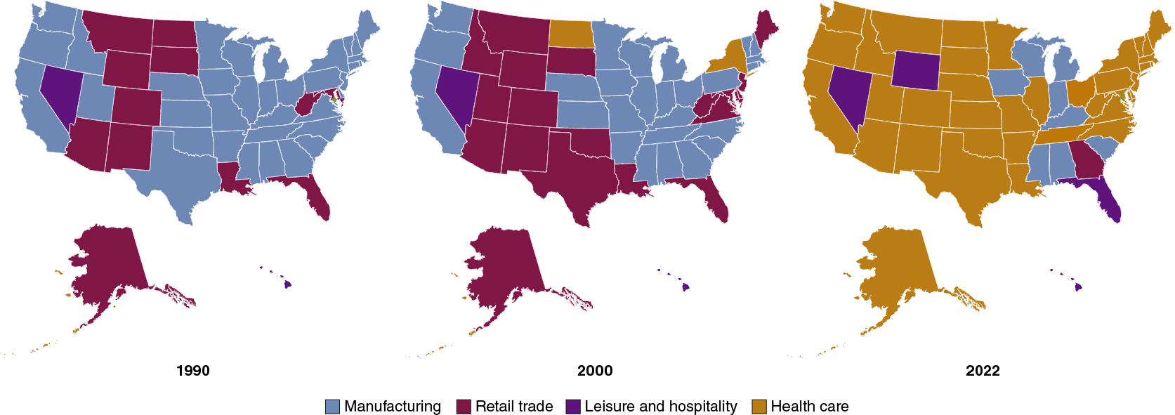
Apply the Concept: The Increasing Importance of Health Care in the U.S. Economy
In most states, the health care industry is now the industry with the most workers. The figure shows each state’s leading employment sector in 1990, 2000, and 2022.
The B L S forecasts that 4 of the 20 fastest-growing occupations over the next 10 years will be in health care.
Notes:
The maps are as follows. Map 1 represents 1990, map 2 represents 2000, and map 3 represents 2022.
In 1990, the majority of the country was dominated by manufacturing jobs, with few exceptions, particularly through the vertical center of the country, where retail trade dominated. Leisure and hospitality was only dominant in Nevada.
In 2000, the majority of the map is still dominated by manufacturing, but retail trade has expanded across the South Western states, and grown in the East. For the first time, health care has been added to the map, in New York and North Dakota.
In 2022, the majority of the country is dominated by health care. Leisure and hospitality dominate in Nevada, Wyoming, and Florida, retail trade dominates in South Carolina, and manufacturing dominates in Wisconsin, Georgia, Iowa, Michigan, Indiana, Kentucky, Mississippi, and Alabama.

Slide 15
Health Care Systems in Comparison Countries (summary of Table 5.2)
Canada:
Single-payer health care system: The government provides health insurance to all residents, funded through taxes. Private companies provide the care. Individuals pay an annual fee of $744 for services not covered by insurance.
Japan:
Universal health insurance: Every resident is required to enroll in a nonprofit health insurance society or enroll in the national government’s program.
Individuals have substantial copayments, up to 30%.
U K:
Socialized medicine: A health care system under which the government owns most of the hospitals and employs most of the doctors.
Some
people supplement with private health
insurance.

Slide 16
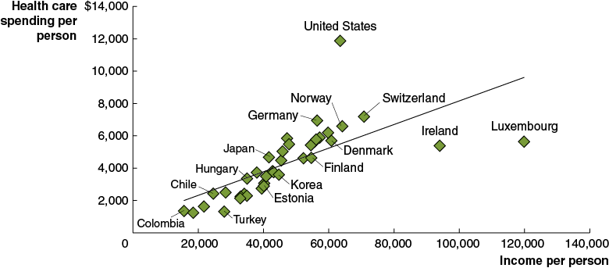
Figure 5.3 Levels of Income per Person and Spending per Person on Health Care
Health care is a normal good; higher income leads to higher expenditure on health care.
But the United States spends a greater proportion of income per person on health care than other countries.
Notes:
The X axis represents income per person ranging from 0 to 140,000 in increments of 20,000. The Y axis represents health care spending per person ranging from 0 to 14,000 in increments of 2,000. The data plotted are as follows. Colombia, (16,000, 1,500). Chile, (28,000, 2,100). Turkey, (28,000, 1,500). Hungary, (38,000, 2,800). Japan, (42,000, 4,300). Denmark, (43,000, 4,800). Estonia, (40,000, 3,100). Korea, (44,000, 3,900). Finland, (58,000, 4,100). Germany, (57,000, 6,100). Norway, (67,000, 5,900). Ireland, (93,000, 5,350). Switzerland, (68,000, 7,100). United States, (94,000, 11,900). Luxembourg, (119,000, 5,900).

Slide 17
Table 5.3 Health Outcomes in High-Income Countries (1 of 2)
Life Expectancy
Health Care Outcome | United States | Canada | Japan | United Kingdom | O E C D Average
Life expectancy at birth | 77.0 years | 82.7 years | 84.5 years | 81.5 years | 79.7 years
Male life expectancy at age 65 | 17.0 years | 19.4 years | 20.1 years | 18.0 years | 17.8 years
Female life expectancy at age 65 | 19.8 years | 22.1 years | 24.9 years | 20.6 years | 21.0 years
Infant mortality (deaths per 1,000 live births) | 5.4 | 4.5 | 1.8 | 3.6 | 5.5
Health Risks
Health Care Outcome | United States | Canada | Japan | United Kingdom | O E C D Average
Obesity (percentage of the population with B M I > 30) | 41.9% | 24.3% | 4.6% | 28.0% | blank
Percentage of adult population smoking daily | 9.4% | 9.4% | 16.7% | 14.5% | blank
Diagnostic Equipment
Health Care Outcome | United States | Canada | Japan | United Kingdom | O E C D Average
M R I units per 1,000,000 population | 38.0 | 10.1 | 57.4 | 7.2 | 15.8
C T scanners per 1,000,000 population | 42.6 | 14.6 | 115.7 | 9.5 | 27.1

Slide 18
Table 5.3 Health Outcomes in High-Income Countries (2 of 2)
Cancer
Health Care Outcome | United States | Canada | Japan | United Kingdom | O E C D Average
Cancer per 100,000 population | 318.0 | 295.7 | 217.1 | 272.9 | blank
Deaths from cancer per 100,000 population | 182.2 | 200.3 | 176.6 | 221.8 | 184.5
Deaths from colorectal cancer per 100,000 population | 16.4 | 21.9 | 24.4 | 23.4 | 19.7
Five-year breast cancer survival rate | 90.2% | 88.6% | 89.4% | 89.4% | 84.2%
Five-year colon cancer survival rate | 66.0% | 67.5% | 67.4% | 59.7% | 61.6%
Covid-19
Health Care Outcome | United States | Canada | Japan | United Kingdom | O E C D Average
Deaths from Covid-19 per 1 million people as of January 2023 | 3,253 | 1,301 | 511 | 3,183 | 2,333
Notes:
Note: For Covid-19 death rates, the value given for the OECD is the authors’ calculation using individual country data from worldindata.org.
Source: For all data but Covid-19 death rates: Organization for Economic Co-operation and Development, “OECD Health Statistics 2020,” most recent data available, typically for 2018. Data on obesity and cancer are standardized for age differences across countries; for Covid-19 death rates: “Cumulative Confirmed Covid-19 Deaths per Million People,” ourworldindata.org.

Slide 19
How Useful Are Cross-Country Comparisons of Health Outcomes?
Comparing across countries is often difficult, and potentially misleading due to:
Data problems Countries may not collect data in the same way. Ex: Classifying deaths related to Covid-19.
Problems with measuring health care delivery Quality of care is hard to measure. Ex: Are savings worth longer waiting times?
Lifestyle choices Obesity and diabetes, for example, may have more to do with the choices of consumers than the effectiveness of health care.
Problems with determining consumer preferences Disconnect between prices people pay and services received.

Slide 20
5.3 Information Problems and Externalities in the Market for Health Care
Define information problems and externalities and explain how they affect the market for health care.
The health care market is characterized by asymmetric information: a situation in which one party to an economic transaction has less information than the other party.
This can lead to market failure, the inability of the market to maximize economic well-being.
Two main forms of asymmetric information:
Adverse selection
Moral hazard

Slide 21
Asymmetric Information and Insurance Markets
Asymmetric information problems can be particularly severe in insurance markets.
Insurance companies need to accurately predict the chance of claims:
Predict too few, and you charge too little and lose money.
Predict too many, and you charge too much and risk losing customers.
The problem is made worse if people buying insurance have a better idea than the insurance company of how many claims they will make.

Slide 22
Adverse Selection and the Market for “Lemons”
Suppose you want to buy a used car. If someone offers to sell you one, would you believe:
The car is high quality, and the seller just happens to want to sell it; or
The car is low quality (a “lemon”), and the seller is trying to unload their problems on you.
If you offer a moderate price, then only people with low-quality cars will sell to you.
So, without further information, you don’t want to buy a car from anyone who is willing to sell you one!
“I don’t want to belong to any club that will accept people like me as a member.”
-Groucho Marx

Slide 23
Adverse Selection in the Market for Health Insurance
Health insurance suffers from a similar “adverse selection” problem:
Adverse selection: The situation in which one party to a transaction takes advantage of knowing more than the other party to the transaction.
The people who want health insurance are the ones who are likely to use it.
So, the premiums need to be high to cover the expected costs.
But now people with only moderate needs may find health insurance too expensive, causing them to drop out, etc.
This problem is lessened if people are very risk-averse: wanting to avoid risk.

Slide 24
Coping With Adverse Selection
Health insurance companies have tried to lessen the impact of adverse selection by excluding pre-existing conditions.
It is a normative (value judgment) question whether the gains for society through avoiding adverse selection outweigh the costs to society through reductions in health insurance coverage.
An alternative way around the adverse selection problem is to mandate that individuals carry insurance.
Example: Most states require automobile accident insurance.
2010 Affordable Care Act (A C A) introduced an individual mandate to buy health insurance and restricted exclusions of pre-existing conditions. (The individual mandate was repealed in 2017.)

Slide 25
Moral Hazard in Health Insurance—Patients
Moral hazard refers to actions people take after entering into a transaction, that make the other party to the transaction worse off.
Example: People with car insurance might drive less carefully, knowing they are financially protected if they crash.
People might use more health care when they don’t have to pay for its full cost:
Going to the doctor unnecessarily
Engaging in risky behavior
Accepting excessive treatment options
Such actions would increase the cost of health care to society, perhaps without providing substantial benefits.

Slide 26
Moral Hazard in Health Insurance—Doctors
The financial structure of insurance contracts may make doctors change their behavior also:
Ordering unnecessary tests and procedures
Since patients pay little out-of-pocket for the additional care, they are likely to agree to extra treatment
This illustrates the principal-agent problem: A problem caused by an agent pursuing the agent’s own interests rather than the interests of the principal who hired the agent.
The insurance company must delegate decision-making power to the doctor, who may not have the same interests as the company.

Slide 27
Do Doctors Succumb to Moral Hazard?
While the number of medical procedures has been increasing, doctors tend to claim that they do not order extra tests and procedures for financial gain, but order them either:
Out of genuine concern for their patients, or
As defensive medicine in order to avoid malpractice lawsuits.

Slide 28
Coping With Moral Hazard in Health Care
The key to coping with moral hazard is to try to make sure people don’t change their behavior too much.
Patients:
Deductibles (patient pays first $X of treatment cost)
Coinsurance (patient pays Y percent of treatment cost)
Doctors:
Standardized payments for particular illnesses
Such methods reduce, but do not eliminate, moral hazard problems.

Slide 29
Externalities in the Market for Health Care
An external cost or benefit will result in market failure because (from society’s perspective) the “wrong” quantity will be consumed.
Positive externalities:
Vaccinations reduce the chance of others getting sick
A healthy population is good for employers (fewer sick days)
Negative externalities:
Poor health choices (like obesity and smoking) are paid for by others (through higher premiums and taxes)

Slide 30
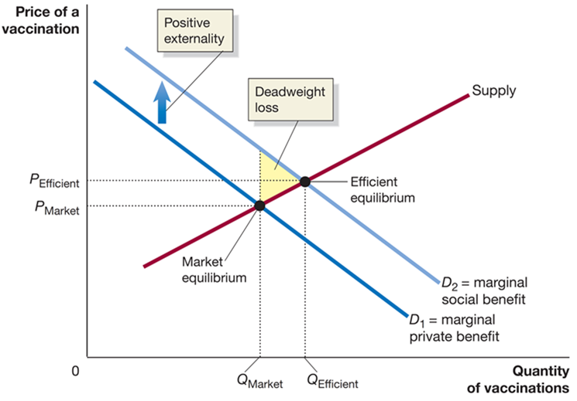
Figure 5.4 The Effect of a Positive Externality on the Market for Vaccinations
In the figure, we assume people pay the full price of vaccinations
Vaccinations have positive externalities, so the marginal
social benefit curve
is higher than the marginal
private benefit curve
Consumers will purchase
vaccinations—too few, resulting in a
deadweight loss.
In practice, subsidized vaccinations reduce this externality problem
Notes:
The X-axis represents quantity of vaccinations, and the Y-axis represents price of a vaccination. Demand line D sub 1 = marginal private benefit, shifts up in positive externality, and becomes D sub 2 = marginal social benefit. The supply curve intersects D sub 1 at (Q sub market, P sub market), the market equilibrium, and D sub 2 at (Q sub efficient, P sub efficient), the efficient equilibrium. The small triangular area left of the intersection of the curves represents deadweight loss.

Slide 31
Should the Government Run the Health Care System?
If health care were a public good, that would be a strong argument for government involvement.
Is health care:
Non-rival in consumption?
Non-excludable?
Neither of these seems likely, so health care seems to be a private good.
However, the externalities and information asymmetries may generate enough market failure to prompt government involvement.
Overall, the government’s role in health care is controversial.

Slide 32
Or Should There Be Greater Reliance on Market-Based Policies?
Presently, markets are delivering inaccurate signals to consumers: When buying health care, consumers pay a price well below the true cost of providing the service.
Also, tax treatment of health insurance encourages over-consumption of health insurance and hence health care.
Market-based reforms could re-align the prices consumers pay with the services they receive.

Slide 33
5.4 The Debate Over Health Care Policy in the United States
Explain the major issues involved in the debate over health care policy in the United States.
The Affordable Care Act (A C A) was passed by Congress in 2010 but remains controversial.
The United States spends more per person on health care than any other country.
And this cost appears to continue to rise.
What should be done about this cost? We will explore this topic in this section.

Slide 34
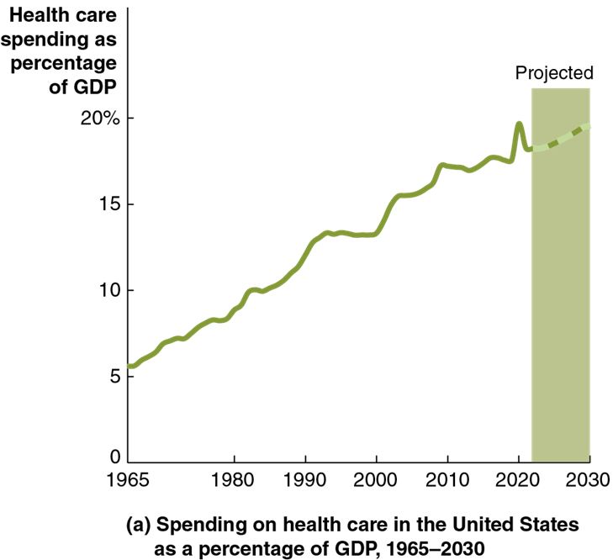
Figure 5.5 The Trend in U.S. Health Care Spending (1 of 2)
Expenditure on health care in the United States, as a percentage of national income, has been rising.
It is projected to continue to rise.
Notes:
Graph A depicts spending on health care in the United States as a percentage of G D P between 1965 and 2030. The X axis represents the year and ranges from 1965 to 2030 in increments of 10 years. The Y axis represents health care spending as a percentage of G D P and ranges from 0 to 20% in increments of 5%. The projection reaches 25%, and the amount of spending rises from 6% in 1965, rising with slight irregularity, intersecting the projection at 20% by 2020. It continues onto its highest point of (2030, 20).

Slide 35
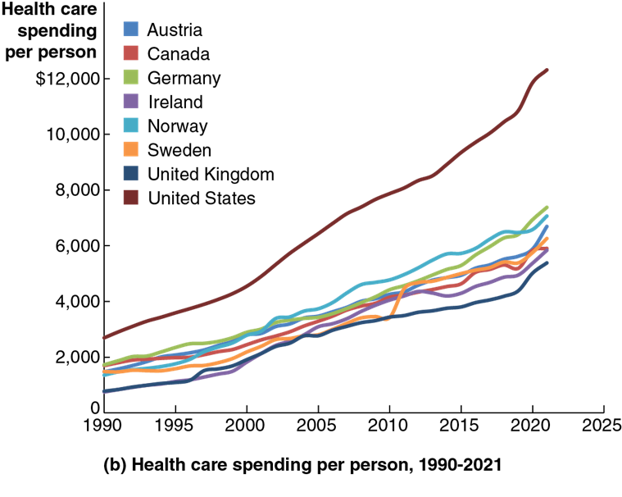
Figure 5.5 The Trend in U.S. Health Care Spending (2 of 2)
The figure shows health care spending per person, 1990–2021.
Growth in health care spending has been faster in the U.S. than in other high-income countries.
Notes:
Graph B represents healthcare spending per person between 1990 and 2021. The X axis represents the year and ranges from 1990 to 2025 in increments of 5 years. The Y axis represents health care spending per person and ranges from 0 to 12,000 in increments of 2,000. Austria, Canada, Germany, Norway, Sweden, United Kingdom, Ireland, United States, are all tightly grouped together, following the same general, upward path. The majority rise consistently from between y = 0 and 1,900, before taking an upturn near 2000. United Kingdom has the lowest path of growth, ending near (2020, 4900), Germany has the highest path, ending at (2020, 6150), and the United States exists higher outside the group, beginning at (1990, 2600), and rising sharply to (2020, 12,000). All values are estimated.

Slide 36
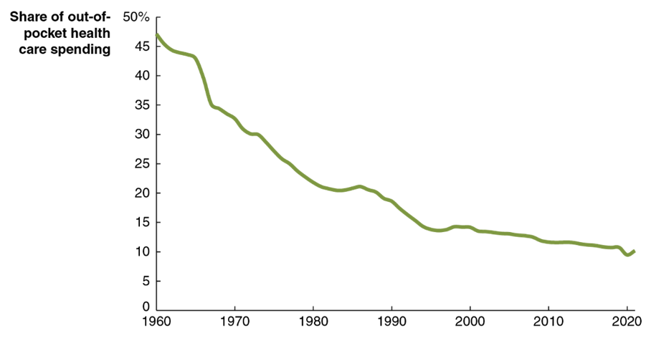
Figure 5.6 The Declining Share of U.S. Out-of-Pocket Health Care Spending
At the same time, Americans are paying a smaller and smaller proportion of health care costs out-of-pocket.
Americans would likely not choose the same level of health care expenditure if they had to pay a higher out-of-pocket share.
Combined with rising health care costs, this presents problems for government budgets.
Notes:
The X axis represents the year and ranges from 1960 to 2020 in increments of 10 years. The Y axis represents the share of out of pocket health care spending and ranges from 0 to 50% in increments of 5%. The line starts at (1960, 47%), falls to (1995, 16%), before rising slightly, and falling more gradually to the lowest point, 10% in 2020. All values are estimated.

Slide 37
Apply the Concept: Are U.S. Firms Disadvantaged by Paying for Their Employees’ Health Insurance?
U.S. firms frequently pay for their employees’ health insurance, unlike in most other countries.
This appears to put them at a competitive disadvantage.
Ex: Pay $50,000 salary plus $10,000 health insurance.
But if the government provided health care, it would likely be paid for via payroll taxes; so, the total compensation paid by firms would likely not change much.
Ex: Pay $50,000 salary plus $10,000 “health care tax.”

Slide 38
Why Are Health Care Costs Rising So Fast? (1 of 2)
Administrative costs?
While paperwork etc. is significant, it’s not increasing fast enough to explain the rise in spending.
Prescription drug prices?
Prescription drugs have higher prices in the United States than in most other high-income countries. But prescription drugs account for only 10 percent of total health care spending.

Slide 39
Why Are Health Care Costs Rising So Fast? (2 of 2)
Malpractice lawsuits?
Significant cost (Congressional Budget Office says 1%, economists estimate as much as 7% of total health care cost).
But again, not rising fast enough to explain changes.
Uninsured patients?
Increase in costs of between 1% and 4% due to getting treatment in the “wrong places” (emergency room versus doctor’s office).
Still not rising enough to explain changes.

Slide 40
Primary Reason #1: Health Care Sector “Cost Disease”
Service providers (like health care providers) have not seen huge productivity gains like in manufacturing or farming.
Labor productivity in health care has risen less than half as much as in the economy as a whole
But in order to keep workers, wages have risen in the service sector also—including health care, of course.
This is known as the service sector “cost disease.”

Slide 41
Primary Reason #2: Aging Population and Advances in Medical Technology
Older people require more health care, and as medical advances keep people alive longer and birth rates slow, the proportion of elderly people will rise.
The C B O estimates federal government spending on healthcare will rise from 5.7% of G D P in 2022 to 8.8% of G D P in 2052.

Slide 42
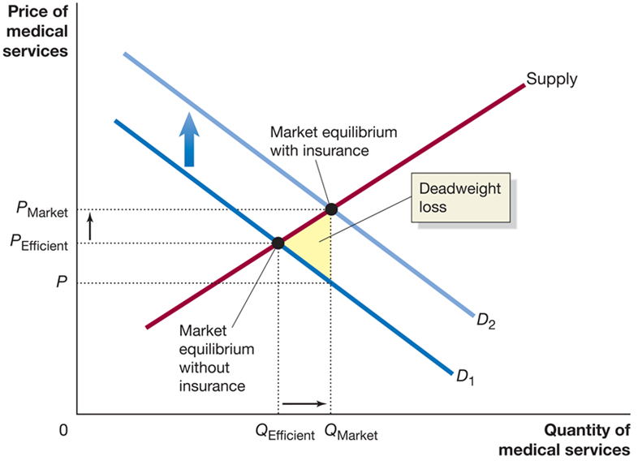
Figure 5.7 The Effect of the Third-Party Payer System on the Demand for Medical Services
Primary reason #3 is the distorted economic incentives in health care arising from insurance.
The disconnect between service and payment means consumers have little reason to accept fewer services for lower cost.
The overconsumption of health care (relative to efficient levels) creates a deadweight loss.
Notes:
The X-axis represents quantity of medical services, and the Y-axis represents price of medical services. Demand curve D sub 1 shifts up to become D sub 2. The supply curve intersects D sub 1 at (Q sub efficient, P sub efficient), the market equilibrium without insurance, and D sub 2 at (Q sub market, P sub market), the market equilibrium with insurance. The small triangular area to the right of the intersection of the lines is the deadweight loss.

Slide 43
Health Insurance Differs from Other Types of Insurance
In most insurance markets, consumers transfer the risk of rare adverse events to the insurance company.
But in health insurance, the ‘events’ covered are often routine and predictable.
Early programs run by Blue Cross and Blue Shield in the 1930s and 1940s were sold as prepaid medical care.
The disconnect between payment and service encourages the overuse of health care services.

Slide 44
The Continuing Debate Over Health Care Policy
Extending health care coverage to be more universal has been attempted and rejected several times:
1945: President Harry Truman proposed national health insurance.
1993: President Bill Clinton proposed a universal public/private plan.
Each time, Congress declined to enact the plans.

Slide 45
The Affordable Care Act (2010)
In 2009, President Barack Obama proposed significant health care reform in the form of the A C A; in March 2010, Congress approved the legislation.
The A C A includes:
Individual mandate to obtain health insurance (repealed by Congress in late 2017)
State health insurance marketplaces to increase access to policies
Employer mandate for most firms to provide health insurance
Regulation of health insurance altering how health insurance companies can act
Expansion of Medicaid eligibility
Increased taxes on high-income individuals, high-cost insurance plans, and some health care related industries

Slide 46
Market-Based Reforms
Some economists and policymakers support market-based reforms, changes in the market for health care that would make it more like the markets for other goods and services.
For example, employer-based health insurance is tax-free, encouraging its use in compensation packages. This tax break was worth about $225 billion in 2022; removing it would discourage high-coverage employer-based insurance, reducing spending on these programs by 33%.

Slide 47
Apply the Concept: Should Congress Increase the Federal Government’s Role in Providing Health Care? (1 of 3)
A “Medicare for All” (M F A) program would change U.S. health care to a single-payer plan (as in Canada).
Supporters see the following advantages:
Universal coverage
Less paperwork for patients
Less paperwork for administrators
Cost savings due to the bargaining power of the government

Slide 48
Apply the Concept: Should Congress Increase the Federal Government’s Role in Providing Health Care? (2 of 3)
Opponents of M F A see the following drawbacks:
Very high cost
Reduced flexibility
Reduced medical innovation
Increased moral hazard problems
Such a dramatic change as M F A seems unlikely to be enacted soon; in surveys, many people dislike the likely outcomes of higher taxes and potential delays in treatment enough to convince them M F A is a bad idea.

Slide 49
Apply the Concept: Should Congress Increase the Federal Government’s Role in Providing Health Care? (3 of 3)
President Joe Biden has proposed another alternative: a public option for health insurance, to compete with employer-based insurance; along with lowering the age for Medicare eligibility from 65 to 60.
Premiums would likely be lower with a public option; critics fear this would destroy private insurance companies, resulting in an outcome essentially like M F A.
As of late 2023, it appears unlikely that Congress will pass legislation enacting either M F A or a public option.

Slide 50
Conclusions About Health Care
With health care expenditure projected to consume almost 20 percent of national income by 2030, we must find a way to control costs.
Are people willing to accept service reductions in exchange for cost reductions?
Or can we find a way to reduce costs without giving up the quality and/or quantity of health care consumed?
Health care policy is sure to remain a topic of heated debate.

Slide 51

Copyright
This work is protected by United States copyright laws and is provided solely for the use of instructors in teaching their courses and assessing student learning. Dissemination or sale of any part of this work (including on the World Wide Web) will destroy the integrity of the work and is not permitted. The work and materials from it should never be made available to students except by instructors using the accompanying text in their classes. All recipients of this work are expected to abide by these restrictions and to honor the intended pedagogical purposes and the needs of other instructors who rely on these materials.

