Slide 1


Macroeconomics
Ninth Edition
Chapter 14
Banks, Money, and the Federal Reserve System
Copyright © 2025, 2021, & 2018 Pearson Education, Inc. All Rights Reserved
Notes:
If this PowerPoint presentation contains mathematical equations, you may need to check that your computer has the following installed:
1) MathType Plugin
2) Math Player (free versions available)
3) NVDA Reader (free versions available)

Slide 2
Chapter Outline
14.1 What Is Money, and Why Do We Need It?
14.2 How Is Money Measured in the United States Today?
14.3 How Do Banks Create Money?
14.4 The Federal Reserve System
14.5 The Quantity Theory of Money

Slide 3
Silicon Valley Bank and the Fragility of Banking
Wednesday, March 8, 2023: Silicon Valley Bank (S V B) is seemingly sound, with assets of over $200 billion and more than $175 billion in deposits.
Friday, March 10, 2023: S V B fails and is taken over by the Federal Deposit Insurance Corporation (F D I C).
Banks are critically important to the economy, but banking involves more risks than nearly any other kind of business, making government supervision of the banking system crucial for the economy.

Slide 4
Money
Money is one of our most important inventions.
Economists consider money to be any asset that people are generally willing to accept in exchange for goods and services or for payment of debts.
Asset: Anything of value owned by a person or a firm.
We begin this chapter by considering what role money serves, and what can be used as money.
Then, we consider modern forms of money and the roles of banks and the government in creating and managing money.
Finally, we create a model relating prices to the amount of money.

Slide 5
14.1 What Is Money, and Why Do We Need It?
Define money and discuss the four functions of money.
Suppose you were living before the invention of money.
If you wanted to trade, you would have to barter, trading goods and services directly for other goods and services.
Trades would require a double coincidence of wants.
Eventually, societies started using commodity money—goods used as money that also have value independent of their use as money—like animal skins or precious metals.
The existence of money makes trading much easier and allows specialization, an important step for developing an economy.

Slide 6
The Four Primary Functions of Money
Medium of exchange
Money is acceptable to a wide variety of parties as a form of payment for goods and services.
Unit of account
Money allows a way of measuring value in a standard manner.
Store of value
Money allows people to defer consumption till a later date by storing value. Other assets can do this too, but money does it particularly well because it is liquid, easily exchanged for goods.
Standard of deferred payment
Money facilitates exchanges across time when we anticipate that its value (purchasing power) in the future will be predictable.

Slide 7
What Can Serve as Money?
In order to serve as an acceptable medium of exchange (and hence a potential “money”), a good should have the following characteristics:
The good must be acceptable to (usable by) most people.
It should be of standardized quality so any two units are alike.
It should be durable so that value is not lost by wearing out.
It should be valuable relative to its weight, so that it can easily be transported even in large quantities.
It should be divisible enough to be used for purchases of both low-priced and high-priced goods.

Slide 8

Commodity Money
Commodity money has a value independent of its use as money.
Some important historical and modern commodity moneys:
Cowrie shells in Asia (the classical Chinese character for
money/currency,
originated as a pictograph of a
cowrie shell)
Precious metals, such as gold or silver
Animal pelts and skins in colonial North America
Cigarettes in prisons and prisoner-of-war camps

Slide 9
Paper Money to Fiat Money
Beginning in China in the tenth century and spreading throughout the world, paper money was issued by banks and governments. The paper money was exchangeable for some commodity, typically gold, on demand.
In modern economies, paper money is generally issued by a central bank run by the government.
The Federal Reserve is the central bank of the United States. However, money issued by the Federal Reserve is no longer exchangeable for gold, nor is any current world currency. Instead, the Fed issues currency known as fiat money.
Fiat money is any money, such as paper currency, that is authorized by a central bank or governmental body and that does not have to be exchanged by the central bank for gold or some other commodity money.

Slide 10
Fiat Money—Advantages and Disadvantages
Fiat money has the advantage that governments do not have to be willing to exchange it for gold or some other commodity on demand.
This makes central banks more flexible in creating money.
However, it also creates a potential problem: fiat money is only acceptable as long as households and firms have confidence that if they accept paper dollars in exchange for goods and services, the dollars will not lose much value during the time they hold them.
If people stop “believing” in the fiat money, it will cease to be useful.

Slide 11

Apply the Concept: Your Money Is No Good Here! (1 of 2)
In 2017 Dig Inn, a Manhattan-based food chain, chose to require customers to pay ahead or with a mobile wallet payment app at most locations.
By not taking cash, Dig Inn hoped to speed up service, and eliminate the chance of robberies.
Can they do this legally? Yes! Firms are not obliged to accept currency as payment. (Debts are a different story.)

Slide 12
Apply the Concept: Your Money Is No Good Here! (2 of 2)
Similarly, many convenience stores and gas stations refuse to take large-denomination bills (typically $50 or more).
Some whole countries (like Sweden) are almost cashless now; will the United States follow suit?
The Covid-19 pandemic accelerated the cashless society in the United States when many people preferred “contactless” purchases.

Slide 13
14.2 How Is Money Measured in the United States Today?
Discuss the definitions of the money supply used in the United States today.
How much money is there in the United States? This is harder to answer than it first appears, because we have to decide what to count as “money.”
M1 is the narrower definition of the money supply: the sum of currency in circulation and checking account and savings account deposits in banks.
M2 is a broader definition of the money supply that includes M1, plus small-denomination time deposits, and noninstitutional money market fund shares.

Slide 14
How Big Is the Money Supply?
In September 2023, M1 was about $18.1 trillion and M2 was about $20.8 trillion.
About 13 percent of M1 is currency: about $2.3 trillion. This is more than $6,600 per person living in the United States.
75 percent of U.S. paper currency is $100 bills, the largest U.S. banknotes currently in circulation.
U.S. currency holdings are unusually high by world standards. People in other countries sometimes hold and use U.S. dollars, typically either because
Confidence in the value of the local currency is low, or
To facilitate a large underground economy.

Slide 15
M1 versus M2: Which One Should We Use?
When we want to talk about the money supply, which definition should we use?
Recent changes in how the Fed defines M1 and M2 mean that they are quite similar, so it doesn’t matter which monetary aggregate we use.
In our discussion of money, we will keep in mind that:
The money supply includes both checking and savings account balances as well as currency.
Banks play an important role in the money supply, since they control what happens to money when it is in a checking account or savings account.

Slide 16
What about Debit and Credit Cards?
Debit cards directly access checking accounts, but the card is not money, the checking account balance is.
Credit cards are a convenient way to obtain a short-term loan from the bank issuing the card. But transactions are not really complete until you pay the loan off—transferring money to pay off the credit card loan.
So, credit cards do not represent money.

Slide 17

Apply the Concept: Is Bitcoin Money? (1 of 2)
When we think of money, we typically think of currency issued by a government.
But currency is only a small part of the money supply.
Over the last decade or so, consumers have come to trust forms of e-money or digital funds, such as PayPal, Apple Pay, and Google Pay.

Slide 18
Apply the Concept: Is Bitcoin Money? (2 of 2)
Bitcoins are a new form of e-money, made not by a government or firm, but by a decentralized system of linked computers.
Bitcoins can be traded for other currencies on websites.
Some websites accept bitcoins as a form of payment.
Should bitcoins be included in a measure of the money supply?
For now, they are not; if they grow popular, maybe they should be.

Slide 19
14.3 The Role of Banks in the Economy
Explain the role of banks in the economy.
Banks play a critical role in the economy.
Recall that there is more money held in checking accounts than there is actual currency in the economy.
So, somehow money is being created by banks.
Further, banks are generally profit-making private firms: some small, but some among the largest corporations in the country.
Their activities are designed to allow themselves to make a profit.
To understand the role that banks play, we will first consider how banks operate as a business.

Slide 20
Figure 14.1 The Balance Sheet of a Typical Large Bank (1 of 2)
Assets (in billions)
Reserves | $135
Loans (to the bank’s customers) | 900
Securities | 700
Buildings and equipment | 15
Others assets | 550
Total assets | $2,300

Slide 21
Figure 14.1 The Balance Sheet of a Typical Large Bank (2 of 2)
Liabilities and Stockholders’ Equity (in billions)
Deposits (of the bank’s customers) | $1,000
Short-term borrowing | 400
Long-term debt | 360
Other liabilities | 275
Total liabilities | $2,035
Stockholders’ equity | 265
Total liabilities and stockholders’ equity | $2,300
On a balance sheet, a firm’s assets are listed on the left, and its liabilities (and stockholders’ equity, or net worth) are listed on the right. The left and right sides must add to the same amount.
Banks use money deposited with them to make loans and buy securities (investments).
Their largest liabilities are their deposit accounts: money they owe to their depositors.

Slide 22
Reserves
Reserves are deposits that a bank keeps as cash in its vault or on deposit with the Federal Reserve.
A bank does not keep enough deposits on hand to cover all of its deposits. This is how the bank makes a profit: lending out or investing money deposited with it.
Banks in the United States used to be required to hold a particular fraction of their checking account deposits as required reserves—previously 10 percent of all checking deposits, plus a little depending on the size of the bank—but this is no longer the case.
In March 2020, the Fed eliminated the reserve requirement by setting it equal to 0 percent of a bank’s checking account deposits.
The Fed indicated it had no plans to reinstate reserve requirements for checking deposits.

Slide 23
The Economic Importance of Bank Lending (1 of 2)
Depositors earn a low rate of interest on their deposits, while borrowers may a higher rate of interest. Why do they need banks, when they could just borrow from, and lend to, one another?
Banks reduce transactions costs, the costs in time and other resources that parties incur in the process of agreeing to and carrying out an exchange of goods or services. They do this by using economies of scale, allowing their employees to specialize in tasks like loan evaluation, processing, or legal documentation.

Slide 24
The Economic Importance of Bank Lending (2 of 2)
Depositors earn a low rate of interest on their deposits, while borrowers may a higher rate of interest. Why do they need banks, when they could just borrow from, and lend to, one another?
Banks reduce information problems, particularly those of asymmetric information, a situation in which one party to an economic transaction has less information than the other party.
Banks can evaluate the characteristics of borrowers to identify who is a good risk to lend to. They do this through statistical analysis and relationship banking, the ability of banks to assess credit risks on the basis of private information about borrowers.

Slide 25

Apply the Concept: Help for Young Borrowers: Fintech or Ceilings on Interest Rates? (1 of 2)
In recent years, some new financial technology or fintech companies—such as LendingClub and UpStart—have emerged to offer peer-to-peer lending on the Internet.
These firms earn flat fees for facilitating a loan and charge fees for collecting payments but take none of the risk of the loans defaulting.
Will these firms facilitate too many risky loans? Early evidence suggests “yes.”

Slide 26
Apply the Concept: Help for Young Borrowers: Fintech or Ceilings on Interest Rates? (2 of 2)
Some U.S. politicians have proposed capping credit card interest rates at 15 percent.
Would this be a better way to help younger borrowers or people with low credit scores, who often face 25–30 percent credit card interest rates?
Bankers: “Arbitrary, one-size-fits-all caps might be good headlines but are bad policy because they would make loans harder for Americans, particularly those with lower credit scores or non-traditional sources of income, to receive.”

Slide 27
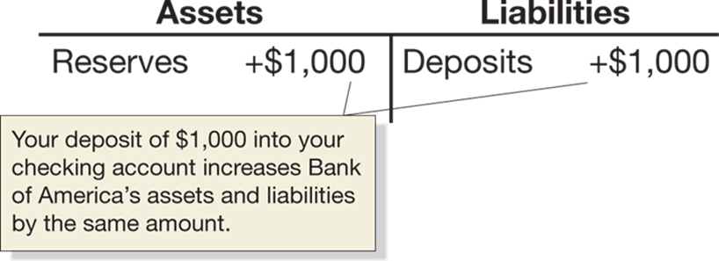
Do Banks Create Money?
A T-account is a stripped-down version of a bank balance sheet, showing only how a transaction changes a bank’s balance sheet.
When you deposit $1,000 in currency at Bank of America, its reserves increase by $1,000 and so do its deposits.
The currency component of the money supply decreases by the $1,000, since that $1,000 is no longer in circulation, but the checking deposits component increases by $1,000. So, there is no net change in the money supply—yet.

Slide 28
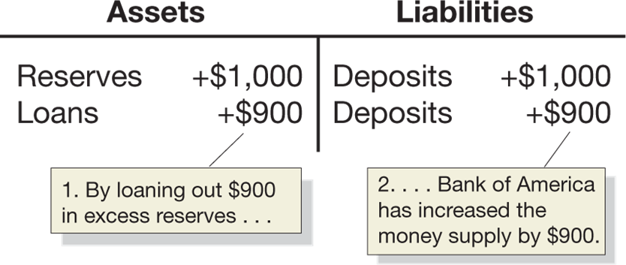
Bank of America Lends Money Out
But Bank of America needs to make a profit, so it keeps 10 percent of the deposit as reserves and lends out the rest, creating a $900 checking account deposit.
This is characteristic of a fractional reserve banking system, in which banks keep less than 100 percent of deposits as reserves.

Slide 29
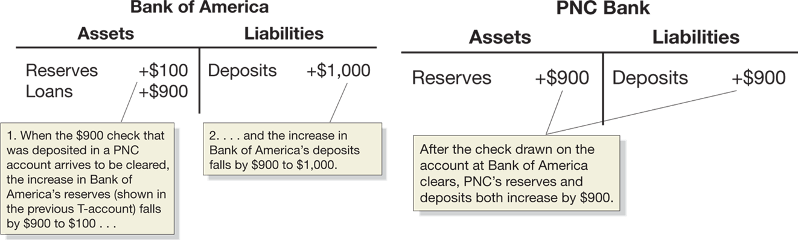
Follow the Money
The $900 initially appears in a Bank of America checking account, but will soon be spent, and Bank of America will transfer $900 in currency to the bank at which the $900 check is deposited—P N C in this case.
Notes:
Bank of America assets include reserves of $100 and loans of 900. Liabilities include deposits of $1,000. When the $900 check that was deposited in a PNC account arrives to be cleared the increase in Bank of America’s reserves, shown in the previous T-account, falls by $900 to $100, and the increase in Bank of America’s deposits fall by $900 to $1,000. PNC Bank assets include reserves of $900, and liabilities include deposits of $900. After the check drawn on the account at Bank of America clears, PNC’s reserves and deposits both increase by $900.

Slide 30
So, Do Banks Create Money?
The original $1,000 deposit has now become $1,900 in deposits; but the process won’t end here, as P N C will now lend out some of its deposits—the multiple expansion of deposits.
So yes, in the process of making loans as their reserves increase, banks create money in the form of new deposits.
Notes:
Bank of America assets include reserves of $100 and loans of 900. Liabilities include deposits of $1,000. When the $900 check that was deposited in a PNC account arrives to be cleared the increase in Bank of America’s reserves, shown in the previous T-account, falls by $900 to $100, and the increase in Bank of America’s deposits fall by $900 to $1,000. PNC Bank assets include reserves of $900, and liabilities include deposits of $900. After the check drawn on the account at Bank of America clears, PNC’s reserves and deposits both increase by $900.

Slide 31
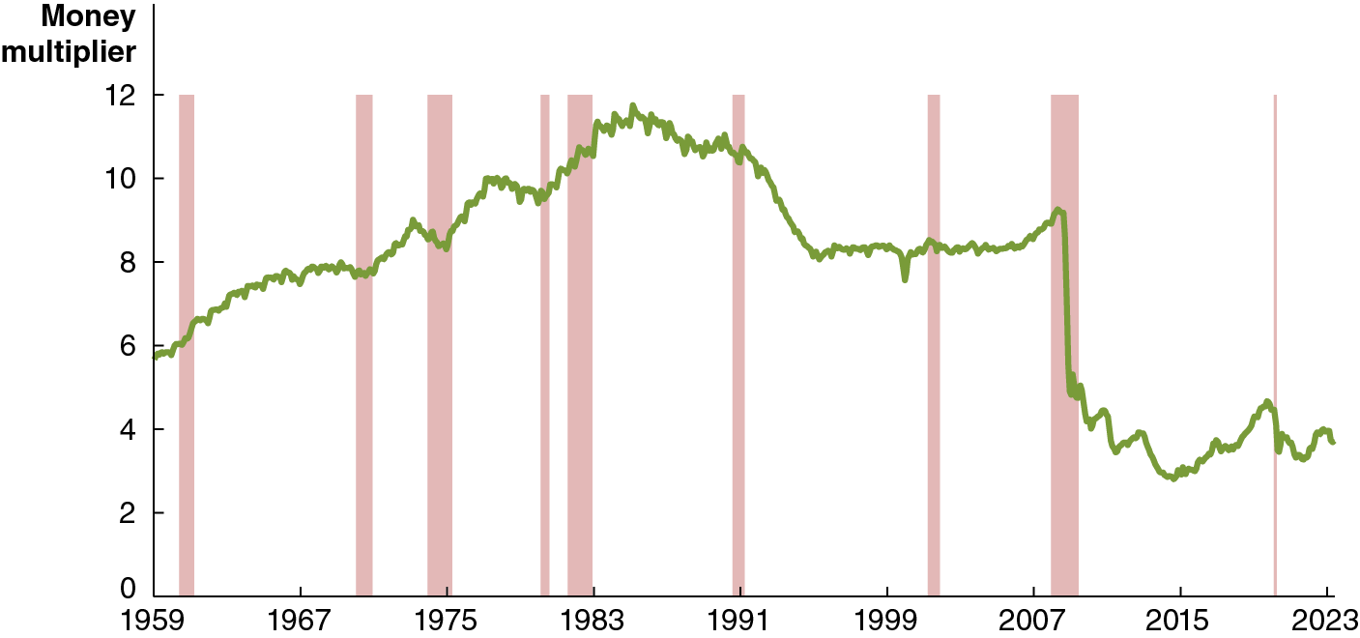
Figure 14.2 The Instability of the Money Multiplier
The multiple expansion of deposits creates results in a money multiplier, the ratio of money supply to the monetary base, or M/B.
The money multiplier was stable from the mid-1990s through 2007, but since 2007 it has become unstable.
Because of this instability, the Fed now has limited control of the money supply, and focuses on controlling interest rates instead.
Notes:
The horizontal axis represents year, and ranges from 1959 to 2023, in increments of 8 years. The vertical axis represents money multiplier, and ranges from 0 to 12, in increments of 2. The recession periods, 1960 to 1961, 1968 to 1970, 1973 to 1975, 1980 to 1981, 1982 to 1983, 1990 to 1991, 2001 to 2002, 2007 to 2009, and 2020 are indicated as shaded areas. The line begins at 5.9 in 1959, and rises irregularly to the highest rate of 11.9 by 1985. The line falls to 7.8 by 1999, rises to 9 in 2008, and falls to the lowest point of 3.7 by 2015. The line slowly rebounds reaching 4.5 by 2020, and ends at 4 in 2023. All values are estimated.

Slide 32
Interest on Reserve Balances
Prior to 2008, the Fed did not pay banks interest on their reserves, resulting in a scarce-reserves regime, in which banks hold few reserves beyond those the central bank requires them to hold.
In October 2008, the Fed began paying interest on reserve balances banks keep with the Fed, called the interest rate on reserve balances (I O R B).
Now, we are in an ample-reserves regime, in which banks hold substantially more reserves than the central bank requires them to hold.

Slide 33
Why Does the Money Multiplier Fluctuate? (1 of 2)
Fluctuations in the amount of reserves banks hold relative to their deposits.
While banks are not required to keep a particular level of reserves, they do keep reserves to comply with other banking regulations, and to ensure they have enough cash-on-hand for their depositors.
They change their reserves in response to market conditions; when they decide to lend more, they create more new demand deposits, and raise the money multiplier.

Slide 34
Why Does the Money Multiplier Fluctuate? (2 of 2)
Fluctuations in the amount of currency households and firms hold relative to their deposits.
Sometimes firms and households might change how much currency they choose to hold.
If they choose to hold more currency, less money is available for banks to create new deposits by lending their reserves, so the monetary base (the sum of currency in circulation and bank reserves) is smaller.
A smaller monetary base means the money multiplier (the money supply (M) divided by the monetary base (B)) is larger.

Slide 35
14.4 The Federal Reserve System
Describe the role the Fed plays in the financial system.
We have described that, in the United States (and all other countries), banks keep less than 100 percent of deposits as reserves: a fractional reserve banking system.
But what if many depositors simultaneously lost confidence in a bank and tried to withdraw their money? This situation is known as a bank run, and was what caused Silicon Valley Bank’s failure.
If many banks experience bank runs at the same time, a bank panic occurs.

Slide 36
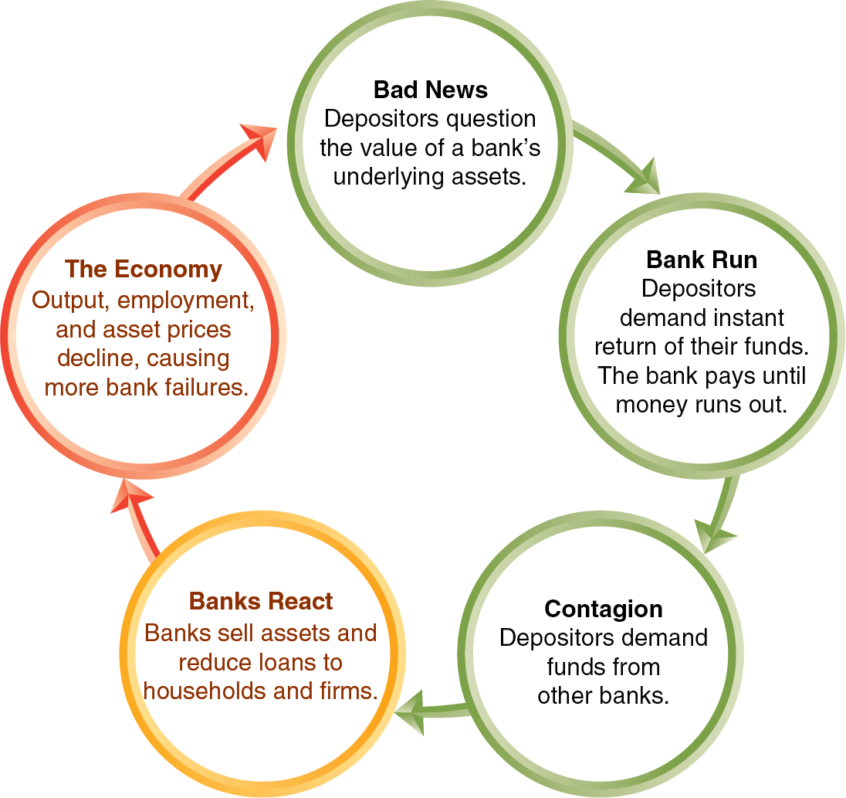
Figure 14.3 The Feedback Loop during a Bank Panic
The figure shows how a bank panic can take place.
Central banks, like the Federal Reserve, can help to prevent bank runs and panics by acting as a lender of last resort, promising to make loans to banks in order to pay off depositors.
This assurance can break the negative feedback loop.
Notes:
The feedback loop includes stages as follows.
Bad news, depositors question the value of a bank’s underlying assets.
Bank run, depositors line up to demand instant return on their funds. The bank pays until money runs out.
Contagion, depositors demand funds from other banks.
Banks react, banks sell assets and reduce loans to households and firms.
The economy, output, employment, and asset prices decline, causing more bank failures
The cycle perpetuates to bad news.

Slide 37
The Establishment of the Federal Reserve System
In the late nineteenth and early twentieth centuries, the United States experienced several bank panics.
In 19 14, the Federal Reserve system started. “The Fed” makes loans to banks called discount loans, charging a rate of interest called the discount rate.
During the Great Depression of the 19 30s, many banks were hit by bank runs. Afraid of encouraging bad banking practices, the Fed refused to make discount loans to many banks, and more than 9,000 banks failed.
Today, many economists are critical of the Fed’s decisions in the early 19 30s, believing they made the Great Depression worse.

Slide 38
Response to the Great Depression
In 1934, Congress established the Federal Deposit Insurance Corporation (F D I C).
The F D I C insures deposits in many banks, up to a limit (currently $250,000). This government guarantee has helped to limit bank panics.
Bank runs are still possible; during the recession of 2007–2009, a few banks experienced runs from large depositors whose deposits exceeded the F D I C limit; the same situation was what caused the failure of Silicon Valley Bank.

Slide 39
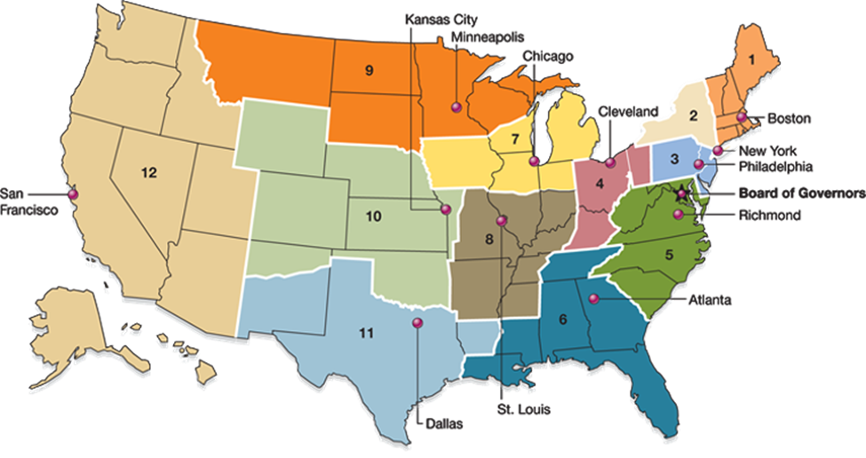
Figure 14.4 The Federal Reserve System (1 of 2)
Board of Governors
Responsible for overseeing the Federal Reserve System. Seven members are appointed by the president and serve 14-year, nonrenewable terms. One member is appointed chair and serves a 4-year, renewable term.
In 1913, Congress divided the country into 12 Federal Reserve districts, each of which provides services to banks in the district.
But the real power of the Fed lies in Washington D C, with the Board of Governors.
In 2023, the chair of the Board of Governors was Jerome (Jay) Powell.
Notes:
Areas in the country are grouped into 12 zones and color coded as follows.
The North Eastern most states are zone 1, in brown.
New York is zone 2, in tan.
Boston, Connecticut, and some of Pennsylvania are zone 3, in light blue.
Some of Pennsylvania, Ohio, and some of Kentucky are zone 4, in purple.
Virginia, West Virginia, North Carolina and South Carolina are zone 5, in green.
Some of Tennessee, Alabama, Georgia, Florida, some of Mississippi and some of Louisiana are zone 6, in teal.
Michigan, Northern Indiana and Illinois, and Southern Wisconsin and Minnesota are zone 7, in yellow.
Central to Southern Indiana and Illinois, Eastern Missouri, Western Kentucky and Tennessee, Northern Mississippi, and Northern Arkansas are zone 8, in gray.
Northern Wisconsin and Minnesota, North and South Dakota, and Montana are zone 9, in orange.
Wyoming, Colorado, Kansas, Oklahoma, some of Western Missouri, and northern Arizona, are zone 10, in light green.
Southern Arizona, Texas, and Northern Louisiana are zone 11, in light blue.
Washington, Idaho, Oregon, California, Nevada, Utah, New Mexico, Alaska and Hawaii are zone 12, in light brown.

Slide 40
Figure 14.4 The Federal Reserve System (2 of 2)
Federal Open Market Committee (F O M C)
Responsible for open market operations. Twelve members, consisting of the 7 members of the Board of Governors, the president of the Federal Reserve Bank of New York, and 4 presidents of the other 11 district banks, who serve rotating 1-year terms. The chair of the Board of Governors also serves as chair of the F O M C.
Meeting eight times per year, the Federal Open Market Committee (F O M C) is the Federal Reserve committee that is responsible for open market operations and managing the money supply in the United States.
Notes:
Areas in the country are grouped into 12 zones and color coded as follows.
The North Eastern most states are zone 1, in brown.
New York is zone 2, in tan.
Boston, Connecticut, and some of Pennsylvania are zone 3, in light blue.
Some of Pennsylvania, Ohio, and some of Kentucky are zone 4, in purple.
Virginia, West Virginia, North Carolina and South Carolina are zone 5, in green.
Some of Tennessee, Alabama, Georgia, Florida, some of Mississippi and some of Louisiana are zone 6, in teal.
Michigan, Northern Indiana and Illinois, and Southern Wisconsin and Minnesota are zone 7, in yellow.
Central to Southern Indiana and Illinois, Eastern Missouri, Western Kentucky and Tennessee, Northern Mississippi, and Northern Arkansas are zone 8, in gray.
Northern Wisconsin and Minnesota, North and South Dakota, and Montana are zone 9, in orange.
Wyoming, Colorado, Kansas, Oklahoma, some of Western Missouri, and northern Arizona, are zone 10, in light green.
Southern Arizona, Texas, and Northern Louisiana are zone 11, in light blue.
Washington, Idaho, Oregon, California, Nevada, Utah, New Mexico, Alaska and Hawaii are zone 12, in light brown.

Slide 41
The Fed, Banks, and the Money Supply
While the Fed was established primarily to stop bank panics by acting as a lender of last resort, today it performs a variety of actions.
This includes engaging in monetary policy: The actions the Federal Reserve takes to manage interest rates to pursue macroeconomic policy objectives.

Slide 42
Open Market Operations
Open market operations: The buying and selling of Treasury securities by the Federal Reserve in order to control the money supply.
To increase the money supply, the Fed directs its trading desk in New York to conduct an open market purchase of U.S. Treasury securities—Treasury bills, notes, and bonds, which are short-term (1 year or less), medium-term (2–10 years), or long-term (30 years) tradable loans to the U.S. Treasury.
To decrease the money supply, the Fed sells its securities—an open market sale.
These open market operations can occur very quickly and are easily reversible.

Slide 43
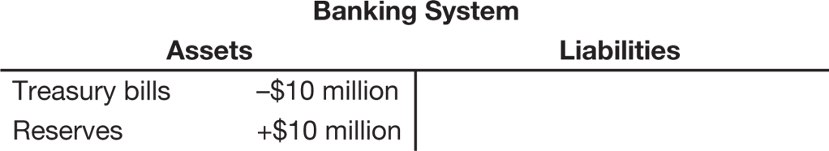
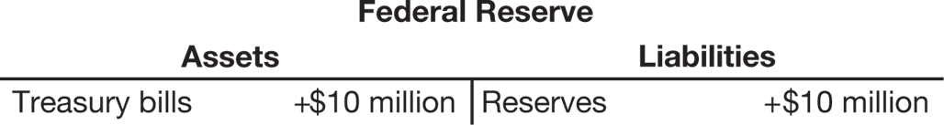
Open Market Operations in Action
Suppose the Fed engages in an open market purchase of $10 million.
The banking system’s T-account reflects an increase in reserves and a corresponding decrease in assets due to its debt to the Fed.
The banking system’s reserves are liabilities for the Fed, but it gains assets equal to the debt owed to it by the banking system.

Slide 44
How the Fed Can Control the Money Supply
The Fed can affect the money supply through open market operations by changing the monetary base:
An open market purchase will increase bank reserves and, therefore, the monetary base. The money supply will increase by the change in the monetary base multiplied by the money multiplier.
An open market sale will decrease bank reserves, the monetary base, and hence the money supply.

Slide 45
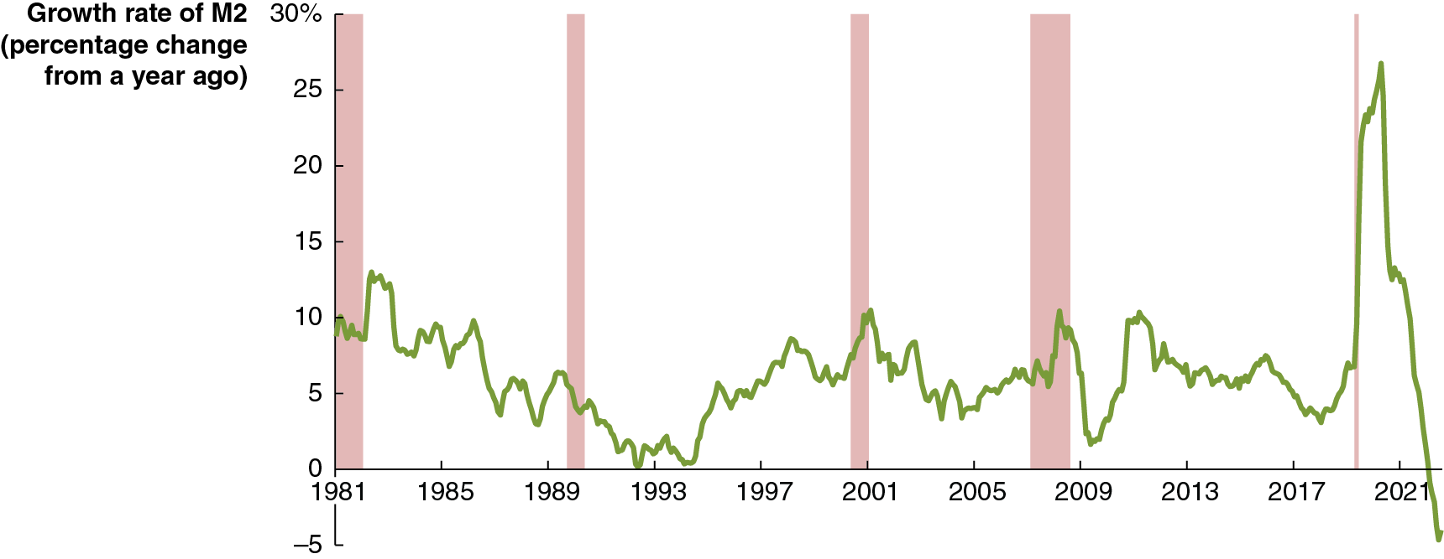
Figure 14.5 Fluctuations in the Growth Rate of M2, 1981–2023
In recent decades, the Fed has not concentrated on controlling the money supply, because most economists and Fed policymakers don’t believe short-run movements in M2 have much effect on inflation and unemployment.
As a result, there have been wide fluctuations from month to month in the growth rate of M2.
Notes:
The horizontal axis represents year, and ranges from 1981 to 2021, in increments of 4 years. The vertical axis represents the growth rate of M 2, percentage change from a year ago, and ranges from 0 to 30%, in increments of 5%. The recession periods, 1981, 1982 to 1983, 1990 to 1991, 2001 to 2002, 2007 to 2009, and 2020 are indicated as shaded areas. The line begins at 9.9 in 1981, and rises and falls irregularly, passes through 13 by 1982. The line falls to 0 by 1992, rises to 10 in 2001, and falls to 2 by 2009. The line slowly rebounds reaching 10 by 2010, and falls to 3 in 2018, peaks to the highest value of 27 in 2020, and ends at negative 4 in 2023. All values are estimated.

Slide 46
The Fed and Other Financial Regulators
Because of their importance in the financial system and the economy, banks are subject to substantial regulation, from the Fed, the F D I C, state regulators, and the federal Office of the Comptroller of the Currency.
Banks also follow regulations from Congress, including being required to fulfill a liquidity coverage ratio (L C R), that is, holding sufficient high-quality liquid assets to meet the bank’s expected cash outflows even when the financial system is under stress.

Slide 47
Moral Hazard in the Banking System
When a bank like Silicon Valley Bank fails, the Fed and other regulators face conflicting goals:
They want to prevent a run on one bank turning into a bank crisis or panic.
They want to avoid encouraging risky behavior by bank managers in the future: moral hazard.
To avoid this moral hazard, when the F D I C takes control of a failed bank, it must resolve the bank, selling its assets and paying off creditors (including depositors) in the least costly way.
Consequently bank owners will typically lose their investment, and some large depositors will lose a fraction of their deposits.

Slide 48
Moral Hazard and the Bank Runs of 2023
Decreasing the risk of moral hazard has the downside of increasing the chance of a bank panic.
If a bank’s failure would pose systemic risk to the financial system, the F D I C can decide to reimburse all deposits, even above the usual $250,000 limit.
The F D I C chose to protect the funds of Silicon Valley Bank depositors in this way.
This raises the risk of moral hazard, since large depositors will anticipate similar protections in the future, and not push their banks to avoid risky behavior.

Slide 49
The “Shadow Banking System” and the Financial Crisis of 2007–2009
The banks we have been discussing so far are commercial banks, whose primary role is to accept funds from depositors and make loans to borrowers.
In the last 25 years, two important developments have occurred in the financial system:
Banks have begun to resell many of their loans rather than keep them until they are paid off.
Financial firms other than commercial banks have become sources of credit to businesses.

Slide 50
Securitization Comes to Banking
A security is a financial asset—such as a stock or a bond—that can be bought and sold in a financial market.
Traditionally, when a bank made a loan like a residential mortgage loan, it would “keep” the loan and collect payments until the loan was paid off.
In the 1970s, secondary markets developed for securitized loans, allowing them to be traded, much like stocks and bonds.
Securitization: The process of transforming loans or other financial assets into securities.

Slide 51
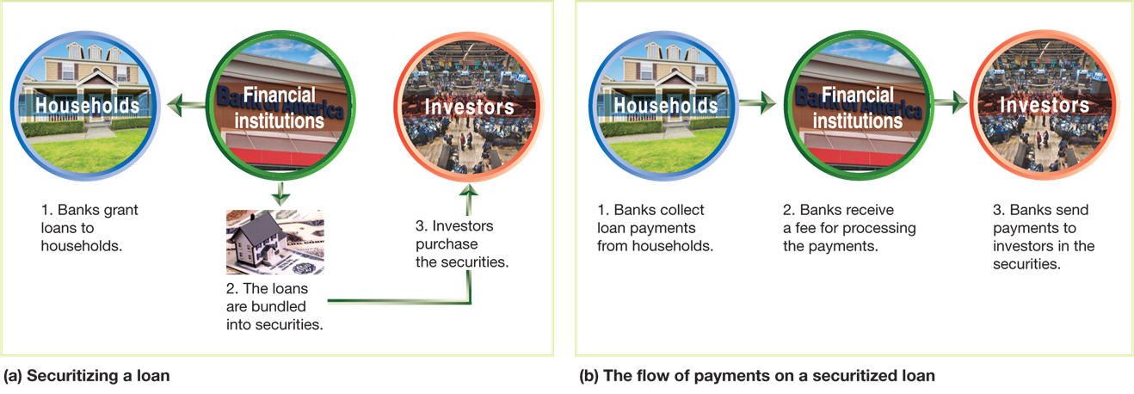
Figure 14.6 The Process of Securitization
The first set of three images show the securitization process of a bank loan.
The next set follows the money repaying the loan.
Notes:
Diagram A represents securitizing a loan. Banks grant loans to households. Financial institutions bundles the loans into securities, and investors then purchase the securities. Diagram B represents the flow of payments on a securitized loan. Banks collect loan payments from households, the banks receive a fee for processing the payments, and the banks send payments to the investors in the securities.

Slide 52
The Shadow Banking System
The 1990s and 2000s brought increasing importance of nonbank financial firms, including:
Investment banks: Banks that do not typically accept deposits from or make loans to households; they provide investment advice and also engage in creating and trading securities such as mortgage-backed securities.
Money market mutual funds: Funds that sell shares to investors and use the money to buy short-term Treasury bills and commercial paper (loans to corporations).
Hedge funds: Funds that raise money from wealthy investors and make “sophisticated” (often nonstandard, high-risk) investments.
By raising funds from investors and providing them directly or indirectly to firms and households, these firms have become a “shadow banking system.”

Slide 53
The Financial Crisis of 2007–2009
What made this “shadow banking system” different from commercial banks?
These firms were less regulated by the government, including not being F D I C-insured.
These firms were highly leveraged, relying more heavily on borrowed money; hence their investments had more risk, both of gaining and losing value.
Beginning in 2007, firms in the shadow banking system were quite vulnerable to runs.
As housing prices fell, some borrowers defaulted on their mortgages, so the value of mortgage-backed securities fell.
Highly leveraged firms experienced large losses, and some went bankrupt.

Slide 54
The Fed’s Response
The Fed and the U.S. Treasury took vigorous action to deal with the financial crisis.
The Fed modified its discount policy, granting loans to previously ineligible financial firms.
The Fed bought commercial paper (short-term unsecured commercial debt) for the first time since the 1930s.
The Fed took similar actions in the Covid-19 recession.
These and other actions eventually stabilized the financial system, though it took several years for the flow of funds from savers to borrowers to return to normal levels.

Slide 55
14.5 The Quantity Theory of Money
Explain the quantity theory of money and use it to explain how high rates of inflation occur.
Beginning in the sixteenth century, Spain sent gold and silver from Mexico and Peru back to Europe.
These metals were minted into coins, increasing the money supply.
Prices in Europe rose steadily during those years.
This helped people make the connection between the amount of money in circulation and the price level.

Slide 56
Connecting Money and Prices: The Quantity Equation
In the early twentieth century, Irving Fisher formalized the relationship between money and prices as the quantity equation:
M: Money supply
V: Velocity of money: The average number of times each dollar in the money supply is used to purchase goods and services included in G D P.
P: Price level
Y: Real output
Rewriting this equation by dividing through by M, we obtain:

Slide 57
Calculating the Velocity of Money
Measuring the:
Money supply (M) with M2,
Price level (P) with the G D P deflator, and
Level of real output (Y) with real G D P, so
is nominal G D P,
We obtain the following value for velocity (V) in 2022:
We can always calculate V. But will we always get the same answer? The quantity theory of money asserts that, subject to measurement error, we will:
Quantity theory of money: A theory about the connection between money and prices that assumes that the velocity of money is constant.

Slide 58
The Quantity Theory Explanation of Inflation
When variables are multiplied together in an equation, we can form the same equation with their growth rates added together.
So, the quantity equation:
generates:
Growth rate of the money supply + Growth rate of velocity = Growth rate of the price level (or the inflation rate) + Growth rate of real output
Rearranging this to make the inflation rate the subject, and assuming that the velocity of money is constant, we obtain:

Slide 59
The Inflation Rate According to the Quantity Theory
This equation provides the following predictions:
If the money supply grows faster than real G D P, there will be inflation.
If the money supply grows slower than real G D P, there will be deflation (a decline in the price level).
If the money supply grows at the same rate as real G D P, there will be neither inflation nor deflation: the price level will be stable.
Is velocity truly constant from year to year? The answer is no.
But the quantity theory of money can still provide insight:
In the long run, inflation results from the money supply growing at a faster rate than real G D P.

Slide 60
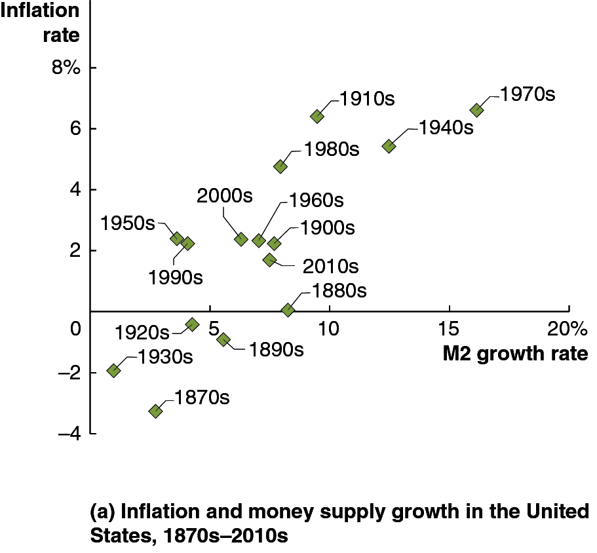
Figure 14.7 The Relationship between Money Growth and Inflation Over Time and around the World (1 of 2)
Real G D P growth has been relatively consistent over time.
So based on the quantity theory of money, there should be a predictable, positive relationship between the annual rates of inflation and growth rates of the money supply.
Historical U.S data shows a positive relationship, but not the consistent relationship implied by a constant velocity of money.
Notes:
NOTE: In the digital chapter, The figure 14.7 is an interactive real-time data graph, which means it automatically updates when new data becomes available.
(a) The panel depicts a scatterplot for inflation and money supply growth in the United States between 1870s and 2010s. The horizontal axis represents M 2 growth rate, and ranges from 0 to 20%, in increments of 5%. The vertical axis represents inflation rate, and ranges from negative 4 to 8%, in increments of 2%.
1870s (3, negative 3)
1880s (8, 0)
1890s (5.5, negative 1)
1900s (7, 2)
1910s (9, 6.2)
1920s (4, negative 0.2)
1930s (1, negative 2)
1940s (12, 5.5)
1950s (4, 2)
1960s (7, 2.2)
1970s (16, 6.4)
1980s (8, 5)
1990s (4, 2.2)
2000s (6, 2.6)
2010s (6.8, 1.6)

Slide 61
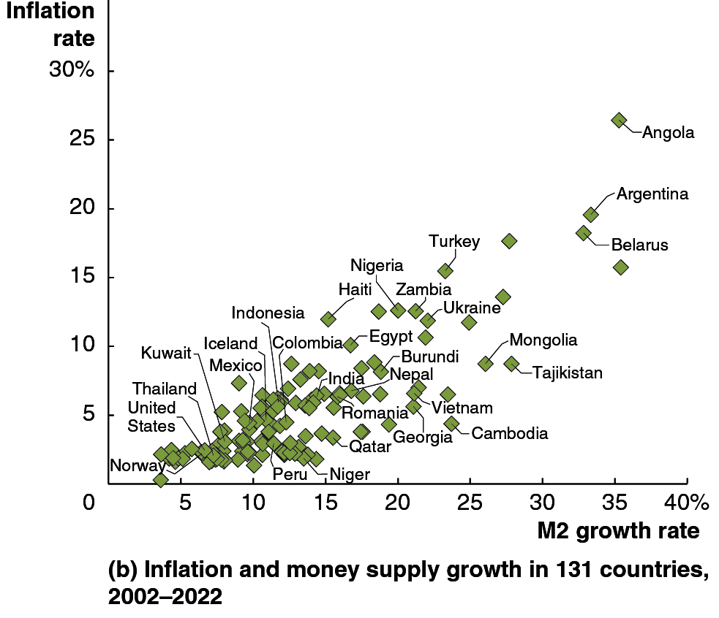
Figure 14.7 The Relationship between Money Growth and Inflation Over Time and around the World (2 of 2)
We see a similar story when we compare average rates of inflation and growth rates of the money supply across different countries.
Although the relationship is not entirely predictable, countries with higher growth in the money supply do have higher rates of inflation.
Notes:
NOTE: In the digital chapter, The figure 14.7 is an interactive real-time data graph, which means it automatically updates when new data becomes available.
(b) The panel depicts a scatterplot for inflation and money supply growth in 131 countries between 2002 and 2022. The horizontal axis represents M 2 growth rate, and ranges from 0 to 40%, in increments of 5%. The vertical axis represents inflation rate, and ranges from 0 to 30%, in increments of 5%. The majority of the represented countries are grouped tightly together between (5, 5), and (20, 10). Smaller countries are further spread out, and rise through the graph. All values are estimated.

Slide 62
High Rates of Inflation
Very high rates of inflation—in excess of 50 percent per month—are known as hyperinflation.
Hyperinflation results when central banks increase the money supply at a rate far in excess of the growth rate of real G D P.
This might happen when governments want to spend much more than they raise through taxes, so they force their central bank to “buy” government bonds.

Slide 63
Recent Examples of Hyperinflation
Recently, hyperinflation has occurred in Zimbabwe. During the 2000s, prices increased by more than 10,000 percent per year.
At that rate, a can of soda costing $1 this year would cost over $100 next year and over $10,000 the year after that.
In 2008 the Zimbabwe inflation rate reached 15 billion percent.
In 2019 Venezuela experienced inflation rates over 2 million percent.
Hyperinflation tends to be associated with slow growth, if not severe recession.

Slide 64
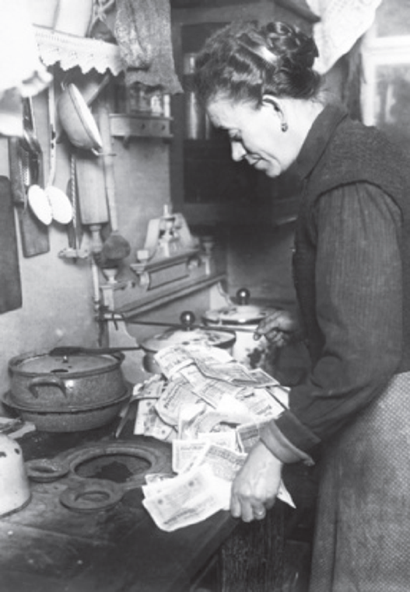
Apply the Concept: The German Hyperinflation of the Early 19 20s (1 of 2)
After Germany lost World War
the Allies forced Germany to pay reparations.
Unable to cover both its regular spending and the reparations, the German government sold bonds to its central bank, the Reichsbank.

Slide 65
Apply the Concept: The German Hyperinflation of the Early 19 20s (2 of 2)
The value of the German mark started to fall, and the Allies demanded payment in their own currencies; so Germany was forced to buy their currency with its own.
This required massive expansion of the money supply.
From 1922–1923, the German price index rose from 1,440 to 126,160,000,000,000, making the German mark (and any savings held in German currency) worthless.

Slide 66

Copyright
This work is protected by United States copyright laws and is provided solely for the use of instructors in teaching their courses and assessing student learning. Dissemination or sale of any part of this work (including on the World Wide Web) will destroy the integrity of the work and is not permitted. The work and materials from it should never be made available to students except by instructors using the accompanying text in their classes. All recipients of this work are expected to abide by these restrictions and to honor the intended pedagogical purposes and the needs of other instructors who rely on these materials.

