Slide 1
A Dog’s Life
Proposal for Website

Slide 2
Site Map
Home Page
Grooming Services
How to Select a Good Pet
Contact information
Map to Store

Slide 3

Home Page
A Dog’s Life
A Dog’s Life
Grooming Services
How to Select a Good Pet
Contact Information
Grooming Services
How to Select a Good Pet
Contact Information
Busy life? Rowdy pet who doesn’t like to sit still for grooming? Let us take care of your furry friend’s grooming needs.
Busy life? Rowdy pet who doesn’t like to sit still for grooming? Let us take care of your furry friend’s grooming needs.

Slide 4

Grooming Services
A Dog’s Life
A Dog’s Life
Grooming Services
Grooming Services
Home
Grooming Services
Home
Grooming Services
Large/Giant Breeds
(50 lbs & Up)
Bath & Brush (Short Hair)
$75 +
Bath & Brush (Long Hair)
$85 +
Bath & Brush + Trim
$95 +
Face, Paws, Sanitary
Full Grooming
$130 +
Small Breeds
(Up to 20 lbs)
Bath & Brush (Short Hair)
$45 +
Bath & Brush (Long Hair)
$50 +
Bath & Brush + Trim
$55 +
Face, Paws, Sanitary
Full Grooming
$65 +
Small Breeds
(Up to 20 lbs)
Bath & Brush (Short Hair)
$45 +
Bath & Brush (Long Hair)
$50 +
Bath & Brush + Trim
$55 +
Face, Paws, Sanitary
Full Grooming
$65 +
Medium Breeds
(21 - 49 lbs)
Bath & Brush (Short Hair)
$60 +
Bath & Brush (Long Hair)
$65 +
Bath & Brush + Trim
$65 +
Face, Paws, Sanitary
Full Grooming
$80 +
Medium Breeds
(21 - 49 lbs)
Bath & Brush (Short Hair)
$60 +
Bath & Brush (Long Hair)
$65 +
Bath & Brush + Trim
$65 +
Face, Paws, Sanitary
* Prices are estimates and may vary slightly depending on dog's size, current coat condition & grooming required (hand scissoring, etc)

Slide 5
How to Select A Good Pet
A Dog’s Life
A Dog’s Life
How to Select a Good Pet
How to Select a Good Pet
Home
How to Select a Good Pet
Home
How to Select a Good Pet
7 Factors to Consider When Choosing a Pet
Allergies – Do you or your loved ones have allergies to dander or saliva that comes with dogs or cats?
Your space – Some pets need more space than others. If you rent, do your landlords or property managers allow pets?
Your life – Being a pet owner takes a lot of work. Are you prepared to make sure your dog gets enough exercise, regular veterinary care, training, and socialization?
4. Age – Puppies and kittens are a lot of work. They will require potty, socialization, spaying and neutering, and may even destroy things.
5. Personality and temperament – Meet before you get your companion!
7 Factors to Consider When Choosing a Pet
Allergies – Do you or your loved ones have allergies to dander or saliva that comes with dogs or cats?
Your space – Some pets need more space than others. If you rent, do your landlords or property managers allow pets?
Your life – Being a pet owner takes a lot of work. Are you prepared to make sure your dog gets enough exercise, regular veterinary care, training, and socialization?
4. Age – Puppies and kittens are a lot of work. They will require potty, socialization, spaying and neutering, and may even destroy things.
5. Personality and temperament – Meet before you get your companion! It’s hard to know from an online photo if a pet will have a personality and energy level that is a good match for you.
6. Life span – Dogs live an average of 12 years. This is an average, so your pet may not live so long or live longer. Are you emotionally prepared to outlive your pet?
7. Financial situation – It can cost an upwards of $3,000 a year for a dog after paying one-time costs. Some pets have more needs than other pets, which can increase costs. We need to take good care of our pets. It’s important to schedule regular check-ups to keep pets vaccinated and protected against parasites and disease.

Slide 6
Contact Information
A Dog’s Life
A Dog’s Life
Contact Us
Contact Us
Home
Contact Us
Home
Contact Us
Directions to Store
Send us an email
Send us an email
Schedule An Appointment
We love caring for pets! Send us a message or call the spa to schedule an appointment for your furry friend.
Name
Name
Email*
Email*
Message
A Dog’s Life
1212 E Main St, Scottsdale AZ 85251
(602) 510-2310
Message
Hours
M-F 08:00 – 19:00
Sat. 09:00 – 13:00
Sun. Closed
Send
Send

Slide 7
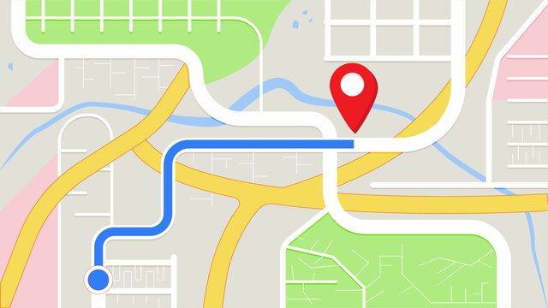



Store Map
A Dog’s Life
A Dog’s Life
Directions to Store
Directions to Store
Home
Contact Us
Home
Directions to Store
Contact Us
Directions to Store
Contact Us

