Slide 1

FAO/GFCM/JRC Summer School in Quantitative Fisheries Stock Assessment
10-22 July 2017 – Capo Granitola, Italy
The role of advice in support of decision making within the GFCM
GFCM Secretariat & FAO Fisheries Department

Slide 2
The role of the General Fisheries Commission for the Mediterranean (GFCM)
Established in 1949 in the framework of the Food and Agriculture Organization (FAO) of the United Nations (UN)
Objective:
  To ensure the conservation and sustainable use, at the biological, social, economic and environmental level, of living marine resources
  To ensure the sustainable development of aquaculture
Area of application:
  The Mediterranean Sea and the Black Sea
Membership:
  24 Contracting Parties:
  19 Mediterranean states, 3 Black Sea states, EU and Japan
  3 Cooperating non-Contracting Parties:
  Bosnia & Herzegovina, Georgia & Ukraine
Key functions:
  Adopt binding recommendations for fisheries and aquaculture governance
  Provide technical assistance and level the playing field

Slide 3
Advice, decision making and compliance within the GFCM
COC
Compliance assessment
Decision making
at the Commission
Proposals by Member States
Scientific Advisory Committee on Fisheries
WG on stock assessments
- Small pelagic
- Demersal
Workshop on simulation of management measures
Subregional committees
Adhoc Technical meetings
Working Group on the Black Sea
Subregional Group on Stock Assessments (all species)
Adhoc Technical meetings
Scientific Advisory Committee on Aquaculture
WG on Environment and Health
WG on Governance
WG on Quality and Market
WG on Innovation
WGBS
CAQ
SAC

Slide 4
The need for advice
Recent GFCM Recommendations strongly rely on advice from SAC or WGBS
  If advice is not clear difficult to reach consensus between GFCM CPCs
  Need to prioritize on which stocks require urgent action
  A clear advice is needed; need to evolve from ”reduce fishing mortality” to a more concrete technical advice:
    When analytical assessment is possible:
      Reference points required to estimate how much reduction (catches, effort) is needed
      Simulations needed to provide assessment on expectations under different situations (recruitment, changes in the fishery, etc)
    When no analytical assessment is possible (data deficiencies) but indications of urgency to adopt management measures exist -> Precautionary approach (data limited stock assessment methods, precautionary management measures, etc.)

Slide 5
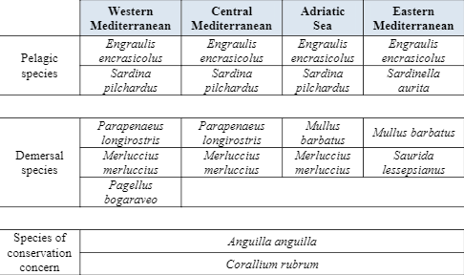
The need for advice
Priority stocks
Sources: SAC Work Plan for 2016 – 2017; Report of the 40th session of the Commission

Slide 6
The need for advice
For priority stocks under management plans:
  Need to simulate the potential effects of alternative management scenarios:
  Scenarios should be previously defined based on accepted principles (MSY, precautionary biomass limits) or on agreement between scientist – national administrations
  A framework for the simulation of potential effects should be designed; Management Strategy Evaluation (MSE)

Slide 7
We need to continue improving our advice!
Better coverage (more species, more areas)
Better assessment models (more robust, more precise, better adapted to our fisheries)
Better simulations frameworks (better understanding of stock recruitment, possibility to integrate socio-economic aspects, possibility to simulate more complex management scenarios)
Better methods for advice on data limited situations
Notes:
Good to finish saying that is what these courses are for!

Slide 8
We need to continue improving our advice!
MID-TERM
FISHERIES STRATEGY
Improve, by
2020, the sustainability
of Mediterranean and
Black Sea
fisheries
TARGET 1
Reverse the declining trend of fish stocks through strengthened scientific advice in support of management
TARGET 2
Support livelihoods for coastal communities through sustainable small-scale fisheries
TARGET 3
Curb IUU fishing through a regional plan of action
TARGET 4
Minimize and mitigate unwanted interactions between fisheries and marine ecosystems and environment
TARGET 5
Enhance capacity-building and cooperation
Mediterranean and Black Sea countries are embarked in a Strategy to improve the sustainability of fisheries
The improvement of advice is key to allow for the adoption of better management measures
WE need more and better experts like you!

Slide 9
Thank you for your attention

