Slide 1

Mining Time Series:
Forecasting
Mining Massive Datasets
Prof. Carlos Castillo — https://chato.cl/teach

Slide 2
Sources
Data Mining, The Textbook (2015) by Charu Aggarwal (chapter 14)
Introduction to Time Series Mining (2006) tutorial by Keogh Eamonn [alt. link]
Time Series Data Mining (2006) slides by Hung Son Nguyen

Slide 3

(A similar phrase is attributed to Niels Bohr, Danish physicist and winner of the Nobel Prize in 1922)

Slide 4
Forecasting
(AR, MA, ARMA, ARIMA, ...)

Slide 5
Stationary vs Non-Stationary processes
Stationary process
  Parameters do not change over time
  E.g., White noise has zero mean, fixed variance, and zero covariance between y_{t} and y_{t+L} for any lag L
Non-stationary process
  Parameters change over time
  E.g., price of oil, height of a child, glucose level of a patient, ...

Slide 6
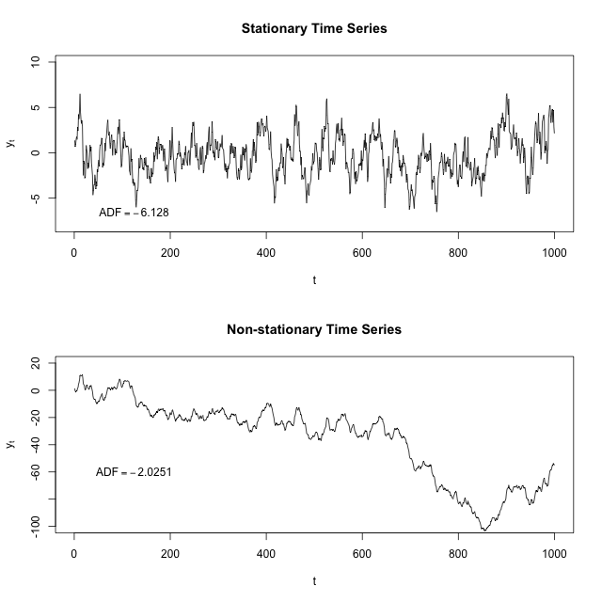
Stationary process
Non-stationary process
By Protonk at English Wikipedia, CC BY-SA 3.0
https://commons.wikimedia.org/w/index.php?curid=41600857

Slide 7
Strictly stationary time series
A strictly stationary time series is one in which the distribution of values in any time interval [a,b] is identical to that in [a+L, b+L] for any value of time shift (lag) L
In this case, current parameters (e.g., mean) are good predictors of future parameters

Slide 8
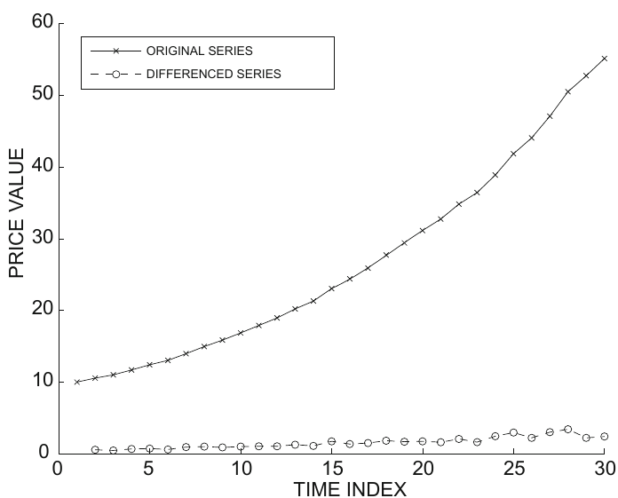
Differencing
First order differencing
In this first example, if the original series is superlinear, the differenced series is stationary or non-stationary?

Slide 9
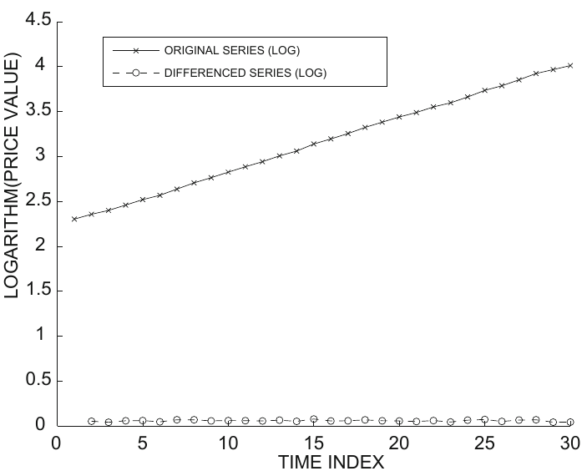
Differencing (cont.)
First order differencing
In this second example, where the series is linear, the differenced series is stationary or non-stationary?

Slide 10
Other differencing operations
Second-order differencing
Seasonal differencing (m = 24 hours, 7 days, …)
If you find a differencing that yields a stationary series, the forecasting problem is basically solved.

Slide 11
Autoregressive model AR(p)
Autocorrelation lines in [-1,1]
High absolute values ⇒ predictability
Autoregressive model of order p, AR(p):

Slide 12
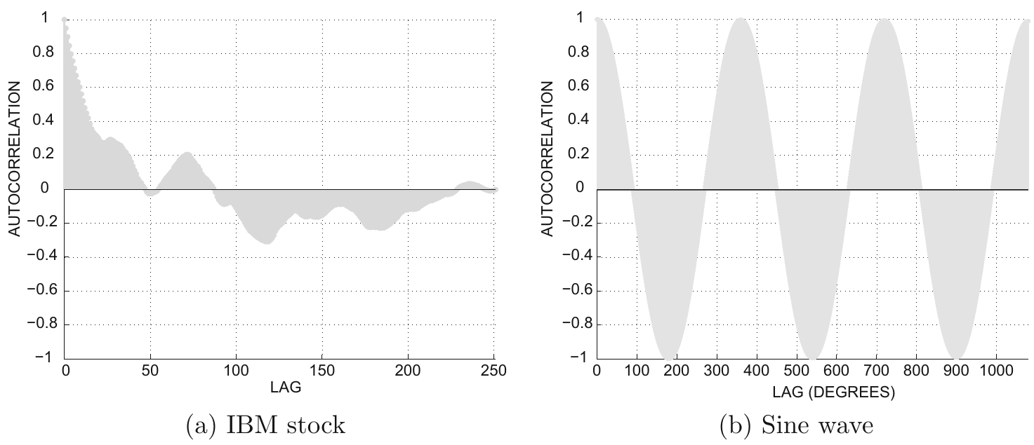
How to decide p? Autocorrelation plots
What is a reasonable range for p in these cases?

Slide 13
Finding coefficients and evaluating
Each data point is a
training element
Coefficients found by least-squares regression
Best models have R² → 1

Slide 14
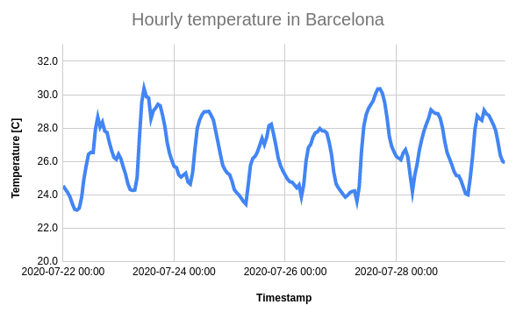

Exercise: simple auto-regressive model
Create a simple auto-regressive model for temperature in a city
Use two lags:
  1 hour
  24 hours
Compute the predicted series
  (optionally: include it in the plot)
Compute the maximum error
Spreadsheet links: https://upfbarcelona.padlet.org/chato/hogch321o6pws1fd

Slide 15
Moving average model MA(q)
Focus on the variations (shocks) of the model, i.e., places where change was unexpected
AR(p) model:
MA(q) model:

Slide 16
Autoregressive moving average model ARMA(p,q)
Combines both the autoregressive and the moving average model
Select small p, q, to avoid overfitting

Slide 17
Autoregressive integrated moving average model ARIMA(p,q)
Combines both the autoregressive and the moving average model on differenced series
Note: this is an ARIMA(p,1,q) model as we’re using first order differencing
See also: ARIMA end-to-end project in Python by Susan Li (2018)

Slide 18
Event detection
(a simple framework)

Slide 19
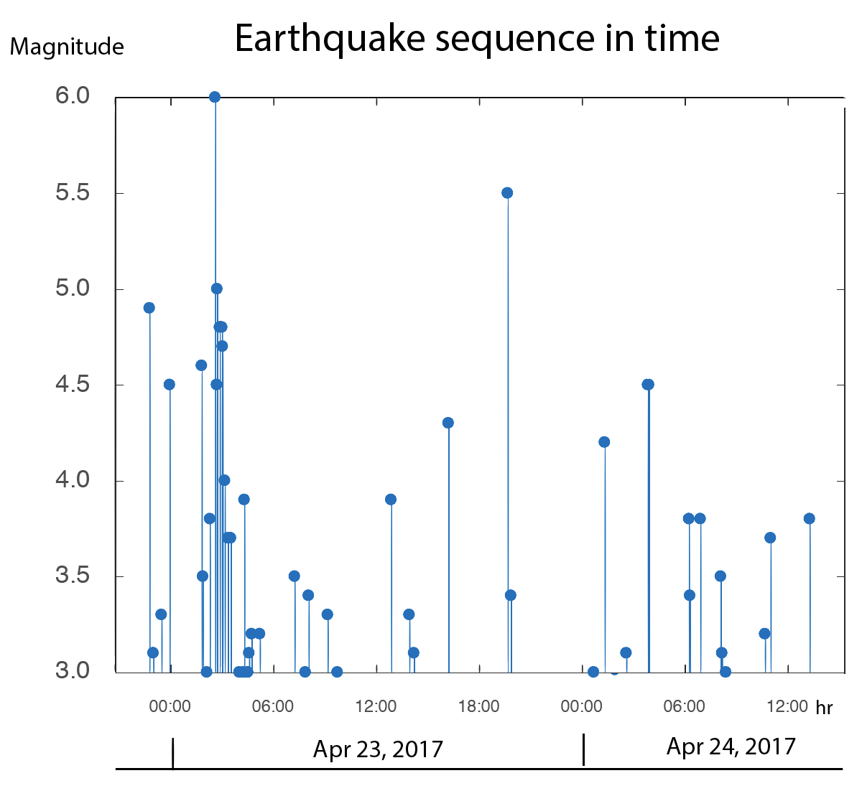
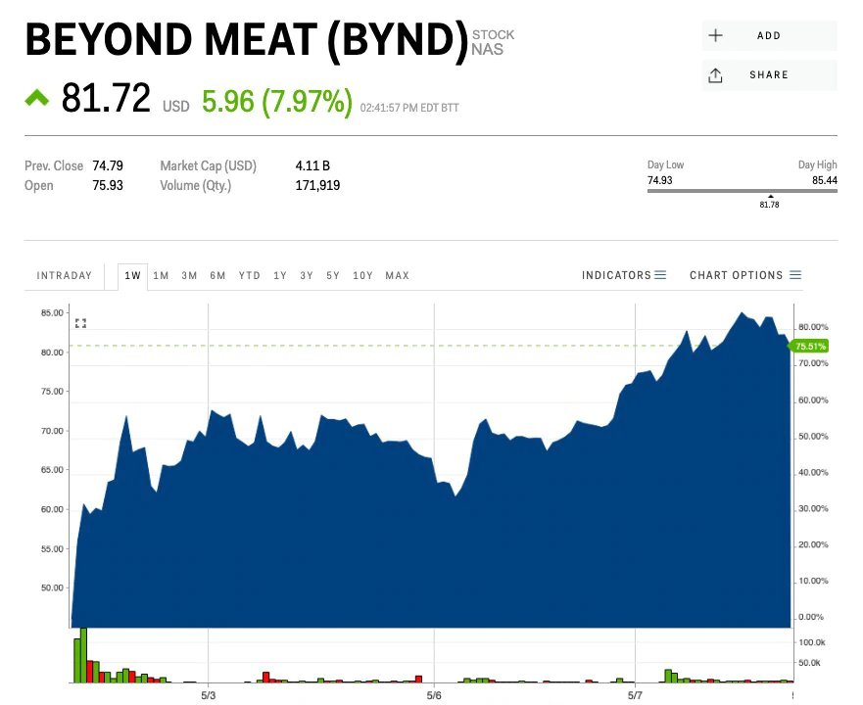
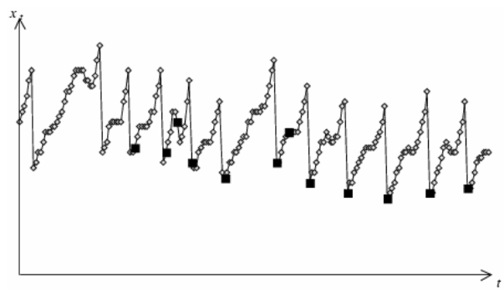
Event: an important occurrence
Earthquake or
aftershock
Droplet
release
Sudden
price change
Time Series Data Mining (2006) slides by Hung Son Nguyen

Slide 20
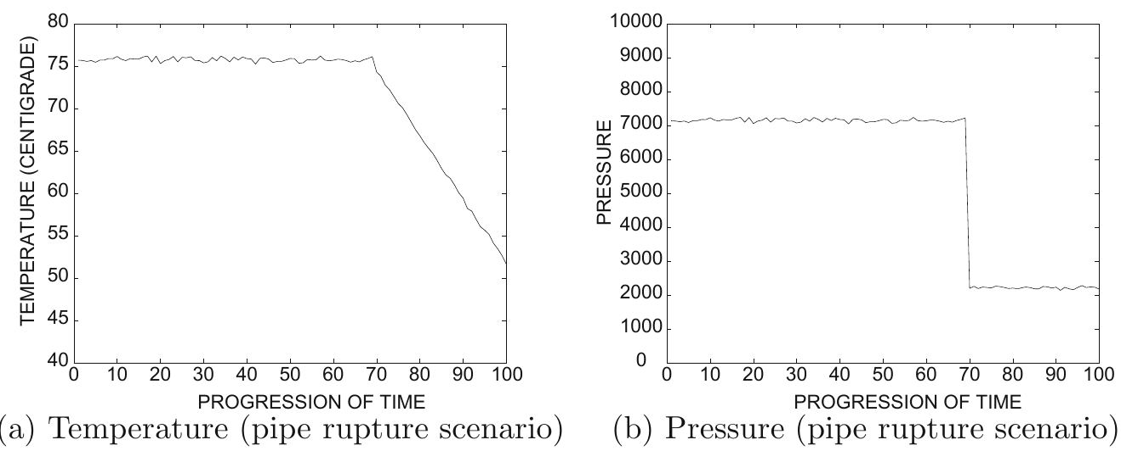
Example: pipe rupture

Slide 21
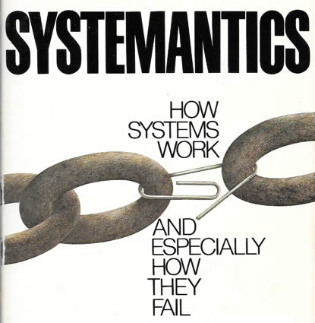
(But what if sensors fail? ...
“Systems in general work poorly or not at all”
“In complex systems, malfunction and even total non-function may not be detectable for long periods, if ever”
Gall, John. Systemantics: the underground text of systems lore:
how systems really work and especially how they fail. Ann Arbor, MI, 1975.

Slide 22
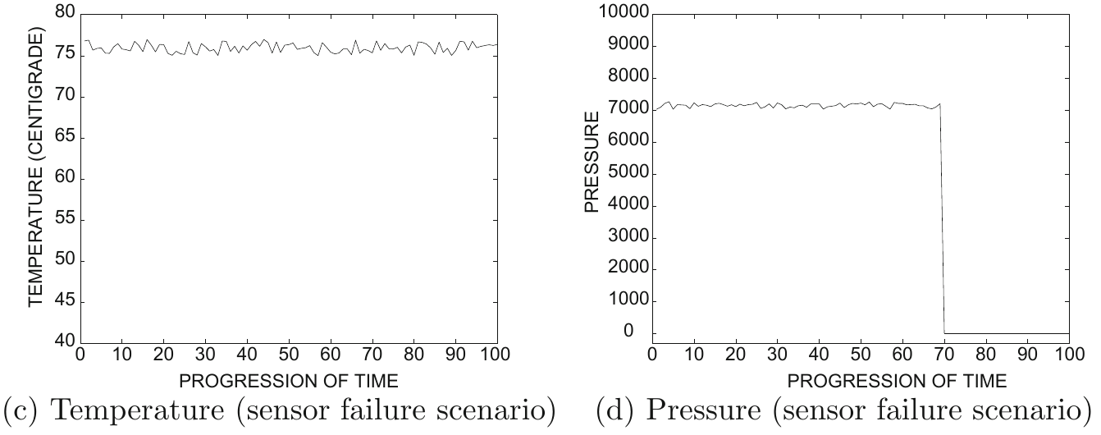
… Can we still detect failure?)

Slide 23
A general scheme for event detection in multivariate time series
Let T₁, T₂, …, T_{r} be times at which an event has been observed in the past
(Offline) Learn coefficients α₁, α₂, …, α_{d} to distinguish between event times and non-event times
(Online) Observe series and determine deviation of every stream i at timestamp t as z_{t}^{i}
(Online) Compute composite alarm level

Slide 24
Learning discrimination coefficients α₁ , α₂ , … , α_{d}
Average alarm level for events
Average alarm level for non-events
(we assume most points are non-events)

Slide 25
Learning discrimination coefficients α₁ , α₂ , … , α_{d} (cont.)
For events
For non-events
Maximize
subject to
Use any off-the-shelf iterative
optimization solver

Slide 26
Summary

Slide 27
Things to remember
Time series forecasting
Event detection

Slide 28
Exercises for TT27-TT29
Data Mining, The Textbook (2015) by Charu Aggarwal
  Exercises 14.10 → 1-6

