Slide 1

Outlier Detection:
Density and Partitioning-based Methods
Mining Massive Datasets
Prof. Carlos Castillo
Topic 21

Slide 2
Sources
Liu, F. T., Ting, K. M., & Zhou, Z. H. Isolation forest. ICDM 2008.
(1) Eryk Lewinson: Outlier detection with isolation forest (2018)
(2) Tobias Sterbak: Detecting network attacks with isolation forests (2018)

Slide 3
Density-based methods

Slide 4
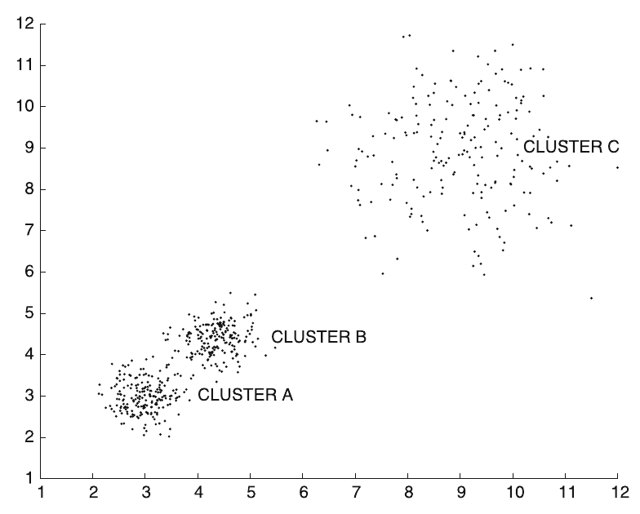
Density-based methods
Key idea:
find sparse regions in the data
Limitation:
cannot handle variations of density

Slide 5
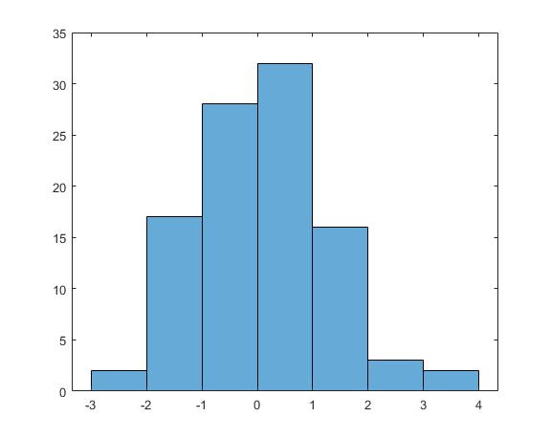
Histogram- and grid-based methods
Histogram-based method:
Put data into bins
Outlier score: num – 1,
where num is the number of
items in the same bin
Clear outliers are alone or almost alone in a bin

Slide 6
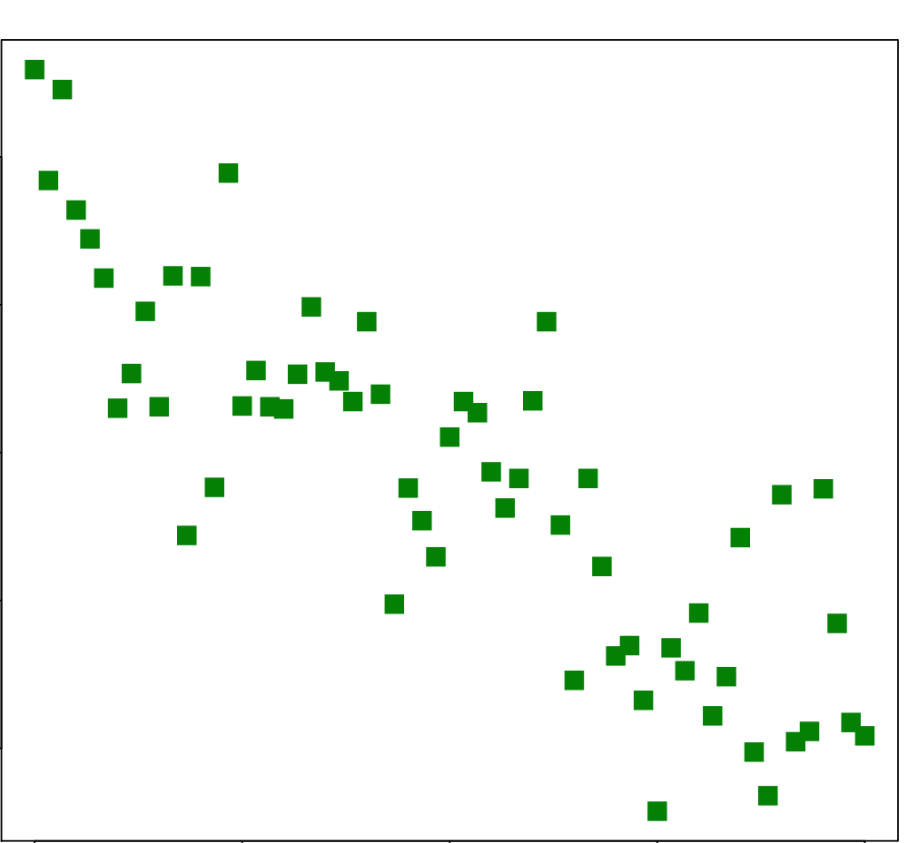

Histogram- and grid-based methods
Grid-based method
Put data into a grid
Outlier score: num – 1,
where num is the number of
items in the same cell
Clear outliers are alone or almost alone in a cell

Slide 7
Problems with grid-based methods
How to choose the grid size?
Grid size should be chosen
considering data density,
but density might vary
across regions
If dimensionality is high, then
most cells will be empty

Slide 8
Kernel-based methods
Given n points
K_{h} is a function peaking at X_{i} with bandwidth h
For instance, a Gaussian kernel:

Slide 9
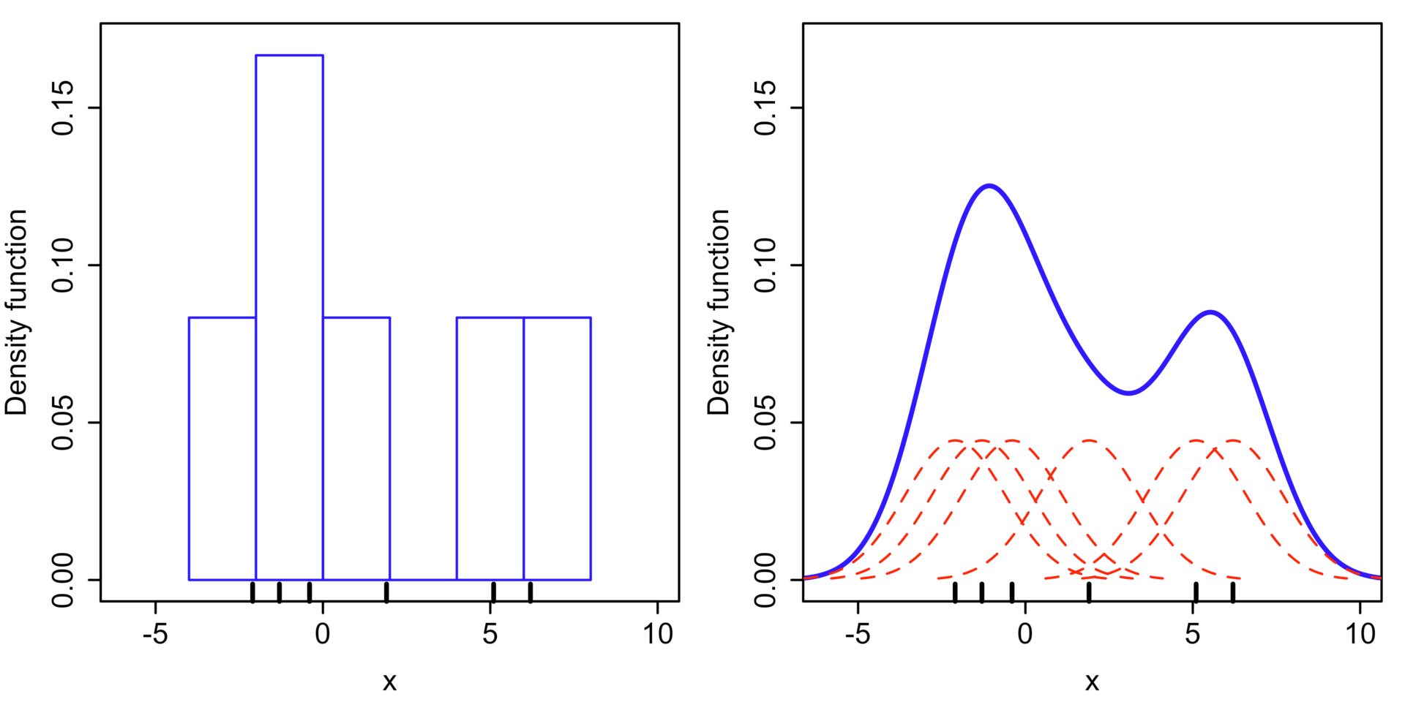
Kernel-based methods (cont.)
Example with a Gaussian kernel
  X = < -2.1, -1.3, -0.4, 1.9, 5.1, 6.2 >
Each K_{h} in red
f = sum of K_{h} in blue
Histogram
Kernel density est.
[Wikipedia: Kernel density estimation]

Slide 10
Information-theoretic models
Describe “ABABABABABABABABABABABABABABABABAB”
  “AB” 17 times
Describe “ABABACABABABABABABABABABABABABABAB”
  Minimum description length increased
Information-theoretic models: learn a model, then look at increases in model size due to a data point

Slide 11
Partitioning-based method: isolation forest

Slide 12
Isolation forest method
tree_build(X)
  Pick a random dimension r of dataset X
  Pick a random point p in [min_{r}(X), max_{r}(X)]
  Divide the data into two pieces: x_{r} < p and x_{r} ≥ p
  Recursively process each piece

Slide 13
Stopping criteria for recursion
Stop when a maximum depth has been reached
-or-
Stop when each point is alone in one partition

Slide 14
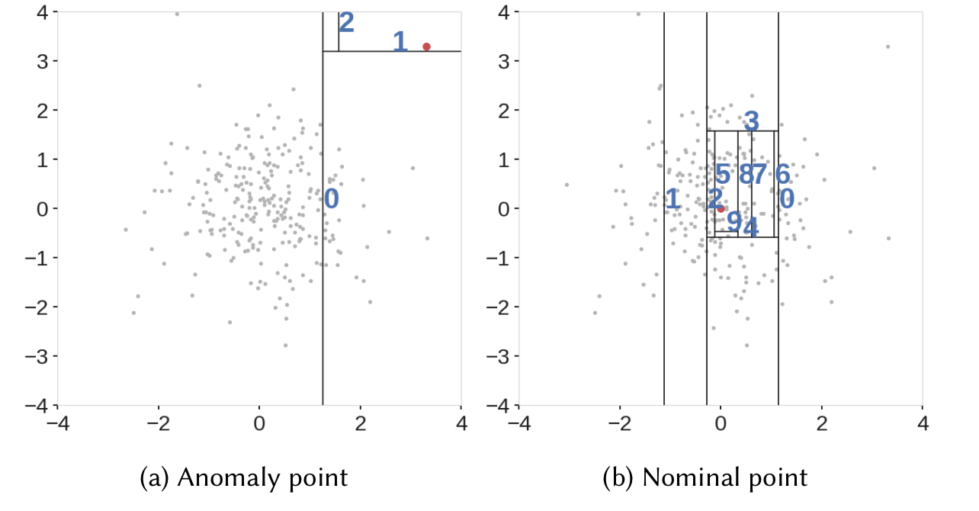
Key: outliers lie at small depths
https://towardsdatascience.com/outlier-detection-with-extended-isolation-forest-1e248a3fe97b

Slide 15
Outlier score
Let c(n) be the average path length of an unsuccessful search in a binary tree of n items
h(x) is the depth at which x is found in tree
Score:

Slide 16
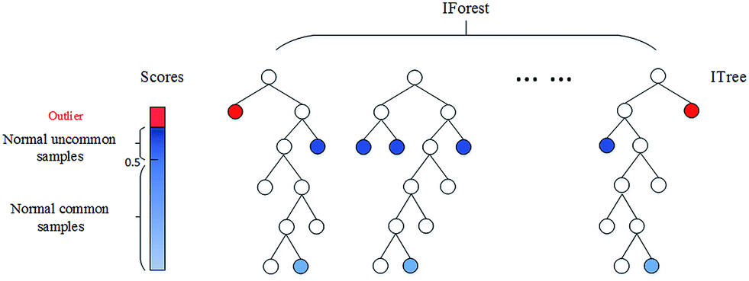
Outlier scores in isolation forests
(each tree is built from a sub-sample of original data)
https://donghwa-kim.github.io/iforest.html

Slide 17
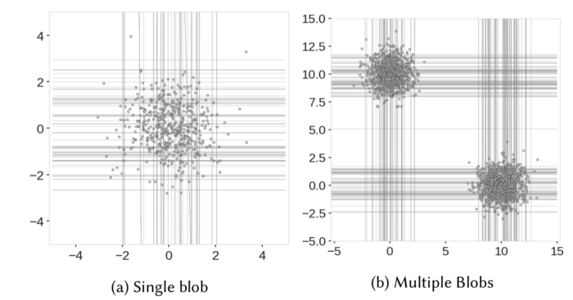
Example

Slide 18
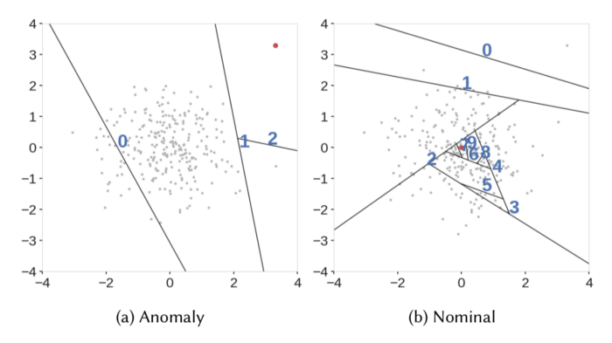
Extended Isolation Forest
More freedom to partitioning by choosing a random slope and a random intercept
https://towardsdatascience.com/outlier-detection-with-extended-isolation-forest-1e248a3fe97b

Slide 19
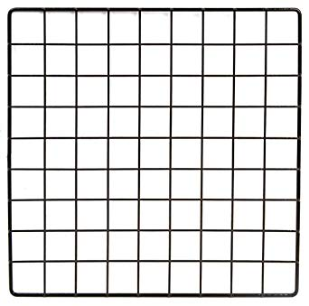
Exercise
Answer in
Nearpod Draw-it
1 2 3 4 5 6 7 8 9
Create one tree of the isolation forest by repeating 4 times:
  Picking a sector containing >1 element
  Picking a random dimension
  Picking a random cut-off between min and max value along that dimension
Draw the lines of your cuts
Label each point with its depth h(x)
This is normally repeated several times, in the end:
1 2 3 4 5 6 7 8 9
a
b
c
d
e
f
g
h
i
j
In this case c(10) = 2xH(9) – (2x9/10) ≃ 3.857 ≃ 4

Slide 20
1 2 3 4 5 6 7 8 9
1 2 3 4 5 6 7 8 9
a
b
c
d
e
f
g
h
i
j

Slide 21
Example answer
Dimension x₂
1 2 3 4 5 6 7 8 9
Let A = original data
First cut, applied over A
  Randomly pick dimension: x₁
  In part A along dimension x₁, min=2, max=9
  Randomly pick cut in [2,9]: 7
  Let B = A(x₁ < 7)
  Let C = A(x₁ ≥ 7)
Second cut, applied over B
  Randomly pick dimension: x₁
  In part B along dimension x₁, min = 2, max=3
  Randomly pick cut in [2,3]: 3
  Let D = B(x₁ < 3)
  Let E = B(x₁ ≥ 3)
Third cut, applied over C
  Randomly pick dimension: x₂
  In part C along dimension x₂, min=3, max=9
  Randomly pick cut in [3,9]: 8
  Let F = C(x₂ < 8)
  Let G = C(x₂ ≥ 8)
1 2 3 4 5 6 7 8 9
1
2
Dimension x₁
2
1
3
x₁ < 7
A
x₁ ≥ 7
j
B
C
3
x₁ < 3
x₁ ≥ 3
x₂ < 8
x₂ ≥ 8
h(j) = 3 (three cuts to isolate)
D
E
F
G

Slide 22
From this slide to the end of this slide deck:
Additional materials
[NOT FOR THE EXAM]

Slide 23
Distance-based methods

Slide 24
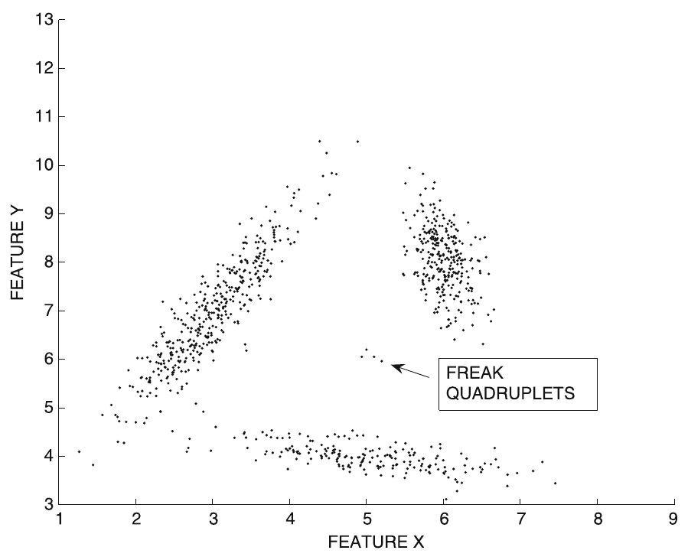
Instance-specific definition
The distance-based outlier score of an object x is its distance to its k^{th} nearest neighbor
In this example of a
small group of 4
outliers, we can set
k > 3

Slide 25
Problem: computational cost
The distance-based outlier score of an object x is its distance to its k^{th} nearest neighbor
In principle this requires O(n²) computations!
  Index structure:
  useful only for cases of low data dimensionality
  Pruning tricks:
  useful when only top-r outliers are needed

Slide 26
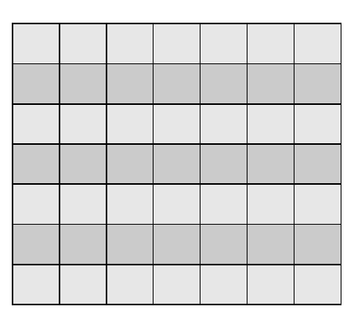
Problem: computational cost
The distance-based outlier score of an item x is its distance to its k^{th} nearest neighbor
In principle this requires:
  O(n²) computations for evaluating the n x n distance matrix
  O(n²) computations for finding the r smallest values on each row
n
n
Distance to k^{th} nearest neighbor

Slide 27
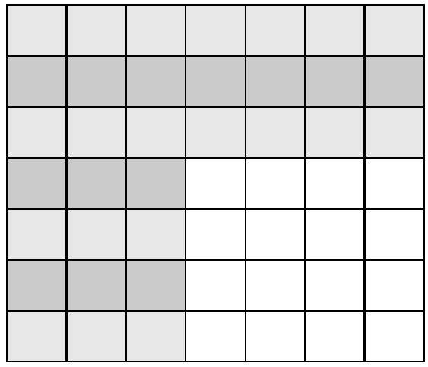
Pruning method: sampling
Evaluate s x n distances
For points
1...s we are OK
For points (s+1)...n we know only upper bounds
s
n

Slide 28
Pruning method: sampling (cont.)
From points
1...s we already know the r “winners”
(r≤s nodes with the larger distance to their k^{th} nearest neighbor)
Any point having
V_{k} < L_{s} cannot be among the top r outliers
s
n

Slide 29
Pruning method: sampling (cont.)
From points
1...s we already know the r “winners”
(r≤s nodes with the larger distance to their k^{th} nearest neighbor)
Any point having
V_{k} < L_{s} cannot be among the top r outliers
s
n

Slide 30
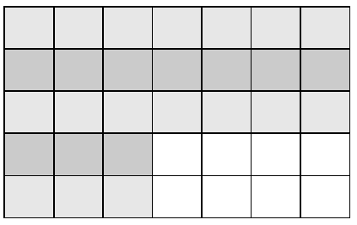
Pruning method: sampling (cont.)
Remove points
having
Update L_{r} keeping
r largest values, and
stop computing for a
row if one already finds
k nearest neighbors in that row that are all below distance L_{r}
s
n

Slide 31
Local outlier factor

Slide 32
Local Outlier Factor (LOF)
Let V_{k}(X) be the distance of X to its k-nearest neighbor
Reachability distance

Slide 33
Local Outlier Factor (LOF) (cont.)
V_{k}(X): distance of X to its k-nearest neighbor
Reachability distance
Not symmetric
Equal to simple distance for long distances
Smoothed by V_{k}(X)
for short distances
X
Y

Slide 34
Local Outlier Factor (LOF) (cont.)
Reachability distance
Average reachability distance
L_{k}(X) is the set of points within distance V_{k}(X) of X (might be more than k due to ties)

Slide 35
Local Outlier Factor (LOF) (cont.)
Local outlier factor Outlier score
Large for outliers, close to 1 for others

Slide 36
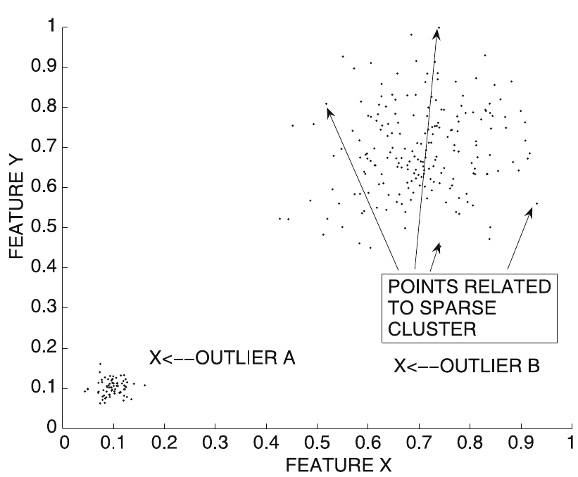
Local Outlier Factor (LOF) (cont.)
Local outlier factor
LOF values for points inside a cluster are close to one if cluster is homogeneous
LOF values much higher for outliers: they are computed in terms of average distances of near-by clusters

Slide 37
Try it! compare outlier score LOF(u), LOF(v)
a
u
b
v
0
1
2
3
4
5
6
Let k=2
LOF₂(u) = E[ {AR₂(u) /AR₂(a), AR₂(u)/AR₂(b)}] = _______
LOF₂(v) = E[ {AR₂(v) /AR₂(b), AR₂(v)/AR₂(u)}] = _______
AR₂(u) = E[ {R_{k}(u,a), R_{k}(u,b) }] = ______
AR₂(v) = E[ {R_{k}(v,b), R_{k}(v,u) }] = ______
AR₂(a) = E[ {R_{k}(a,u), R_{k}(a,b) }] = _____
AR₂(b) = E[ {R_{k}(b,u), R_{k}(b,a) }] = _____
R_{k}(a,u) = ____; R_{k}(a,b) = ____; R_{k}(b,u) = _____; R_{k}(b,a) = ______
R_{k}(u,a) = ____; R_{k}(u,b) = _____; R_{k}(v,b) = ______; R_{k}(v,u) = _____
V₂ = distance to 2nd nearest neighbor: V₂(u) = ____ ; V₂(v) = ____; V₂(a) = ____ ; V₂(b) = ____

Slide 38
Answer
a
u
b
v
0
1
2
3
4
5
6
Let k=2
LOF₂(u) = E[ {AR₂(u) /AR₂(a), AR₂(u)/AR₂(b)}] = (1.33+1.33)/2 = 1.33
LOF₂(v) = E[ {AR₂(v) /AR₂(b), AR₂(v)/AR₂(u)}] = (3+2.25)/2 = 2.63
AR₂(u) = E[ {R_{k}(u,a), R_{k}(u,b) }] = 2
AR₂(v) = E[ {R_{k}(v,b), R_{k}(v,u) }] = 4.5
AR₂(a) = E[ {R_{k}(a,u), R_{k}(a,b) }] = 1.5
AR₂(b) = E[ {R_{k}(b,u), R_{k}(b,a) }] = 1.5
R_{k}(a,u) = 1; R_{k}(a,b) = 2; R_{k}(b,u) = 1; R_{k}(b,a) = 2
R_{k}(u,a) = 2; R_{k}(u,b) = 2; R_{k}(v,b) = 4; R_{k}(v,u) = 5
V₂ = distance to 2nd nearest neighbor: V₂(u) = 1; V₂(v) = 5; V₂(a) = 2 ; V₂(b) = 2

Slide 39
Summary

Slide 40
Things to remember
Density-based methods
Isolation forest
Distance-based methods

Slide 41
Exercises for TT19-TT21
Data Mining, The Textbook (2015) by Charu Aggarwal
  Exercises 8.11 → all except 10, 15, 16, 17

