Slide 1

Mining Time Series:
Computing Similarity
Mining Massive Datasets
Prof. Carlos Castillo
Topic 28

Slide 2
Sources
Data Mining, The Textbook (2015) by Charu Aggarwal (chapter 14)
Introduction to Time Series Mining (2006) tutorial by Keogh Eamonn [alt. link]
Time Series Data Mining (2006) slides by Hung Son Nguyen

Slide 3
Using Euclidean distance on time series

Slide 4

Euclidean distance for time series
Euclidean distance between series y and z
Sensitive to noise (see previous slides on how to fix this)
Sensitive to different offsets, amplitudes, and trends
numpy.linalg.norm(y-z)
Slides on this section from: Introduction to Time Series Mining (2006) tutorial by Keogh Eamonn [alt. link]

Slide 5
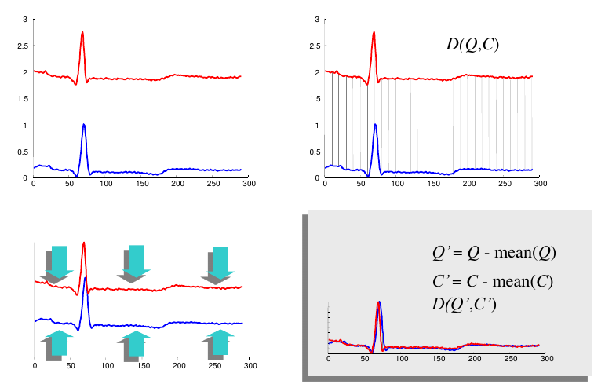
Offset translation: subtract the mean
d(y,z)
Series look different
series y
series z
Series look similar
y’ = y – avg(y)
z’ = z - avg(z)

Slide 6
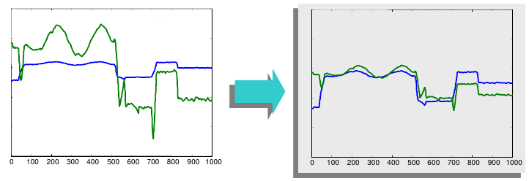
Amplitude scaling: normalize
d(y,z)
d(y’,z’)
— y
— z
— y’
— z’
Standardization
Range-based normalization

Slide 7
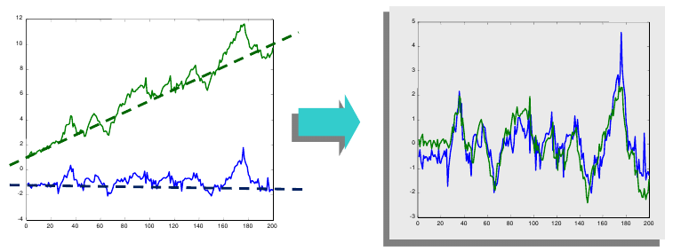
Trend removal: remove linear trend
d(y,z)
d(y’,z’)
— y
— z
— y’
— z’
1. Find best straight line fitting data
2. Subtract that line from the data

Slide 8
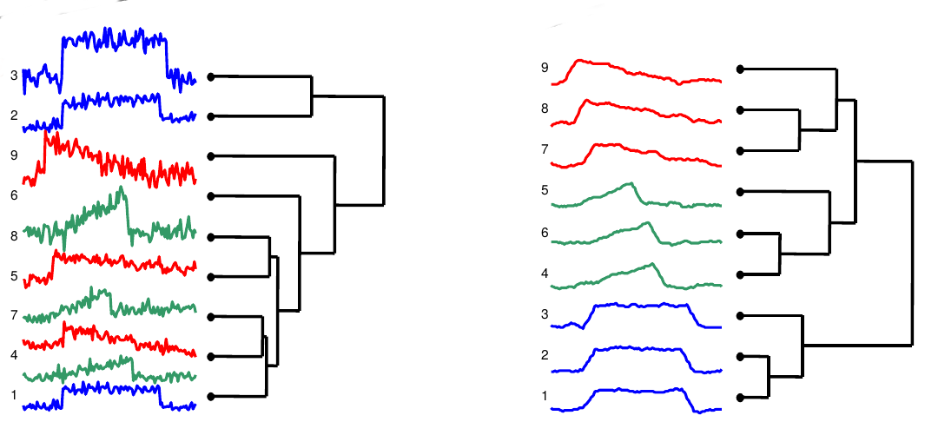
Example: clustering of time series after using smoothing, offset translation, amplitude scaling, and trend removal
Clustering using euclidean distance on original series
Clustering using euclidean distance on processed series

Slide 9
Dynamic time warping

Slide 10
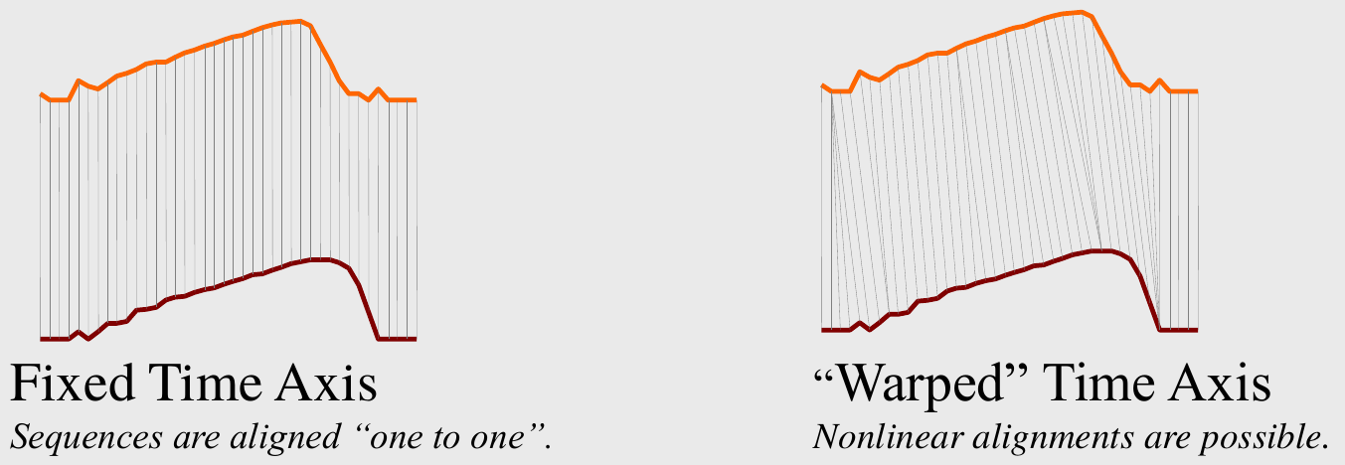
Dynamic time warping
Slides on this section from: Introduction to Time Series Mining (2006) tutorial by Keogh Eamonn [alt. link]

Slide 11
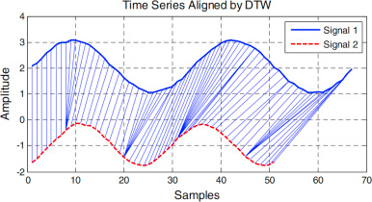
Dynamic time warping example
Image credits: Lu et al. 2016

Slide 12
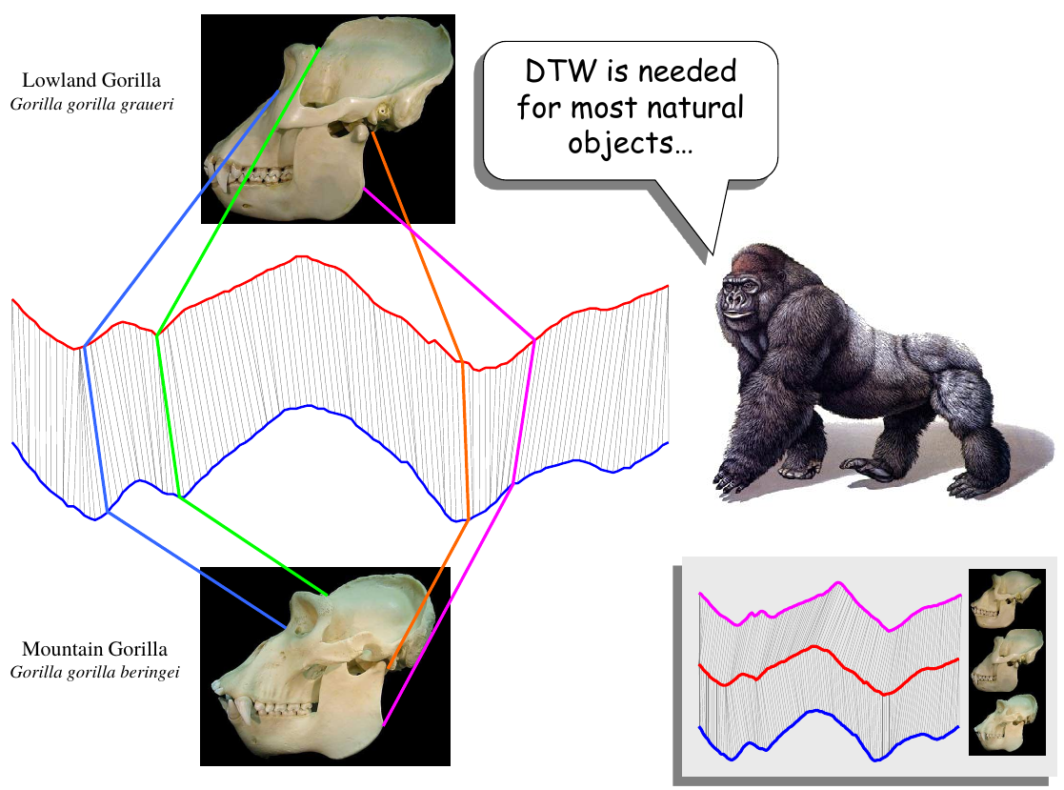

Slide 13
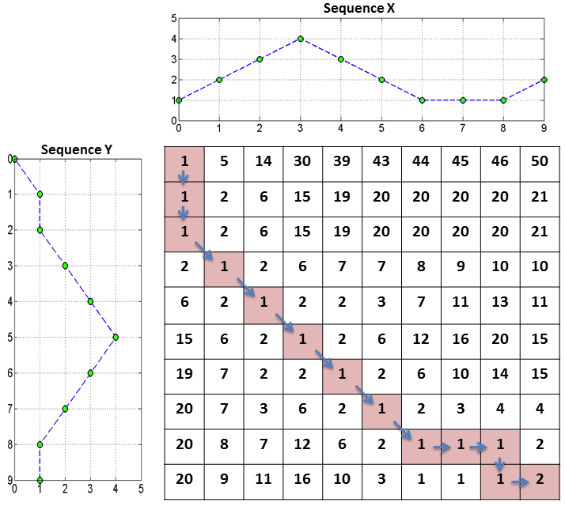
Computing DTW(X,Y)
Create a matrix M of size |X|×|Y|
Fill-in the matrix using dynamic programming
1 | 5 | 14 | 30
1 | 2 | 6 | 15
[Source]

Slide 14
Computing DTW(X,Y) (cont.)
Create a matrix M of size |X|×|Y|
Fill-in the matrix using dynamic programming
Find lighter path
Cell (a,b) in path ⇒ points a,b should be aligned
[Source]

Slide 15
Try it!
Compute the DTW for these two series
t | 1 | 2 | 3 | 4 | 5 | 6
Y_{t} | 2 | 5 | 2 | 5 | 3 | --
X_{t} | 0 | 3 | 6 | 0 | 6 | 1
Ko et al. 2008

Slide 16
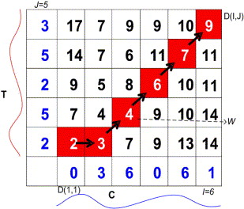
Answer
Y
X
Ko et al. 2008

Slide 17
Faster DTW through size reduction
How to avoid having a large matrix?
Use less points
  Sub-sample from original series
  Bin the original series
If sampling was done, after doing DTW:
  Interpolate warpings for intermediate points

Slide 18
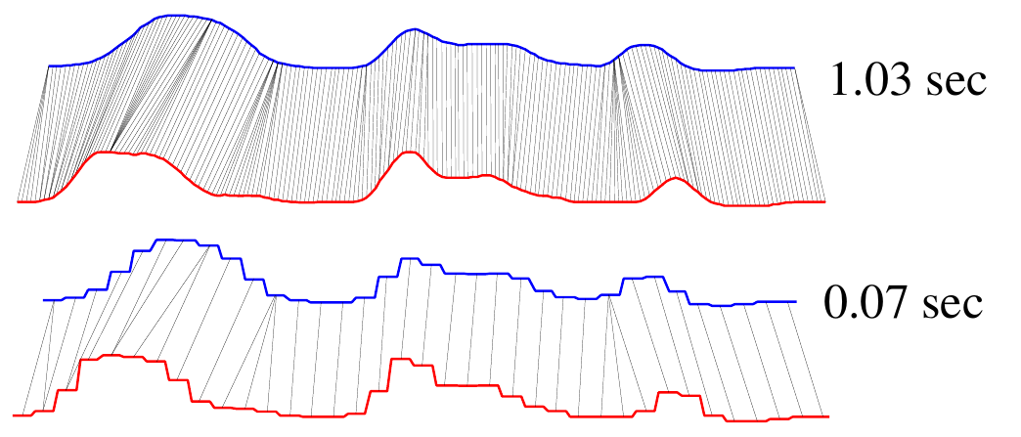
Example: faster DTW through sub-sampling

Slide 19
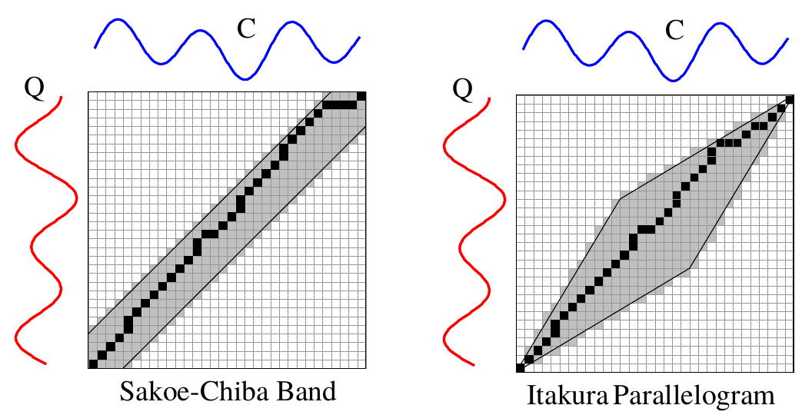
How to avoid pathological warpings?
Assume original series cannot be so far apart from each other, using domain knowledge

Slide 20
Summary

Slide 21
Things to remember
Dynamic time warping

Slide 22
Exercises for TT27-TT29
Data Mining, The Textbook (2015) by Charu Aggarwal
  Exercises 14.10 → 1-6

