Slide 1

Outlier Detection:
Extreme Values
Mining Massive Datasets
Prof. Carlos Castillo
Topic 19

Slide 2
Sources
Data Mining, The Textbook (2015) by Charu Aggarwal (chapter 8) – slides by Lijun Zhang

Slide 3
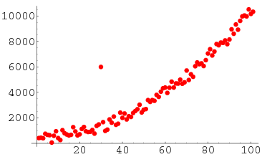

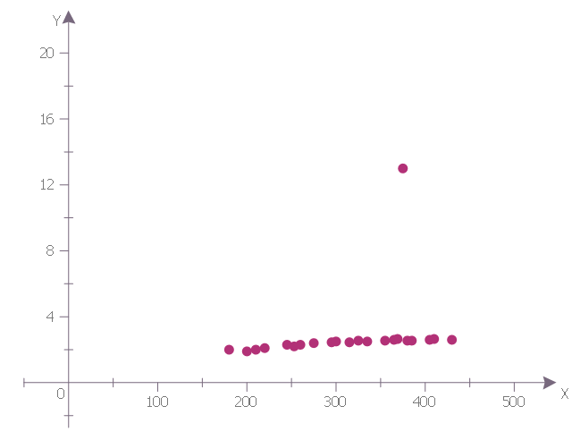

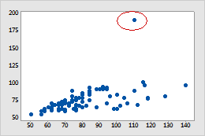
Outliers
Sultan Kösen
Serena Williams

Slide 4
What is an outlier?
Informally, “An outlier is an observation which deviates so much from the other observations as to arouse suspicions that it was generated by a different mechanism.”
  Clustering seeks to group points that are similar
  Outlier detection seeks points that are different from the remaining data

Slide 5

Outliers happen all the time
Sensor malfunction
Error in data transmission
Transcription error
Fraudulent behaviour
Sample contamination
Interesting natural occurrence

Slide 6
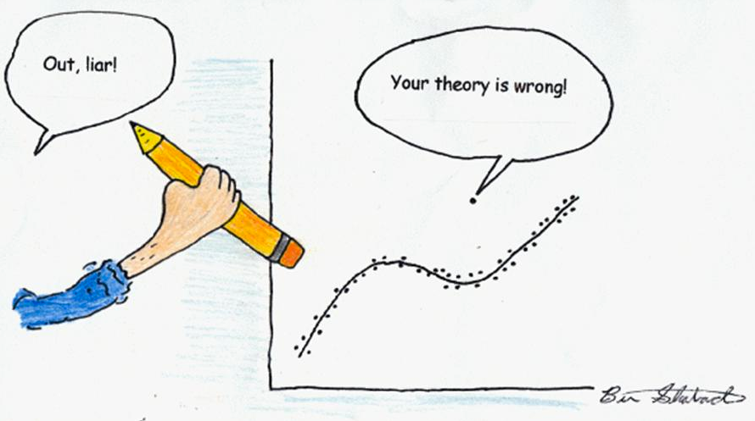

Slide 7
Some applications
Data cleaning
  Remove noise in data
Credit card fraud
  Unusual patterns of credit card activity
Network intrusion detection
  Unusual records/changes in network traffic

Slide 8
Outlier detection methods
Key idea
  Create a model of normal patterns
  Outliers are data points that do not naturally fit within this normal model
  The “outlierness” of a data point is quantified by a outlier score
Outputs of Outlier Detection Algorithms
  Real-valued outlier score
  Binary label (outlier / not outlier)

Slide 9
Evaluation
(outlier validity)

Slide 10
Internal (unsupervised) criteria
Rarely used in outlier analysis
For any method, a measure can be created that will favor that method (~overfit)
Solution space is small
  Maybe there is just one outlier, finding it or missing it makes all the difference between perfect and useless performance

Slide 11
External (supervised) criteria
Known outliers from a synthetic dataset or rare items (e.g., belonging to smallest class)
Suppose D is the data, G are the real outliers, and S(t) are found when threshold t is used

Slide 12
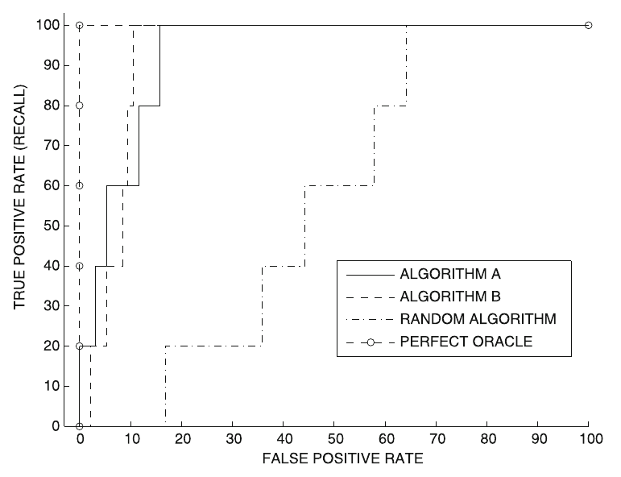
ROC curve = (FPR(t), TPR(t))_{t}
Rank of ground-truth outliers:
Algorithm A
  1, 5, 8, 15, 20
Algorithm B
  3, 7, 11, 13, 15
Random
  17, 36, 45, 59, 66
Perfect oracle
  1, 2, 3, 4, 5

Slide 13
Remainder of TT19-TT21:
Outlier detection methods

Slide 14
Extreme values analysis

Slide 15
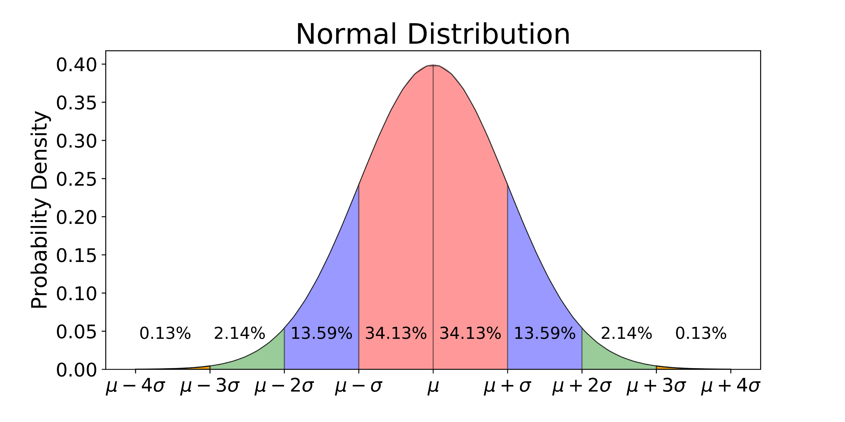
Extreme value analysis:
Statistical Tails

Slide 16
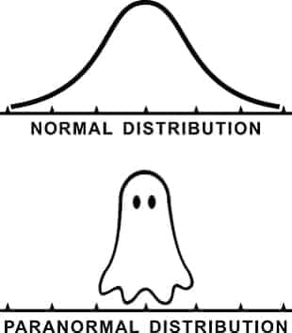
Sorry!

Slide 17
Extreme value analysis (cont.)
Hypothesis: all extreme
values are outliers
However, outliers may
not be extreme values:
  {1,3,3,3,50,97,97,100}
  1 and 100 are extreme values
  50 is an outlier but no an extreme value

Slide 18
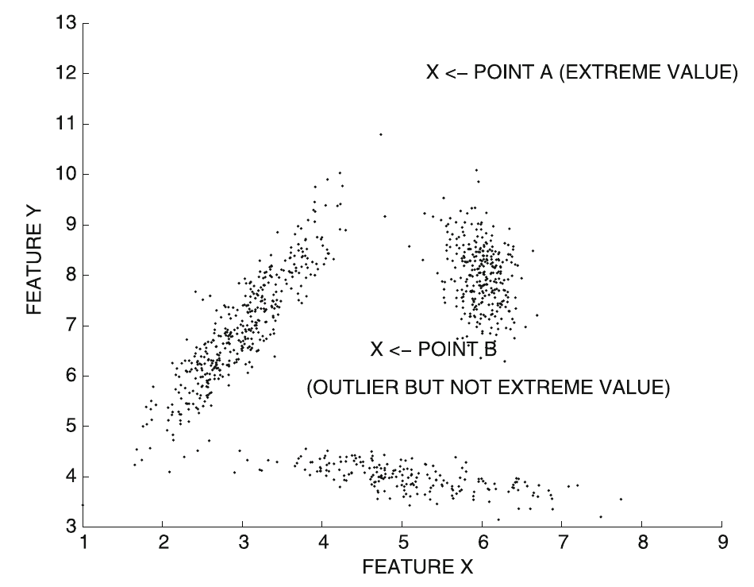
Extreme value analysis (cont.)
Point A is an extreme value (hence, an outlier)
Point B is an outlier but not an extreme value

Slide 19
Univariate extreme value analysis
Statistical tail confidence test
  Let density be f_{X}(x)
  Tails are extreme regions s.t. f_{X}(x) ≤ θ

Slide 20
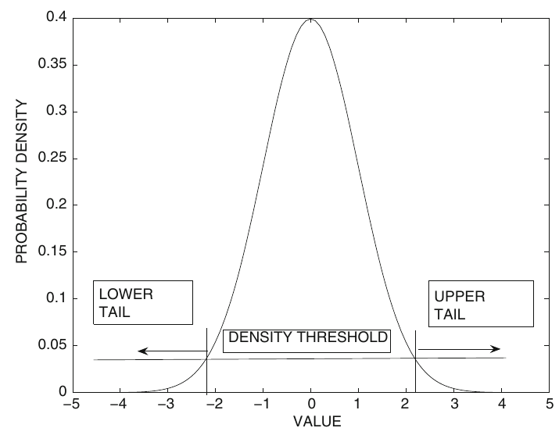
Univariate extreme value analysis (cont.)
Let density be f_{X}(x); tails are extreme regions s.t. f_{X}(x) ≤ θ
Symmetric distribution
  Two symmetric tails
  Areas inside tails represent cumulative distribution

Slide 21
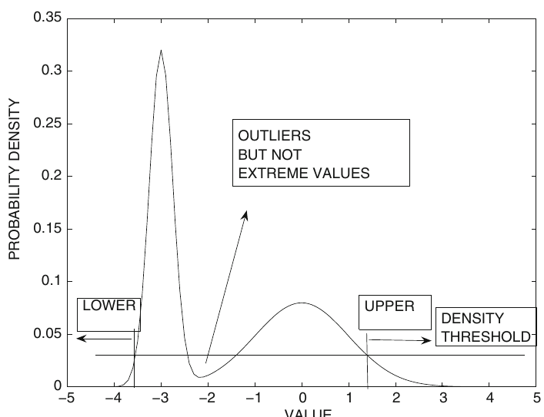
Univariate extreme value analysis (cont.)
Let density be f_{X}(x); tails are extreme regions s.t. f_{X}(x) ≤ θ
Asymmetric distribution
  Areas in two tails are different
  Regions in the interior are not tails

Slide 22
Standardization for univariate outlier analysis
Normal distribution assumed
Parameters
  From prior knowledge
  Estimated from data

Slide 23
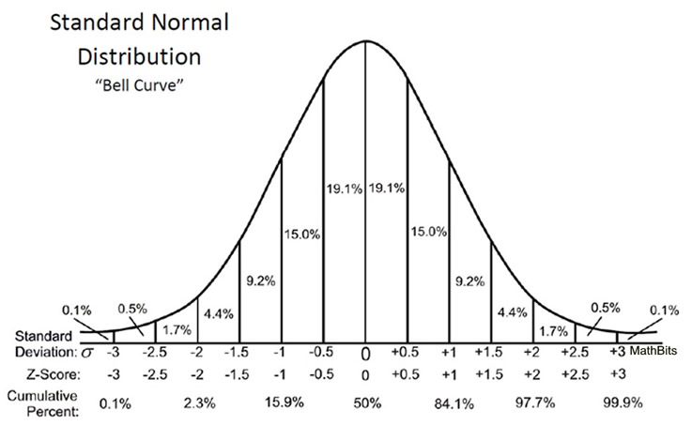
Standardization for univariate outlier analysis (cont.)
z-value
Follows normal distribution with mean 0 and standard deviation 1
  Large z-value: upper tail
  Small z-value: lower tail

Slide 24
Exercise
Answer in
Google Spreadsheet
Find the absolute z-score of each feature in the electrical scooters dataset
Compute max z-score across features as an outlier metric
Indicate which are the #1 and #2 most unusual electric scooters in this list and why

Slide 25
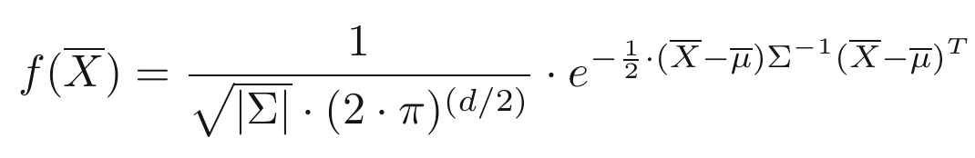
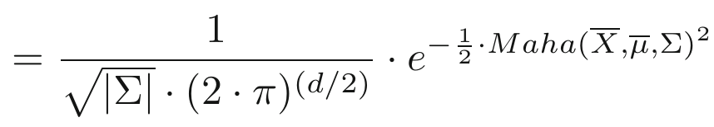
Multivariate extreme values
Probability density function of a Multivariate Gaussian distribution in d dimensions
Maha(X, μ, Σ) is the Mahalanobis distance
|Σ| is the determinant of the covariances matrix

Slide 26
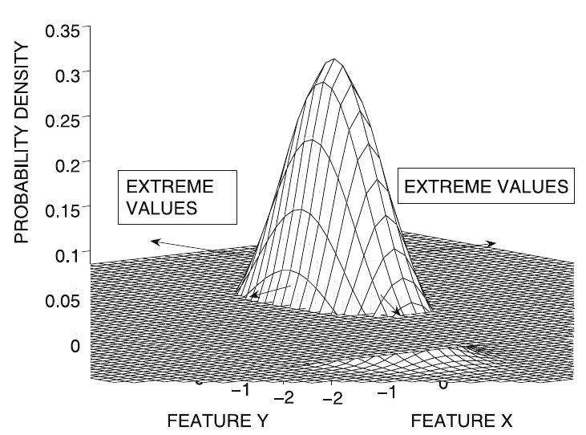
Multivariate extreme values (cont.)
Extreme value score of X
  Maha(X, μ, Σ)
  Mahalanobis distance to
  the mean of the data
  Larger values imply
  more extreme behavior

Slide 27
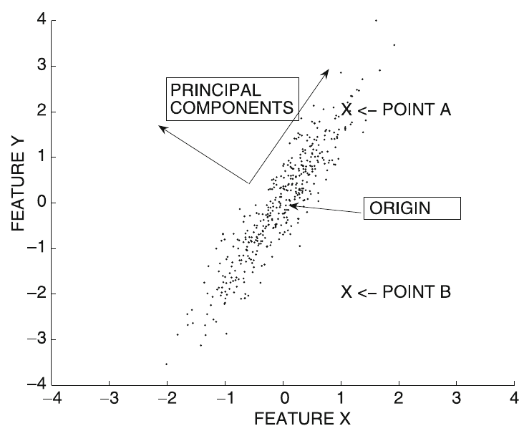
Multivariate extreme values (cont.)
Extreme value score of X
  Maha(X, μ, Σ)
  Mahalanobis distance to
  the mean of the data
  Larger values imply
  more extreme behavior
  The Mahalanobis distance is the Euclidean distance in a transformed (axes-rotated) data set after dividing each of the transformed coordinate values by the standard deviation along its direction

Slide 28
Depth-based methods

Slide 29
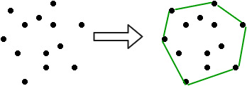
Key concept: convex hull
The convex hull of a set C is the set of
all convex combinations of points in C

Slide 30
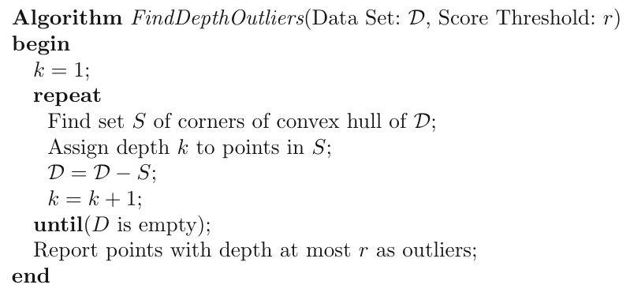
Algorithm

Slide 31
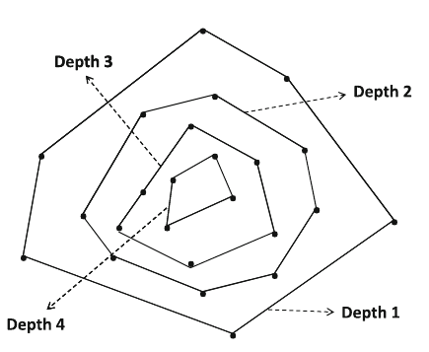
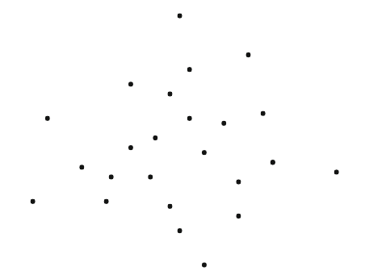
Explanation: peeling layers

Slide 32
Limitations of this method
How many outliers?
No normalization
Computational complexity increases significantly with dimensionality
Many data points are indistinguishable

Slide 33
Summary

Slide 34
Things to remember
Extreme value analysis
  Univariate, multivariate, depth based
Outlier evaluation/validity

Slide 35
Exercises for TT19-TT21
Data Mining, The Textbook (2015) by Charu Aggarwal
  Exercises 8.11 → all except 10, 15, 16, 17

