Slide 1

Mining Time Series
Mining Massive Datasets
Prof. Carlos Castillo
Topic 27

Slide 2
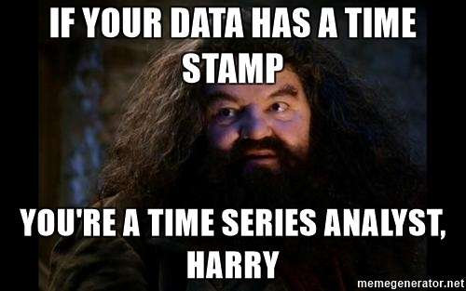

Slide 3
Sources
Data Mining, The Textbook (2015) by Charu Aggarwal (chapter 14)
Introduction to Time Series Mining (2006) tutorial by Keogh Eamonn [alt. link]
Time Series Data Mining (2006) slides by Hung Son Nguyen

Slide 4
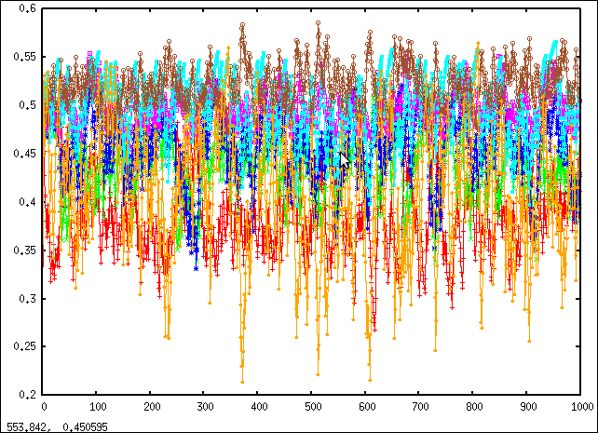
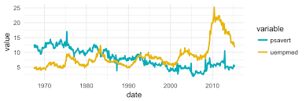
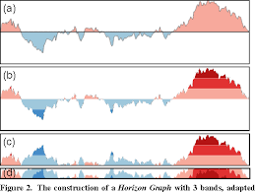
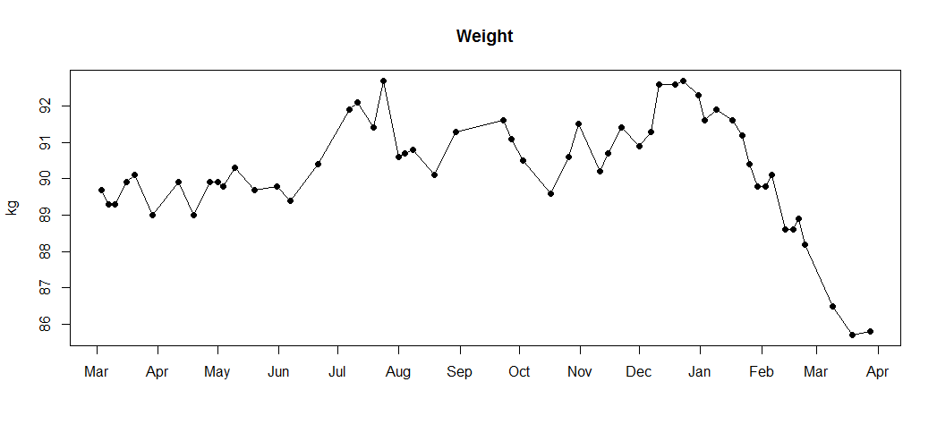
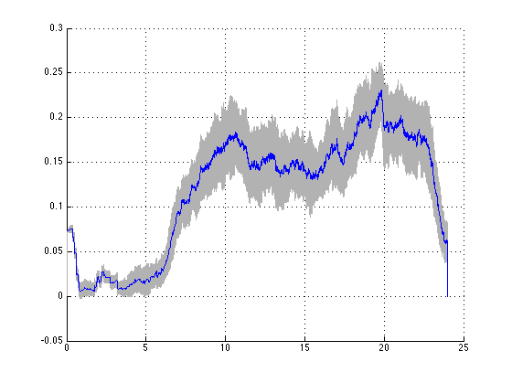
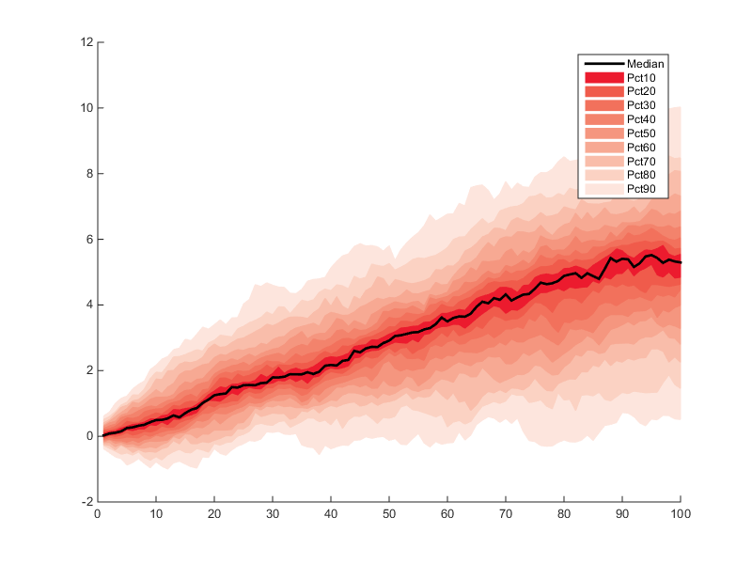
Why do we mine time series? Examples

Slide 5
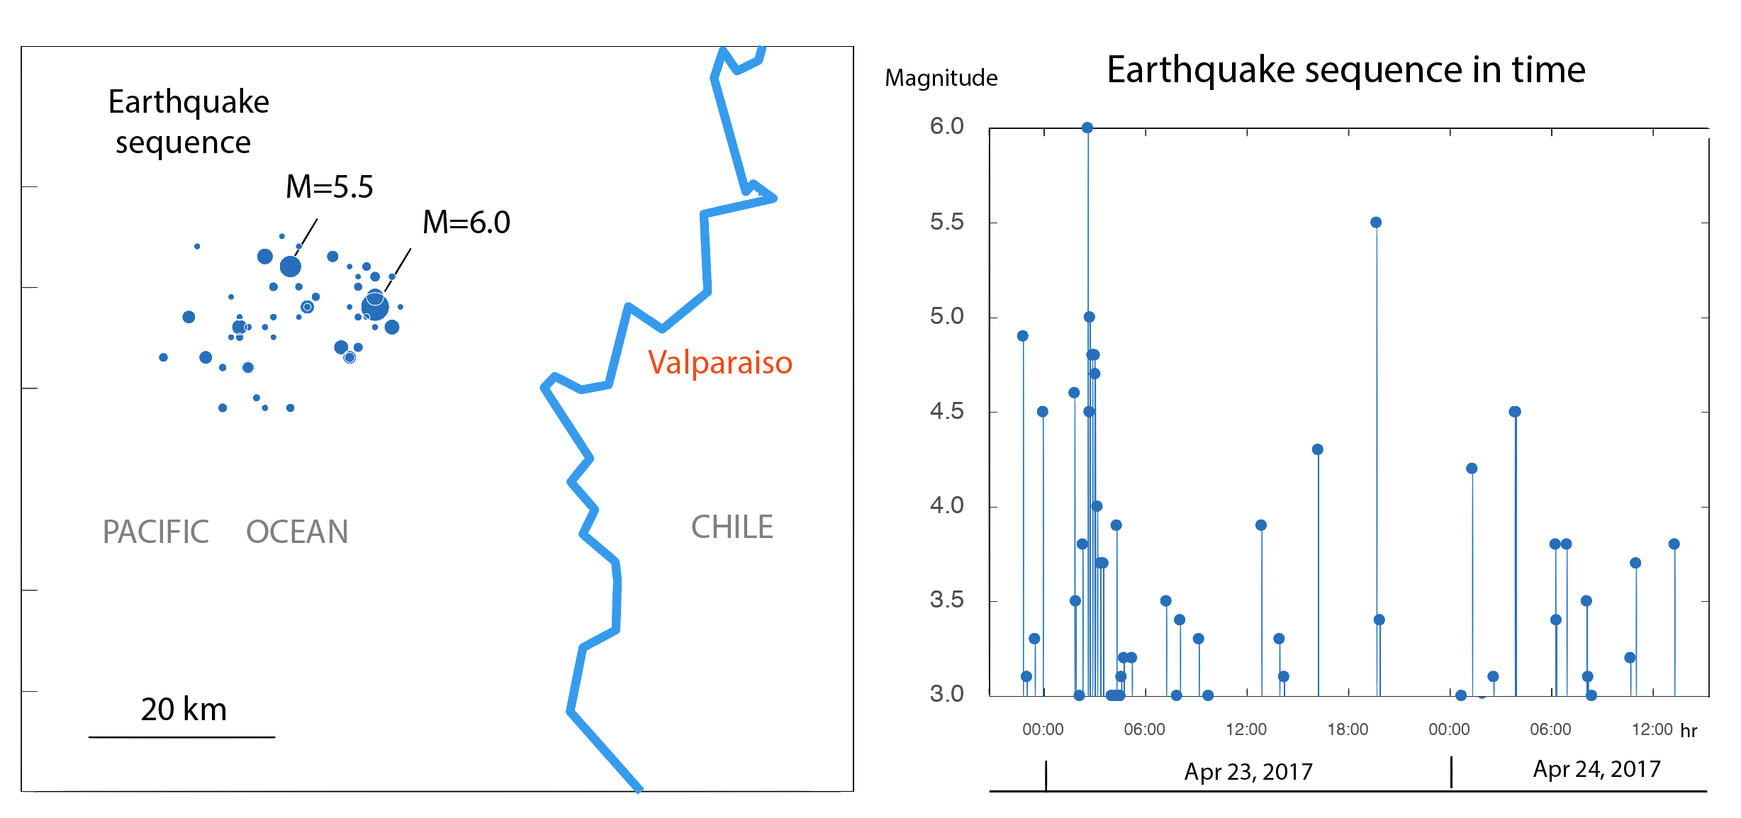
Seismic data
Observations = earthquakes
Goal: characterize when peeks occur

Slide 6
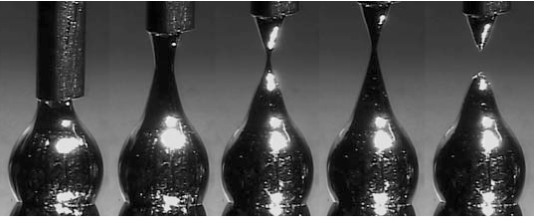
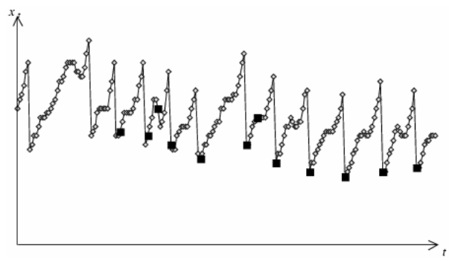
Liquid metal droplets
= length of hot metal droplet
= droplet release
  (chaotic, noisy)
Goal: prediction of release
Time Series Data Mining (2006) slides by Hung Son Nguyen

Slide 7
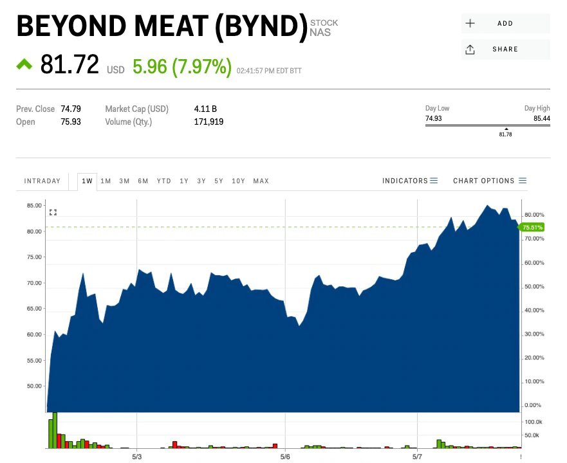
Stock prices
Price
Volume traded
Goal: find hidden patterns providing an advantage

Slide 8
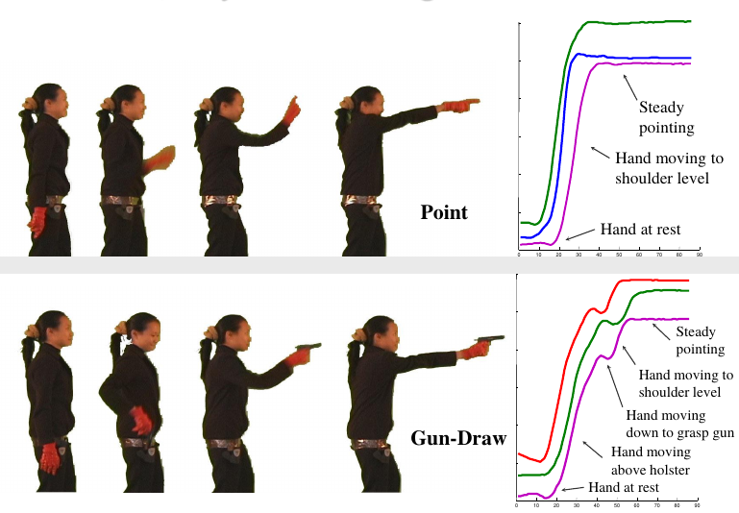
Video data / gestures
Series of angles of articulations in the body
Temporal patterns can reveal gestures
Introduction to Time Series Mining (2006) tutorial by Keogh Eamonn [alt. link]

Slide 9
Applications
Clustering
Classification
Motif discovery
Event detection
...
All require a reasonable definition of the similarity between two time series
All can be done in real-time or retrospectively

Slide 10
Context vs Behavior
Contextual attribute(s)
  x(i) = t_{i} = timestamp is the typical one
  Sometimes other attributes providing context
Behavioral attribute(s)
  y^{j}(i) = temperature, angle, price, sensor reading, …
  j ∊ 1 … d

Slide 11
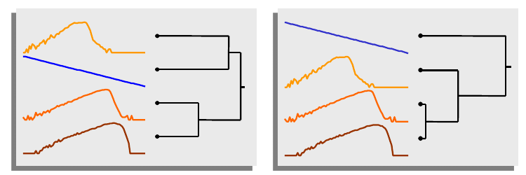
What are the difficulties?
High sampling rate of many series over extended periods of time means ...
  Tons of data
  Things are bound to fail at several points
  (missing data, noisy data)
Subjectivity
Introduction to Time Series Mining (2006) tutorial by Keogh Eamonn [alt. link]

Slide 12
Preparing a time series

Slide 13
Notation: multivariate time series
Length n, timestamps t₁, t₂, …, t_{n}
Values at time t_{i} : (y_{i}¹, y_{i}², …, y_{i}^{d})
If series is univariate we drop the superscript

Slide 14
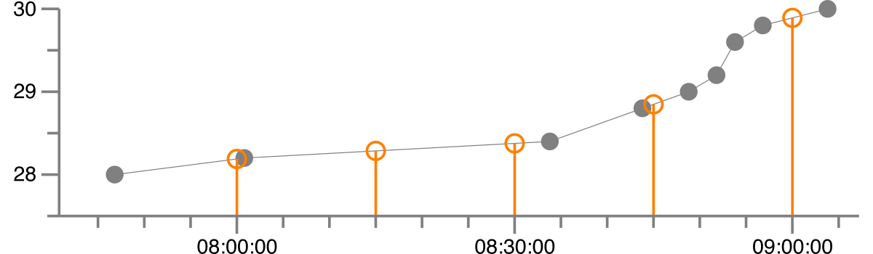
Missing values: linear interpolation
Let t_{i} < t_{x} < t_{j}
Example: make an irregular series regular

Slide 15
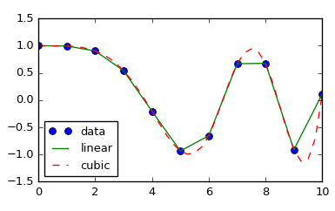
Missing values: splines
Cubic polynomials between y_{i}, y_{i+1} that have the same slope at those points as the original curve.
http://lagrange.univ-lyon1.fr/docs/scipy/0.17.1/tutorial/interpolate.html

Slide 16
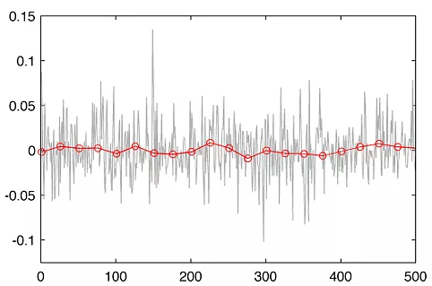
Noise removal: binning
Replace series by average of values in bins (subsequences) of length k
— original series
— binning with k=25
http://www.quantatrisk.com/2013/03/22/rebinning-of-financial-time-series/

Slide 17
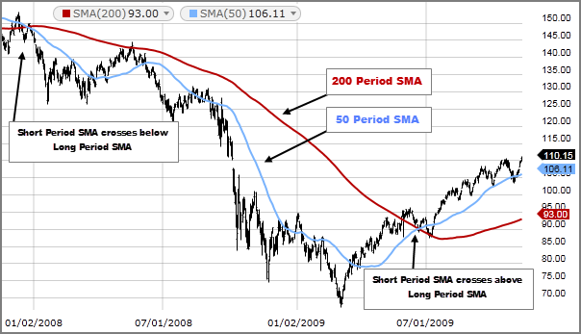
Noise removal: moving average smoothing
Equivalent to overlapping bins
Larger k leads to smoother series, but losses more
information
Use smaller k for first k-1 items
k=200
k=50
original
https://www.fidelity.com/learning-center/trading-investing/technical-analysis/technical-indicator-guide/sma

Slide 18
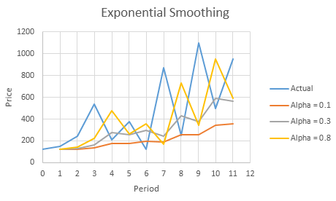
Noise removal: exponential smoothing
Combine previously
smoothed point with
current point
Recursively substituting
Which y’ has the
larger alpha?

Slide 19
Noise removal: exponential smoothing
Combine previously
smoothed point with
current point
Recursively substituting

Slide 20
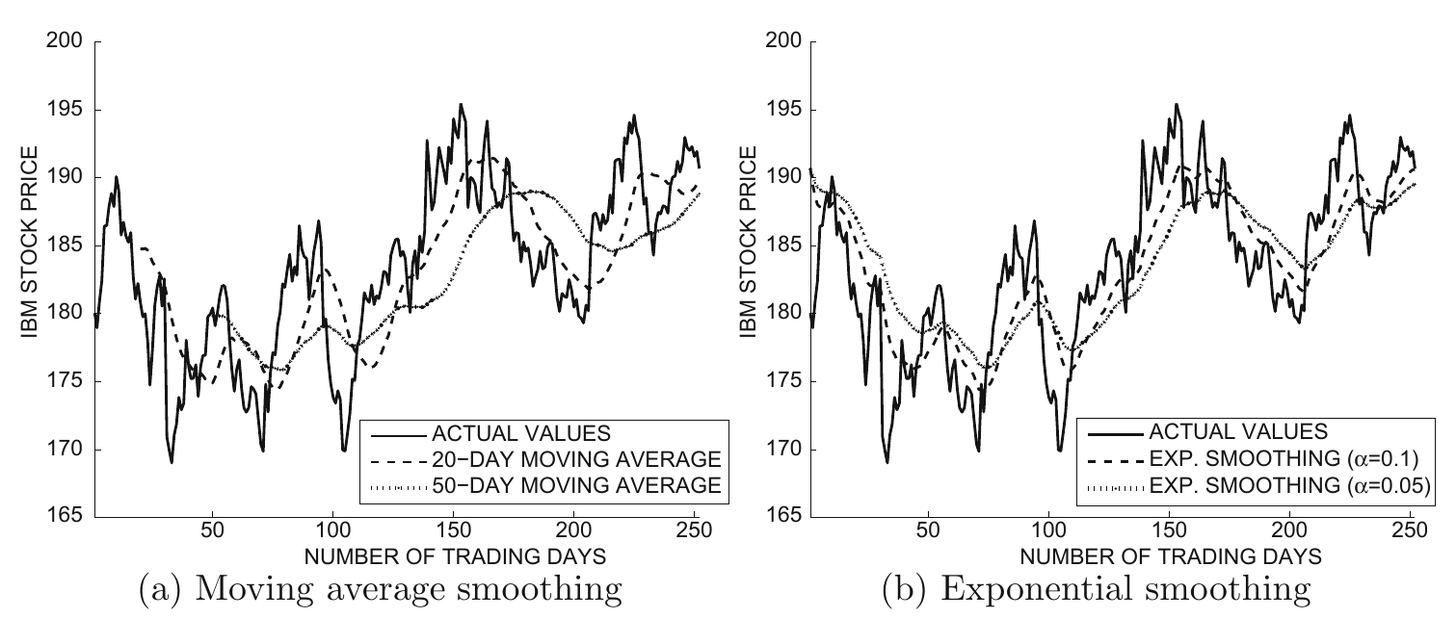
Moving average vs exponential smoothing

Slide 21
Exercise
Answer in
Google Spreadsheet
Given the following series:
1. Moving average with k=3
2. Exponential average with alpha=0.5
t | 1 | 2 | 3 | 4 | 5 | 6 | 7 | 8 | 9 | 10
y(t) | 2 | 4 | 12 | 2 | 1 | -2 | 0 | 15 | 3 | 3
1. y’(t)
2. y’(t)

Slide 22
Answer
Given the following series:
y_{t}’: moving average with k=3
y_{t}’’: exponential average with alpha=0.5
t | 1 | 2 | 3 | 4 | 5 | 6 | 7 | 8 | 9 | 10
y_{t} | 2 | 4 | 12 | 2 | 1 | -2 | 0 | 15 | 3 | 3
y_{t}’ | 2 | 3 | 6 | 6 | 5 | 0.33 | -0.33 | 4.33 | 6 | 7
y_{t}’’ | 2 | 3 | 7.5 | 4.75 | 2.88 | 0.44 | 0.22 | 7.61 | 5.30 | 4.15

Slide 23

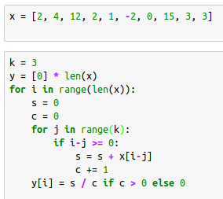
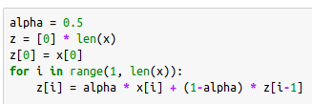
Answer (code)

Slide 24
Summary

Slide 25
Things to remember
Series preparation
  Interpolation
  Smoothing

Slide 26
Exercises for TT27-TT29
Data Mining, The Textbook (2015) by Charu Aggarwal
  Exercises 14.10 → 1-6

