Slide 1
Resit exam questions
(sample)

Slide 2
Resit exam (sample)
This was an oral resit exam
Students had to answer ~20 questions in ~20-25 minutes
Questions were chosen at random by throwing a dice, advancing the number shown on the dice, and asking that question, then throwing the dice again, and so on ...

Slide 3
Exam protocol
Choose language es/ca/en
We are recording now, the recording will stay in the platform with access only to me, me unless the university authorities request it for some reason
Please place your mobile in airplane mode (unless you’re using it for communicating with me)
Please briefly show me the room where you are giving your exam
Please briefly share with me (“present”) your entire computer screen
We will start with a topic you think you’ve studied more, then we will go back to slide #3 and roll the dice to determine each question; if we land on a question you’ve already answered or a non-question slide, I ask you the next one; if we get to the end we restart
I’ll ask you questions for 20 minutes starting now – pick the initial topic please

Slide 5
TT02 Data, methods, scenarios
Is ordinal a type of categorical data?
Why or why not?

Slide 6
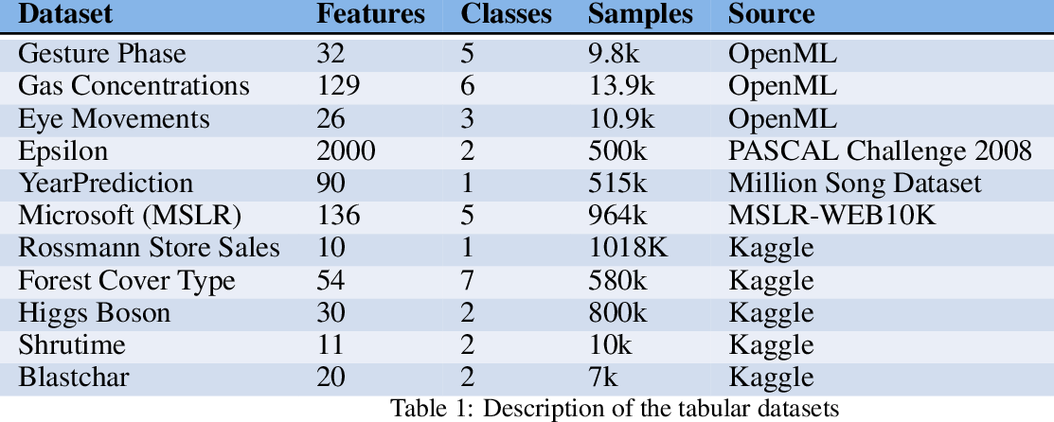
TT02 Data, methods, scenarios
If you use one-hot encoding for “Source” and remove the original column, how many columns will the resulting table have?

Slide 7
TT03. Data preparation: data types
How would you convert a numerical variable into an ordinal variable?

Slide 8
TT03. Data preparation: data types
Suppose data are:
-10, -6, -1, 4, 20, 30
Divide into three equi-width bins
(none of the bins can be empty).
Divide into three equi-depth bins.

Slide 9
TT04. Data prep.: integration & cleaning
What is a set membership constraint?
Give an example

Slide 10
TT04. Data prep.: integration & cleaning
Name two reasons why we perform data cleaning

Slide 11
TT04. Data prep.: integration & cleaning
Give an example of cross-field validation

Slide 12
TT04. Data prep.: integration & cleaning
Suppose in a sample of people from Catalonia the city is missing for 10% of the people
How would you decide whether to impute city=Barcelona or drop the rows without city?

Slide 13
TT04. Data prep.: integration & cleaning
What is standardization?

Slide 14
TT04. Data prep.: integration & cleaning
We have a variable taking values {-3, 0, 3}
Normalize by using min-max scaling

Slide 15
TT04. Data prep.: integration & cleaning
Describe clearly how to perform seasonal standardization

Slide 16
TT05. Reduction and transformation
Suppose a population contains 10 people from Barcelona and 5 from Madrid. Describe how to sample 4 elements using stratified sampling by city

Slide 17
TT06. Similarity on numerical data
Explain what is the curse of dimensionality

Slide 18
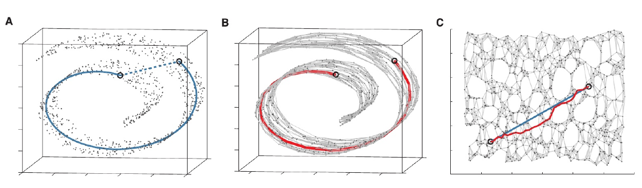
TT06. Similarity on numerical data
Explain how ISOMAP works

Slide 19
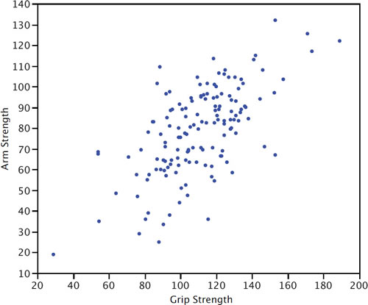
TT06. Similarity on numerical data
The Mahalanobis distance would consider that
d(A,B) < d(A,C) or d(A,B) > d(A,C) ?
B
A
C

Slide 20
TT07. Similarity: beyond numerical
Write and explain the formula for the Goodall measure

Slide 21
TT07. Similarity: beyond numerical
Compute the Jaccard distance between these two sets:
{apple, banana}
{tomato, banana}

Slide 22
TT08. Near duplicates
Explain the principle behind min hashing,
and give an example

Slide 23
TT08. Near duplicates
How many different 2-word-gram shingles are contained in the phrase “to be or not to be”?

Slide 24
TT08. Near duplicates
Permutation π
Rows=Shingles, Columns=Documents
D1 D2 D3 D4
2
3
6
4
1
5
0
0
0
1
Compute the signature vector under π
1
0
1
1
D1 D2 D3 D4
1
1
0
1
0
1
0
1
0
0
0
1
1
0
0
0

Slide 25
TT08. Near duplicates
What is the similarity between each pair of documents, in this signature matrix?
D1 D2 D3 D4
1
1
2
2
π₁
π₂
2
3
3
2
5
5
4
5
π₃

Slide 26
TT11. Itemsets
Give 3 examples of transactions
from 3 different application domains

Slide 27
TT11. Itemsets
What is the maximum possible support of an itemset that exists in a database?

Slide 28
TT11. Itemsets
Indicate the support of the itemset
“Scissor, Eraser”
tid | Set of items
1 | Pencil, Eraser, Paper
2 | Scissors, Eraser
3 | Pencil, Scissors
4 | Eraser, Paper, Scissors
5 | Pencil, Highlighter, Eraser

Slide 29
TT11. Itemsets
Explain the support monotonicity property using as example the itemset {“Eraser”}
tid | Set of items
1 | Pencil, Eraser, Paper
2 | Scissors, Eraser
3 | Pencil, Scissors
4 | Eraser, Paper, Scissors
5 | Pencil, Highlighter, Eraser

Slide 30
TT11. Itemsets
What is a closed itemset?

Slide 31
TT11. Itemsets
What is a maximal itemset?

Slide 32
TT11. Itemsets
What is a closed itemset in this database?
What is a non closed itemset in this database?
tid | Set of items
1 | Pencil, Eraser, Paper
2 | Scissors, Eraser
3 | Pencil, Scissors
4 | Highlighter, Paper, Scissors
5 | Pencil, Highlighter, Eraser

Slide 33
TT11. Itemsets
Draw an itemset lattice for the following transactions:
TID | Items
1 | Tomato, Pear
2 | Strawberry, Pear, Apple
3 | Apple, Pear
4 | Apple, Strawberry, Tomato, Pear

Slide 34
TT12. Association rules
What does it mean if the lift of a rule is
smaller than 1.0?

Slide 35
TT13. Association rule mining
Explain the apriori algorithm on this dataset, with minsup=0.5
Tip: first write a table with itemsets of size 1 (itemset, support)
tid | Set of items
1 | x1 x2 x3
2 | x2 x3 x4
3 | x4 x5
4 | x1 x2 x4
5 | x1 x2 x3 x5
6 | x1 x2 x3 x4

Slide 36
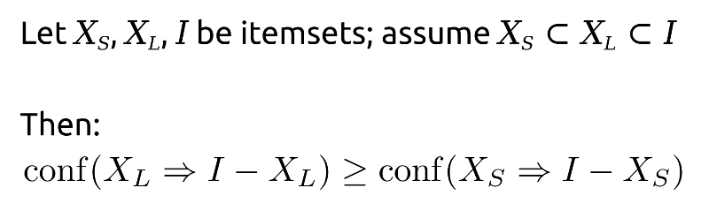
TT13. Association rule mining
Explain the confidence monotonicity property

Slide 37
TT16. Recommender systems
What is the difference between explicit and implicit preferences in an utility matrix? Give some examples.

Slide 38
TT17. Recommender systems
What does it mean cold-start in a recommender system?

Slide 39



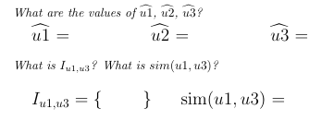
TT17. Recommender systems

Slide 40
TT18. Factorization-based recsys
What is the objective function in an factorization-based recommender system?

Slide 41
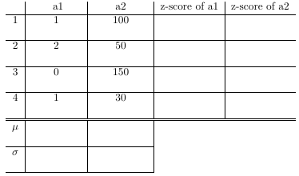


TT19. Outlier detection
Use the method based on
z-scoring

Slide 42
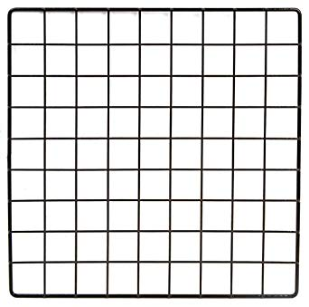
TT21. Outlier detection
Indicate how do you create an isolation forest over the graph on the right
Explain what the outlier score for a point depends on (no need to give a formula)
1 2 3 4 5 6 7 8 9
1 2 3 4 5 6 7 8 9
b
c
d
e
a
g
f

Slide 43
TT22. Streams
Suppose we have a stream of the type (a, b) indicating that user a purchased book b
Indicate how to sample 1% of the users and the books they have bought from this stream

Slide 44
TT22. Streams
Suppose we have a stream of photos from a photo sharing site
Indicate how to sample 10 photos from this stream uniformly at random

Slide 45
TT23. Streams
Explain how reservoir sampling works

Slide 46
TT24. Bloom filters
In a bloom filter, why would we sometimes want to increase the number of bits of the filter?

Slide 47
TT24. Bloom filters
When a bloom filter says an object
is not a member of a set, it is:
(a) always right (b) sometimes right
When a bloom filter says an object
is a member of a set, it is:
(a) always right (b) sometimes right

Slide 48
TT27. Time series
Interpolate the following time series using linear interpolation to obtain the values on Monday at midnight and Tuesday at noon
Monday 12:00 – 36ºC
Monday 23:59 – ???
Tuesday 06:00 – 30ºC
Tuesday 12:00 – ???
Tuesday 18:00 – 35ºC

Slide 49
TT27. Time series
Compute a moving average with k=3 in the following series:
t | 1 | 2 | 3 | 4 | 5
y_{t} | 1 | 5 | 67 | 10 | 23

Slide 50
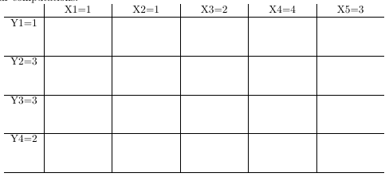
TT27. Time series
Consider series
X = 1, 1, 2, 4, 3
Y = 1, 3, 3, 2
Draw a table like this on paper and calculate the alignment path

