Slide 1

Association Rules Mining
Mining Massive Datasets
Carlos Castillo
Topic 13

Slide 2
Sources
Data Mining, The Textbook (2015) by Charu Aggarwal (Chapters 4, 5) – slides by Lijun Zhang
Mining of Massive Datasets 2nd edition (2014) by Leskovec et al. (Chapter 6) - slides
Data Mining Concepts and Techniques, 3rd edition (2011) by Han et al. (Chapter 6)
Introduction to Data Mining 2nd edition (2019) by Tan et al. (Chapters 5, 6) – slides ch5, slides ch6

Slide 3
Association rule
Let X, Y be two itemsets; the rule X⇒Y is an association rule of minimum support minsup and minimum confidence minconf if:
sup(X⇒Y) ≥ minsup
and
conf(X⇒Y) ≥ minconf

Slide 4
Association rule mining framework
In the first phase, all the frequent itemsets are generated at the minimum support of minsup
  The most difficult (computationally expensive) step
In the second phase, the association rules are generated from the frequent itemsets at the minimum confidence level of minconf
  Relatively straightforward

Slide 5
A straightforward implementation of the second phase
For each frequent itemset I // sup(I) ≥ minsup
  For each possible partition X, Y = I – X
    Check if conf(X⇒Y) ≥ minconf
Use the confidence monotonicity property (next slide) to reduce search space

Slide 6
Confidence monotonicity property
Let X_{S}, X_{L}, I be itemsets; assume X_{S} ⊂ X_{L} ⊂ I
Then:

Slide 7
Exercise: prove conf. monotonicity
Tip: start from what you want to prove:
1. Use the definition of confidence on this
2. Try to arrive to
which we know is true because
Answer in
Nearpod Collaborate

Slide 8
Proof: confidence monotonicity property
Let X_{S}, X_{L}, I be itemsets and X_{S} ⊂ X_{L} ⊂ I

Slide 9
Brute-force itemset mining algorithms

Slide 10
Naïve approach
Generate all candidate itemsets (2^{|U|} of them)
  Not practical, U=1000 ⇒ more than 10³⁰⁰ itemsets
Calculate sup(I) for every itemset
Key observation
  If no k-itemsets are frequent
  No (k+1)-itemsets are frequent

Slide 11
Improved approach
Start with k=1
Generate all k-itemsets
Determine sup(I)
If no k-itemset has sup(I) ≥ minsup, stop
Otherwise, k ← k+1 and repeat

Slide 12
Improved approach is a significant improvement
Let l be the final value of k
For |U| = 1000, l=10, this is ≃ 10²³

Slide 13
Further improvements to brute-force method
Reducing the size of the explored search space (lattice) by pruning candidate itemsets (lattice nodes) using tricks, such as the downward closure property
Counting the support of each candidate more efficiently by pruning transactions that are known to be irrelevant for counting a candidate itemset
Using compact data structures to represent either candidates or transaction databases that support efficient counting

Slide 14
The Apriori Algorithm

Slide 15
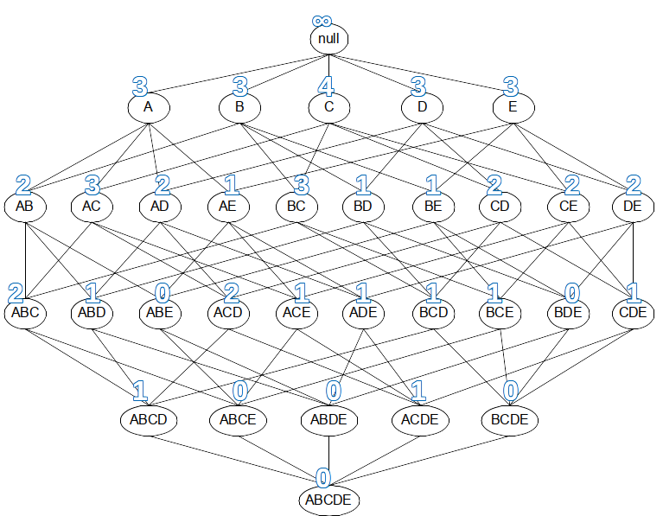
Apriori algorithm principle
Downward closure property: every subset of a frequent itemset is also frequent
Conversely, if an itemset has a subset that is not frequent, the itemset cannot be frequent
What are subsets in the lattice?

Slide 16
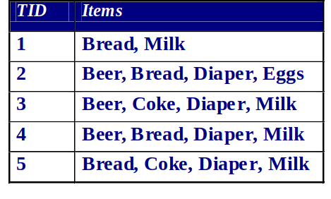
Example
Items (1-itemsets)
Item | Count
Bread | 4
Coke | 2 | X
Milk | 4
Beer | 3
Diaper | 4
Eggs | 1 | X
Minimum Support = 3
Introduction to Data Mining 2nd edition (2019) by Tan et al. (Chapters 5, 6) – slides ch5, slides ch6

Slide 17
Example
Items (1-itemsets)
Item | Count
Bread | 4
Coke | 2 | X
Milk | 4
Beer | 3
Diaper | 4
Eggs | 1 | X
Minimum Support = 3
Introduction to Data Mining 2nd edition (2019) by Tan et al. (Chapters 5, 6) – slides ch5, slides ch6

Slide 18
Example (cont.)
Items (1-itemsets)
Item | Count
Bread | 4
Coke | 2 | X
Milk | 4
Beer | 3
Diaper | 4
Eggs | 1 | X
Pairs (2-itemsets)
Item | Count
{Bread, Milk} | 3
{Beer, Bread} | 2 | X
{Bread, Diaper} | 3
{Beer, Milk} | 2 | X
{Diaper, Milk} | 3
{Beer, Diaper} | 3
Minimum Support = 3
Introduction to Data Mining 2nd edition (2019) by Tan et al. (Chapters 5, 6) – slides ch5, slides ch6

Slide 19
Example (cont.)
Items (1-itemsets)
Item | Count
Bread | 4
Coke | 2 | X
Milk | 4
Beer | 3
Diaper | 4
Eggs | 1 | X
Pairs (2-itemsets)
Item | Count
{Bread, Milk} | 3
{Beer, Bread} | 2 | X
{Bread, Diaper} | 3
{Beer, Milk} | 2 | X
{Diaper, Milk} | 3
{Beer, Diaper} | 3
Minimum Support = 3
Introduction to Data Mining 2nd edition (2019) by Tan et al. (Chapters 5, 6) – slides ch5, slides ch6

Slide 20
Example (cont.)
Items (1-itemsets)
Item | Count
Bread | 4
Coke | 2 | X
Milk | 4
Beer | 3
Diaper | 4
Eggs | 1 | X
Pairs (2-itemsets)
Item | Count
{Bread, Milk} | 3
{Beer, Bread} | 2 | X
{Bread, Diaper} | 3
{Beer, Milk} | 2 | X
{Diaper, Milk} | 3
{Beer, Diaper} | 3
Triplets (3-itemsets)
Item | Count
{Bread, Diaper, Milk} | 2 | X
{Beer, Bread, Diaper} | 2 | X
{Bread, Diaper, Milk} | 2 | X
{Beer, Bread, Milk} | 1 | X
Minimum Support = 3
Introduction to Data Mining 2nd edition (2019) by Tan et al. (Chapters 5, 6) – slides ch5, slides ch6

Slide 21
Example (cont.)
Items (1-itemsets)
Item | Count
Bread | 4
Coke | 2 | X
Milk | 4
Beer | 3
Diaper | 4
Eggs | 1 | X
Pairs (2-itemsets)
Item | Count
{Bread, Milk} | 3
{Beer, Bread} | 2 | X
{Bread, Diaper} | 3
{Beer, Milk} | 2 | X
{Diaper, Milk} | 3
{Beer, Diaper} | 3
Triplets (3-itemsets)
Item | Count
{Bread, Diaper, Milk} | 2 | X
{Beer, Bread, Diaper} | 2 | X
{Bread, Diaper, Milk} | 2 | X
{Beer, Bread, Milk} | 1 | X
Minimum Support = 3, found 8 frequent itemsets
Introduction to Data Mining 2nd edition (2019) by Tan et al. (Chapters 5, 6) – slides ch5, slides ch6

Slide 22
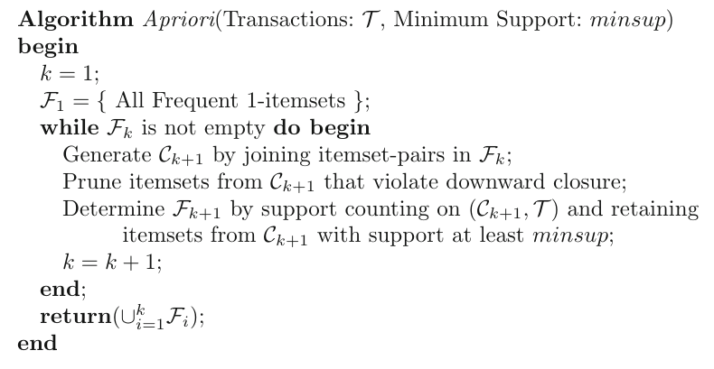
Pseudocode of Apriori
(1) Generation
(2) Pruning
(3) Support counting

Slide 23
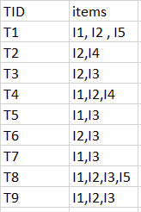
Exercise: Apriori
Answer in
Google Spreadsheet
Use the Apriori algorithm to obtain all rules of the form {a,b}→{c} having
minimum support = 2
and
confidence >= 50%
Note: to generate only rules of the form {a,b}→{c}, use only the itemsets of size 3

Slide 24
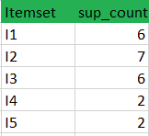
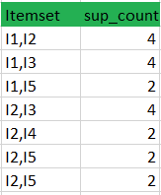

Answer
Example rules for itemset {I1, I2, I3}
[I1,I2]⇒[I3] //confidence = sup(I1,I2,I3)/sup(I1^I2) = 2/4*100=50%
[I1,I3]⇒[I2] //confidence = sup(I1,I2,I3)/sup(I1^I3) = 2/4*100=50%
[I2,I3]⇒[I1] //confidence = sup(I1,I2,I3)/sup(I2^I3) = 2/4*100=50%
[I1]⇒[I2,I3] //confidence = sup(I1,I2,I3)/sup(I1) = 2/6*100=33%
[I2]⇒[I1,I3] //confidence = sup(I1,I2,I3)/sup(I2) = 2/7*100=28%
[I3]⇒[I1,I2] //confidence = sup(I1,I2,I3)/sup(I3) = 2/6*100=33%
Itemset {l1,l2,l5} is done in an analogous manner.
Source: https://www.geeksforgeeks.org/apriori-algorithm/

Slide 25
Summary

Slide 26
Things to remember
Support and confidence on a rule
Downward closure property
  every subset of a frequent itemset is also frequent
  hence, if an itemset X has a subset that is not frequent, X cannot be frequent
Apriori algorithm

Slide 27
Exercises for TT13-TT14
Data Mining, The Textbook (2015) by Charu Aggarwal
  Exercises 4.9 → 9-10
Mining of Massive Datasets 2nd edition (2014) by Leskovec et al.
  Exercises 6.2.7 → 6.2.5 and 6.2.6
Introduction to Data Mining 2nd edition (2019) by Tan et al.
  Exercises 5.10 → 9-12

