Slide 1

Extending Association Analysis
Mining Massive Datasets
Carlos Castillo
Topic 15

Slide 2
Sources
Data Mining, The Textbook (2015) by Charu Aggarwal (Chapters 4, 5)
  See slides by Lijun Zhang
Introduction to Data Mining 2nd edition (2019) by Tan et al. (Chapter 6)
  See slides ch6

Slide 3
Alternative to minsup itemsets and minconf rules: interesting itemsets and rules

Slide 4
Advantages of frequent itemsets
Simple and intuitive
  Support computed from frequency
  Confidence computed from conditional probabilities
Efficient
  Downward closure property enables efficient algorithms

Slide 5
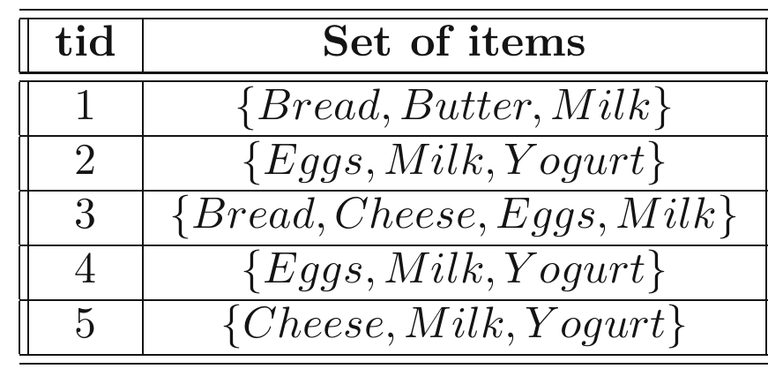
Disadvantages of frequent itemsets
Patterns are not always significant from an application-specific perspective
{Milk} can be appended
to any itemset and does
not change its frequency
For any itemset X, the
rule X⇒{Milk} has
100% confidence

Slide 6
Disadvantages of frequent itemsets
(cont.)
Cannot adjust to the skew in the individual item support values
  Support of {Milk, Butter}
  is different from
  {¬Milk, ¬Butter}
  We would like a method
  that treats both presence
  and absence similarly

Slide 7
Statistical coefficient of correlation
Pearson coefficient
Estimated correlation
Properties
  Lines in [-1, 1]; is symmetric wrt presence/absence
  It is hard to understand intuitively

Slide 8
χ² measure
Given a k-itemset X, there are 2^{k} possible states
  2-itemset:
  {Bread, Butter}
  2² states:
  {Bread, Butter}, {¬Bread, Butter},
  {Bread, ¬Butter}, {¬Bread, ¬Butter}

Slide 9
χ² measure (cont.)
The χ² measure for an itemset:
  O_{i} observed support, E_{i} expected support
Properties
  Larger values ⇒ greater dependence
  Treats presence and absence similarly
  High computational complexity
  Does not satisfy the downward closure property
“All subsets of
a frequent itemset
are also frequent”

Slide 10
Interest ratio
Definition
Properties
  When items are statistically independent ⇒ 1
  Value >1 indicates positive correlations
  Misleading if some items are extremely rare
  Does not satisfy the downward closure property

Slide 11
Symmetric confidence
In general conf(X⇒Y) ≠ conf(Y⇒X)
We can symmetrize:
  Minimum, maximum, average of both
  Geometric mean: cosine measure
Can be generalized to k-itemsets
Does not satisfy the downward closure property

Slide 12
Cosine measure (cosine coefficient) on columns
Interpretation: cosine between two columns of the data matrix, which we interpret as vectors
It is symmetric
Prove this is the
geometric mean
of conf(i⇒j) and conf(j⇒i)

Slide 13
Cosine as geometric mean (answer)
Note this is sqrt(conf(i⇒j) x conf(j⇒i)), i.e., the geometric mean

Slide 14
Jaccard Coefficient
Jaccard coefficient
Properties
  Satisfies downward closure property
  Why?

Slide 15
Why this satisfies downward closure? (Answer)
Jaccard coefficient (generalization)
Properties
  Satisfies downward closure property
Cannot increase with k
Cannot decrease with k

Slide 16
Jaccard Coefficient
Jaccard coefficient (generalization)
Properties
  Satisfies downward closure property
  Speed up by min-hash trick

Slide 17
Collective strength
An itemset is in violation in a transaction if some, but not all of the items in I are present in the transaction
Violation rate v(I)
  Fraction of violations of itemset I over all transactions

Slide 18
Collective strength (cont.)
The expected value of v(I) is calculated assuming statistical independence of the individual items
0 indicates perfect negative correlation
∞ indicates perfect positive correlation

Slide 19
Collective strength (cont.)
Simple interpretation of collective strength
An itemset I is said to be strongly collective at level s, if it satisfies the following properties:
  The collective strength C(I) of the itemset I is at least s.
  Closure property: The collective strength C(J) of every subset J of I is at least s.

Slide 20
Useful techniques/tricks
(meta algorithms)

Slide 21
Sampling
1. Sample a subset of the transactions
2. Apply mining to sample data
3. Profit!
However, there can be:
false positives (frequent in sample but not overall) or
false negatives (frequent overall but not in the sample)

Slide 22
Data partitioned ensembles
1. Partition the DB into k disjoint segments
2. Apply the mining algorithm independently on each segment
3. Post-process to remove false positives
There are never false negatives

Slide 23
Extension to categorical attributes
Introduction to Data Mining 2nd edition (2019) by Tan et al. (Chapters 5, 6) – slides ch6

Slide 24
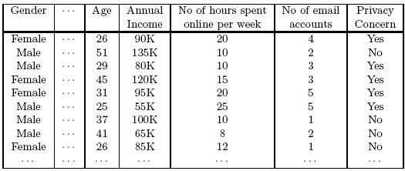
Other types of association analysis
Example of the kind of rule we want to mine:
{Gender=Male, Age∊[21,30)} ⇒ {Hours online ≥ 10}

Slide 25
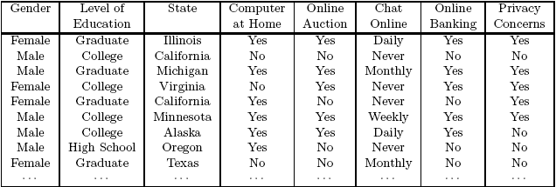
Other types of association (cont.)
Example of the kind of rule we want to mine:
{Level of Education=Graduate, Online Banking=Yes}
⇒ {Privacy Concerns = Yes}

Slide 26
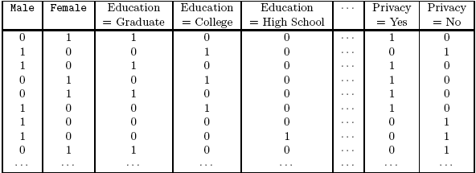
Solution: a dummy binary variable for each attribute=value pair

Slide 27
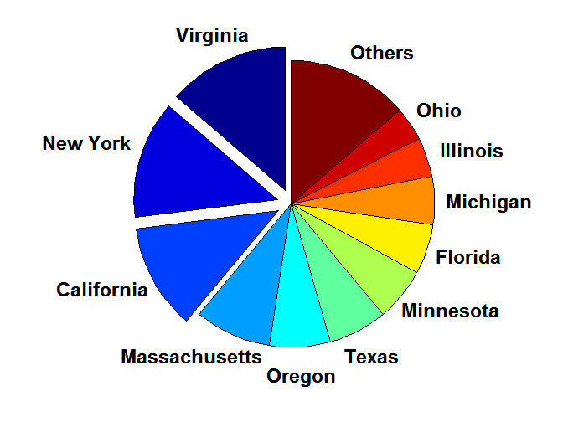
Problem: too infrequent attribute values
It is not necessary to add an extra column for attribute values that rarely appear. Bundle them.

Slide 28
Problem: too frequent attribute values
Distribution of attribute values can be highly skewed
Example: 85% of survey participants own a computer at home
Most records have Computer at home = Yes
Computation becomes expensive; many frequent itemsets involving this
Potential solution: discard the highly frequent items
Computational Complexity
Binarizing the data increases the number of items
But the width of the “transactions” remain the same as the number of original (non-binarized) attributes
Produce more frequent itemsets but maximum size of frequent itemset is limited to the number of original attributes

Slide 29
Extension to continuous attributes
Introduction to Data Mining 2nd edition (2019) by Tan et al. (Chapters 5, 6) – slides ch6

Slide 30
Handling continuous attributes
Different methods:
  Discretization-based
  Statistics-based
  Non-discretization based (e.g., minApriori)
Different kinds of rules can be produced:
{Age∊[21,30), No of hours online∊[10,20)}
⇒ {Chat Online=Yes}
{Age∊[21,30), Chat Online=Yes}
  ⇒ No of hours online: μ=14, σ=4

Slide 31
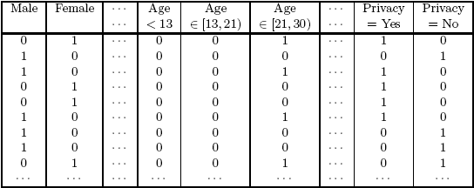
Discretization-based methods

Slide 32
Types of discretization
Unsupervised discretization
  Equal-width (max-min in each bin is constant)
  Equal-depth (number of elements per bin is constant)
  Clustering-based
Supervised discretization
Continuous attribute, v
₁
₂
₃
₄
₅
₆
₇
₈
₉
Chat Online = Yes
0
0
20
10
20
0
0
0
0
Chat Online = No
150
100
0
0
0
100
100
150
100
bin₁
bin₂
bin₃

Slide 33

Interval width issues
Example patterns:

Slide 34
Interval width issues (cont.)
Interval too wide (e.g., Bin size= 30 in the example of previous slide)
  May merge several disparate patterns
    Patterns A and B are merged together
  May lose some of the interesting patterns
    Pattern C may not have enough confidence
Interval too narrow (e.g., Bin size= 2 in the example of previous slide)
  Pattern A is broken up into two smaller patterns
    Can recover the pattern by merging adjacent subpatterns
  Pattern B is broken up into smaller patterns
    Cannot recover the pattern by merging adjacent subpatterns
  Some intervals may not meet support threshold

Slide 35
Discretization: all possible intervals
Number of intervals = k
Total number of Adjacent intervals = k(k-1)/2
Execution time
  If the range is partitioned into k intervals, there are O(k²) new items
  If an interval [a,b) is frequent, then all intervals that subsume [a,b) must also be frequent
    E.g.: if {Age ∈[21,25), Chat Online=Yes} is frequent,
    then {Age ∈[10,50), Chat Online=Yes} is also frequent
  Improve efficiency:
    Use maximum support to avoid intervals that are too wide

Slide 36
Handling redundant rules: keep the most general one
R1: {Age ∊[18,20), Age ∊[10,12)} ⇒ {Chat Online=Yes}
R2: {Age ∊[18,23), Age ∊[10,20)} ⇒ {Chat Online=Yes}
If both rules have the same support and confidence,
  prune (remove) the most specific rule (R1)
  keep the most general rule (R2)

Slide 37
Statistics-based methods
Example:
{Income > 100K, Online Banking=Yes} ⇒ Age: μ=34
Approach
  Remove target attribute (e.g., “Age”)
  Extract frequent itemsets
  For each frequent itemset X, create a rule X ⇒ Age stats
  Apply statistical test to determine interestingness

Slide 38
Statistics-based methods (example)
Frequent Itemsets:
Candidate association rules:
{Male, Income > 100K}
{Income < 30K, No hours ∈[10,15)}
{Income > 100K, Online Banking = Yes}
….
{Male, Income > 100K} → Age: μ = 30
{Income < 40K, No hours ∈[10,15)} → Age: μ = 24
{Income > 100K,Online Banking = Yes}
→ Age: μ = 34
….

Slide 39
Statistics-based methods: what is an interesting candidate?
Compare the statistics for segment covered by the rule vs rest of the population:
    A ⇒ B: μ versus A ⇒ B: μ’
Statistical hypothesis testing:
    Null hypothesis: H0: μ’ = μ + Δ
    Alternative hypothesis: H1: μ’ > μ + Δ
    Z has zero mean and variance 1 under null hypothesis

Slide 40
Finding an interesting candidate
Example: Buy=Yes ⇒ Age μ=23
Suppose rule is interesting if difference between μ and μ’ is more than 5 years (Δ = 5)
  For r, suppose n₁ = 50, σ₁ = 3.5, μ=23
  For r’ (complement): n₂ = 250, σ₂ = 6.5, μ’=30

Slide 41
Finding an interesting candidate (cont.)
Example: Buy=Yes ⇒ Age μ=23
For 1-sided test at 95% confidence level, critical Z-value for rejecting null hypothesis is 1.64.
Since Z=3.11 is greater than 1.64, r is an interesting rule

Slide 42
Min-Apriori
Document-term matrix showing that W1 and W2 tend to appear together

Slide 43
Min-Apriori (cont.)
What is the support of a word? Can’t be frequency; instead, we normalize word vectors (columns add up to one)
Normalize

Slide 44
Min-Apriori (cont.)
New definition of support
Example:
Sup(W1,W2,W3)
= 0 + 0 + 0 + 0 + 0.17
= 0.17

Slide 45
Min-Apriori (cont.)
Anti-monotone property of support
Example:
Sup(W1) = 0.4 + 0 + 0.4 + 0 + 0.2 = 1
Sup(W1, W2) = 0.33 + 0 + 0.4 + 0 + 0.17 = 0.9
Sup(W1, W2, W3) = 0 + 0 + 0 + 0 + 0.17 = 0.17

Slide 46
Categories in a hierarchy

Slide 47
Why should we incorporate concept hierarchy?
Rules at lower levels may not have enough support to appear in any frequent itemsets
Rules at lower levels of the hierarchy are overly specific
  e.g., soy milk → tofu, almond milk → smoked tofu,
  soy milk → smoked tofu, etc.
  are indicative of a more general association between soy milk and tofu
But, rules at higher level may be too generic

Slide 48
Support and confidence in a hierarchy
If X is the parent item for both X1 and X2,
then sup(X) ≤ sup(X1) + sup(X2)
  If sup(X1 ∪ Y1) ≥ minsup,
  and X is parent of X1, Y is parent of Y1
  then sup(X ∪ Y1) ≥ minsup, sup(X1 ∪ Y) ≥ minsup
  sup(X ∪ Y) ≥ minsup
  If conf(X1 ⇒ Y1) ≥ minconf,
  then conf(X1 ⇒ Y) ≥ minconf

Slide 49
Mining multi-level association rules
Approach 1:
  Extend current association rule formulation by augmenting each transaction with higher level items
  Original Transaction: {skim milk, wheat bread}
  Augmented Transaction: {skim milk, wheat bread, milk, bread, food}
Issues:
  Items that reside at higher levels have much higher support counts
    if support threshold is low, too many frequent patterns involving items from the higher levels
  Increased dimensionality of the data

Slide 50
Mining multi-level association rules
Approach 2:
  Generate frequent patterns at highest level first
  Then, generate frequent patterns at the next highest level, and so on
Issues:
  I/O requirements will increase dramatically because we need to perform more passes over the data
  May miss some potentially interesting cross-level association patterns

Slide 51
Summary

Slide 52
Things to remember
Interestingness measures
Categorical attributes
Continuous attributes
Min-Apriori
Mining multi-level rules on a hierarchy

Slide 53
Exercises on this topic
Introduction to Data Mining 2nd edition (2019) by Tan et al.
  Exercises 6.8 → 2-4, 6-9
Data Mining, The Textbook (2015) by Charu Aggarwal
  Exercises 4.9 → 20-21

