Slide 1

Data Streams:
Probabilistic Counting
Mining Massive Datasets
Carlos Castillo
Topic 25

Slide 2
Sources
Mining of Massive Datasets (2014) by Leskovec et al. (chapter 4)
  Slides part 1, part 2
Tutorial: Mining Massive Data Streams (2019) by Michael Hahsler

Slide 3
Probabilistic counting

Slide 4
Motivating example how many neighbors?
Let n(u,h) be the number of nodes reachable through a path of length up to h from node u
Naïve method
  Maintain a set for each node u, initialize S(u) = {u}
  Repeat h times:
  Answer n(u,h) = |S(u)|

Slide 5
What is the problem with this method?
Let n(u,h) be the number of nodes reachable through a path of length up to h from node u
Naïve method
  Maintain a set for each node u, initialize S(u) = {u}
  Repeat h times:
  Answer n(u,h) = |S(u)|

Slide 6
Let’s look at each node
We will receive a stream of items
  Our neighbors at distance <= h
  Repeated many times because of loops
We want to use a small amount of memory
We don’t care which items are in the stream
We just want to know how many are distinct

Slide 7


Counting fishes with pebbles
Normally, to count with pebbles, you add one pebble every time you see an event
How do you extend this method to count up to 1000 fishes with 10 pebbles?
Assume you have access to a random number generator but not to an abacus for … reasons

Slide 8
Answer
How to count up to 1000 fishes with 10 pebbles?
Every time you see a fish:
  generate a random integer between 1 and 100
  Add one pebble if that number is 1 (or any fixed value)
Return 100 x number of pebbles as an approximation

Slide 9
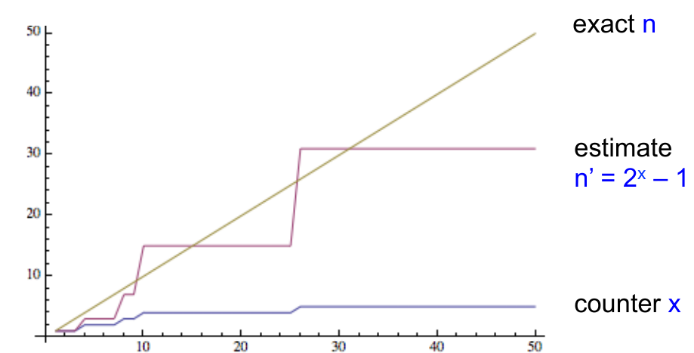
Morris’ probabilistic counting (1977)
x ← 0
For each of the n events:
  x ← x + 1 with probability (1/2)^{x}
Return estimate n’ = 2^{x}+1
Counter x needs only log₂(n) bits
Source: Slides by Nick Duffield

Slide 10
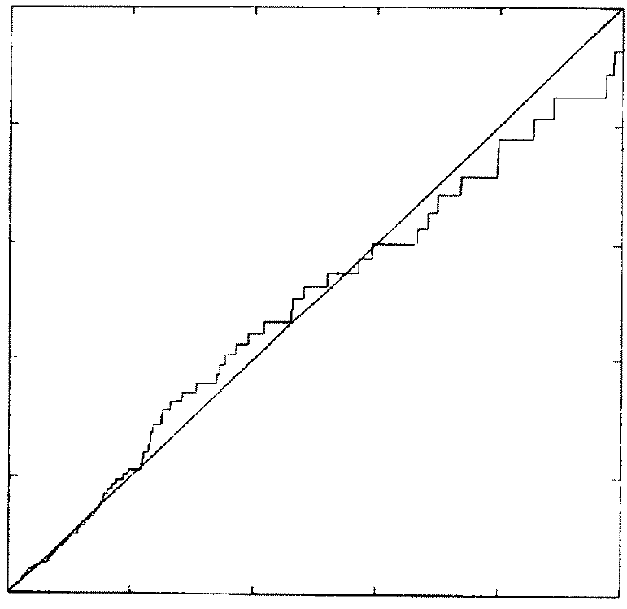
n (actual value)
Simulation results by Flajolet (1985)
n’ (approximation)

Slide 11
Morris’ algorithm provides an unbiased estimator
Init x=0, let p_{x} = 2^{-x}, estimate n’ = 2^{x} - 1
n = 1
  before: x = 0 p₀ = 1;
  prob. 1: x → 1
  estimate n’ = 2¹ – 1 = 1 = n
n = 2
  before: x = 1; p₁ = 1⁄2
  prob. 1⁄2: x stays at 1; n’ = 2¹ – 1 = 1
  prob. 1⁄2: x → 2. n’ = 2² -1 = 3
  E[n’] = 1⁄2 x 1 + 1⁄2 x 3 = 2 = n
Source: Slides by Nick Duffield

Slide 12
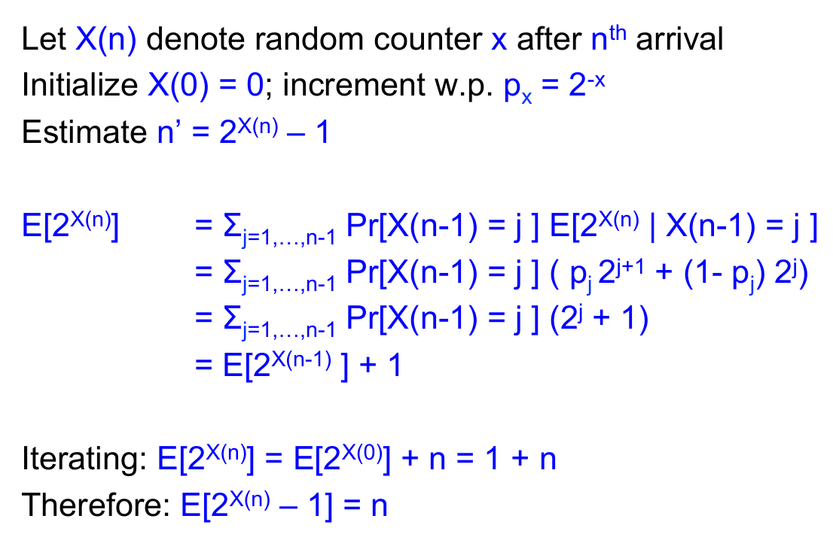
Morris’ algorithm provides an unbiased estimator (cont.)
Source: Slides by Nick Duffield

Slide 13
Flajolet-Martin algorithm for counting distinct elements
For every element u in the stream, compute hash h(u)
Let r(u) be the number of trailing zeros in hash value
  Example: if h(u) = 001011101000 then r(u) = 3
Maintain R = max r(u) seen so far
Output 2^{R} as an estimator of the number of distinct elements seen so far

Slide 14
Flajolet-Martin algorithm
(intuitive, hand-waving explanation)
Let r(u) be the number of trailing zeros in hash value, keep R = max r(u), output 2^{R} as estimate
Repeated items don’t change our estimates because their hashes are equal
About ½ of distinct items hash to *******0
  To actually see a *******0, we expect to wait until seeing 2 distinct items
About ¼ of distinct items hash to ******00
  To actually see a ******00, we expect to wait until seeing 4 items
…
If we actually saw a hash value of ***000...0 (having R trailing zeros) then on expectation we saw 2^{R} different items
J. Leskovec, A. Rajaraman, J. Ullman: Mining of Massive Datasets, http://www.mmds.org/

Slide 15
Flajolet-Martin, correctness proof
Let m be the number of distinct elements
Let z(r) be the probability of finding a tail of r zeroes
We will prove that
  z(r) → 1 if m ≫ 2^{r}
  z(r) → 0 if m ≪ 2^{r}
Hence 2^{r} should be around m
J. Leskovec, A. Rajaraman, J. Ullman: Mining of Massive Datasets, http://www.mmds.org/

Slide 16
Flajolet-Martin, correctness proof (cont.)
Probability a hash value ends in r zeroes = (1/2)^{r}
  Assuming h(u) produces values at random
  Prob. random binary ends in r zeroes = (1/2)^{r}
Probability of seeing m distinct elements and NOT seeing a tail of r zeroes = (1 – (½)^{r})^{m}
J. Leskovec, A. Rajaraman, J. Ullman: Mining of Massive Datasets, http://www.mmds.org/

Slide 17
Flajolet-Martin, correctness proof (cont.)
Probability of seeing m distinct elements and NOT seeing a tail of r zeroes = (1 – (½)^{r})^{m}
Remember (1-ε)^{1/ε} ≃ 1/e for small ε
Hence
J. Leskovec, A. Rajaraman, J. Ullman: Mining of Massive Datasets, http://www.mmds.org/

Slide 18
Flajolet-Martin, correctness proof (cont.)
Probability of seeing m distinct elements and NOT seeing a tail of r zeroes
If m ≫ 2^{r}, this tends to 0
  We almost certainly will see a tail of r zeroes
If m ≪ 2^{r}, this tends to 1
  We almost certainly will not see a tail of r zeroes
Hence, 2^{r} should be around m
J. Leskovec, A. Rajaraman, J. Ullman: Mining of Massive Datasets, http://www.mmds.org/

Slide 19
Flajolet-Martin: increasing precision
Idea: repeat many times or compute in parallel for multiple hash functions
How to combine?
  Average? E[2^{r}] is infinite, extreme values will skew the number excessively
  Median? 2^{r} is always a power of 2
Solution: group hash functions, take median of values obtained in each group, then average across groups

Slide 20
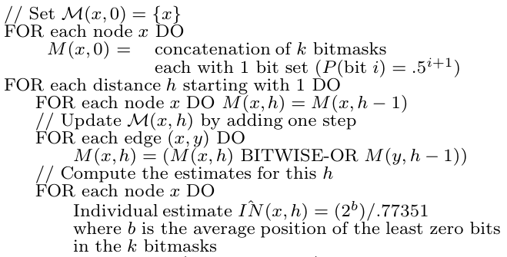
Let’s go back to counting neighbors
Naïve method:
Maintain a set for each node u, initialize S(u) = {u}
Repeat h times:
Answer n(u,h) = |S(u)|
ANF method:
Palmer, C. R., Gibbons, P. B., & Faloutsos, C. (2002, July). ANF: A fast and scalable tool for data mining in massive graphs. In Proc. KDD.

Slide 21
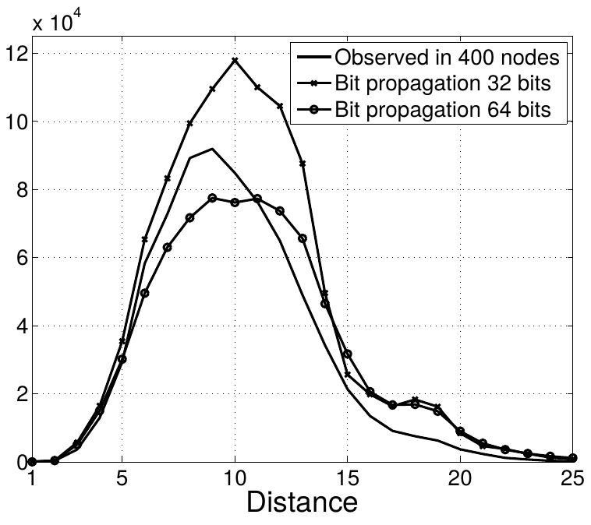
Example of another variant of the same type of algorithm
More repetitions of the algorithm yield better precision
Becchetti, Luca, Carlos Castillo, Debora Donato, Stefano Leonardi, and Ricardo Baeza-Yates. "Using rank propagation and probabilistic counting for link-based spam detection." In Proc. of WebKDD, 2006.

Slide 22
Summary

Slide 23
Things to remember
Probabilistic counting algorithms:
  Morris
  Flajolet-Martin

Slide 24
Exercises for TT22-T26
Mining of Massive Datasets (2014) by Leskovec et al.
  Exercises 4.2.5
  Exercises 4.3.4
  Exercises 4.4.5
  Exercises 4.5.6

