Slide 1

Finding Near-Duplicates
Mining Massive Datasets
Prof. Carlos Castillo — https://chato.cl/teach

Slide 2
Source for this deck
Mining of Massive Datasets 2nd edition (2014) by Leskovec et al. (Chapter 3) [slides ch3]

Slide 3
Fast near-neighbor applications
For documents
  Find “legitimate” duplicates
    Copies of the same press release or cable
    Mirrors of the same documents, for efficiency
  Find “illegitimate” duplicates
    Plagiarism
For baskets
  Find customers who purchase similar items

Slide 4
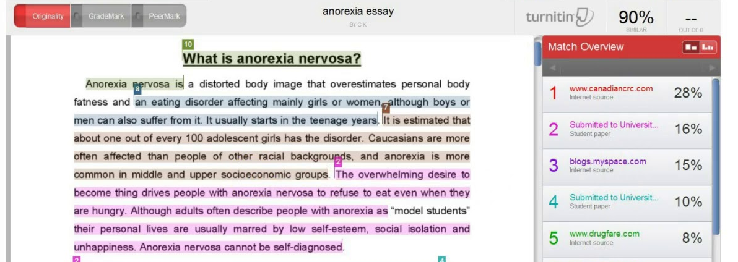

Example: plagiarism detection

Slide 5
Fast near-neighbor challenges
Too many documents to compare all pairs
  OK to pay linear or log cost, but not quadratic
Documents cannot fit in main memory
  They are too large or too many
Many small pieces of one document can appear out of order in another

Slide 6
Shingling
(ngrams)

Slide 7
First step: shingling
Candidate
pairs:
those pairs
of signatures
that we need
to test for
similarity
Locality-
Sensitive
Hashing
Shingling
Min
Hashing
Document
Sets of
k letters or words
that appear
consecutively
in the document
Signatures:
short integer
vectors that
represent the
sets, and
reflect their
similarity

Slide 8
Naïve solution: feature selection over bag of words
Document = set of terms
  → Document = set of important terms
Now, compute all pairs similarity
Doesn’t work for at least two reasons, why?

Slide 9
Naïve solution: feature selection over bag of words
Document = set of terms
  → Document = set of important terms
Now, compute all pairs similarity
Doesn’t work for at least two reasons, why?
  Doesn’t preserve the ordering
  Unimportant terms are also relevant (stylistic)

Slide 10
Shingles
An n-gram in a document is a sequence of n tokens that appears in the document
Shingles are either n-grams (word-level) or sequences of characters (“character n-grams”), depending on the application
Character-level example: k=2; document D1 = abcab
Set of 2-shingles: S(D1) = {ab, bc, ca}
  Option: Shingles as a bag (multiset), count ab twice: S’(D1) = {ab, bc, ca, ab}

Slide 11
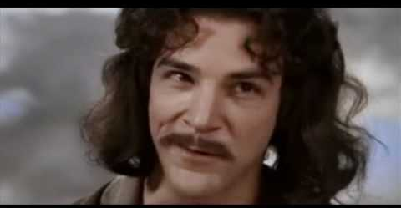
Example: 4-grams
E.g., 4-shingles of
“My name is Inigo Montoya. You killed my father. Prepare to die”:
{
    my name is inigo
    name is inigo montoya
    is inigo montoya you
    inigo montoya you killed
    montoya you killed my
    you killed my father
    killed my father prepare
    my father prepare to
    father prepare to die
}

Slide 12
Compressed representation of shingles
To compress long shingles, we can hash them to (say) 4 bytes
Represent a document by the set of hash values of its k-shingles
  Note we could have false positives due to hash collisions
Example: k=2; document D1= abcab
Set of 2-shingles: S(D1) = {ab, bc, ca}
Hash the singles (example): h(D1) = {1, 5, 7}

Slide 13
Documents as sets of shingles
A document is now a set of shingles
  Dimensionality reduced from “words in a dictionary” to “number of distinct shingles”
  Higher dimensionality but more sparse
Working assumption
  Documents that have lots of shingles in common have similar text, even if the text appears in different order
In practice, k should be large enough, or most documents will have most shingles
  k = 5 is OK for short documents
  k = 10 is better for long documents

Slide 14

Using shingles directly
Suppose we need to find near-duplicate documents among one million documents
Naïvely, we would have to compute all pairwise Jaccard similarities ≈ 5*10¹¹ comparisons
At 10⁵ secs/day and 10⁶ comparisons/sec, it would take 5 days
For 10 million documents, it takes more than a year…

Slide 15
Min hashing

Slide 16
Next step: min hashing
Candidate
pairs:
those pairs
of signatures
that we need
to test for
similarity
Locality-
Sensitive
Hashing
Shingling
Min
Hashing
Document
Sets of
k letters or words
that appear
consecutively
in the document
Signatures:
short integer
vectors that
represent the
sets, and
reflect their
similarity

Slide 17
Sets can be bit vectors
Many similarity problems involve finding subsets with substantial intersection
Remember we can encode sets using bit vectors
  set intersection = bitwise AND
  set union = bitwise OR
Example: C₁ = 10111; C₂ = 10011
  Size of intersection = 3; size of union = 4,
  Jaccard similarity (not distance) = 3/4
  Distance: d(C₁,C₂) = 1 – (Jaccard similarity) = 1/4

Slide 18
From sets to boolean matrices
Documents
Rows = items (shingles)
Columns = sets (documents)
  1 in row e and column s if and only if e is a member of s
Column similarity is the Jaccard similarity of the corresponding sets (rows with value 1)
Typical matrix is very sparse!
1
1
1
0
1
1
0
1
0
1
0
1
0
0
0
1
Shingles
1
0
0
1
1
1
1
0
1
0
1
0

Slide 19
Hashing set representations
We don’t want to compare c₁, c₂, they might be too large, slowing down the computation
Instead, we compute signatures h(c₁), h(c₂) that are smaller in size than c₁ and c₂
Desired properties:
c₁ = c₂ ⇒ Prob.(h(c₁) = h(c₂)) is large
c₁ ≠ c₂ ⇒ Prob.(h(c₁) ≠ h(c₂)) is large

Slide 20
Hashing set representations (cont.)
Naïve approach (non-LSH-based):
  1) Compute signatures of columns: small summaries of columns
  2) Examine all pairs of signatures to find similar columns
    Essential: Similarities of signatures and columns are related
  3) Optional: verify that columns with similar signatures are really similar
Warnings:
  Comparing all pairs may take too much time: Job for LSH
  These methods can produce false negatives, and even false positives
  (if the optional check is not made)

Slide 21
Hash function for Jaccard metric: min hashing
Imagine the rows of the boolean matrix permuted under random but fixed permutation π
Define a “hash” function h_{π}(C) = the index of the first (in the permuted order π) row in which column C has value 1
Use several (e.g., 100) independent hash functions (that is, permutations) to create a signature of a column

Slide 22
Minhash example
Rows=Shingles, Columns=Documents
Permutations
D1 D2 D3 D4
Signature matrix M
2
4
3
4
7
2
6
1
5
1
0
1
0
D1 D2 D3 D4
2
1
2
1
3
2
1
0
0
1
2
1
4
1
7
1
0
1
0
1
1
2
1
2
6
3
0
1
0
1
1
6
0
1
0
1
4th element of the permutation is the first to map to a 1
5
7
1
0
1
0
4
5
1
0
1
0

Slide 23

Exercise: shingling
Rows=Shingles, Columns=Documents
Permutation
D1 D2 D3 D4
3
2
1
4
7
5
6
1
0
1
0
1
0
0
1
Signature matrix M
0
1
0
1
D1 D2 D3 D4
0
1
0
1
0
1
0
1
Index of the bit vector position where the first 1 occurs according to the ordering of the permutation
1
0
1
0
1
0
1
0
Pin board: https://upfbarcelona.padlet.org/chato/bu8ekcrferwf6lv5

Slide 24
Answer
Rows=Shingles, Columns=Documents
Permutation
D1 D2 D3 D4
3
2
1
4
7
5
6
1
0
1
0
Signature matrix M
1
0
0
1
D1 D2 D3 D4
2
1
3
1
0
1
0
1
0
1
0
1
0
1
0
1
1
0
1
0
1
0
1
0

Slide 25
Minhash approximates Jaccard
Let π be a random permutation
Let h_{π}(S) be the first element of S under the permutation π
If h_{π}(A) = h_{π}(B) and there are no collisions, then:
  Among all elements in A ∪ B …
  … the chosen element is in A ∩ B
This happens with probability |A ∩ B|/|A ∪ B| = Jaccard(A, B)
Hence Pr[h_{π}(A) = h_{π}(B)] = Jaccard(A, B)

Slide 26
We will use multiple permutations
Jaccard(A, B) = E[h_{π}(A) = h_{π}(B)]
  = number of matches / number of permutations
We will use many permutations, e.g., 100

Slide 27
Example: three permutations
Rows=Shingles, Columns=Documents
Permutations
D1 D2 D3 D4
Signature matrix M
2
4
3
4
7
2
6
1
5
1
0
1
0
D1 D2 D3 D4
2
1
2
1
3
2
1
0
0
1
2
1
4
1
7
1
0
1
0
1
1
2
1
2
6
3
0
1
0
1
1
6
0
1
0
1
Similarities | 1-3 | 2-4 | 1-2 | 3-4
Complete | 0.75 | 0.75 | 0 | 0
Signatures | 0.67 | 1.00 | 0 | 0
5
7
1
0
1
0
4
5
1
0
1
0

Slide 28
Minhash signatures
Pick π₁ … π₁₀₀ random permutations of the rows (K=100)
Think of sig(C) as a column vector
  sig(C)[i] = according to the i-th permutation, the index of the first row that has a 1 in column C
  sig(C)[i] = min (π_{i}(C))
The signature or “sketch” of document C has fixed size!
  We achieved our goal: we “compressed” long bit vectors into short signatures

Slide 29
Implementation
Permuting rows even once is prohibitive
Instead, we create π₁ … π₁₀₀ by using K = 100 hash actual functions H_{i …} which map to integer numbers
  Ordering of {1,2,…,n} under H_{i}
    … i.e., computing h(1), h(2), …, h(n) and sorting
  … is a random permutation!

Slide 30
Summary

Slide 31
Things to remember
Shingling: Convert documents to sets
  We used hashing to assign each shingle an ID
Min-Hashing: Convert large sets to short signatures, while preserving similarity
  We used similarity preserving hashing to generate signatures with property Pr[h_{π}(C₁) = h_{π}(C₂)] = sim(C₁, C₂)
  We used hashing to get around generating random permutations

Slide 32
Exercises for TT08-TT09
Mining of Massive Datasets 2nd edition (2014) by Leskovec et al.
  Exercises 3.1.4 (Jaccard similarity)
  Exercises 3.2.5 (Shingling)
  Exercises 3.3.6 (Min hashing)
  Exercises 3.4.4 (Locality-sensitive hashing)

