Slide 1

Data Preparation
Mining Massive Datasets
Carlos Castillo
Topic 02

Slide 2
Main Sources
Data Mining, The Textbook (2015) by Charu Aggarwal (Chapter 2) + slides by Lijun Zhang
Introduction to Data Mining 2nd edition (2019) by Tan et al. (Chapter 2)
Data Mining Concepts and Techniques, 3rd edition (2011) by Han et al. (Chapter 3)

Slide 3

Success depends upon previous preparation, and without such preparation there is sure to be failure – Confucius

Slide 4
Typical datasets
Records / Matrices
Documents
Transactions
Graphs
Temporal / Sequences
Spatial

Slide 5
Data preparation
Feature Extraction and Portability
  Extract relevant elements for our analysis
  Convert heterogeneous data types
Data Cleaning
  Deal with missing, erroneous, and inconsistent data
Data Integration
  Bring different data sources into a common framework
Data Reduction, Selection, and Transformation
  Done for both efficiency and effectiveness

Slide 6
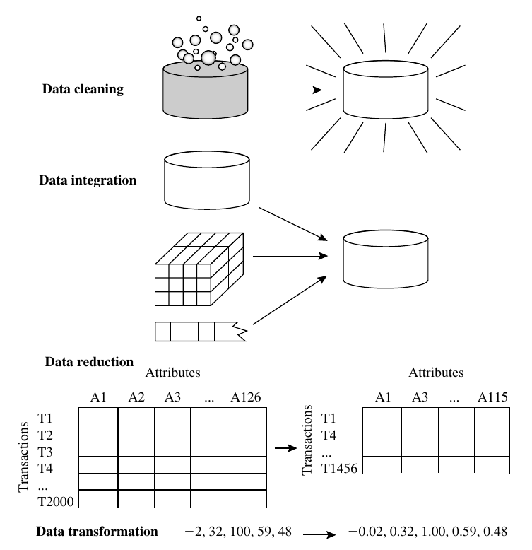
Data Mining Concepts and Techniques, 3rd edition (2011) by Han et al. (page 87)

Slide 7
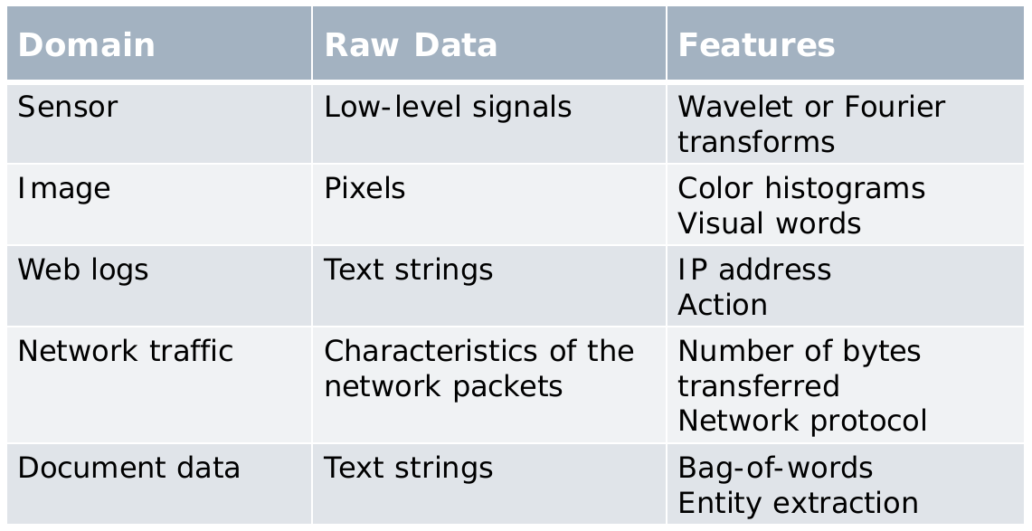
Feature extraction
This is both a skill and an art that the analyst develops over the years.

Slide 8
Data type portability
Data is Often Heterogeneous
  A demographic data set may contain both numeric and mixed attributes
Possible Solutions
  Designing an algorithm with an arbitrary combination of data type
  Time-consuming and sometimes impractical
Converting between various data types
  Utilize off-the-shelf tools for processing

Slide 9
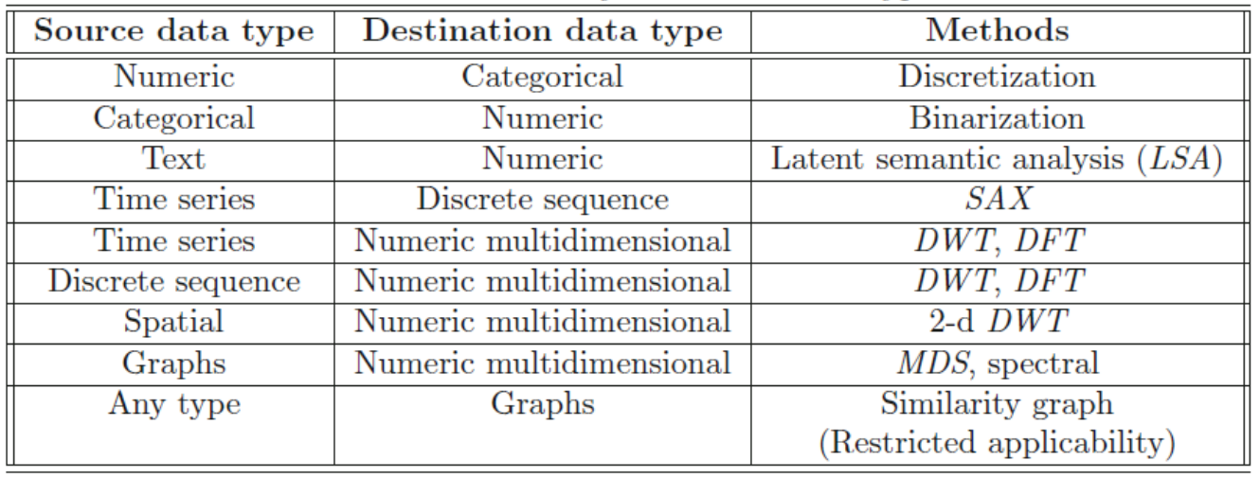
Data type portability (cont.)
Some ways of converting between data types

Slide 10
Numerical Categorical

Slide 11
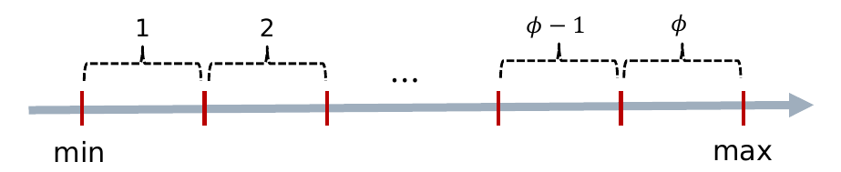
Numerical to categorical: discretization
Divide the range for the numerical variable into Φ different ranges

Slide 12
Numerical to categorical: discretization (cont.)
Equi-width ranges (l_{i} – r_{i} is constant)
Equi-log ranges (log r_{i} – log l_{i} is constant)
Equi-depth ranges (num. items in [l_{i}, r_{i}] constant)

Slide 13
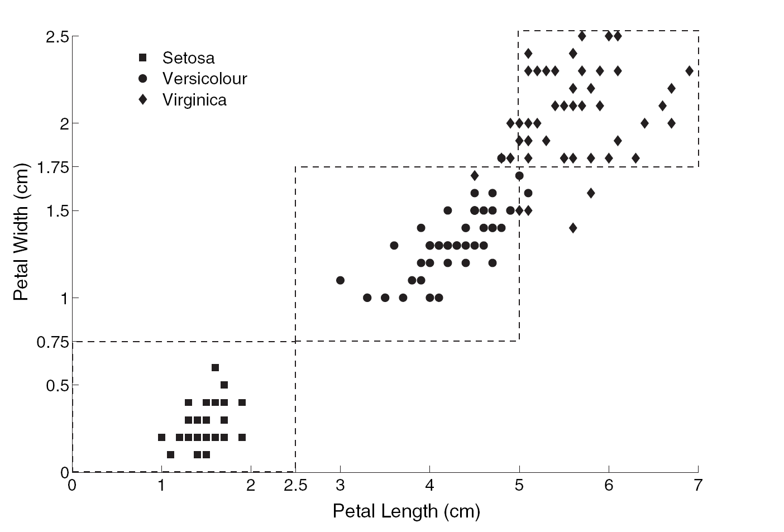
Example discretization in IRIS dataset
Continuous variables are converted to three possible values per feature: small, medium, large

Slide 14
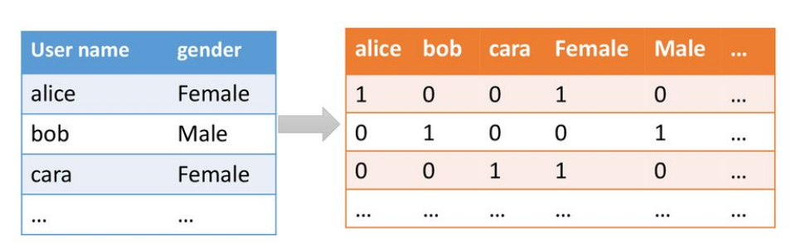
Categorical to numerical: binarization
One categorical value with Φ categories
⇒ indicator vector with Φ binary variables
https://slideplayer.com/slide/14461691/

Slide 15
Text pre-processing

Slide 16
Text pre-processing
Character decoding
Tokenization
Normalization
Stopword removal
Stemming/lemmatization
Part of speech tagging
Dependency parsing

Slide 17
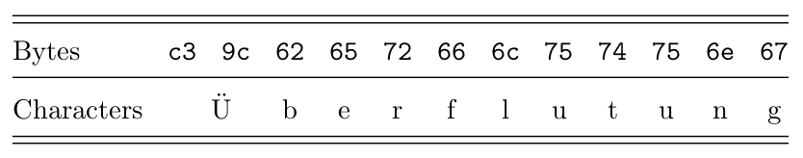
Character decoding
E.g. UTF-8

Slide 18
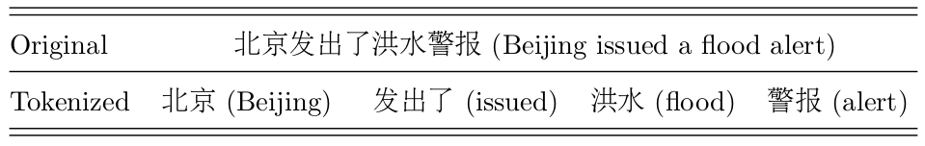
Tokenization
Trivial in most western languages:
  Separate at spaces and punctuations
Harder in other languages

Slide 19
Normalization
Help! = HELP = help
U.N. = UN
ikr / smh / lol / etc.
árboles = arboles
8alb = qalb (arabizi)

Slide 20
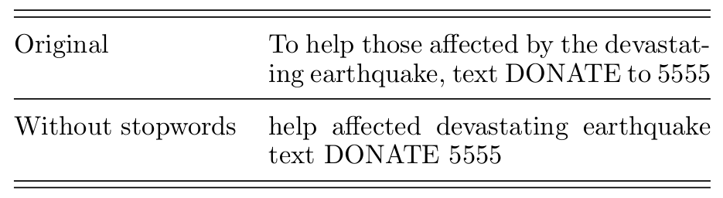
Stopword removal
Removes functional words
  Keeps content words

Slide 21
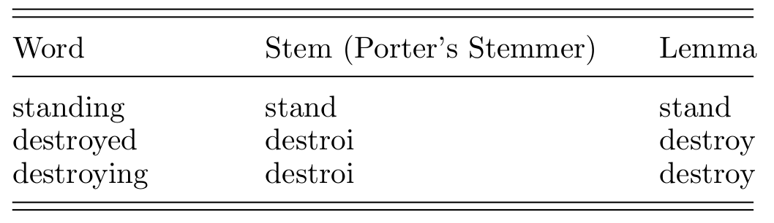
Stemming and lemmatization
The lemma is always a valid word, while the stem might be just a string

Slide 22
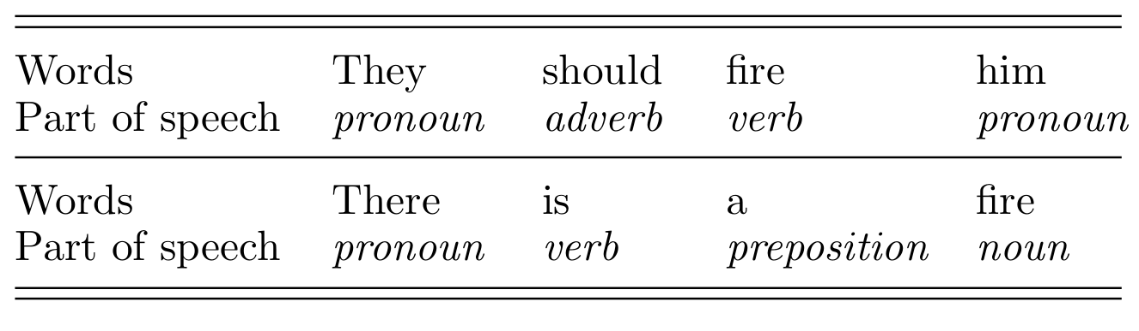
Part of speech tagging

Slide 23
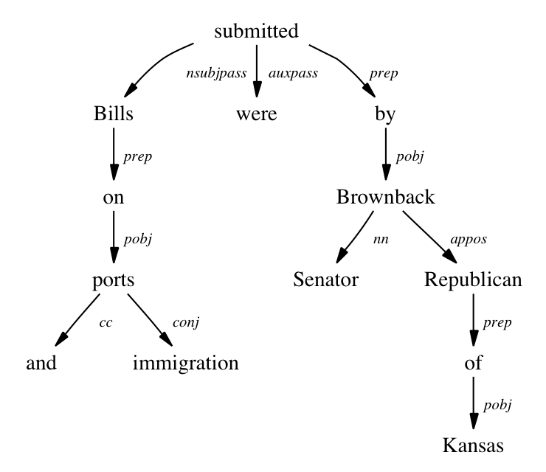
Dependency parsing

Slide 24
Text representation
Bag-of-words model = Document-term matrix
  Binary indicator variable for every word
  Numerical attribute indicating frequency or other measure of relevance
Sequence of categories

Slide 25
Series and sequences

Slide 26
Time series to discrete sequence
Symbolic Aggregate Approximation (SAX)
  Window-based averaging
    Evaluate the average value in each window
  Value-based discretization
    Discretize the average value by equi-depth intervals
How to Ensure Equi-depth?
  Assume certain distribution, such as Gaussian
  Estimate the distribution

Slide 27
Time series to numeric data
Discrete Wavelet Transform (DWT)
Discrete Fourier transform (DFT)
Advantages
  Remove Dependence

Slide 28
Discrete sequence to numeric
Discrete sequence to a Set of (binary) Time Series
  ACACACTGTGACTG (4 Symbols)
  10101000001000 (A)
  01010100000100 (C)
  00000010100010 (T)
  00000001010001 (G)
Map Each of These Time Series into a Multidimensional Vector
Features from the Different Series are Combined

Slide 29
Graphs Numerical

Slide 30
Convert any data type to a graph
Determine distance measure between elements d(u,v)
All elements with d(u,v)≤θ are connected

Slide 31
Graphs to numerical
Spectral transformation
  Each node is converted into a point in a low-dimensional space
  Nearby nodes in the low-dimensional space are connected by short paths in the graph

Slide 32
Data integration

Slide 33
Data integration aspects
Schema integration
  Bring different schemata together
  Equal concepts should be represented with equal types
Object matching / Entity identification
  Equal entities should be equally identified across datasets (unless re-identification forbidden by policy)

Slide 34
Data integration aspects (cont.)
Redundancy analysis
  Sometimes data needs to be integrated because different sets are row-incomplete
  Sometimes those sets don’t form a partition ⇒ there will be repeated entities to be removed
Resolution of value conflicts
  Same entity, different attribute values

Slide 35
Data cleaning

Slide 36
Why data cleaning?
Data Collection Technologies are Inaccurate
  Sensors
  Optical character recognition
  Speech-to-text data
Privacy Reasons
Manual Errors
Data collection is expensive and inaccurate

Slide 37
What is data cleaning?
Is a process by which data records are
modified or deleted
until each record passes data validity criteria

Slide 38
Data validity criteria
Data-Type constraints: values in a column must be of a particular datatype
Range constraints: numbers or dates should fall within a certain range
Mandatory constraints: certain columns cannot be empty.
Unique constraints: a field, or a combination of fields, must be unique
Set-Membership constraints: values in a column come from a set of discrete values or codes
Foreign-Key constraints: set membership constraint where valid values in a column are defined in a column of another table that contains unique values
Regular expression patterns: e.g., phone numbers [0-9]{9}
Cross-field validation: certain conditions that utilize multiple fields must hold, e.g., percentages add up to 1.0 or to 100

Slide 39
Handling missing entries
Why is a value missing?
Missing completely at random (MCAR)
  Missingness of a value is independent of attributes
  Fill in values based on the attribute
  Analysis may be unbiased overall
Missing at Random (MAR)
  Missingness is related to other variables
  Fill in values based other values
  Almost always produces a bias in the analysis
Missing Not at Random (MNAR)
  Missingness is related to unobserved measurements
  Informative or non-ignorable missingness
In general, it is not possible to know the situation just from the data

Slide 40
Handling missing entries
Delete the Data Record Containing missing entries
Estimate or Impute the Missing Values
  Additional errors may be introduced
  Good under certain conditions (e.g., Matrix Completion)
Designing an Algorithm that can work with Missing Data

Slide 41
Handling Incorrect and
Inconsistent Entries
Inconsistency Detection
  E.g., full name and abbreviation
Domain Knowledge
  Age cannot be 800
Data-centric Methods
  Outlier detection

Slide 42
Scaling and normalization
Features have Different Scales
  Age versus Salary
Standardization (“z-scoring”)
  Mean 0 and stdev 1
Min-Max Scaling
  Map to [0,1]
  Sensitive to noise

Slide 43
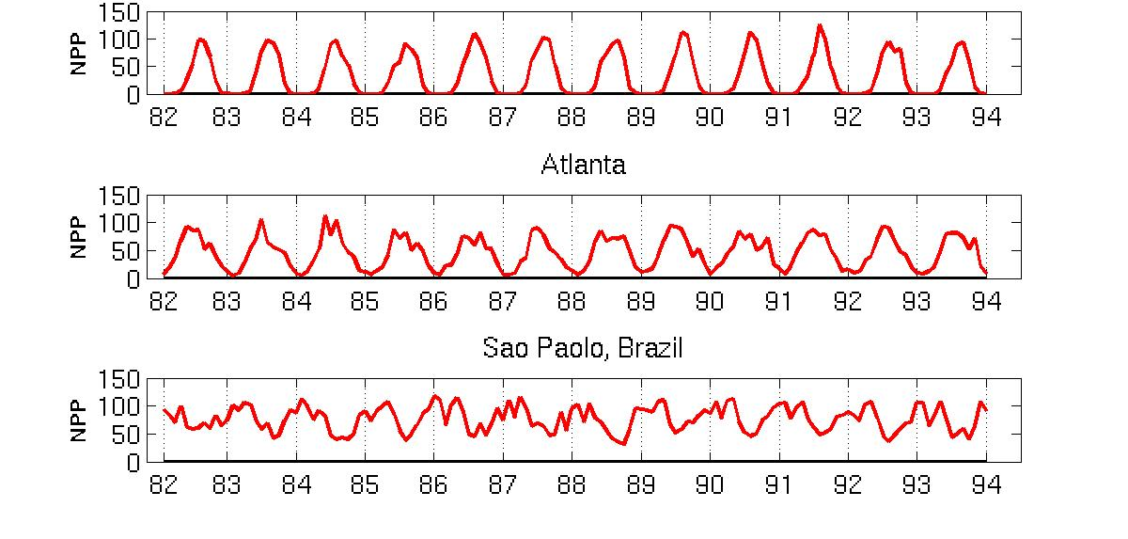
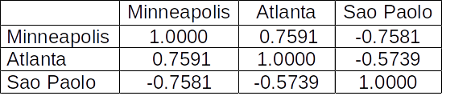
Example: seasonal standardization
Minneapolis
Net Primary Production (NPP) is a measure of plant growth used by ecosystem scientists.
Introduction to Data Mining 2nd edition (2019) by Tan et al. (Chapter 2)
Correlations between time series

Slide 44
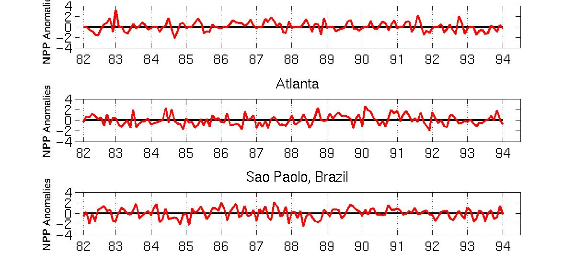
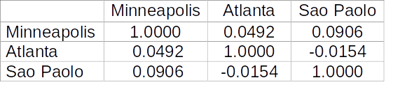
Example: seasonal standardization
Minneapolis
Normalized using monthly Z Score:
Subtract off monthly mean and divide by monthly standard deviation
Introduction to Data Mining 2nd edition (2019) by Tan et al. (Chapter 2)
New correlations between time series

Slide 45
Data Reduction and Transformation

Slide 46
Data reduction and transformation
Sampling
  ≃ “Less rows”
Dimensionality Reduction
  ≃ “Less columns”

Slide 47
Why reduce/transform data?
The Advantages
  Reduce space complexity
  Reduce time complexity
  Reduce noise
  Reveal hidden structures
    E.g., manifold learning
The Disadvantages
  Information loss

Slide 48
Sampling for static data
Uniform random sampling
  with/without replacement
Biased sampling
  e.g., emphasize recent items
Stratified sampling
  Partition data in strata, sample in each stratum

Slide 49
Sampling example
There are 10000 people which contain 100 millionaires
Uniform random sample of 100 people
  In expectation, one millionaire will be sampled
  There is ≃ 37% chance no millionaires are sampled, why?
Stratified Sampling
  Unbiased Sampling 1 from 100 millionaires
  Unbiased Sampling 99 from remaining

Slide 50
Sampling from data streams
The Setting
  Data arrive sequentially
  We want sample of them uniformly
  There is a reservoir that can hold k data points
The Algorithm
  The first k data points are kept
  Insert the n-th data point with probability k/n
  Drop one of the existing data points uniformly at random

Slide 51
Reducing data dimensionality

Slide 52
Feature selection
Unsupervised Feature Selection
  Using the performance of unsupervised learning (e.g, clustering) to guide the selection
Supervised Feature Selection
  Using the performance of supervised learning (e.g., classification) to guide the selection

Slide 53
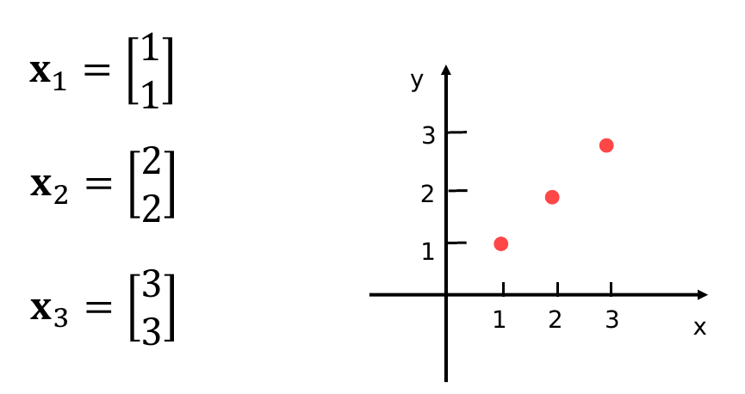
Dimensionality reduction with axis rotation (perfect case)
Motivation: three points in a line in two-dimensional space

Slide 54
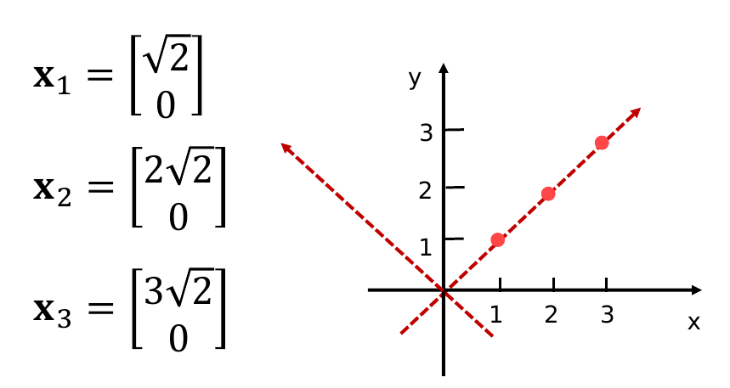
Dimensionality reduction with axis rotation (perfect case, cont.)
Coordinates after axes rotation

Slide 55
Dimensionality reduction with axis rotation (perfect case, cont.)
Coordinates after axes rotation
Drop second coordinate, no information is lost.
2D data reduced to 1D data

Slide 56
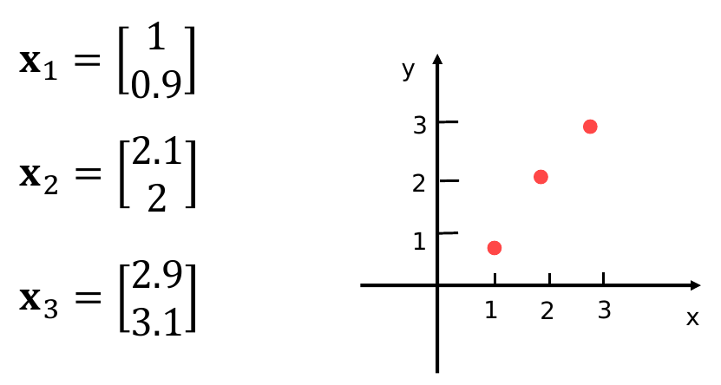
Dimensionality reduction with axis rotation (noisy case)
Suppose points don’t lie exactly on a line

Slide 57
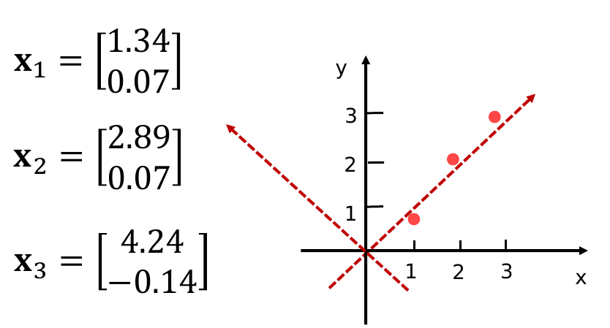
Dimensionality reduction with axis rotation (noisy case, cont.)
Suppose points don’t lie exactly on a line

Slide 58
Dimensionality reduction with axis rotation (noisy case, cont.)
Suppose points don’t lie exactly on a line
Drop second coordinate, some information is lost.
2D data reduced to 1D data

Slide 59
How does this work in reality?
Change of axes removes correlations and reduces dimensionality
Techniques
  Principal Component Analysis (PCA)
  Singular-Value Decomposition (SVD)

Slide 60
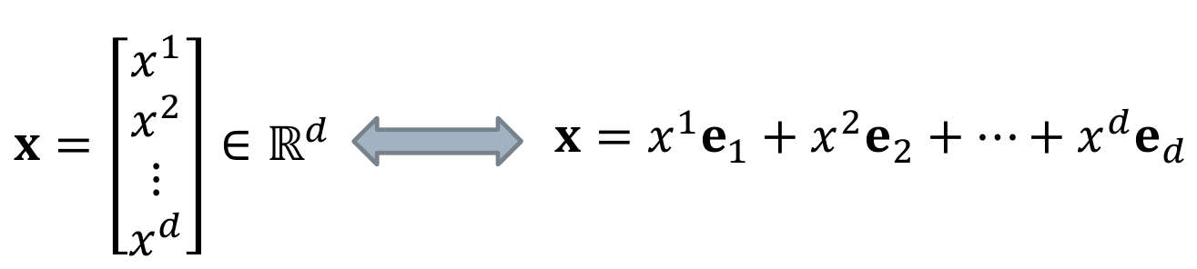
Axis rotation - formulation
Points are described with respect to the standard basis

Slide 61
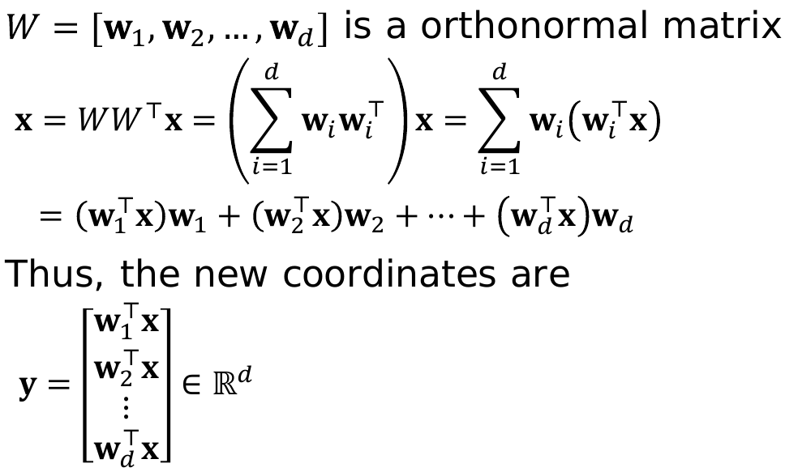
Axis rotation – formulation (cont.)
New coordinates under orthonormal basis { w₁, w₂, …, w_{d} }:
We will drop some dimensions
from here, as we did previously

Slide 62
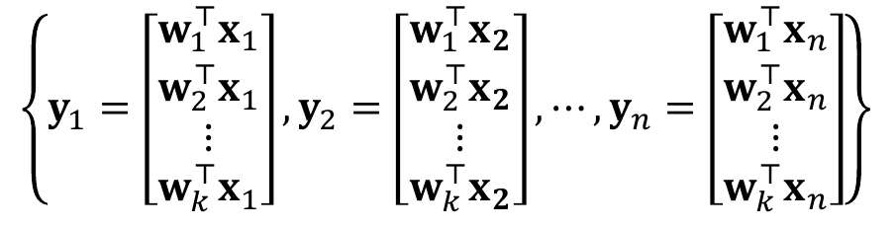
PCA formulation: optimization
Find new basis { w₁, w₂, …, w_{k} }, with k ≤ d such that the variance of this set is maximized:

Slide 63
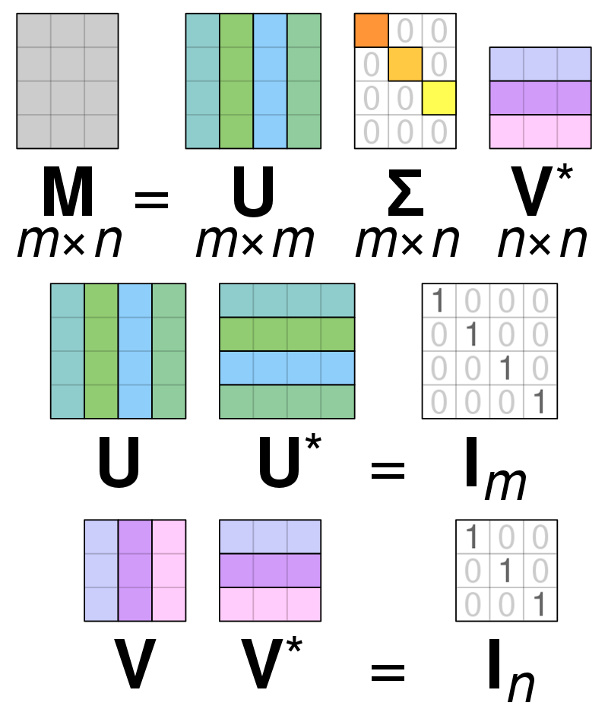
SVD formulation
U and V are rotation matrices; Σ is a scaling matrix
The rotated data is obtained by multiplying U^{T}X
X = U Σ V*
d x n d x d d x n n x n
U U* = I_{d}
V V* = I_{n}

Slide 64
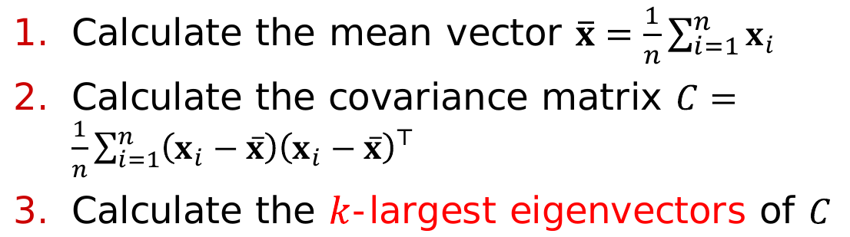
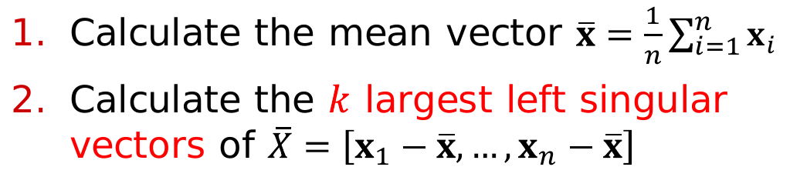
Algorithms for PCA and SVD
PCA
SVD

Slide 65
Summary
Feature Extraction and Portability
Data Cleaning
Data Integration
Data Reduction, Selection, and Transformation

